Slide 1
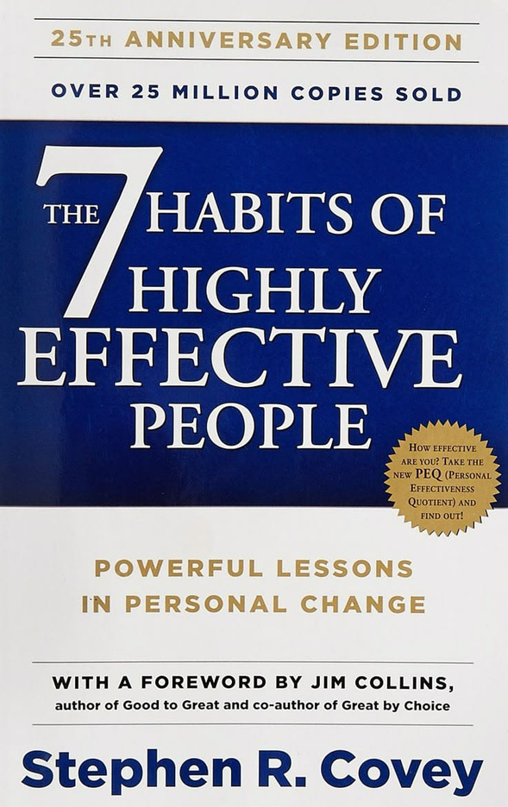

7 HABITS
HIGHLY EFFECTIVE
PEOPLE
BY STEPHEN R. COVEY

Slide 2
TEAM
Faizan Zain
BUS-24F-632
Hamza Khalid
BUS-24F-610
Umer Shaikh
BUS-24F-626
Ali Huzaifa
BUS-22S-010
Mustafa Abdul Shakoor
BUS-22S-170
Tanzeel Ali
BUS-22S-126
Hamza Faraz
BUS-22S-080

Slide 3
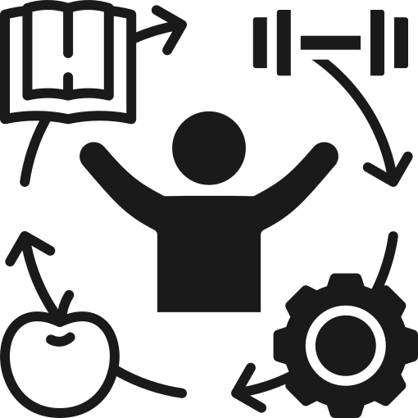

HABIT 1 – BE PROACTIVE (FROM THE 7 HABITS OF HIGHLY EFFECTIVE PEOPLE)
Take responsibility for your life
Focus on things you can control
Choose your response, not your reaction
Act based on values, not emotions
Take initiative in every situation

Slide 4
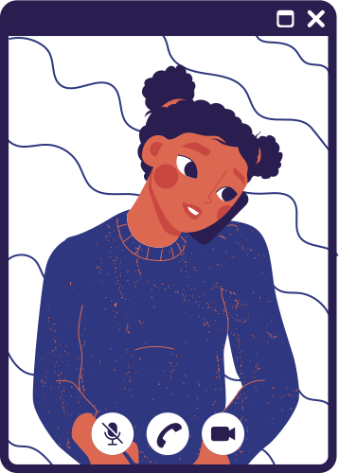
HABIT 1 – BE PROACTIVE (FROM THE 7 HABITS OF HIGHLY EFFECTIVE PEOPLE)
Key Idea & Quote (by Stephen Covey)
Focus on solutions, not problems
Control your attitude and behavior
Use positive language: “I can”, “I will”
Don’t blame others or circumstances
Quote:
“Between stimulus and response,
man has the freedom to choose.”

Slide 5


HABIT 2 – BEGIN WITH THE END IN MIND
Set clear goals:
Decide what you want to achieve in life.
Know your purpose: Understand why you are doing something.
Think about your future: Always keep long-term results in mind.
Have a clear direction: Plan your steps before starting.
Book Line (The 7 Habits of Highly Effective People – Stephen R. Covey):
“Begin with the end in mind means to start with a clear understanding of your destination.”

Slide 6
HABIT 2 – BEGIN WITH THE END IN MIND
Set clear goals:
Explanation / Example
Plan before action: Think first, then start your work.
Visualize success: Imagine your goal clearly in your mind.
Make better decisions: Choose actions that match your goals.
Real-life example: A student studies daily to achieve a good career.
Book Line:
“All things are created twice—first in the mind, then in reality.”

Slide 7
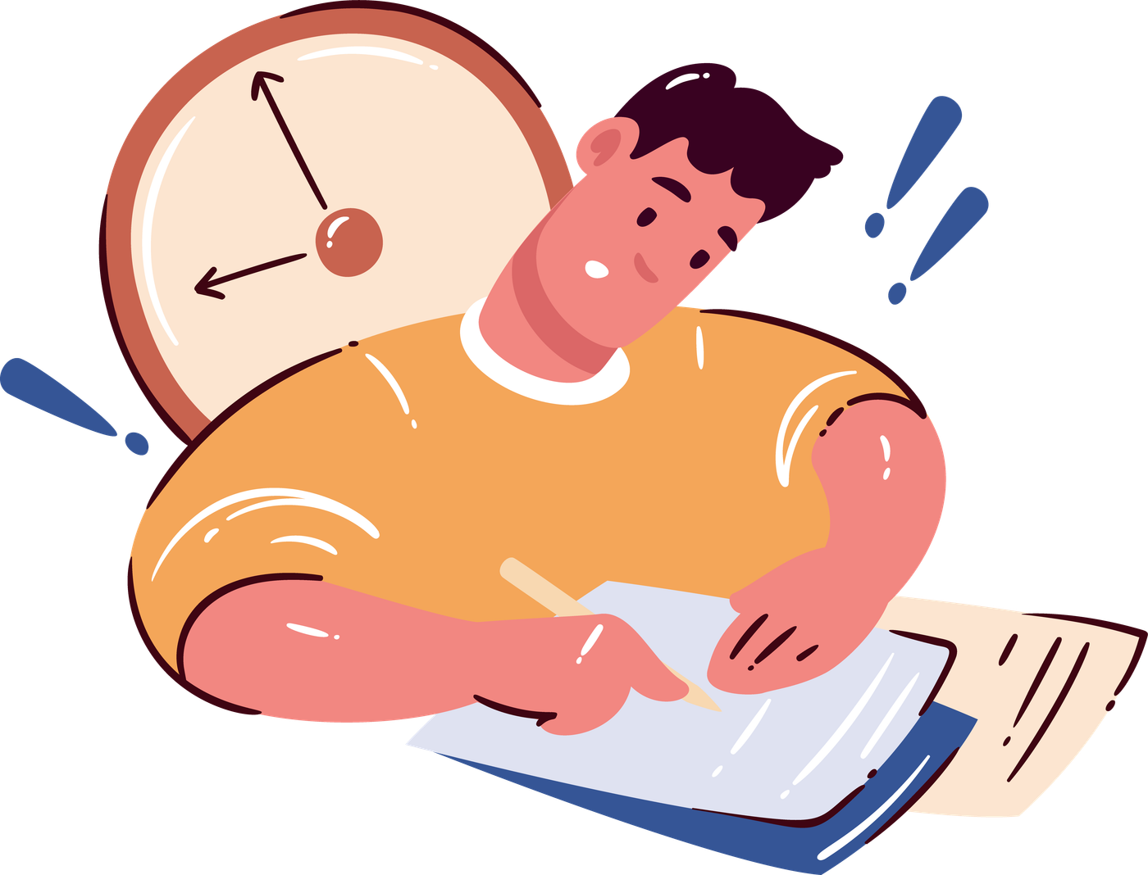

‎‎Habit 3 – Put First Things First
‎(from The 7 Habits of Highly Effective People)
Concept:
‎Focus on priorities, not just urgency
‎Manage time based on importance
‎Do important tasks first
‎Avoid distractions and time-wasting
‎Plan your day with clear goals

Slide 8
‎‎Habit 3 – Put First Things First
‎(from The 7 Habits of Highly Effective People)
Key Idea (by Stephen Covey)
‎Discipline and self-management are important
‎Balance work, study, and personal life
‎Focus on long-term goals, not short-term comfort
‎Say “no” to less important tasks
‎Quote:
‎“The key is not to prioritize what’s on your schedule, but to schedule your priorities.”

Slide 9

‎Habit 4 – Think Win-Win
‎(from The 7 Habits of Highly Effective People)
Think Win-Win (Concept)
‎Mutual benefit: both people win
‎Life is cooperation, not competition
‎Aim for solutions where both are satisfied
‎Not “your way or my way,” but a better third solution
‎Based on abundance mentality (there is enough for everyone)

Slide 10

‎Habit 4 – Think Win-Win
‎(from The 7 Habits of Highly Effective People)
‎Character matters:
‎Integrity (clear values)
‎Maturity (courage + respect)
‎Build strong relationships: trust is essential
‎Understand both sides’ needs
‎Find mutual solutions
‎Focus on long-term relationships
‎Win-Lose or Lose-Win → both lose in the long run

Slide 11
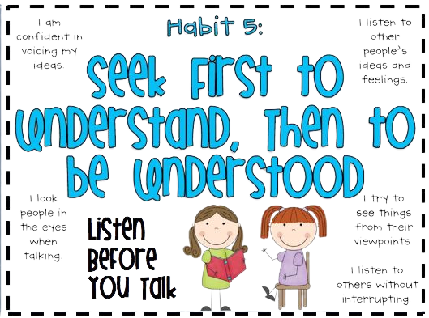
HABIT 5 – SEEK FIRST TO UNDERSTAND, THEN TO BE UNDERSTOOD
CORE IDEA:
EFFECTIVE COMMUNICATION BEGINS WITH UNDERSTANDING OTHERS BEFORE
EXPRESSING YOUR OWN POINT OF VIEW.

Slide 12
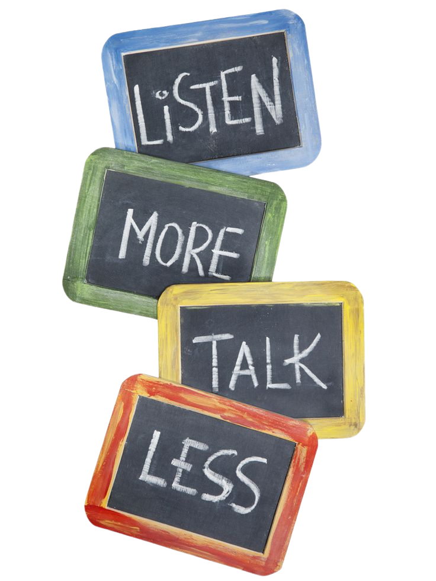
HABIT 5 – SEEK FIRST TO UNDERSTAND, THEN TO BE UNDERSTOOD
Key Principles:
Most people listen to reply, not to understand.
Real communication requires empathic listening.
Empathic listening means listening with the intent to truly understand another person’s feelings, thoughts, and perspective.
We should diagnose before we prescribe.
Trust and understanding are the foundation of influence.
Important Message:
People do not want immediate advice first — they want to feel understood first.

Slide 13
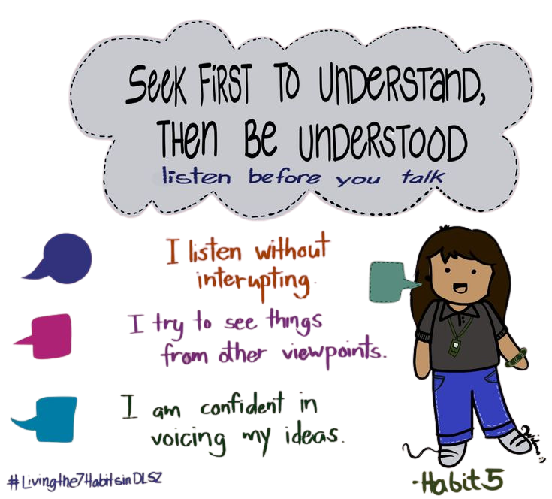
HABIT 5 – SEEK FIRST TO UNDERSTAND, THEN TO BE UNDERSTOOD
Benefits of Practicing Habit 5:
Builds trust and stronger relationships
Reduces misunderstandings and conflict
Helps uncover the real problem
Creates emotional safety and openness
Makes problem-solving more effective
Conclusion:
When we listen with empathy, we create connection, improve communication, and open the door to better solutions

Slide 14


‎HABIT 6 – SYNERGIZE (TEAMWORK)
‎(FROM THE 7 HABITS OF HIGHLY EFFECTIVE PEOPLE)
Definition & Key Points
‎Synergy means working together for better results
‎“Together we are stronger”
‎Everyone has different ideas and perspectives
‎Respect differences
‎Open communication leads to better solutions

Slide 15
‎HABIT 6 – SYNERGIZE (TEAMWORK)
‎(FROM THE 7 HABITS OF HIGHLY EFFECTIVE PEOPLE)
Example & Conclusion (by Stephen Covey)
‎Group assignments improve when all members share ideas
‎Sports teams win through coordination and teamwork
‎Teamwork creates stronger outcomes than individual effort
‎Quote:
‎“The whole is greater than the sum of its parts.”

Slide 16


‎Habit 7 – Sharpen the Saw (Self-Improvement)
Definition
‎Continuous self-improvement to stay effective
‎Physical → Exercise, health
‎Mental → Learning, reading
‎Social → Relationships, communication
‎Spiritual → Inner peace, values

Slide 17
‎Habit 7 – Sharpen the Saw (Self-Improvement)
Example & Conclusion (by Stephen Covey)
‎Only studying leads to burnout and low productivity
‎Balanced routine (study + rest + exercise) improves performance
‎Balance leads to long-term success
‎Quote:
‎“Sharpen the saw means preserving and enhancing the greatest asset you have—you.”

Slide 18

THANK
YOU

