Slide 1



Exploring the book
7 HABITS OF HIGHLY EFFECTIVE PEOPLE
* GROUP MEMBERS *
° ZOHAIB HASSAN (BUS-24F-600)
° MAHNOOR BUKHARI (BUS-24F-641) ° NIMRA (BUS-24F-613)
° M. MUDASSIR ( BUS-24F-636) ° HEMAN RAJU (BUS-24F-600)
° AYESHA JAVED (BUS-24F-637) ° DHARA KUMARI (BUS-24F-600)

Slide 2
Begins with the End Of Mind
First Thing First
BE PROACTIVE
Think Win-Win
First To Understood
Synergize
Sharpen The saw

Slide 3
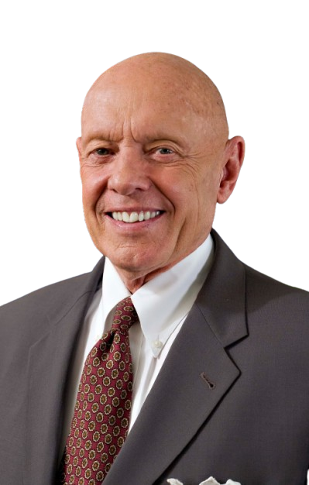
BE PROACTIVE
1. R. COVEY CORE IDEA: Between stimulus and response, you have the freedom to choose
2. PROACTIVE PEOPLE: Focus energy on things they can control or influence
3. REACTIVE PEOPLE: Focus on things they can’t control – blame, complain, wait

Slide 4

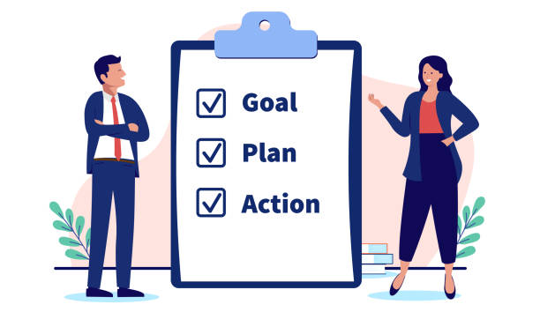
Learning Objectives
Key Concepts of Proactivity
Circle of Influence vs Circle of Concern
Proactive = expand influence by acting where you have power
Reactive = shrink influence by worrying about concerns

Slide 5
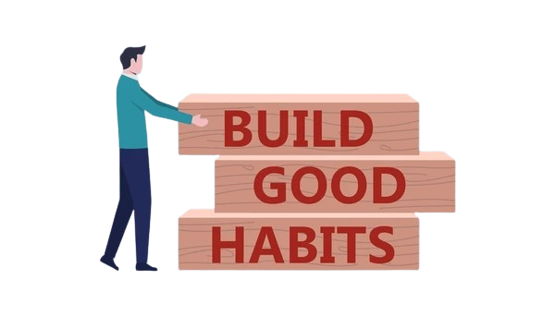
How to Build the Proactive Habit
Pause & Choose: Use self-awareness to stop automatic reactions
Make & Keep Commitments: Start small – build integrity with yourself
Focus on Influence: List 1 problem → Identify actions in your control → Do it this week
Carry Your Own Weather: Don’t let others’ moods or external events decide your attitude Result: More control, less stress, better outcomes

Slide 6
2nd Habbit: Begins with the End Of Mind
Introduction:
“Begin with the End in Mind” is from Stephen R. Covey’s book “The 7 Habits of Highly Effective People.” It means that before starting any work, we should think about our goal and the result we want to achieve.
This habit teaches us to plan our life and actions according to our future goals. When we know our destination, it becomes easier to decide what steps we should take.
Explanation: “Begin with the End in Mind” means that we should imagine our success or final result first, and then work toward it. It helps us stay focused and make better decisions.
1. Clear Goal:
Always knows what you want to achieve before starting anything.
2. Think About the Future:
Imagine your final result or success first, then plan your actions.

Slide 7
3. Life has Direction:
This habit gives your life a clear direction and purpose.
4. Better Decision Making:
When your goal is clear, you can make right and smart decisions.
5. Personal mission Statement:
Create a statement about:
Your goals
Your values.
What you want to become.

Slide 8
6. Stay Focused:
It helps your avoid distractions and stay focused on your goal.
7. Plan Before Action:
First think and plan, then take action.
8. Applies to Daily Life:
Use it in:
Studies
Career
Personal life.
Conclusion:
“ Begin with the End in Mind” means first decide your goal, then work step by step to achieve it.”

Slide 9
Put first Things first
INTRODUCTION:.
1. Focuses on time management and priorities.
2. Help us organize our life and work effectively.
Meaning:
1. Do the most important task first.
2. Focus on what really matters.
3. Manage your Time,Energy & Priorities.

Slide 10
Time Management Matrix:
Urgent & Important (crisis, deadlines)
Not Urgent but Important (planning, study, goals) Urgent but Not Important (interruptions, calls)
Not Urgent & Not Important (wasting time)
Key Principles:
Discipline: control yourself.
Prioritization: choose important work.
Planning: organize tasks daily/weekly.
Balance: work, family, and health.

Slide 11
Student life example:
Important: Study for exams.
Not important: Watching TV all day.
How to Apply:
Make a to-do list Set priorities (A, B, C)
Avoid distractions.
Focus on important tasks first.
Conclusion:
“Put First Things First” means doing what matters most first.
Success comes from discipline and proper planning.
Focus on important things, not just urgent ones.

Slide 12
What is Think Win-Win
Main message: Think Win-Win means looking for solutions where everyone benefits, instead of treating success like a competition where one side must lose. It comes from an abundance mindset and depends on balancing courage with consideration
Text you can put on the slide:
Seek mutual benefit
Avoid win-lose thinking
Build trust and partnership
Use courage + consideration
Short speaking script:
“Think Win-Win is about finding outcomes that are good for both sides. Instead of competing for a limited result, we focus on cooperation, trust, and shared success.”

Slide 13
How to Apply It
Main message: To apply Think Win-Win, first understand what both sides need, then search for a fair solution that satisfies key interests. This approach strengthens relationships and improves collaboration.
Text you can put on the slide:
Listen to both sides
Identify shared goals
Create a fair solution
Strengthen long-term relationships
Example to say: “In a team project, Think Win-Win means dividing tasks fairly, respecting everyone’s ideas, and choosing a solution that helps the whole group succeed.”

Slide 14
7%
Words(what you say)
53%
40%
Tone & Feeling
(how you say it)
Body Language
(what you show)
Listen with Eyes, Heart & Ears Understand not just words but tone, emotion, and body language — seek meaning, not just sound.
Stand in Their Shoes Put yourself fully in their situation. Trying to "win" leads only to Win-Lose or Lose-Lose.
Practice Mirroring Reflect the meaning with care — not repeating exact words, but echoing understanding with affection.

Slide 15
What Does Habit 5 Mean?
Understand Others First
See Their Point of View
Before seeking to be heard, truly listen and understand the other person's perspective and feelings.
Shifting to another's perspective can dramatically change how you judge and connect with them.
Listen First, Talk Second
Most people want to be understood before they'll open up to understanding you in return.

Slide 16
Key Takeaways
Seek First to Understand
Then to Be Understood
Listen Deeply
Empathy First
Use your eyes, ears, and heart. 93% of communication comes from tone and body language, not words.
Stand in their shoes before you speak. Understanding someone changes how you judge and connect with them.
Give Real Feedback
Courage to Be Understood
Only give feedback that truly helps. When you do, make it a first-person, caring comment.
Seeking to be understood requires vulnerability and courage — but it deepens every relationship.
Habit 5: Seek First to Understand — Aisha Javed Khan | BUS_24F_637

Slide 17
Habit 6: Synergize
Combining Strengths Through
Creative Cooperation
What is Synergize?
Synergize means working together in a way that produces better results than working alone.
Easy Definition: Synergize is when people combine their ideas, skills, and efforts to achieve a result that is greater than individual work.

Slide 18
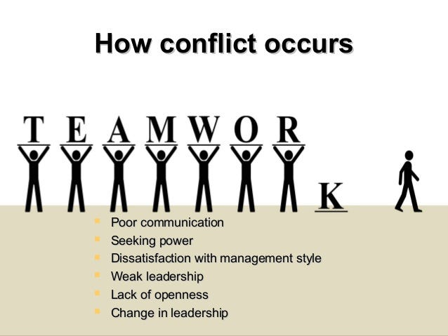
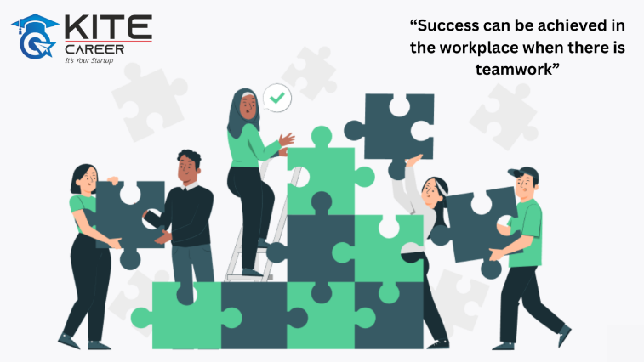
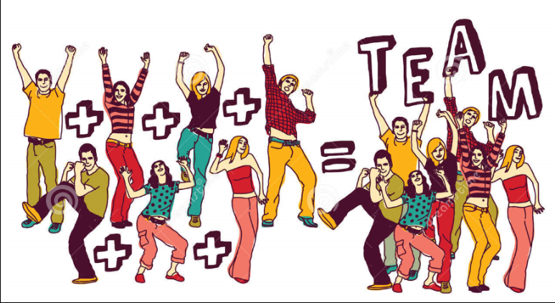
How to Practice Synergy, Barriers & Conclusion
How to Practice
Barriers to Synergy
Conclusion
Be open-minded
Listen actively
Respect differences
Focus on shared goals
Ego, lack of trust
Poor communication
Lack of openness
Seeking power over others
Value differences in others
Collaboration = Extraordinary results
Synergy builds stronger teams

Slide 19
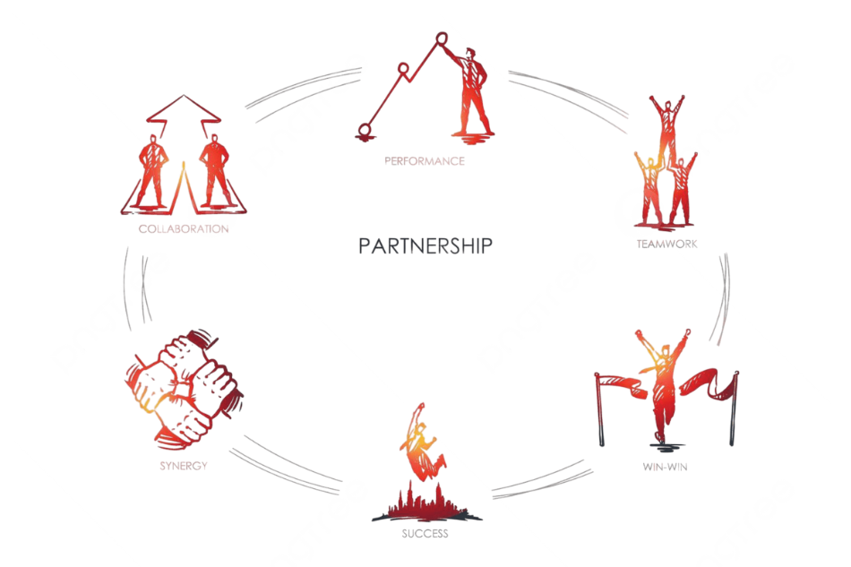
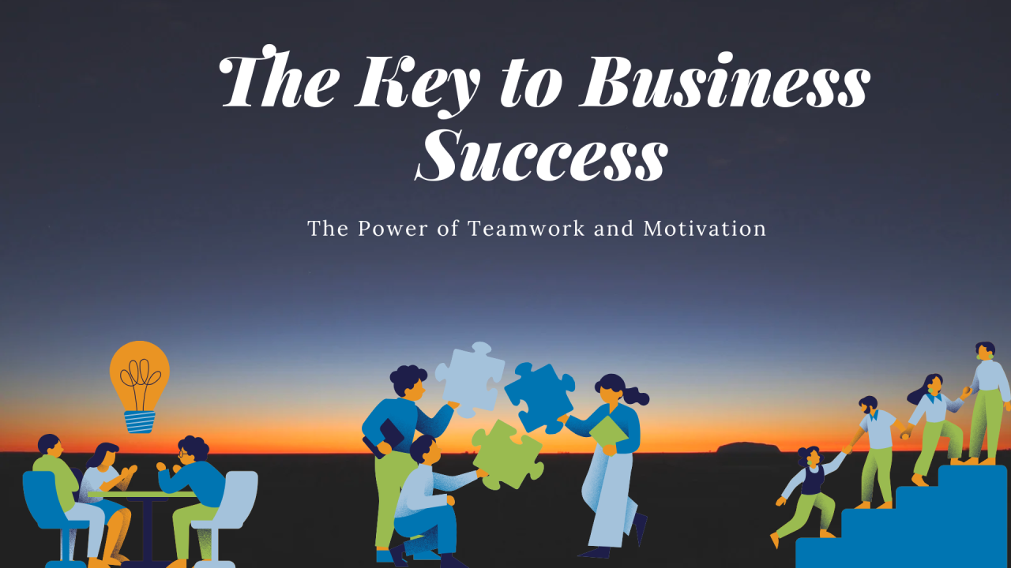
Importance & Types of Interaction
Types of Interaction
Why Synergy is Important
Improves teamwork
Creates better solutions
Boosts creativity & innovation
Builds strong relationships
Defensive: Win / Lose
Respectful: Compromise
Synergistic: Win / Win (Best)

Slide 20
Exploring the book
7 HABITS OF HIGHLY EFFECTIVE PEOPLE
* GROUP MEMBERS *
° ZOHAIB HASSAN (BUS-24F-600)
° MAHNOOR BUKHARI (BUS-24F-641) ° NIMRA (BUS-24F-613)
° M. MUDASSIR ( BUS-24F-636) ° HEMAN RAJU (BUS-24F-600)
° AYESHA JAVED (BUS-24F-637) ° DHARA KUMARI (BUS-24F-600)

Slide 21

Basics
THE 7th HABIT
Balance Life
Invest in Yourself
Continuous Self-Renewal
Improve Efficiency
Means to continuously renewing yourself in all key areas of life to stay effective, balanced, and productive.

Slide 22
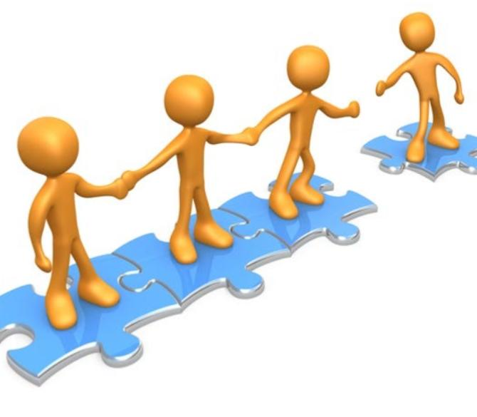
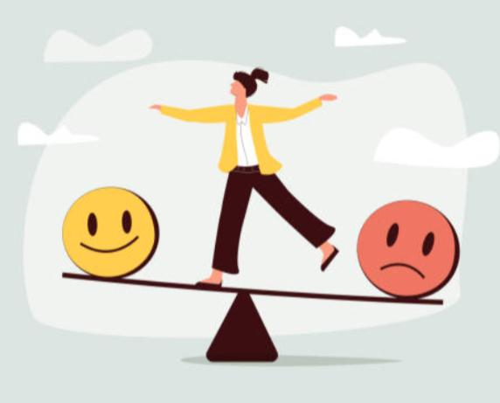


Sharpen the Saw as in four dimensions
Renewing these four areas to stay balanced and effective
EMOTIONAL /SOCIAL RENEWAL
PHYSICAL RENEWAL
MENTAL RENEWAL
SPIRITUAL RENEWAL
Maintains health & energy
Improves strength, stamina & daily performance
Keeps your mind active, focused & growing
Improves thinking & creativity
Gives purpose & inner peace
Connects with values and beliefs
Guides decisions in life
Builds strong relationships & emotional balance
Improves communication & empathy

Slide 23
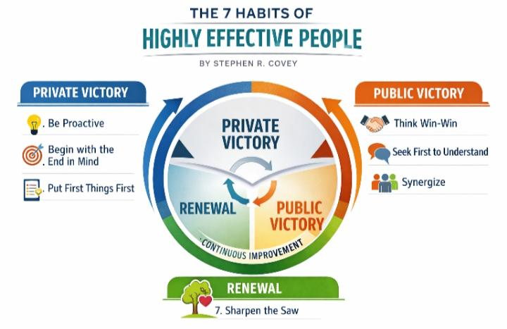
Continuous cycle of growth
PRIVATE VICTORY
Self-mastery & discipline
From dependence → independence
Control your habits first
PUBLIC VICTORY
Build strong relationships
From independence → interdependence
Cooperation & mutual benefit
This habit connects and sustains all six habits by encouraging continuous self-renewal and lifelong improvement.

