Slide 1

PERSONAL & CORPORATE SKILLS
TOPIC : 7 HABBITS OF EFFECTIVE PEOPLE
FAHAD RAMZAN : BUS-23S-080
SHAHROZ AHMED : BUS-21S-097
SYED ALI RAZA : BUS-21F-012

Slide 2

INTRODUCTION
The 7 Habits are principles for personal and professional success.
Focus on long-term effectiveness.
Used worldwide in leadership and self-development.

Slide 3
OVERVIEW OF THE 7 HABITS
Be Proactive
Begin with the End in Mind
Put First Things First
Think Win-Win
Seek First to Understand, Then to Be Understood
Synergize
Sharpen the Saw

Slide 4
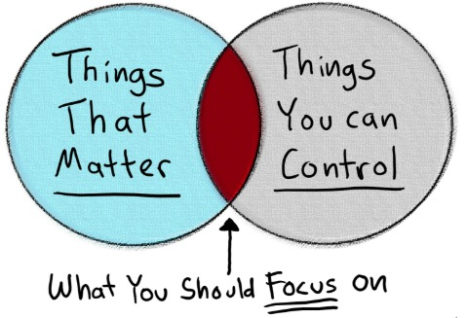
HABIT 1 – BE PROACTIVE
Take responsibility for your actions
Focus on what you can control
Example:
A student fails a test but instead of blaming
the teacher, they review their mistakes and
study harder for the next exam.

Slide 5

HABIT 2 – BEGIN WITH THE END IN MIND
Set clear goals
Plan your future
Example:
A student who wants to become a doctor plans early
by choosing science subjects and preparing for
medical entrance exams.

Slide 6

HABIT 3 –PUT FIRST THING FIRST
Prioritize important tasks
Manage time effectively
Example:
Finishing homework before playing games or using social
media.

Slide 7

HABIT 4 –THINK WIN-WIN
Seek mutual benefit
Build trust in relationships
Example:
Two classmates working on a project divide
tasks fairly so both get good grades.

Slide 8

HABIT 5 – SEEK FIRST TO UNDERSTAND
Listen before speaking
Practice empathy
Example:
Listening carefully to a friend’s problem
before giving advice.

Slide 9

HABIT 6 – SYNERGIZE
Teamwork produces better results
Respect different ideas
Example:
In a group assignment, each member contributes
different skills (research, design, presentation) to
create a better project.

Slide 10

HABIT 7 – SHARPEN THE SAW
Take care of yourself
Continuous self-improvement
Example:
Exercising regularly, reading books, and taking
breaks to stay fresh and productive.

Slide 11
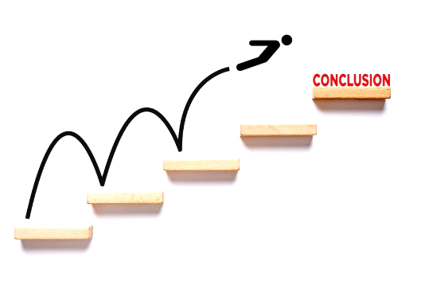
CONCLUSION
Small habits lead to big success
Practice daily for improvement
Helps in school, career, and life

