Slide 1
Lending Club Case Study
- Neha Sharma and Rawoof Mohammad

Slide 2
Purpose
This case study analyzes a consumer finance company specializing in lending diverse types of loans to urban customers.
The primary objective is to identify predictive patterns and factors that indicate the likelihood of loan default.
These insights will help form strategic decisions such as denying loans, reducing loan amounts, or adjusting interest rates for higher-risk applicants.

Slide 3
Steps
Importing the data
Removing the attributes with null values
Removing the attributes with only single value
Correcting the data types and value formats
Fixing attributes with null values
Removing the attributes that are not relevant
Removing outliers if any
Deriving new columns as needed
Univariate, Bivariate and multivariate analysis

Slide 4
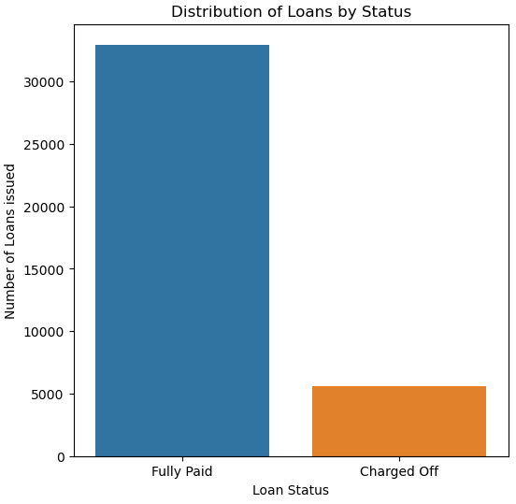
Distribution of loans by status - Among the 39717 loans given by the lender, 32950 loans are fully paid and 5627 loans are charged off and remaining 1140 loans are in current running state. - Considering loans which are not in progress, 14.58% of loans were charged off causing loss to the lenders.
85.42%
14.58%

Slide 5
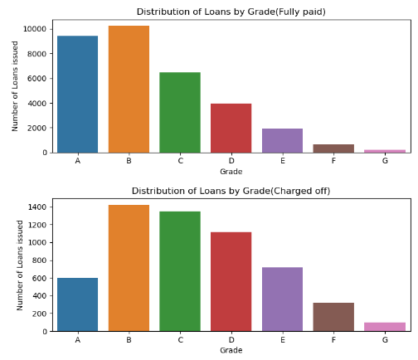
Distribution of loans by Grades - Overall , more loans were given to grades A,B and C. - Out of which, maximum number of charged off loans belongs to grades B and C.

Slide 6
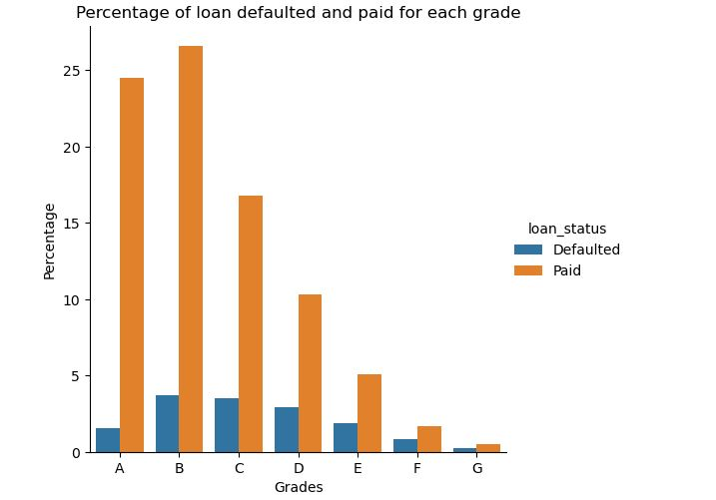
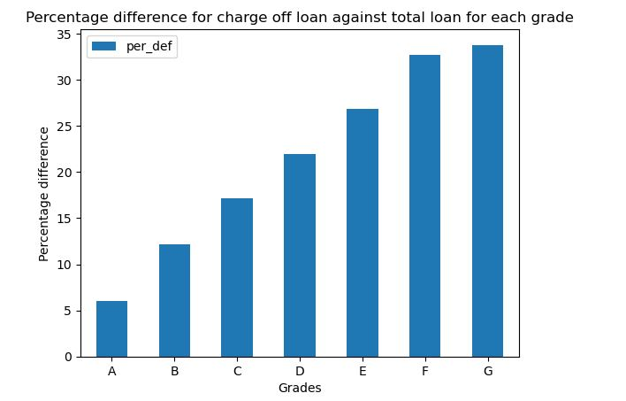
Distribution of loans by Grades It can be observed from the plots that though a greater number of defaulters where from group B and C, percentage of defaulters is above 20% in grades D, E, F and G

Slide 7
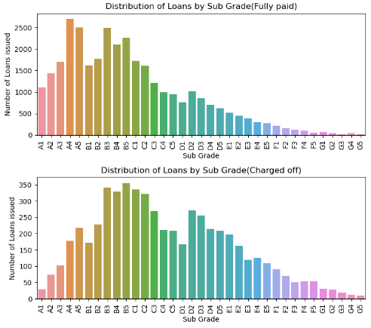
Distribution of loans by Sub-grades - Out of which, a greater number of charged off loans belongs to sub-grades B5,B3,B4 followed by C1 and C2.

Slide 8
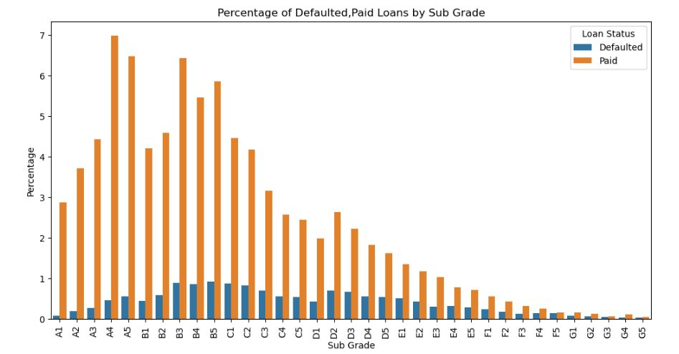
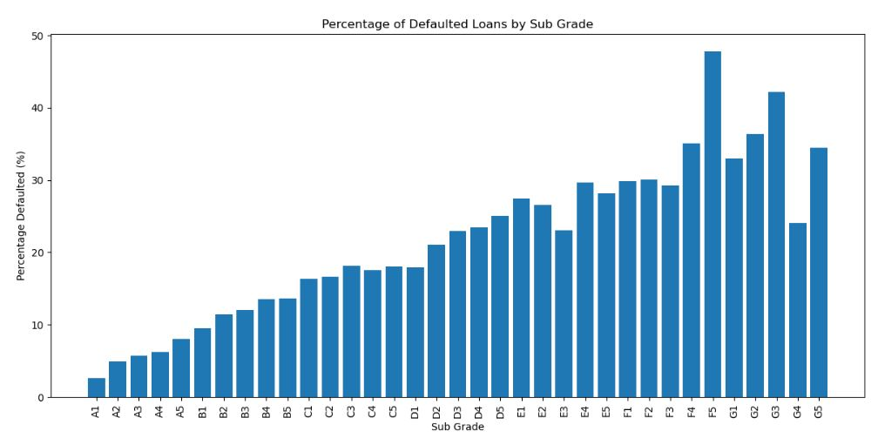
Distribution of loans by Sub-grades It can be observed from the plots that though a greater number of defaulters where from sub grades A4, A5, B3, B5, percentage of defaulters is above 20% from sub-grades D2 to G and highest in F5.

Slide 9
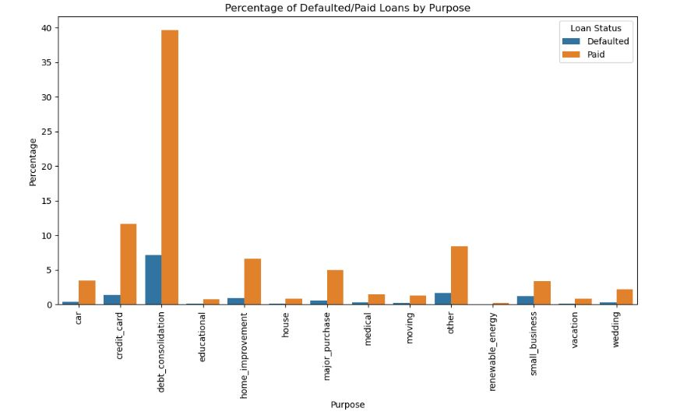
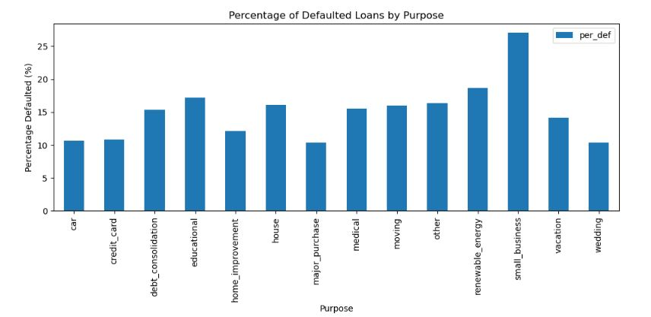
Distribution of loans by Purpose More loans are taken by people for debt consolidations and repaying credit card bills. It can be deduced from the below plots that more than 25% of small business customers default loans.

Slide 10
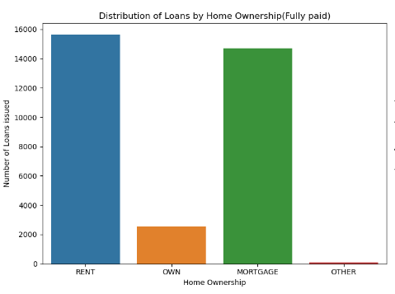
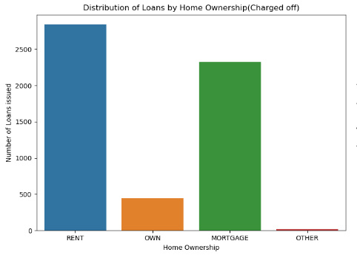
Distribution of loans by House ownership More loans are taken by people who are on rent or mortgage and also have higher chances of defaulting. However, there is no significant difference in distribution of paid loans vs charged off loans w.r.t home ownership.

Slide 11
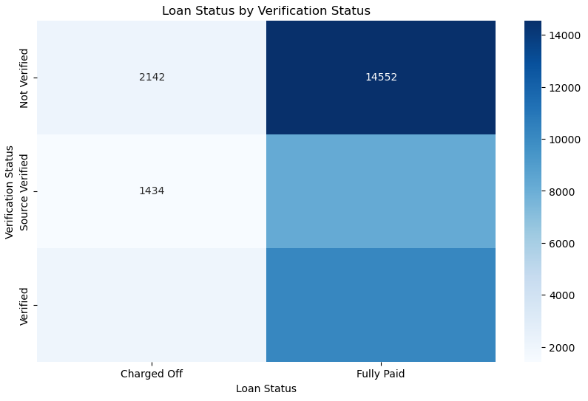
Verification status - Most of the non-verified loans are paid off hence the nature of loan re-payment is not dependent upon the verification status.

Slide 12
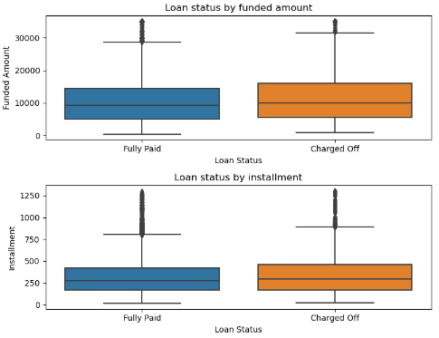
Loan amount & Installment - There is a very little difference in loan amount and installment among both fully paid and charged off loans. - Funded amount and installments both seems to be little higher for charged off loans than that for fully paid loans.

Slide 13
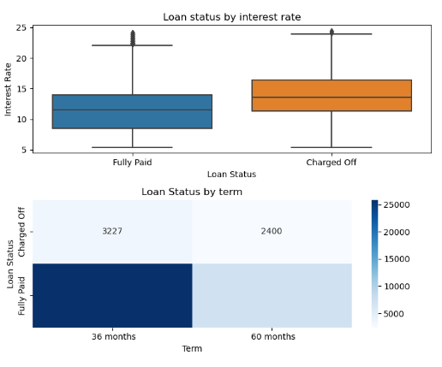
Interest rate and Term - Loans charged off typically had higher interest rates, signaling riskier loan terms that increase the likelihood of default. - A higher proportion of loans with a 3-year (36-month) term were charged off compared to those with a 5-year (60-month) term. - Also, 25% of loans with 60 months term were defaulted
Interest rate & Term

Slide 14
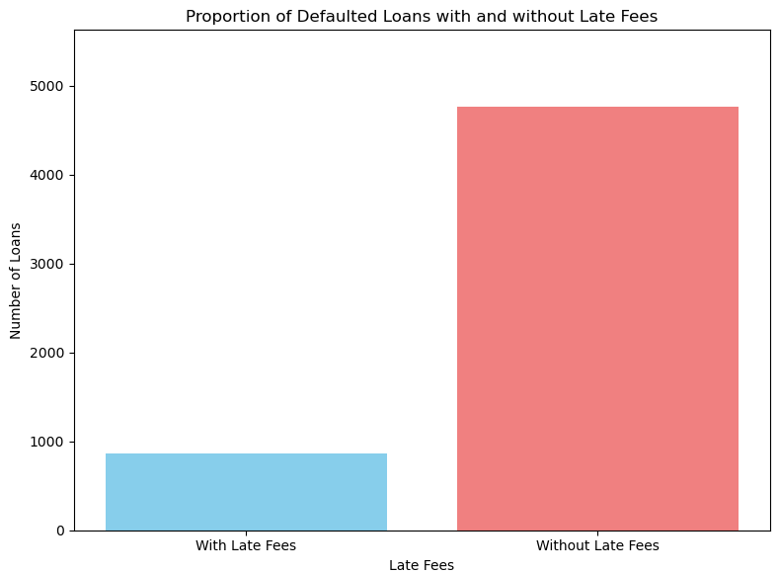
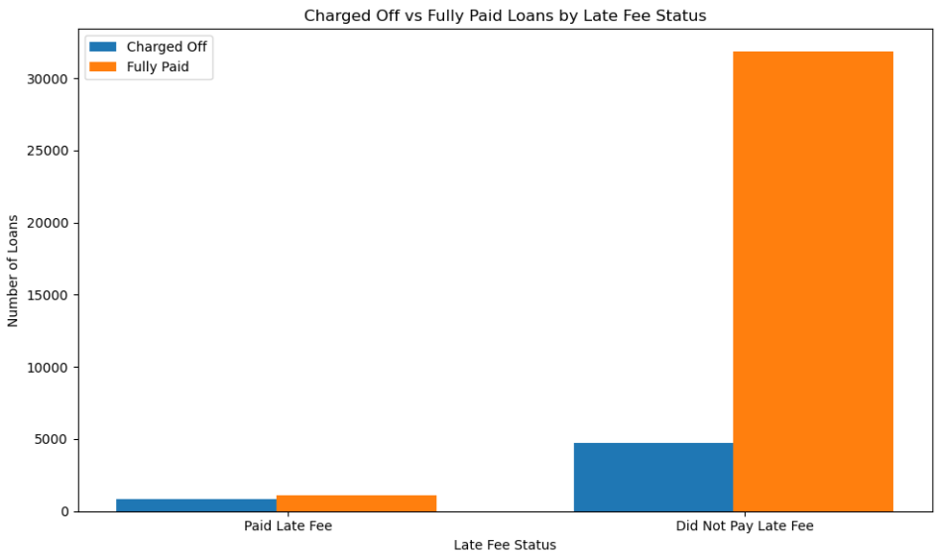
Distribution of Loans by late fees - Among the 1995 customers who paid late fees, 863 of them defaulted. - Hence it can be concluded that , people with history of late fee payment will have 43% chance of becoming a defaulter.
Analyzing late fees factor against defaulters

Slide 15
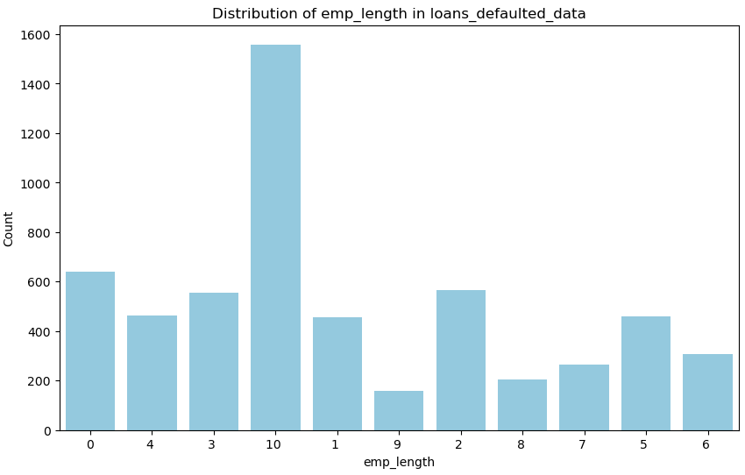
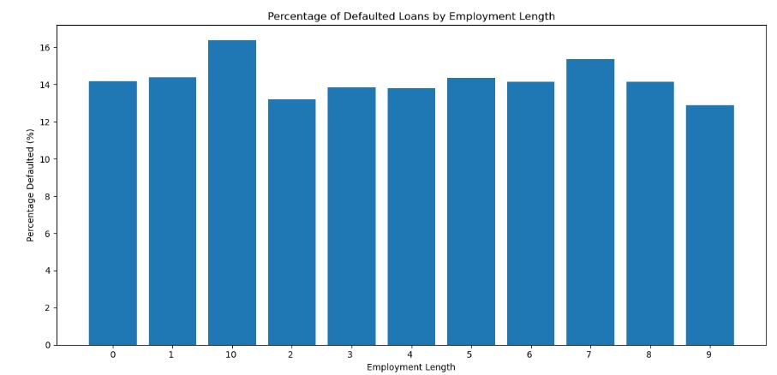
Analyzing employment length for charged off loans - Majority of charged off loans belonged to clients having 10+ years of experience . However, percentage of loans defaulted by each employment length group is around 15% . So, nothing can be derived w.r.t employment length.

Slide 16
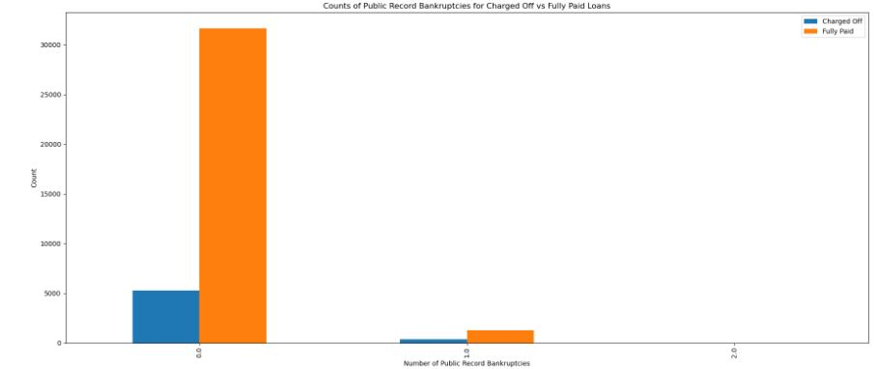
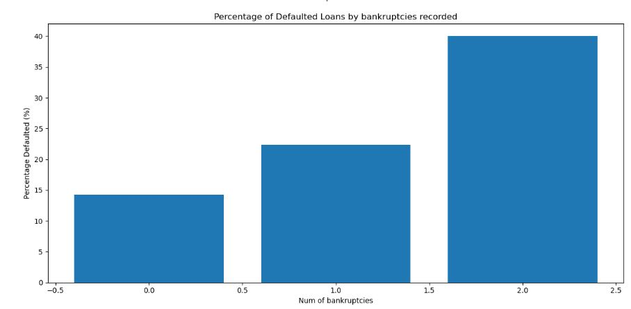
Analyzing public recorded bankruptcies for charged off loans 1274 customers had record of bankruptcies and 368 among them defaulted. 28% customers with public record of bankruptcies have defaulted.

Slide 17
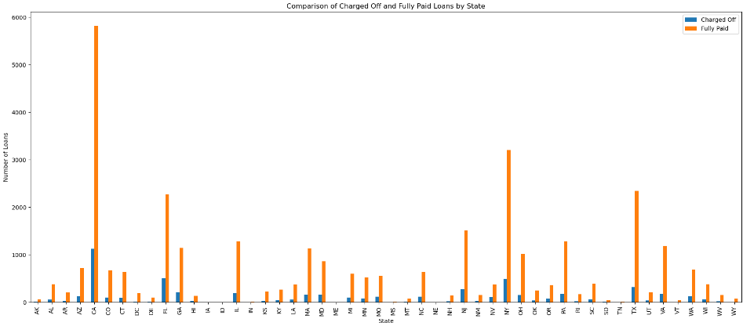
Analyzing Charged off loans and Fully paid loans in each state Higher number of defaulted loans belonged to states CA,FL and NY likely due to economic factors. Conversely, states with no defaulters such as AK, DC, DE, MT, SD, VT, and WY, though having fewer loans, demonstrate stronger repayment behavior These insights highlight the importance of regional risk assessment in lending practices.

Slide 18
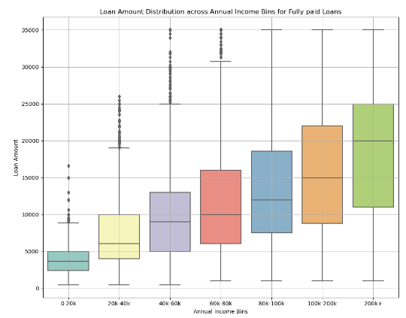
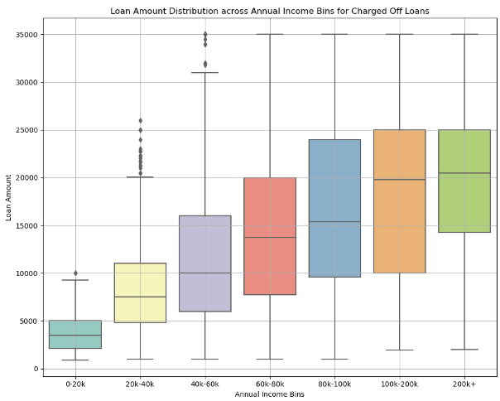
Analyzing annual income vs loan amount when salary, loan is divided into categories of 20k, 5k increments respectively, and we find the median of loans for defaulted vs paid customers, it is observed that defaulted customer have a higher median.

Slide 19
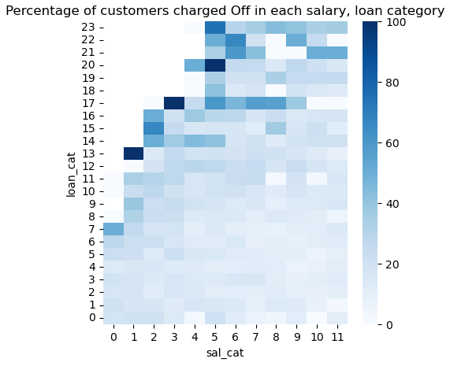
Analyzing annual income vs loan amount Figure shows the heat map of percentage of defaulted customers in each salary and loan category. Here, salary and loan are divided into categories of 6500k, 1.5k increments respectively (considering salary range 15k to 95k) It can be observed that defaulted percentage is maximum in highest loan category in each salary category. It indicates that customers who defaulted took highest loans w.r.t their salary category and could not pay back the loans. Max loan to a customer needs to be reduced to avoid such scenarios.

Slide 20
Conclusions
Lender should be aware of below customer trends to avoid/reduce lending to loan defaulters,
Customers with late fee payments have 43% of being a defaulter.
Customers belonging to grade D,E,F default by more than 25%. Its 47%,42%,36%,35%,32%,30% for F5, G3, G2, F4, G1, F2 sub-grade customers, respectively.
Loans given for the purpose of small business get defaulted by 25%
Customer with public record of bankruptcies default by 29%.
Customers who defaulted had higher DTI ratio and by categorizing of salary and loan it was observed that defaulters took high category loans compared to their annual income. Maximum loan provided for a given salary can be reduced further.
Loans with 60 months term had 25% defaulters.

Slide 21
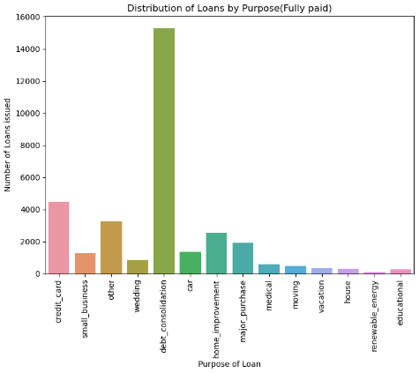
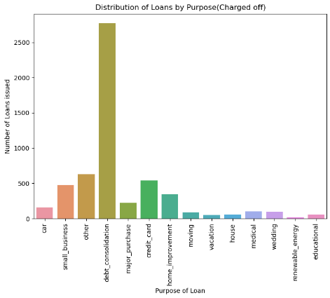
Distribution of loans by Purpose
More loans are taken by people for debt consolidations and repaying credit card bills
People often take out loans for debt consolidation to streamline payments and manage various debts like credit cards and medical bills. However, if their financial situation worsens or they misjudge their repayment capability, these consolidation loans can become challenging to handle, potentially resulting in defaults.

Slide 22
Distribution of loans by Home ownership
More loans are taken by people who are on rent or mortgage and also have higher chances of defaulting.
Renters or homeowners with mortgages may already have significant monthly financial commitments, such as rent or mortgage payments, utilities, insurance, housing expenses, etc. Taking on additional loans can lead to a higher debt-to-income ratio, making it harder to manage repayments, especially if their income fluctuates or decreases.

Slide 23
Analyzing late fees factor against defaulters
Number of people who paid late fees and defaulted were 863 out of total defaulted people of count 5627
However , total no. of people who paid late fees where 1995 out of which 863 defaulted and 1132 paid the loan.
Hence it can be concluded that , people with history of late fee payment will have 43% chance of becoming a defaulter.

Slide 24
Analyzing Charged off loans and Fully paid loans in each state
Higher number of defaulted loans belonged to states CA,FL and NY likely due to economic factors.
Conversely, states with no defaulters such as AK, DC, DE, MT, SD, VT, and WY, though having fewer loans, demonstrate stronger repayment behavior.
These insights highlight the importance of regional risk assessment in lending practices.

Slide 25
Analyzing Annual income vs loan amount
Need to conclude

Slide 27
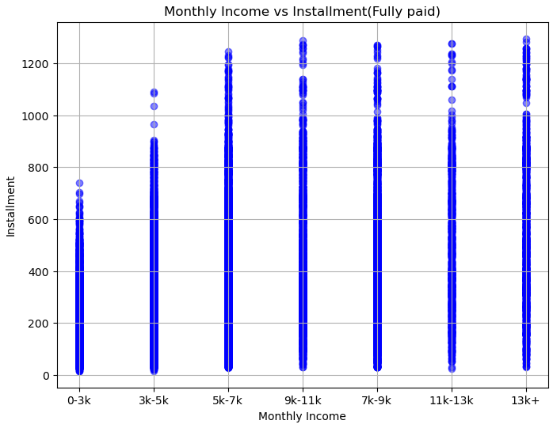
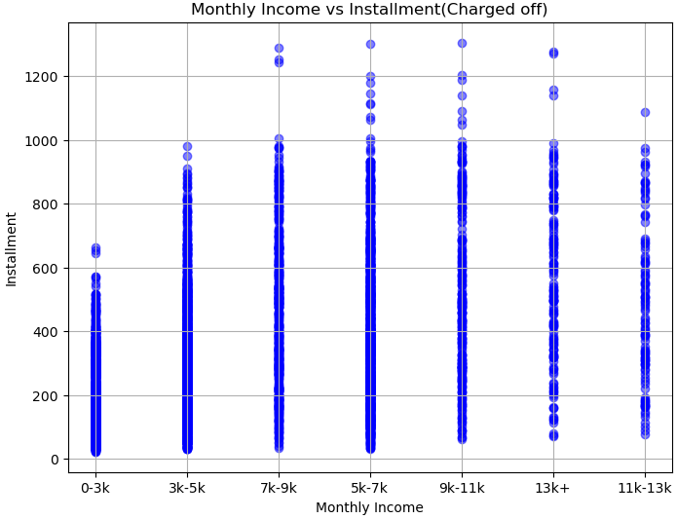
Analyzing Monthly income vs Installment
Need to conclude

