Slide 1
Lending Club Case Study
- Neha Sharma and Rawoof Mohammad

Slide 2
Purpose
This case study analyzes a consumer finance company specializing in lending diverse types of loans to urban customers.
The primary objective is to identify predictive patterns and factors that indicate the likelihood of loan default.
These insights will help form strategic decisions such as denying loans, reducing loan amounts, or adjusting interest rates for higher-risk applicants.

Slide 3
Steps
Importing the data
Removing the attributes with null values
Removing the attributes with only single value
Correcting the data types and value formats
Fixing attributes with null values
Removing the attributes that are not relevant
Removing outliers if any
Deriving new columns as needed
Univariate, Bivariate and multivariate analysis

Slide 4
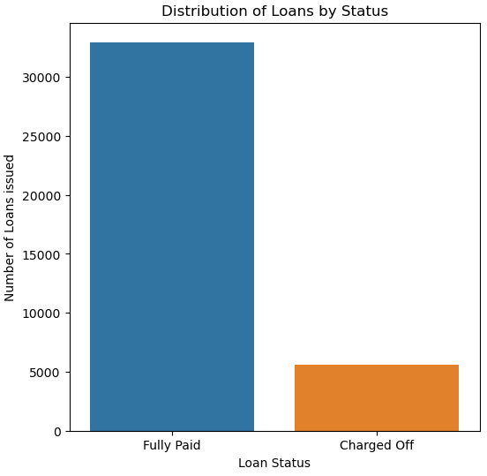
Distribution of loans by status - Among the 39717 loans given by the lender, 32950 loans are fully paid and 5627 loans are charged off and remaining 1140 loans are in current running state. - Considering loans which are not in progress, 14.58% of loans were charged off causing loss to the lenders.
85.42%
14.58%

Slide 5
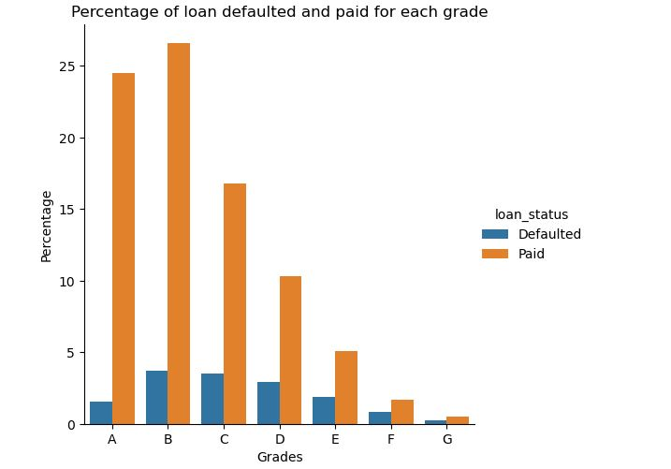
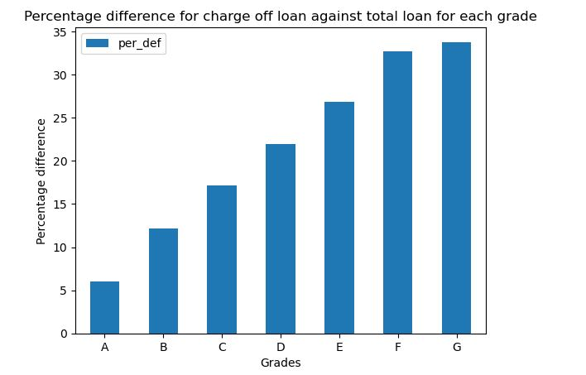
Distribution of loans by Grades - It can be observed from the plots that though a greater number of defaulters where from group B and C, percentage of defaulters is above 20% in grades D, E, F and G

Slide 6
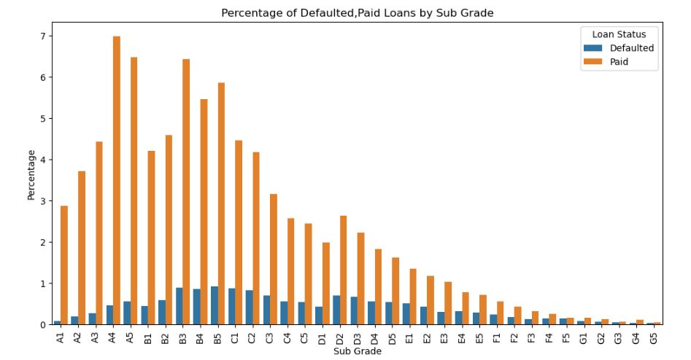
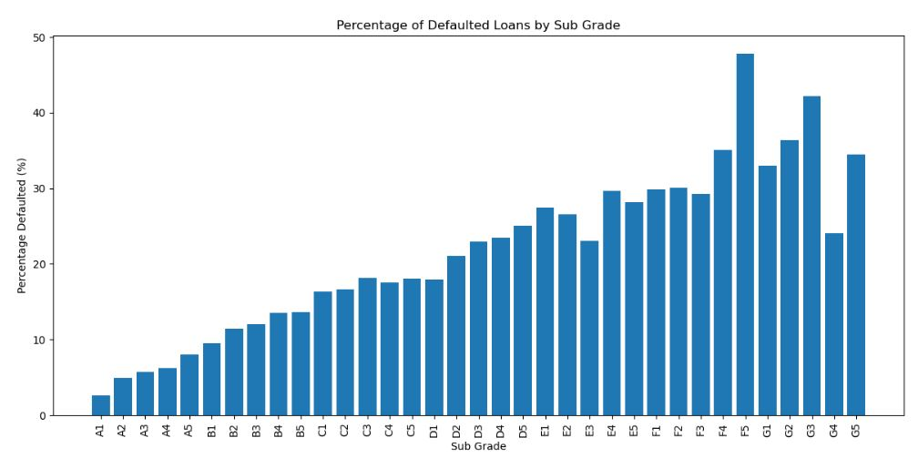
Distribution of loans by Sub-grades - It can be observed from the plots that though a greater number of defaulters where from sub grades A4, A5, B3, B5, percentage of defaulters is above 20% from sub-grades D2 to G and highest in F5.

Slide 7
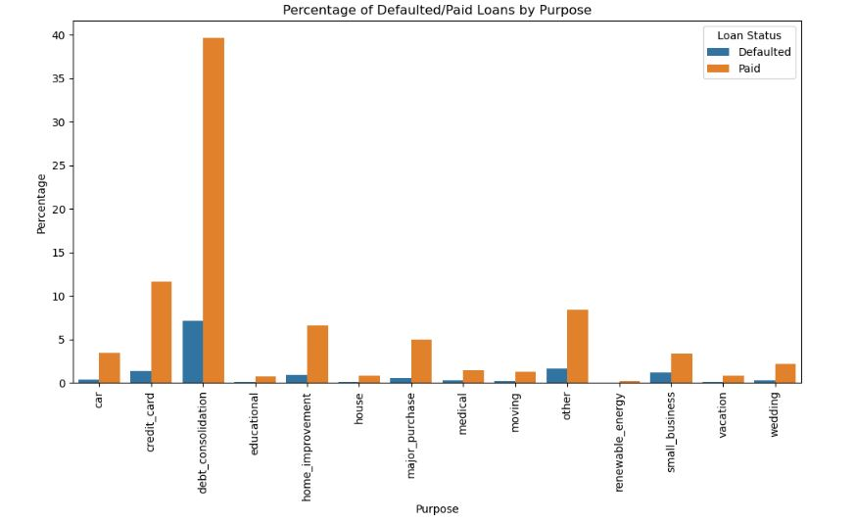
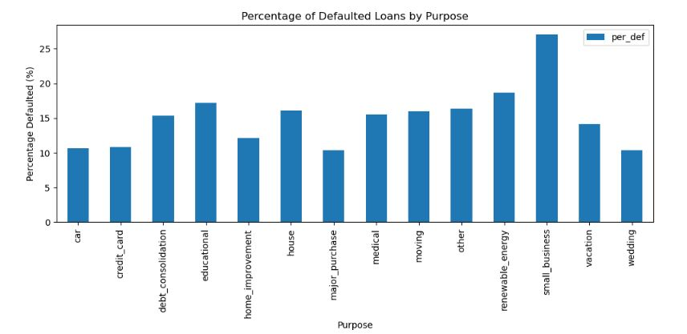
Distribution of loans by Purpose - More loans are taken by people for debt consolidations and repaying credit card bills. - It can be deduced from the below plots that more than 25% of small business customers default loans.

Slide 8
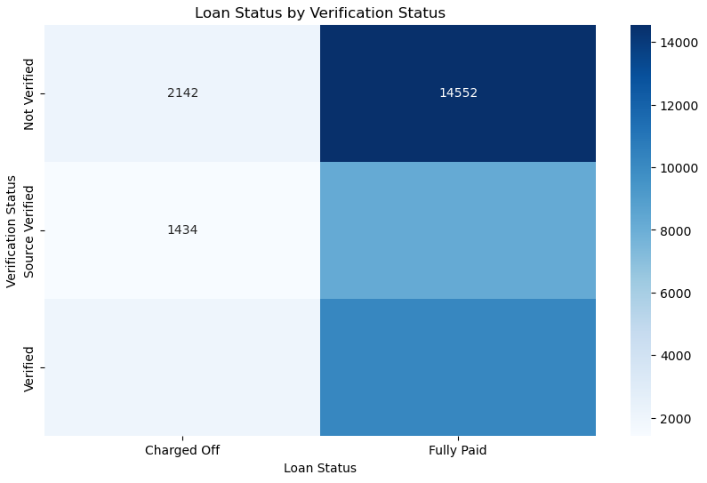
Verification status - Most of the non-verified loans are paid off hence the nature of loan re-payment is not dependent upon the verification status.

Slide 9
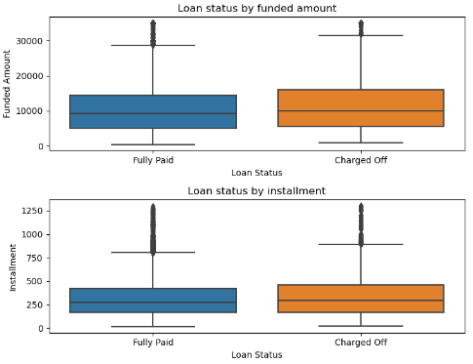
Loan amount & Installment - There is a very little difference in loan amount and installment among both fully paid and charged off loans. - Funded amount and installments both seems to be little higher for charged off loans than that for fully paid loans.

Slide 10
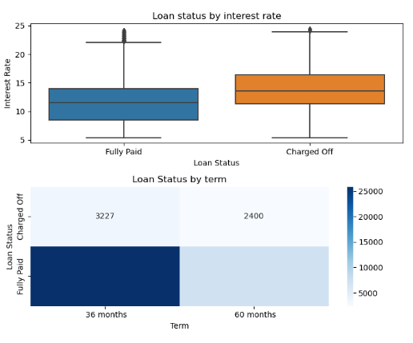
Interest rate and Term - Loans charged off typically had higher interest rates, signaling riskier loan terms that increase the likelihood of default. - A higher proportion of loans with a 3-year (36-month) term were charged off compared to those with a 5-year (60-month) term. - Also, 25% of loans with 60 months term were defaulted

Slide 11
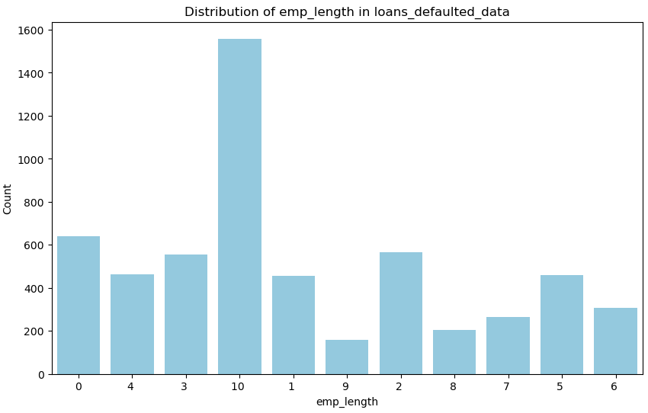
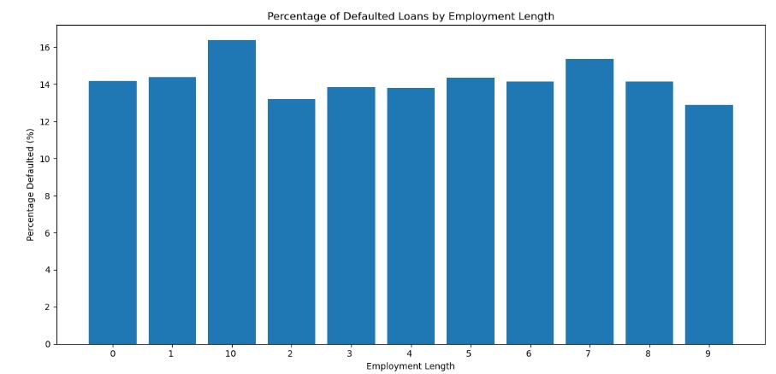
Analyzing employment length for charged off loans
Majority of charged off loans belonged to clients having 10+ years of experience .

Slide 12
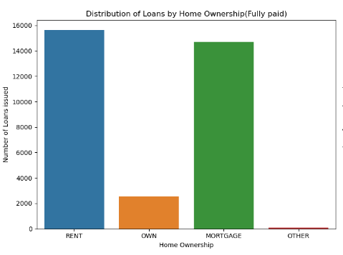
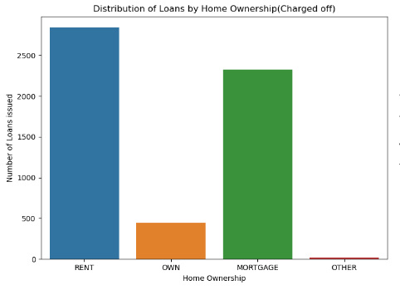
Distribution of loans by Home ownership
More loans are taken by people who are on rent or mortgage and also have higher chances of defaulting.
Renters or homeowners with mortgages may already have significant monthly financial commitments, such as rent or mortgage payments, utilities, insurance, housing expenses, etc. Taking on additional loans can lead to a higher debt-to-income ratio, making it harder to manage repayments, especially if their income fluctuates or decreases.

Slide 13
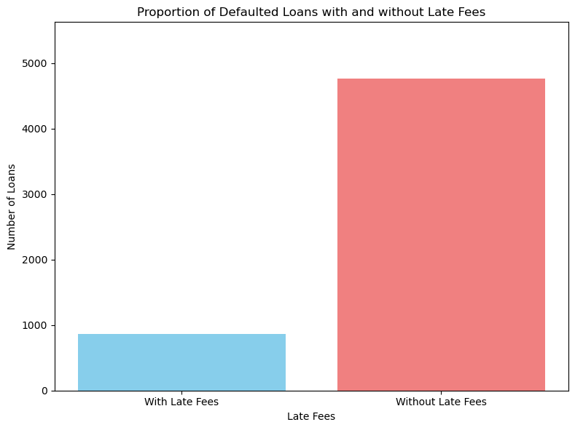
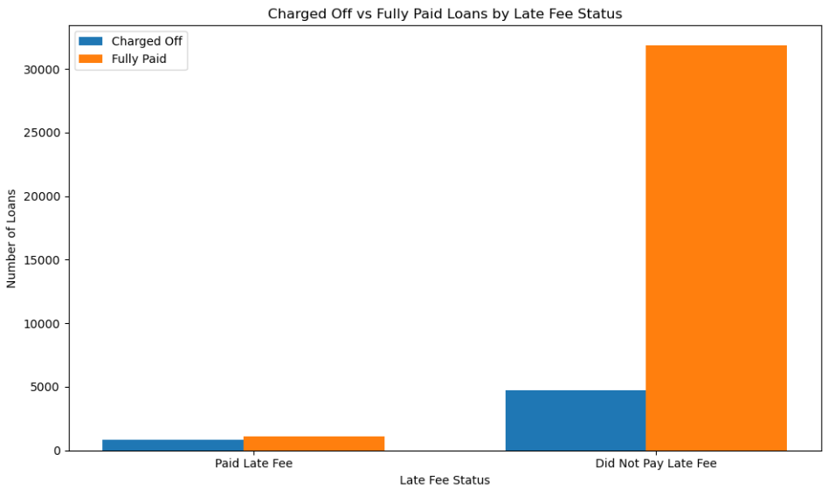
Analyzing late fees factor against defaulters
Number of people who paid late fees and defaulted were 863 out of total defaulted people of count 5627
However , total no. of people who paid late fees where 1995 out of which 863 defaulted and 1132 paid the loan.
Hence it can be concluded that , people with history of late fee payment will have 43% chance of becoming a defaulter.

Slide 14
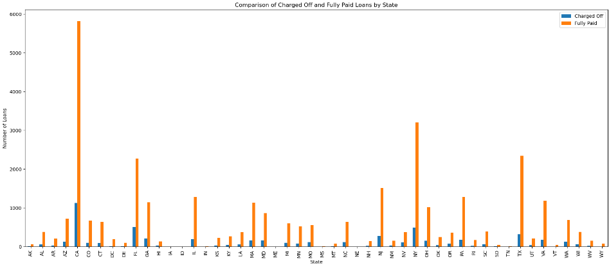
Analyzing Charged off loans and Fully paid loans in each state
Higher number of defaulted loans belonged to states CA,FL and NY likely due to economic factors.
Conversely, states with no defaulters such as AK, DC, DE, MT, SD, VT, and WY, though having fewer loans, demonstrate stronger repayment behavior.
These insights highlight the importance of regional risk assessment in lending practices.

Slide 15
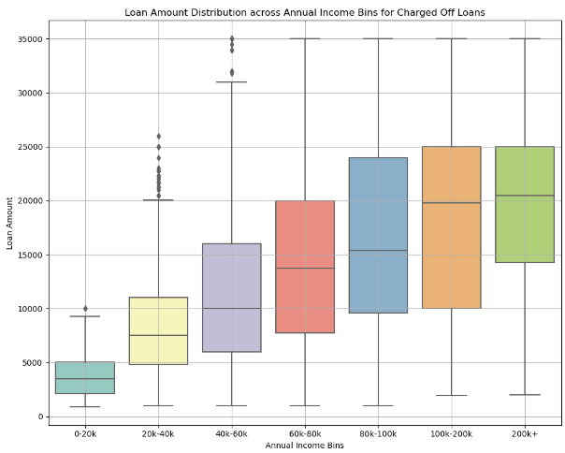
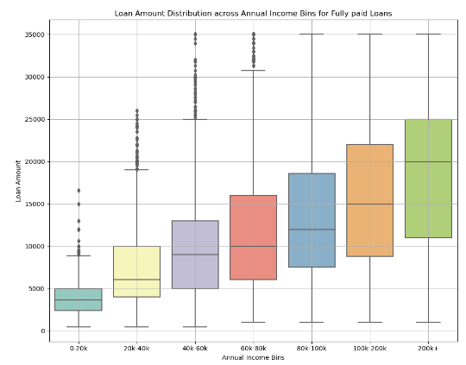
Analyzing Annual income vs loan amount
When salary and loan is divided into categories of 20k, 5k increments respectively, and we find the median of loans for defaulted vs paid customers, it is observed that defaulted customer have a higher median.

Slide 16
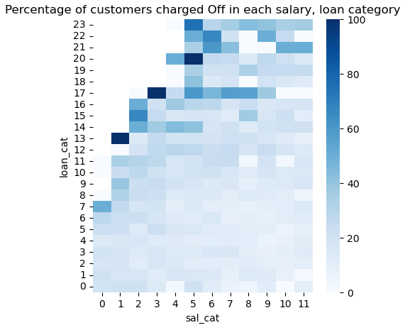
Analyzing annual income vs loan amount
Figure shows the heat map of percentage of defaulted customers in each salary and loan category.
Here, salary and loan are divided into categories of 6500k, 1.5k increments respectively (considering salary range 15k to 95k).
It can be observed that defaulted percentage is maximum in highest loan category in each salary category.
It indicates that customers who defaulted took highest loans w.r.t their salary category and could not pay back the loans.
Max loan to a customer needs to be reduced to avoid such scenarios.

Slide 17
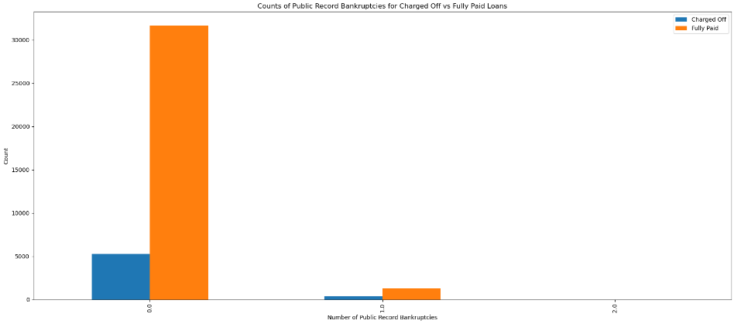
Analyzing public recorded bankruptcies for charged off loans

Slide 18
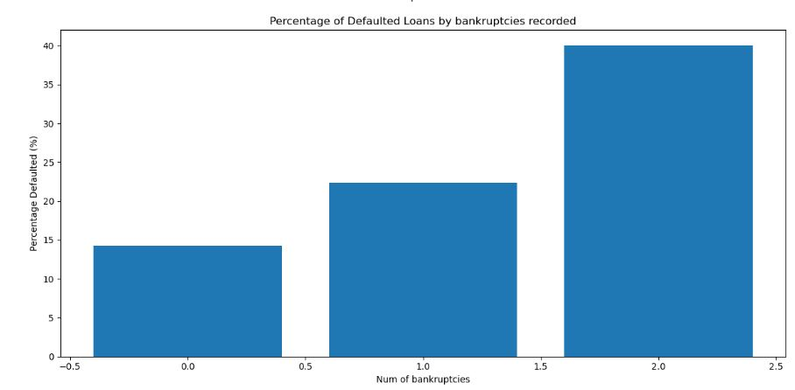
1274 customers had record of bankruptcies and 368 among them defaulted.
29% customers with public record of bankruptcies have defaulted.

Slide 19
Conclusions
Lender should be aware of below customer trends to avoid/reduce lending to loan defaulters:
- Customers with late fee payments have 43% of being a defaulter.
- Customers belonging to grades G,F,E,D defaulted by more than 25%. Its 47%,42%,36%,35% for F5, G3, G2, F4 sub-grade customers, respectively.
- Loans given for the purpose of small business get defaulted by 25%
- Customer with public record of bankruptcies default by 29%.
- Customers who defaulted had higher DTI ratio and by categorizing of salary and loan it was observed that defaulters took high category loans compared to their annual income. Maximum loan provided for a given salary can be reduced further.
- Total loans with 60 months term had 25% defaulters. A greater percentage of loans with a 3-year (36-month) term defaulted compared to those with a 5-year (60-month) term

