Slide 1

Missing Context Dataset Analysis
An analysis of a missing context Time Series Dataset from 2018 to 2024
By Rofiat Muhammad | Data Analyst
Date: 28th of November 2025.
Rofiat Muhammad

Slide 2
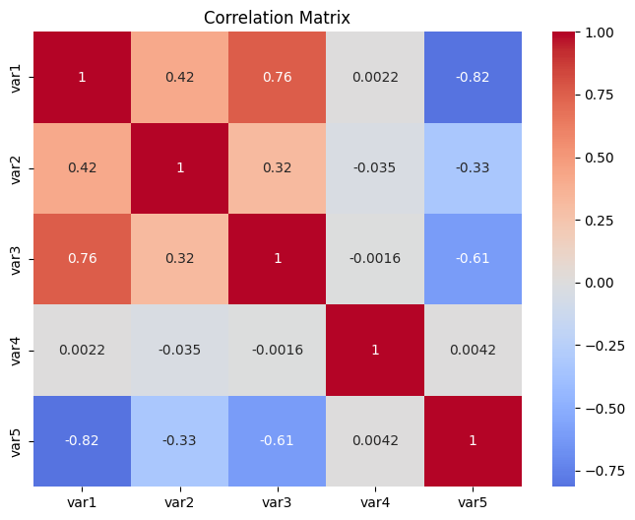
Data Ontology
Var1: is from 7 to 156. It is like a high magnitude activity metric.
Var2: from -0.7 to 0.7.
Var3: from 0 to 22. It looks like it is mirroring Var1.
Var4: is a binary spike of 0 and 1. It might represent true or false data.
Var5: from 2 to 60. It is inverse to Var1 and Var3
Var1 and Var3 (r=+0.76) are closely related
Var1 and Var5 (r=-0.82) suggest a substitution that causes casualty.
Var1 and Var2 (r=+0.42). It shows that they are closely related.
Fig. 1: Correlation chart showing the variable relationship.

Slide 3
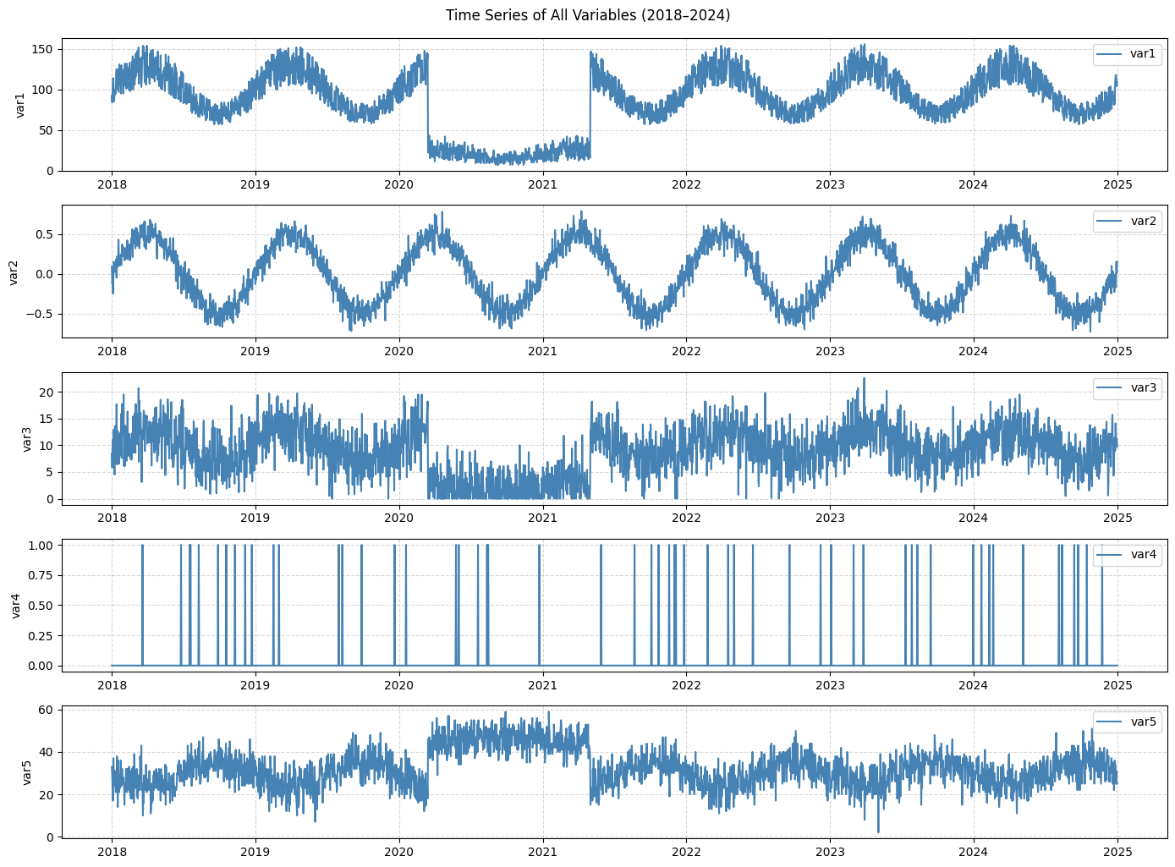
Fig 2: Chart showing the possible pattern in the Data

Slide 4
The Anomalies and Hypotheses
Anomaly | Time | Key Change | Top Hypothesis
1 | Aug 2019 | Var3 drops sharply from 16.2 to 10, with Var1 from 136 to 82 while others were stable. | Economic: Local shock (Trade war between China and Us)
2 | March 2020 | Var3 and Var1 crashed from 15 to 3 and 120 to 20, respectively, unlike Var5, which went from 37 to 45. | Economic: Global lockdowns (Businesses were forced to stop)
3 | May 2021 | Var3 from 5 to 15.9 and Var1 from 14 to 137, while Var5 drop from 54 to 25. | Economic: Reopening of businesses and activities.

Slide 5
Primary Narrative
Var1: Daily Foot traffic in a commercial District.
Var2: Investors’ or Business Owners’ confidence level.
Var3: Small business and startup sales performance.
Var4: Trade restriction.
Var5: Home internet usage and Remote work logins.
August 2019: The trade war affected small business activities.
March 2020: The disease breakout halted all physical activities, including businesses.
May 2021: Recovery phase, activities are gradually returning.

Slide 6
Counter Narrative
Var1: Simulated vehicle traffic.
Var2: System health score.
Var3: NPC (non-player character) interactions.
Var4: Scheduled maintenance triggers.
Var5: Human-controlled agents.
August 2019: A simulation Bug or rule update reduces NPC activity.
March 2020: Developer intentionally activated a stress test scenario that halted the simulated activity.
May 2021: The fixes after the stress test re-enabled simulated activities.

Slide 7
Reflection on Epistemic Uncertainty
My narration will be false if
The daily data that I assumed to be from a different system is from the same system.
Assumed daily human data is from a natural system.
External information says there was no global crisis in 2020.
Var4 is proven to be a random noise that was not recorded from any event.
Var5 is revealed to be the temperature measured in Celsius.

Slide 8
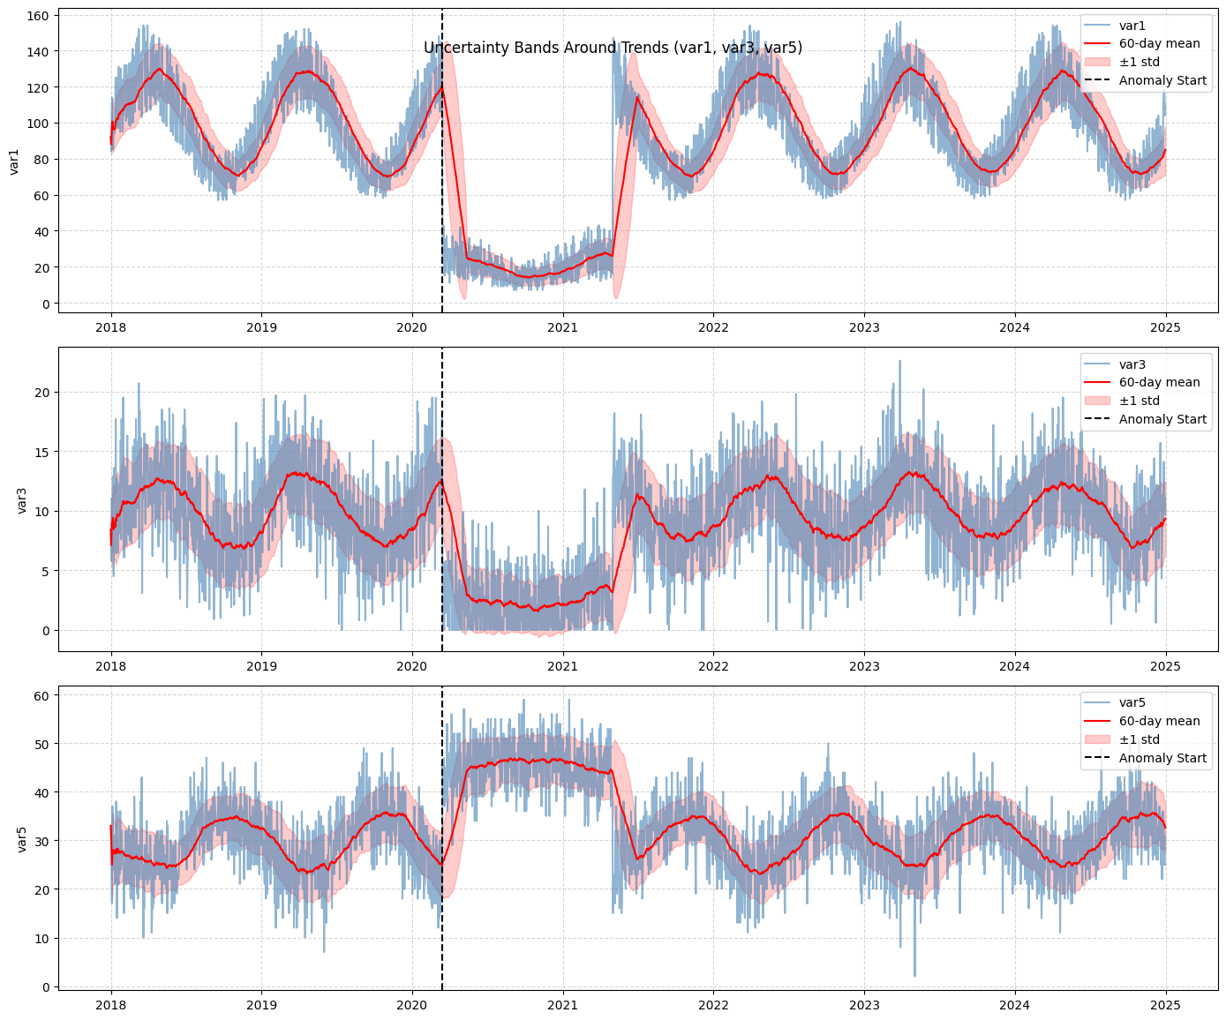
Quantifying my Epistemic Uncertainty
INSIGHTS
Var1 falls sharply from 100 to 20.
Var3 shows a similar collapse from 15 to 5.
Var5 rises from 30 to 45.
Fig. 3: Chart showing when the anomalies happened

Slide 9
Key Insight and Findings
Statistically: March 2020, Var1 and Var3 drop exceed the 3std, implying that it has a 0.3% probability of happening under normal conditions.
Interpretively, I estimated 70% confidence that this is a human behavior system, 20% that it is from a simulation, and 10% that it is from another system.
Even if I am sure that my hypotheses are anomalies, the cause is still unknown.

Slide 10
Thank You

