Slide 1

Network Analysis of Orkut’s Ground Truth Communities
Understanding the ground truth communities using Orkut Insight for Deen AI
By Rofiat Muhammad | Data Analyst
Date: 5th of December 2025.
Rofiat Muhammad

Slide 2
Dataset Description
Analyzed 5000 ground truth communities of 731thousand users from Orkut.
Sampled 2M connection edges to study how people self-organize around shared needs.
Orkut users also show how people naturally form groups based on their interests, which align with Deen AI.
The goal was to understand a healthy community structure, how users gather around shared interests, and apply the insights into the product principle for Deen AI.

Slide 3
Research Questions
How dense are real Orkut communities compared to random node sets?
Are ground-truth communities well-separated from the rest of the network?
Do Orkut groups exhibit strong triadic closure (i.e., friends of friends are also friends)?
How cohesive are these communities? Are they connected with subgraphs?
What is the size distribution of high-quality communities (those with strong internal structure)?
How many ground-truth communities does a typical user belong to, and how does this relate to their social connectivity (degree)?

Slide 4
Analytical Methods
Google Colab because the Dataset was too heavy.
Pandas and NumPy for data manipulation and statistical computation.
Matplotlib for visualization.
NetworkX for graph construction and structural metrics.
I also defined the following metrics:
Density: Ratio of actual edges to possible edges in a community.
Separability: Ratio of actual internal edges to external edges.
Triadic Closure: Fraction for users in one triangle at least (if friends of friends are friends).
Cohesiveness: whether the induced subgraph is connected.

Slide 5
Key Findings and Visualizations
Statistics Summary | Density | Separability | Clustering
Count | 5000 | 5000 | 5000
Mean | 0.006684 | 93600.049628 | 0.056056
Std | 0.035861 | 291300.535376 | 0.166761
Min | 0.000000 | 0.000000 | 0.000000
25% | 0.000000 | 0.000000 | 0.000000
50% | 0.000000 | 0.000000 | 0.000000
75% | 0.001514 | 0.123915 | 0.000000
Max | 0.794872 | 1000000 | 1

Slide 6
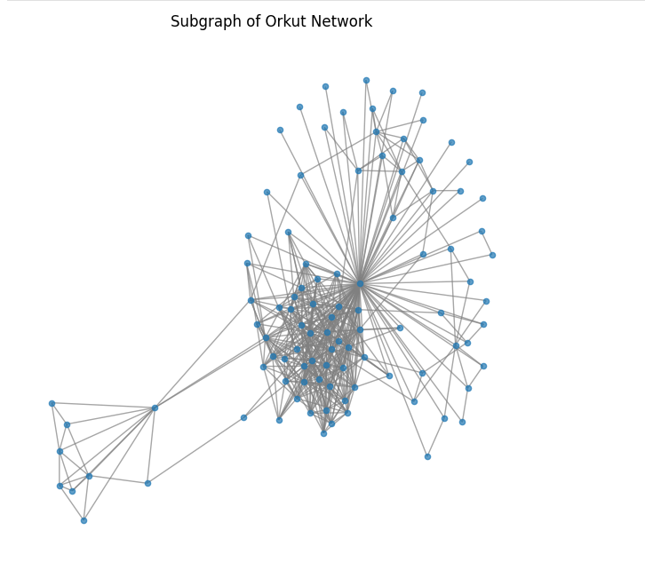
Key Findings and Visualizations
Fig. 1: Chart showing when the anomalies happened

Slide 7
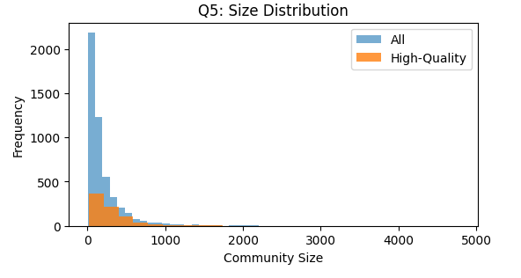
Fig 2: size distribution of the communities.

Slide 8
Key Findings and Visualizations
1,953× denser than random.
90.6% of communities have more external than internal edges.
Real communities have a clustering score of 0.0561, while the random sets score near 0.
Only 0.6% of communities are fully connected.
Median size of high-quality communities is 223 users, which shows that the communities are medium-scale.
Average membership per user: 1.5, Median: 1. Most users belong to only one group, suggesting focused intent.

Slide 9
Implications for Deen AI
Users are seeking connection, so Deen AI should offer features that reflect intentionality.
Deen AI can work with this by building flexible user profiles, recommending content across overlapping interests.
Deen AI should help users form small interest-based groups by connecting people and recommending similar faith habits.
For Deen AI, this shows that real users may join the same faith-focused space but remain disconnected in practice.
Users often begin their spiritual journey with one clear need. Deen AI should meet their exact needs and not overwhelm choices.

Slide 10
Thank You

