Slide 1
STARTUP FUNDING & BANKRUPTCY ANALYSIS
A data-driven view of which industries, regions, and investors produce durable startups — and which don't
Prepared for Client Review Raxit Pansuriya · Data Analyst · SQL · Python · Power BI · Tableau

Slide 2
01
Capital gets allocated on hype, not evidence.
Investors, accelerators, and founder-support teams face the same recurring question: which industries, regions, and investor types actually produce durable startups — and which combinations tend to end in failure? Without a structured way to connect funding history to outcomes, that insight stays anecdotal.
THE BUSINESS
PROBLEM
1
No visibility into which industries convert funding into durable outcomes vs. failure
2
No risk signal on investors with repeat exposure to startups that go bankrupt
3
No repeatable model — every review starts from scratch instead of a live, queryable dataset
Startup Funding & Bankruptcy Analysis
2

Slide 3
OUR APPROACH
Model the full startup lifecycle, then answer the questions that matter
1
2
3
Quantify capital flow
Measure survival vs. closure
Surface top performers
Total funding deployed, broken down by industry, to see where the market is placing its bets.
Startup survival rate against bankruptcy/inactive rate as a headline health KPI.
Top-funded startups within each industry to spot capital concentration.
4
5
6
Flag investor risk
Track momentum
Make it repeatable
Trace which investors were exposed to startups that later went bankrupt.
Cumulative and round-over-round funding growth per startup.
A live SQL model, not a one-time spreadsheet snapshot.
Startup Funding & Bankruptcy Analysis
3

Slide 4
THE DATASET
A 5-table relational model, 56,740+ rows
10,500
500
33,615
$1.94T+
15
Startups tracked
Investors
Funding rounds
Total funding
Industries · Countries
Table | Rows | Description
startups | 10,500 | Industry, country, region, city, founded year, status
investors | 500 | Investor name, type (VC / Angel / PE / etc.), country
funding | 33,615 | Every round — date, round type, amount, investor
bankruptcy | 1,625 | Bankruptcy date, reason, funding raised before closure
closure_reason | 10,500 | Closure/status reason mapped to every startup
Startup Funding & Bankruptcy Analysis
4

Slide 5
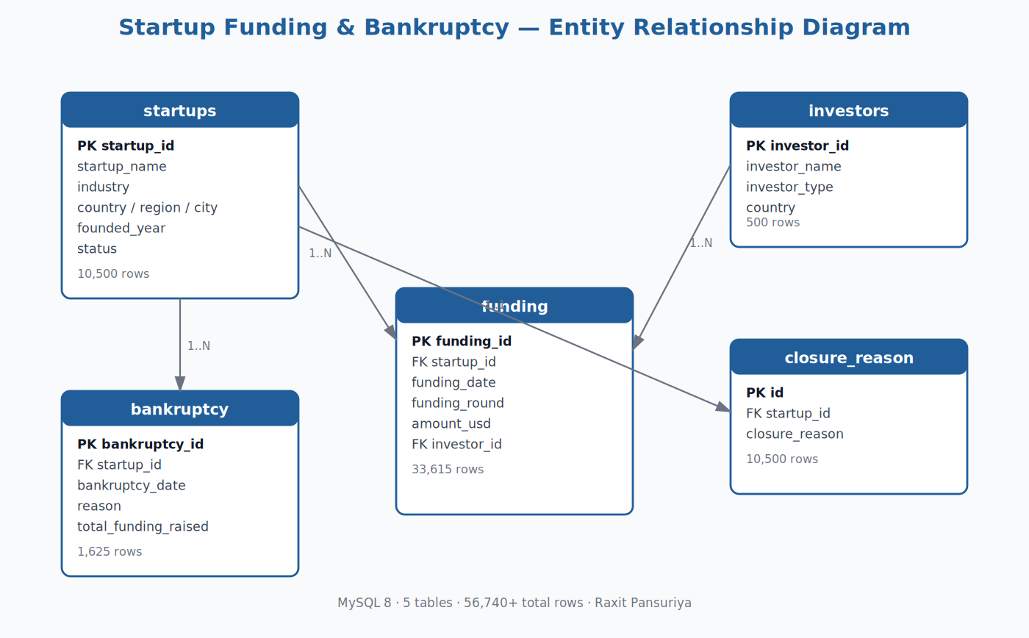
DATA MODEL
Entity Relationship Diagram
Startup Funding & Bankruptcy Analysis
5

Slide 6
KEY INSIGHT 01
CleanTech, PropTech & BioTech lead total funding
Why it matters
Capital is concentrated in CleanTech ($143B), PropTech ($138B), and BioTech ($136B) — ahead of more "hyped" categories like AI/ML ($112B). That's a signal for where the market has historically placed conviction bets, not just headlines.
Startup Funding & Bankruptcy Analysis
6

Slide 7
KEY INSIGHT 02
~75% of tracked startups reach a durable outcome
45.0%
Active
19.8%
Acquired
9.8%
IPO
25.4%
Closed (Inactive + Bankrupt)
Survival rate (Active + Acquired + IPO) sits at ~75%, giving a reassuring baseline health metric — but the remaining 25% closure rate is exactly where investor risk and industry weakness concentrate.
Startup Funding & Bankruptcy Analysis
7

Slide 8
KEY INSIGHT 03
Some investors carry repeat exposure to bankrupt startups
By joining investors → funding → startups → bankruptcy, the model surfaces exactly which investors backed a company that later filed for bankruptcy — and why. This turns a vague reputational hunch into a concrete, queryable due-diligence signal that can be re-run on every new funding round.
investors
↓
funding
↓
startups
↓
bankruptcy
1,625
Query 9
"Find Investors Who Invested
in Bankrupt Startups" — a single
join query, reusable on demand.
bankruptcy records — each traceable
back to every investor who funded it
Startup Funding & Bankruptcy Analysis
8

Slide 9
CONCLUSION
The ecosystem is healthier than headlines suggest — but capital and risk are unevenly distributed
~75%
3 industries
1 live model
of tracked startups reach a durable outcome — active, acquired, or IPO'd
CleanTech, PropTech, BioTech absorb the largest share of capital
replaces static spreadsheet reporting with repeatable, query-driven KPIs
This SQL model turns "how are our startups doing?" into a live, recomputable answer — total funding, survival rate, top performers per industry, and investor risk exposure, on demand.
Startup Funding & Bankruptcy Analysis
9

Slide 10
NEXT STEPS
Recommendations
1
Rebalance capital allocation Weight new investment toward industries with both high funding density and high survival rate — not most-funded alone.
2
Flag high-risk investors Add repeat exposure to bankrupt startups as a standing due-diligence check on new deals.
3
Monitor growth momentum Use the round-over-round growth-rate query as an early warning signal for flattening startups.
4
Extend the model Add post-bankruptcy outcome data (founder re-entry, asset acquisition) to move from a lagging report to a predictive one.
Startup Funding & Bankruptcy Analysis
10

Slide 11
Thank you
Questions & discussion welcome
Raxit Pansuriya Data Analyst · SQL · Python · Power BI · Tableau github.com/RaxitPansuriya03

