Slide 1


CS6456. Ivan Kirillov & Luis Cruz

Slide 2
About the Widget
A Pie Menu for quick navigation in large hierarchy menus
  8 root level buttons
  12 hierarchy levels
Implemented in Java Swing (MVC).
PieMenu root rotates by using mouse wheel
Hierarchy menu rotates

Slide 3
Affordance
Unfortunately it inherits the affordance problems of a pop-up menu
Rotation feature also lacks affordance, but it could be fixed by adding some “hover” tooltips
  Problem: Adding hints adds cluttering to the widget

Slide 4
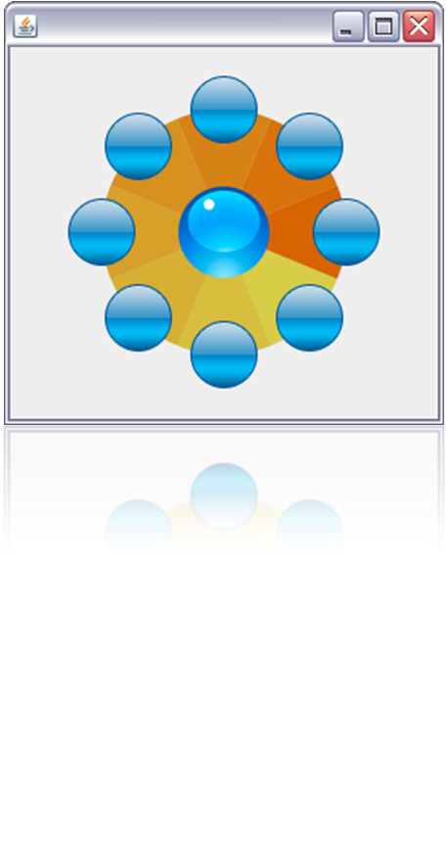
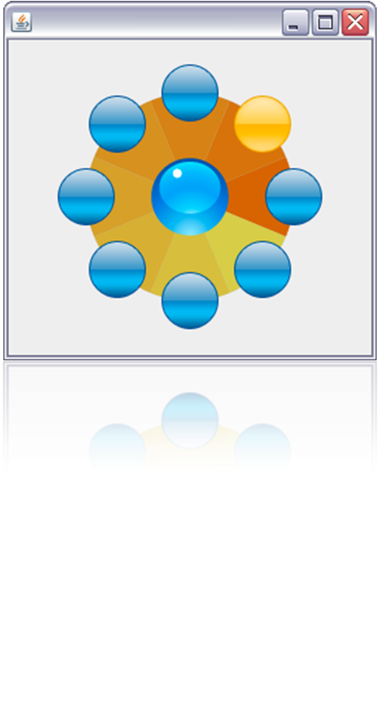
Feedback (root level)
Initial state
Hover state

Slide 5
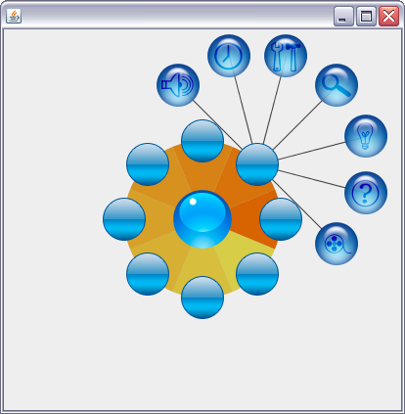
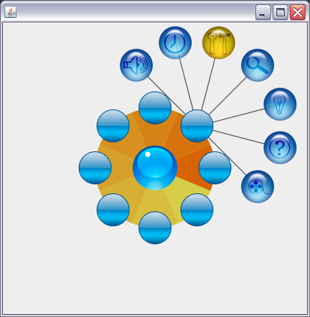
Feedback (hierarchy level)
Initial state
Hover state

Slide 6
Rotation
Implemented by using MouseWheelMoved listener
Angle in incremented or decremented for each button.
See live demo

Slide 7
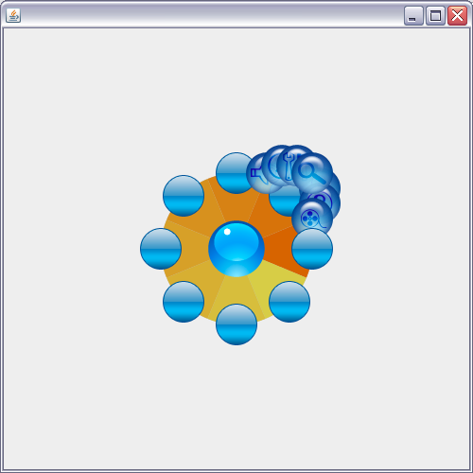
Animation
Implemented by using the Timer Class
The radius for each button in incremented or decremented for a specific amount of time
See live demo
Initial steps in animation.

Slide 8


