Slide 1
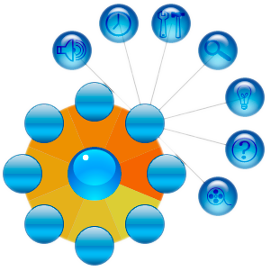
Pie Menu Widget
CS6456
Ivan Kirillov & Luis Cruz

Slide 2
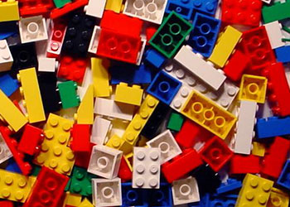
Motivation
Pie Menus
Equidistant buttons – good Fitts’ law properties
Angular positioning makes buttons easier to remember than with linear menus
Muscle memory can be utilized
Our Proposed Extensions
Hierarchy
Animations
Mouse-wheel scrolling
Hierarchical & Regular Menu

Slide 3
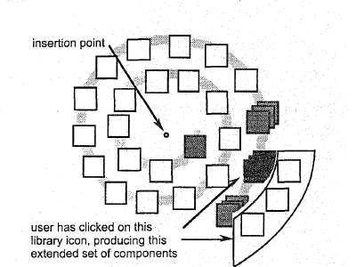
Related Work
Jack Callahan & Don Hopkins, 1988
Fixed length menus, 8 items
Formal study of user performance – 15-20% improvement over linear menus
P.J. Lyons & M.Pitchforth, 1996
1 level of hierarchy, “children and parents”
Concentric menus

Slide 4
Implementation
Done 100% in Java Swing 1.6.x
MVC Structure for Pie Buttons and Pie Menu itself
All painting & mouse event handling done in BasicUI of the Pie Menu
All button layout logic based on parametric equations & degree-based angles
Basic trigonometry – sin(x), cos(x), atan2(dist)
Hierarchical button display logic based on quadrants
Mouse detection over pie menu buttons done using arcs

Slide 5


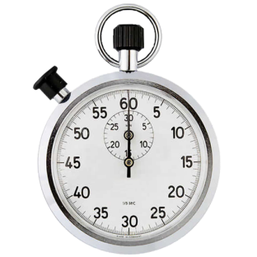
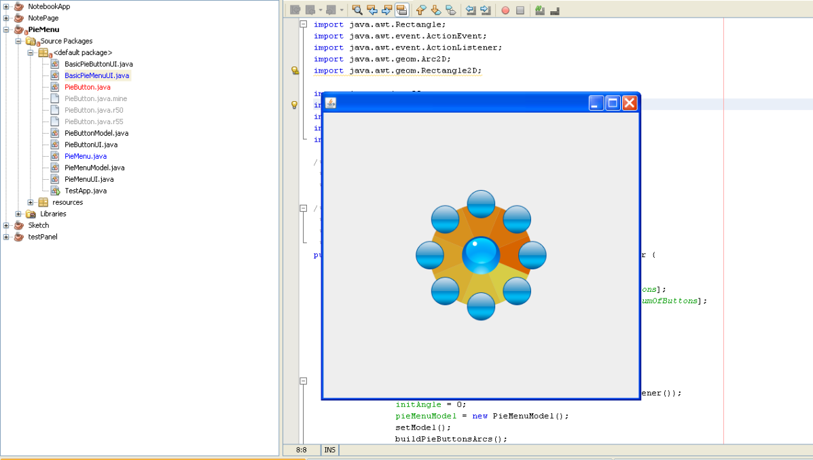
Implementation
Button images imported as .png files
Animations implemented using javax.swing.Timer class
Created a Test Widget:

Slide 6
About the Widget
A Pie Menu for quick navigation in large hierarchy menus
8 root level buttons
12 hierarchy levels
Intended to mimic a pie-menu replacement of a linear menu
Implemented in Java Swing (MVC)
PieMenu root rotates by using mouse wheel

Slide 7
Affordance
Unfortunately it inherits the affordance problems of a pop-up menu
Rotation feature also lacks affordance, but it could be fixed by adding some “hover” tooltips
Problem: Adding hints adds cluttering to the widget

Slide 8
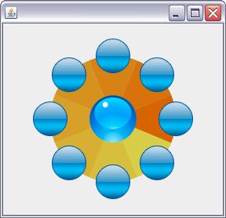
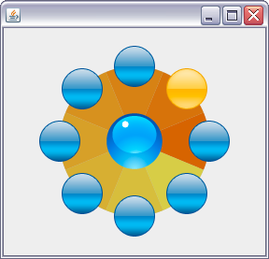
Feedback (root level)
Initial state
Hover state

Slide 9
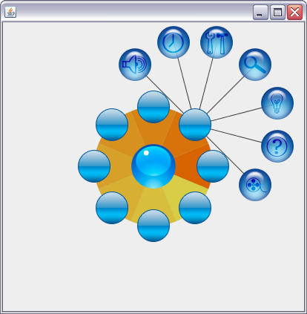
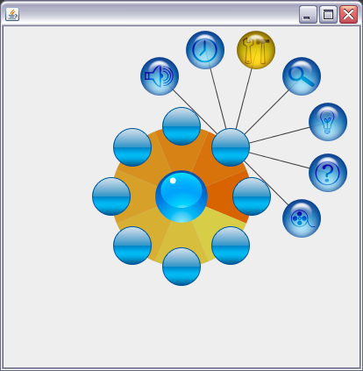
Feedback (hierarchy level)
Initial state
Hover state

Slide 10
Rotation
Implemented by using MouseWheelMoved listener
Angle is increased or decreased for each button.
See live demo

Slide 11
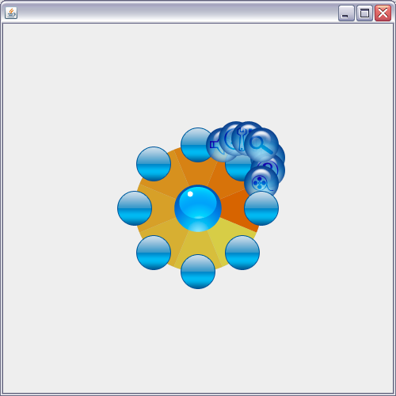
Animation
Implemented by using the Timer Class
The radius for each button is increased or decreased for a specific amount of time
See live demo
Initial steps in animation.

Slide 12
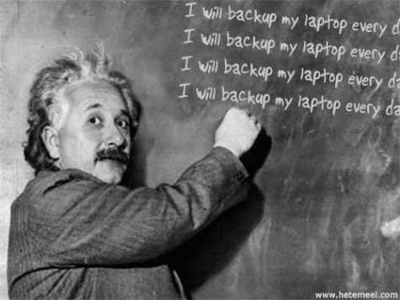
Lessons Learned
Circular math in a rectangular layout system can be troublesome
Pie Menus cannot usefully represent more than a fixed number of items
Icons work well in Pie Menus, but text is much more difficult
Pie Menus can take up substantial screen real-estate
Trade-off between space & usefulness

Slide 13
Questions?

