Slide 1
L=0.1 N=256

Slide 2
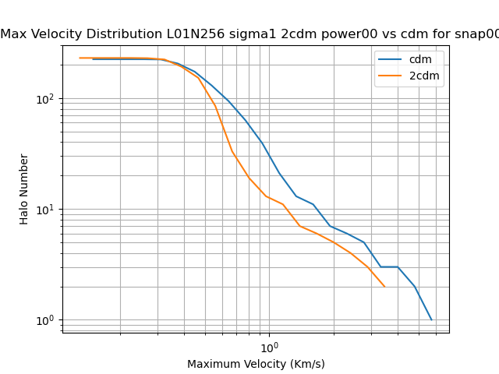
Max velocity profile cdm vs 2cdm(from AHF) (At least there is some difference)

Slide 3
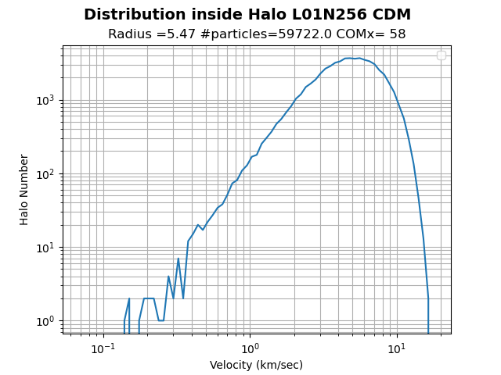
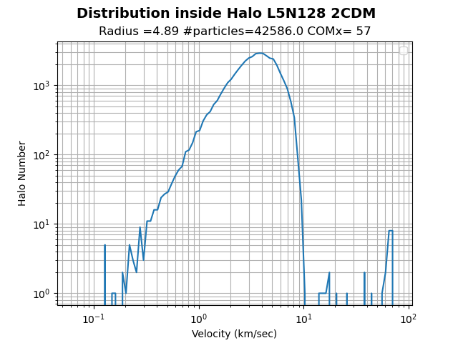
Particle distribution inside halo cdm vs 2cdm (I am working on a script to plot these together)

Slide 4
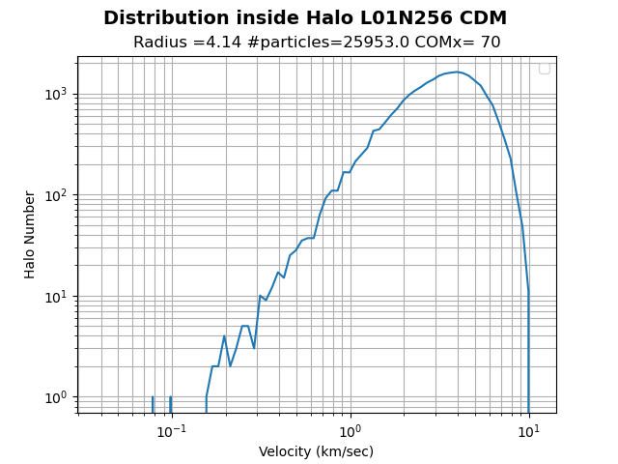
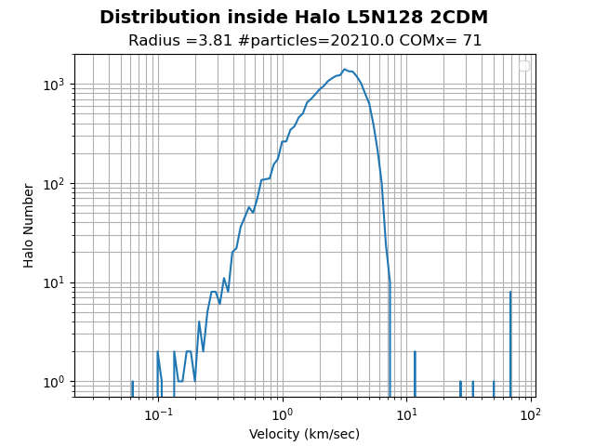
Particle distribution inside halo cdm vs 2cdm (same as before , Just another halo)

Slide 5
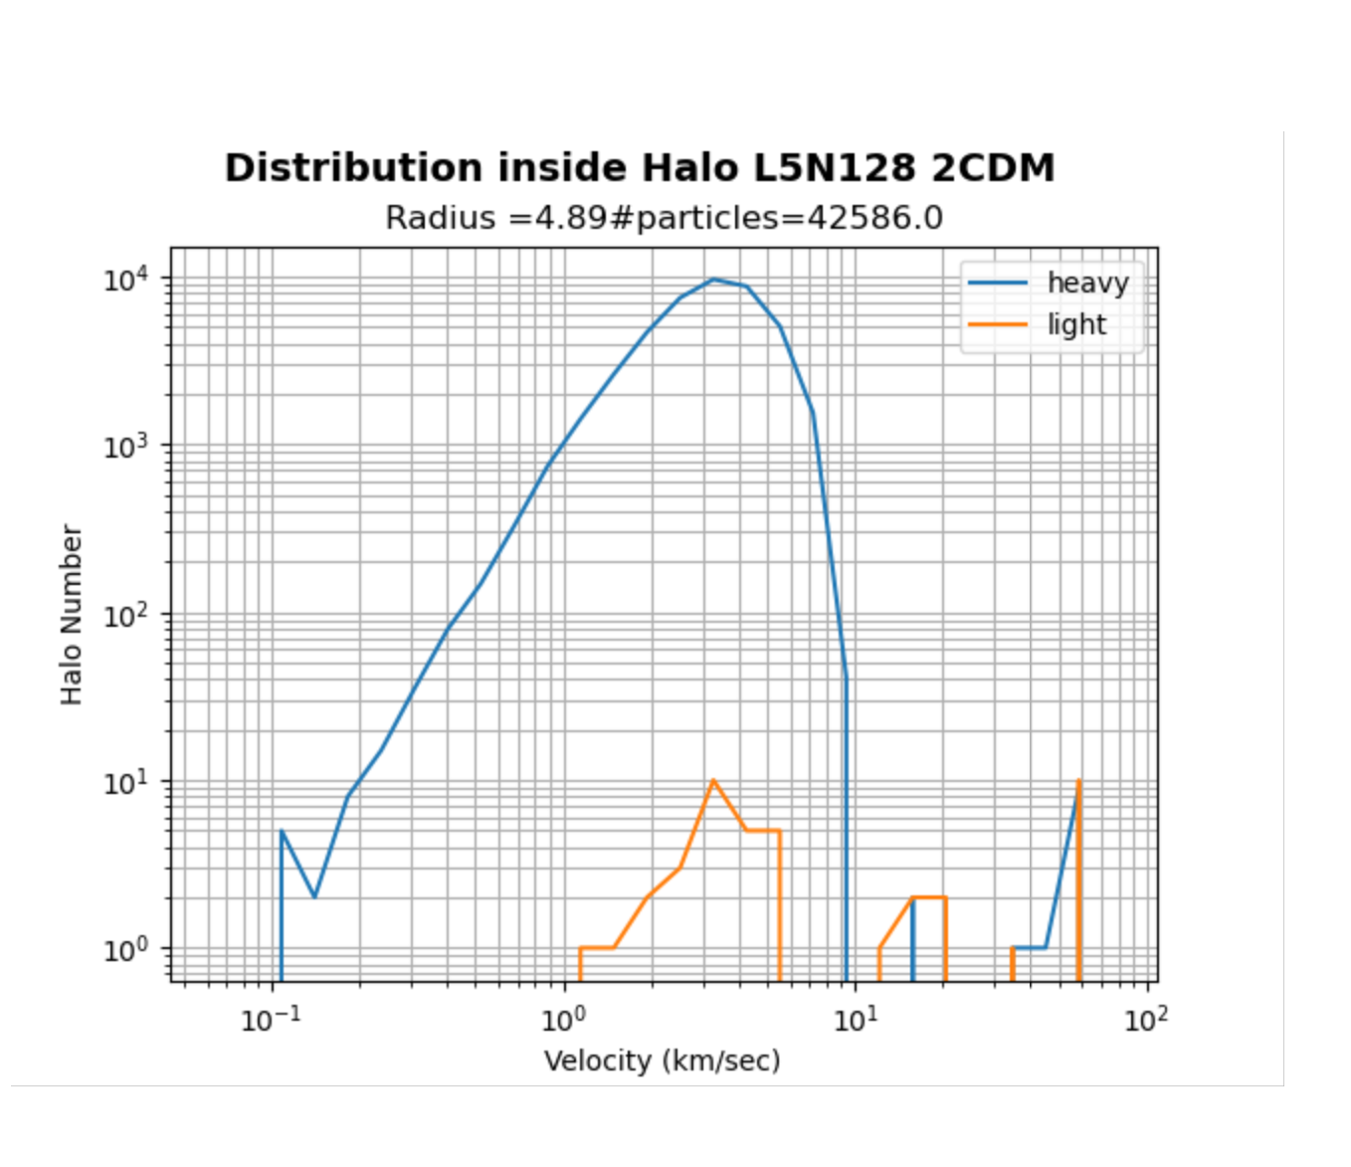
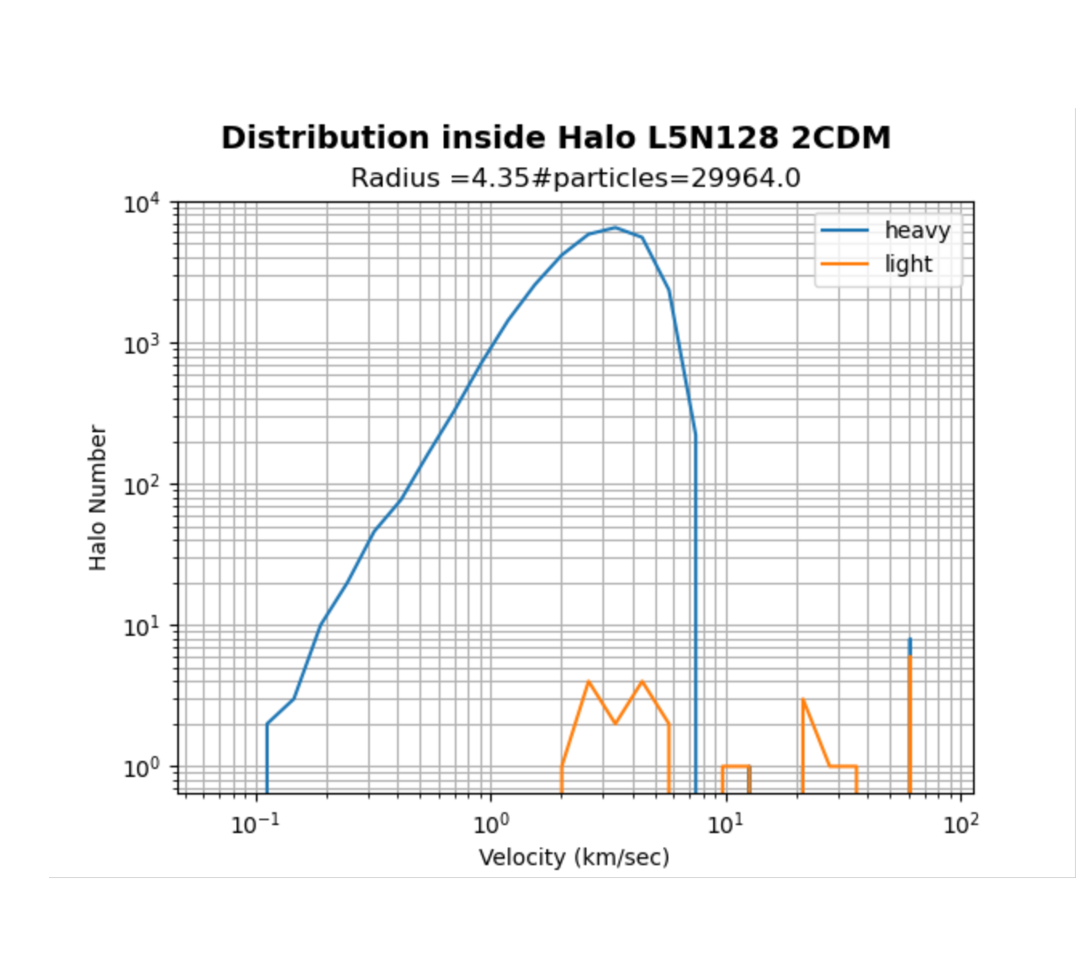
Species distribution inside two 2cdm halos The lighter particles have higher velocity, this is as expected right?

Slide 6
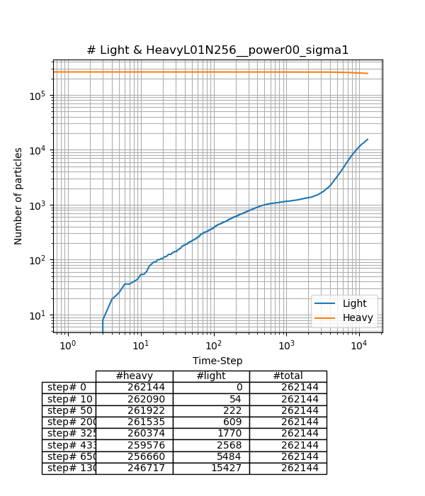
Species evolution (from logfile)

