Slide 1
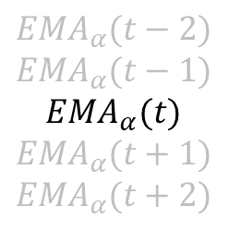
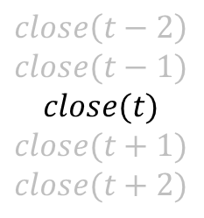



$$h=EMA_{α}(t−1)$$
$$close\left(t−2\right)$$
$$close(t−1)$$
$$close(t)$$
$$close(t+1)$$
$$close(t+2)$$
$${EMA}_{α}(t−2)$$
$${EMA}_{α}(t−1)$$
$${EMA}_{α}(t)$$
$${EMA}_{α}(t+1)$$
$${EMA}_{α}(t+2)$$
$$1−α$$
$$α$$

