Slide 1

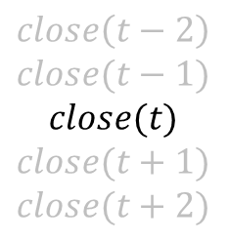






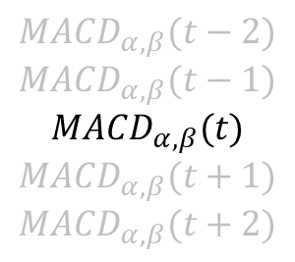

$$1−α$$
$$α$$
$${EMA}_{α}(t)$$
$${MACD}_{α,β}(t−2)$$
$${MACD}_{α,β}(t−1)$$
$${MACD}_{α,β}(t)$$
$${MACD}_{α,β}(t+1)$$
$${MACD}_{α,β}(t+2)$$
$$close\left(t−2\right)$$
$$close(t−1)$$
$$close(t)$$
$$close(t+1)$$
$$close(t+2)$$
$$1$$
$$−1$$
$$β$$
$${EMA}_{β}(t)$$
$$1−β$$

