Slide 1
Using Code::Blocks

Slide 2
What is Code::Blocks?
An Integrated Development Environment (IDE)
Code editing
Build (Compile + Link) and Run
Project and file management
Debugging support
Other IDE’s: Visual Studio, Eclipse, Xcode, NetBeans

Slide 3
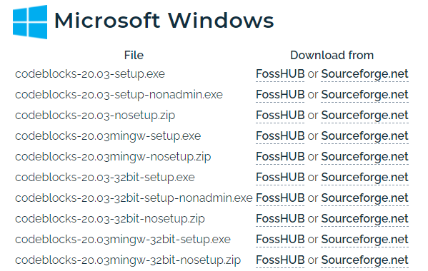
Download and Install (Lab)
http://www.codeblocks.org/downloads/binaries
DO NOT click on any ads on the download site!
Our lab computers are running Windows
Choose this one

Slide 4
Download and Install (Windows)
For Windows, mingw (i.e., GNU GCC/G++ compiler and GDB debugger) is needed for this course.
Choose one:
Casual and portable use on Windows (for lab computers or your own computer):
codeblocks-20.03mingw-nosetup.zip
Unzip to a folder and launch, even on a USB drive.
Windows Installer (for your own computer only):
codeblocks-20.03mingw-setup.exe

Slide 5
Download and Install (Mac)
Mac users shall download and install Xcode before setting up and using Code::Blocks.
For Mac users please notice that the latest version 20.3 is not available due to various OS issues; please try the latest available version on the site

Slide 6
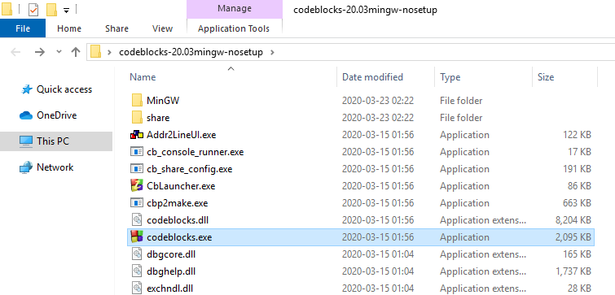
Execute “codeblocks.exe”

Slide 7
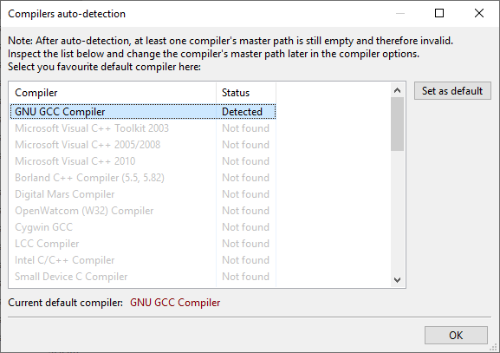
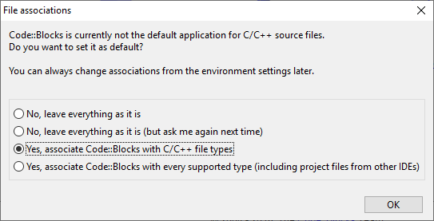
1. Make sure that the “GNU GCC compiler” can be detected
(If not, you may have downloaded a wrong installation file)
2. Set Code::Blocks to be the default application to open C source files

Slide 8
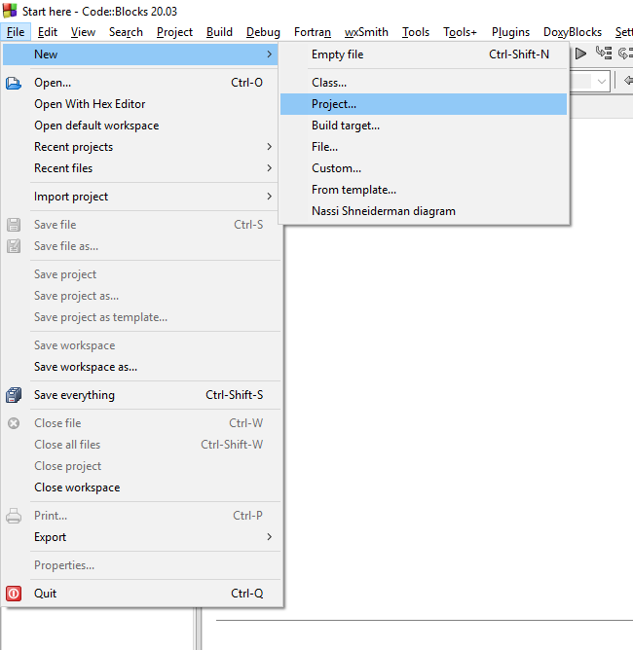
Create a new project

Slide 9
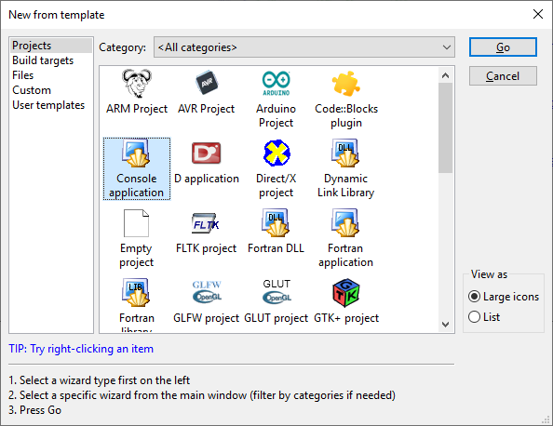
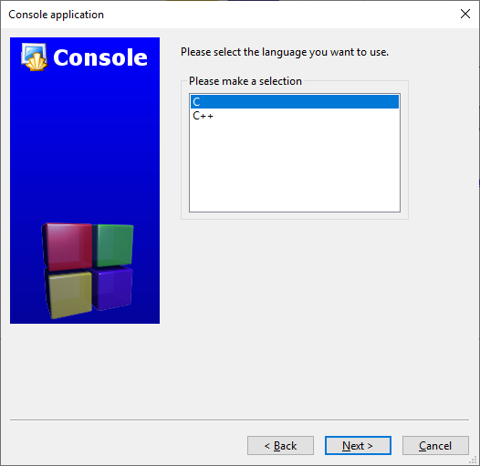
1. Choose “Console application”
2. Choose “C”

Slide 10
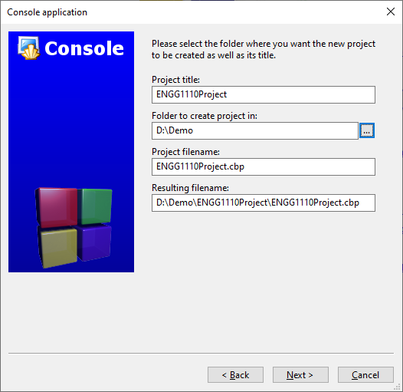
1. Create a project title
(a meaningful name is
recommended)
2. Choose and remember the folder location

Slide 11

Again, make sure that “GNU GCC compiler” is used

Slide 12
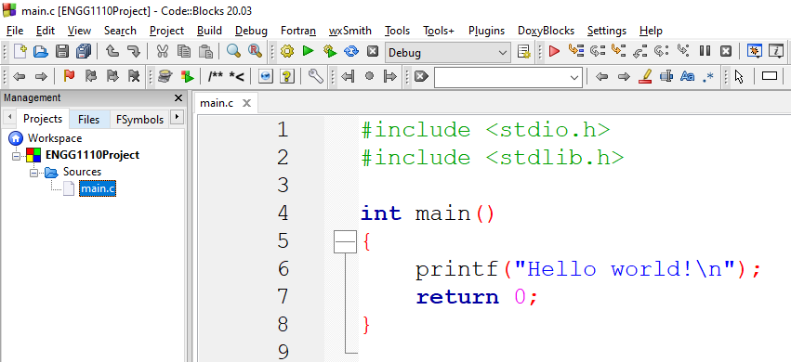
2. Click “Build and run”
1. Type your C source code here

Slide 13
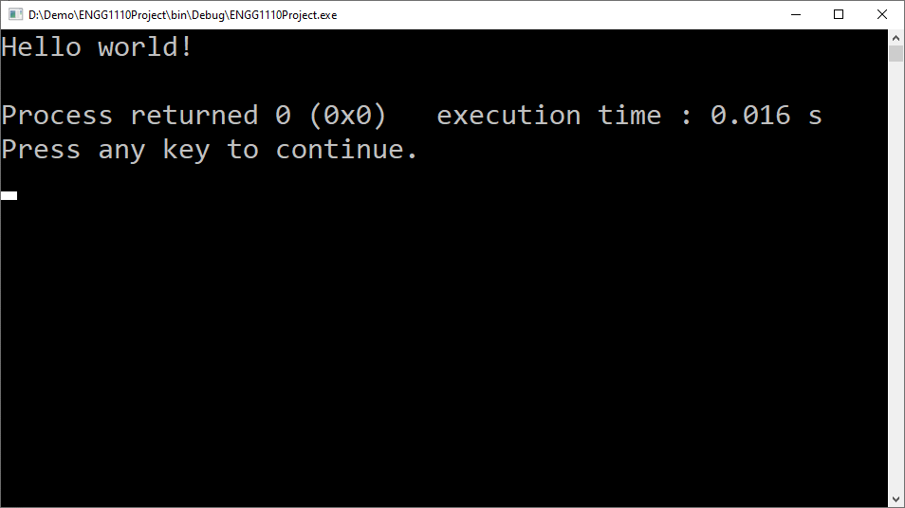
Your program will be executed if there is no compiler error

