Slide 1
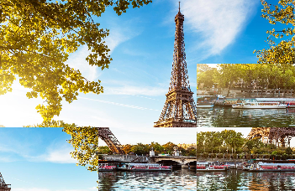
Picture Puzzle
JavaScript Project
Presented by
Michael Barta
Yelena DovGal
Radiah Jones
12/20/2019

Slide 2
About Picture Puzzle Game
Description:
In this game a picture will be rearranged into pieces, which are being shuffled randomly. You will need to move the pieces to reconstruct the original picture. Once you solve the puzzle, you are rewarded with interesting facts about the picture and links to additional information.
Instructions:
You move the pieces by swapping the positions of two tiles. Click a piece to select it and then click another piece to swap the positions of the two tiles. You are going to be evaluated by three factors – the time you spent on solving the puzzle, the quantity of moves you make, and whether you put a tile to the proper position or not. If you exceed the MAX allowed moves, your score goes down, if time runs out – YOU LOSE :)
Options:
You have 3 categories of pictures to choose from – Food, Movies, and Space, and 3 levels of difficulties – Easy, Medium and Hard.
Good Luck!!!

Slide 3

Game Flow
Player
Swap
Proper position
Wrong position
Not scored
Get Scored
Win or Lose
Keep going!
- Hard (25 tiles)
Choose a category
- Food
- Movies
- Space
Choose a difficulty level
- Easy (9 tiles)
- Medium (16 tiles)
Exceeded move quota = losing points!
Win or Lose

Slide 4
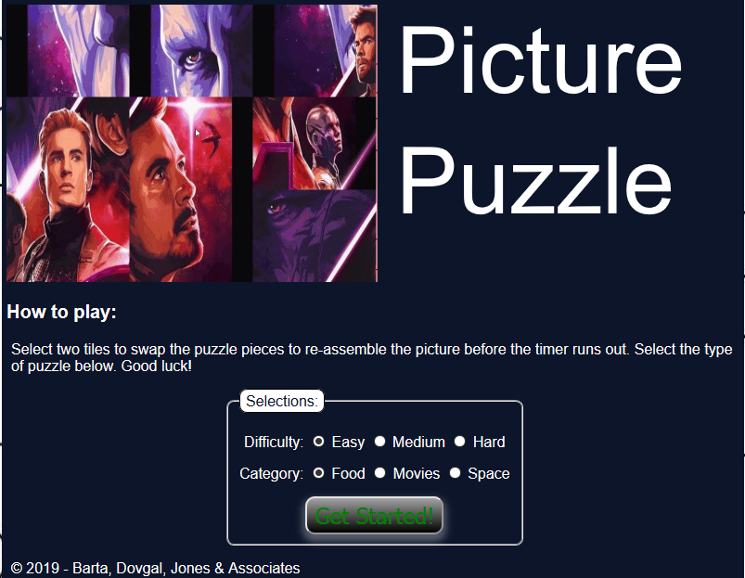
demo

Slide 5
Game logic
Prominent functions: reTile(), swapTile(), assignImage()
drawImage()
shuffle()
Web source
3rd Party API
json
assignImage()
categoryClass
ImageInfo= […]

Slide 6
CHALLENGES AND Possible Upgrades
Make it a Jigsaw-shape puzzle
Make it "Drag-and-drop" vs Swapping
Better API integration

Slide 7
Resources
https://developer.mozilla.org/en-US/
https://developers.google.com/places/web-service/photos
https://code.tutsplus.com/tutorials/create-an-html5-canvas-tile-swapping-puzzle--active-10747
https://api.edamam.com/search
https://api.nytimes.com/svc/movies/v2/reviews/search.json?query=
https://api.nasa.gov/planetary/apod
and lots more...
Code: https://github.com/greymiba/JS_GroupProject_RMY

Slide 8
QUESTIONS

