Slide 1
Java期末复习

Slide 2
正误判断题 – 15 * 1p = 15 points
完形填空题 – 15 * 1p = 15 points
单项选择题 – 10 * 3p = 30 points
模拟运行题 – 10 * 3p = 30 points
手写代码题 – 4 * 5p = 10 points + 10 bonus

Slide 3
正误判断题 – 15 * 1p = 15 points
Assignment operator is evaluated from left to right ( ? )
The expression (y >= z && a == b) is evaluated by first evaluating y >= z and then evaluating a == b ( ? )
The == operator can be used to compare two String objects. The result is true if the two strings are identical ( ? )
Java programs cannot be executed on a computer unless JDK is installed. ( ? )
Calls to overloaded methods are resolved(determine the called method) at compile time ( ? )
All methods in a final class must be explicitly declared final ( ? )

Slide 4
完形填空题 – 15 * 1p = 15 points
The _______ keyword is an access modifier used for attributes, methods and constructors, making them accessible in the same package and subclasses.
You can’t instantiate a(n) _______ class or a(n) _______ .
Two or more methods may have the same name if they differ in parameters. These methods are called ________ methods.
Fill the blank using the most appropriate keyword in the following list: break, class, interface, continue, default, double, private, protected, public, abstract, double, int, long, new, null, this, super, static

Slide 5
单项选择题 – 10 * 3p = 30 points
Which of the following statement is true?
A. In case of overloading, binding of objects with methods happens at runtime.
B. In the case of dynamic polymorphism, method choice is decided at runtime.
C. In the case of overriding, the creation of objects happen at compile time and these objects are used for calling objects at runtime.
D. In the case of overriding, it is the responsibility of the compiler to bind the method calls with the method body.

Slide 6
单项选择题 – 10 * 3p = 30 points
Which line of the following contains a compilation error?
Line1: Public class Test {
Line2: Test() {}
Line3: static void Test() { this(); }
Line4: public static void main(String[] args) {
Line5: Test();
Line6: }
Line7: }
At Line2
At Line3
At Line5

Slide 7
单项选择题 – 10 * 3p = 30 points
Which line of the following statements is true?
X extends Y is correct if and only if X is a class and Y is an interface.
X extends Y is correct if and only if X is an interface and Y is a class.
X extends Y is correct if X and Y are either both classes or both interfaces.
X extends Y is correct for all combinations of X and Y being classes and/or interfaces.

Slide 8
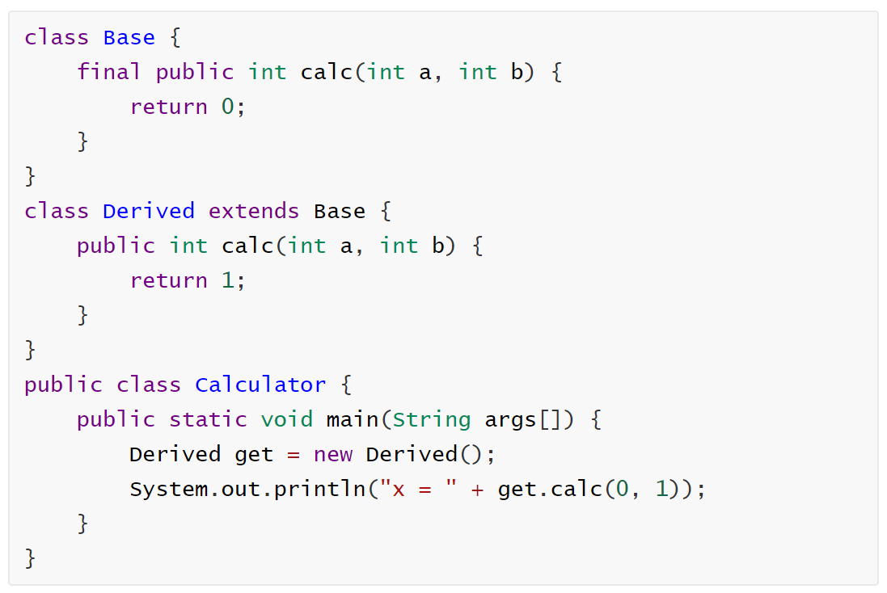
模拟运行题 – 10 * 3p = 30 points

Slide 9
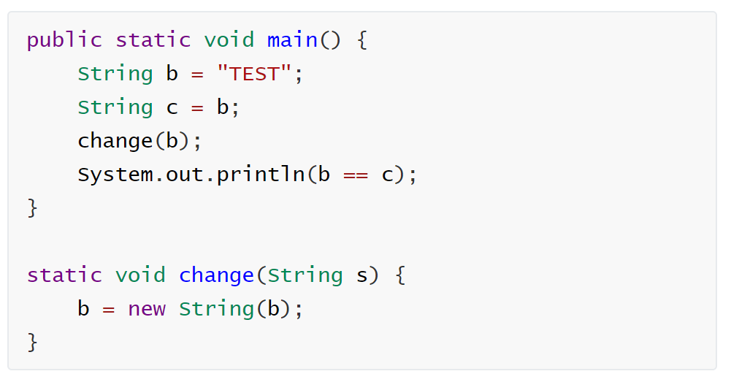
模拟运行题 – 10 * 3p = 30 points

Slide 10
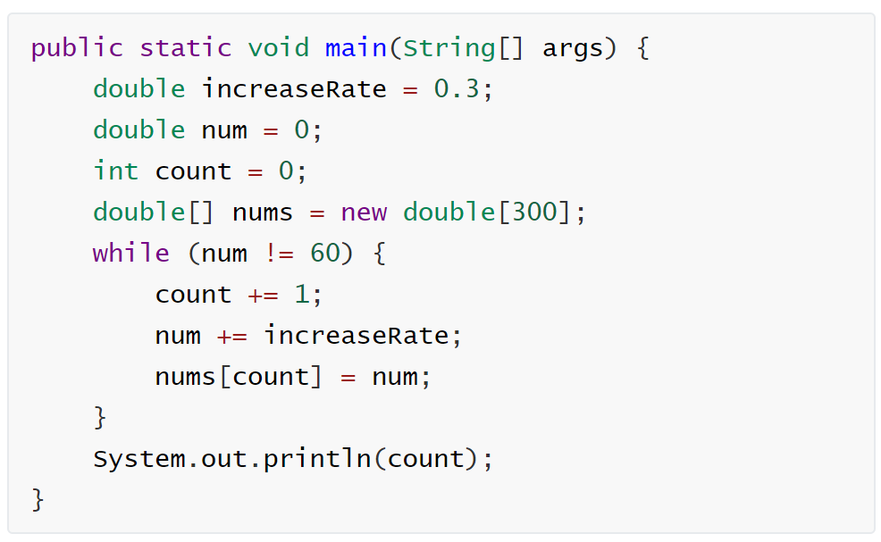
模拟运行题 – 10 * 3p = 30 points

Slide 11
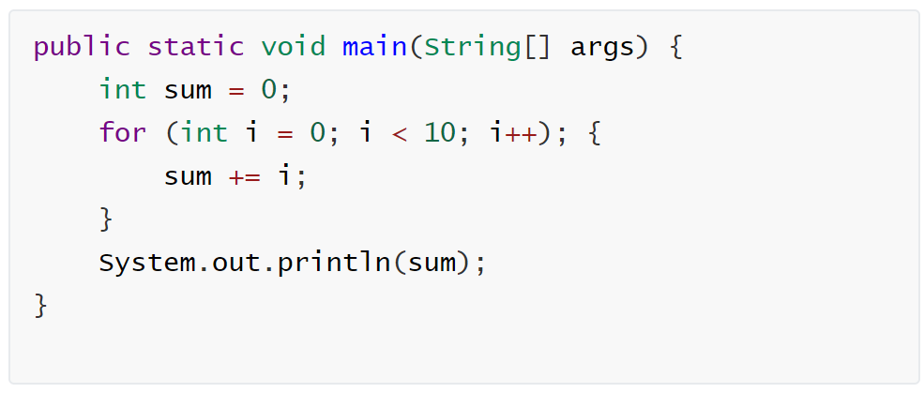
模拟运行题 – 10 * 3p = 30 points

Slide 12
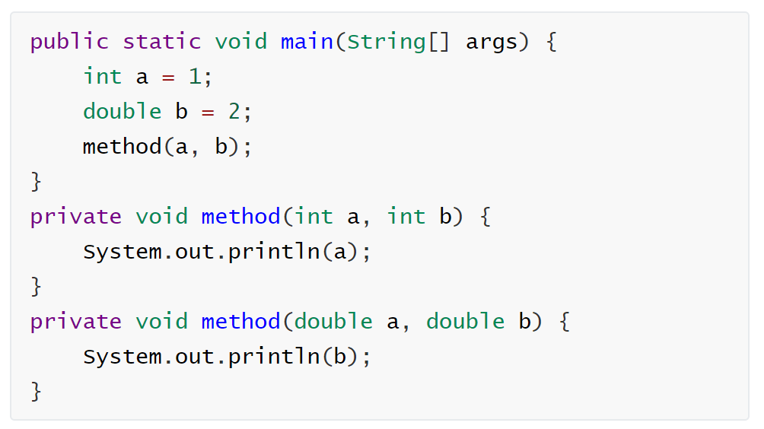
模拟运行题 – 10 * 3p = 30 points

Slide 13
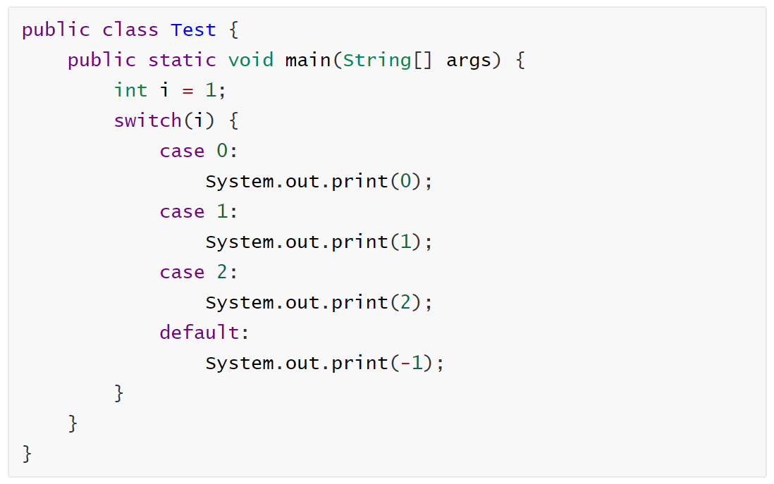
模拟运行题 – 10 * 3p = 30 points

Slide 14
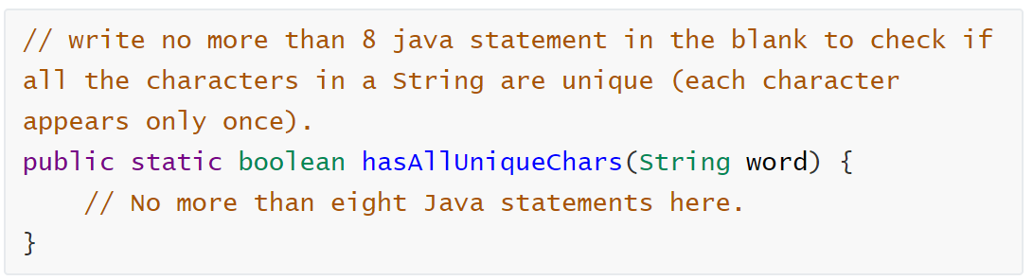
手写代码题 – 4 * 5p = 10 points + 10 bonus

Slide 15
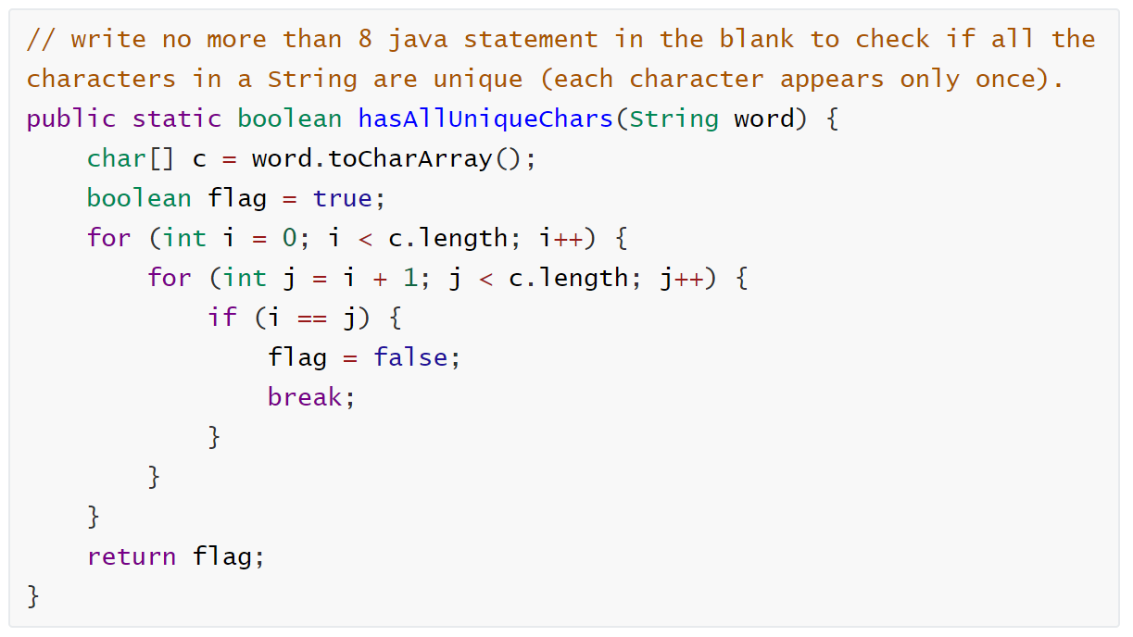
手写代码题 – 4 * 5p = 10 points + 10 bonus

Slide 16
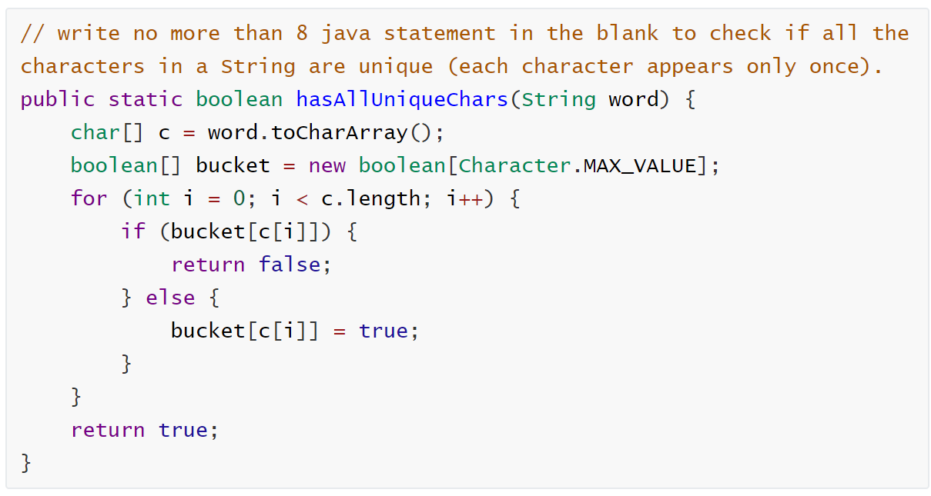
手写代码题 – 4 * 5p = 10 points + 10 bonus

Slide 17
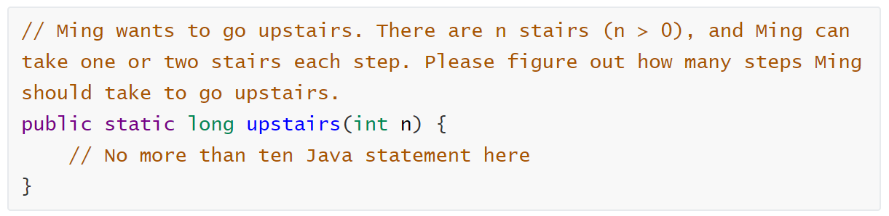
手写代码题 – 4 * 5p = 10 points + 10 bonus

Slide 18
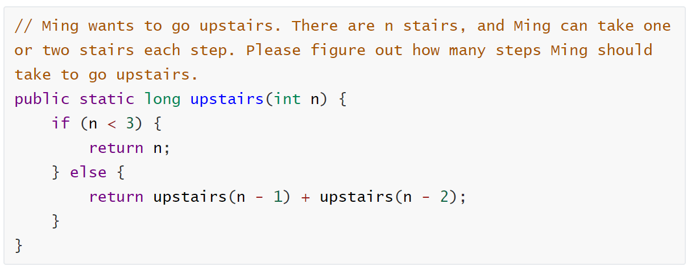
手写代码题 – 4 * 5p = 10 points + 10 bonus

Slide 19
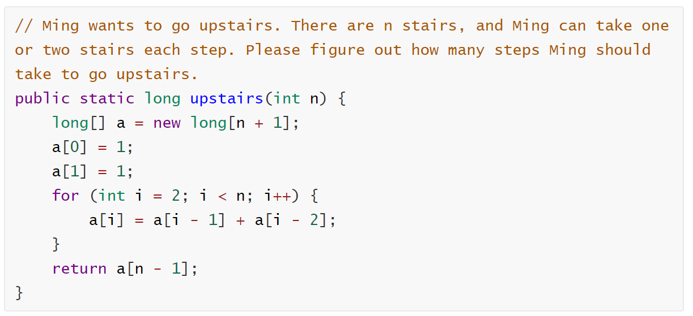
手写代码题 – 4 * 5p = 10 points + 10 bonus

