Slide 1
Kernel-Based Multi-channel PolyCovNet
AI Hackathon Challenge I
Team Borides
Kastan Day, Ruijie Zhu, Aria Coraor, Seonghwan Kim, Jiahui Yang

Slide 2
Contents
1. Problem Restatement
2. Algorithm
3. Results
4. Discussion
5. Summary

Slide 3
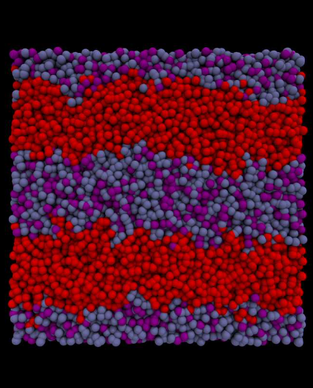
Problem Restatement
Predicting the lamellar period from monomer sequences and interaction parameters
A
B
C
Lamellar
Period
Interaction Parameter
C

Slide 4
Algorithm
Sliding window - extract monomer sequence features
0
1
A
B
C
Sliding Window

Slide 5
Algorithm
Sliding Window
window size
5
[0, 0, 0, 0, 0]
[0, 0, 0, 0, 1]
[0, 0, 0, 1, 0]
[0, 0, 0, 1, 1]
[0, 0, 1, 0, 0]
[0, 0, 1, 0, 1]
[0, 0, 1, 1, 0]
[0, 0, 1, 1, 1]
[0, 1, 0, 0, 0]
[0, 1, 0, 0, 1]
[0, 1, 0, 1, 0]
[0, 1, 0, 1, 1]
[0, 1, 1, 0, 0]
[0, 1, 1, 0, 1]
[0, 1, 1, 1, 0]
[0, 1, 1, 1, 1]
[1, 0, 0, 0, 0]
[1, 0, 0, 0, 1]
[1, 0, 0, 1, 0]
[1, 0, 0, 1, 1]
[1, 0, 1, 0, 0]
[1, 0, 1, 0, 1]
[1, 0, 1, 1, 0]
[1, 0, 1, 1, 1]
[1, 1, 0, 0, 0]
[1, 1, 0, 0, 1]
[1, 1, 0, 1, 0]
[1, 1, 0, 1, 1]
[1, 1, 1, 0, 0]
[1, 1, 1, 0, 1]
[1, 1, 1, 1, 0]
[1, 1, 1, 1, 1]
2
3
4
[0,0]
[0,1]
[1,0]
[1,1]
[0, 0, 0, 0]
[0, 0, 0, 1]
[0, 0, 1, 0]
[0, 0, 1, 1]
[0, 1, 0, 0]
[0, 1, 0, 1]
[0, 1, 1, 0]
[0, 1, 1, 1]
[1, 0, 0, 0]
[1, 0, 0, 1]
[1, 0, 1, 0]
[1, 0, 1, 1]
[1, 1, 0, 0]
[1, 1, 0, 1]
[1, 1, 1, 0]
[1, 1, 1, 1]
[0,0,0]
[0,0,1]
[0,0,0]
[0,0,0]
[0,0,1]
[0,0,0]
[0,0,0]
[0,0,1]
2² = 4
2³ = 8
2⁴ = 16
2⁵ = 32

Slide 6


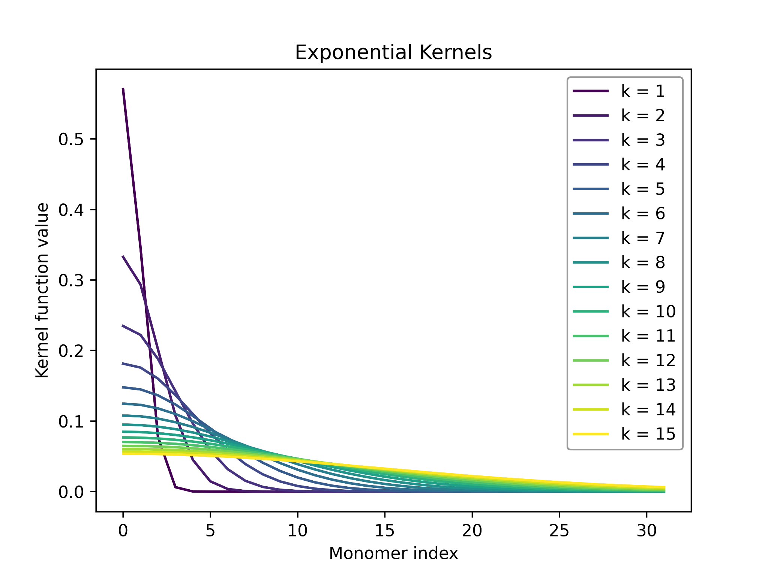
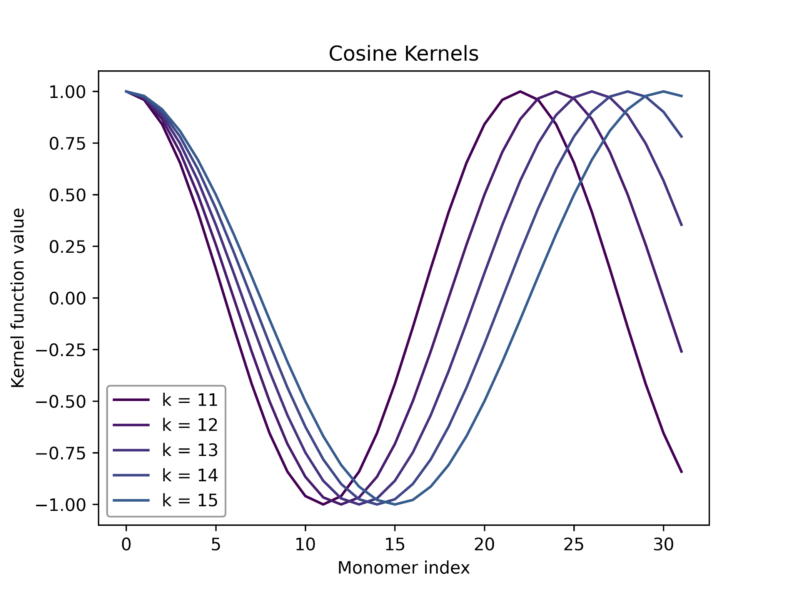

Algorithm
Non-linear kernel functions - preprocess monomer sequences
1. Exponential kernels
2. Cosine kernels
Applying the above kernels on monomer sequences
Non-linearity

Slide 7

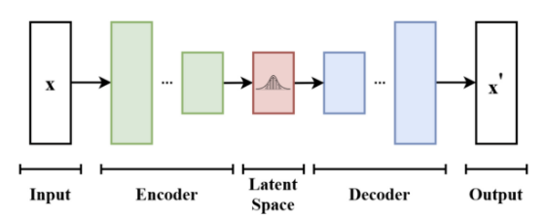
Algorithm
Variational autoencoder - extract features from monomer sequences
Monomer sequences
Monomer sequences
BBBBBCCCCC
BBBBBCCCCC
Reduced feature vectors

Slide 8
Algorithm
Nerual Net Architecture
Input
Conv1d
Exponential / Cosine Kernel
Interaction Parameter
Features obtained using variational autoencoder
Fully Connected
Fully Connected
Prediction

Slide 9
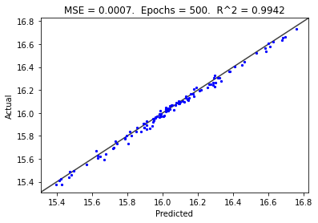
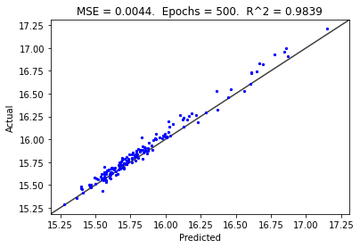
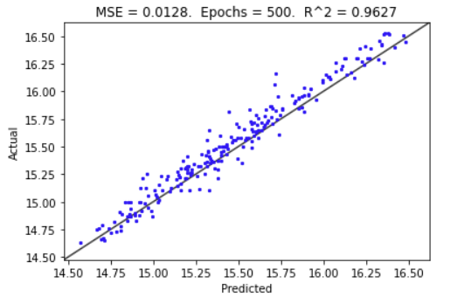
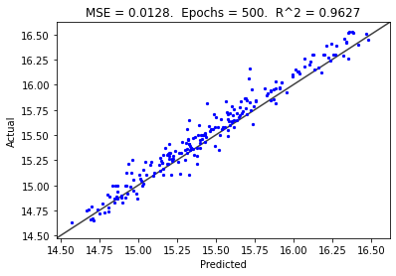
Results
Sliding Window+Kernel
Sliding Window+Kernel
DataSetA
DataSetB
Sliding Window+VAE
Sliding Window+Kernel
500 epoch
0.01 learning rate
DataSetC
DataSetD

Slide 10
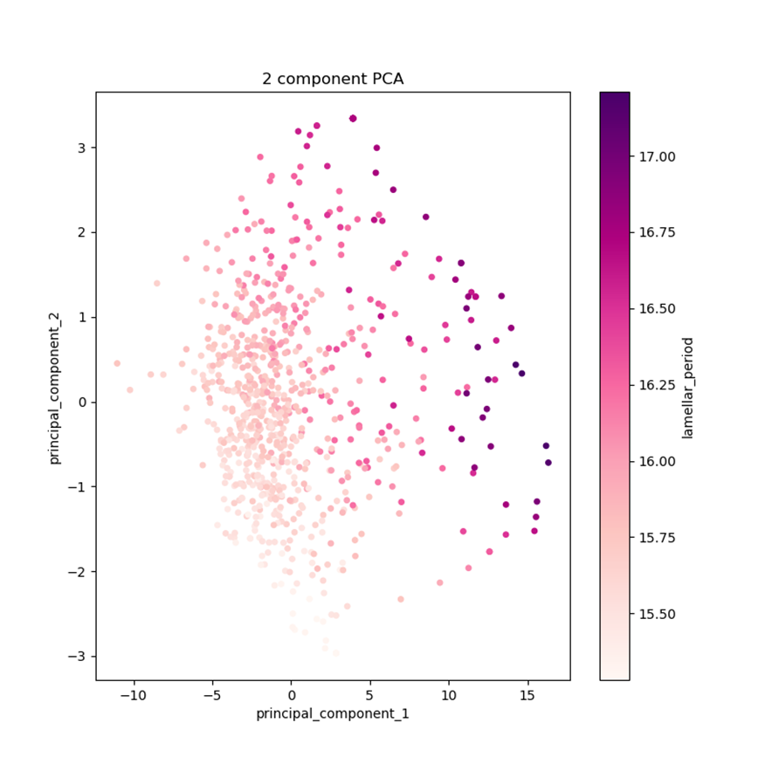
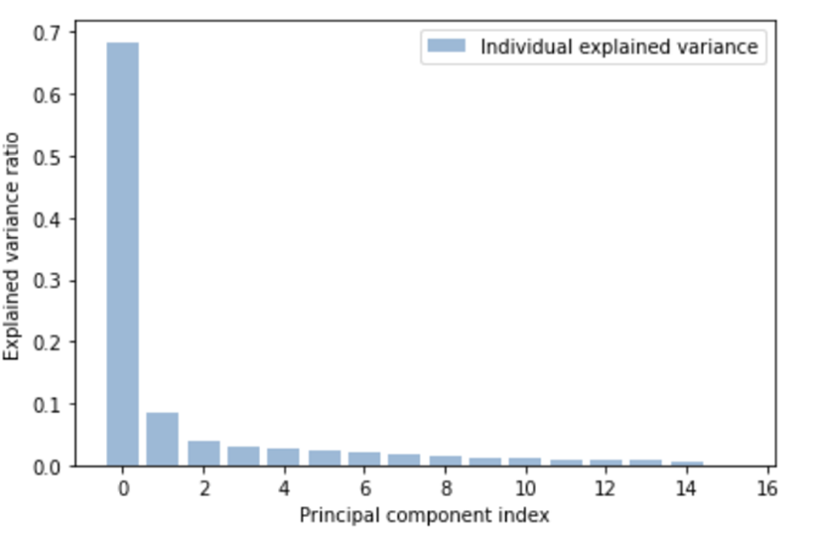
Discussion
Principal component analysis on the latent space
Dataset B
Principal component 1 dominates
Larger principal component 1
Larger lamellar period

Slide 11
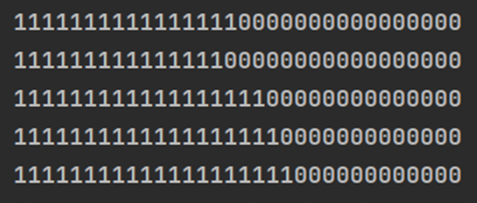
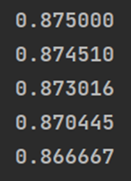

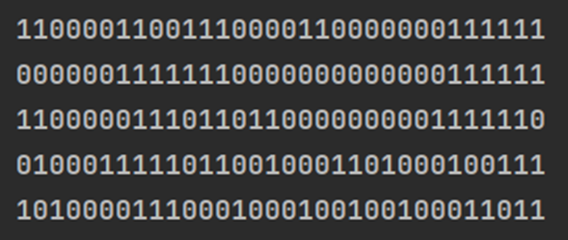
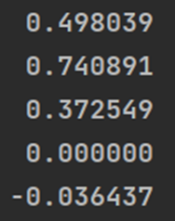
Discussion
Blockiness is important to result in a high lamellar period
Higher principal component 1
Blockiness
Lower principal component 1
Blockiness

Slide 12
Computational Efficiency (500 epochs)
Feature Generation | Time (min)
2-channel Sliding Window Features | 0.5
Exponential / Cosine Kernel Features | 0.08
VAE Features | 30
Model Training / Validation | Time (min)
Training | 1
Validation | 0.02
* All runtimes are reported using ThetaGPU

Slide 13
Thank you!

