Slide 1
Probabilistic Graphical Model 是什麼?
ZhiShengChen
2018/06/11

Slide 2
Goals to Learn
What is Probabilistic Graphical Model (PGM)?
What is Bayesian Network (BN)?
What is Markov Network (MN)? (or Markov Random Field)
What is Conditional Random Field (CRF)?
Part-of-Speech (POS) Tagging
BN approach (HMM)
MN approach (Linear chain CRF with log-linear model)
Learning (Training)
Hands on Project (Haipeng)
State-of-the-art approach (Haipeng)

Slide 3
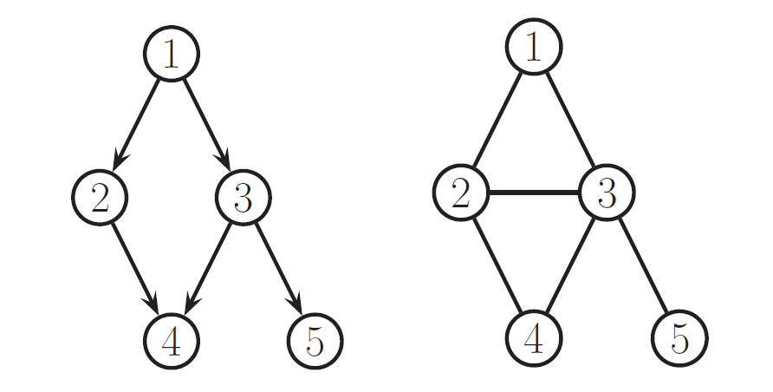

What is Probabilistic Graphical Model (PGM)
A language describes probability distribution
Directed Acyclic Graph (DAG): Bayesian Network
Undirected Graph: Markov Network
$$p\left(x\right)$$
Graph
Ref: Kevin Murphy’s book

Slide 4
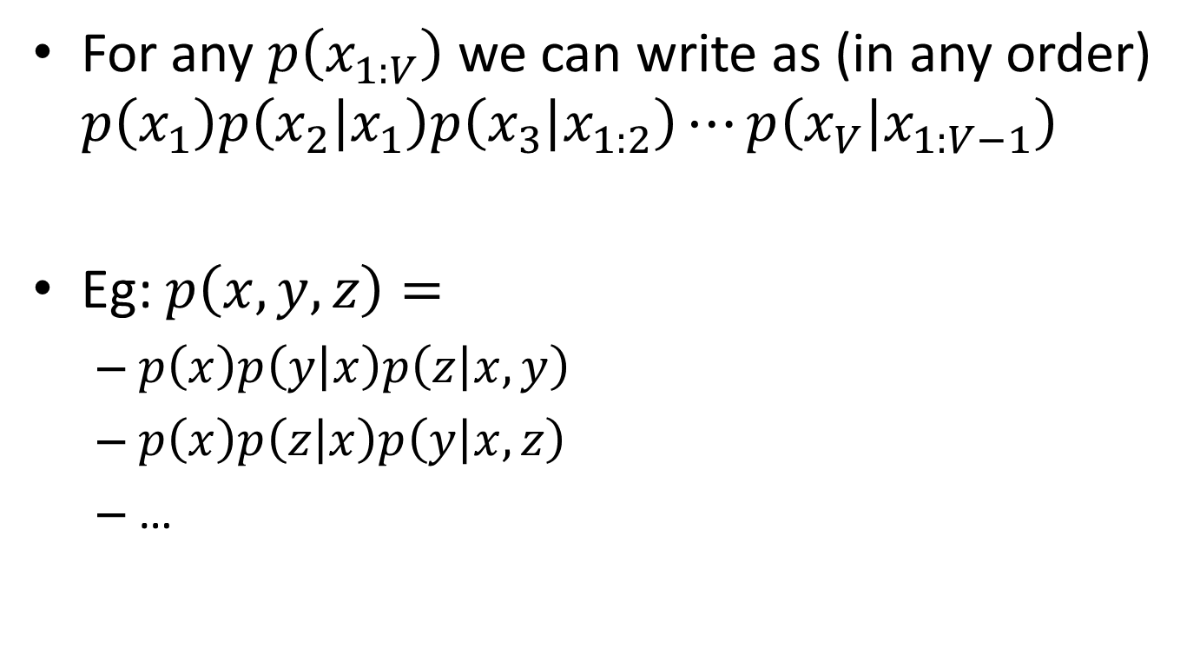
What is Bayesian Network (BN)
For any $p\left(x_{1:V}\right)$ we can write as (in any order) $p\left(x_{1}\right)p\left(x_{2} | x_{1}\right)p\left(x_{3} | x_{1:2}\right)⋯p\left(x_{V} | x_{1:V−1}\right)$
Eg: $p\left(x,y,z\right)=$
$p\left(x\right)p\left(y | x\right)p\left(z | x,y\right)$
$p\left(x\right)p\left(z | x\right)p\left(y | x,z\right)$
…

Slide 5

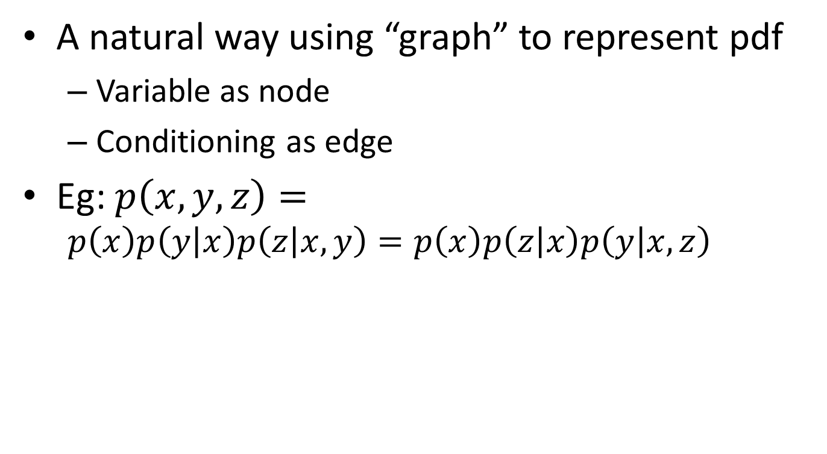
What is Bayesian Network (BN)
A natural way using “graph” to represent pdf
Variable as node
Conditioning as edge
Eg: $p\left(x,y,z\right)=$
$$p\left(x\right)p\left(y | x\right)p\left(z | x,y\right)=p\left(x\right)p\left(z | x\right)p\left(y | x,z\right)$$
x
x
y
z
y
z

Slide 6



Conditioning V.S. Independency
What if we want $x⊥y$?
i.e. $p\left(x,y\right)=p\left(x\right)p\left(y\right)$
Can we just remove the edge from x to y?
Eg:
NO
x
x
Take care of this graph!
y
z
y
z
$$p\left(x\right)p\left(y\right)p\left(z | x,y\right)$$
$$p\left(x\right)p\left(z | x\right)p\left(y | z\right)$$

Slide 7
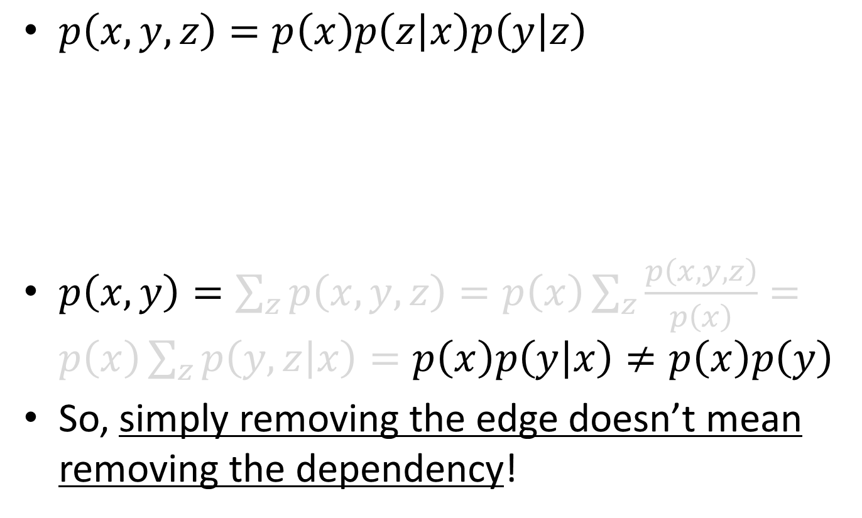
Conditioning V.S. Independency
$p\left(x,y,z\right)=p\left(x\right)p\left(z | x\right)p\left(y | z\right)$
$p\left(x,y\right)=\sum_{z}{p\left(x,y,z\right)}=p\left(x\right)\sum_{z}{\frac{p\left(x,y,z\right)}{p\left(x\right)}}=p\left(x\right)\sum_{z}{p\left(y,z | x\right)}=p\left(x\right)p\left(y | x\right)≠p\left(x\right)p\left(y\right)$
So, simply removing the edge doesn’t mean removing the dependency!
x
y
z

Slide 8
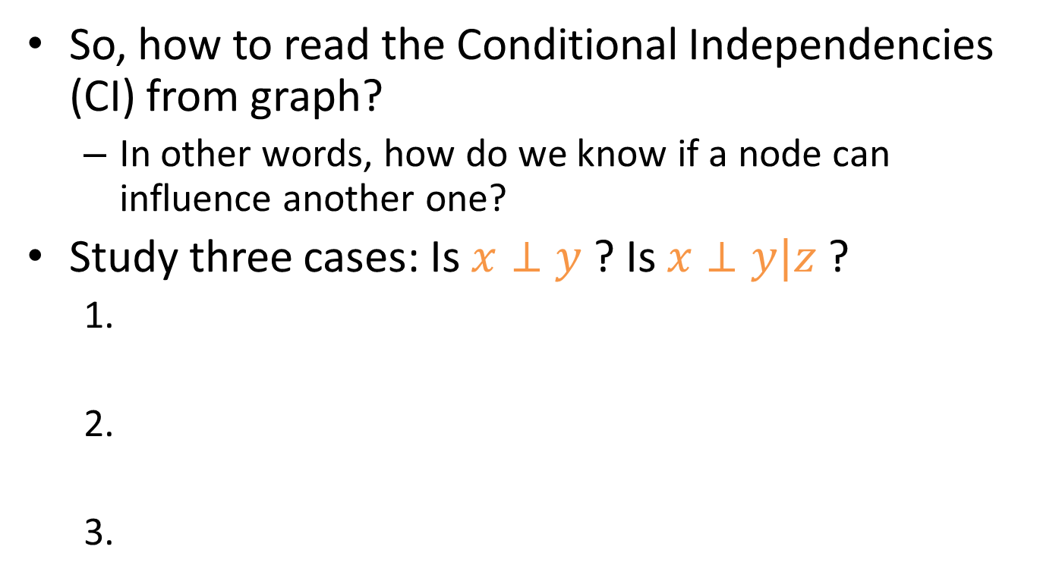
Flow of Influence
So, how to read the Conditional Independencies (CI) from graph?
In other words, how do we know if a node can influence another one?
Study three cases: Is $x⊥y$ ? Is $x⊥y|z$ ?
x
z
y
x
z
y
x
z
y
x
z
y
x
z
y
x
z
y

Slide 9
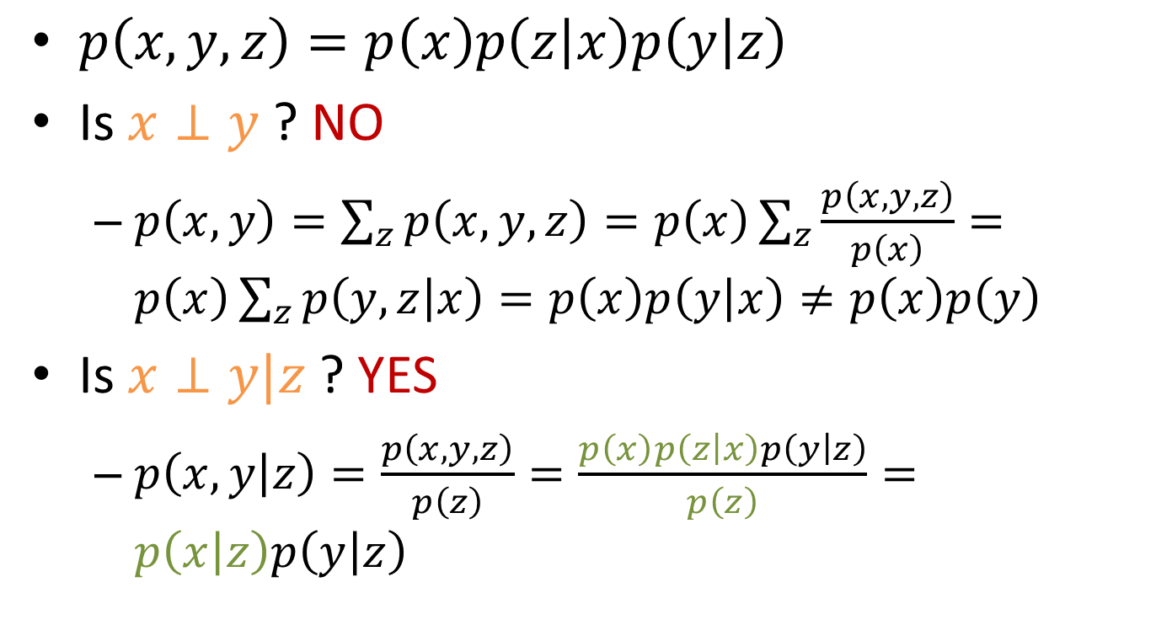
1:
x
z
y
x
z
y
$p\left(x,y,z\right)=p\left(x\right)p\left(z | x\right)p\left(y | z\right)$
Is $x⊥y$ ? NO
$p\left(x,y\right)=\sum_{z}{p\left(x,y,z\right)}=p\left(x\right)\sum_{z}{\frac{p\left(x,y,z\right)}{p\left(x\right)}}=p\left(x\right)\sum_{z}{p\left(y,z | x\right)}=p\left(x\right)p\left(y | x\right)≠p\left(x\right)p\left(y\right)$
Is $x⊥y|z$ ? YES
$p\left(x,y | z\right)=\frac{p\left(x,y,z\right)}{p\left(z\right)}=\frac{p\left(x\right)p\left(z | x\right)p\left(y | z\right)}{p\left(z\right)}=p\left(x | z\right)p\left(y | z\right)$

Slide 10
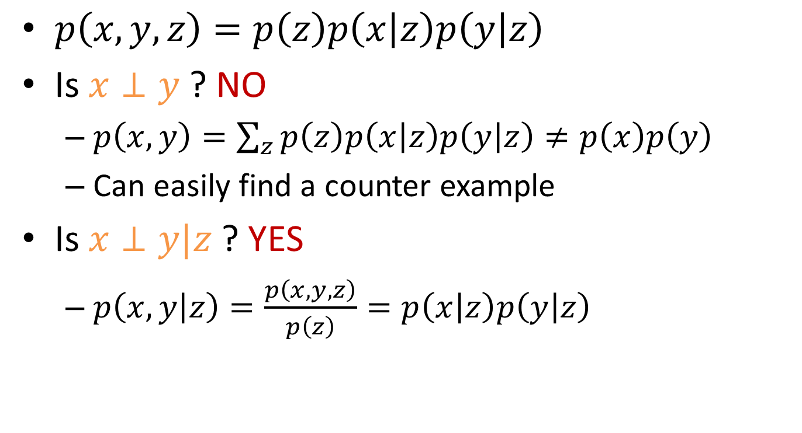
2:
x
z
y
x
z
y
$p\left(x,y,z\right)=p\left(z\right)p\left(x | z\right)p\left(y | z\right)$
Is $x⊥y$ ? NO
$p\left(x,y\right)=\sum_{z}{p\left(z\right)p\left(x | z\right)p\left(y | z\right)}≠p\left(x\right)p\left(y\right)$
Can easily find a counter example
Is $x⊥y|z$ ? YES
$p\left(x,y | z\right)=\frac{p\left(x,y,z\right)}{p\left(z\right)}=p\left(x | z\right)p\left(y | z\right)$

Slide 11
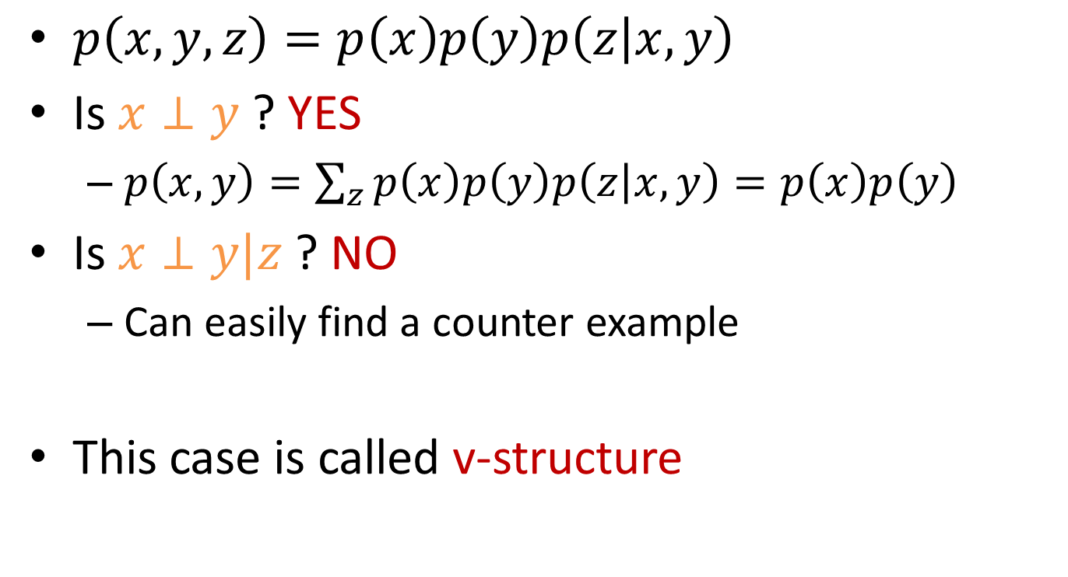
3:
x
z
y
x
z
y
$p\left(x,y,z\right)=p\left(x\right)p\left(y\right)p\left(z | x,y\right)$
Is $x⊥y$ ? YES
$p\left(x,y\right)=\sum_{z}{p\left(x\right)p\left(y\right)p\left(z | x,y\right)}=p\left(x\right)p\left(y\right)$
Is $x⊥y|z$ ? NO
Can easily find a counter example
This case is called v-structure

Slide 12
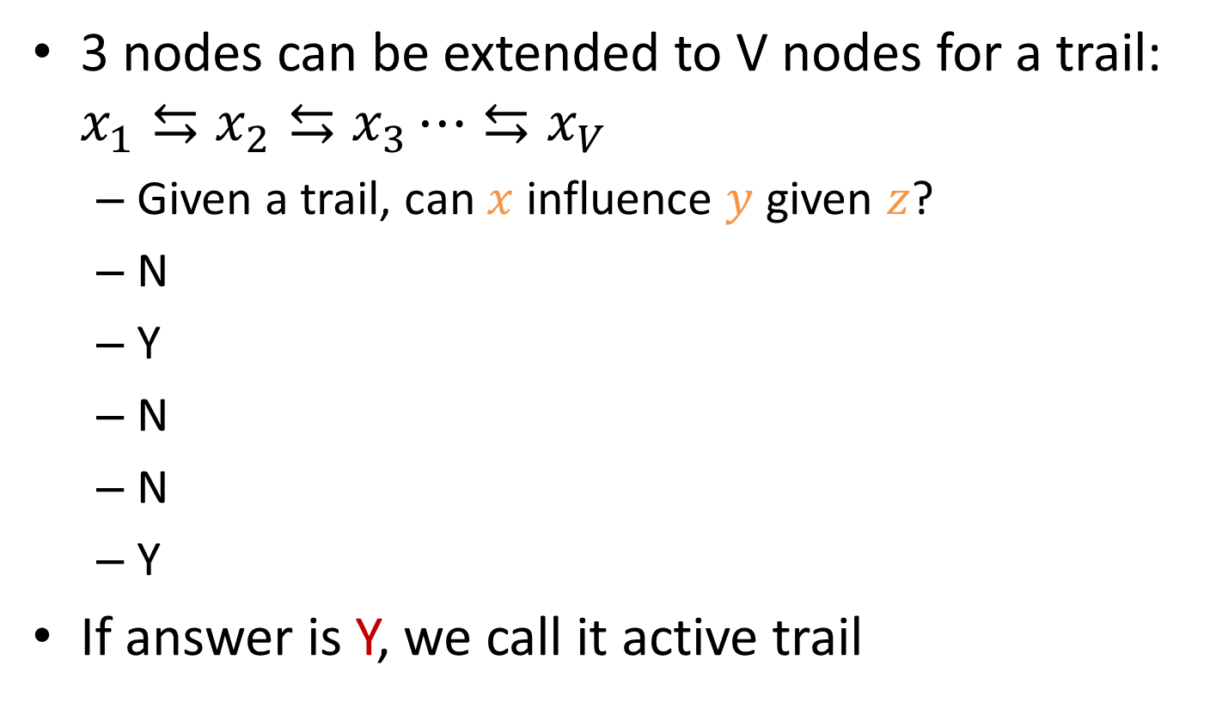
Active Trail in BN
3 nodes can be extended to V nodes for a trail: $x_{1}⇆x_{2}⇆x_{3}⋯⇆x_{V}$
Given a trail, can $x$ influence $y$ given $z$?
N
Y
N
N
Y
If answer is Y, we call it active trail
x
z
y
x
y
x
z
y
x
y
or
x
z
y
x
y
z

Slide 13
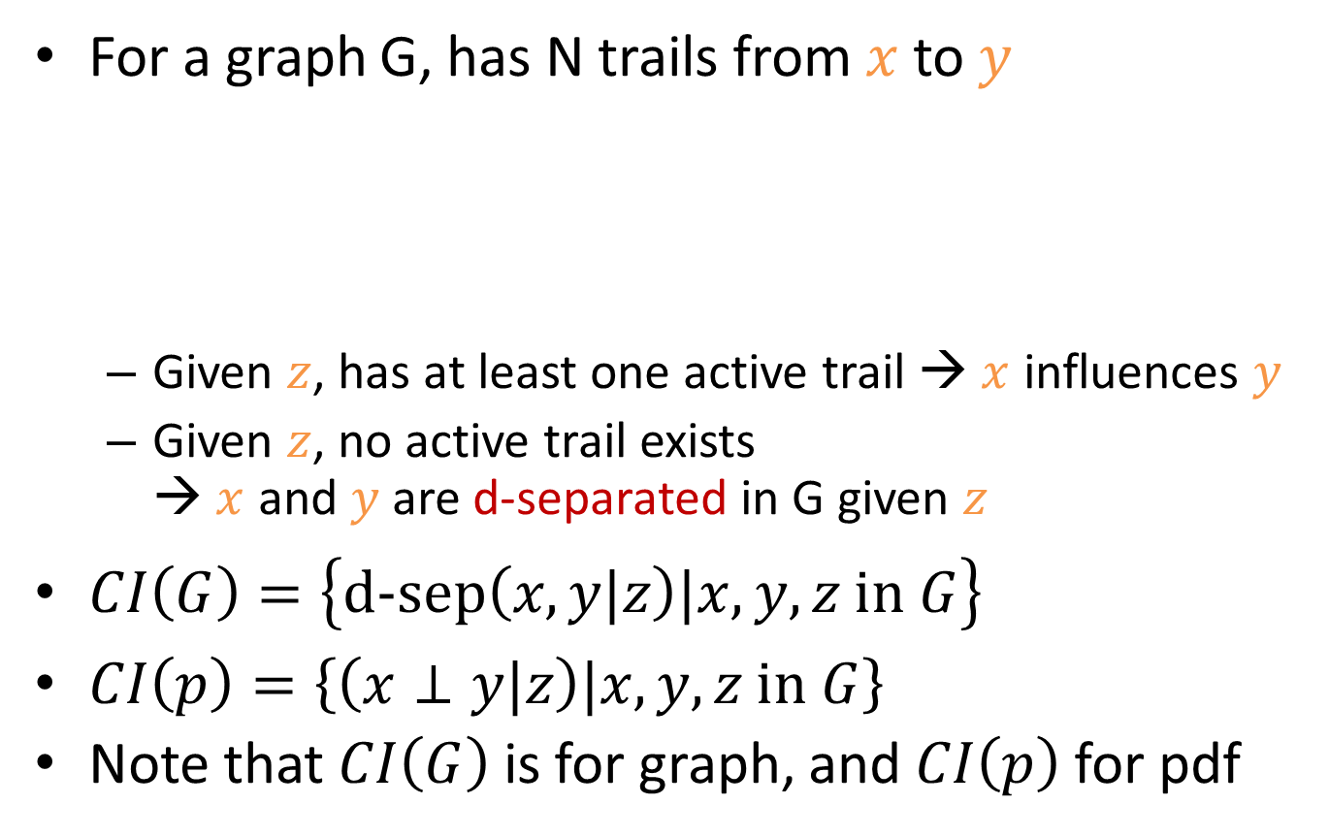
d-separation
For a graph G, has N trails from $x$ to $y$
Given $z$, has at least one active trail → $x$ influences $y$
Given $z$, no active trail exists → $x$ and $y$ are d-separated in G given $z$
$CI\left(G\right)=\left\{\text{d}\text{−}\text{sep}\left(x,y|z\right)|x,y,z \text{in} G\right\}$
$CI\left(p\right)=\left\{\left(x⊥y|z\right)|x,y,z \text{in} G\right\}$
Note that $CI\left(G\right)$ is for graph, and $CI\left(p\right)$ for pdf
x
z
y

Slide 14


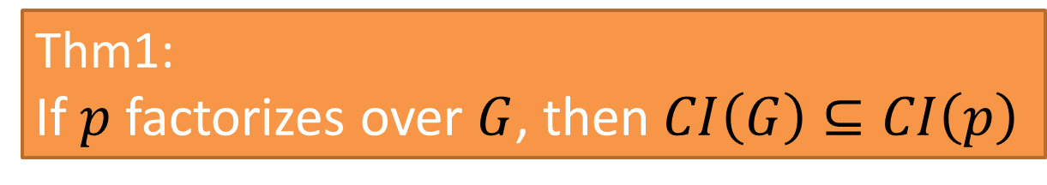
Factorization $⟹$ Independence
We know the probability $p$ represented by a BN $G$ can be written as:
We say $p$ factorizes over $G$
Thm1:
If $p$ factorizes over $G$, then $CI\left(G\right)⊆CI\left(p\right)$

Slide 15


Factorization $⟹$ Independence
白話文: 假設 $p$ 剛好可以寫成 $G$ 的 factorization 型式, 則所有 $G$ 指出需要 $⊥$ 的條件 (根據 d-sep), $p$ 都滿足
Thm1:
If $p$ factorizes over $G$, then $CI\left(G\right)⊆CI\left(p\right)$

Slide 16



Independence $⟹$ Factorization
白話文: 假設所有 $G$ 指出需要 $⊥$ 的條件 (根據 d-sep), $p$ 都滿足, 則 $p$ 可以寫成 $G$ 的 factorization 型式
Thm2:
If $CI\left(G\right)⊆CI\left(p\right)$, then $p$ factorizes over $G$

Slide 17



Independence $⇔$ Factorization
可以更具體嗎?
Thm1:
If $p$ factorizes over $G$, then $CI\left(G\right)⊆CI\left(p\right)$
Thm2:
If $CI\left(G\right)⊆CI\left(p\right)$, then $p$ factorizes over $G$

Slide 18
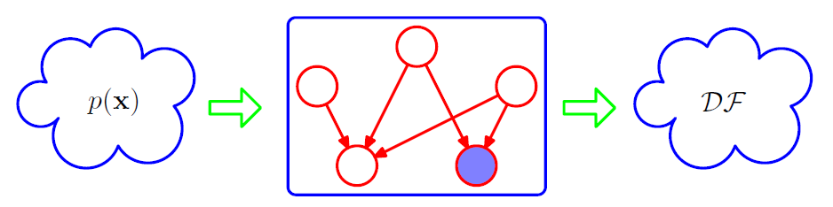
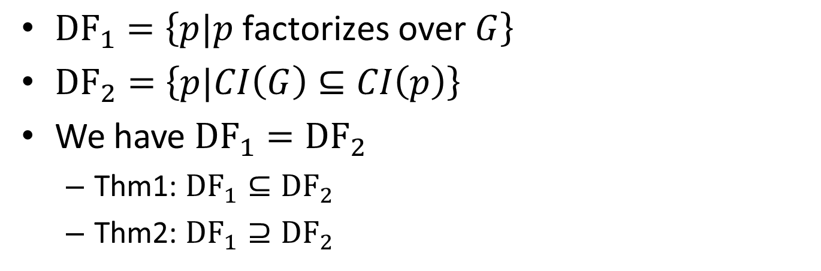
Independence $⇔$ Factorization
G
${\text{DF}}_{1}=\left\{p|p \text{factorizes} \text{over} G\right\}$
${\text{DF}}_{2}=\left\{p|CI\left(G\right)⊆CI\left(p\right)\right\}$
We have ${\text{DF}}_{1}={\text{DF}}_{2}$
Thm1: ${\text{DF}}_{1}⊆{\text{DF}}_{2}$
Thm2: ${\text{DF}}_{1}⊇{\text{DF}}_{2}$
Ref: PRML book

Slide 19
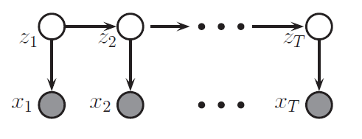
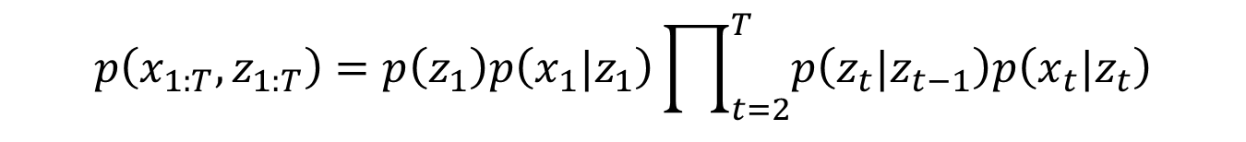
Example
Write out the joint pdf of the following graph
$$p\left(x_{1:T},z_{1:T}\right)=p\left(z_{1}\right)p\left(x_{1}|z_{1}\right)\prod_{t=2}^{T}{p\left(z_{t}|z_{t−1}\right)p\left(x_{t}|z_{t}\right)}$$
HMM
Ref: Kevin Murphy’s book

Slide 20
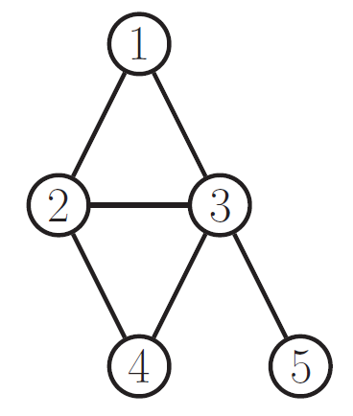
What is Markov Network (MN)
Clique and maximal clique
Has edge between any two nodes in a clique
{1,2}, {1,2,3}, {2,3,4}, and {3,5} are cliques
{1,2,3}, {2,3,4} and {3,5} are maximal cliques
H

Slide 21
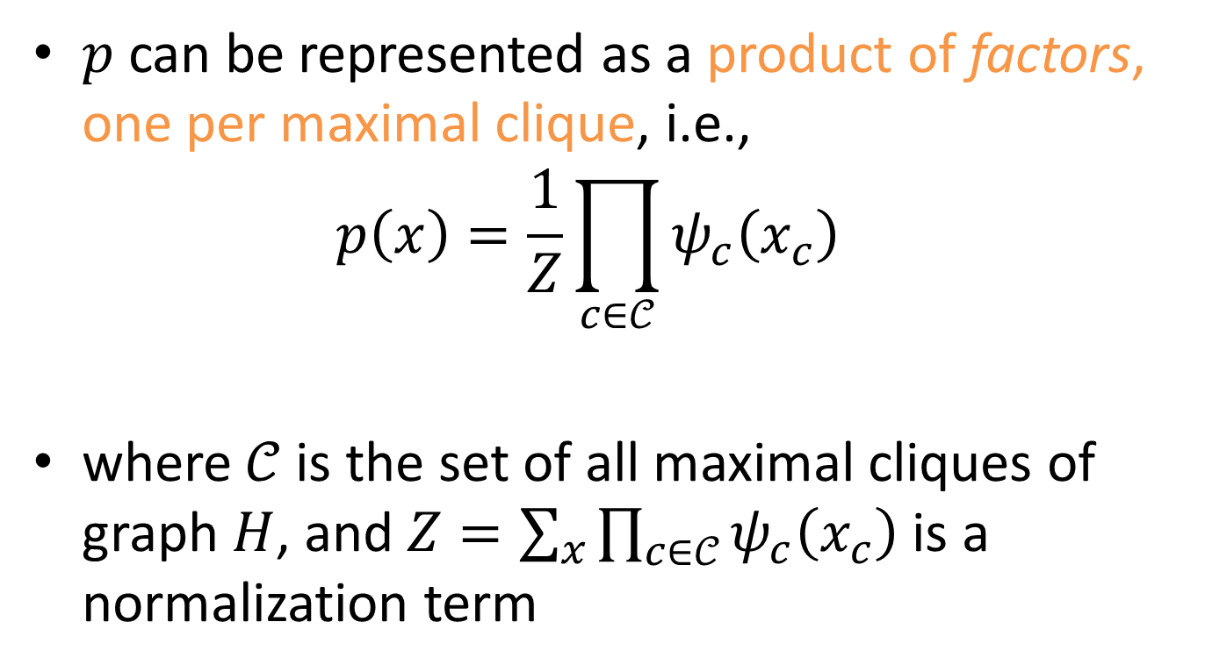
Factorization in MN
$p$ can be represented as a product of factors, one per maximal clique, i.e., $p\left(x\right)=\frac{1}{Z}\prod_{c∈𝒞}{ψ_{c}\left(x_{c}\right)}$
where $𝒞$ is the set of all maximal cliques of graph $H$, and $Z=\sum_{x}{\prod_{c∈𝒞}{ψ_{c}\left(x_{c}\right)}}$ is a normalization term

Slide 22

Factorization in MN
Example
$p\left(x\right)=\frac{1}{Z}ψ_{123}\left(x_{1},x_{2},x_{3}\right)ψ_{234}\left(x_{2},x_{3},x_{4}\right)ψ_{35}\left(x_{3},x_{5}\right)$
H

Slide 23
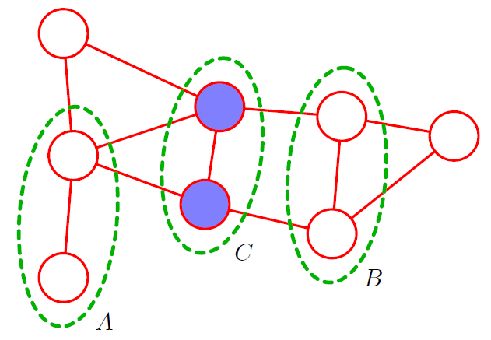
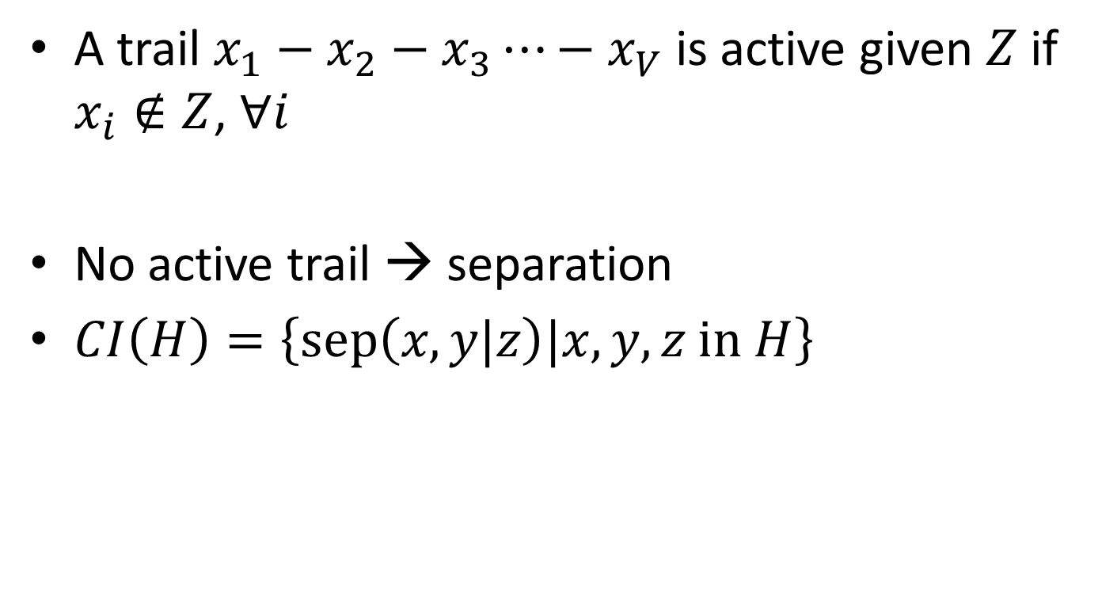
Active Trail and separation in MN
A trail $x_{1}−x_{2}−x_{3}⋯−x_{V}$ is active given $Z$ if $x_{i}∉Z$, $∀i$
No active trail → separation
$CI\left(H\right)=\left\{\text{sep}\left(x,y|z\right)|x,y,z \text{in} H\right\}$
Block!
x
z
y

Slide 24
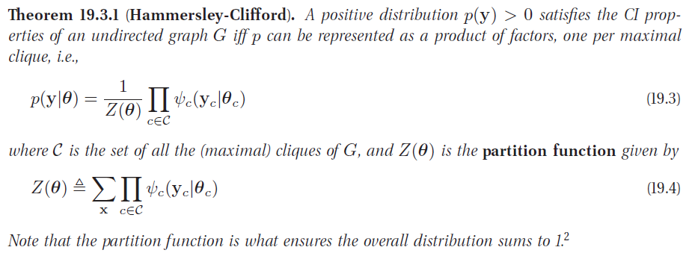
Independence $⇔$ Factorization
Ref: Kevin Murphy’s book

Slide 25
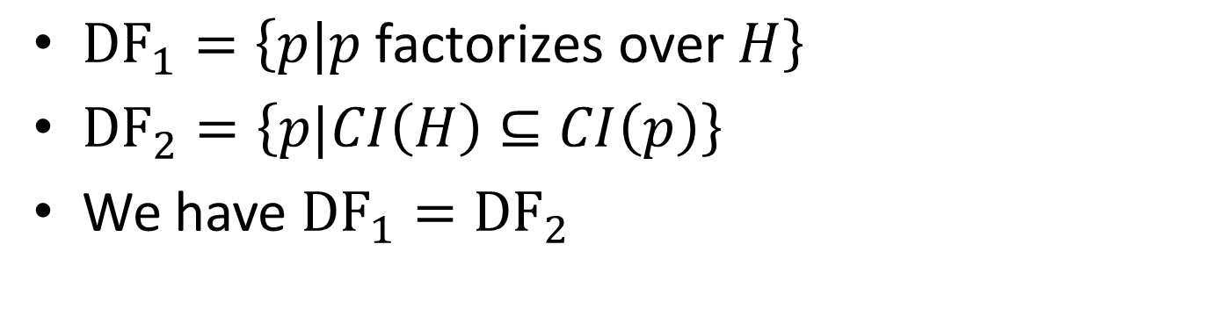
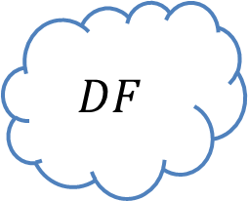
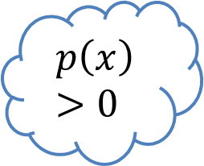
Independence $⇔$ Factorization
$$p\left(x\right)>0$$
H
$$DF$$
${\text{DF}}_{1}=\left\{p|p \text{factorizes} \text{over} H\right\}$
${\text{DF}}_{2}=\left\{p|CI\left(H\right)⊆CI\left(p\right)\right\}$
We have ${\text{DF}}_{1}={\text{DF}}_{2}$

Slide 26
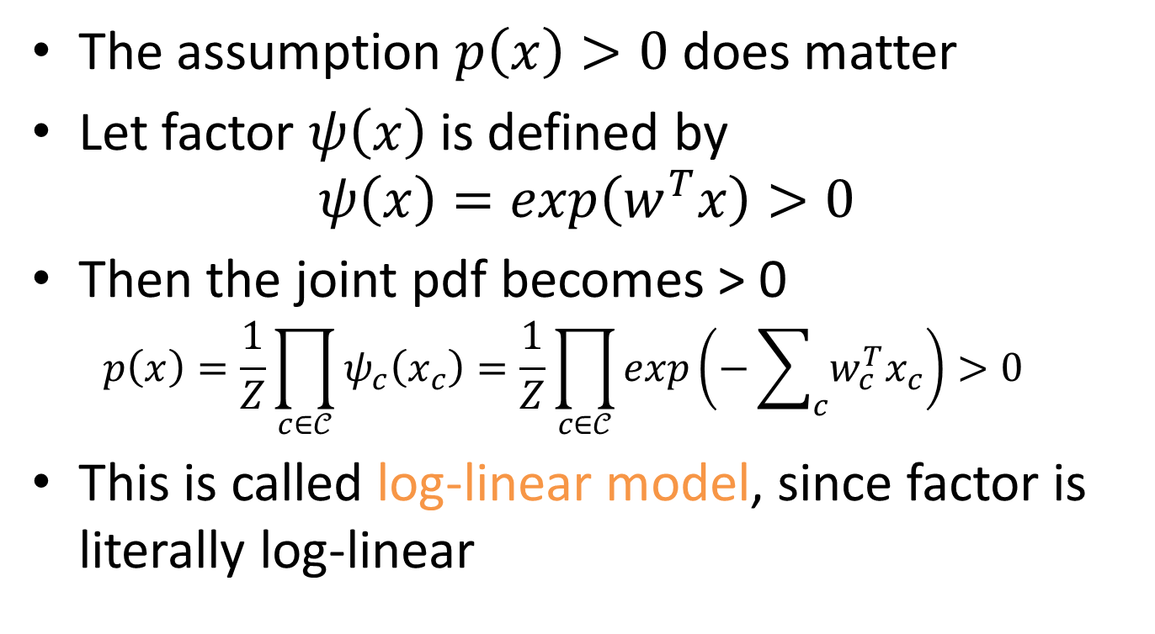
Example Log-Linear Model
The assumption $p\left(x\right)>0$ does matter
Let factor $ψ\left(x\right)$ is defined by $ψ\left(x\right)=exp\left(w^{T}x\right)>0$
Then the joint pdf becomes > 0 $p\left(x\right)=\frac{1}{Z}\prod_{c∈𝒞}{ψ_{c}\left(x_{c}\right)}=\frac{1}{Z}\prod_{c∈𝒞}{exp\left(−\sum_{c}{w_{c}^{T}x_{c}}\right)}>0$
This is called log-linear model, since factor is literally log-linear

Slide 27
喘口氣
我們可以用 graph 簡單的表示出 joint pdf
用 factorization
我們也可以從 graph 中看出 CI statements
用 active tail, separation
PGM 好棒棒
真的嗎? General cases 的話 inference 很麻煩的 (我也沒很懂)

Slide 28
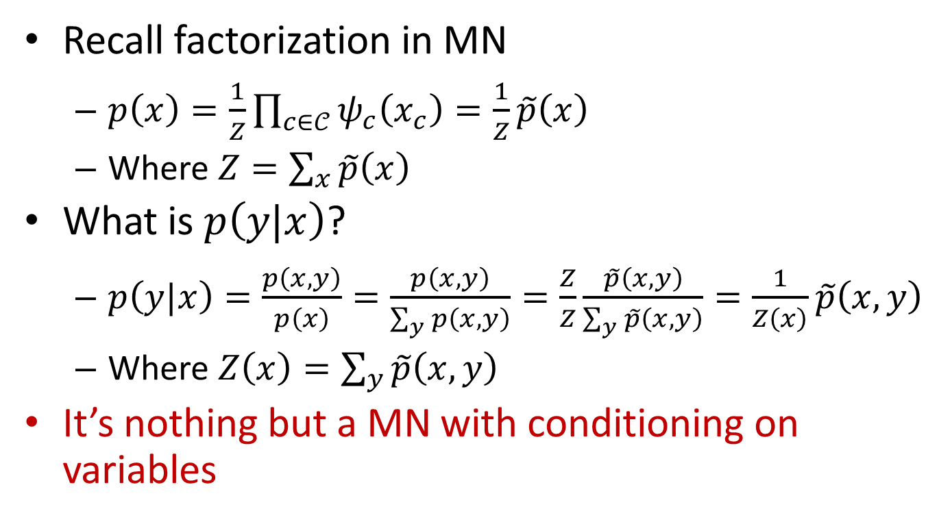
What is Conditional Random Field
Recall factorization in MN
$p\left(x\right)=\frac{1}{Z}\prod_{c∈𝒞}{ψ_{c}\left(x_{c}\right)}=\frac{1}{Z}\tilde{p}\left(x\right)$
Where $Z=\sum_{x}{\tilde{p}\left(x\right)}$
What is $p\left(y|x\right)$?
$p\left(y|x\right)=\frac{p\left(x,y\right)}{p\left(x\right)}=\frac{p\left(x,y\right)}{\sum_{y}{p\left(x,y\right)}}=\frac{Z}{Z}\frac{\tilde{p}\left(x,y\right)}{\sum_{y}{\tilde{p}\left(x,y\right)}}=\frac{1}{Z\left(x\right)}\tilde{p}\left(x,y\right)$
Where $Z\left(x\right)=\sum_{y}{\tilde{p}\left(x,y\right)}$
It’s nothing but a MN with conditioning on variables
Ref: Daphne Koller’s slide

Slide 29







Linear Chain CRF
Write out $p\left(y|x\right)$ according to following MN
What are the maximal cliques?
Therefore $p\left(y|x\right)=\frac{1}{Z\left(x\right)}\prod_{t=1}^{T}{ψ\left(y_{t}|x_{t}\right)}\prod_{t=1}^{T−1}{ψ\left(y_{t−1},y_{t}|x_{t}\right)}$
$$y_{t−1}$$
$$y_{t}$$
$$y_{t+1}$$
$$x_{t−1}$$
$$x_{t}$$
$$x_{t+1}$$

Slide 30
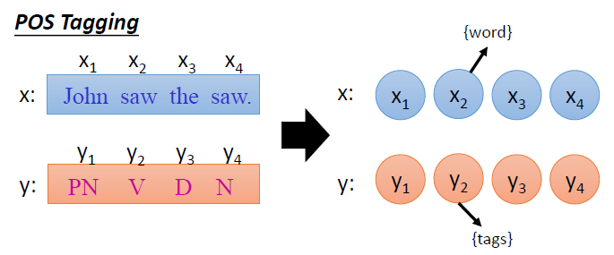
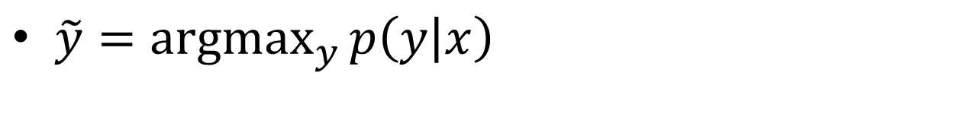
Part-of-Speech (POS) Tagging
$\tilde{y}=\underset{y}{argmax}{p\left(y | x\right)}$
Ref: Prof 李宏毅

Slide 31
Part-of-Speech (POS) Tagging
How to use BN and MN to tackle this problem?
BN: HMM
MN: linear chain CRF with log-linear model
We’ll discuss
HMM approach
then CRF
How to learn parameters?
Hands on project (Haipeng)
State-of-the-art approach (Haipeng)

Slide 32
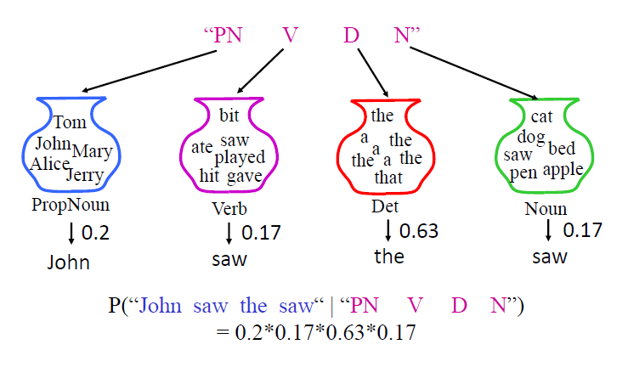
BN Using HMM
No, hidden state during training. So no EM, just counting.
Ref: Prof 李宏毅

Slide 33
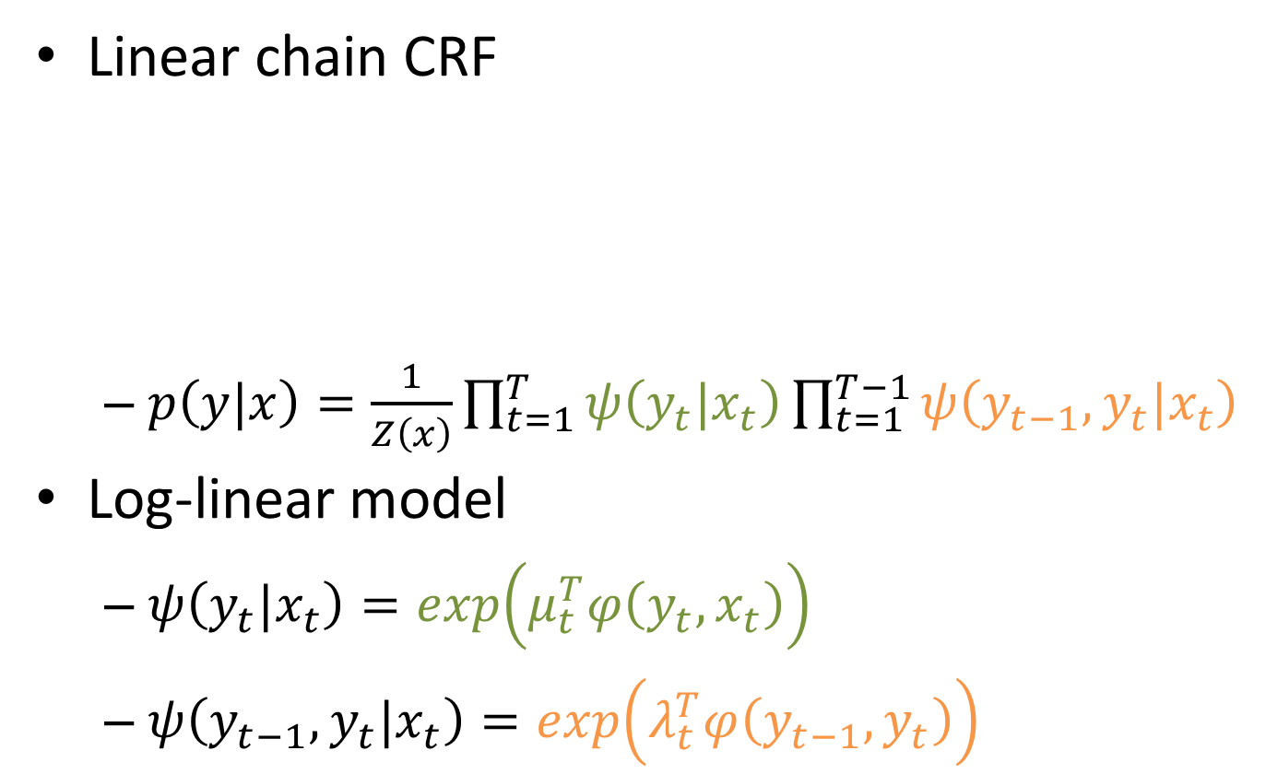
MN Linear-chain CRF with log-linear Model
Linear chain CRF
$p\left(y|x\right)=\frac{1}{Z\left(x\right)}\prod_{t=1}^{T}{ψ\left(y_{t}|x_{t}\right)}\prod_{t=1}^{T−1}{ψ\left(y_{t−1},y_{t}|x_{t}\right)}$
Log-linear model
$ψ\left(y_{t}|x_{t}\right)=exp\left(μ_{t}^{T}φ\left(y_{t},x_{t}\right)\right)$
$ψ\left(y_{t−1},y_{t}|x_{t}\right)=exp\left(λ_{t}^{T}φ\left(y_{t−1},y_{t}\right)\right)$
$$y_{t−1}$$
$$y_{t}$$
$$y_{t+1}$$
$$x_{t−1}$$
$$x_{t}$$
$$x_{t+1}$$

Slide 34
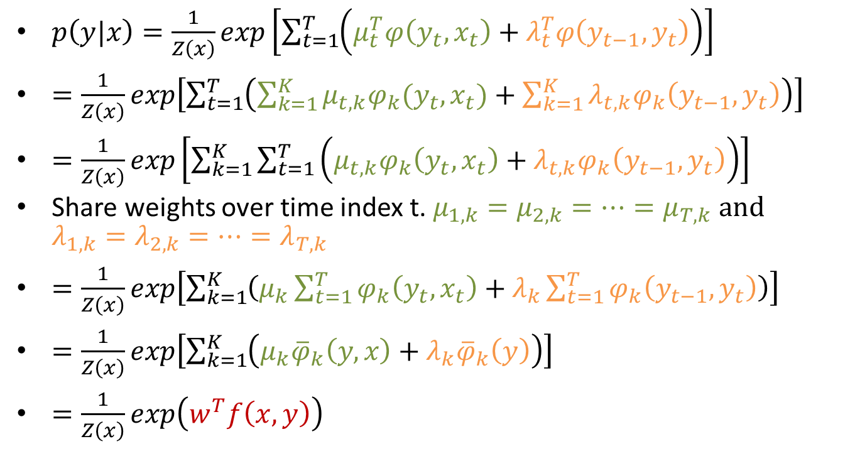
MN Linear-chain CRF with log-linear Model
$p\left(y|x\right)=\frac{1}{Z\left(x\right)}exp\left[\sum_{t=1}^{T}{\left(μ_{t}^{T}φ\left(y_{t},x_{t}\right)+λ_{t}^{T}φ\left(y_{t−1},y_{t}\right)\right)}\right]$
$=\frac{1}{Z\left(x\right)}exp\left[\sum_{t=1}^{T}{\left(\sum_{k=1}^{K}{μ_{t,k}φ_{k}(y_{t},x_{t})}+\sum_{k=1}^{K}{λ_{t,k}φ_{k}\left(y_{t−1},y_{t}\right)}\right)}\right]$
$=\frac{1}{Z\left(x\right)}exp\left[\sum_{k=1}^{K}{\sum_{t=1}^{T}{\left(μ_{t,k}φ_{k}\left(y_{t},x_{t}\right)+λ_{t,k}φ_{k}\left(y_{t−1},y_{t}\right)\right)}}\right]$
Share weights over time index t. $μ_{1,k}=μ_{2,k}=…=μ_{T,k}$ and $λ_{1,k}=λ_{2,k}=…=λ_{T,k}$
$=\frac{1}{Z\left(x\right)}exp\left[\sum_{k=1}^{K}{\left(μ_{k}\sum_{t=1}^{T}{φ_{k}\left(y_{t},x_{t}\right)}+λ_{k}\sum_{t=1}^{T}{φ_{k}\left(y_{t−1},y_{t}\right)}\right)}\right]$
$=\frac{1}{Z\left(x\right)}exp\left[\sum_{k=1}^{K}{\left(μ_{k}{\overline{φ}}_{k}\left(y,x\right)+λ_{k}{\overline{φ}}_{k}\left(y\right)\right)}\right]$
$=\frac{1}{Z\left(x\right)}exp\left(w^{T}f\left(x,y\right)\right)$

Slide 35
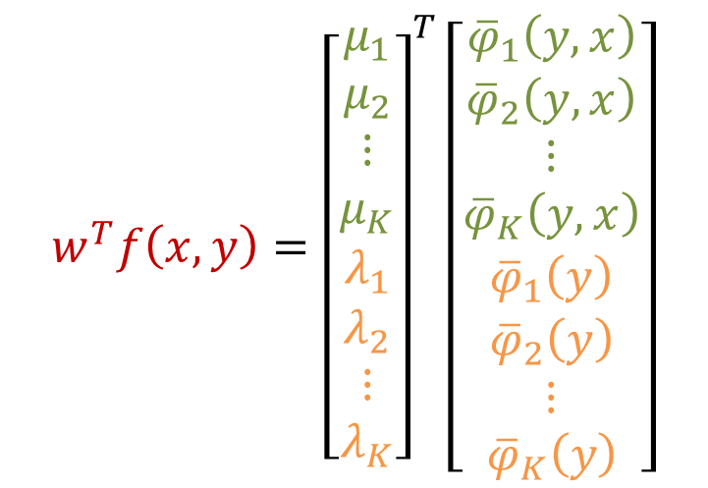
MN Linear-chain CRF with log-linear Model
$${w^{T}f\left(x,y\right)=\left[\begin{matrix}\begin{matrix}μ_{1} \\ μ_{2} \\ \begin{matrix}⋮ \\ μ_{K}\end{matrix}\end{matrix} \\ \begin{matrix}λ_{1} \\ λ_{2} \\ \begin{matrix}⋮ \\ λ_{K}\end{matrix}\end{matrix}\end{matrix}\right]}^{T}\left[\begin{matrix}\begin{matrix}{\overline{φ}}_{1}\left(y,x\right) \\ {\overline{φ}}_{2}\left(y,x\right) \\ \begin{matrix}⋮ \\ {\overline{φ}}_{K}\left(y,x\right)\end{matrix}\end{matrix} \\ \begin{matrix}{\overline{φ}}_{1}\left(y\right) \\ {\overline{φ}}_{2}\left(y\right) \\ \begin{matrix}⋮ \\ {\overline{φ}}_{K}\left(y\right)\end{matrix}\end{matrix}\end{matrix}\right]$$

Slide 36
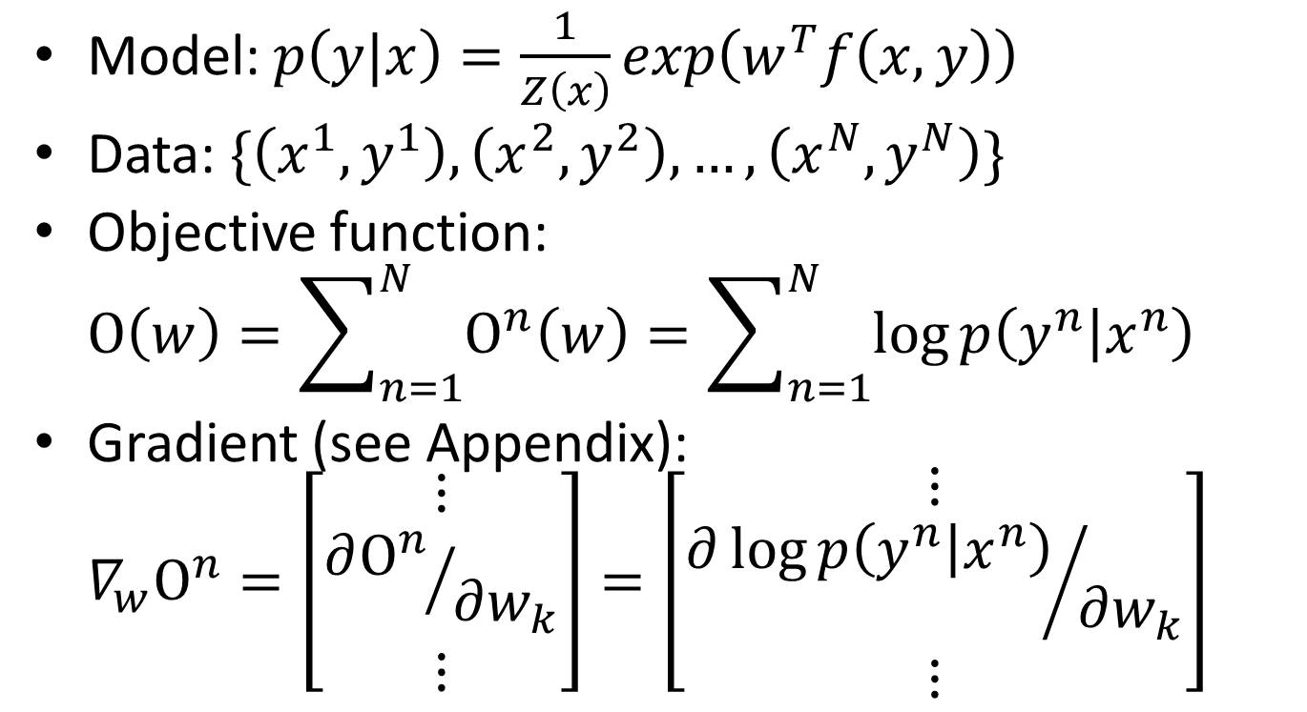
Learning (Training)
Model: $p\left(y|x\right)=\frac{1}{Z\left(x\right)}exp\left(w^{T}f\left(x,y\right)\right)$
Data: $\{\left(x^{1},y^{1}\right),\left(x^{2},y^{2}\right),…,\left(x^{N},y^{N}\right)\}$
Objective function: $Ο\left(w\right)=\sum_{n=1}^{N}{Ο^{n}\left(w\right)}=\sum_{n=1}^{N}{\log{p\left(y^{n} | x^{n}\right)}}$
Gradient (see Appendix): $∇_{w}Ο^{n}=\left[\begin{matrix}⋮ \\ {∂Ο^{n}}/{∂w_{k}} \\ ⋮\end{matrix}\right]=\left[\begin{matrix}⋮ \\ {∂\log{p\left(y^{n} | x^{n}\right)}}/{∂w_{k}} \\ ⋮\end{matrix}\right]$

Slide 37
Hands on Project (Haipeng)

Slide 38
State-of-the-art approach (Haipeng)

Slide 39
Thank You

Slide 40

Appendix Markov Property in MN
Global Markov property → ${CI}_{global}\left(H\right)$
Local Markov property → ${CI}_{local}\left(H\right)$
Pairwise Markov property → ${CI}_{pairwise}\left(H\right)$
H

Slide 41
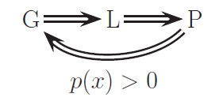

Appendix Markov Property in MN
${CI}_{global}\left(H\right)={CI}_{local}\left(H\right)={CI}_{pairwise}\left(H\right)$
Ref: Kevin Murphy’s book

Slide 42







Example Restrict Boltzmann Machine
Two types of nodes, namely visible $v$ and hidden $h$ nodes
Bi-partite graph
(no connections between $h_{i}$ and $h_{j}$, or $v_{i}$ and $v_{j}$)
$$h_{1}$$
$$h_{2}$$
$$h_{M}$$
$$v_{1}$$
$$v_{2}$$
$$v_{N}$$

Slide 43
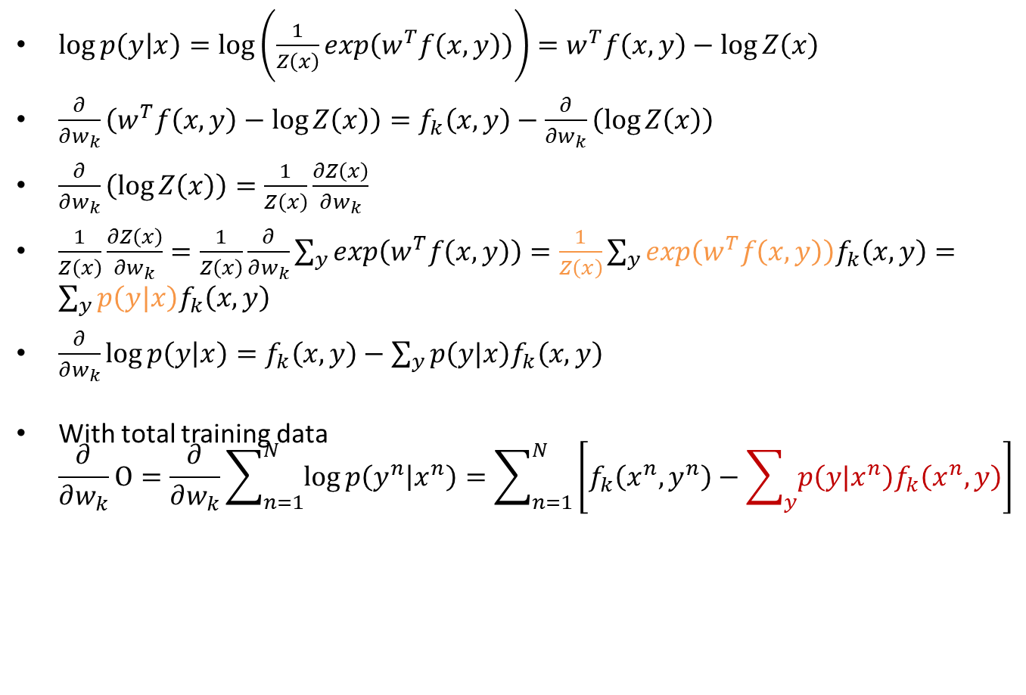
Appendix CRF Learning Gradient Parts
$\log{p\left(y | x\right)}=\log\left(\frac{1}{Z\left(x\right)}exp\left(w^{T}f\left(x,y\right)\right)\right)=w^{T}f\left(x,y\right)−\log{Z\left(x\right)}$
$\frac{∂}{∂w_{k}}\left(w^{T}f\left(x,y\right)−\log{Z\left(x\right)}\right)=f_{k}\left(x,y\right)−\frac{∂}{∂w_{k}}\left(\log{Z\left(x\right)}\right)$
$\frac{∂}{∂w_{k}}\left(\log{Z\left(x\right)}\right)=\frac{1}{Z\left(x\right)}\frac{∂Z\left(x\right)}{∂w_{k}}$
$\frac{1}{Z\left(x\right)}\frac{∂Z\left(x\right)}{∂w_{k}}=\frac{1}{Z\left(x\right)}\frac{∂}{∂w_{k}}\sum_{y}{exp\left(w^{T}f\left(x,y\right)\right)}=\frac{1}{Z\left(x\right)}\sum_{y}{exp\left(w^{T}f\left(x,y\right)\right)f_{k}\left(x,y\right)}=\sum_{y}{p\left(y|x\right)f_{k}\left(x,y\right)}$
$\frac{∂}{∂w_{k}}\log{p\left(y | x\right)}=f_{k}\left(x,y\right)−\sum_{y}{p\left(y|x\right)f_{k}\left(x,y\right)}$
With total training data $\frac{∂}{∂w_{k}}Ο=\frac{∂}{∂w_{k}}\sum_{n=1}^{N}{\log{p\left(y^{n} | x^{n}\right)}}=\sum_{n=1}^{N}{\left[f_{k}\left(x^{n},y^{n}\right)−\sum_{y}{p\left(y|x^{n}\right)f_{k}\left(x^{n},y\right)}\right]}$
In this case, can use Viterbi
Can ref 李航 p201 式 (11.34)
Need efficient Inference

