Slide 1
Large-Scale Domain Adaptation via Teacher-Student Learning
2017 Microsoft AI and Research

Slide 2
T/S learning for domain adaptation
We train AM in near-field domain (source domain)
How to adapt model to far-field domain (target domain) efficiently?
Scenario
Get labeled data in target domain is expensive
Get parallel data is cheap or can be simulated
(Source, Target) domain:
(near-field, far-field)
(adult, children)
(clean, noisy)
…

Slide 3
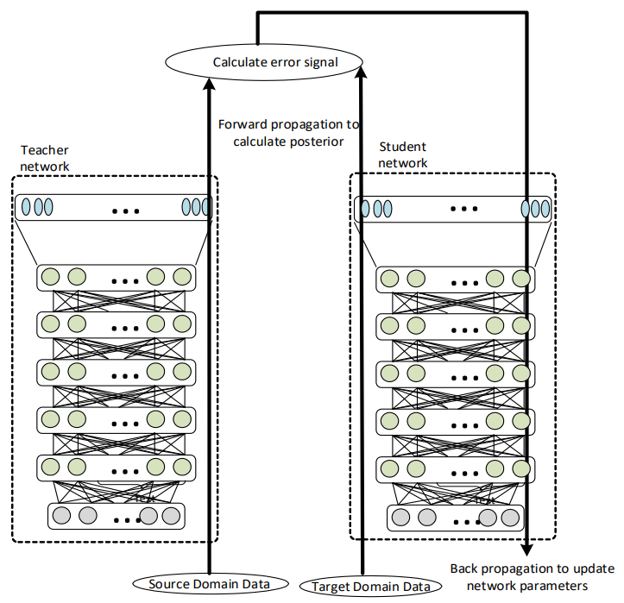
Algorithm
Clone the student network from the teacher network.
Use parallel unlabeled source data (𝑥_{𝑠𝑟𝑐}, 𝑥_{𝑡𝑔𝑡})
Forward to get 𝑃_{𝑇}(𝑠_{𝑖} |𝑥_{𝑠𝑟𝑐}) and 𝑃_{𝑆}(𝑠_{𝑖} |𝑥_{𝑡𝑔𝑡})
Xent(𝑃_{𝑇},𝑃_{𝑆})
Backprob.
Repeat 2 until converge

Slide 4
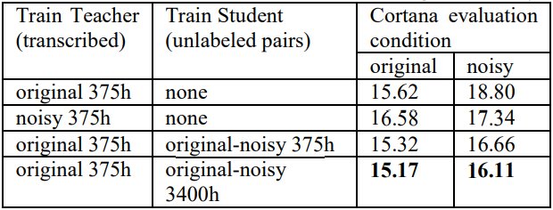
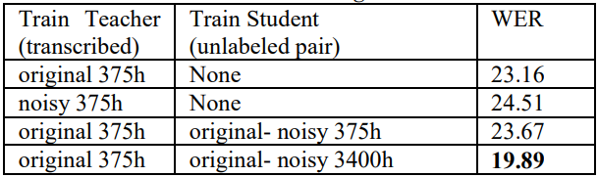
Results
Source = clean
Target = noisy
Source = adult
Target = children

Slide 5
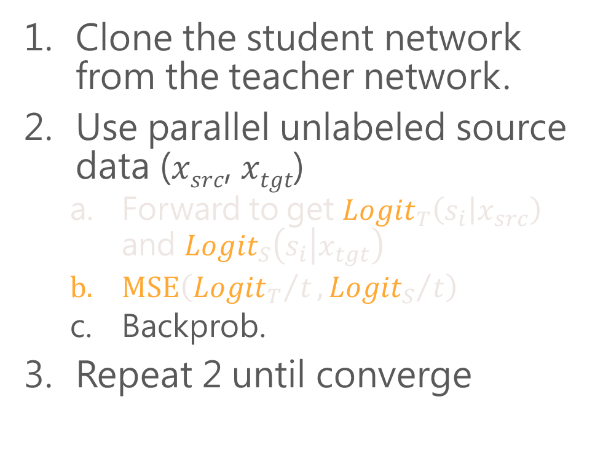
Algorithm (with distilling)
Clone the student network from the teacher network.
Use parallel unlabeled source data (𝑥_{𝑠𝑟𝑐}, 𝑥_{𝑡𝑔𝑡})
Forward to get ${Logit}_{T}\left(s_{i} | x_{src}\right)$ and ${Logit}_{S}\left(s_{i} | x_{tgt}\right)$
$\text{MSE}\left({{Logit}_{T}}/t,{{Logit}_{S}}/t\right)$
Backprob.
Repeat 2 until converge

Slide 6
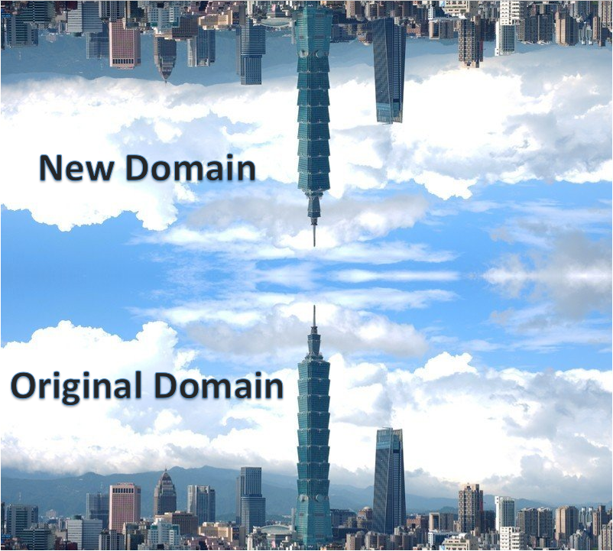
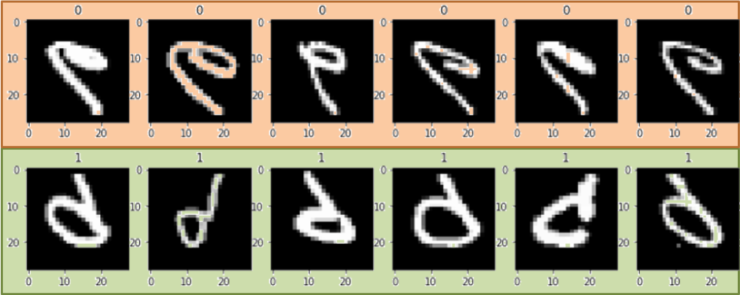
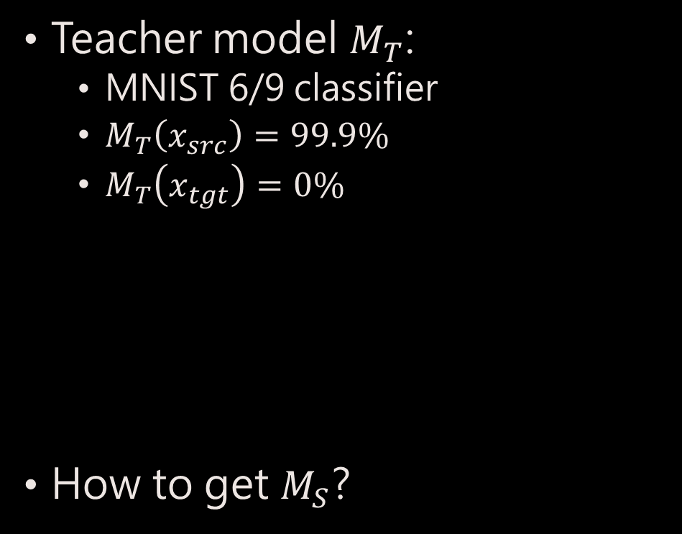
Toy Example
Teacher model $M_{T}$:
MNIST 6/9 classifier
$M_{T}\left(x_{src}\right)=99.9\%$
$M_{T}\left(x_{tgt}\right)=0\%$
How to get $M_{S}$?

Slide 7
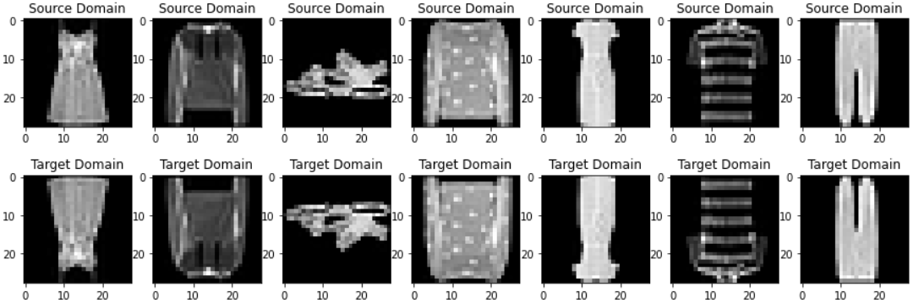
Parallel Data
Fashion Mnist

Slide 8

Results
$M_{S}\left(x_{src}\right)=11.94\%$
$M_{S}\left(x_{tgt}\right)=99.84\%$
NO labeled 6/9 in target domain used to train student model $M_{S}$

