Slide 1
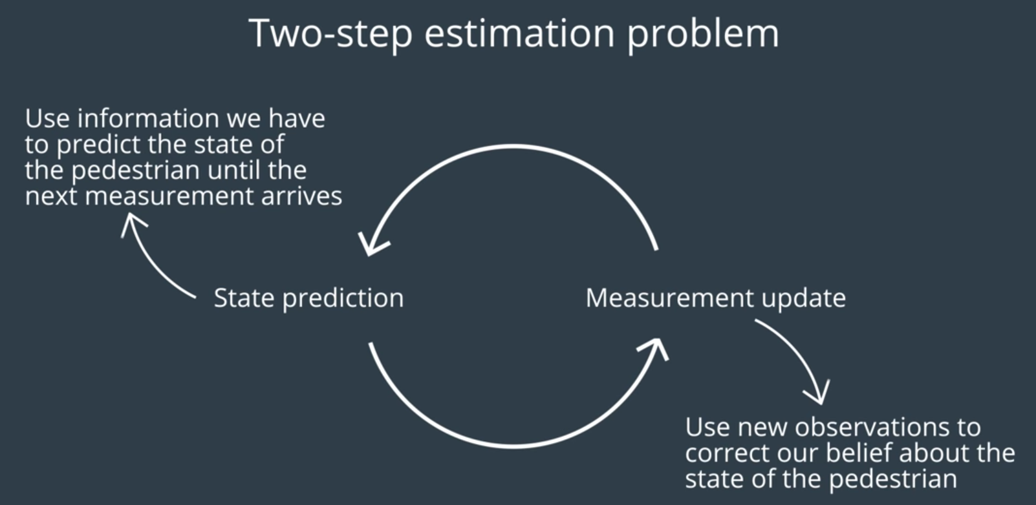


Measurement Update
$$P\left(x | z\right)∝P\left(z | x\right)P\left(x\right)$$
State Prediction
$$P\left(x^{′}\right)=\sum_{x}{P\left(x^{′} | x\right)P\left(x\right)}$$

Slide 2
事後機率
觀測值機率
Measurement Update
$$P\left(x | z\right)∝P\left(z | x\right)P\left(x\right)$$
事前機率
State Prediction
$$P\left(x^{′}\right)=\sum_{x}{P\left(x^{′} | x\right)P\left(x\right)}$$
Motion Model到該點的機率
Convolution

Slide 3
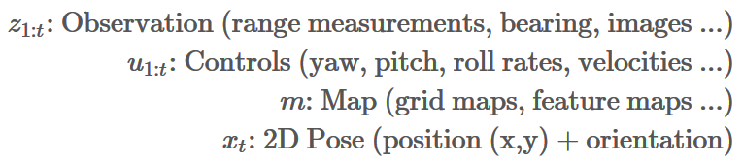
Known
Unknown

Slide 4
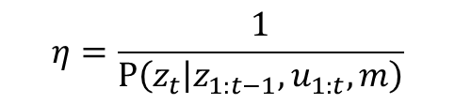
Bayes Rule
事後機率: Believe
觀測值機率: Obs Model
事前機率: Motion Model
$$bel\left(x_{t}\right)=P\left(x_{t} | z_{t},z_{1:t−1},u_{1:t},m\right)=η∙P\left(z_{t} | x_{t},z_{1:t−1},u_{1:t},m\right)∙P\left(x_{t} | z_{1:t−1},u_{1:t},m\right)$$
$$η=\frac{1}{P\left(z_{t} | z_{1:t−1},u_{1:t},m\right)}$$
Normalization constant:

Slide 5

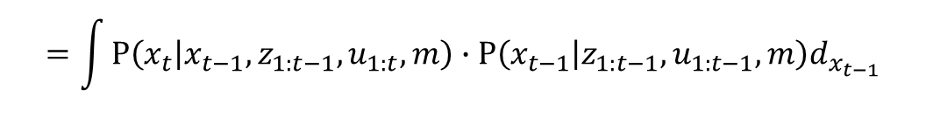

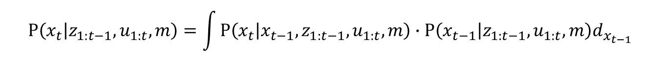

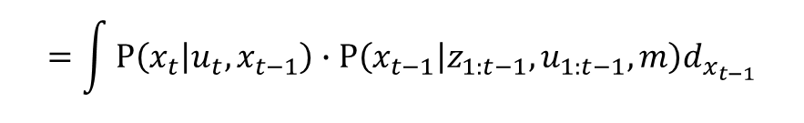
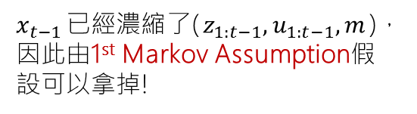
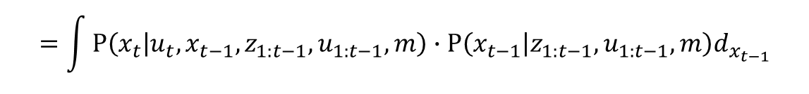
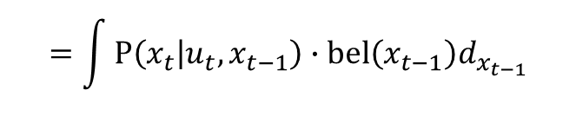
每行的改動用
表示，並且箭號後面有解釋
$$P\left(x_{t} | z_{1:t−1},u_{1:t},m\right)=\int{P\left(x_{t} | x_{t−1},z_{1:t−1},u_{1:t},m\right)∙P\left(x_{t−1} | z_{1:t−1},u_{1:t},m\right)d_{x_{t−1}}}$$
引入$x_{t−1}$
$$=\int{P\left(x_{t} | x_{t−1},z_{1:t−1},u_{1:t},m\right)∙P\left(x_{t−1} | z_{1:t−1},u_{1:t−1},m\right)d_{x_{t−1}}}$$
$u_{t}$ 對於 $x_{t−1}$來說是未來控制，所以可拿掉
$$=\int{P\left(x_{t} | u_{t},x_{t−1},z_{1:t−1},u_{1:t−1},m\right)∙P\left(x_{t−1} | z_{1:t−1},u_{1:t−1},m\right)d_{x_{t−1}}}$$
獨立出$u_{t}$
$$=\int{P\left(x_{t} | u_{t},x_{t−1}\right)∙P\left(x_{t−1} | z_{1:t−1},u_{1:t−1},m\right)d_{x_{t−1}}}$$
$x_{t−1}$已經濃縮了($z_{1:t−1},u_{1:t−1},m$)，因此由1st Markov Assumption假設可以拿掉!
$$=\int{P\left(x_{t} | u_{t},x_{t−1}\right)∙bel\left(x_{t−1}\right)d_{x_{t−1}}}$$
它其實就是 believe ! 遞迴達成!
CTRV估算

Slide 6

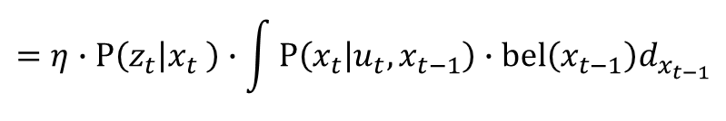


$$bel\left(x_{t}\right)=P\left(x_{t} | z_{t},z_{1:t−1},u_{1:t},m\right)$$
觀測值機率: Obs Model
事前機率: Motion Model
$$=η∙P\left(z_{t} | x_{t},z_{1:t−1},u_{1:t},m\right)∙P\left(x_{t} | z_{1:t−1},u_{1:t},m\right)$$
$$=η∙P\left(z_{t} | x_{t} \right)∙P\left(x_{t} | z_{1:t−1},u_{1:t},m\right)$$
$x_{t}$已經濃縮了($z_{1:t−1},u_{1:t},m$)，因此由1st Markov Assumption假設可以拿掉!
$$=η∙P\left(z_{t} | x_{t} \right)∙\int{P\left(x_{t} | u_{t},x_{t−1}\right)∙bel\left(x_{t−1}\right)d_{x_{t−1}}}$$
“簡化的” 觀測值機率: Obs Model
“遞迴的” 事前機率: Motion Model

Slide 7


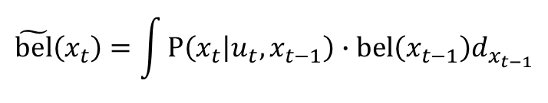

事後機率
觀測值機率
事前機率
事後機率
觀測值機率
事前機率
Measurement Update
$bel\left(x_{t}\right)∝P\left(z_{t} | x_{t} \right)∙$ $\tilde{bel}\left(x_{t}\right)$
Measurement Update
$$P\left(x | z\right)∝P\left(z | x\right)P\left(x\right)$$
$$\tilde{bel}\left(x_{t}\right)=\int{P\left(x_{t} | u_{t},x_{t−1}\right)∙bel\left(x_{t−1}\right)d_{x_{t−1}}}$$
$$P\left(x^{′}\right)=\sum_{x}{P\left(x^{′} | x\right)P\left(x\right)}$$
Motion Update
State Prediction
Motion Model到該點的機率
Motion Model到該點的機率
Convolution
Convolution

