Slide 1
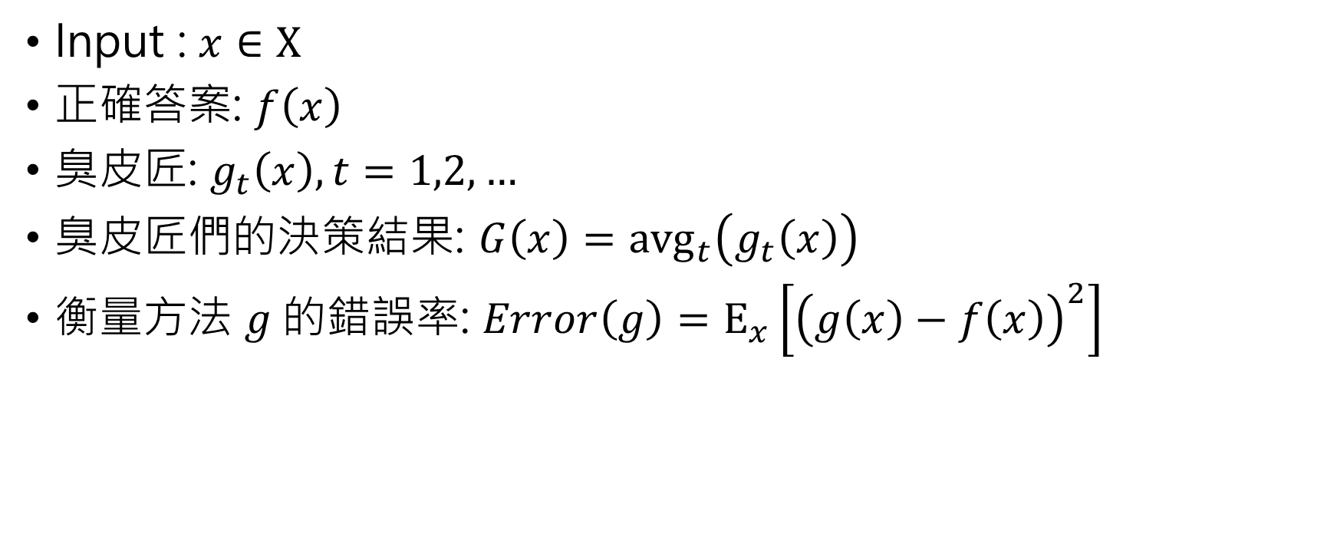
Input : $x∈X$
正確答案: $f\left(x\right)$
臭皮匠: $g_{t}\left(x\right), t=1,2,…$
臭皮匠們的決策結果: $G\left(x\right)={\text{avg}}_{t}\left(g_{t}\left(x\right)\right)$
衡量方法 $g$的錯誤率: $Error\left(g\right)=Ε_{x}\left[{\left(g\left(x\right)−f\left(x\right)\right)}^{2}\right]$

Slide 2

$${\text{avg}}_{t}\left(Error\left(g_{t}\right)\right)={\text{avg}}_{t}\left(Ε_{x}\left[{\left(g_{t}\left(x\right)−f\left(x\right)\right)}^{2}\right]\right)$$

