Slide 1
CTC Model and Loss
棒棒生

Slide 2
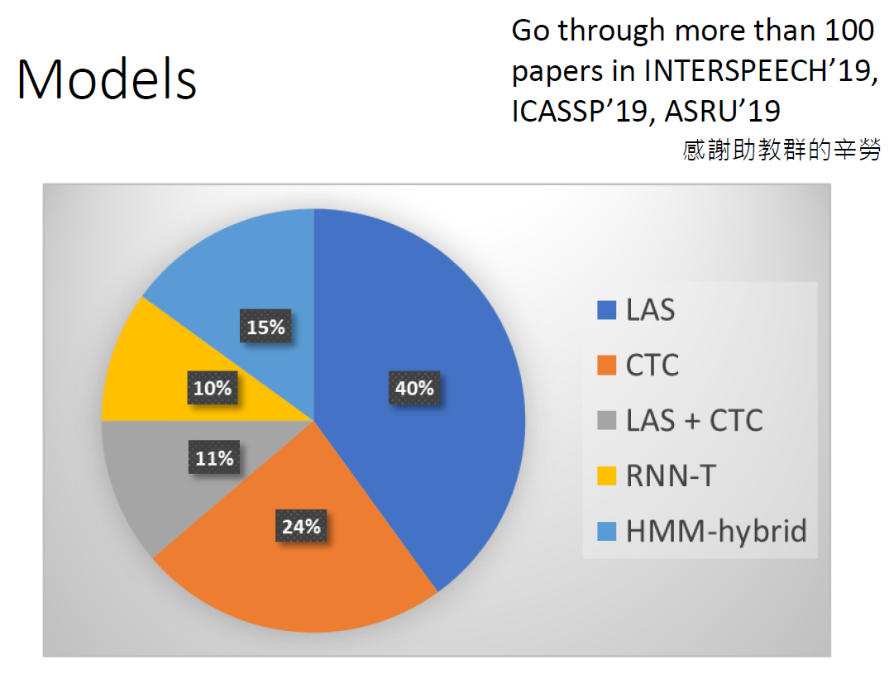
ASR 19’Interspeech [Hungyi Lee]
End-to-end System
Kaldi

Slide 3
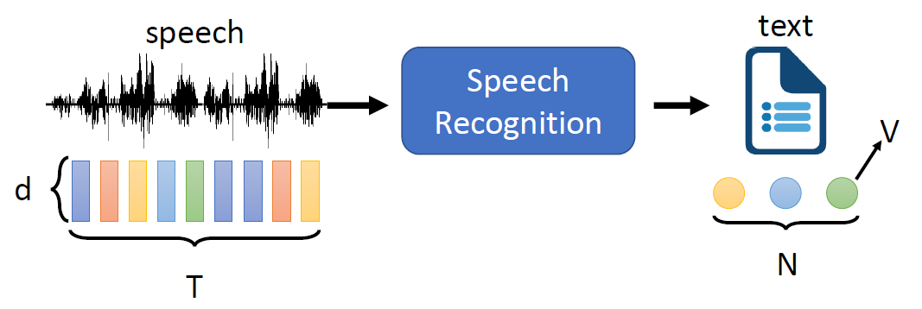
Token 單位:
Phoneme
Grapheme: 書寫最小單位, 英文為{a,…,z}+{空白,…}, 中文為 {所有字}
Word ("詞"): Degas Lexicon, 英文~200K, 中文~700K
Morpheme: smallest meaningful unit (<word, >grapheme)
End2End ASR 就是吃 feature vectors 直接吐出 Token vectors
沒有 lexicon, 沒有 wfst
Training, decoding 比起 hybrid-system 單純很多 (就一個大的NN)

Slide 4
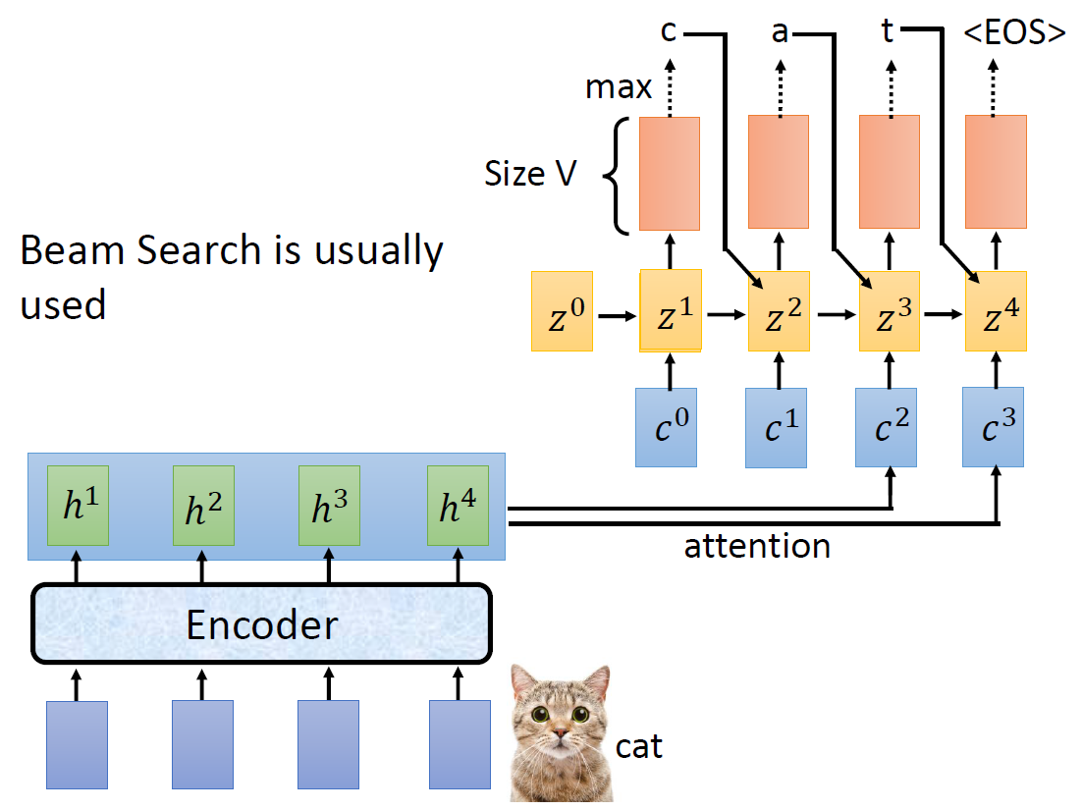
Listen, Attend Spell

Slide 5
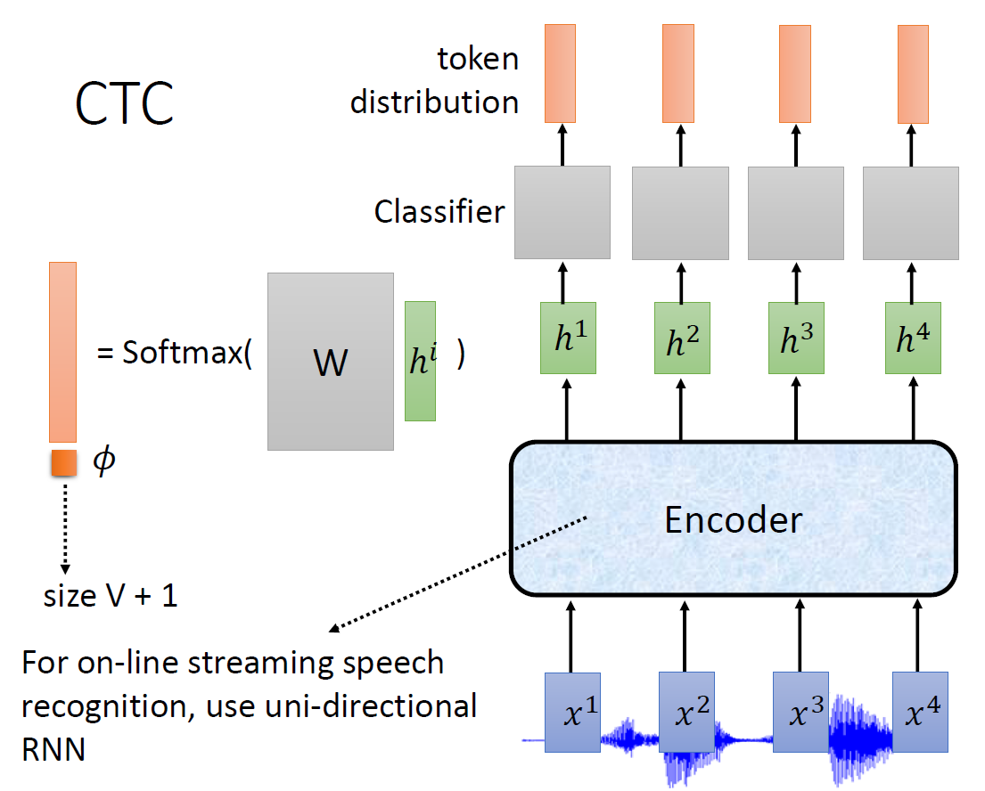

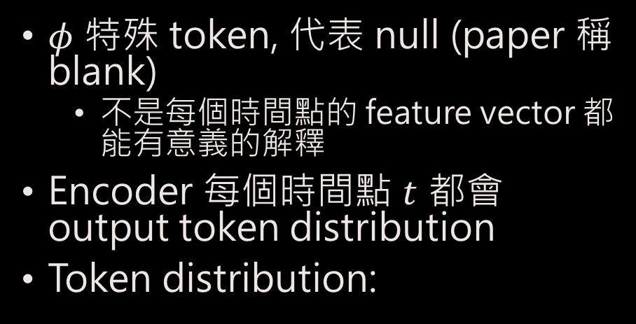




Model of CTC
$φ$ 特殊 token, 代表 null (paper 稱 blank)
不是每個時間點的 feature vector 都能有意義的解釋
Encoder 每個時間點 $t$ 都會 output token distribution
Token distribution:
$$P\left(φ | Χ\right)$$
$$P\left(a | Χ\right)$$
$$P\left(b | Χ\right)$$
$$P\left(c | Χ\right)$$
$$P\left(t | Χ\right)$$

Slide 6
LAS
Can NOT online
NO alignment issue
CTC (RNN-T)
CAN online
Having alignment issue

Slide 7
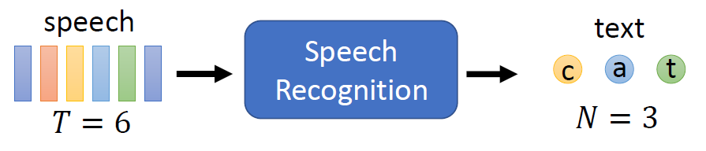


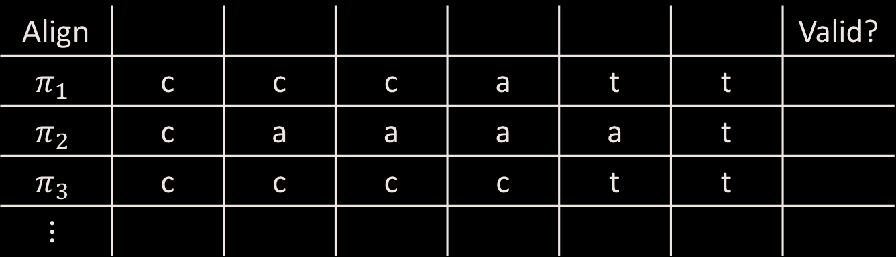
Alignment 解釋方式 (HMM)
Frame 1
Frame 2
Frame 3
Frame 4
Frame 5
Frame 6
Align |  |  |  |  |  |  | Valid?
$$π_{1}$$ | c | c | c | a | t | t
$$π_{2}$$ | c | a | a | a | a | t
$$π_{3}$$ | c | c | c | c | t | t
$$⋮$$

Slide 8
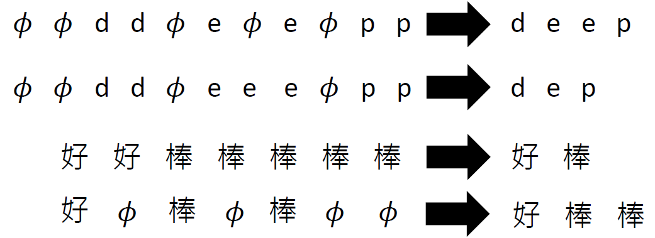

Alignment 解釋方式 (CTC)
Merging duplicate tokens
Removing $φ$

Slide 9
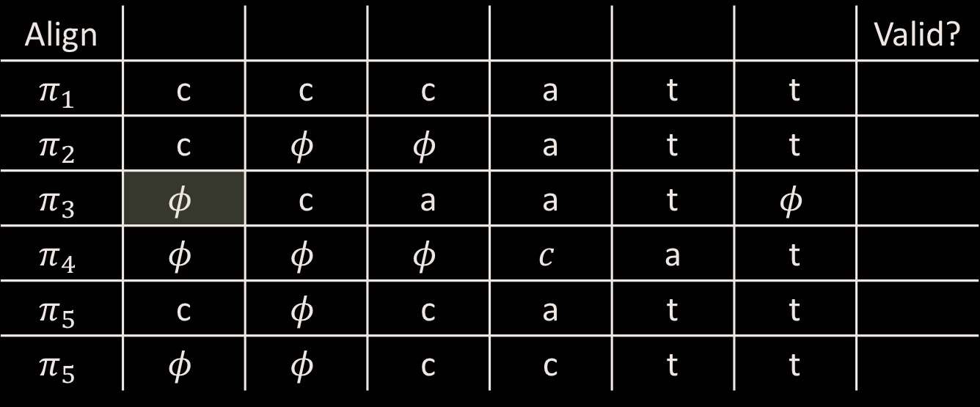

Alignment 解釋方式 (CTC)
Frame 1
Frame 2
Frame 3
Frame 4
Frame 5
Frame 6
Align |  |  |  |  |  |  | Valid?
$$π_{1}$$ | c | c | c | a | t | t
$$π_{2}$$ | c | $$φ$$ | $$φ$$ | a | t | t
$$π_{3}$$ | $$φ$$ | c | a | a | t | $$φ$$
$$π_{4}$$ | $$φ$$ | $$φ$$ | $$φ$$ | $$c$$ | a | t
$$π_{5}$$ | c | $$φ$$ | c | a | t | t
$$π_{5}$$ | $$φ$$ | $$φ$$ | c | c | t | t
註解
可以完全沒有$φ$
$φ$一樣可以重複
開頭結尾可以$φ$
可以最後暴衝一波
ccat
ct

Slide 10
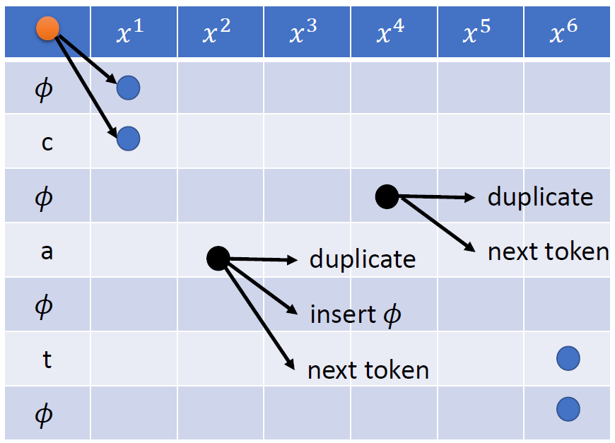
如何走完所有 Alignment? 遊戲規則

Slide 11
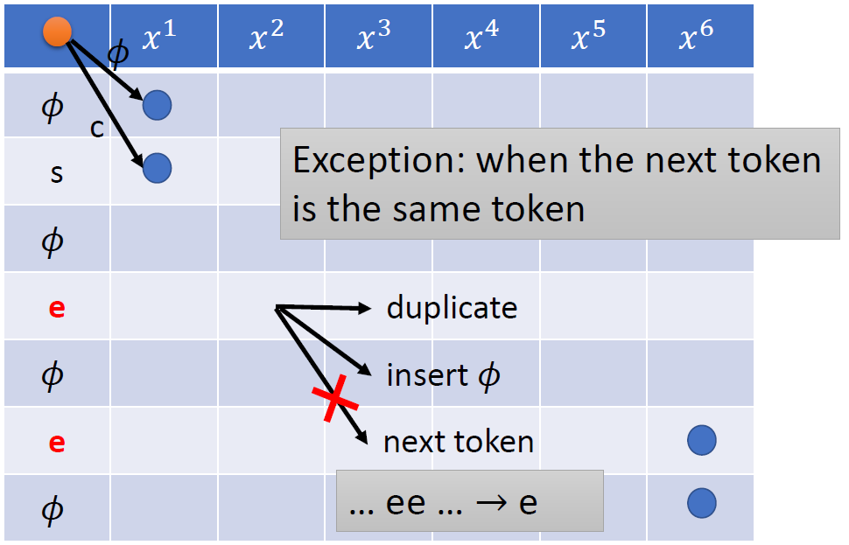
如何走完所有 Alignment? (一個特殊情形)

Slide 12
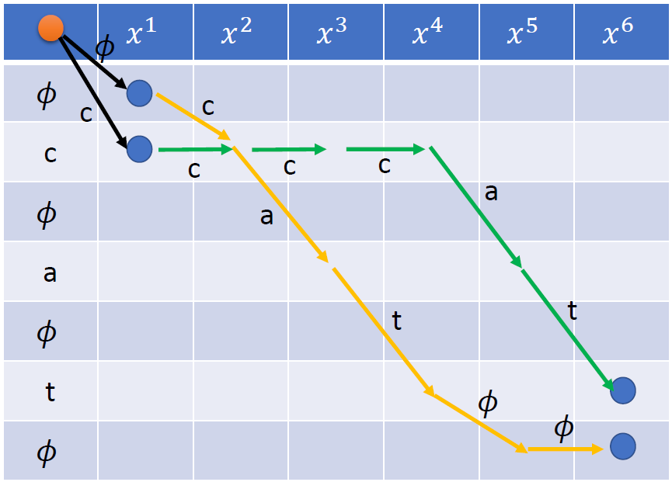

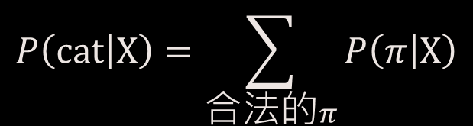
一條 path $π$ 就是一個合法 alignment
$$P\left(\text{cat} | Χ\right)=\sum_{合法的π}{P\left(π | Χ\right)}$$

Slide 13
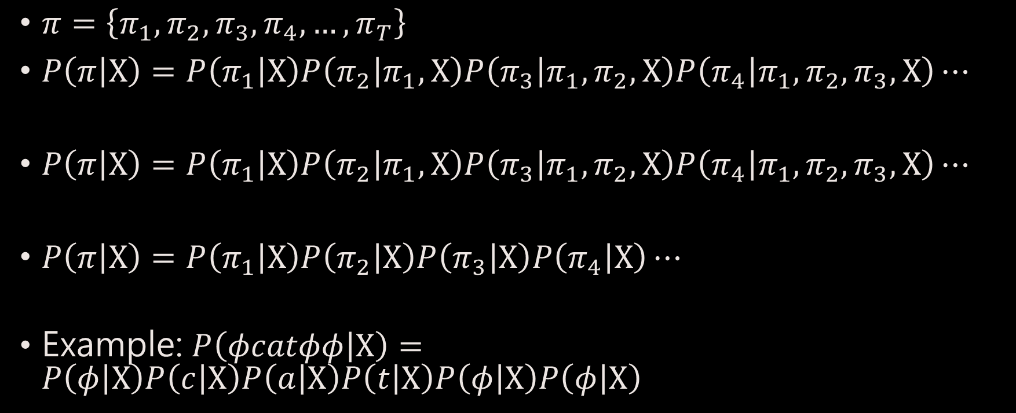

一條 Alignment $π$ 的機率怎麼算?
$π=\left\{π_{1},π_{2},π_{3},π_{4},…,π_{T}\right\}$
$P\left(π | Χ\right)=P\left(π_{1} | Χ\right)P\left(π_{2} | π_{1},Χ\right)P\left(π_{3} | π_{1},π_{2},Χ\right)P\left(π_{4} | π_{1},π_{2},π_{3},Χ\right)⋯$
$P\left(π | Χ\right)=P\left(π_{1} | Χ\right)P\left(π_{2} | π_{1},Χ\right)P\left(π_{3} | π_{1},π_{2},Χ\right)P\left(π_{4} | π_{1},π_{2},π_{3},Χ\right)⋯$
$P\left(π | Χ\right)=P\left(π_{1} | Χ\right)P\left(π_{2} | Χ\right)P\left(π_{3} | Χ\right)P\left(π_{4} | Χ\right)⋯$
Example: $P\left(φcatφφ | Χ\right)=P\left(φ | Χ\right)P\left(c | Χ\right)P\left(a | Χ\right)P\left(t | Χ\right)P\left(φ | Χ\right)P\left(φ | Χ\right)$
CTC indep. assumption

Slide 14





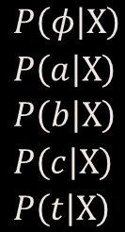
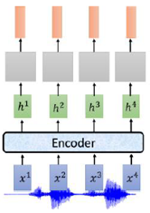
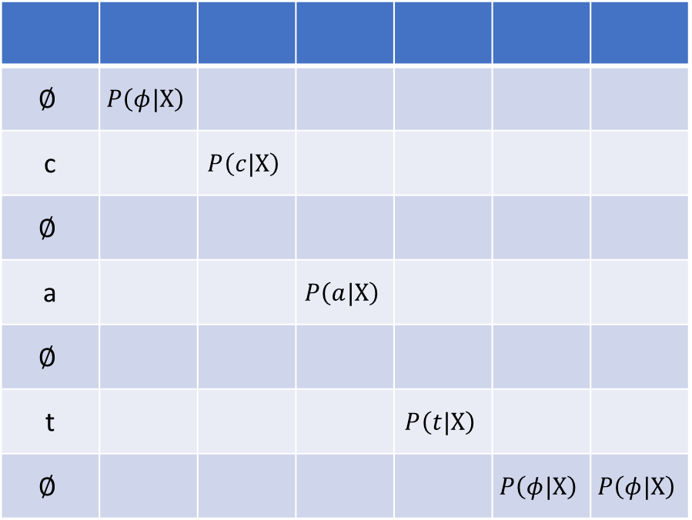
$$P\left(φcatφφ | Χ\right)=P\left(φ | Χ\right)P\left(c | Χ\right)P\left(a | Χ\right)P\left(t | Χ\right)P\left(φ | Χ\right)P\left(φ | Χ\right)$$
$$∅$$ | $$P\left(φ|Χ\right)$$
c |  | $$P\left(c|Χ\right)$$
$$∅$$
a |  |  | $$P\left(a|Χ\right)$$
$$∅$$
t |  |  |  | $$P\left(t|Χ\right)$$
$$∅$$ |  |  |  |  | $$P\left(φ|Χ\right)$$ | $$P\left(φ|Χ\right)$$

Slide 15

怎麼計算$P\left(cat|Χ\right)$? Forward/Backward DP
用一個實際例子舉例 (符號會有點不同)

Slide 16
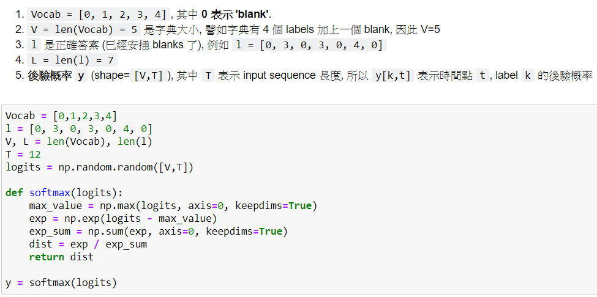
一些變數定義

Slide 17
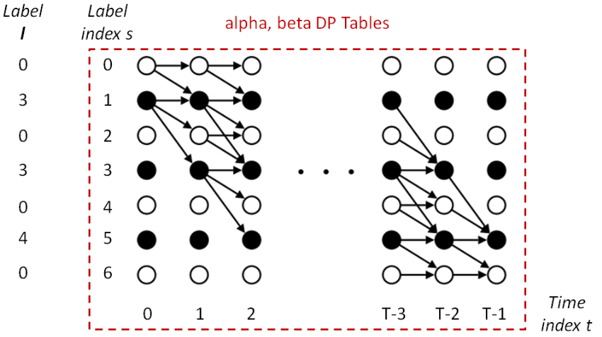



$$α_{t}\left(s\right)$$
$$start$$
因為$l=′33′4$
$$α_{2}\left(3\right)$$
$α_{2}\left(3\right)$ 表示所走到 $\left(t=2,s=3\right)$ 路徑的機率總合

Slide 18
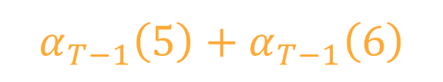



$$α_{t}\left(s\right)$$
$$start$$
$$α_{T−1}\left(5\right)$$
$$α_{T−1}\left(6\right)$$
$$P\left(334 | Χ\right)=$$
$$α_{T−1}\left(5\right)+α_{T−1}\left(6\right)$$

Slide 19


$$β_{t}\left(s\right)$$
$$β_{2}\left(3\right)$$
$$end$$
$β_{2}\left(3\right)$ 表示從 $\left(t=2,s=3\right)$ 開始到路徑結束的機率總合

Slide 20



$$β_{t}\left(s\right)$$
$$β_{0}\left(0\right)$$
$$β_{0}\left(1\right)$$
$$end$$
$$P\left(334 | Χ\right)=β_{0}\left(0\right)+β_{0}\left(1\right)$$

Slide 21
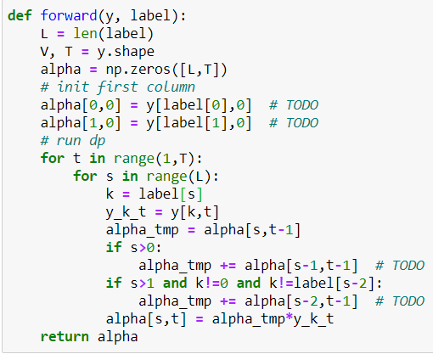
Forward

Slide 22
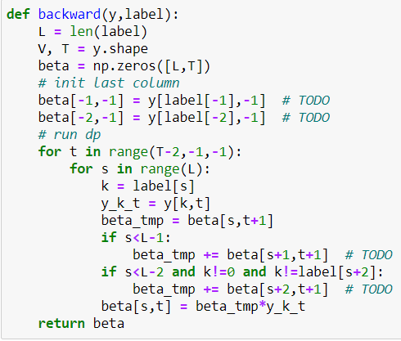
Backward

Slide 23
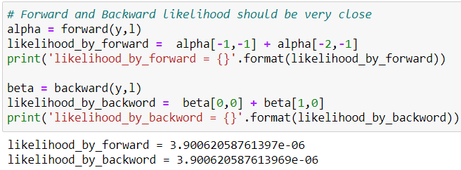
Verify Forward and Backward

Slide 24



$$α_{t}\left(s\right)β_{t}\left(s\right)$$
$$y\left[l_{3},t=2\right]$$
$$α_{2}\left(3\right)=\left(α_{1}\left(2\right)+α_{1}\left(3\right)\right)y\left[l_{3},t=2\right]$$
$$y\left[l_{s=3}=3,t=2\right]$$

Slide 25
$$α_{t}\left(s\right)β_{t}\left(s\right)$$
$$y\left[l_{3},t=2\right]$$
$$β_{2}\left(3\right)=\left(β_{3}\left(3\right)+β_{3}\left(4\right)+β_{3}\left(5\right)\right)y\left[l_{3},t=2\right]$$

Slide 26

$$α_{t}\left(s\right)β_{t}\left(s\right)$$
$$y\left[l_{3},t=2\right]$$
$$α_{2}\left(3\right)β_{2}\left(3\right)=\left(α_{1}\left(2\right)+α_{1}\left(3\right)\right)y\left[l_{3},t=2\right]\left(β_{3}\left(3\right)+β_{3}\left(4\right)+β_{3}\left(5\right)\right)y\left[l_{3},t=2\right]$$
$$=P_{t=2,s=3}\left(334 | Χ\right)y\left[l_{3},t=2\right]$$
所有經過該 node的路徑

Slide 27

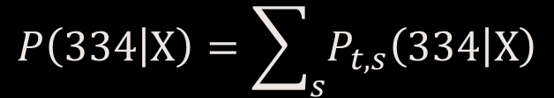
$$α_{2}\left(0\right)β_{2}\left(0\right)$$
$$P\left(334 | Χ\right)=\sum_{s}{P_{t,s}\left(334 | Χ\right)}$$

Slide 28

$$α_{2}\left(1\right)β_{2}\left(1\right)$$
$$P\left(334 | Χ\right)=\sum_{s}{P_{t,s}\left(334 | Χ\right)}$$

Slide 29

$$α_{2}\left(2\right)β_{2}\left(2\right)$$
$$P\left(334 | Χ\right)=\sum_{s}{P_{t,s}\left(334 | Χ\right)}$$

Slide 30

$$α_{2}\left(3\right)β_{2}\left(3\right)$$
$$P\left(334 | Χ\right)=\sum_{s}{P_{t,s}\left(334 | Χ\right)}$$

Slide 31

$$α_{2}\left(4\right)β_{2}\left(4\right)$$
$$P\left(334 | Χ\right)=\sum_{s}{P_{t,s}\left(334 | Χ\right)}$$

Slide 32

$$α_{2}\left(5\right)β_{2}\left(5\right)$$
$$P\left(334 | Χ\right)=\sum_{s}{P_{t,s}\left(334 | Χ\right)}$$

Slide 33

$$α_{2}\left(6\right)β_{2}\left(6\right)$$
$$P\left(334 | Χ\right)=\sum_{s}{P_{t,s}\left(334 | Χ\right)}$$

Slide 34
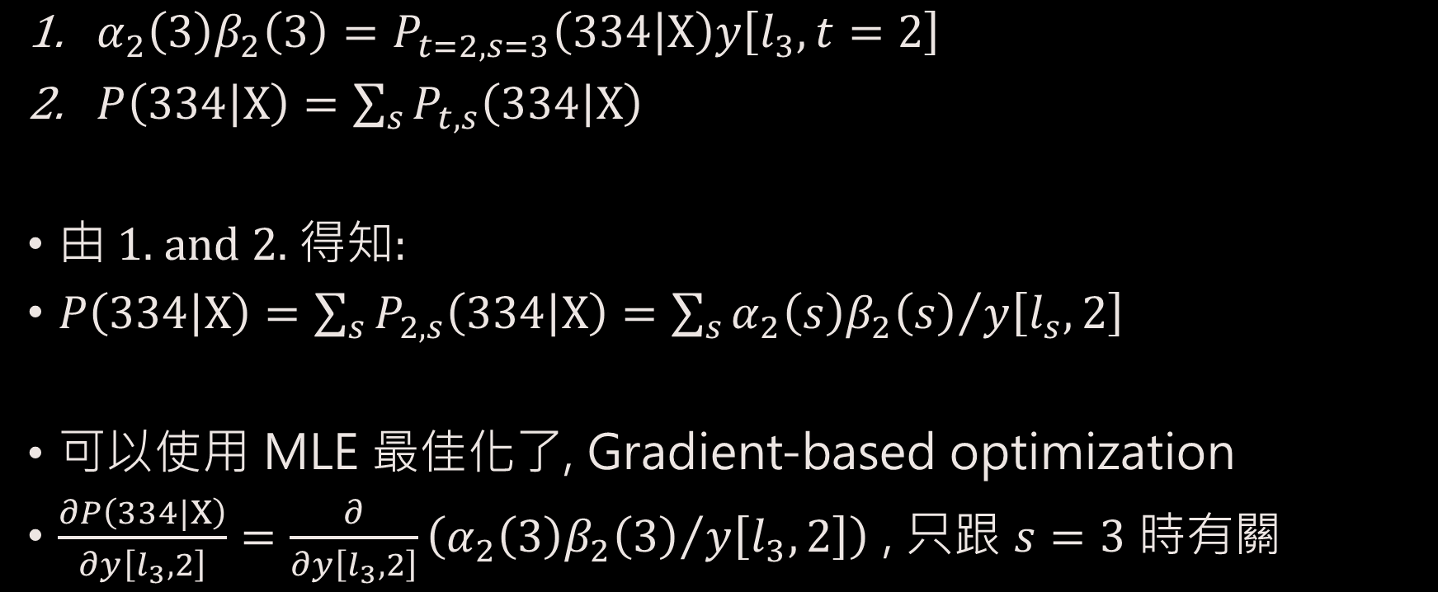

$$P\left(334 | Χ\right)$$
$α_{2}\left(3\right)β_{2}\left(3\right)=P_{t=2,s=3}\left(334 | Χ\right)y\left[l_{3},t=2\right]$
$P\left(334 | Χ\right)=\sum_{s}{P_{t,s}\left(334 | Χ\right)}$
由 1. and 2. 得知:
$P\left(334 | Χ\right)=\sum_{s}{P_{2,s}\left(334 | Χ\right)}=\sum_{s}{{α_{2}\left(s\right)β_{2}\left(s\right)}/{y\left[l_{s},2\right]}}$
可以使用 MLE 最佳化了, Gradient-based optimization
$\frac{∂P\left(334|Χ\right)}{∂y\left[l_{3},2\right]}=\frac{∂}{∂y\left[l_{3},2\right]}\left({α_{2}\left(3\right)β_{2}\left(3\right)}/{y\left[l_{3},2\right]}\right)$ , 只跟 $s=3$ 時有關

Slide 35
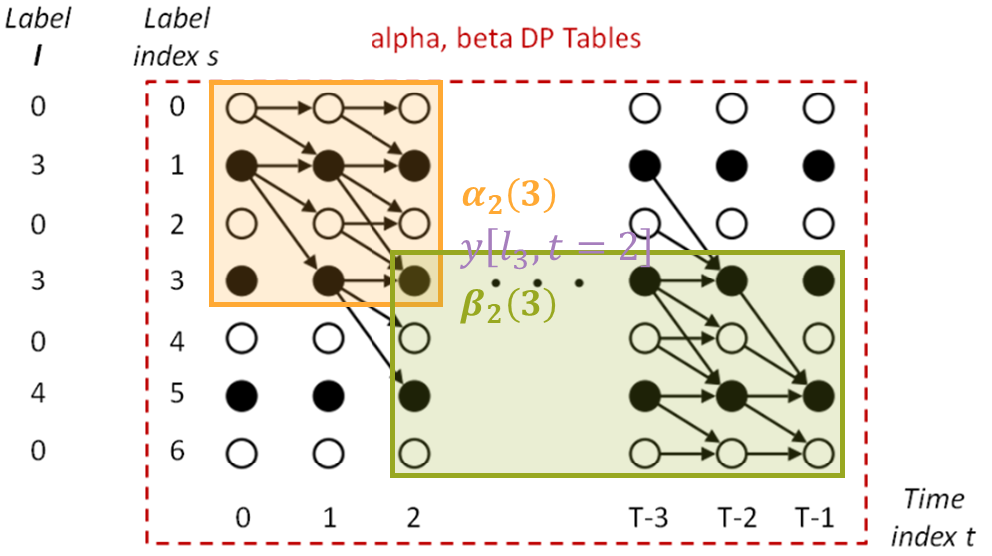
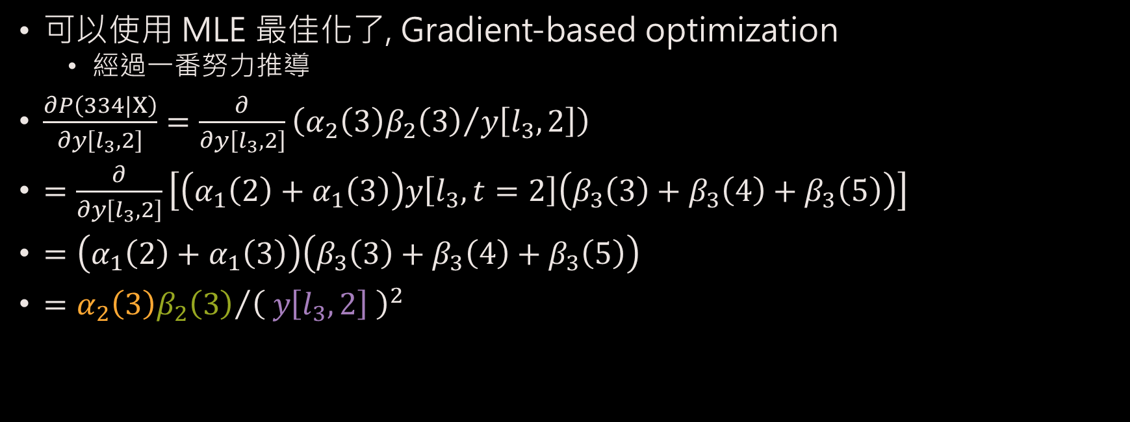

$$\frac{∂P\left(334|Χ\right)}{∂y\left[l_{3},2\right]}$$
可以使用 MLE 最佳化了, Gradient-based optimization
經過一番努力推導
$\frac{∂P\left(334|Χ\right)}{∂y\left[l_{3},2\right]}=\frac{∂}{∂y\left[l_{3},2\right]}\left({α_{2}\left(3\right)β_{2}\left(3\right)}/{y\left[l_{3},2\right]}\right)$
$=\frac{∂}{∂y\left[l_{3},2\right]}\left[\left(α_{1}\left(2\right)+α_{1}\left(3\right)\right)y\left[l_{3},t=2\right]\left(β_{3}\left(3\right)+β_{3}\left(4\right)+β_{3}\left(5\right)\right)\right]$
$=\left(α_{1}\left(2\right)+α_{1}\left(3\right)\right)\left(β_{3}\left(3\right)+β_{3}\left(4\right)+β_{3}\left(5\right)\right)$
$={α_{2}\left(3\right)β_{2}\left(3\right)}/{{\left( y\left[l_{3},2\right] \right)}^{2}}$

Slide 36
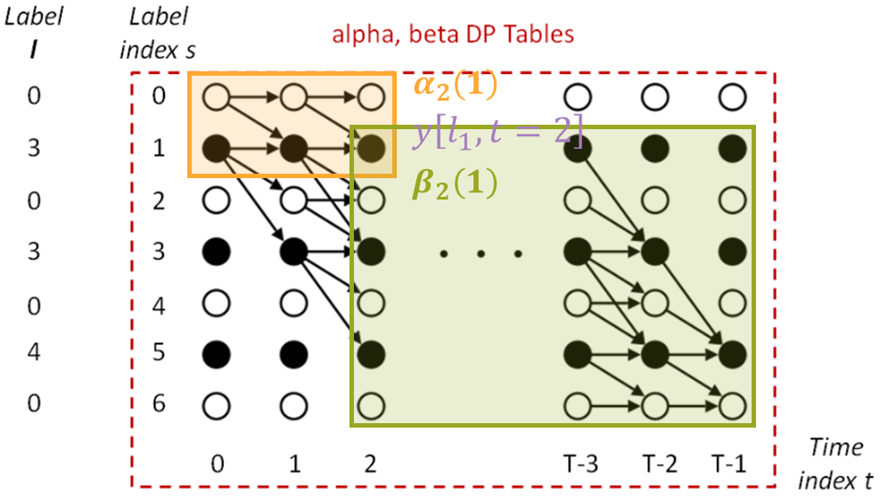
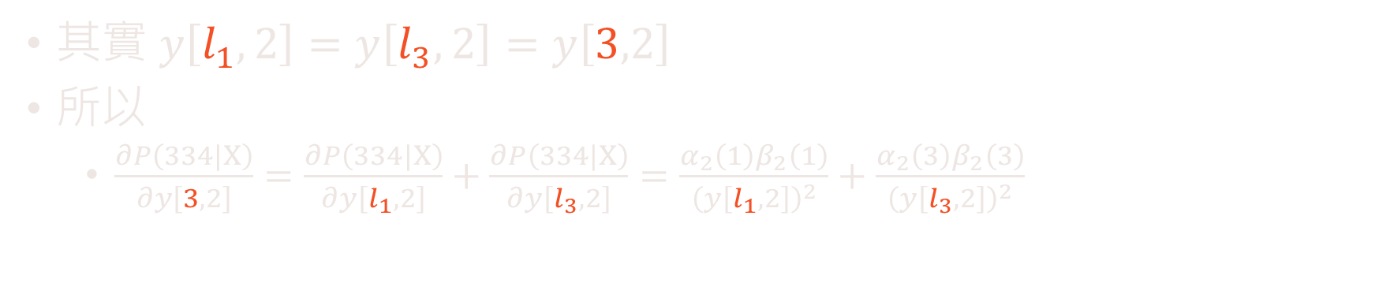

$$\frac{∂P\left(334|Χ\right)}{∂y\left[3,2\right]}$$
其實 $y\left[l_{1},2\right]=y\left[l_{3},2\right]=y\left[3,2\right]$
所以
$\frac{∂P\left(334|Χ\right)}{∂y\left[3,2\right]}=\frac{∂P\left(334|Χ\right)}{∂y\left[l_{1},2\right]}+\frac{∂P\left(334|Χ\right)}{∂y\left[l_{3},2\right]}=\frac{α_{2}\left(1\right)β_{2}\left(1\right)}{{\left(y\left[l_{1},2\right]\right)}^{2}}+\frac{α_{2}\left(3\right)β_{2}\left(3\right)}{{\left(y\left[l_{3},2\right]\right)}^{2}}$

Slide 37

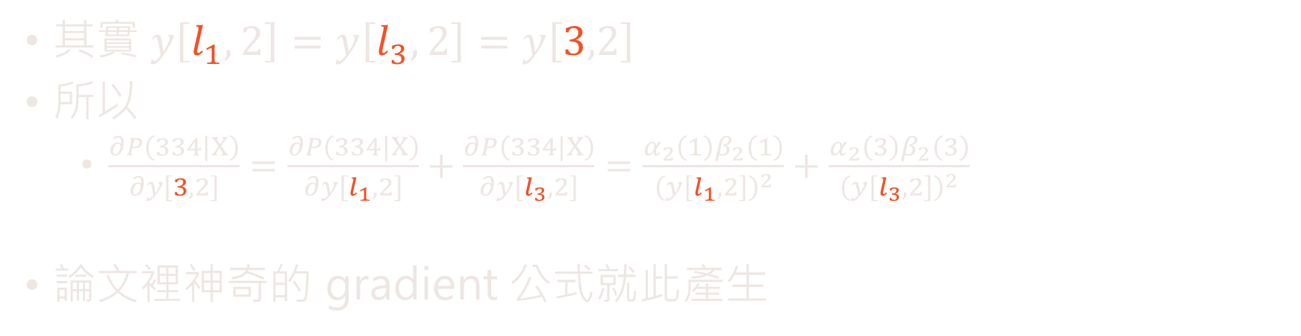
$$\frac{∂P\left(334|Χ\right)}{∂y\left[3,2\right]}$$
其實 $y\left[l_{1},2\right]=y\left[l_{3},2\right]=y\left[3,2\right]$
所以
$\frac{∂P\left(334|Χ\right)}{∂y\left[3,2\right]}=\frac{∂P\left(334|Χ\right)}{∂y\left[l_{1},2\right]}+\frac{∂P\left(334|Χ\right)}{∂y\left[l_{3},2\right]}=\frac{α_{2}\left(1\right)β_{2}\left(1\right)}{{\left(y\left[l_{1},2\right]\right)}^{2}}+\frac{α_{2}\left(3\right)β_{2}\left(3\right)}{{\left(y\left[l_{3},2\right]\right)}^{2}}$
論文裡神奇的 gradient 公式就此產生

Slide 38
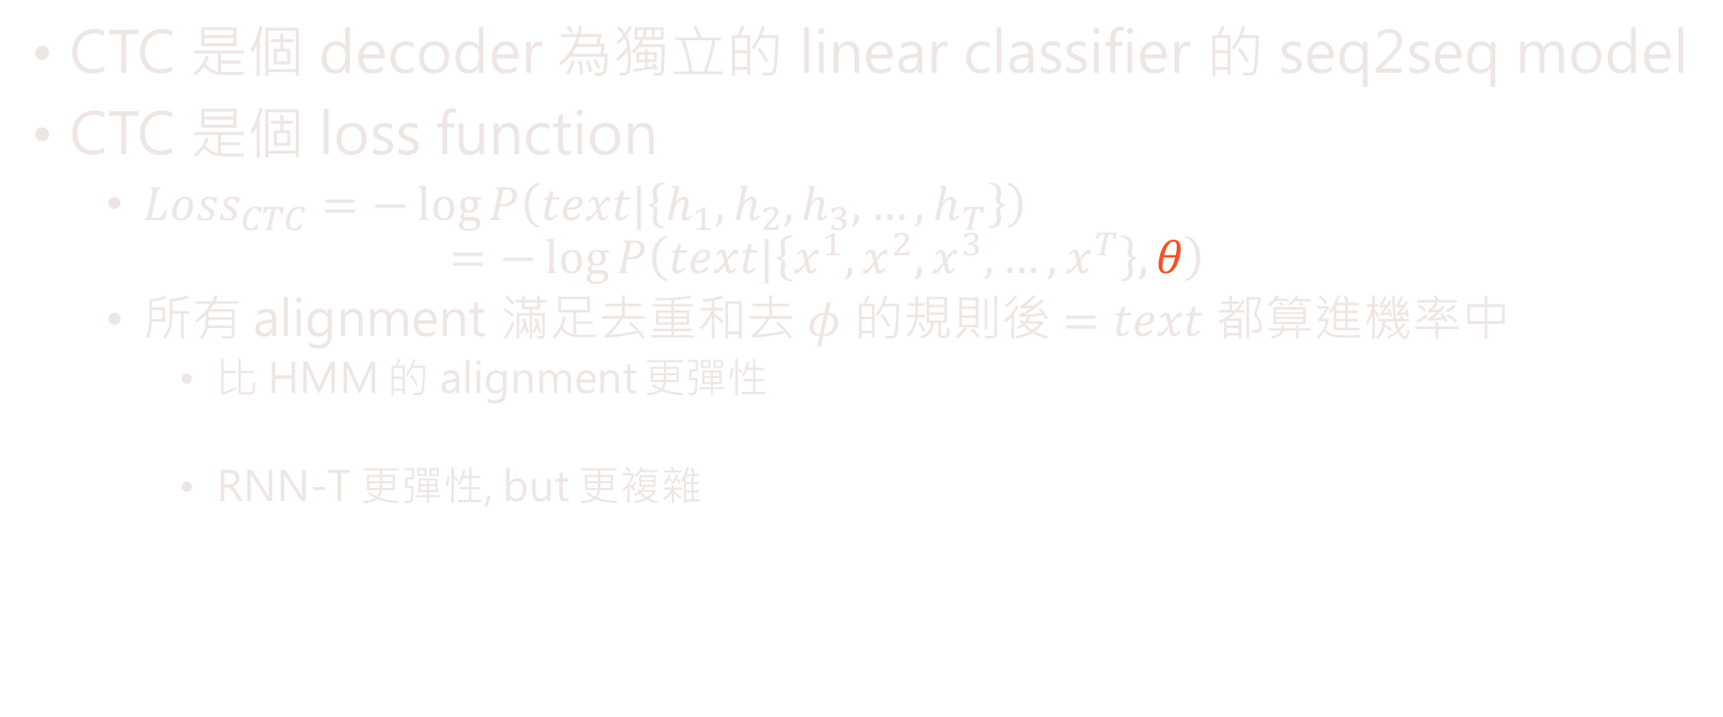

喘口氣的結論
CTC 是個 decoder 為獨立的 linear classifier 的 seq2seq model
CTC 是個 loss function
${Loss}_{CTC}=−\log{P\left(text|\left\{h_{1},h_{2},h_{3},…,h_{T}\right\}\right)}$
$$=−\log{P\left(text|\left\{x^{1},x^{2},x^{3},…,x^{T}\right\},θ\right)}$$
所有 alignment 滿足去重和去 $φ$ 的規則後 $=text$ 都算進機率中
比 HMM 的 alignment 更彈性
RNN-T 更彈性, but 更複雜
$$θ$$

Slide 39
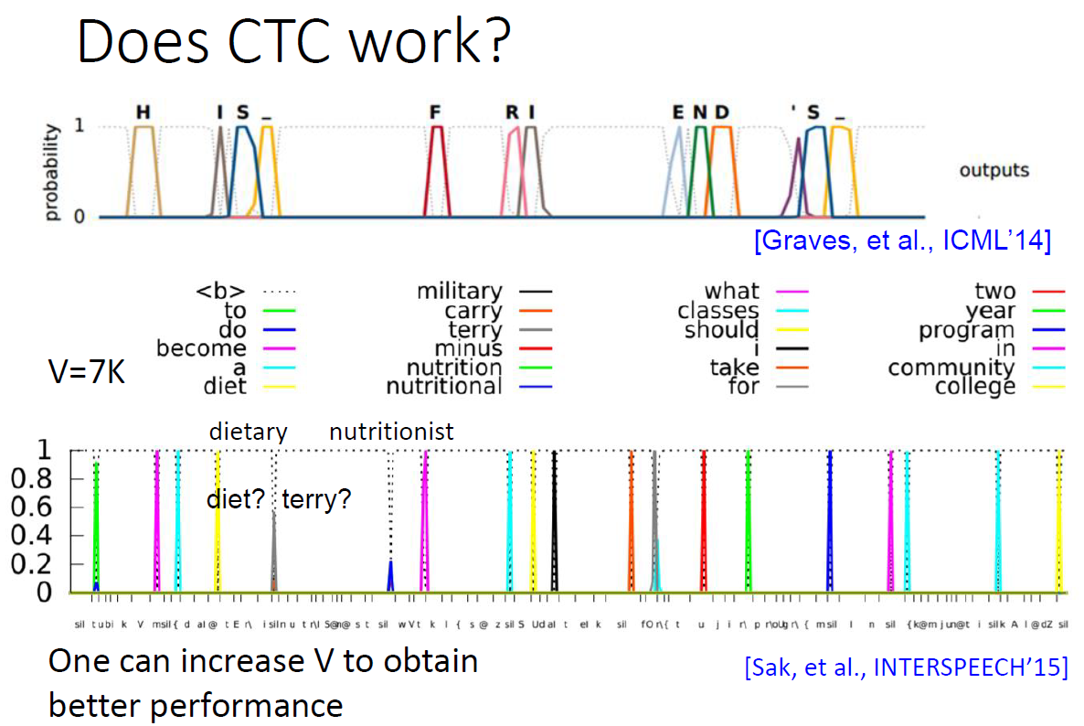

Slide 40
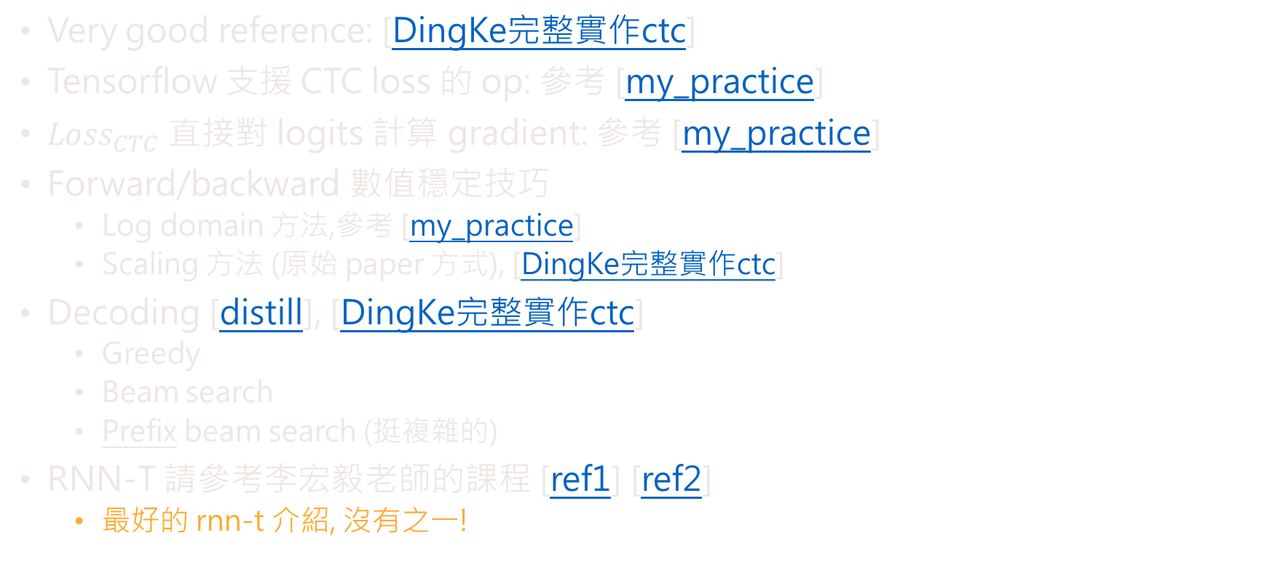
其他
Very good reference: [DingKe完整實作ctc]
Tensorflow 支援 CTC loss 的 op: 參考 [my_practice]
${Loss}_{CTC}$ 直接對 logits 計算 gradient: 參考 [my_practice]
Forward/backward 數值穩定技巧
Log domain 方法,參考 [my_practice]
Scaling 方法 (原始 paper 方式), [DingKe完整實作ctc]
Decoding [distill], [DingKe完整實作ctc]
Greedy
Beam search
Prefix beam search (挺複雜的)
RNN-T 請參考李宏毅老師的課程 [ref1] [ref2]
最好的 rnn-t 介紹, 沒有之一!

Slide 41
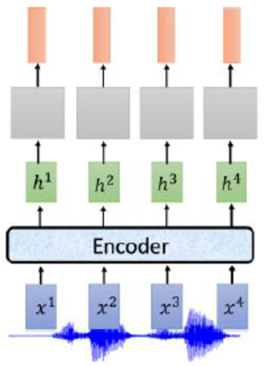
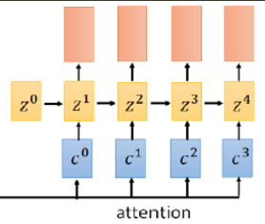



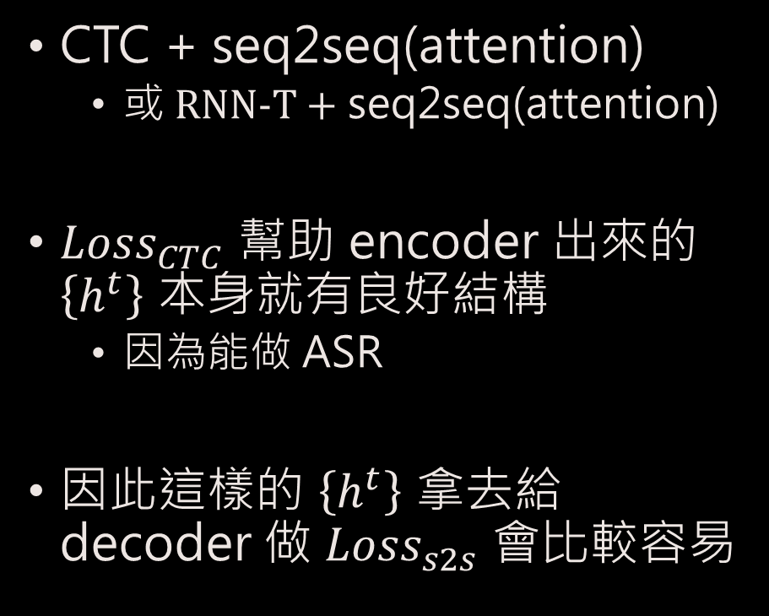

近期 state-of-the-art 的 E2E ASR 架構
$${Loss}_{total}$$
CTC + seq2seq(attention)
或 RNN-T + seq2seq(attention)
${Loss}_{CTC}$ 幫助 encoder 出來的 $\left\{h^{t}\right\}$ 本身就有良好結構
因為能做 ASR
因此這樣的 $\left\{h^{t}\right\}$ 拿去給 decoder 做 ${Loss}_{s2s}$ 會比較容易
$${Loss}_{CTC}$$
$${Loss}_{s2s}$$

Slide 42

[ESPnet] end-to-end speech processing toolkit
Kaldi style complete recipe
ASR: Automatic Speech Recognition
TTS: Text-to-speech
ST: Speech Translation & MT: Machine Translation
VC: Voice conversion
DNN Framework
Flexible network architecture thanks to chainer and pytorch

Slide 43
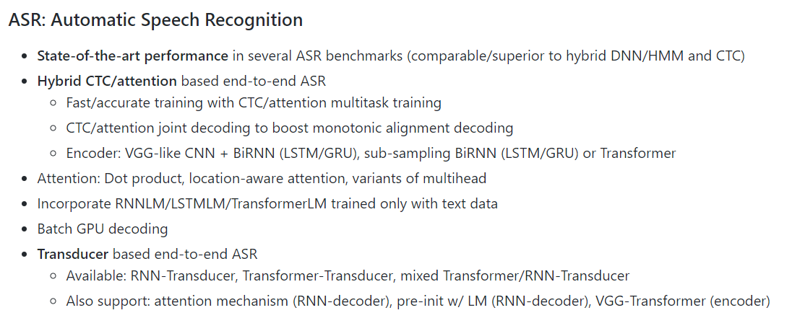
[ESPnet] end-to-end speech processing toolkit

