Slide 1
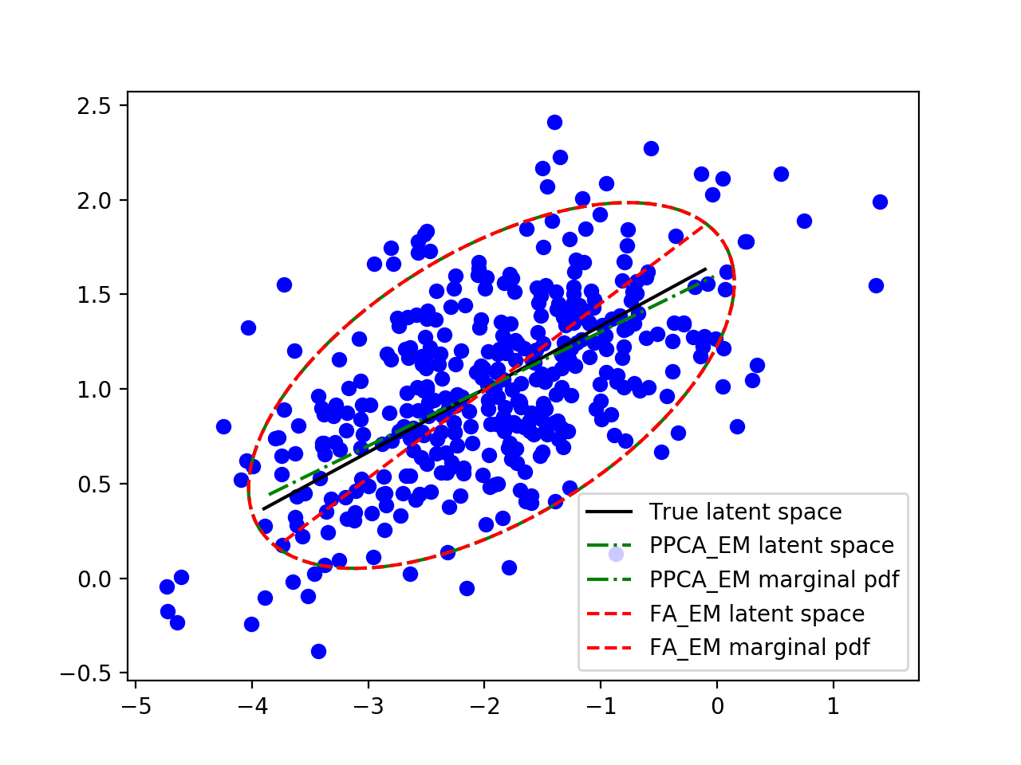
W_{FA}
W_{PPCA}
P(x)
P(x)

Slide 2
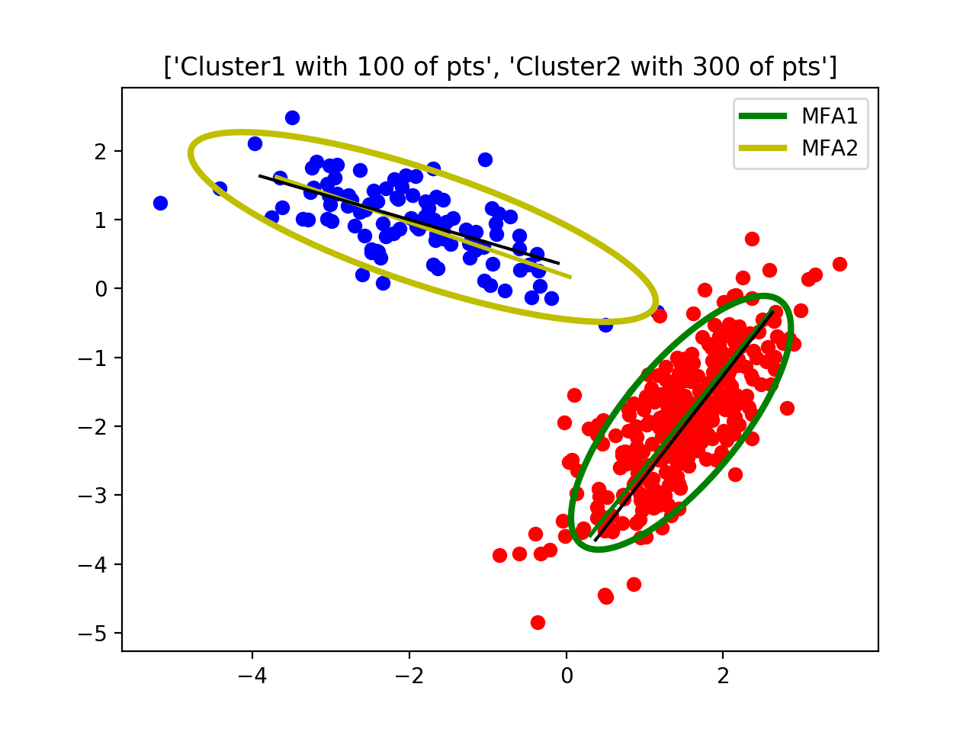
W₂
W₁

Slide 3
p(z1|x,m=1), p(z2|x,m=2)
z₂
z₂
z₁
p(z1|v,m=1), p(z2|v,m=2)
z₁

Slide 4
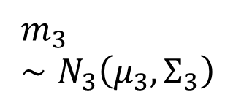


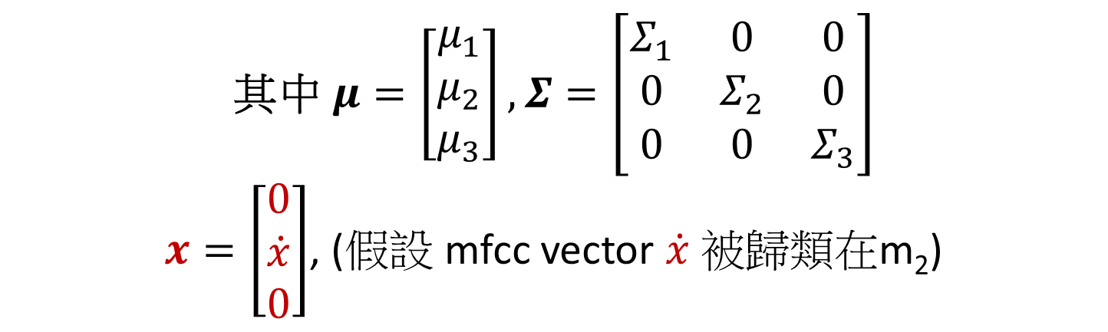



$$m_{1}∼N_{1}\left(μ_{1},Σ_{1}\right)$$
$$x$$
W_{FA}
$$\dot{x}$$
$$m_{2}∼N_{2}\left(μ_{2},Σ_{2}\right)$$
$$N\left(μ,Σ \right)$$
$$m_{3}∼N_{3}\left(μ_{3},Σ_{3}\right)$$
其中 $μ=\left[\begin{matrix}μ_{1} \\ μ_{2} \\ μ_{3}\end{matrix}\right],Σ=\left[\begin{matrix}Σ_{1} & 0 & 0 \\ 0 & Σ_{2} & 0 \\ 0 & 0 & Σ_{3}\end{matrix}\right]$
$x=\left[\begin{matrix}0 \\ \dot{x} \\ 0\end{matrix}\right]$, (假設 mfcc vector $\dot{x}$ 被歸類在m₂)

Slide 5
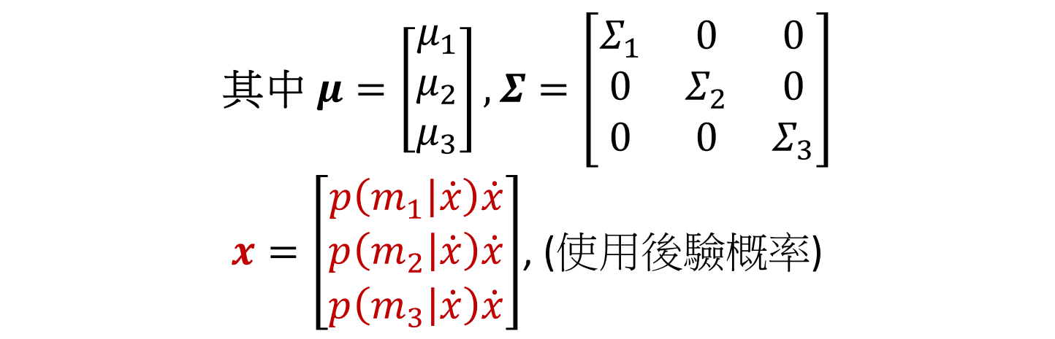
$$m_{1}∼N_{1}\left(μ_{1},Σ_{1}\right)$$
$$x$$
W_{FA}
$$\dot{x}$$
$$m_{2}∼N_{2}\left(μ_{2},Σ_{2}\right)$$
$$N\left(μ,Σ \right)$$
$$m_{3}∼N_{3}\left(μ_{3},Σ_{3}\right)$$
其中 $μ=\left[\begin{matrix}μ_{1} \\ μ_{2} \\ μ_{3}\end{matrix}\right],Σ=\left[\begin{matrix}Σ_{1} & 0 & 0 \\ 0 & Σ_{2} & 0 \\ 0 & 0 & Σ_{3}\end{matrix}\right]$
$x=\left[\begin{matrix}p\left(m_{1} | \dot{x}\right)\dot{x} \\ p\left(m_{2} | \dot{x}\right)\dot{x} \\ p\left(m_{3} | \dot{x}\right)\dot{x}\end{matrix}\right]$, (使用後驗概率)

Slide 6

Speaker Model
UBM
給定一個 latent variable $z^{∗}$,
則 $p\left(x | z^{∗}\right)\sim N\left(x | Wz^{∗}+μ,Σ\right)$, 表示為 “橘色 GMM”

