Slide 1
Quantum Computing Concepts
By abhay a Bhat – 16011A0501

Slide 2
Introduction
A classical computer performs operations using classical bits which can be either 0 or 1.
Qubits can be 0 or 1 both simultaneously which gives quantum computers its superior power.
a qubit can be: a photon, a electron, or a proton.
Quantum technology can support higher clock speeds and an entirely new kind of computation with qualitatively new algorithms based on quantum principles.

Slide 3
History
1980 – Paul Benioff | Proposed a quantum mechanical model of the Turing machine based on Schrodinger’s equations and Heisenberg's principles.
1982 – Richard Feynman | Proposed the idea of creating machines based on the ideas of quantum physics rather than classical physics.
1985 – David Deutsch | Proposed a Universal quantum machine that can simulate any other quantum machine.
1994 – Peter Shor | Came up with a quantum algorithm to factor very large numbers.

Slide 4
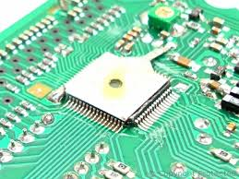
History
1997 – Lov Grover | Developed a quantum search algorithm with O(√N) complexity.
1998 – Oxford University, IBM, Stanford and MIT | 2-qubit NMR quantum computer developed and Grover’s algorithm run.
Refer: https://en.wikipedia.org/wiki/Timeline_of_quantum_computing for more details on the developments in quantum computing.

Slide 5
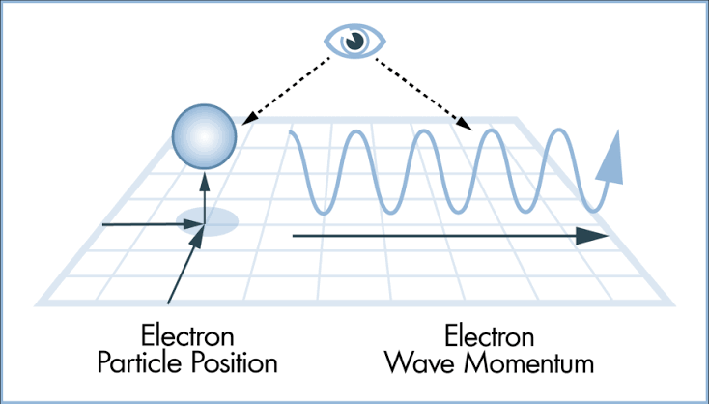

Quantum principles
Heisenberg's uncertainty principle.
Quantum Entanglement or spooky effect.
source: www.science..howstuffworks.com
source: www.livescience.com

Slide 6
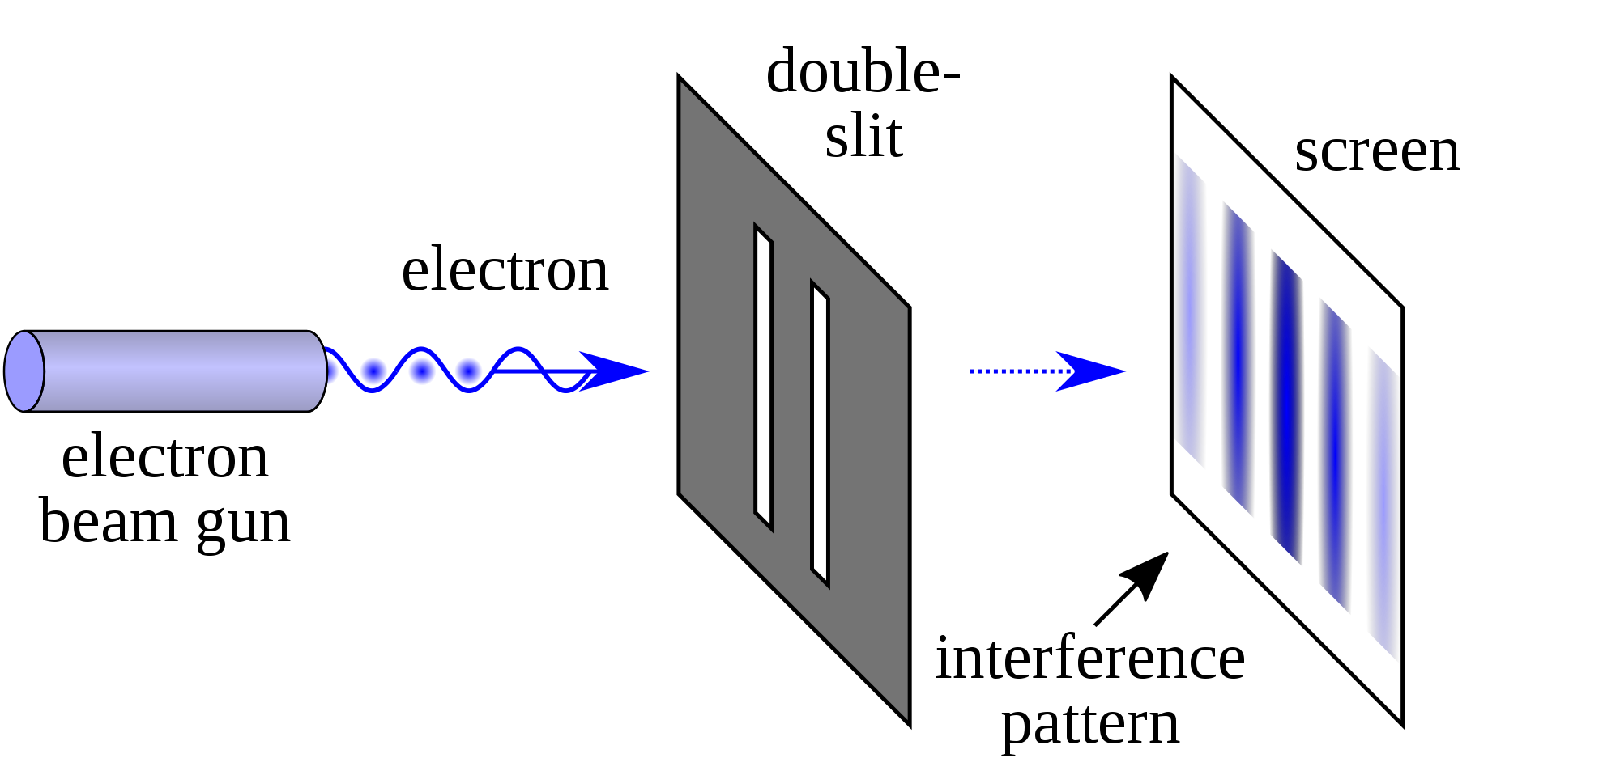
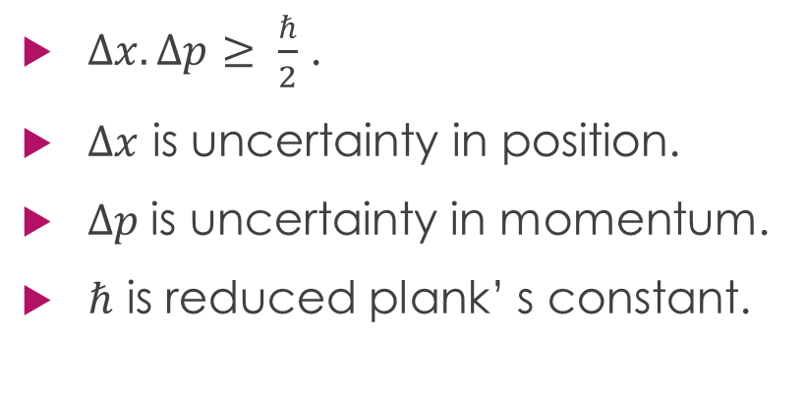
Heisenberg’s Uncertainty Principle
$Δx.Δp≥ \frac{ℏ}{2}$ .
$Δx$ is uncertainty in position.
$Δp$is uncertainty in momentum.
$ℏ$ is reduced plank’ s constant.
source: wikipedia

Slide 7
Binary Logic
Encoded in binary digits which take only two possible values either a 0 or 1.
The physical objects is called a bit and is represented by the state of a transistor inside a silicon chip.
There are a few problems that cannot be even solved by a super computer such as
finding the prime factors of a large number
designing a molecule
finding a shortest path between many cities.

Slide 8
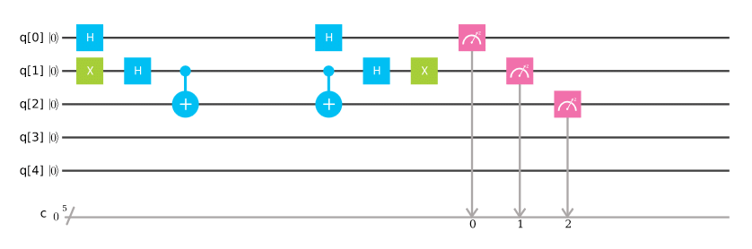
Logic Gates
In classical logic we can implement any logic operation using NAND gates.
Not all gates are allowed for a quantum logic because quantum mechanics imposes a few very stringent rules.
A quantum system must be such that information is lost over time and must be able to reconstruct the past.

Slide 9
Logic Gates
A | B
0 | 0
0 | 1
1 | 0
1 | 1
A | A & B
0 | 0
0 | 0
1 | 0
1 | 1
A | B
|0〉 | |0〉
|0〉 | |1〉
|1〉 | |0〉
|1〉 | |1〉
A | B | A & B
0 | 0 | 0
0 | 1 | 0
1 | 0 | 0
1 | 1 | 1
A | A cnot B
|0〉 | |0〉
|0〉 | |1〉
|1〉 | |1〉
|1〉 | |0〉
Controlled Not gate
AND gate
$$ψ= α|00〉+β|01〉+γ|10〉+δ|11〉$$
→
$$ψ= α|00〉+β|01〉+γ|11〉+δ|10〉$$

Slide 10
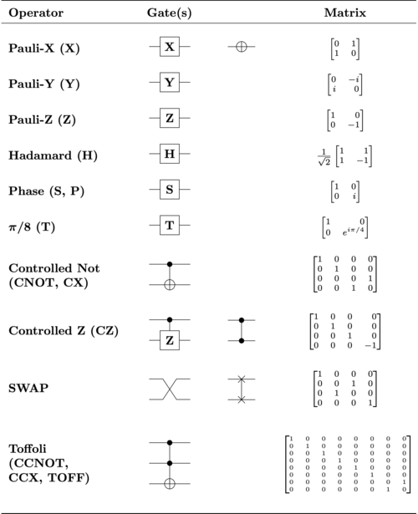
Logic Gates

Slide 11
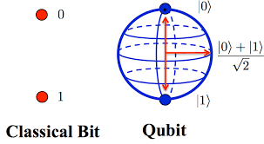

Qubits
Fundamental principles of quantum mechanics is that it is possible to create superposition of different physical configurations.
Qubits thus can not only be in states 0 or 1 like classical bits but also a superposition of these states.
$$ψ= α|0〉+ β|1〉$$

Slide 12


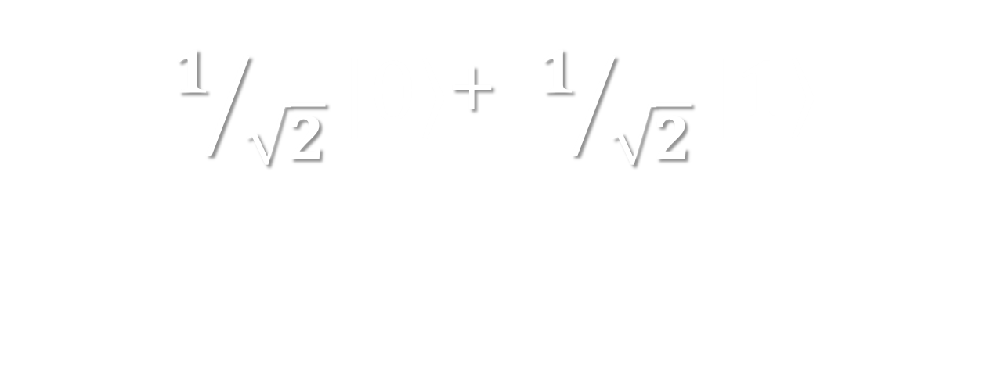
$1/{\sqrt{2}}|0〉$+ $1/{\sqrt{2}}|1〉$
$$|0〉$$
-
-
-
+
+
$$|1〉$$

Slide 13


Spin
Particles have a property of possessing an intrinsic magnetic dipole.
an electron placed in an electric field has two basic quantum states spin up and spin down which we may use to represent quantum information.
-
-
$$|0〉$$
$$|1〉$$

Slide 14


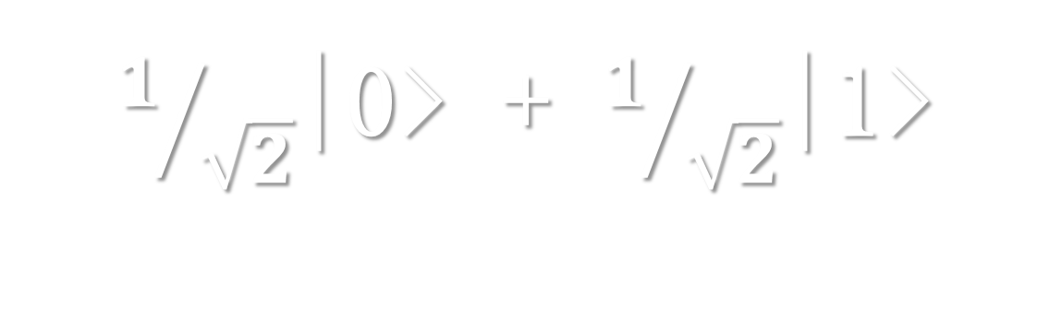
$1/{\sqrt{2}}$|0> + $1/{\sqrt{2}}$|1>
$$|0〉$$
-
$$|1〉$$

Slide 15



Nuclear Magnetic Resonance
-
$$E_{0}$$
E
$$E_{1}$$
$E=E_{1}−E_{0} ⇒ υ= \frac{E_{1}−E_{0}}{h}$

Slide 16
Qubits conti…
Consider 2-qubit system
hence to determine the state of 2-spin system we need 4 complex co-efficients in addition to the classical 2 bits.
Classical bits
00
01
10
11
Quantum mechanics allows superposition
$$ψ= α|00〉+β|01〉+γ|10〉+δ|11〉$$
hence 4-complex numbers needed

Slide 17
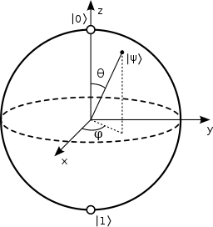
Quantum Measurement
When they are measured they must fall into one of the basic states and all other information about the state before the measurement is lost.
we need to design the logical operations such that the final result is to falls into one of the basic states that can be measured.

Slide 18
Quantum Entanglement
Consider 2 qubits in some superimposition state when brought near, their magnetic field changes energy of each other.
Entangled states help explore exponentially large data and at the same time they are very fragile and can be easily destroyed by external noise
-
-
-
-

Slide 19
UNSW – quantum computing
Phosphorous atom embedded in a silicon crystal right next to a transistor.
At room temperature an electron has enough thermal energy to be bouncing around from spin up to spin down.
Thus the whole apparatus needs to be cooled down to a few 100ths of degrees above absolute zero.
Hit with suitable frequency to write information on the electron.

Slide 20
UNSW –quantum computing
Phosphorous electron in spin up has higher energy than other electrons in silicon thus creates a greater base voltage.
now as this all depends sensitively on magnetic fields we need to make sure we eliminate all spin from the silicon crystal.
source
drain
Phosphorous atom
n
p
n
base

Slide 21
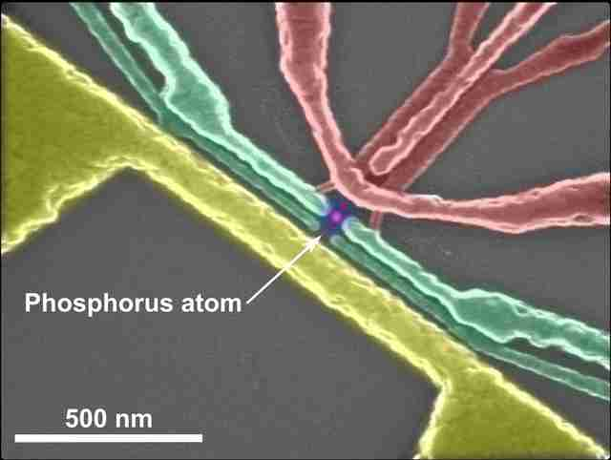
UNSW - quantum computing
Microwave antenna
Silicon Transistor

Slide 22
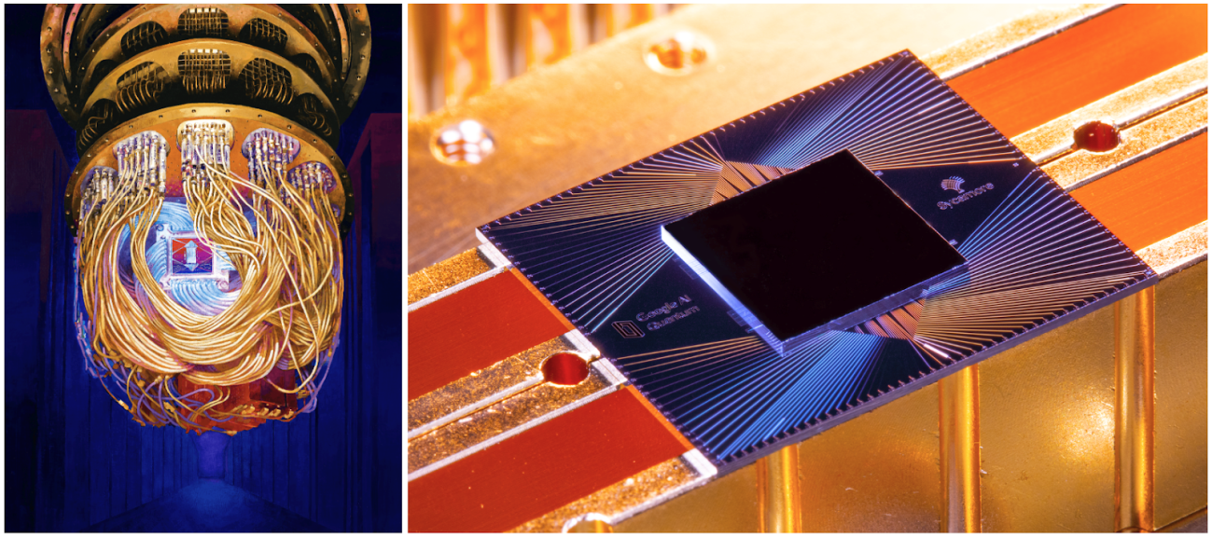
Quantum supremacy
An experiment whose goal is to demonstrate that a programmable quantum device can solve a problem that classical computers practically cannot.
source: https://ai.googleblog.com/

Slide 23
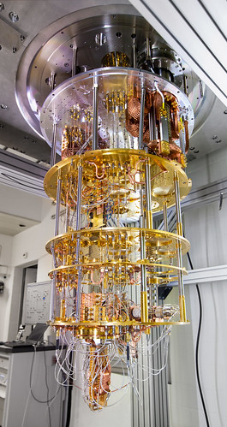
IBM - Q
IBM Q is an industry first initiative to build universal quantum computers for business, engineering and science.
It currently has a worldwide network of Fortune 500 companies, academic institutions, researchers, educators, and enthusiast.
Quantum devices can be accessed over cloud through Qiskit, an open-source quantum programming framework.
source: https://www.ibm.com/blogs/

Slide 24
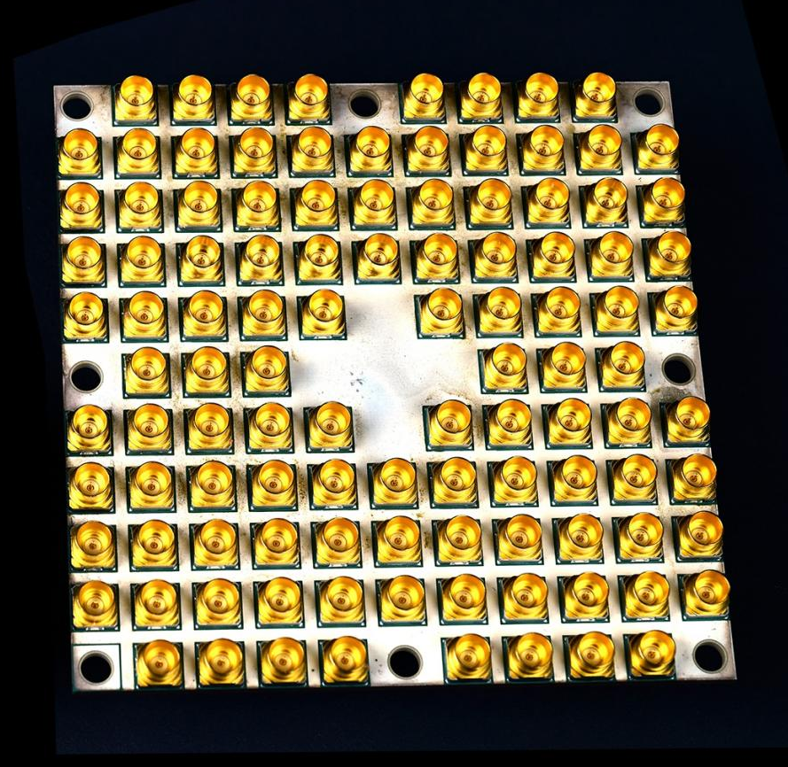
Intel – Tangle Lake
49-bit super conducting quantum chip packaged in a 3in x 3in chip.
There are 108 radio frequency connectors made of gold that carry microwave signals into the chip to operate the quantum bits.
Gold is excellent for anti-corrosion and signal transmission.
source: https://www.intel.in/

Slide 25
Advantages and Disadvantages
Advantages
Disadvantages
Cryptography: Perfectly secure communication.
Searching, especially algorithmic searching (Grover's algorithm).
Factorizing large numbers very rapidly (Shor's algorithm).
Simulating quantum-mechanical systems efficiently.
Electron states are very fragile and are easily destroyed by external noise.
Equipment is costly and huge.
Able to solve only a limited class of problems faster.

Slide 26
Queries
What is a qubit?
In what way is a quantum computer faster than a classical computer?
Is quantum computer digital or analog?
Important quantum concepts needed to understand quantum computing?
What is the quantum computing equivalent of a traditional digital Turing machine?

Slide 27
References
https://www.qubit.org
https://en.m.wikipedia.org/wiki/Qubit
https://www.veritasium.com
https://www.engineering.unsw.edu.au/research/research-priorities/enabling-technology/quantum-computing/quantum-spin
https://ai.googleblog.com/2019/10/quantum-supremacy-using-programmable.html
http://www.oxford-man.ox.ac.uk/sites/default/files/events/Quantum%20Computation%20and%20Machine%20Learning.pdf

Slide 28
Thank You

