Slide 1
Statistical Analysis of Food Environment Atlas
By: Carolina Garza, Tola Ouk, Michael Saenz, and Ray Thomas

Slide 2

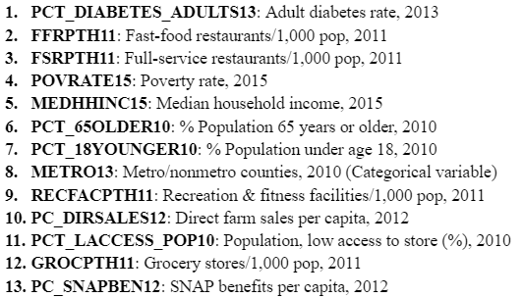
Introduction
Data: “Food Environment Atlas” from the U.S. Department of Agriculture (August 2020) Number of Observations: 3,143 Number of Features: 280
This dataset examines how agriculture, government assistance, grocery store availability, and demographics relate to food availability to households in the US. It is broken down to the State and County level.
We have chosen a subset of 13 variables to answer 4 analytical questions.

Slide 3
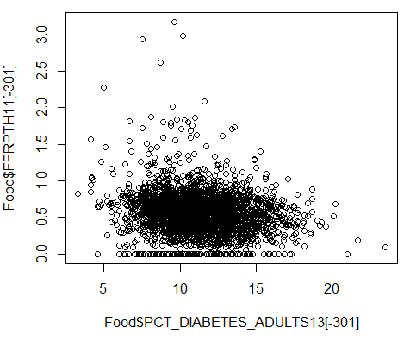
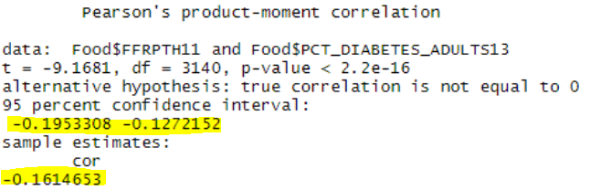
Is there a correlation between diabetes rate and the number of fast-food restaurants?
Very weak negative correlation
[-0.195, -0.127] with 95% confidence

Slide 4
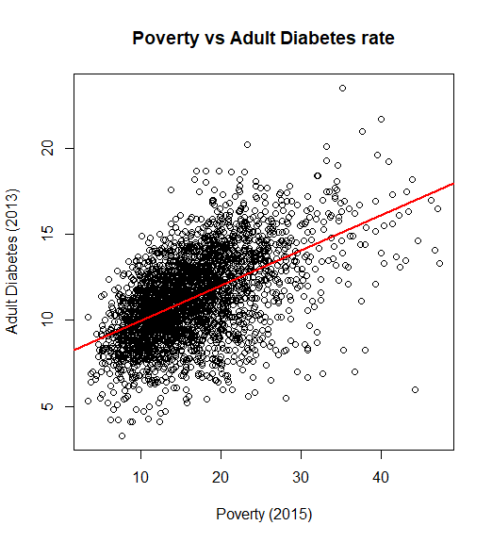
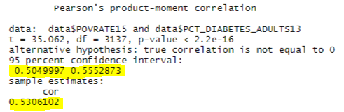
Is there a correlation between health and poverty rates?
Moderate positive correlation
[0.505, 0.555] with 95% confidence
Slope of 0.204

Slide 5
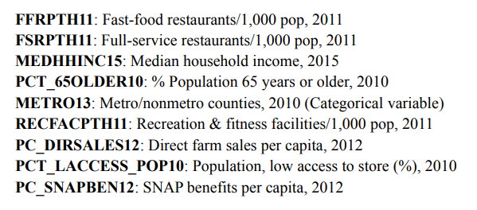
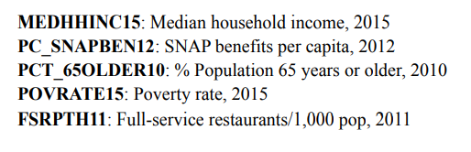
What features can determine diabetes rates the most?
Multiple Linear Regression Model
Random Forest Model
Significant Variables:
Top 5 Variables:
Variation explained: 51%
Variation explained: 58%

Slide 6
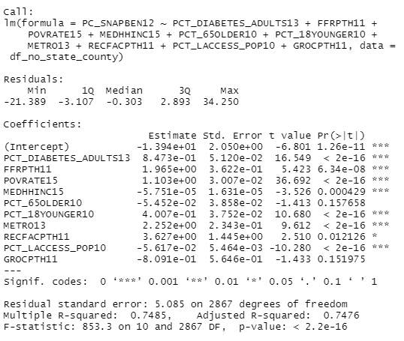
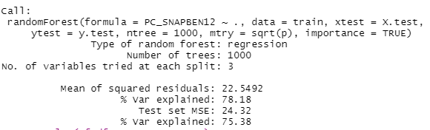
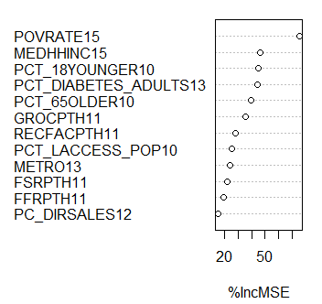
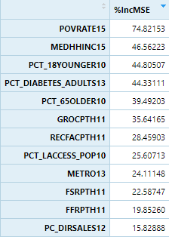
Can we predict the amount of SNAP benefits per capita?
Multiple Linear Regression Model
Random Forest Model
Variable Importance Plot

Slide 7
Reserved Slides

Slide 8
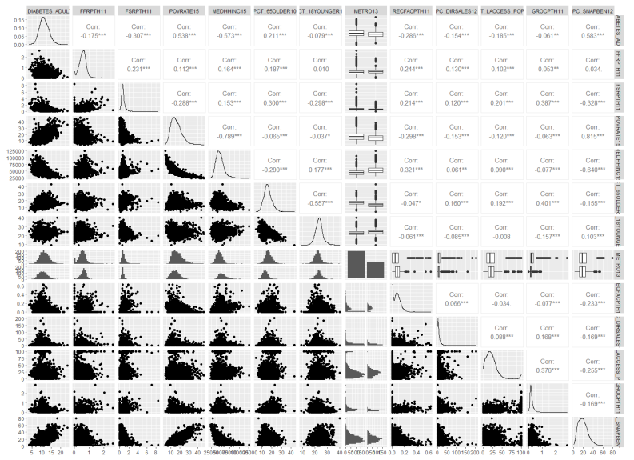
What features can determine diabetes rates the most?
Top correlations with Diabetes rates:
poverty rate
median household income
snap benefit amount
(correlation values of 0.54 - 0.58)

Slide 9
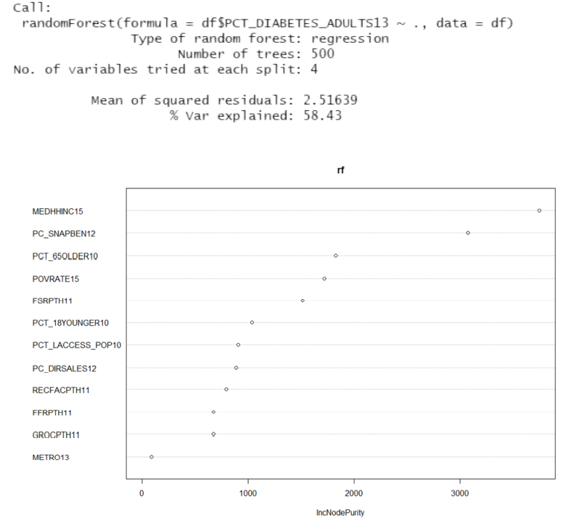
What features can determine diabetes rates the most?
Random Forest Model
Top Variables:

Slide 10
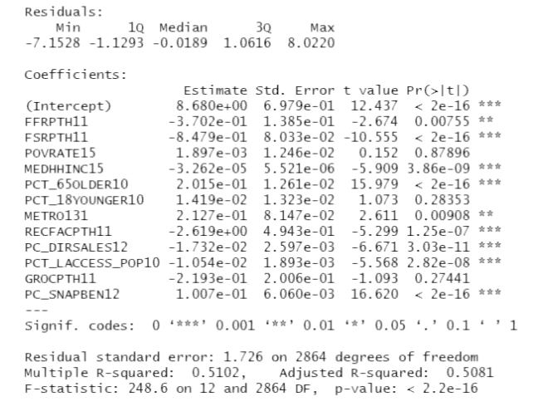
What features can determine diabetes rates the most?
Multiple Linear Regression Model
Significant Variables:

