Slide 1

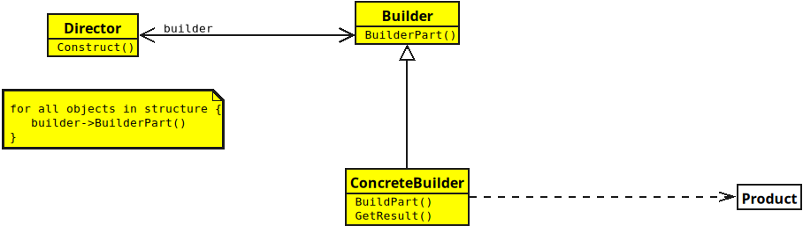
Builder Design Pattern
Notes:
(No Sound)

Slide 2
Builder Design Pattern
Notes:
(No Sound)

