Slide 1
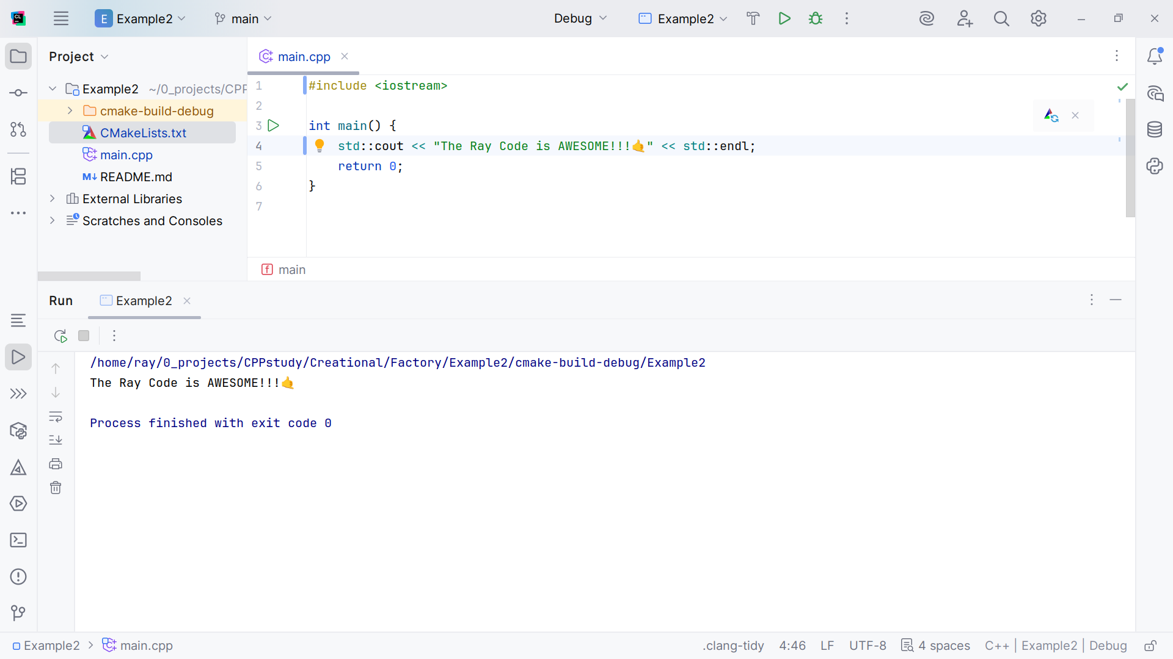
Notes:
No Sound

Slide 2
Notes:
Hello, My name is Ray, I’m the Ray in TheRayCode
Today I want to discuss the Factory design Pattern using C++

Slide 3
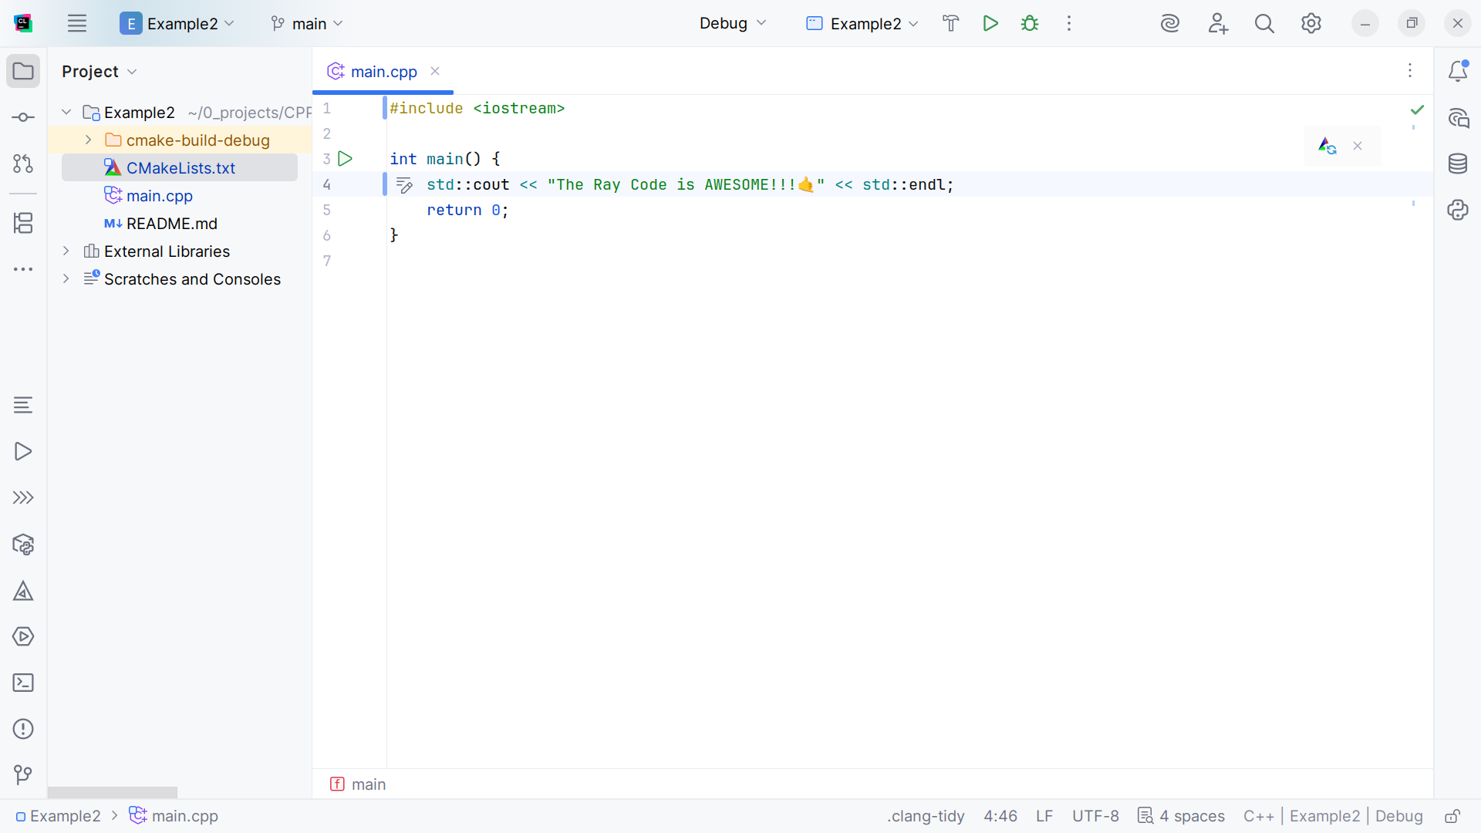
Notes:
The Factory design pattern is a Creational design pattern
In our demo I will be talking about the creation of shapes like a Circle and a Square

Slide 4
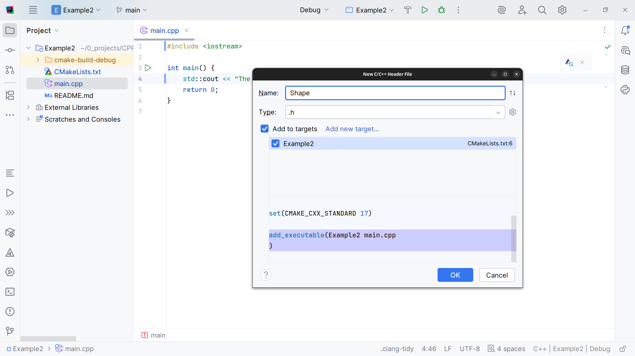
Notes:
We start with the Shape class, the Base class for shapes

Slide 5
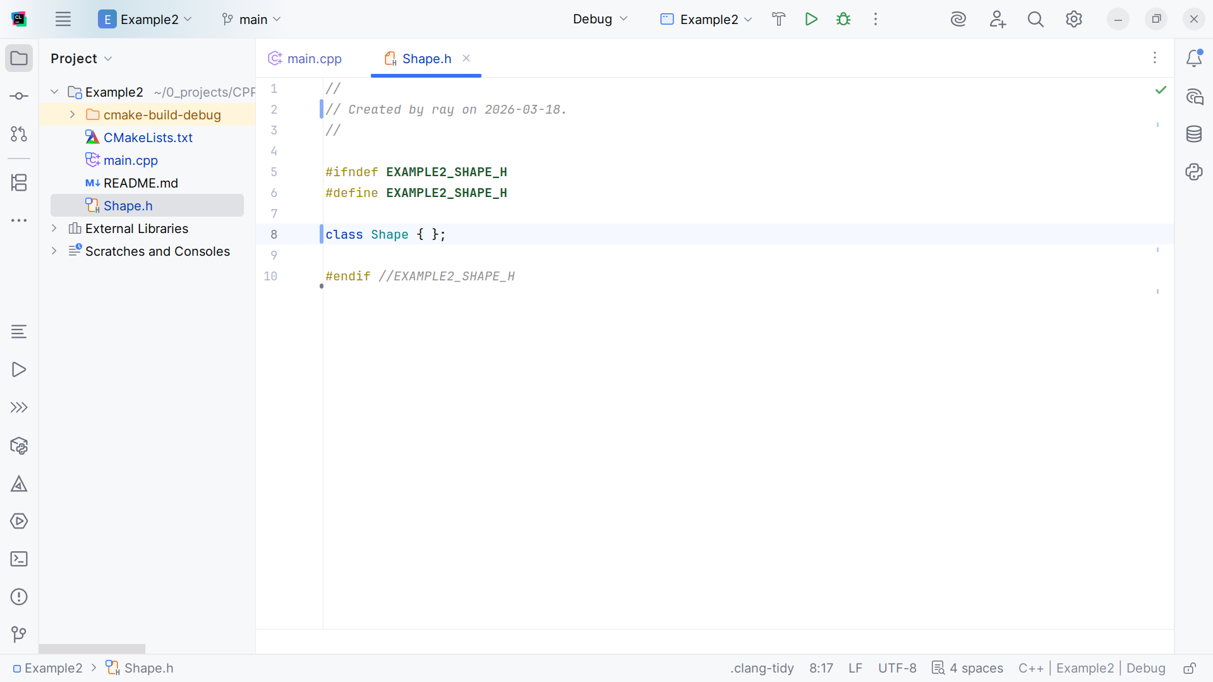
Notes:
We have the class structure

Slide 6

Notes:
And we add the iostream at the top

Slide 7
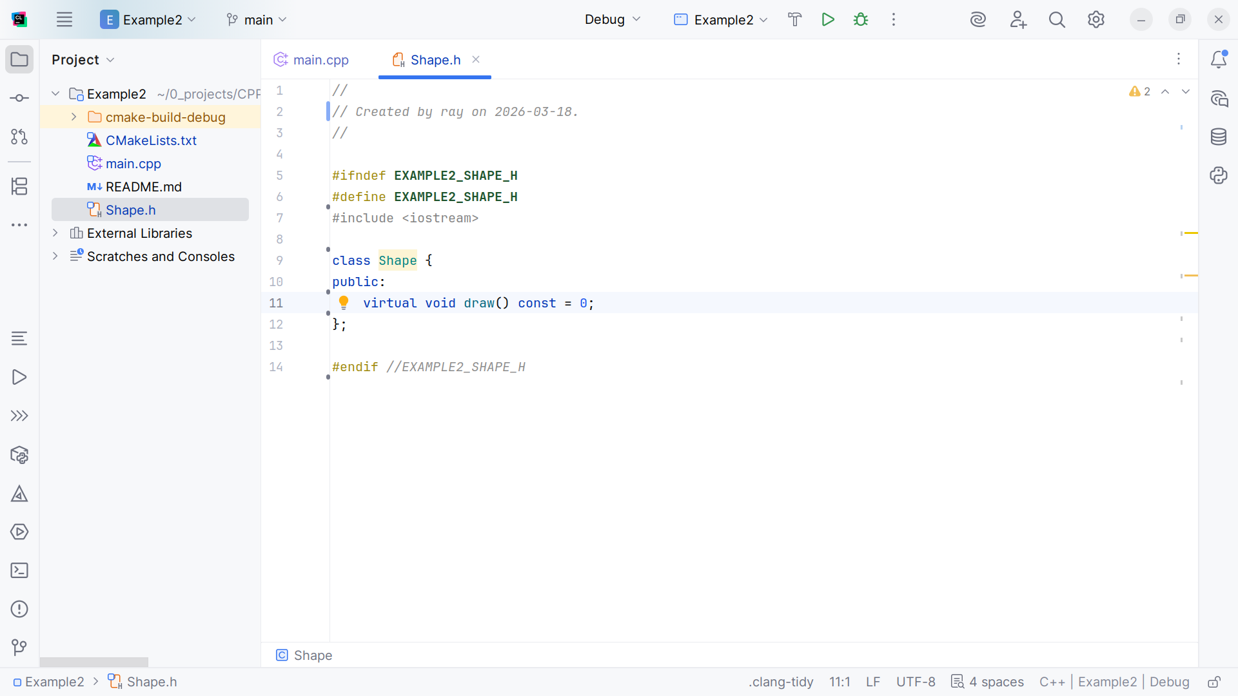
Notes:
We will create a Virtual function draw for polymorphism,

Slide 8
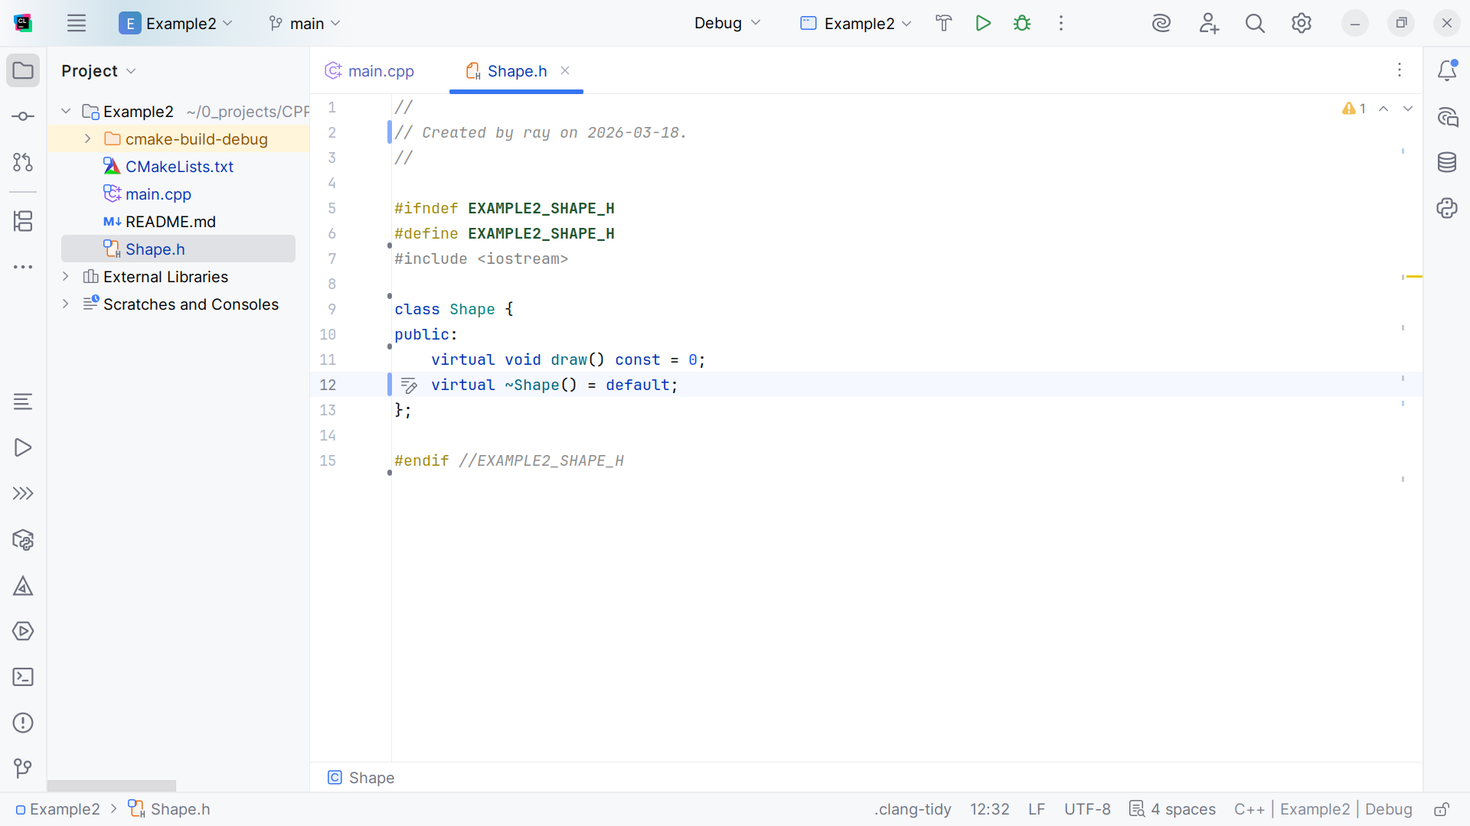
Notes:
And we do some clean up

Slide 9
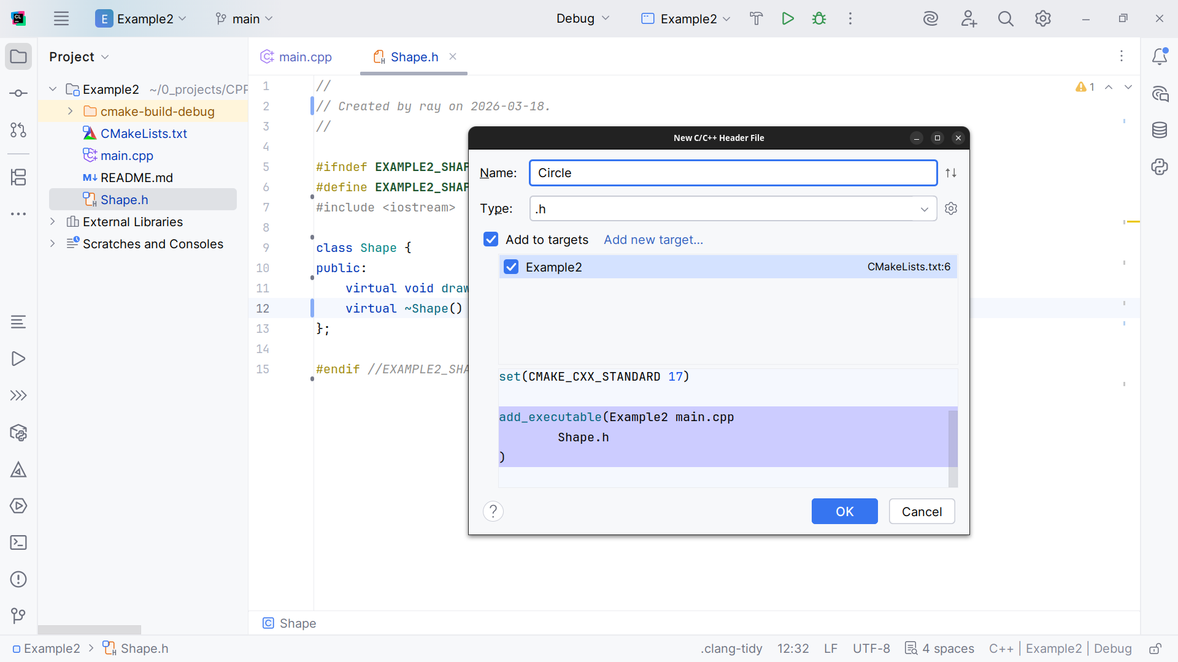
Notes:
Now we will create our shapes we start with a Circle

Slide 10
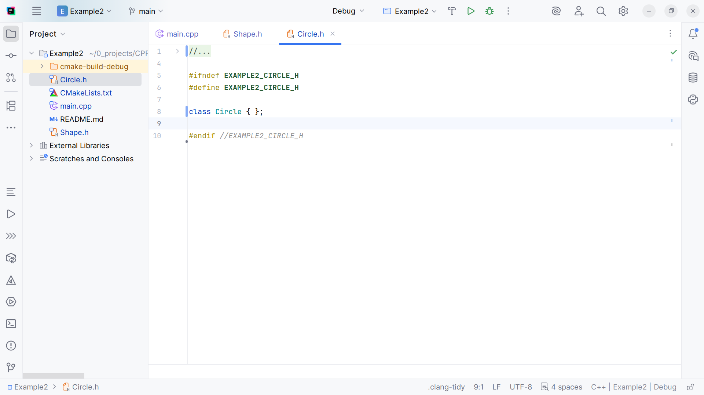
Notes:
Here we have the class structure

Slide 11
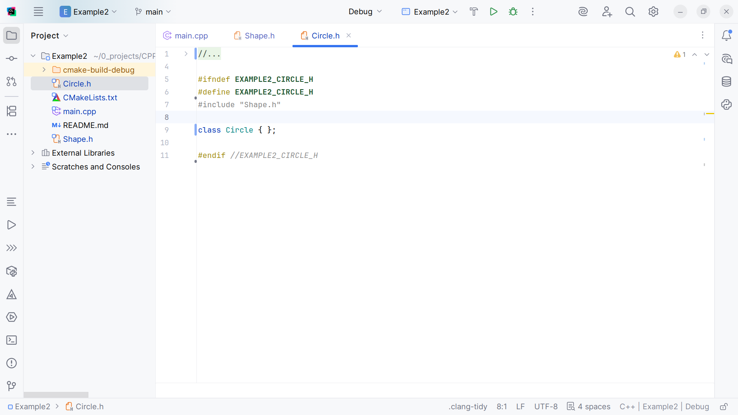
Notes:
At the top we include the Shape interface we just created

Slide 12
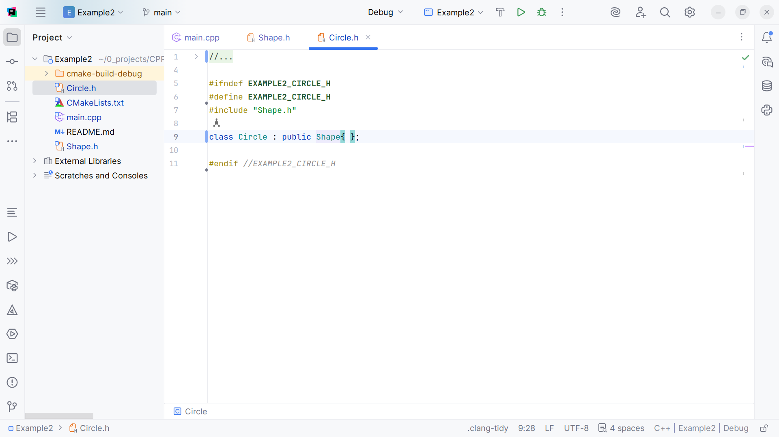
Notes:
So we can extent this class with it

Slide 13
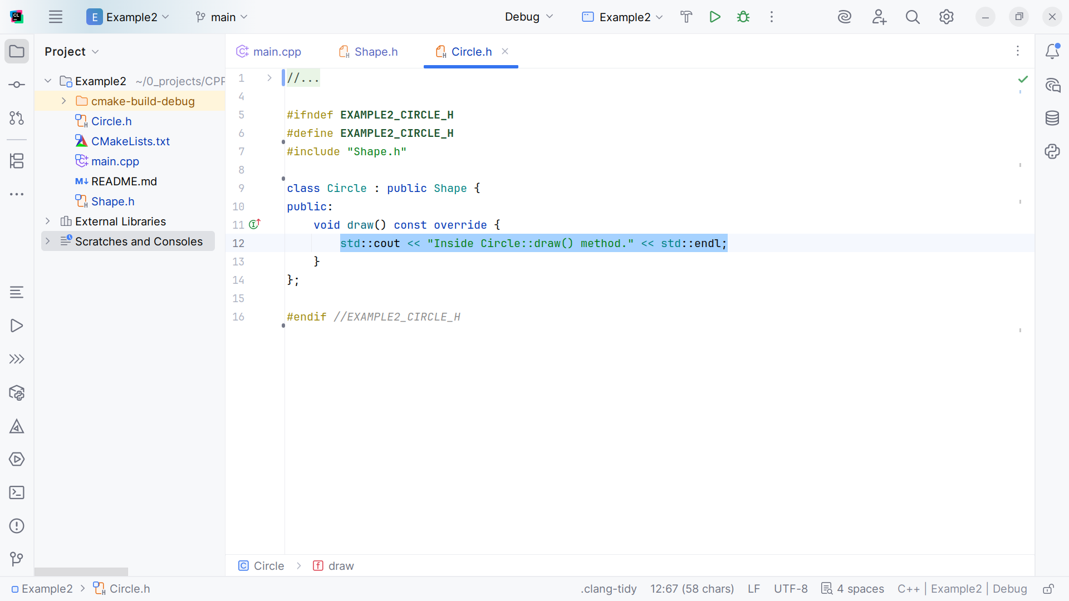
Notes:
We add a draw method that returns the sting “Inside Circle::draw() method”

Slide 14
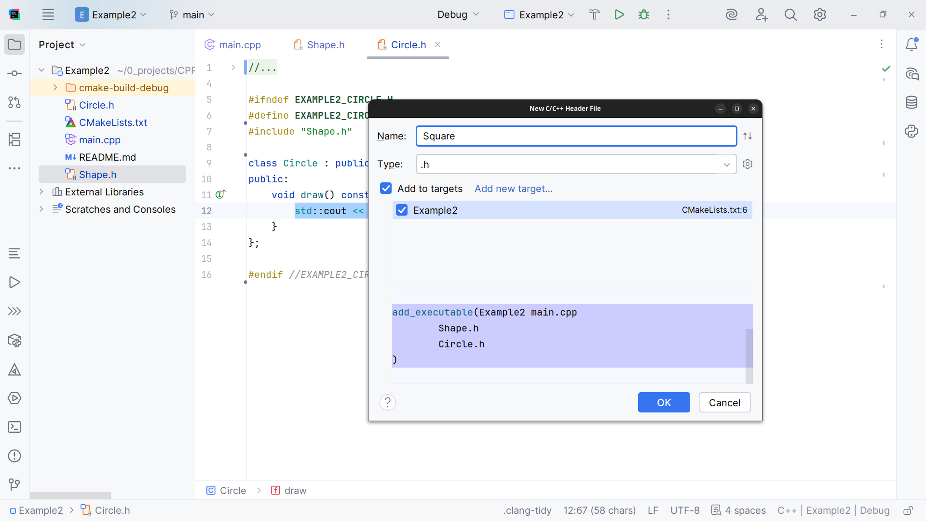
Notes:
The next shape I want to create will be the Square

Slide 15
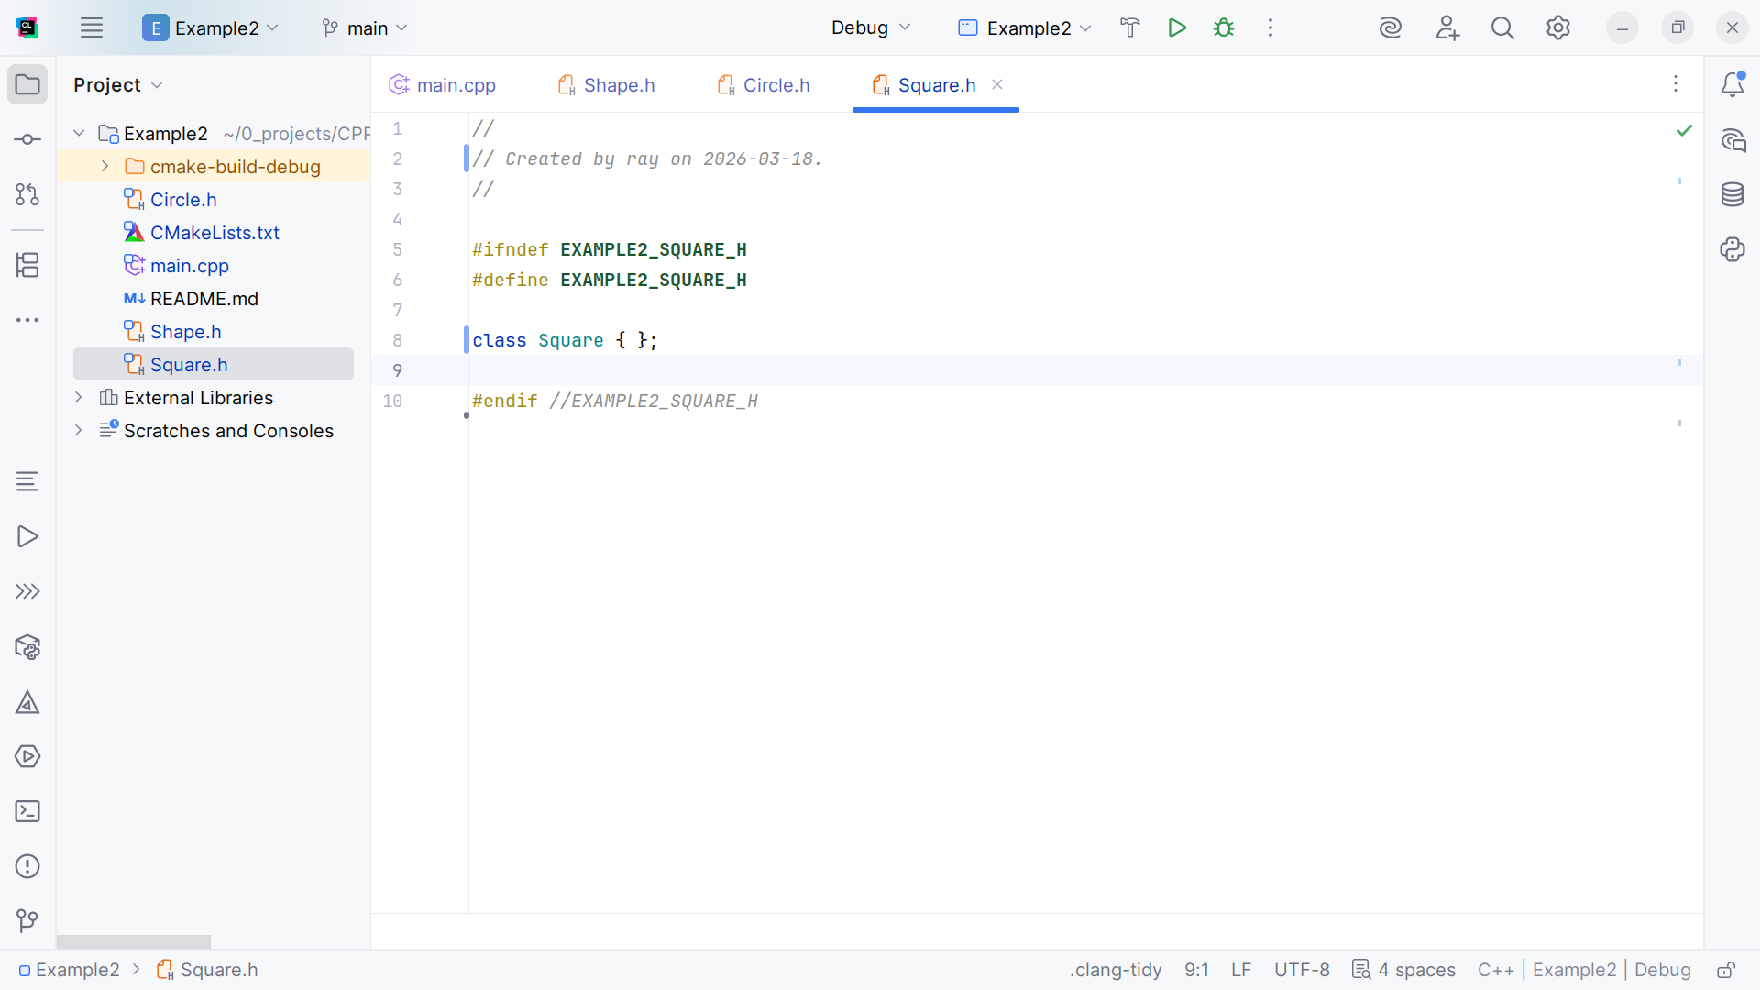
Notes:
We have the class structure

Slide 16
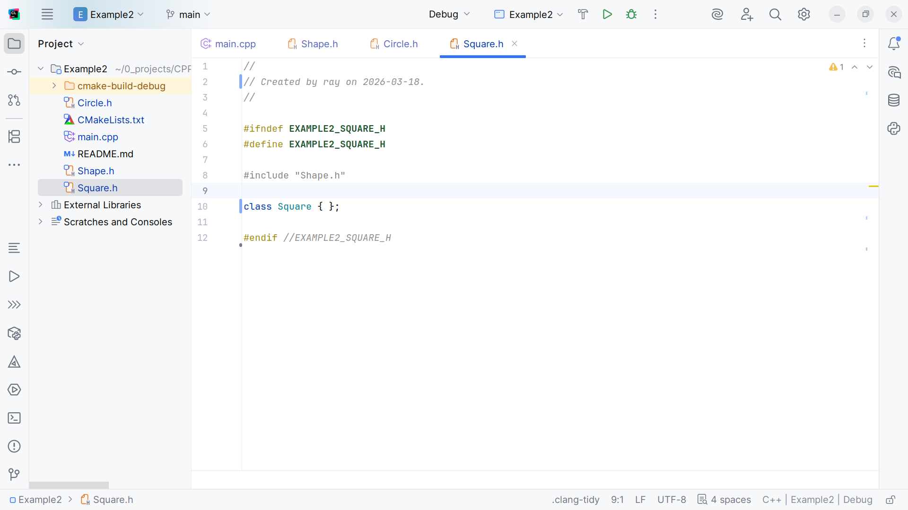
Notes:
At the top we include the Shape interface

Slide 17
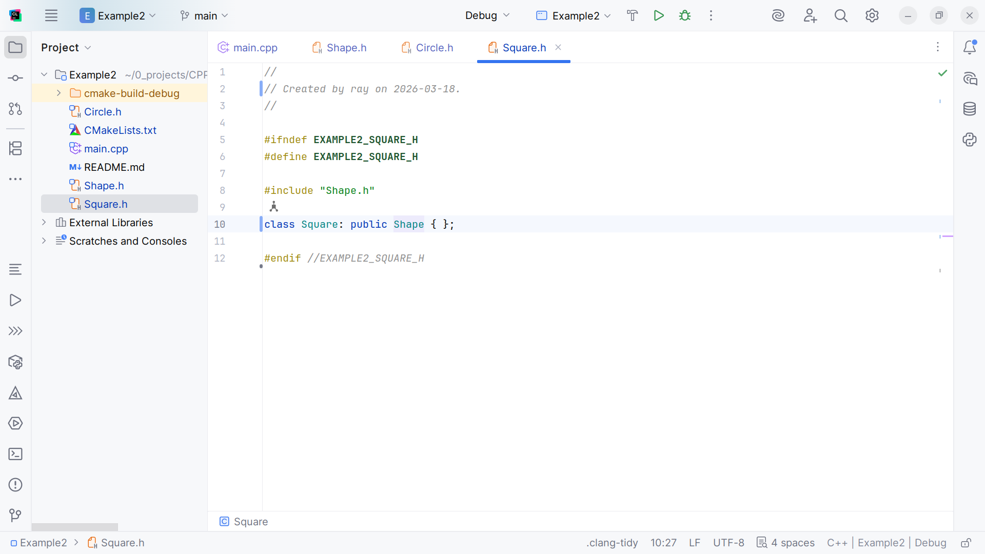
Notes:
So we can extend this class with it

Slide 18
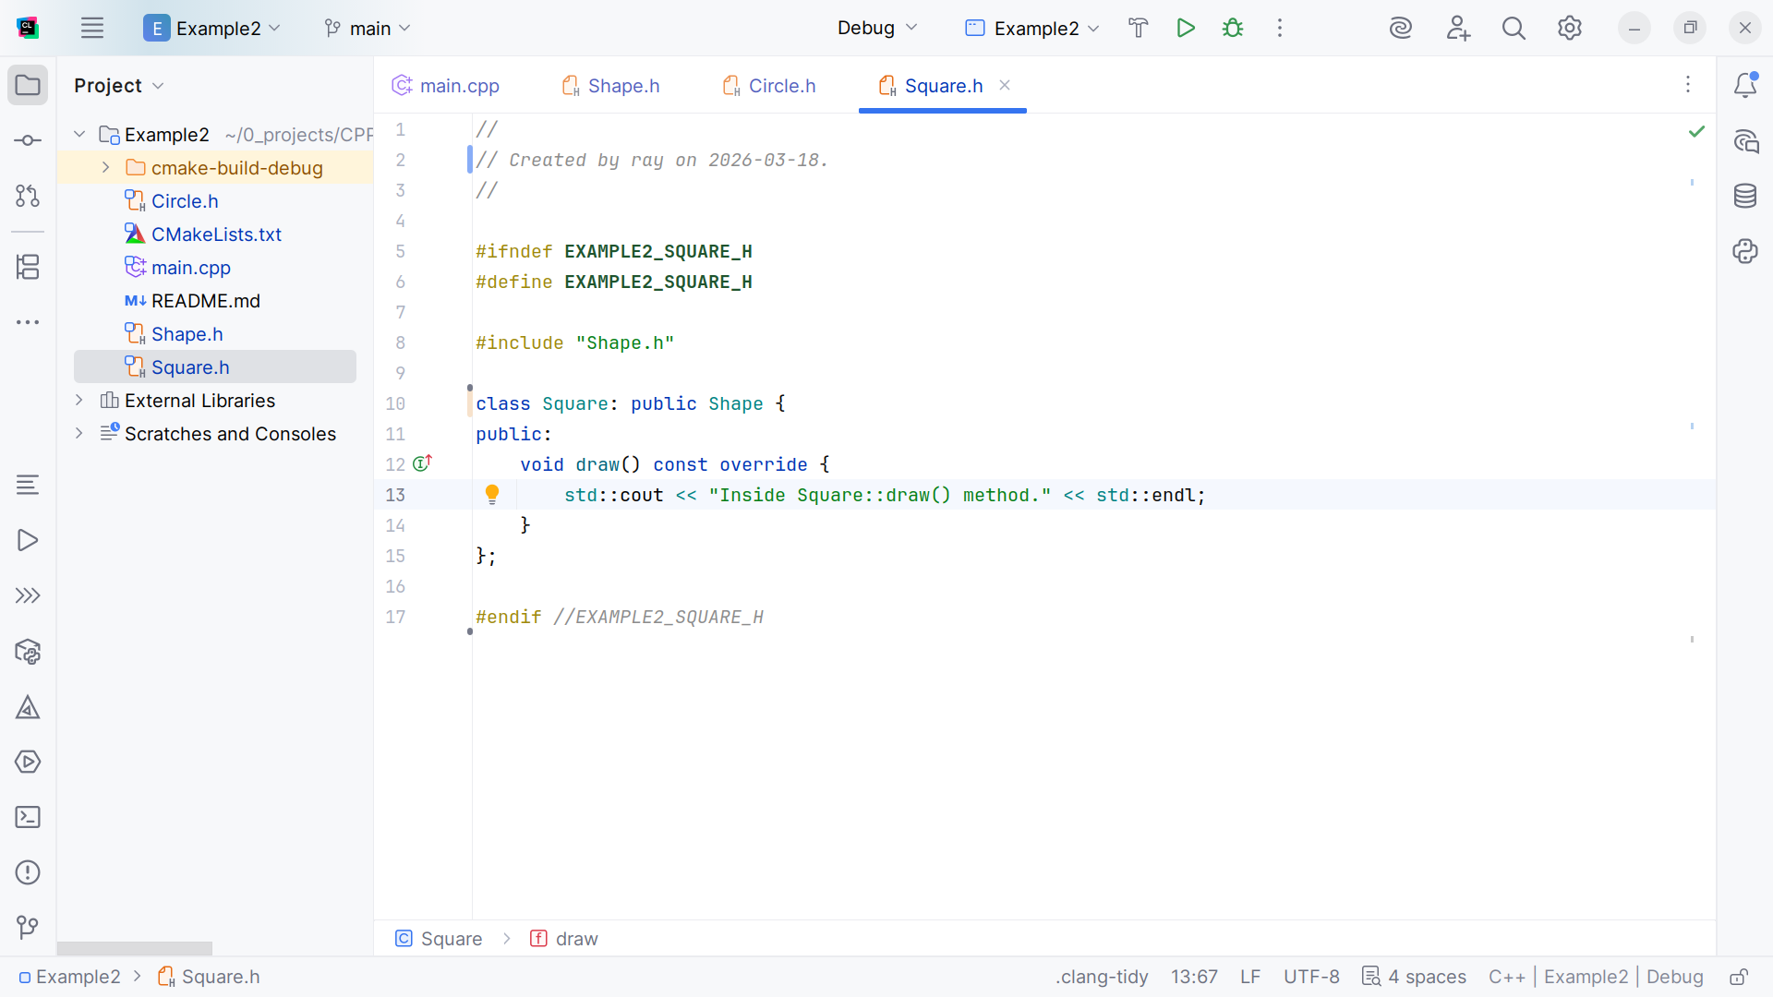
Notes:
And override the draw method to return the string: "Inside Square::draw() method."

Slide 19
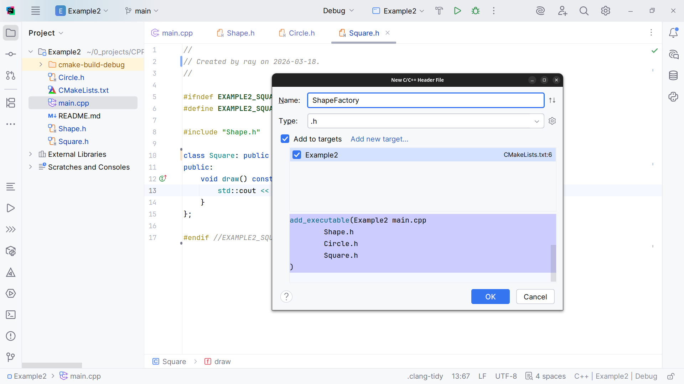
Notes:
I think we have enough shapes so now we will create a Shape Factory

Slide 20
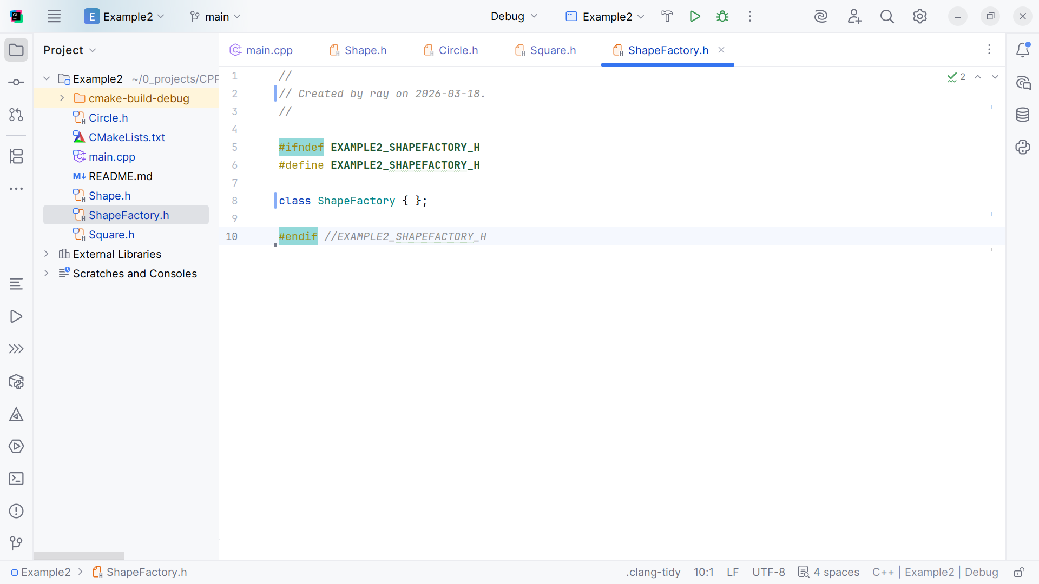
Notes:
We have the Shape Factory class structure

Slide 21
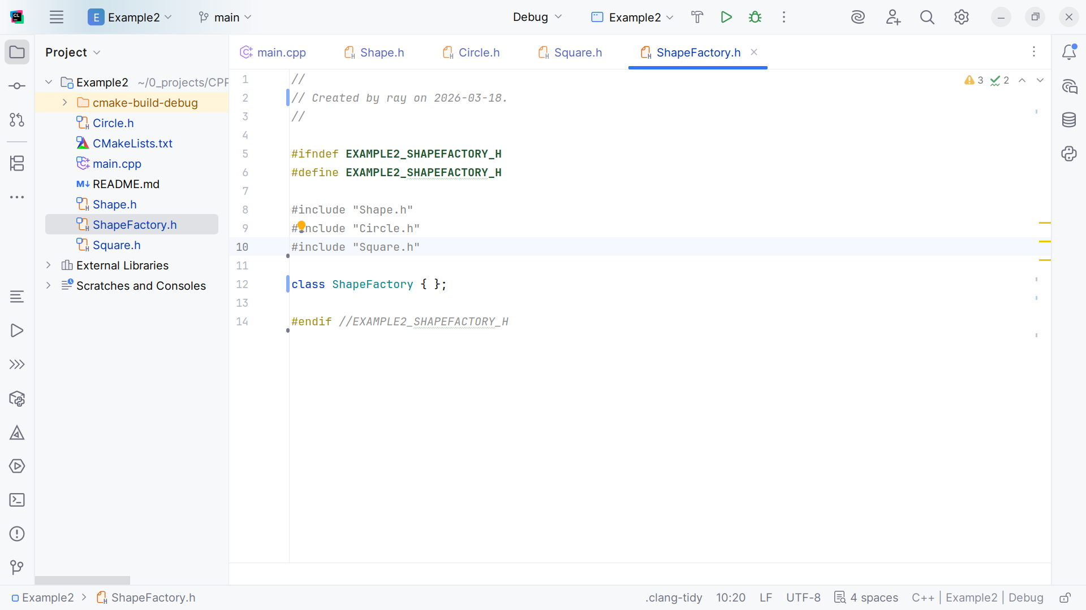
Notes:
We include Shape and the Shapes we created

Slide 22
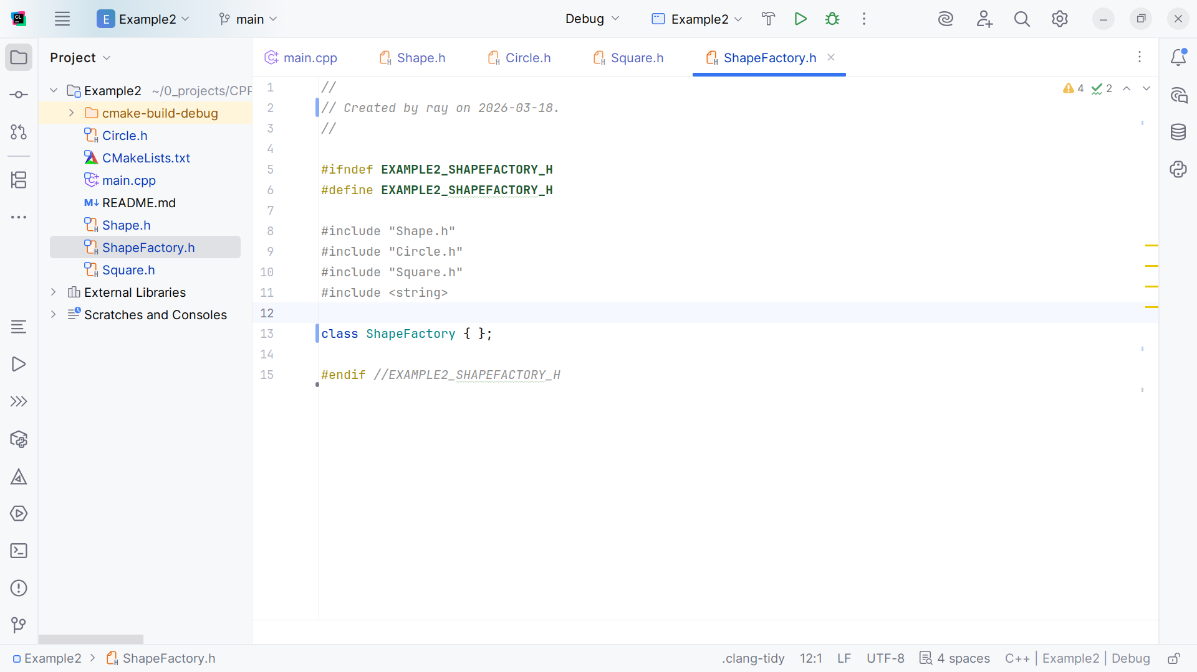
Notes:
And we add the string file so we can write out our results

Slide 23
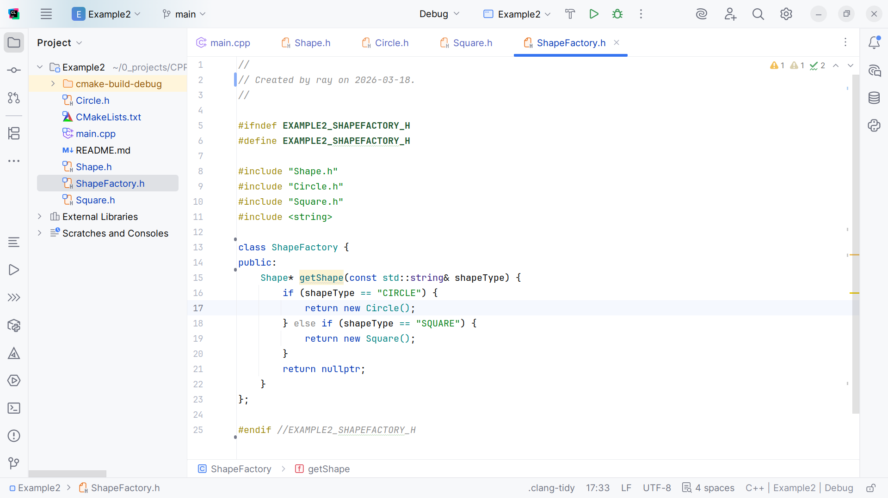
Notes:
If the shape is a CIRCLE we return a new Circle,
If the shape is a SQUARE return a new Square

Slide 24
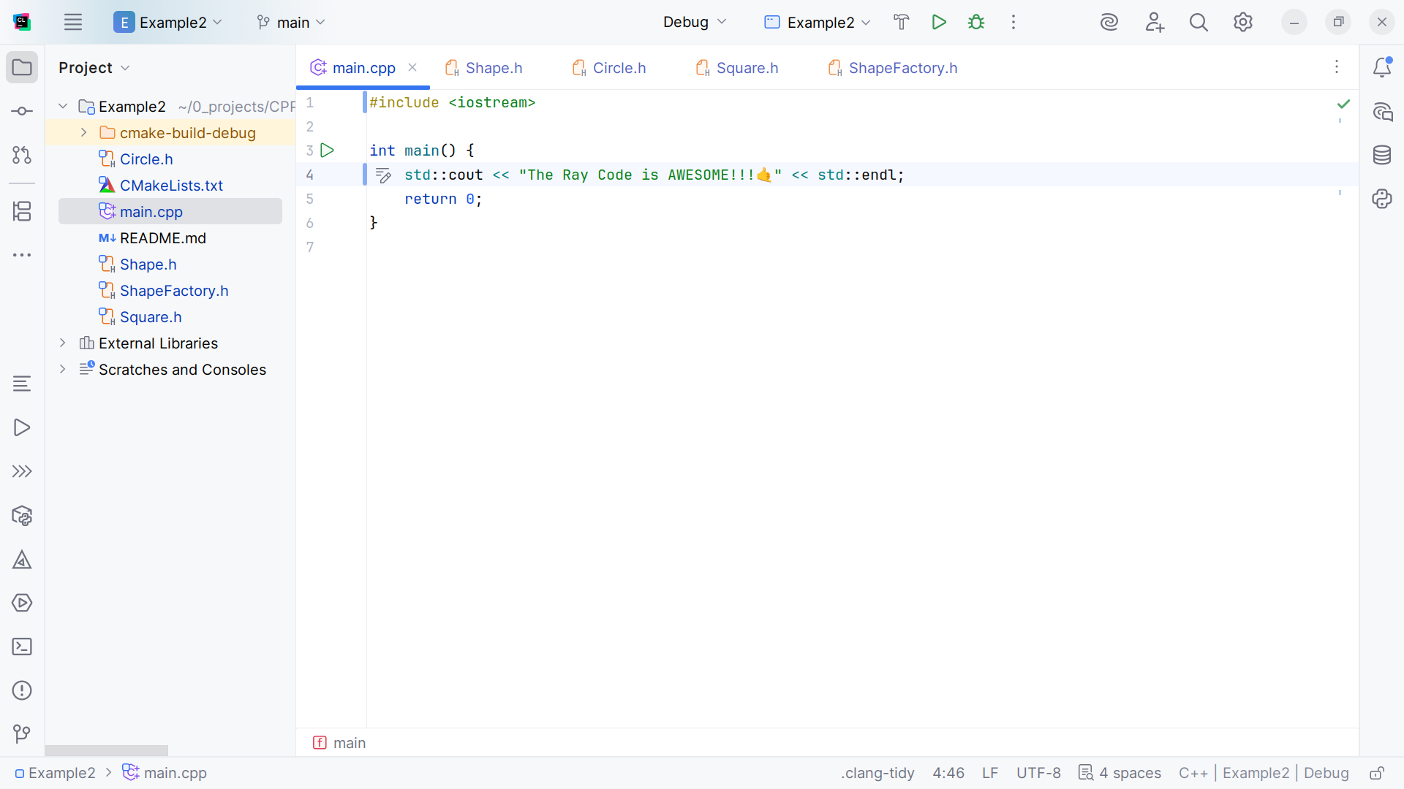
Notes:
Now let’s go to the index page for our demo

Slide 25
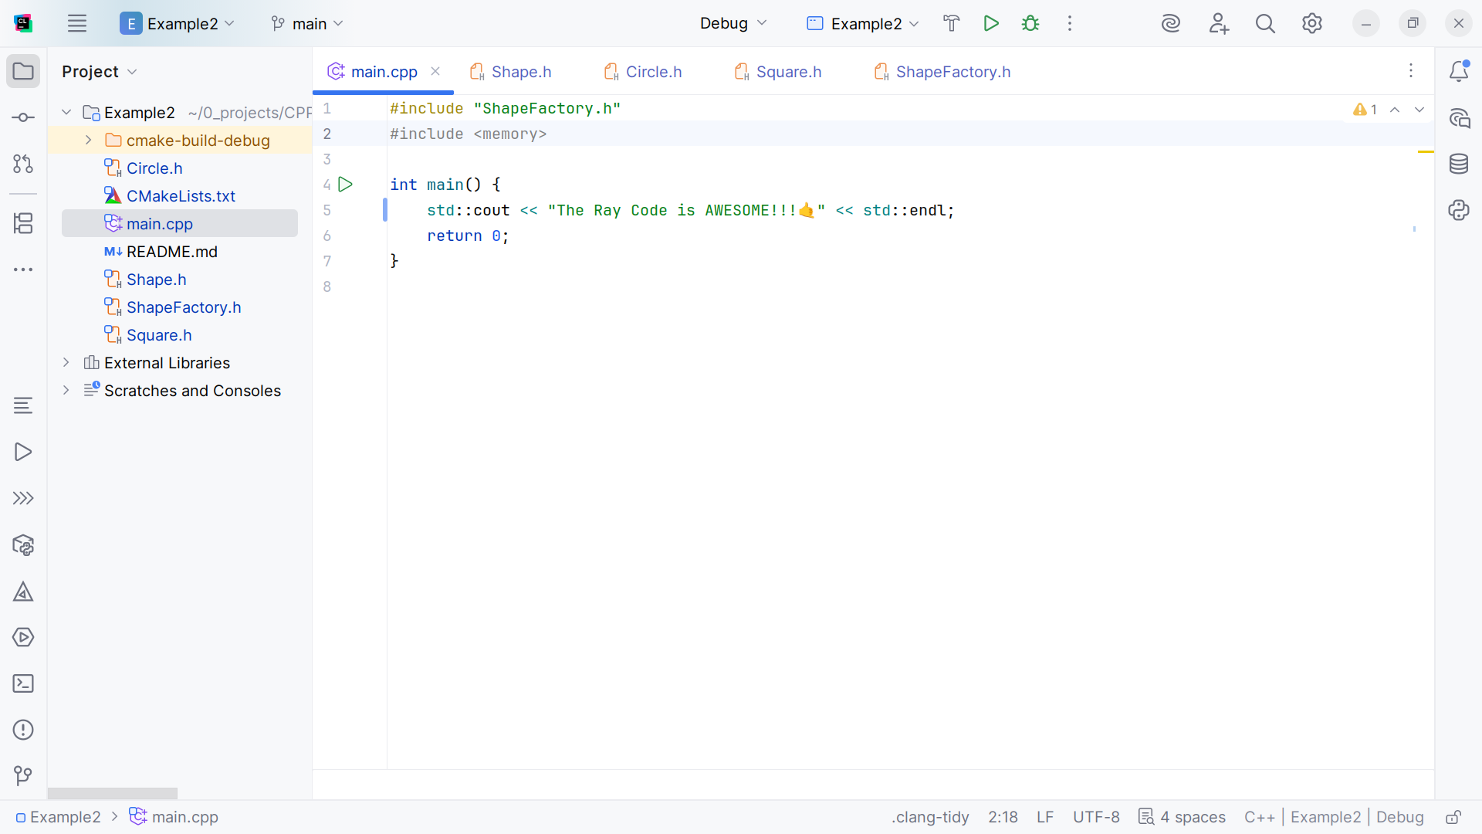
Notes:
At the top we include the Shape Factory and memory, we no longer need the IOSTREAM because we can find it the Shape Factory

Slide 26
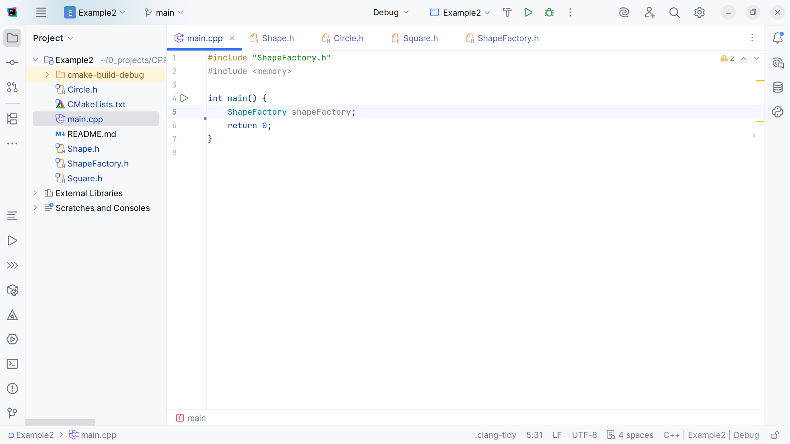
Notes:
We initiate a Shape Factory

Slide 27
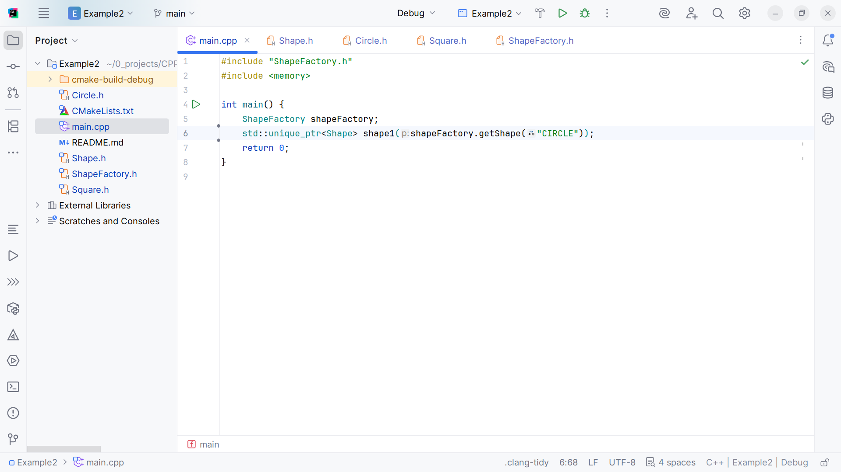
Notes:
We set shape 1 to a circle

Slide 28
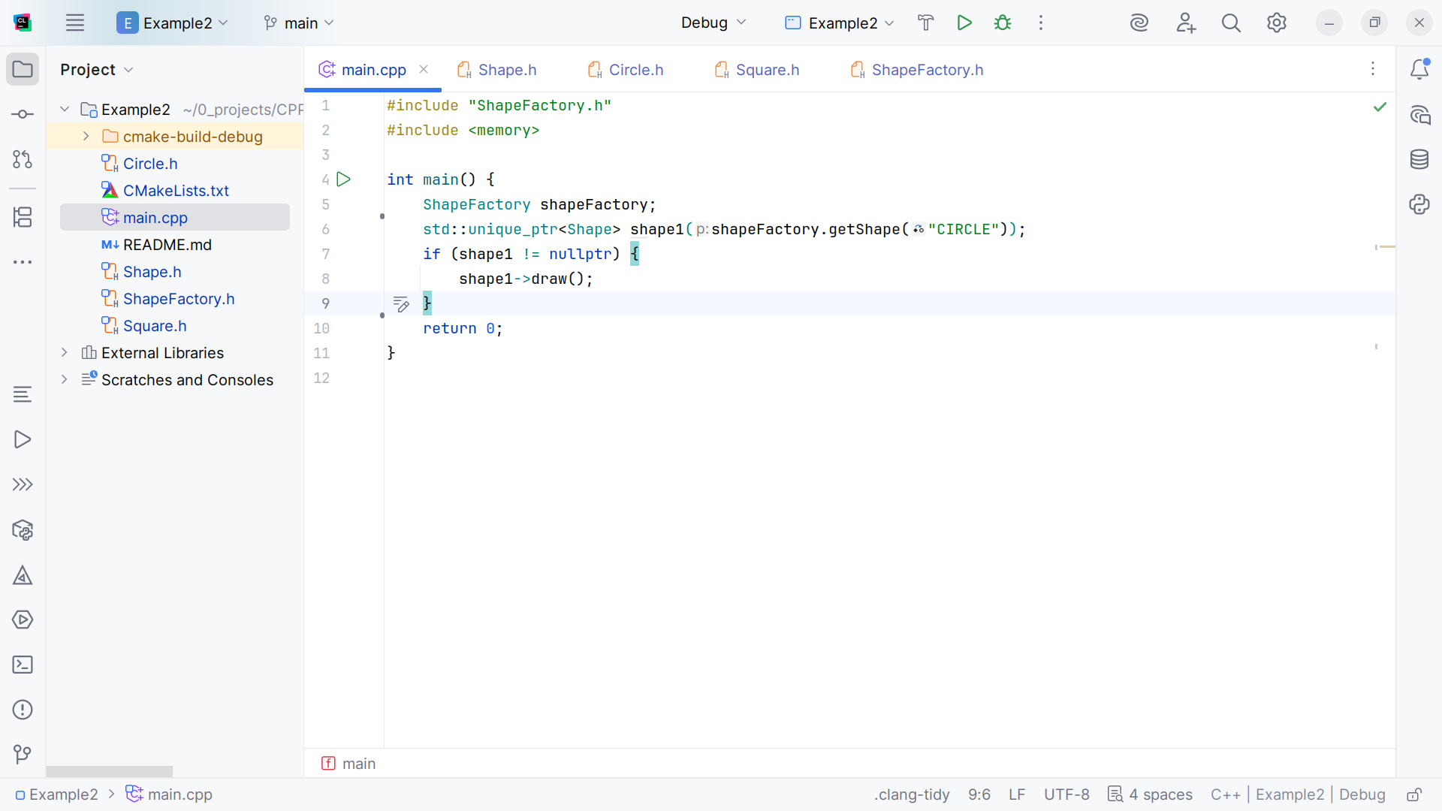
Notes:
And draw it

Slide 29
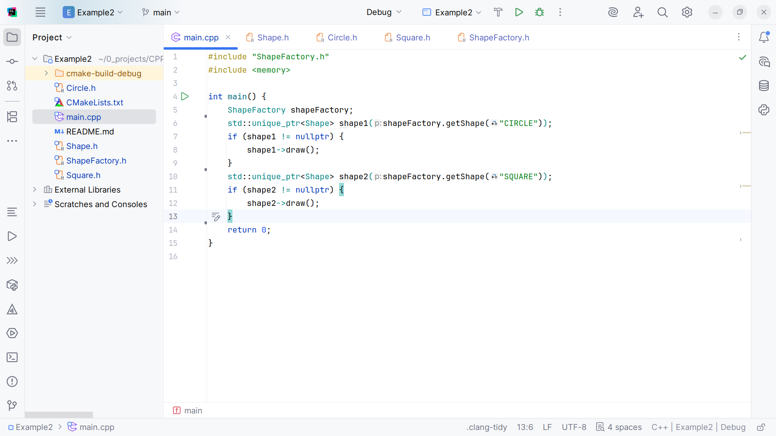
Notes:
We set shape2 a square and draw it. I think we are ready to compile and run

Slide 30
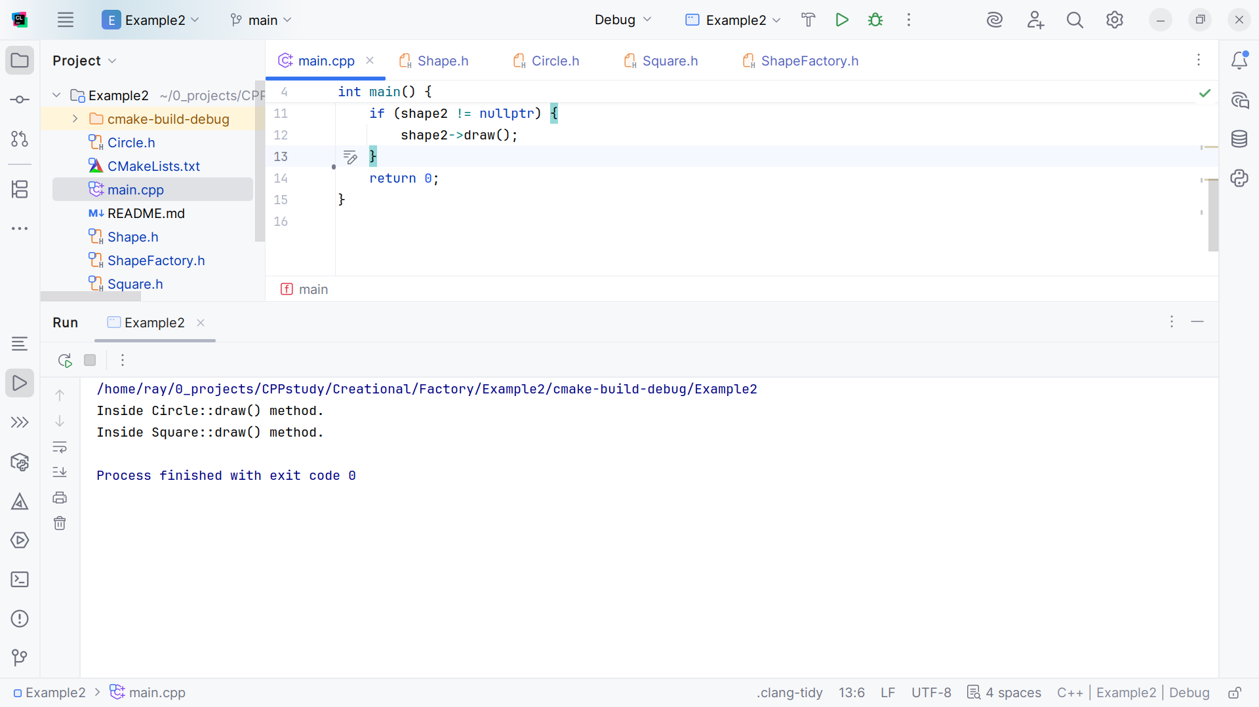
Notes:
We get inside circle draw and inside square draw
My name is Ray always code with a smile

