Slide 1

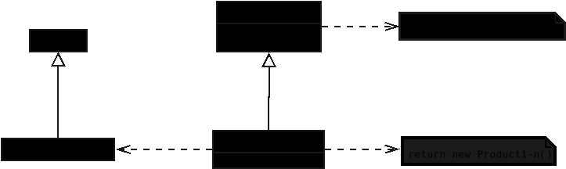

Slide 2
Notes:
Factory Method – UML Elements (C++)

Slide 3
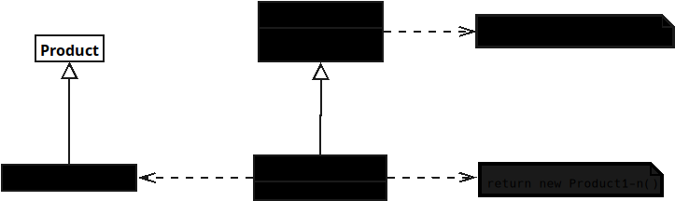
Notes:
1) Product
* **Name:** `Product`
* **Why?**
To define a **common interface** for all objects the factory will create.
* **Function:**
Declares the operations that all concrete products must implement.
Ensures the client can use products **without knowing their concrete type**.

Slide 4
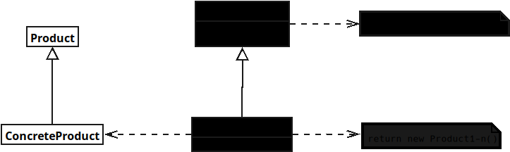
Notes:
2) ConcreteProductA / ConcreteProductB
* **Name:** `ConcreteProductA`, `ConcreteProductB`
* **Why?**
To provide **actual implementations** of the Product interface.
* **Function:**
Implements the behavior defined in `Product`.
Represents the **specific object** that gets created by a corresponding factory.

Slide 5
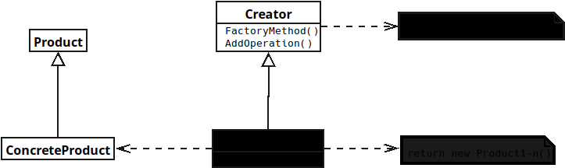
Notes:
**Name:** `Creator`
* **Why?**
To provide **actual implementations** of the Product interface.

Slide 6
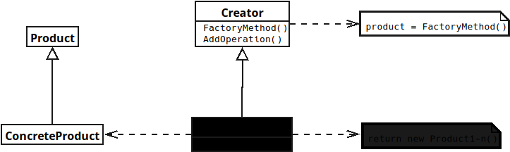
Notes:
**Function:**
Implements the behavior defined in `Product`.
Represents the **specific object** that gets created by a corresponding factory.

Slide 7
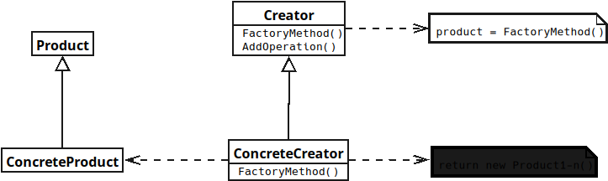
Notes:
Creator
* **Name:** `Concrete Creator`
* **Why?**
To define the **factory method contract** and centralize object creation logic.

Slide 8
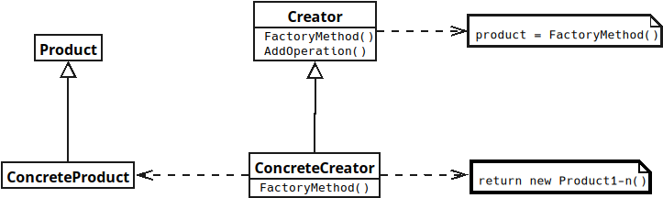
Notes:
*Function:**
* Declares `FactoryMethod()` (usually **virtual / pure virtual** in C++)
* May implement `AnOperation()` which:
* Calls `FactoryMethod()`
* Uses the returned `Product`
* Acts as the **abstraction layer between client and concrete products**

