Slide 1

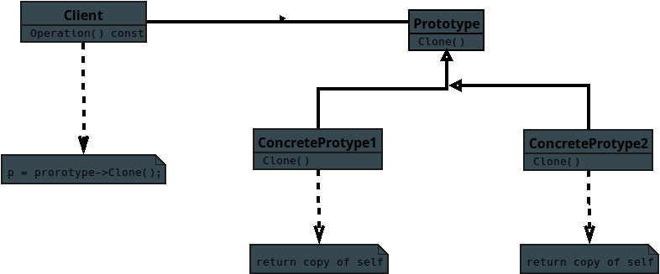
Notes:
Here is the UML diagram for the Prototype pattern a creational pattern for the C++ student

Slide 2
Notes:
Here is the UML diagram for the Prototype pattern a creational pattern for the C++ student

Slide 3
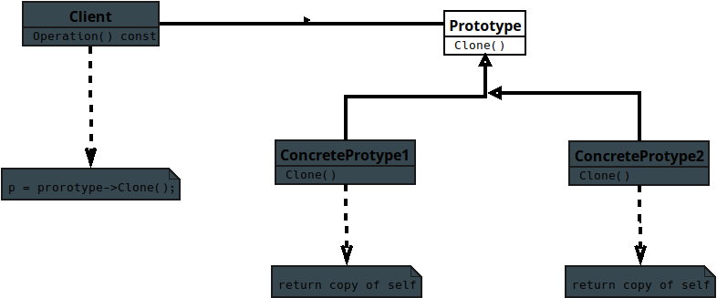
Notes:
Prototype
1. Declares a pure virtual `Clone()` method that returns a pointer to a copied object.

Slide 4
Notes:
2. Provides a common interface so all derived classes can be cloned polymorphically.

Slide 5
Notes:
3. Enables object creation without specifying the exact concrete class.

Slide 6
Notes:
4. Acts as a base class ensuring consistent cloning behavior across all prototypes.

Slide 7
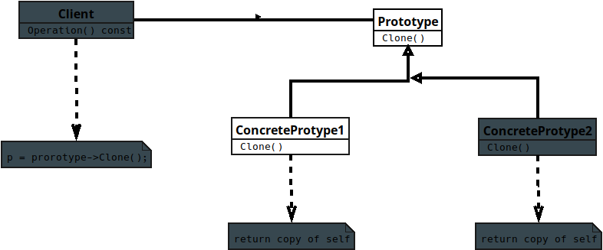
Notes:
Concrete Prototype
1. Implements the `Clone()` method to return a copy of itself using its copy constructor or custom logic.

Slide 8
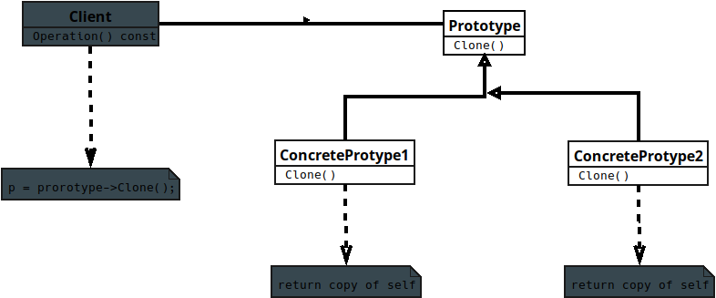
Notes:
2. Ensures the correct concrete type is preserved when cloning (no slicing).

Slide 9
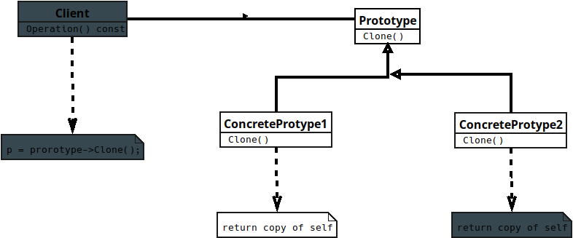
Notes:
3. Handles deep or shallow copying depending on internal resource ownership (e.g., pointers).

Slide 10
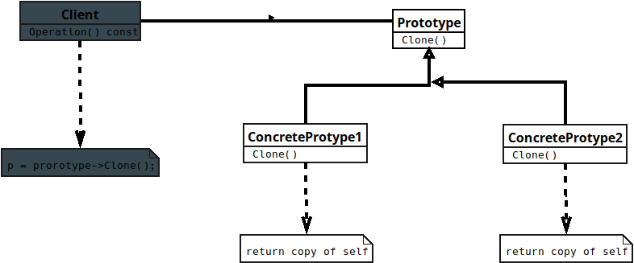
Notes:
4. Encapsulates the details of object duplication, including memory allocation.

Slide 11
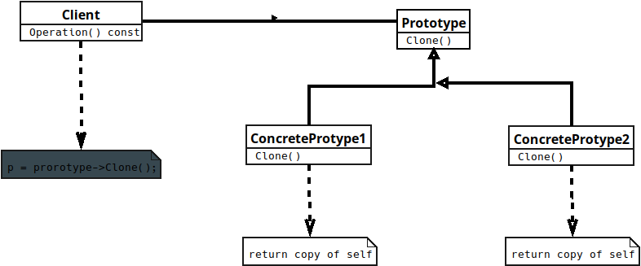
Notes:
Client
1. Creates new objects by calling `Clone()` on a prototype instance.

Slide 12
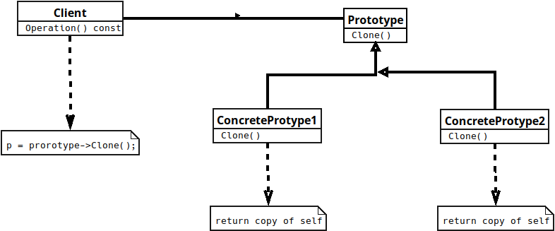
Notes:
2. Interacts only with the `Prototype` interface, not concrete classes.
3. Avoids direct instantiation using `new Concrete Class`, reducing coupling.
4. Relies on polymorphism to generate objects dynamically at runtime.

