Slide 1
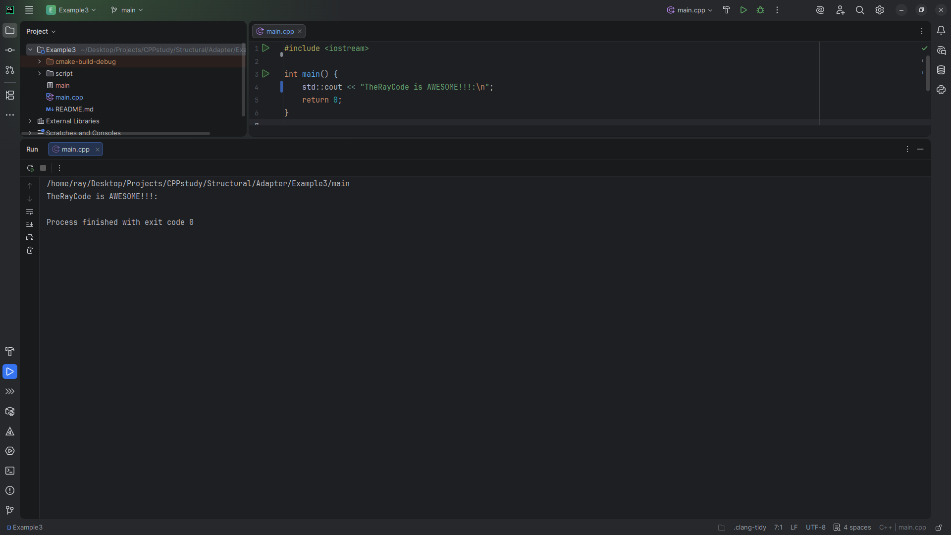
Notes:
No sound

Slide 2
Notes:
Hello my name is Ray I’m the Ray in TheRayCode

Slide 3
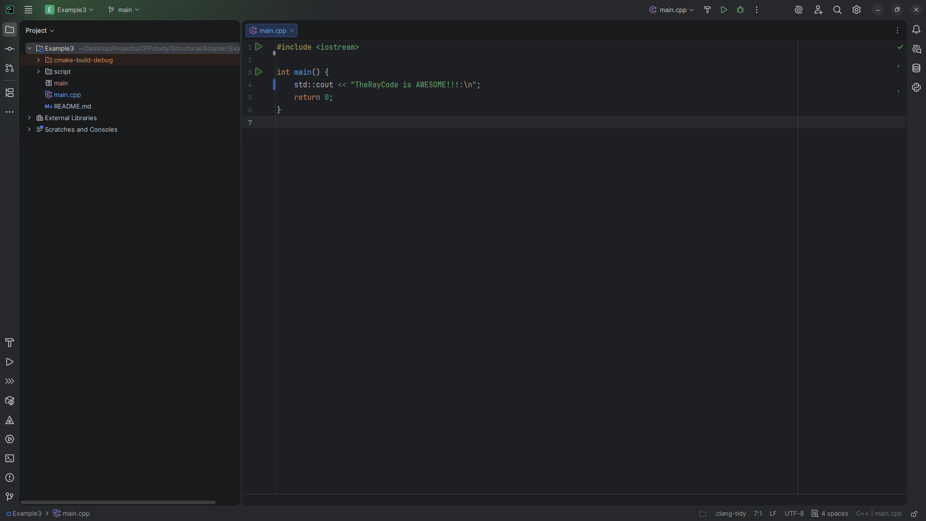
Notes:
In this video I plan to give an example of the Adapter design pattern which is a Structural design pattern

Slide 4
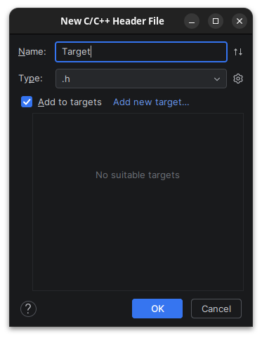
Notes:
We start with a class we call Target

Slide 5
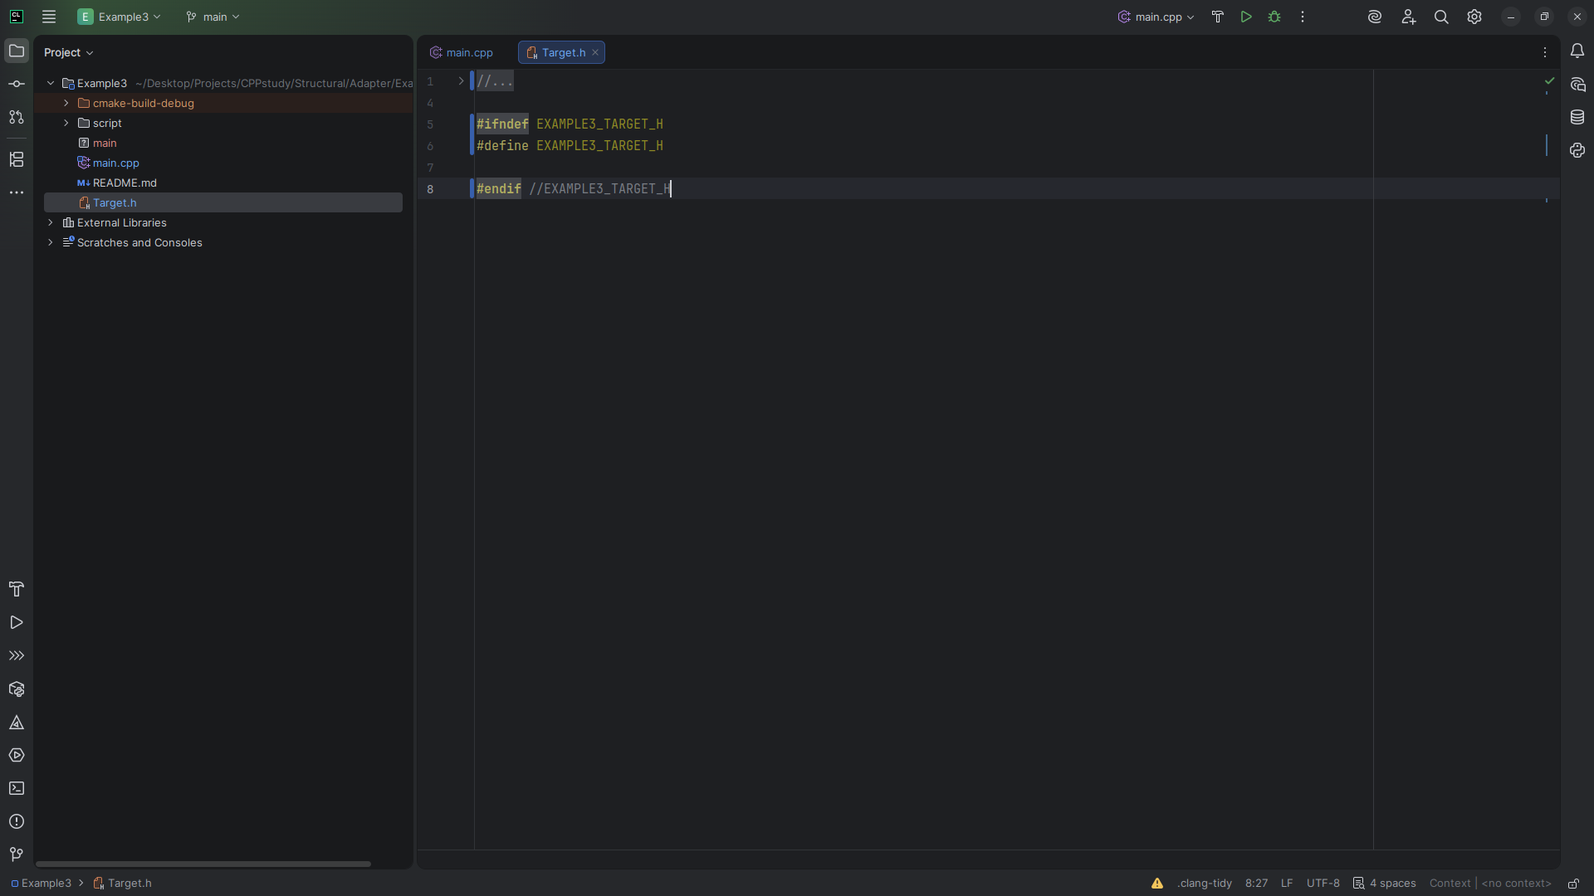
Notes:
The Target class provides an interface in which the Request method clients can utilize.
Here, Request simply returns a default message.

Slide 6
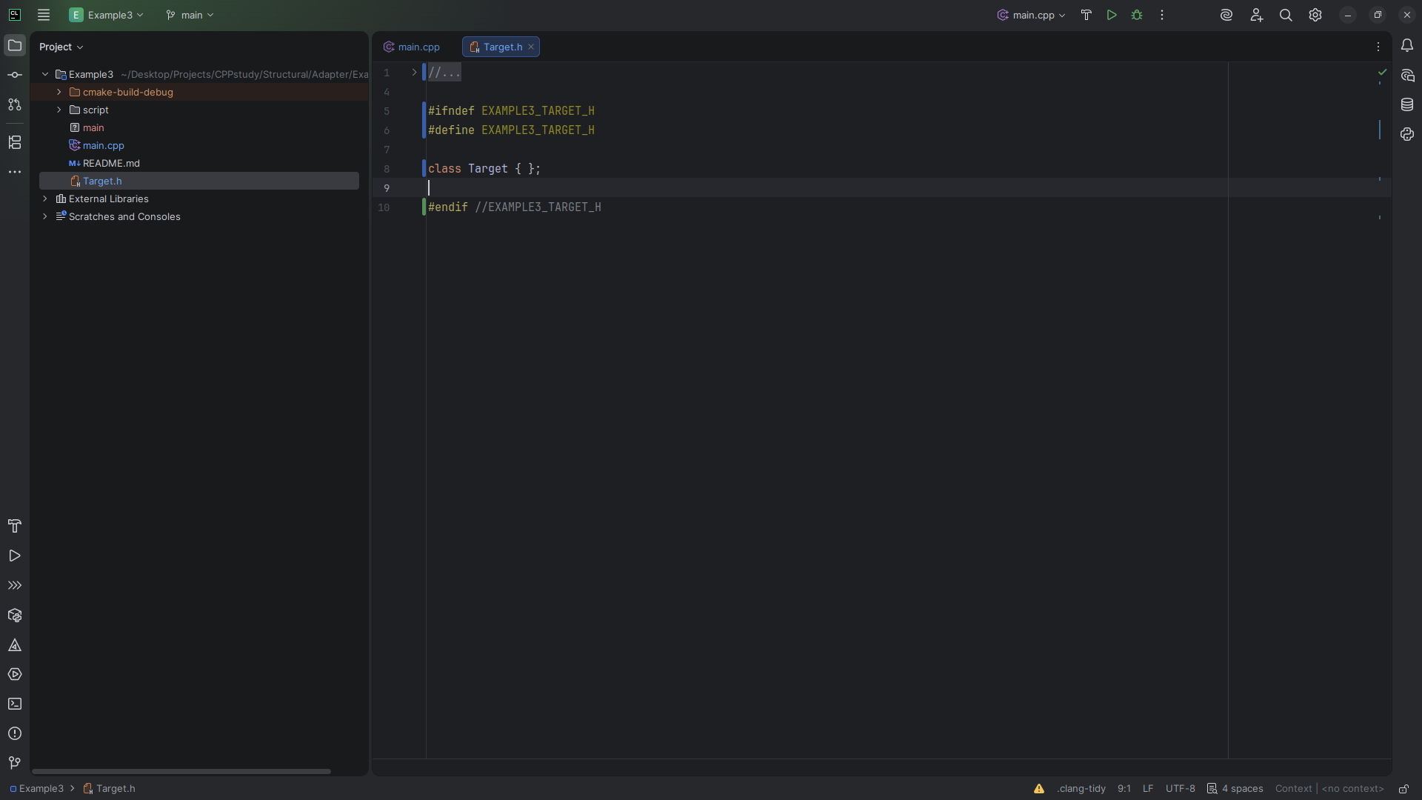
Notes:
We start with the class structure

Slide 7
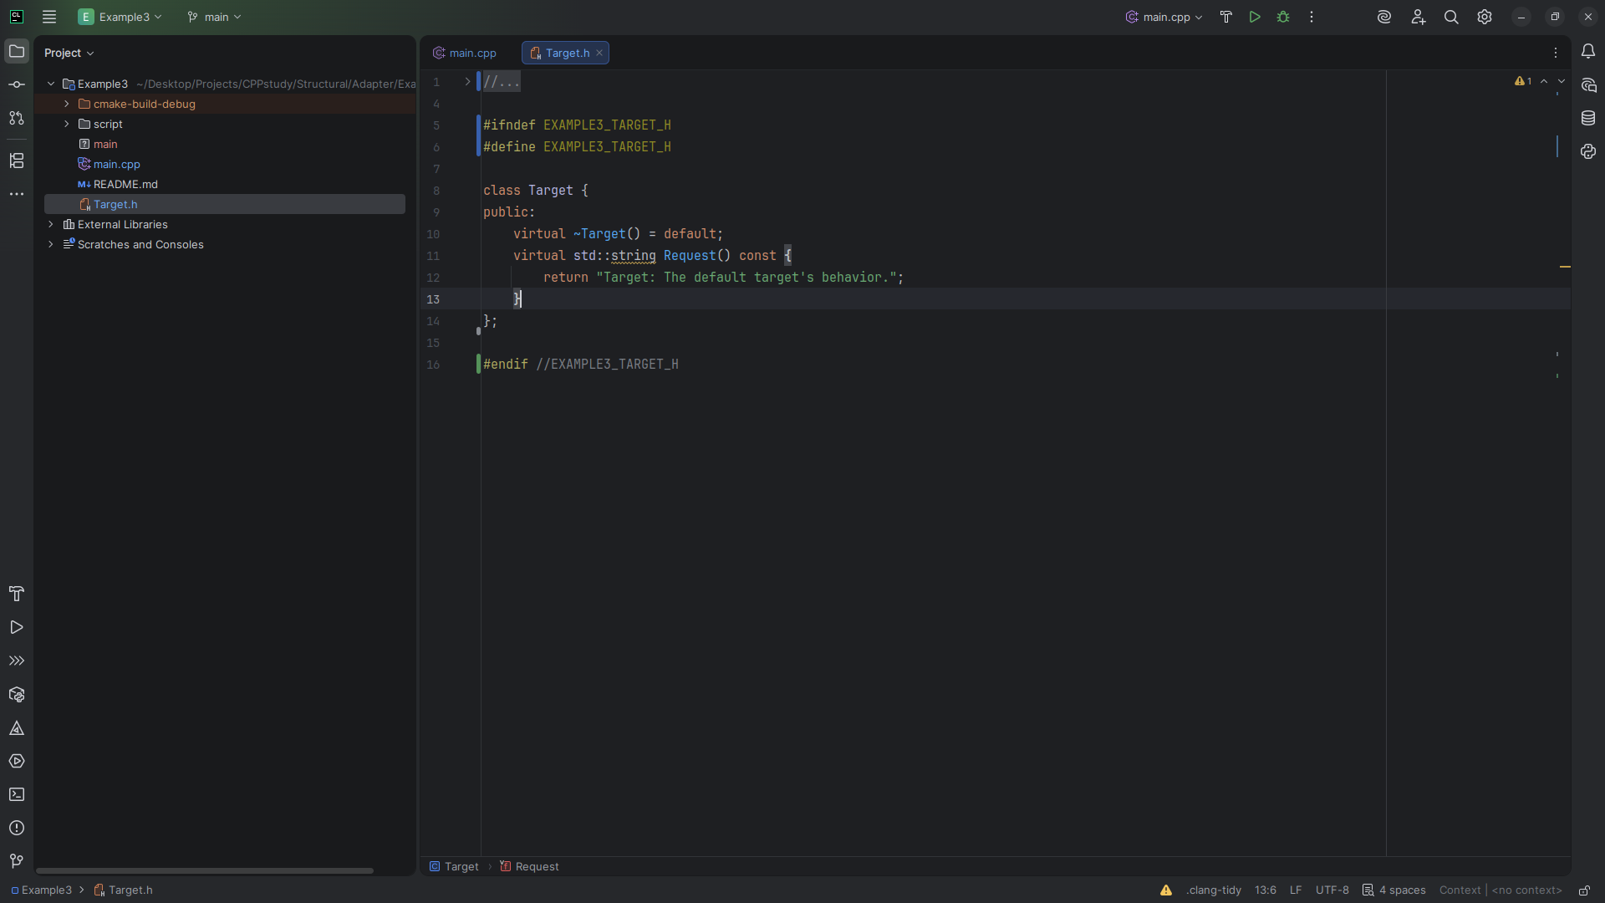
Notes:
Here, Request simply returns a default message.

Slide 8
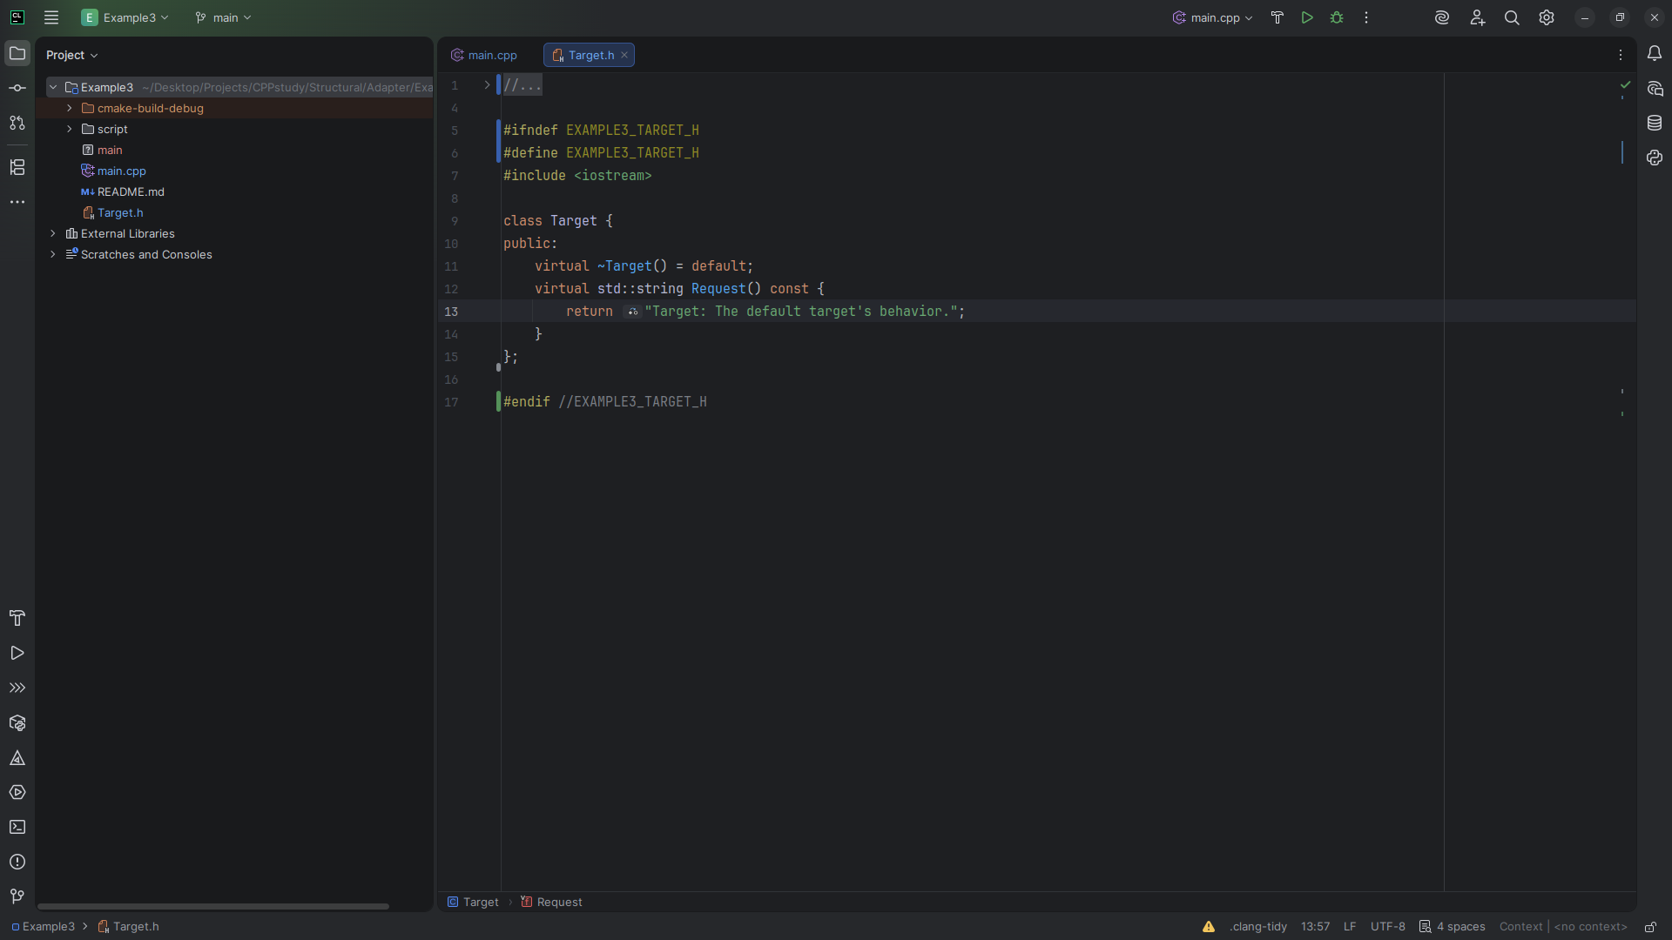
Notes:
At the to I need to include the io stream

Slide 9
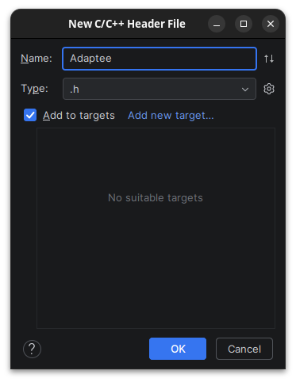
Notes:
Let’s create another class we call Adaptee

Slide 10
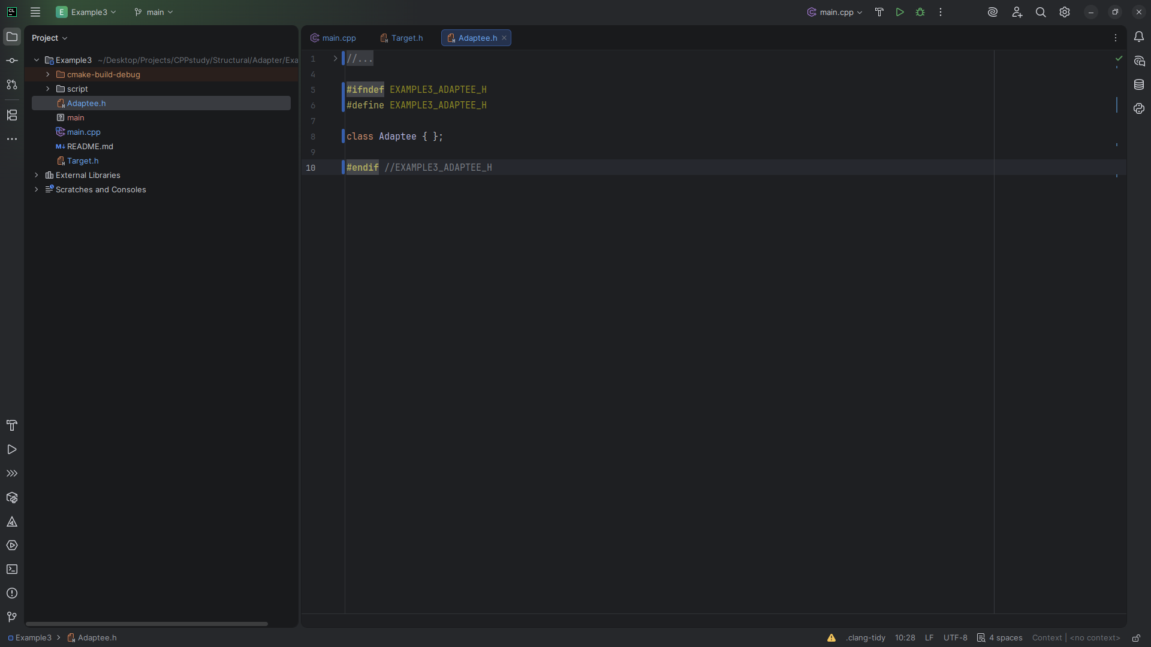
Notes:
The Adaptee class is one that has a different interface (SpecificRequest) than what clients might expect based on the Target class.

Slide 11
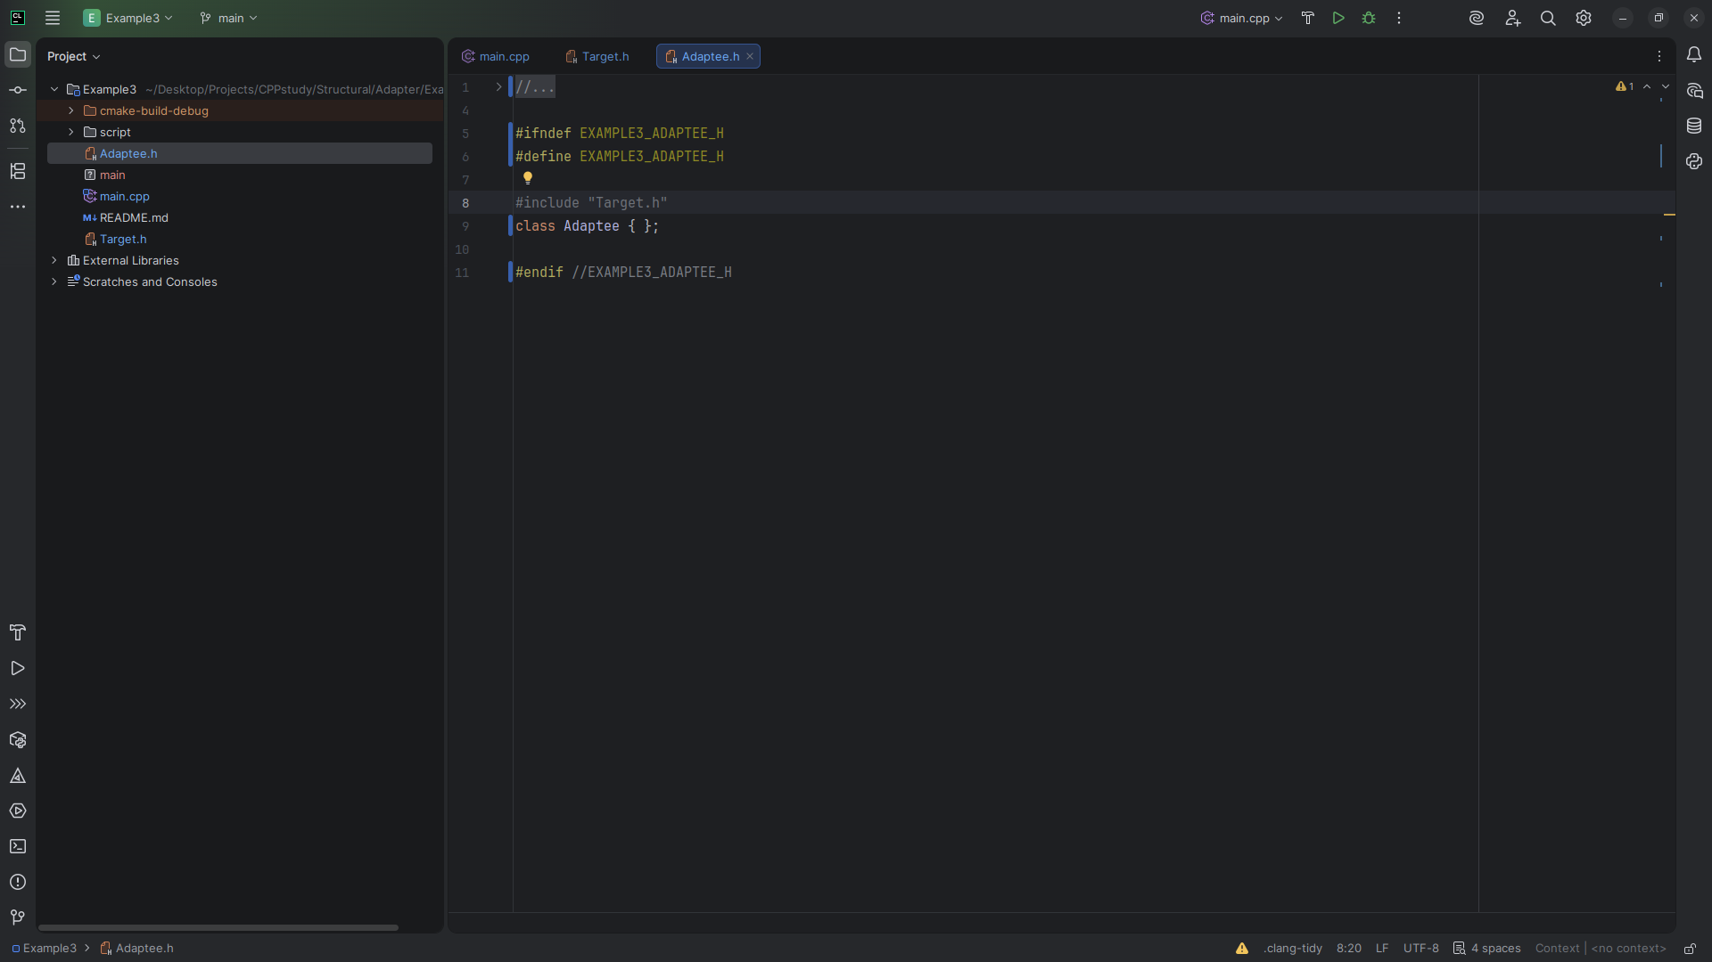
Notes:
We include Target at the top
This is a class you might need to adapt in order to make it work seamlessly with existing or new code.

Slide 12
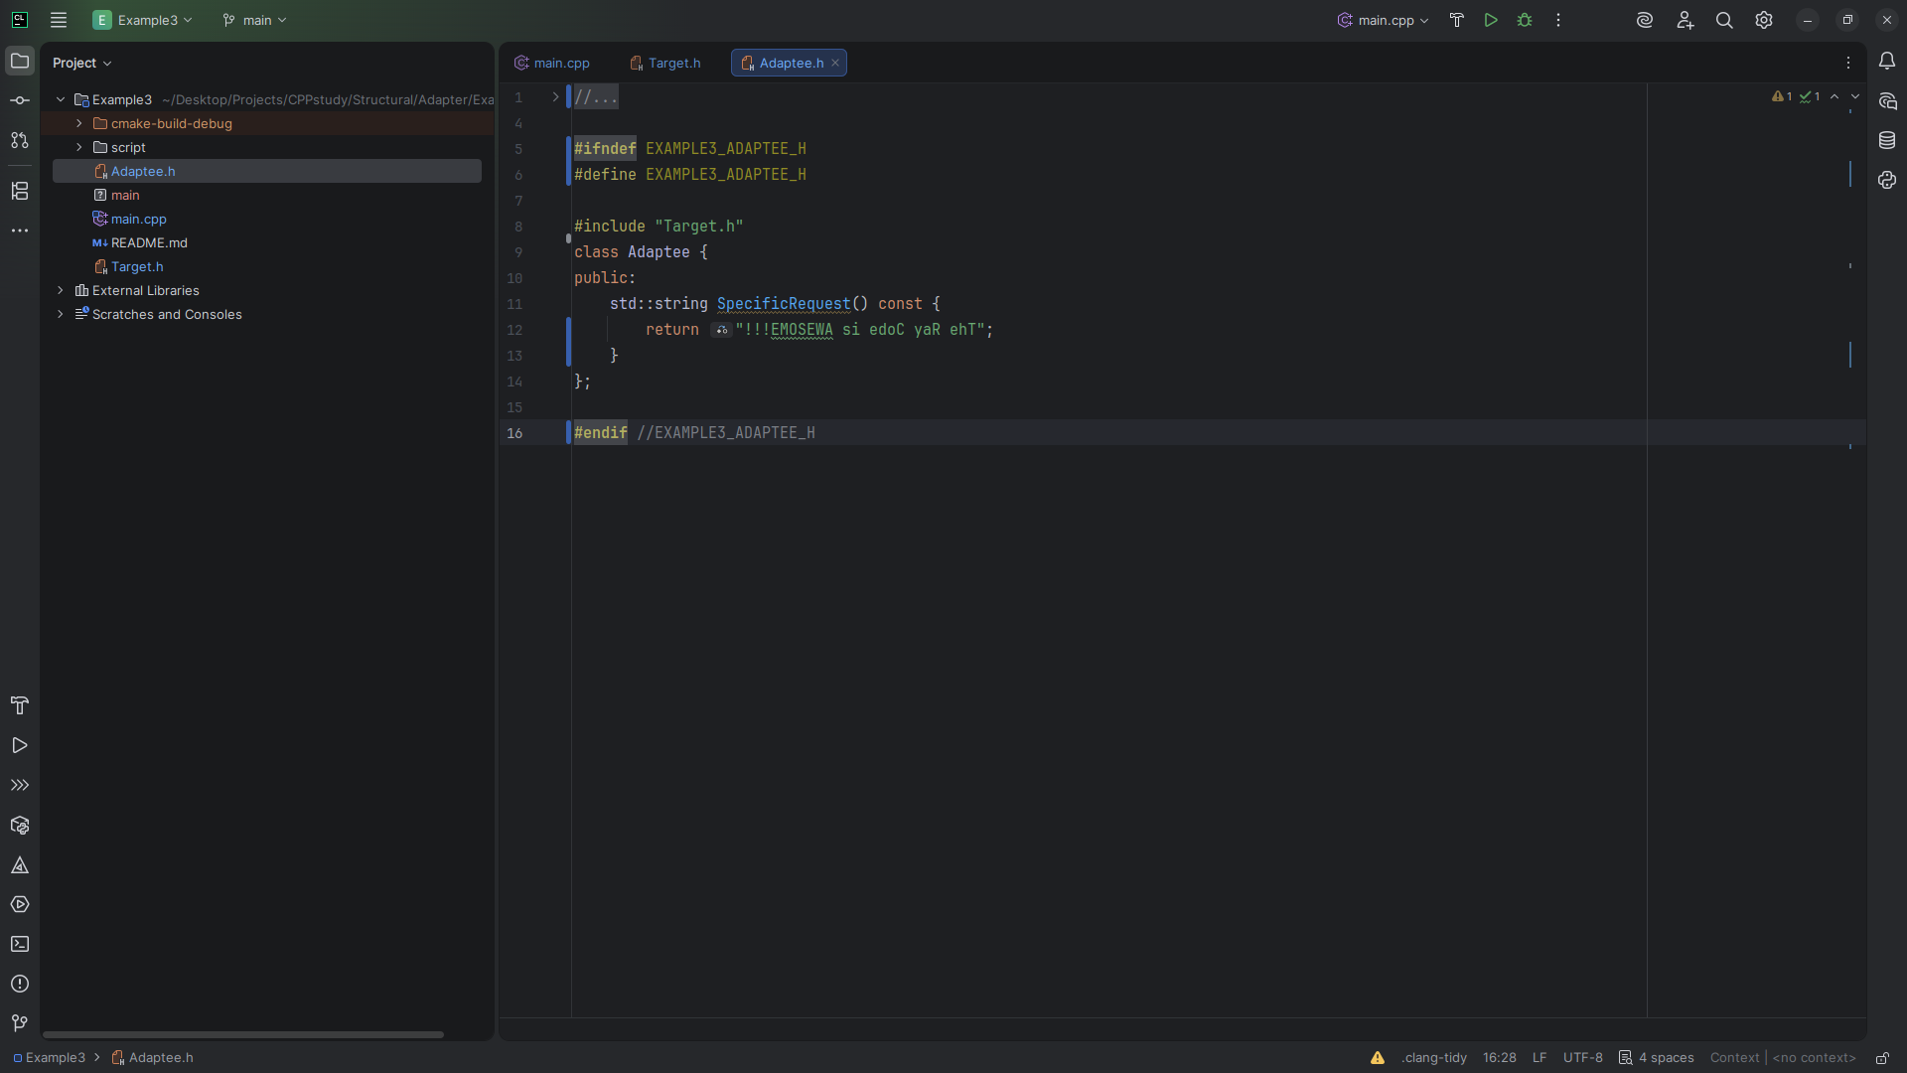
Notes:
Here, SpecificRequest returns a string in reverse order.
The intended message seems to be "The Ray Code is AWESOME!!!" but it's written backward.

Slide 13

Notes:
Now we create the Adaptee

Slide 14
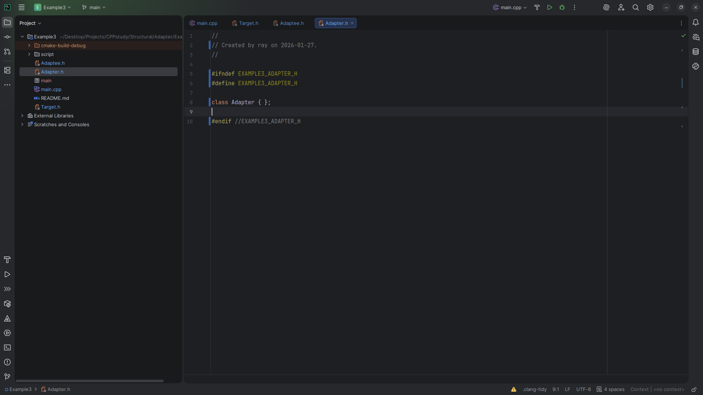
Notes:
The Adaptee class is one that has a different interface (SpecificRequest) than what clients might expect based on the Target class.
This is a class you might need to adapt in order to make it work seamlessly with existing or new code.

Slide 15
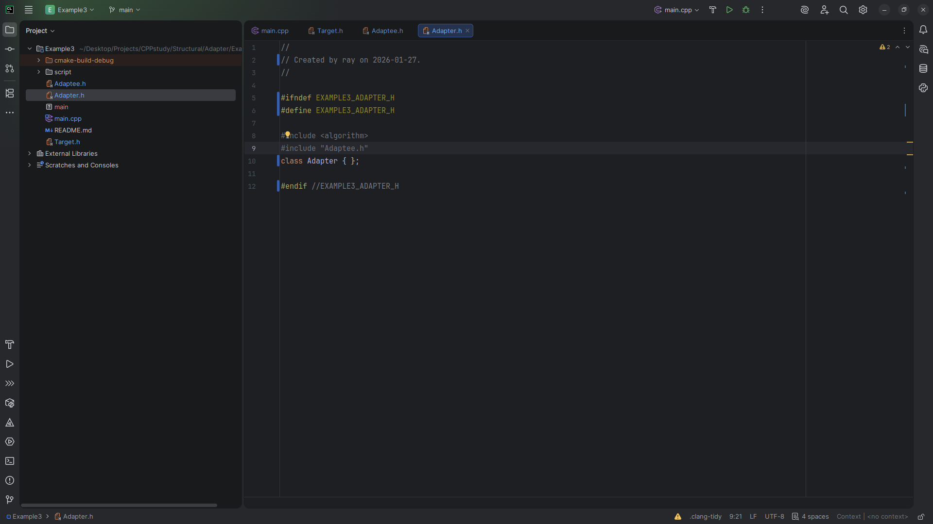
Notes:
At the top we include the Algorithm header and a reference to the Adaptee

Slide 16
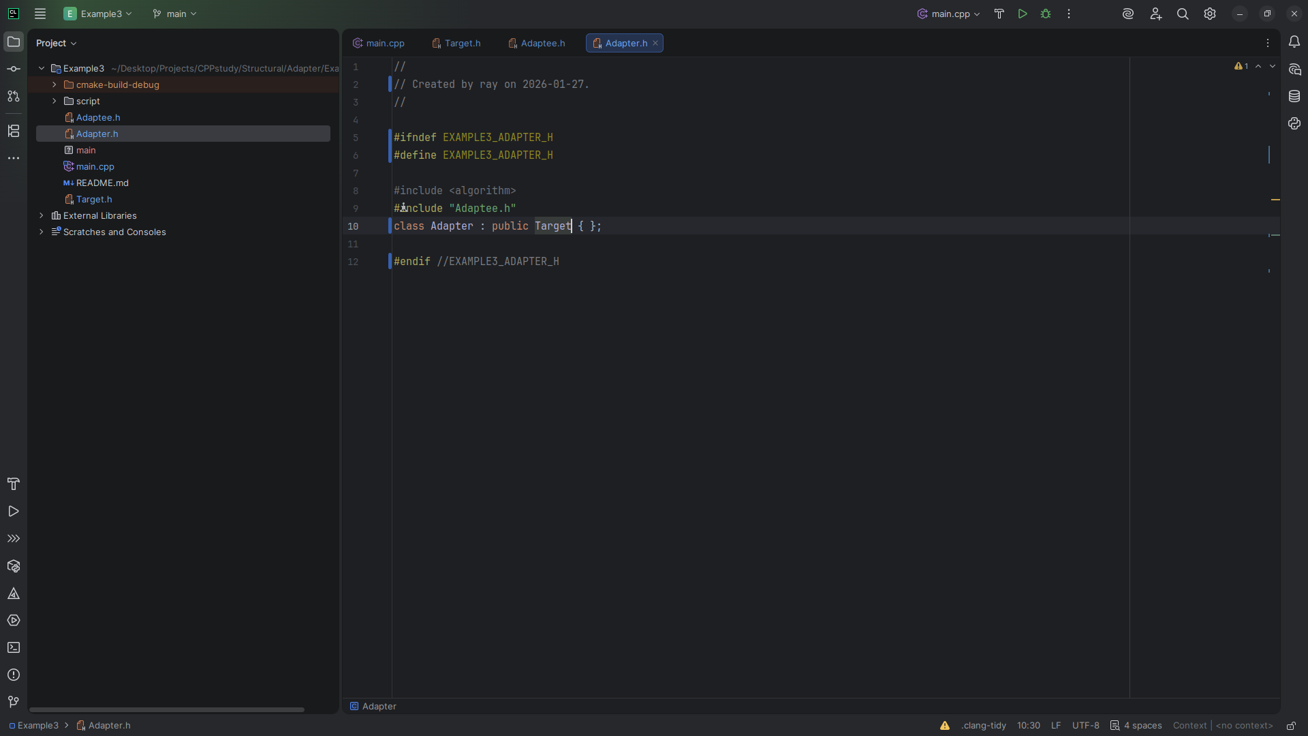
Notes:
We extend the Adapter with the Target interface

Slide 17
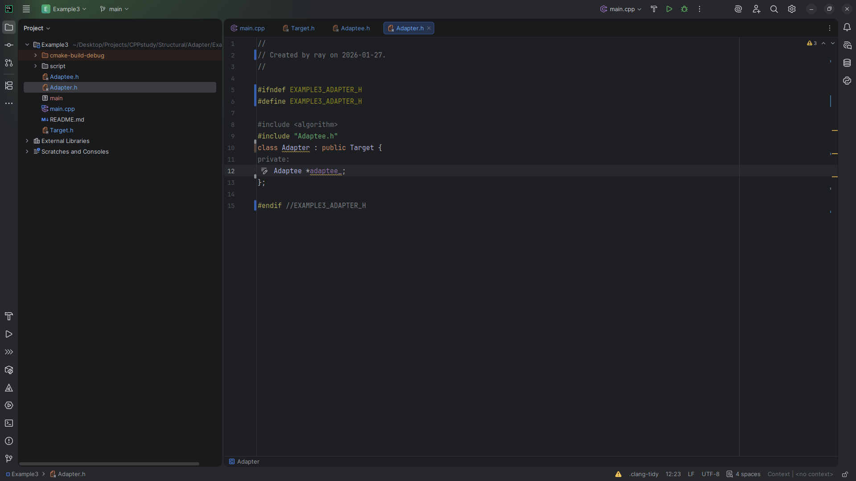
Notes:
We set a private variable, adaptee

Slide 18
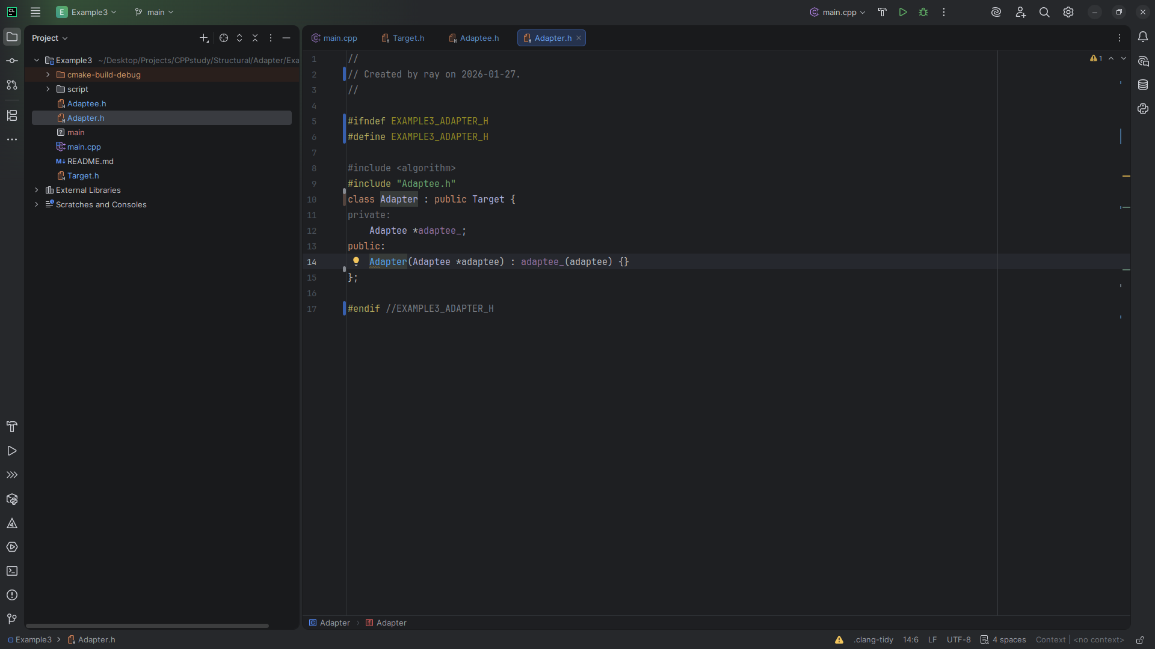
Notes:
Next we have the Adapter take the adaptee

Slide 19
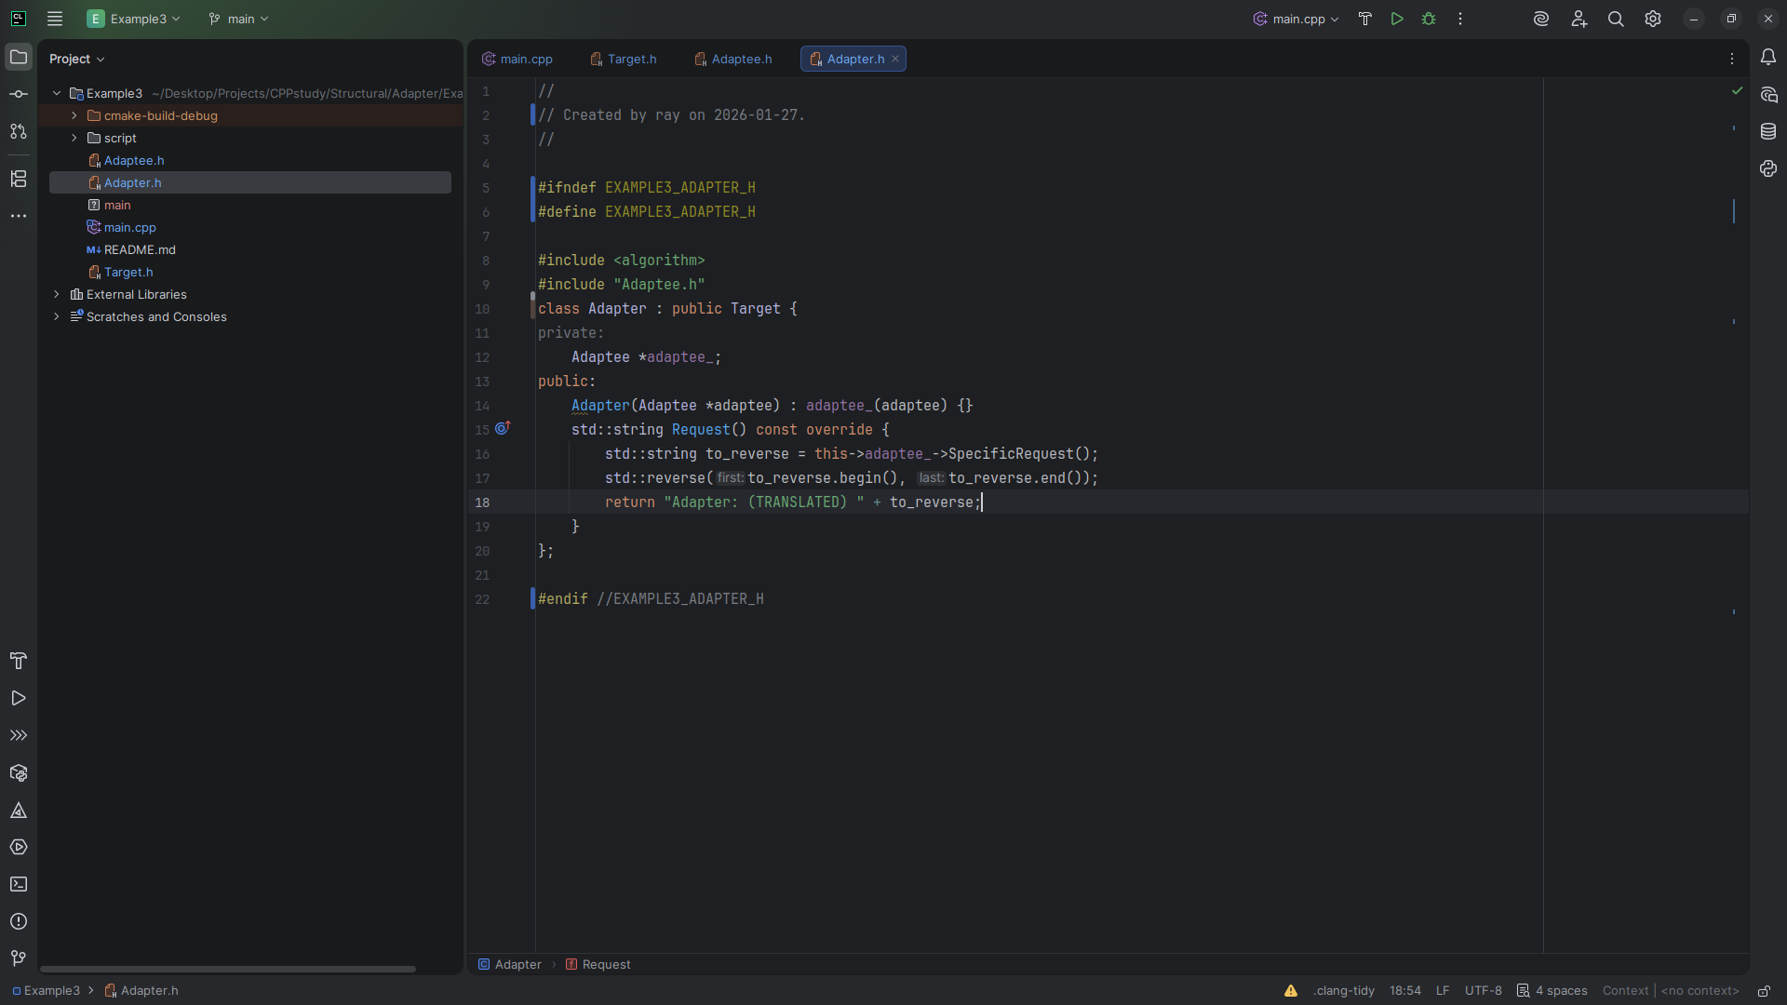
Notes:
And we revers the string given by the Specific Request and SO translating the message

Slide 20
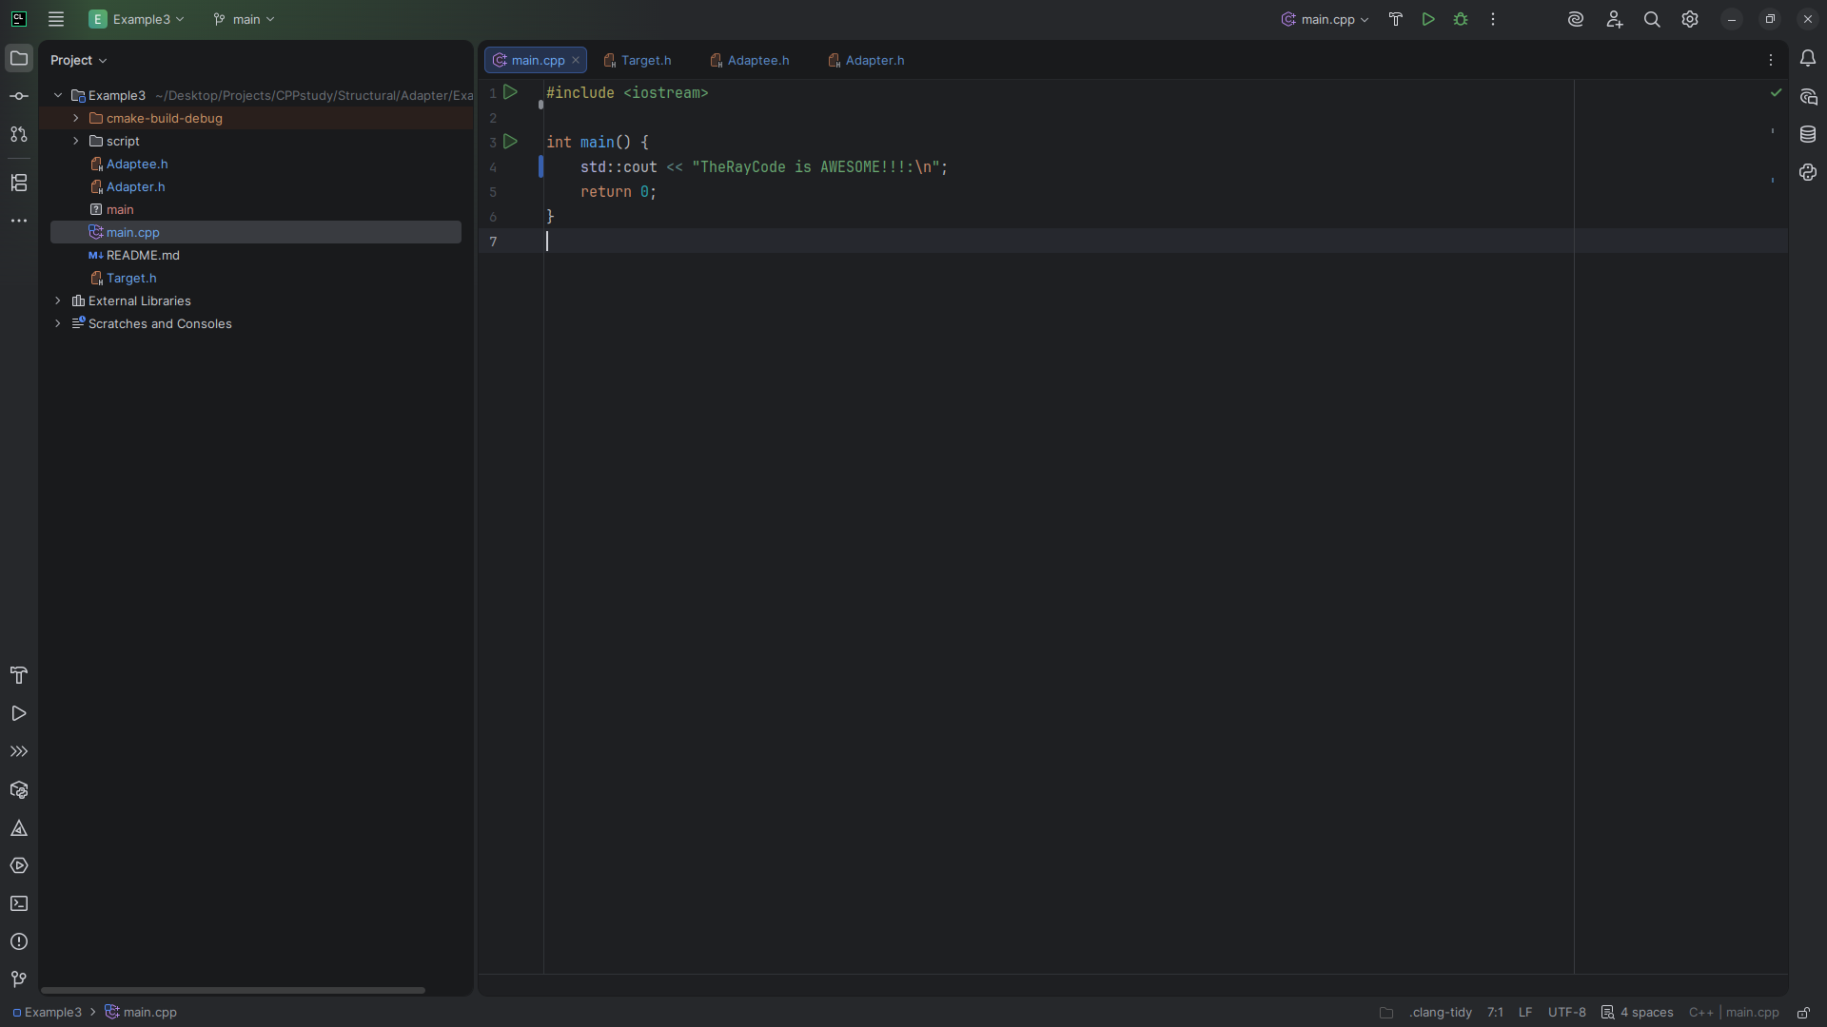
Notes:
Now let go to main for our demo

Slide 21
Notes:
At the top we include

Slide 22
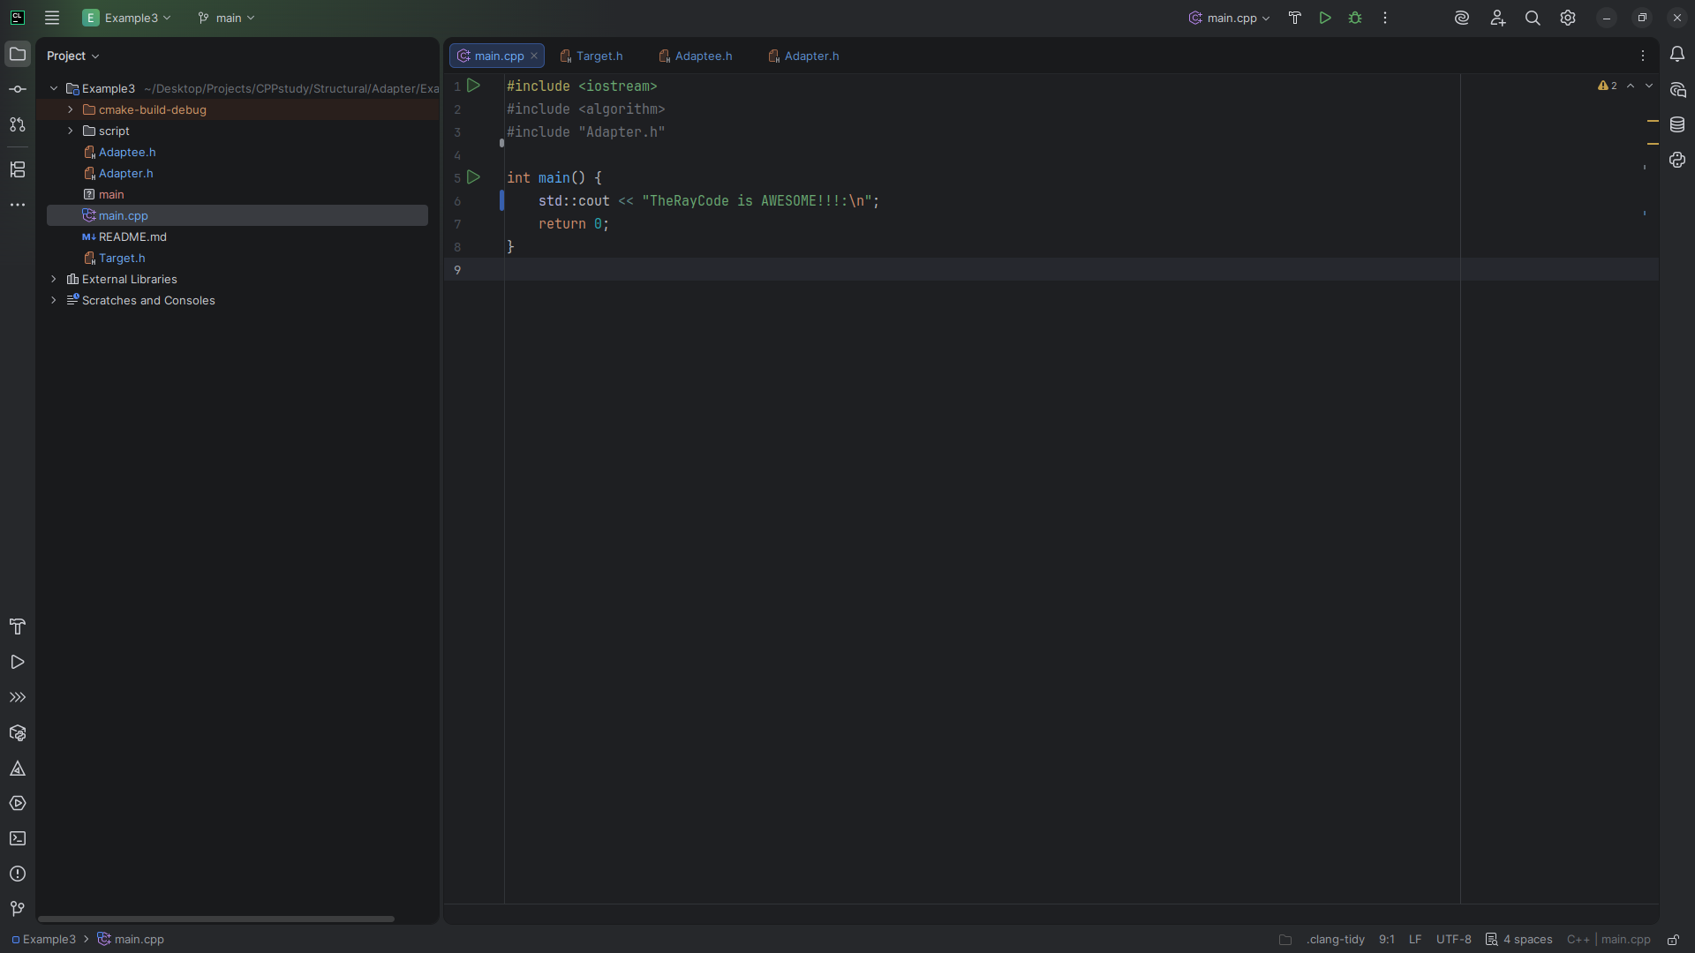
Notes:
algorithm and the Adapter we created

Slide 23
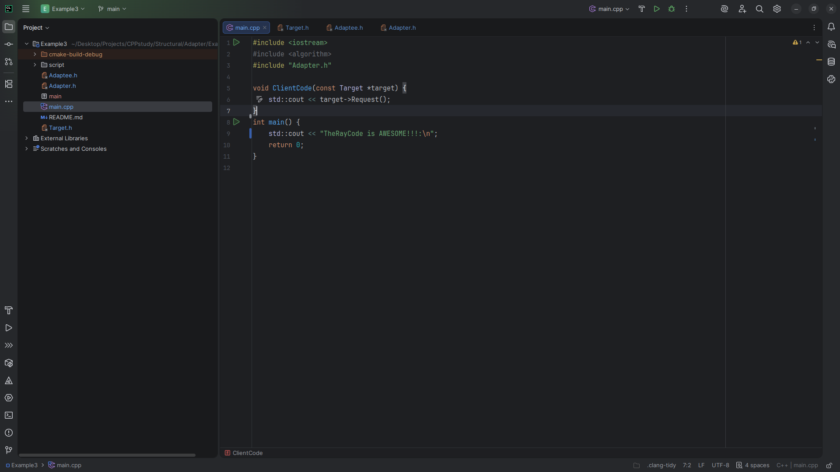
Notes:
We add some Client Code

Slide 24
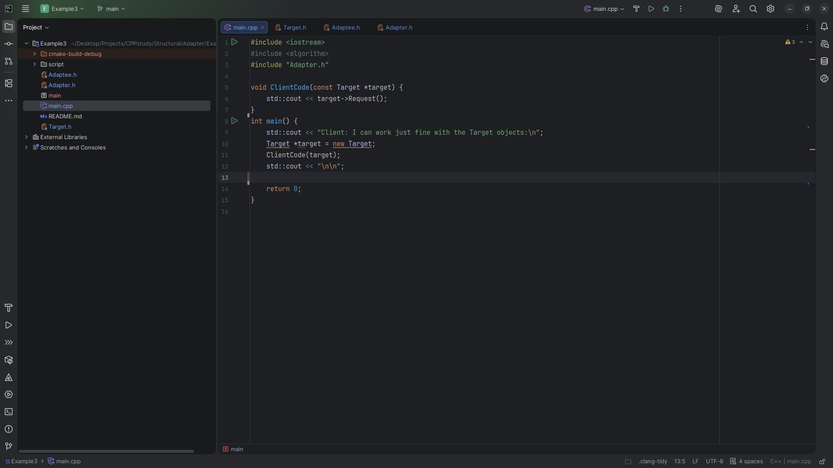
Notes:
We setup the Target

Slide 25
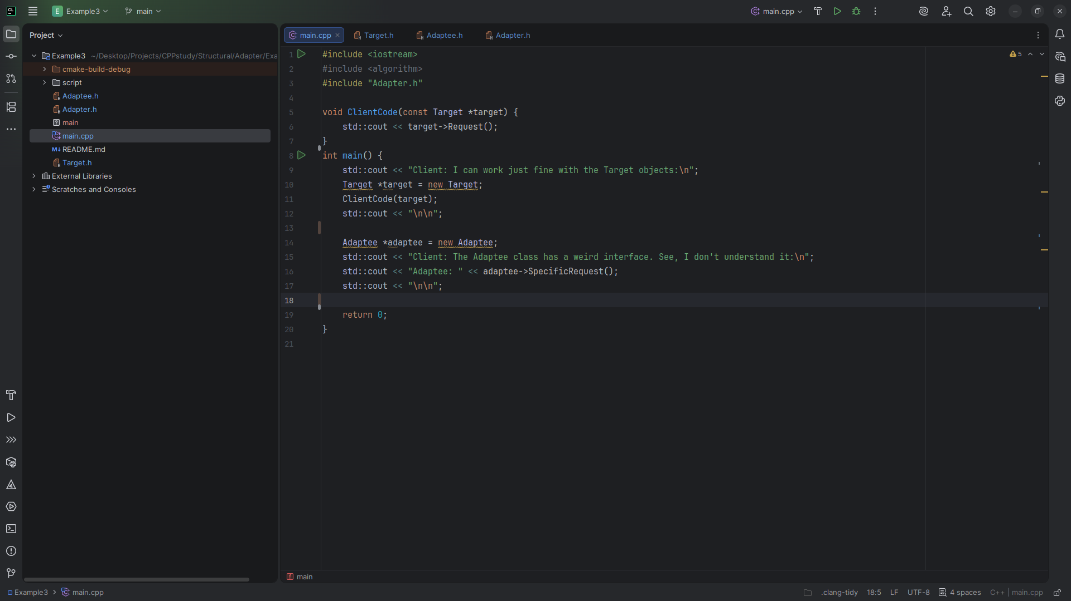
Notes:
And we setup the Adaptee

Slide 26
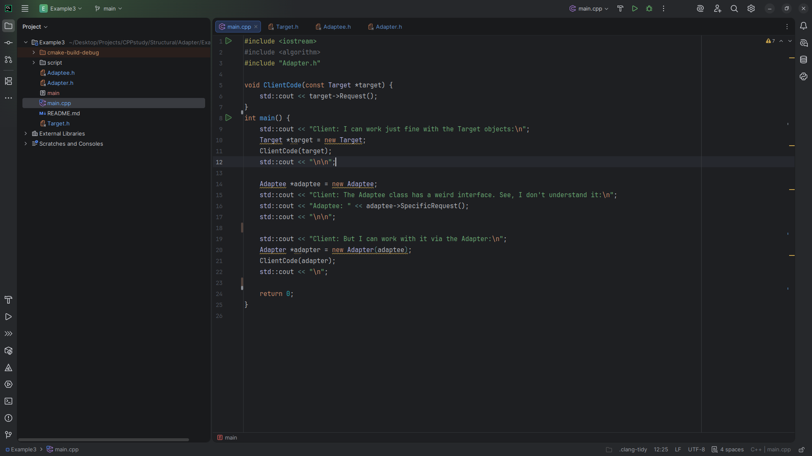
Notes:
And we pass the adaptee into the client code that we just created

Slide 27
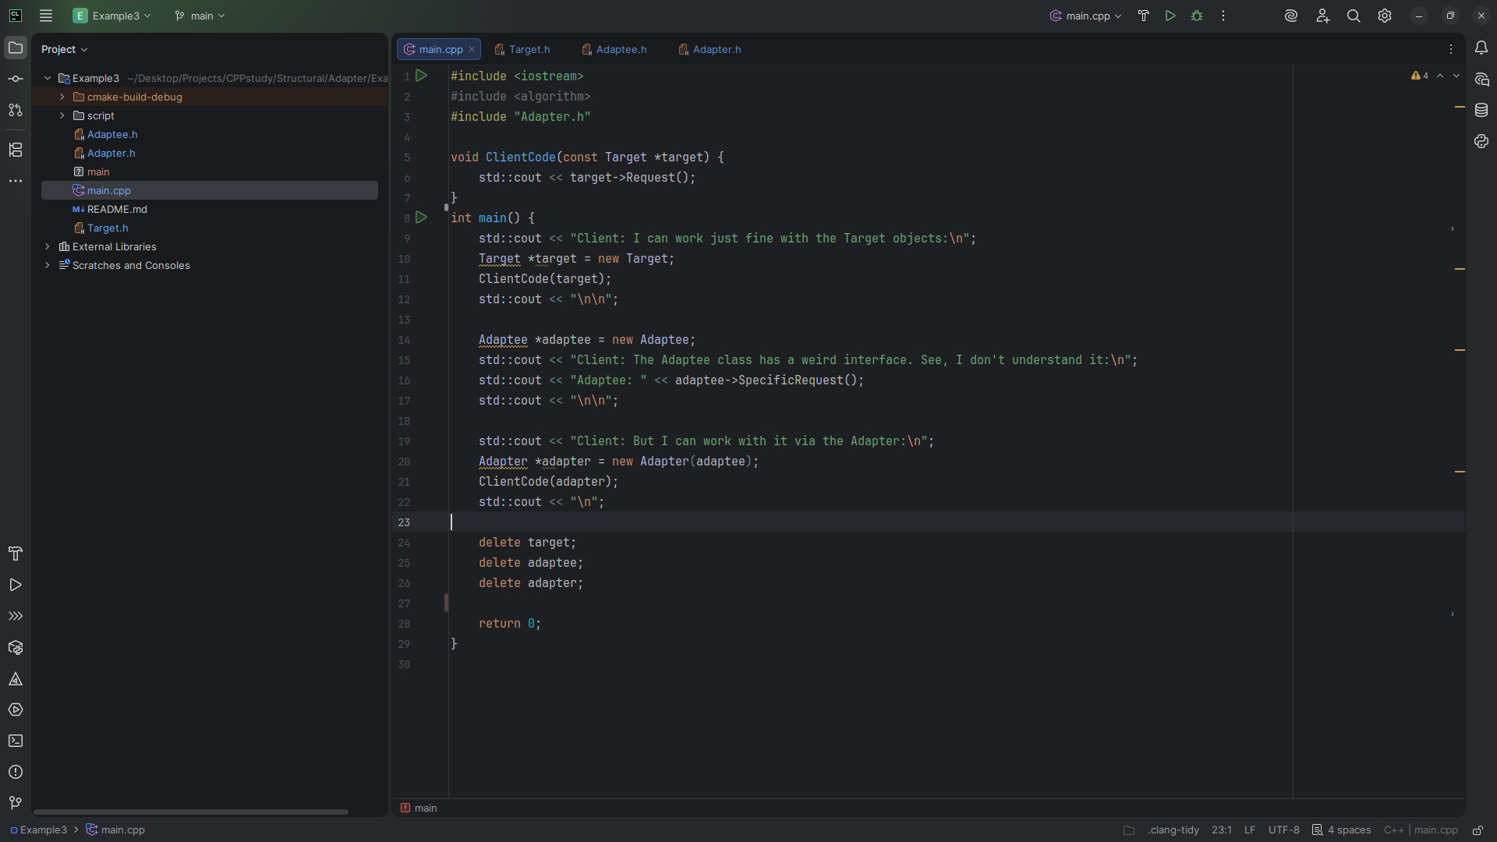
Notes:
Let’s do some cleanup and run

Slide 28
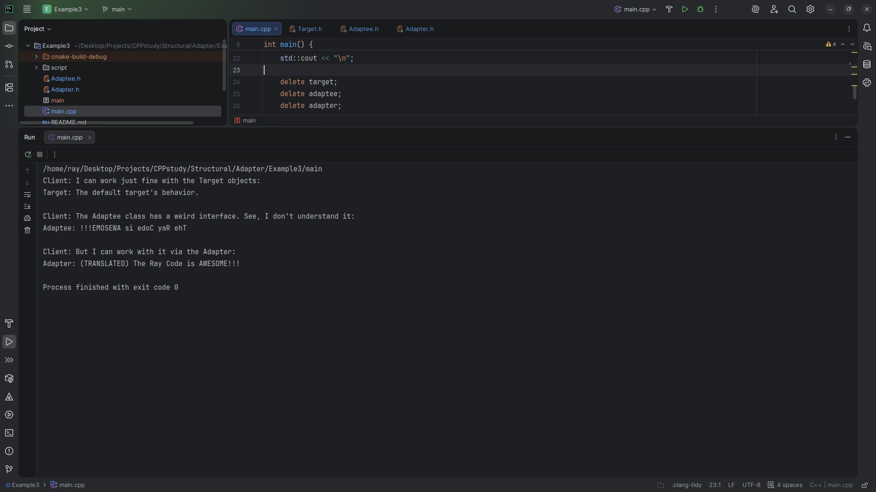
Notes:
We get
Client I can work just fine with the Target
Adaptee a backward message
Client But I can work with it via the Adapter
Adapter Translated The Ray Code is Awesome
Remember to code with a smile

