Slide 1
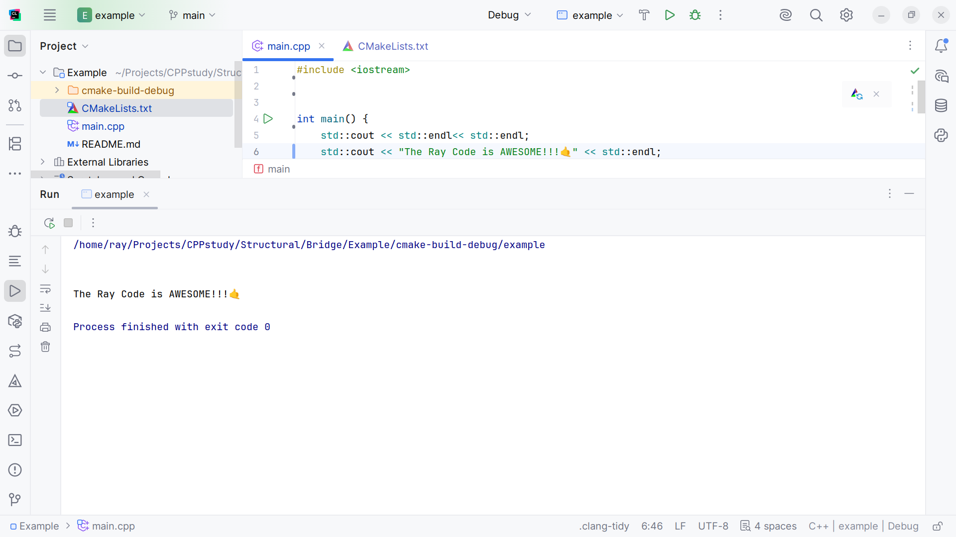
Notes:
(No sound)

Slide 2
Notes:
Hello, My name is Ray and I am the Ray in TheRayCode

Slide 3
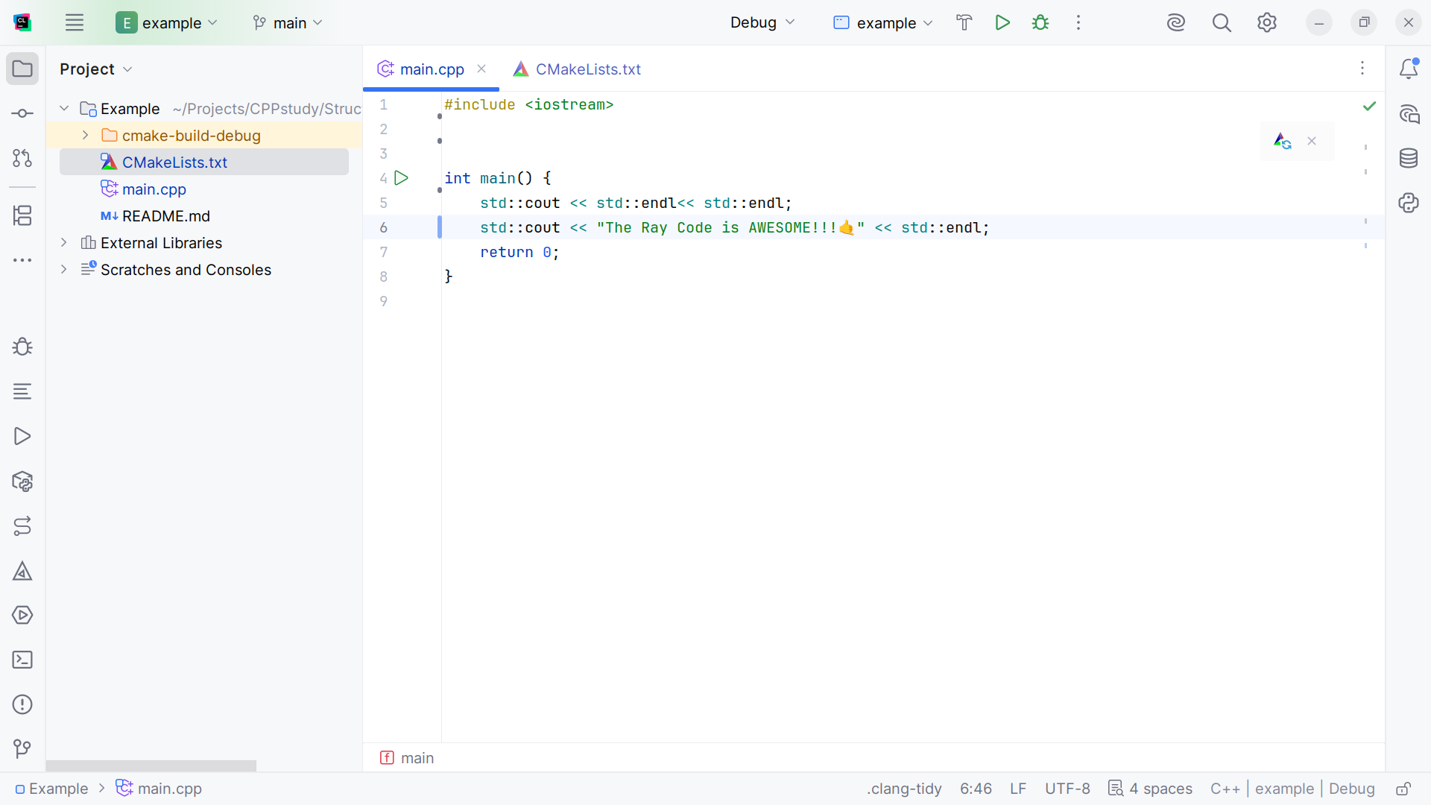
Notes:
In this show I plan to give an example of the Bridge pattern which is a Structural design pattern

Slide 4
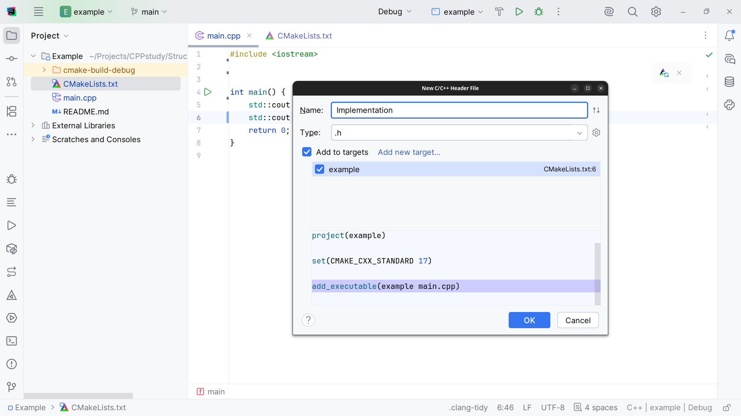
Notes:
This first class I will add to our project will be the Implementation class

Slide 5
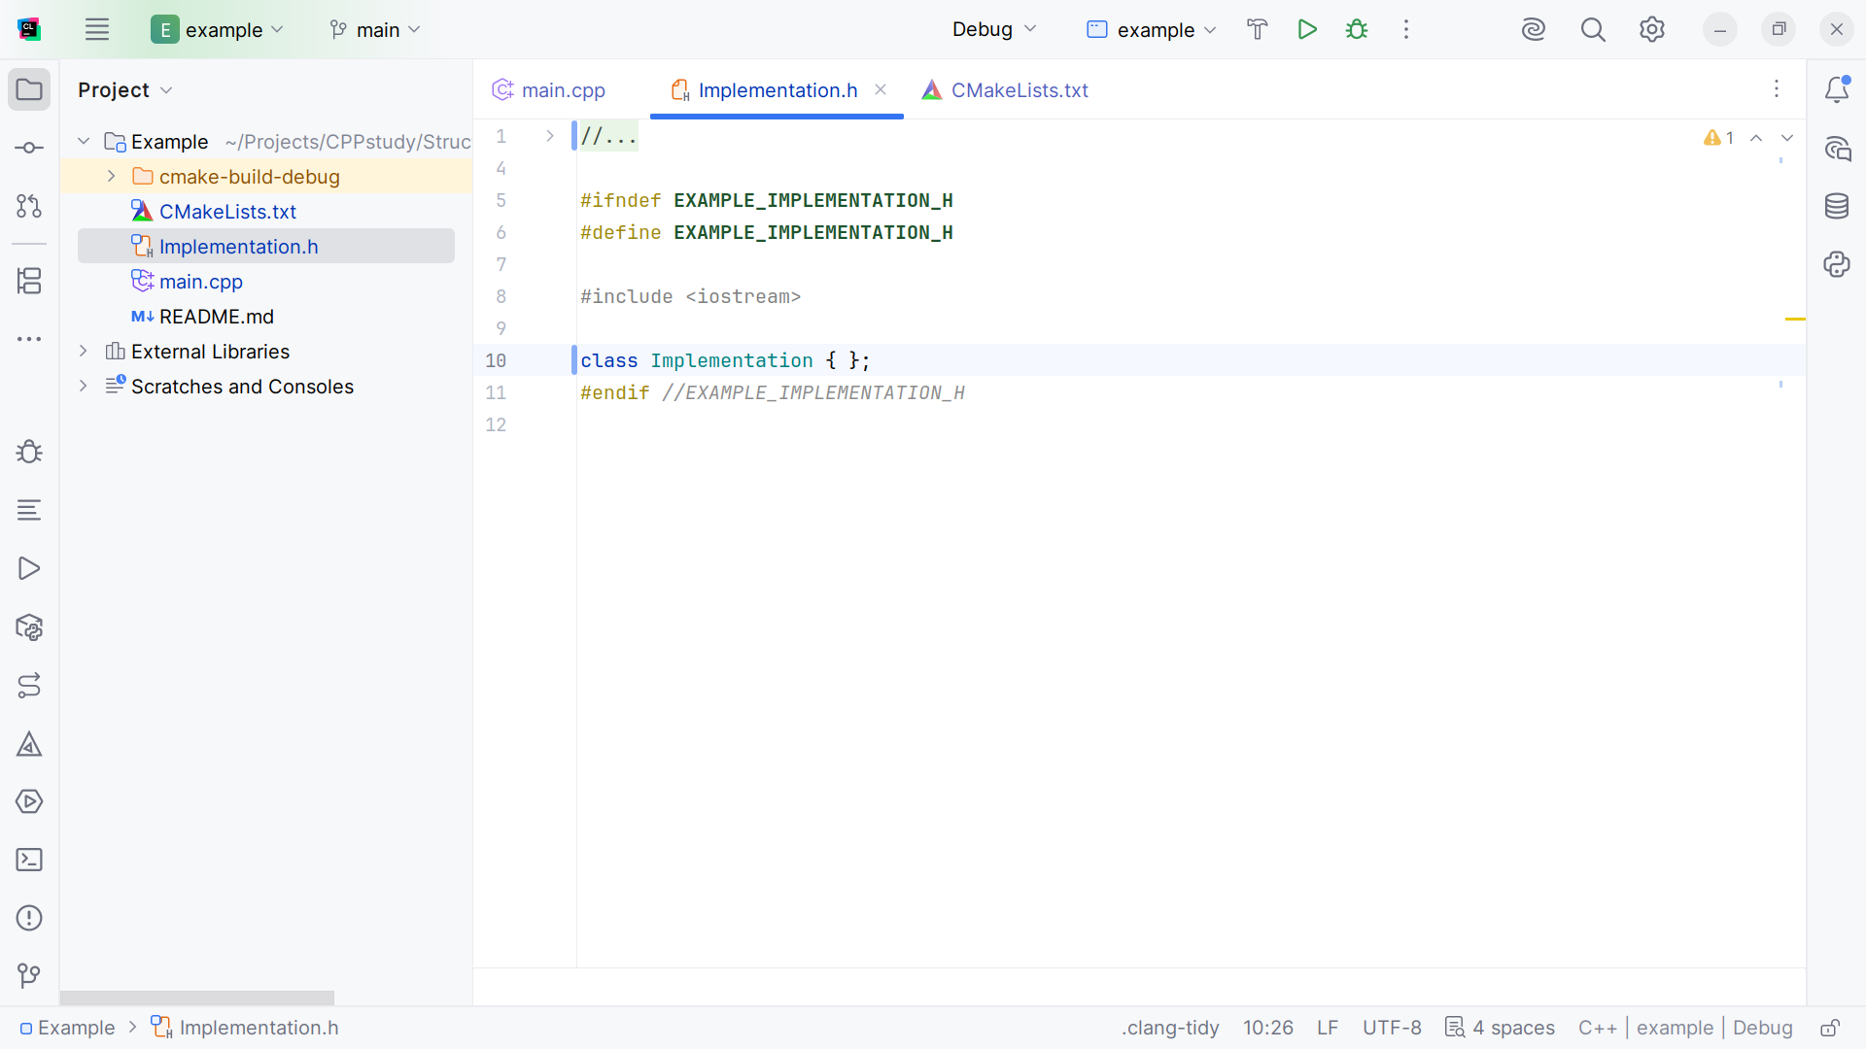
Notes:
Here we have the class structure we include the io stream at the top

Slide 6
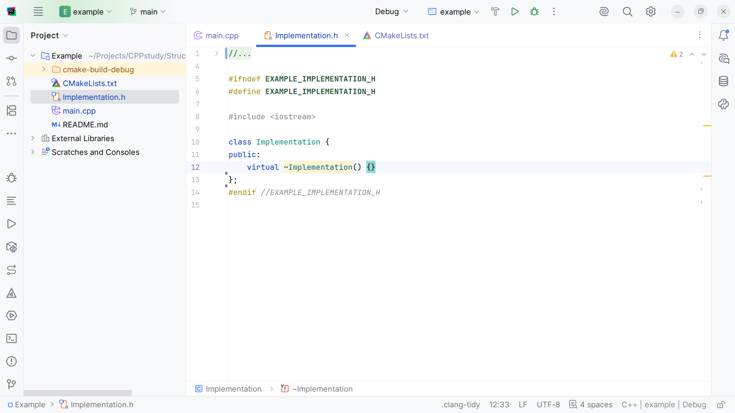
Notes:
We have a public deconstruction method for the Abstraction class

Slide 7
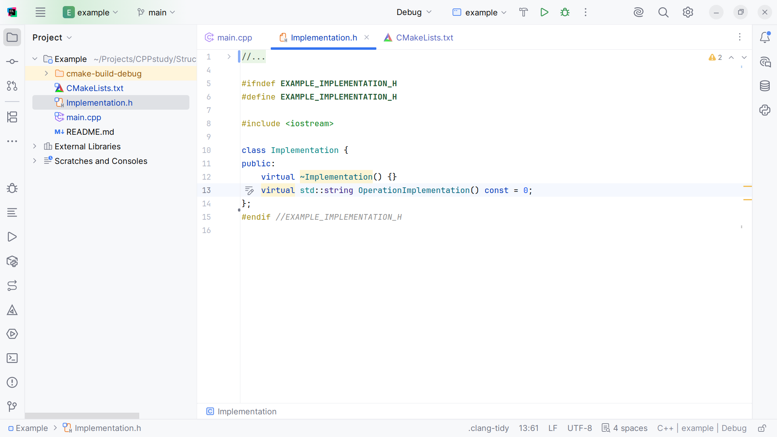
Notes:
We have a virtual Operation Implementation

Slide 8
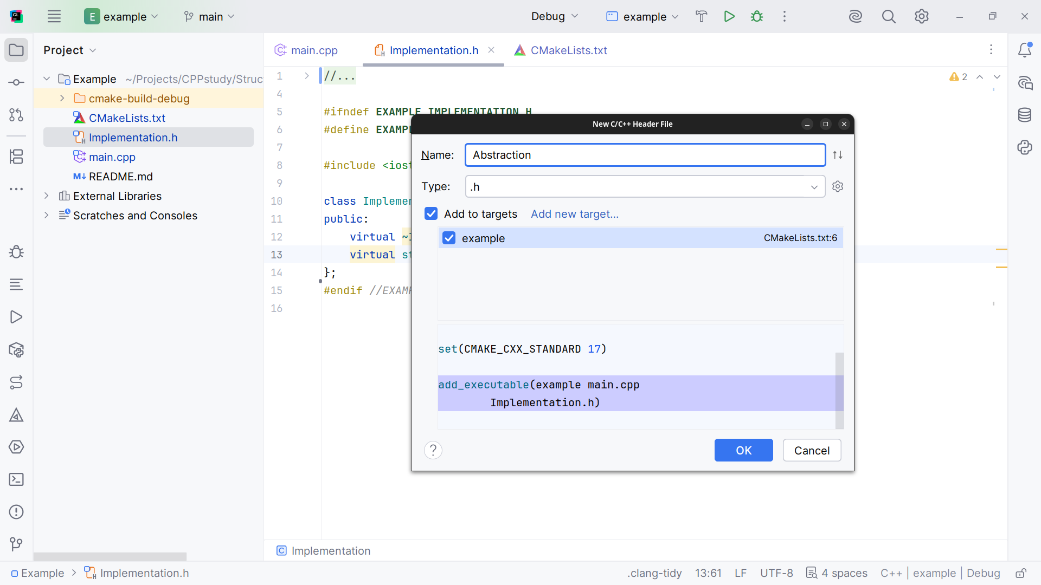
Notes:
Now let’s create the Abstraction class

Slide 9
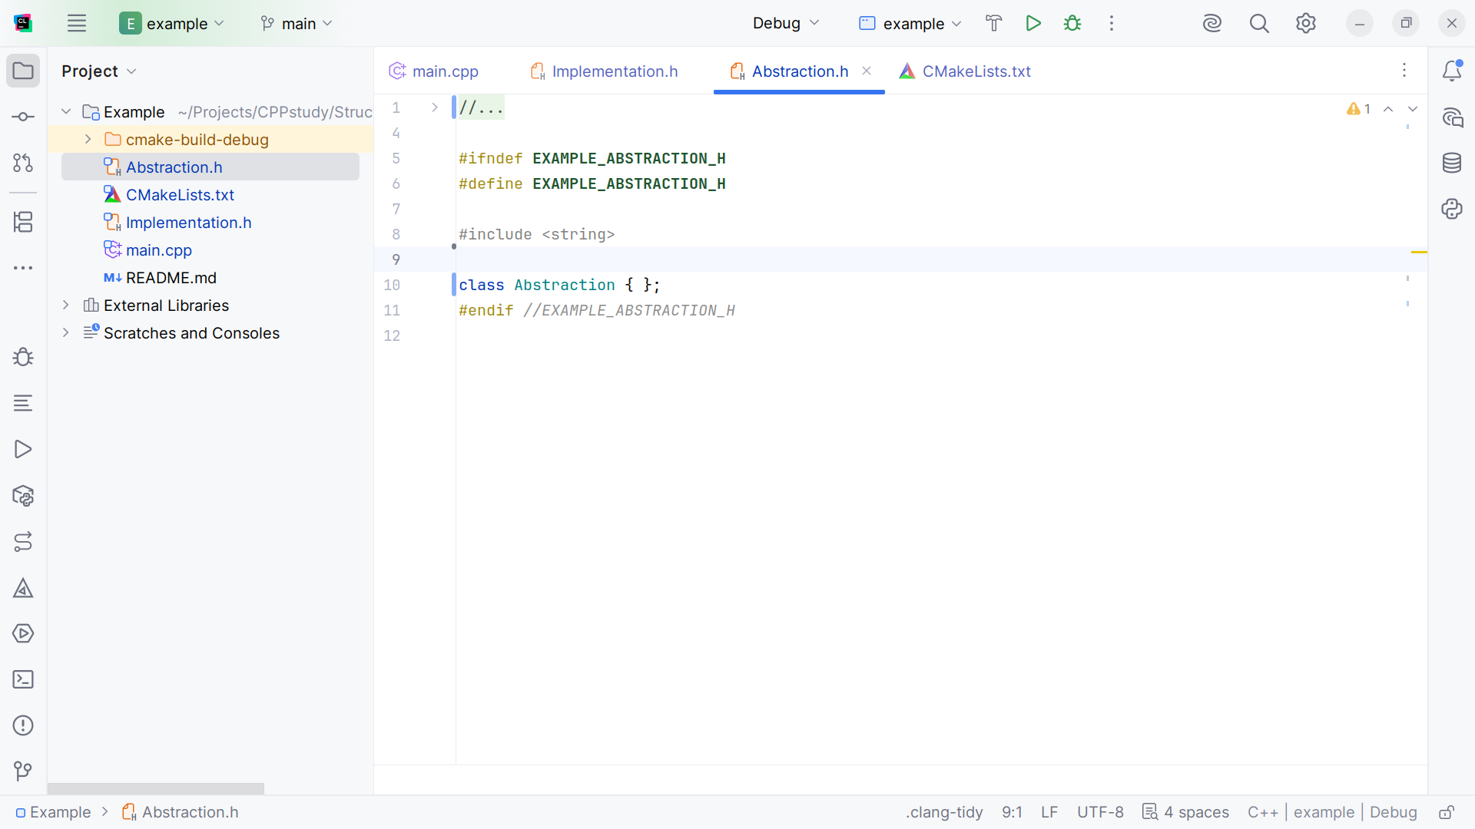
Notes:
At the top we include string library and we have the class structure

Slide 10
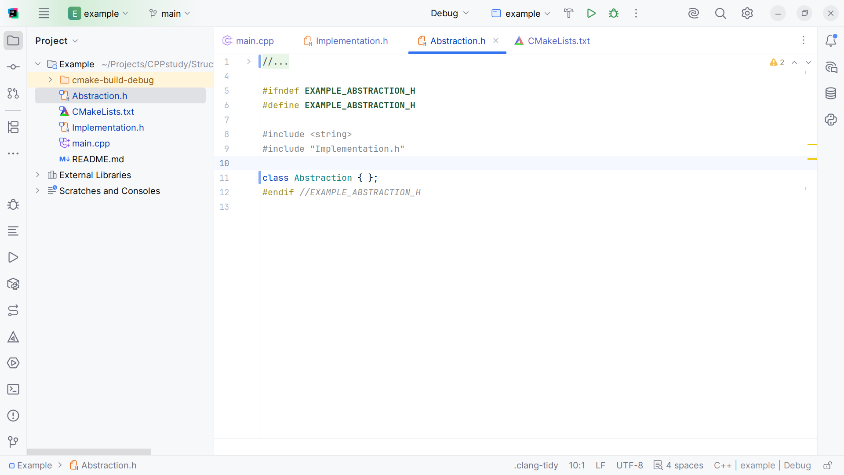
Notes:
We also include the Implementation class

Slide 11
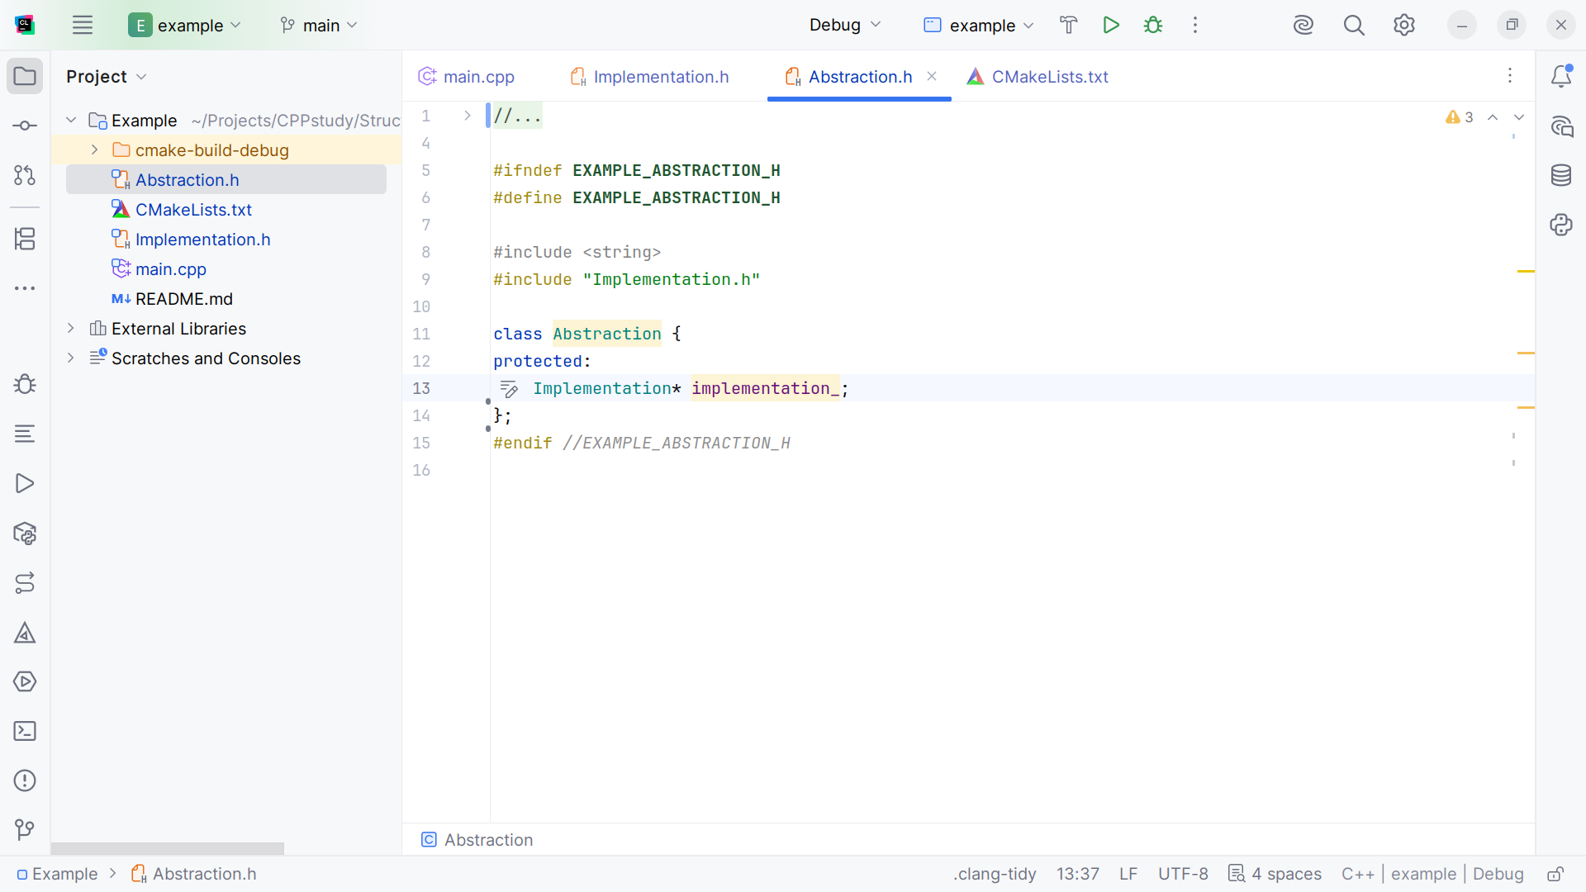
Notes:
We have a protected Implementation pointer to hold the implementation

Slide 12
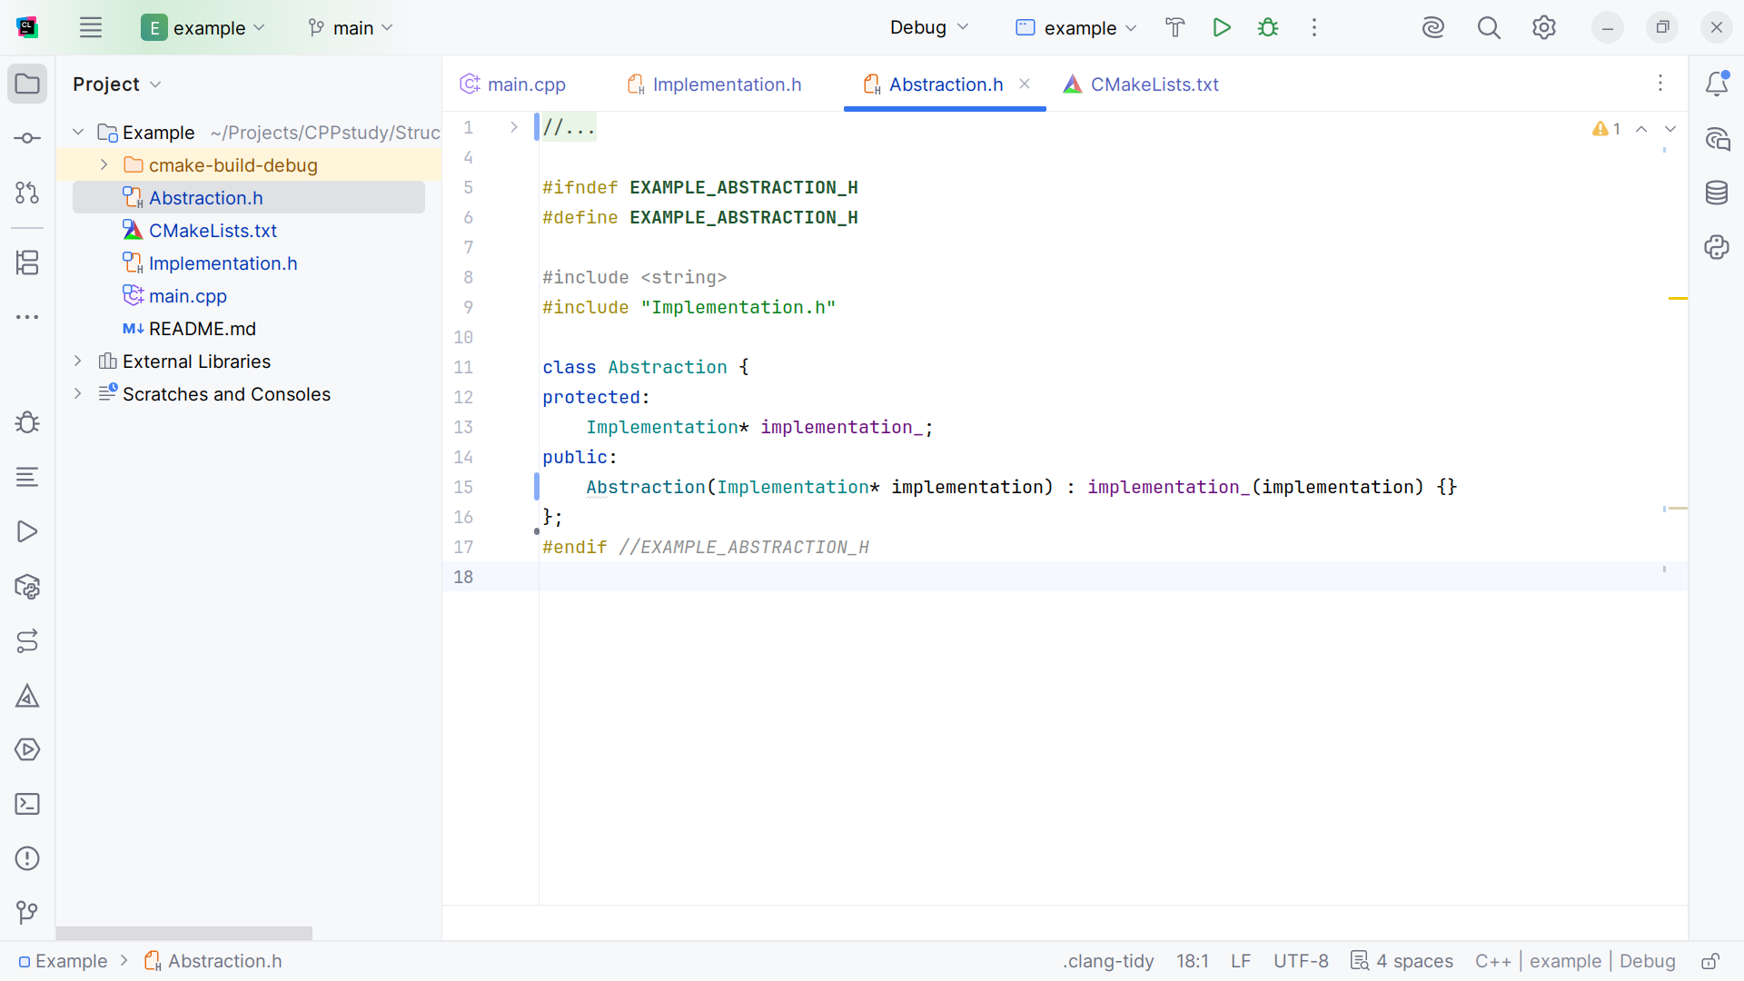
Notes:
Next we have the Abstraction which is extended with the abstraction class

Slide 13
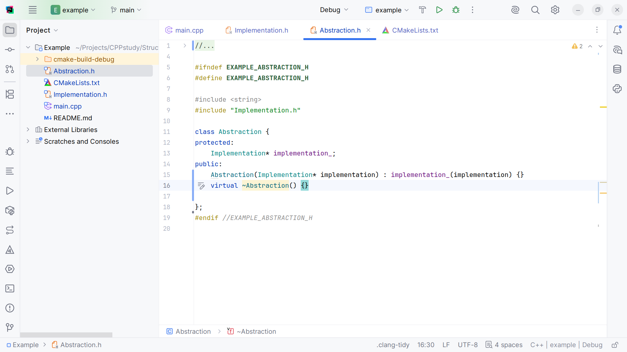
Notes:
We have a de-constructor for the Abstraction so we have proper clean up

Slide 14
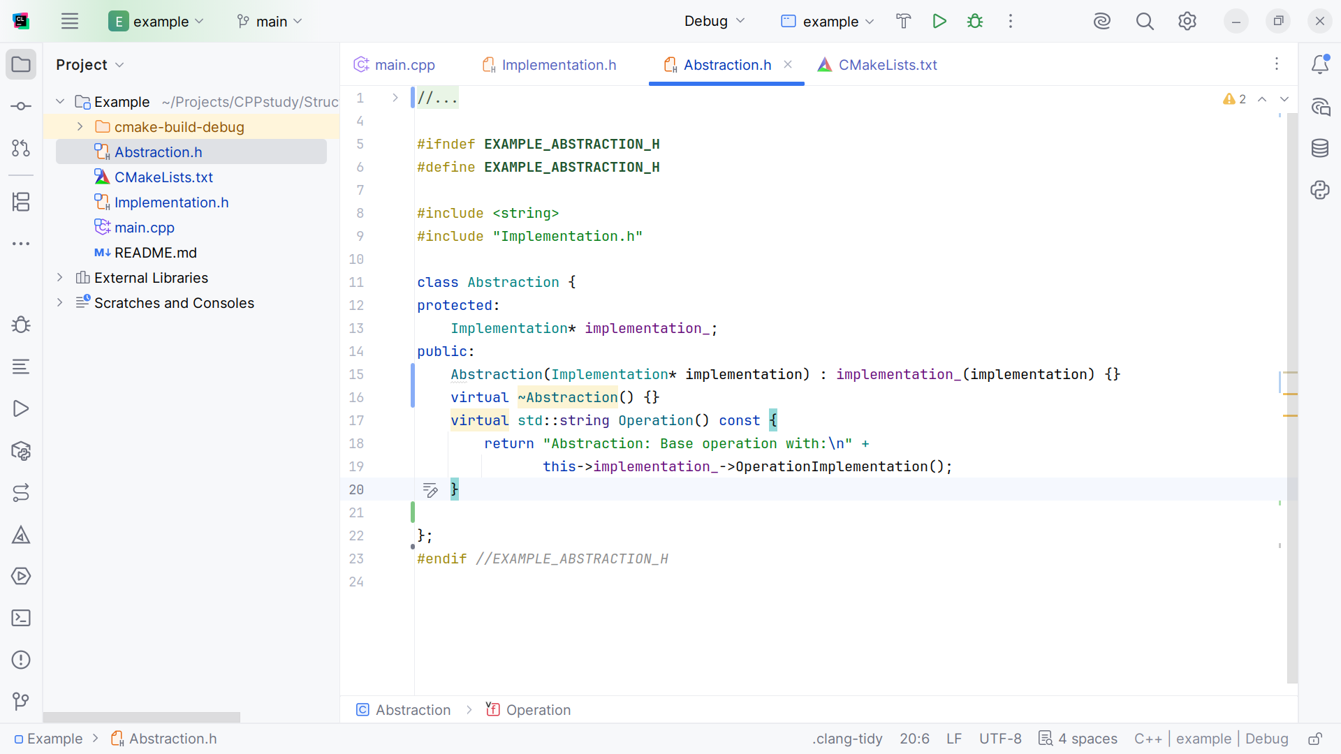
Notes:
Next we add a string Operation() that returns “Abstraction: Base operation with” the implementation we just passed in

Slide 15
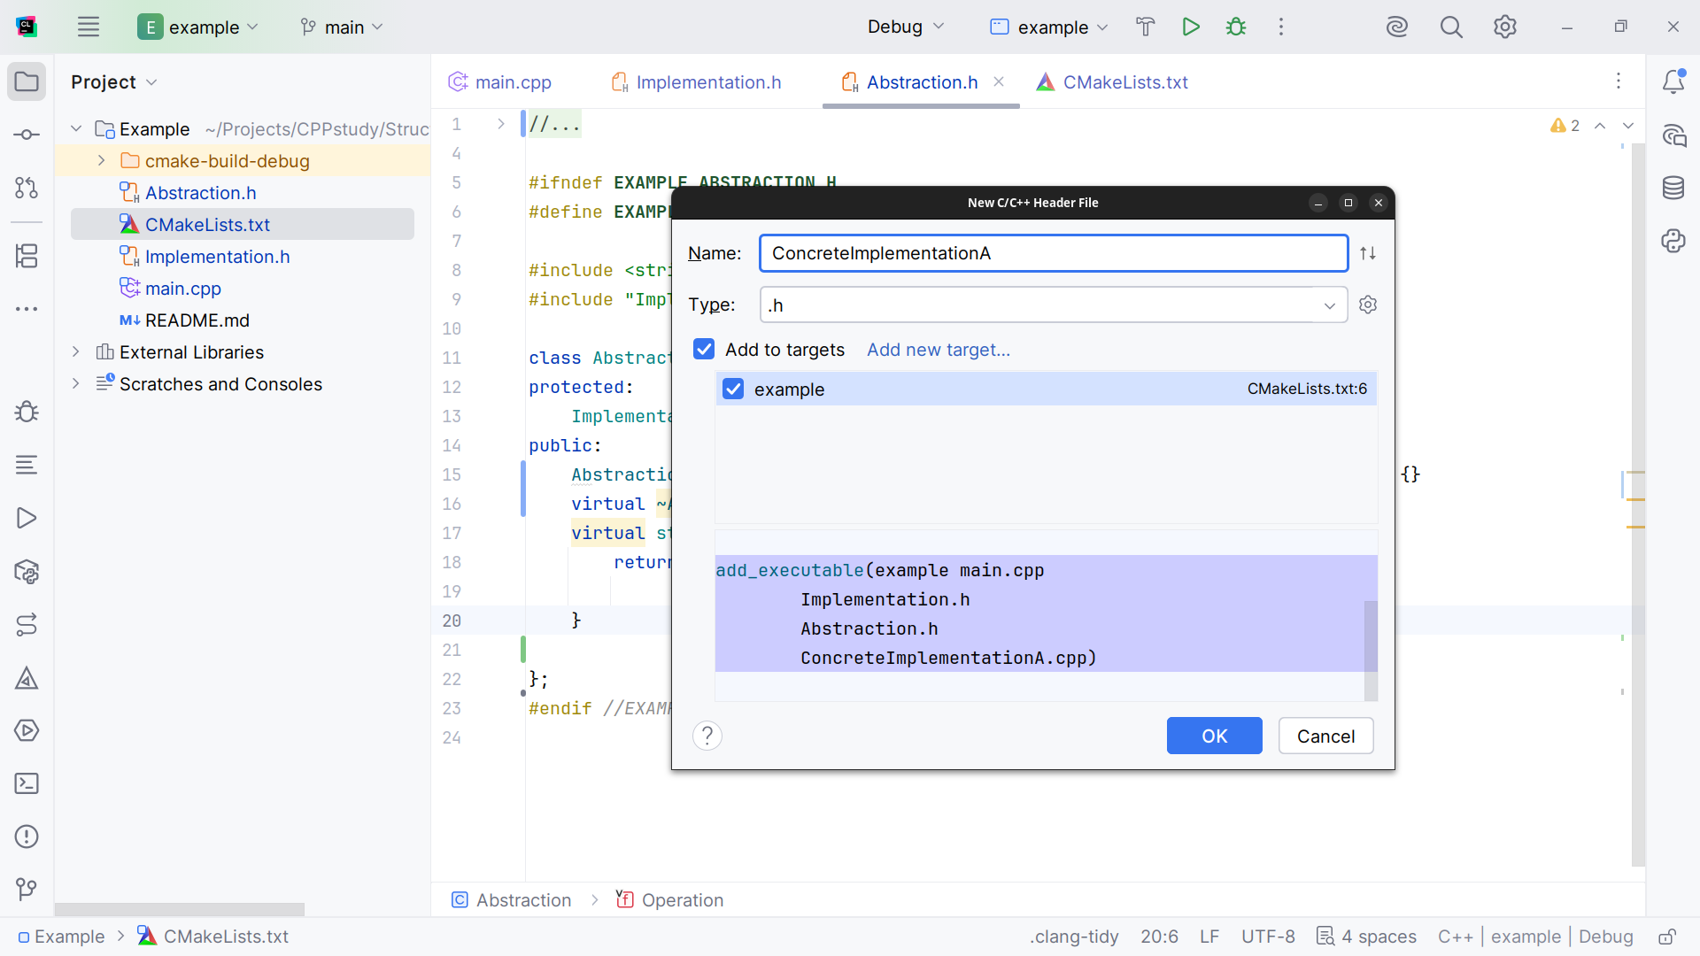
Notes:
Now let’s create a Concrete Implementation A

Slide 16
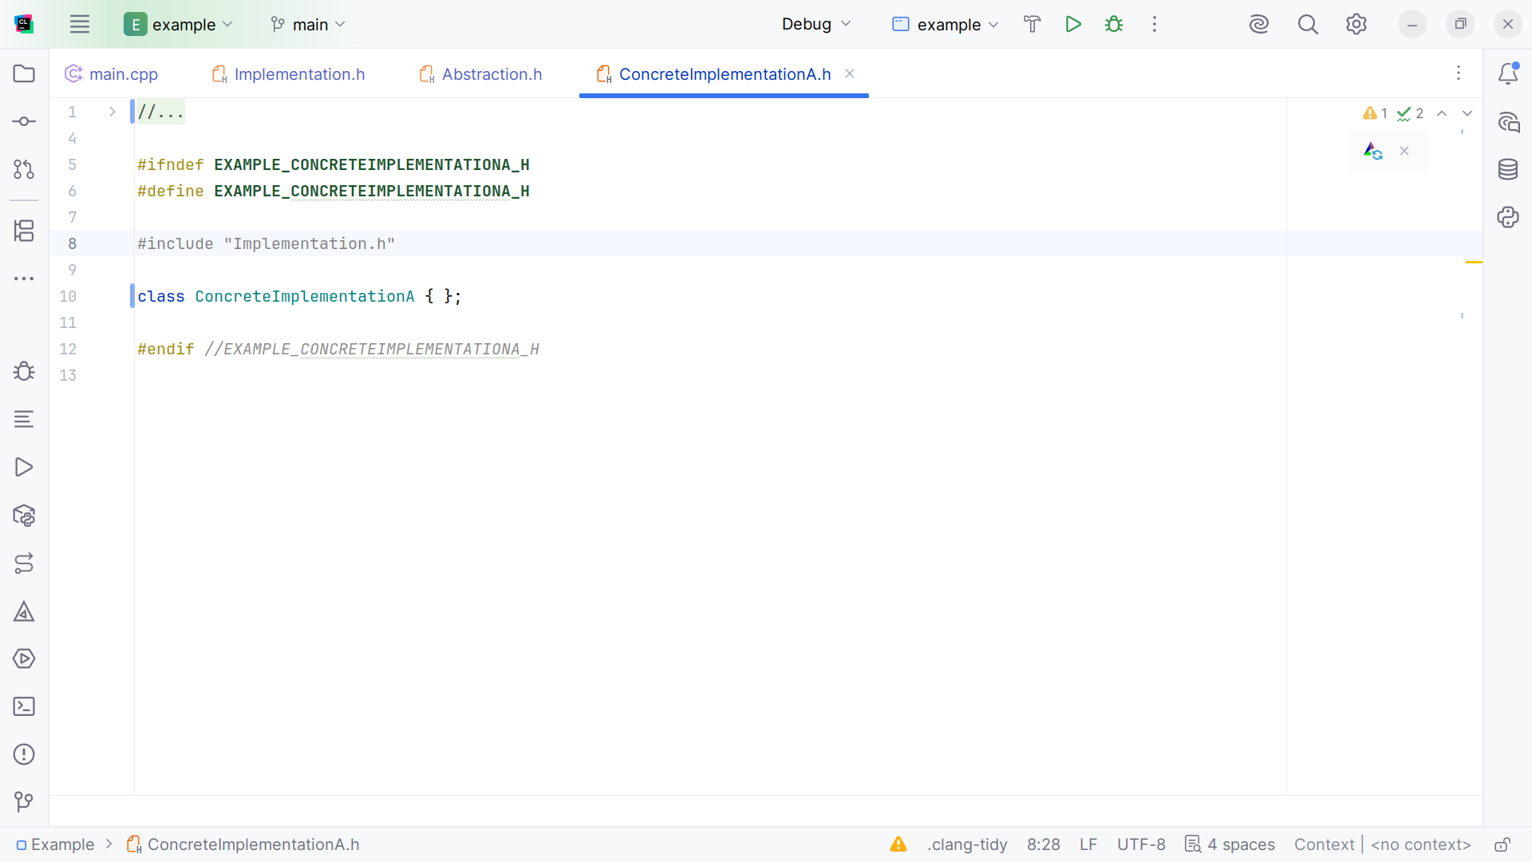
Notes:
(skip)

Slide 17
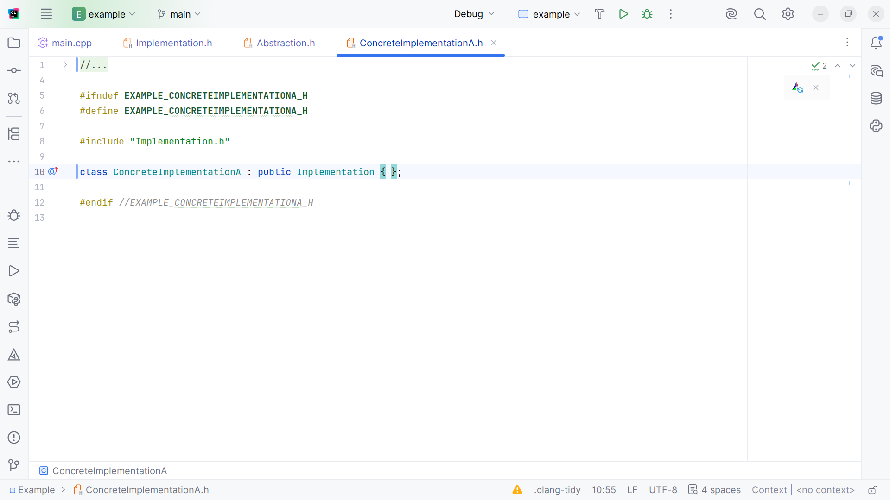
Notes:
We will extend it with the public Implementation class

Slide 18
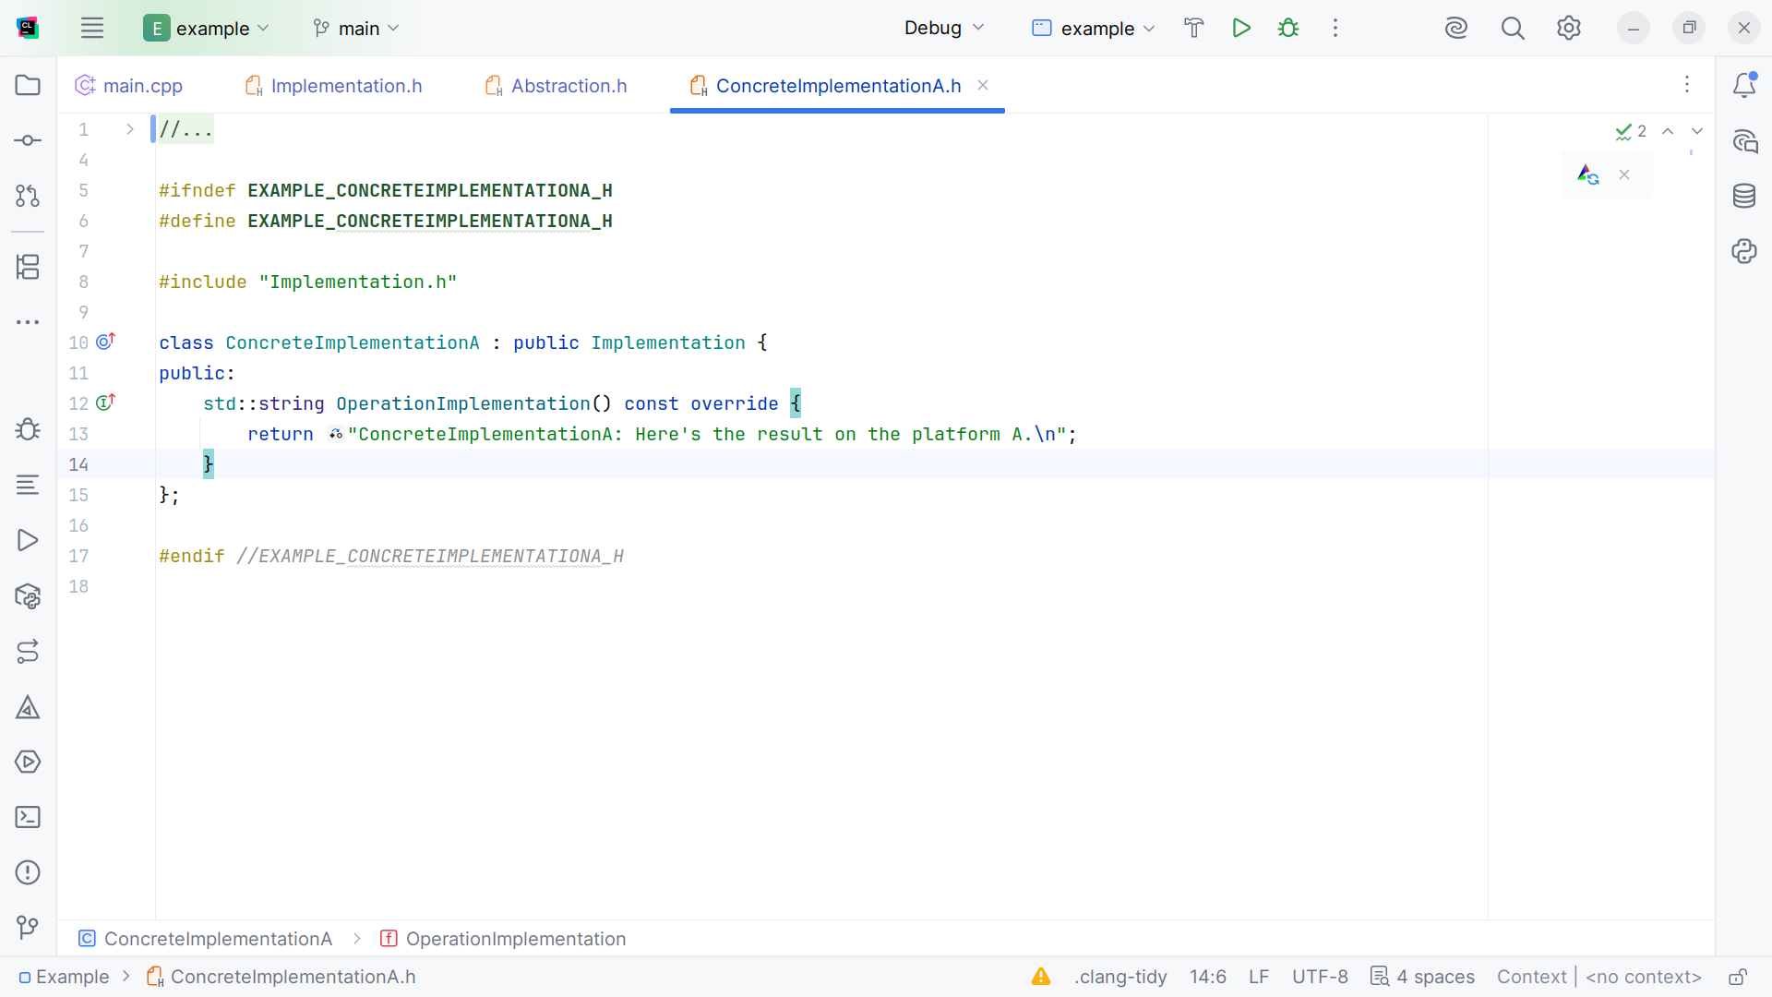
Notes:
We add a Operation Implementation which returns the string message “Concrete Implementation A: Here's the result on the platform A”

Slide 19
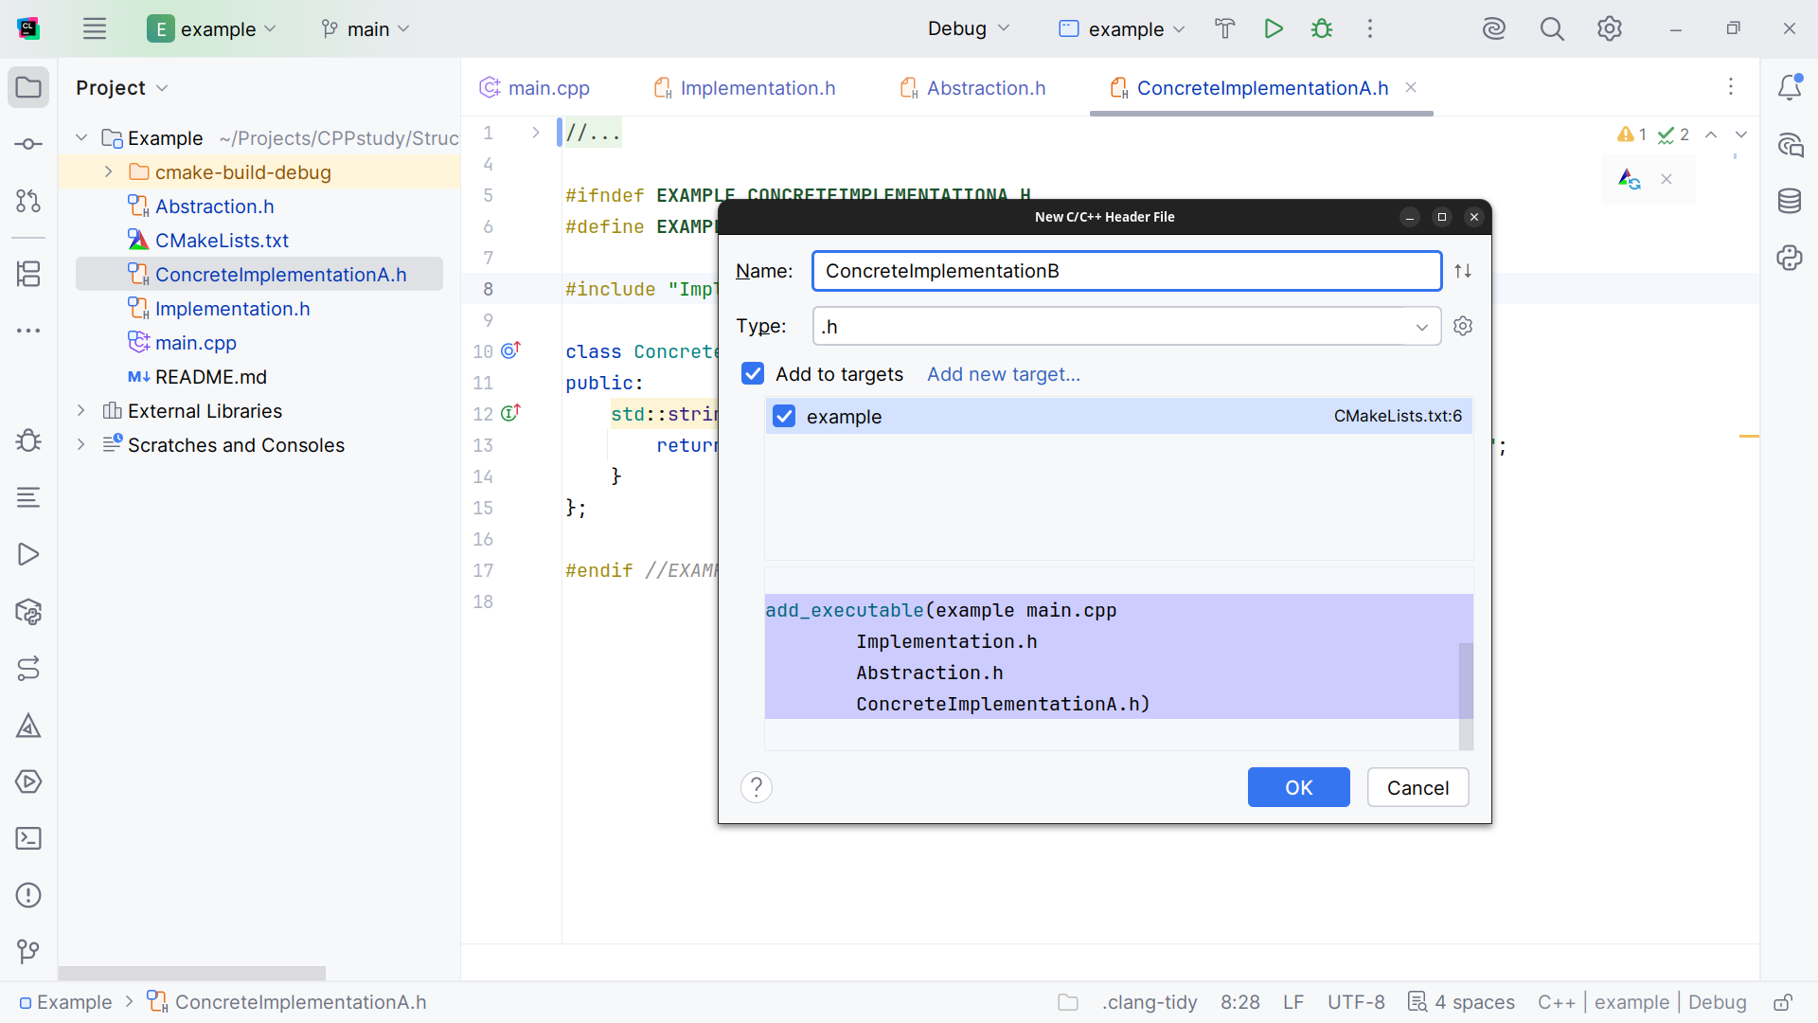
Notes:
Let’s create the Concrete Implementation B class

Slide 20
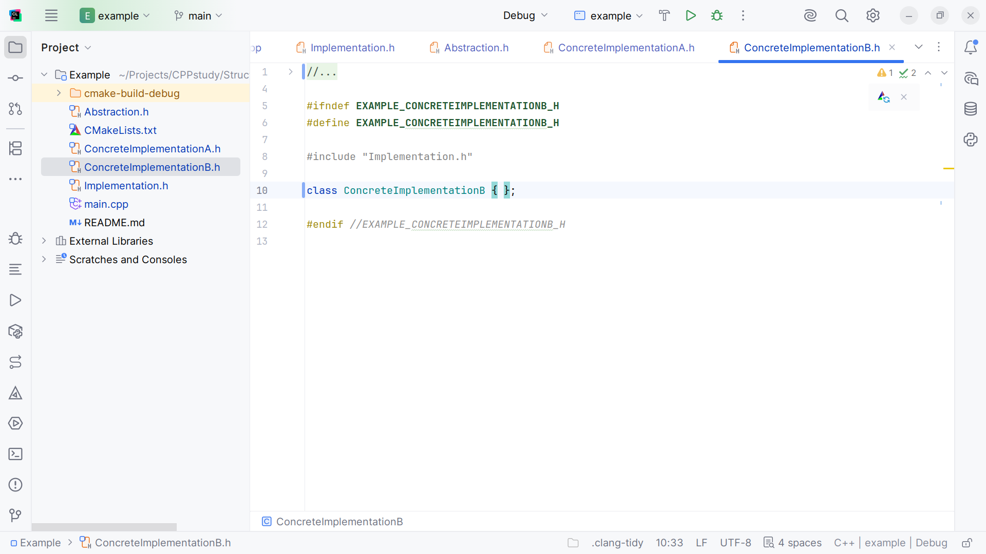
Notes:
Here is the Class structure and we include the Implementation at the top

Slide 21
Notes:
So we may extend this class with it

Slide 22
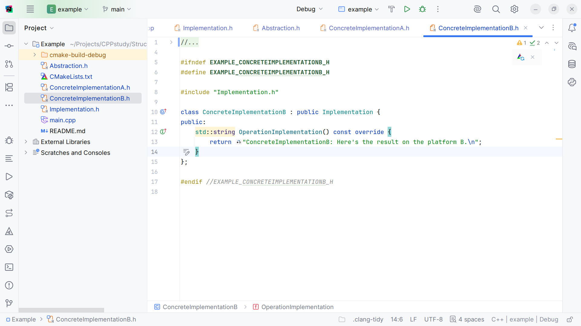
Notes:
As a result we require a the method Operation of which we return the string from Extended Abstraction: “Extended operation with“ Operation Implementation

Slide 23
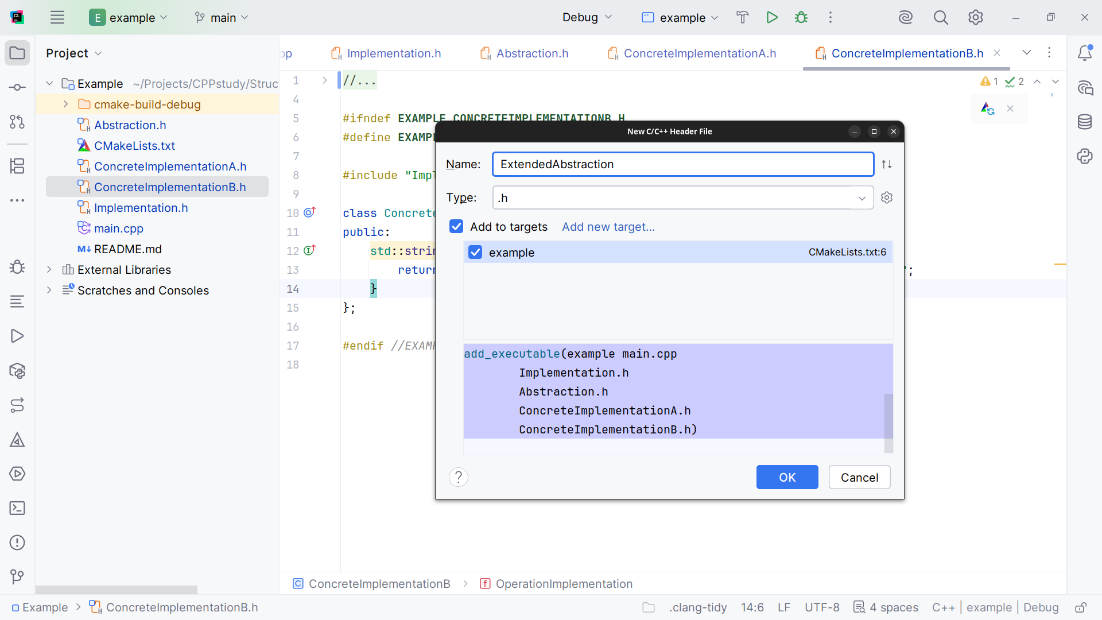
Notes:
Now let’s add the Extended Abstraction class

Slide 24
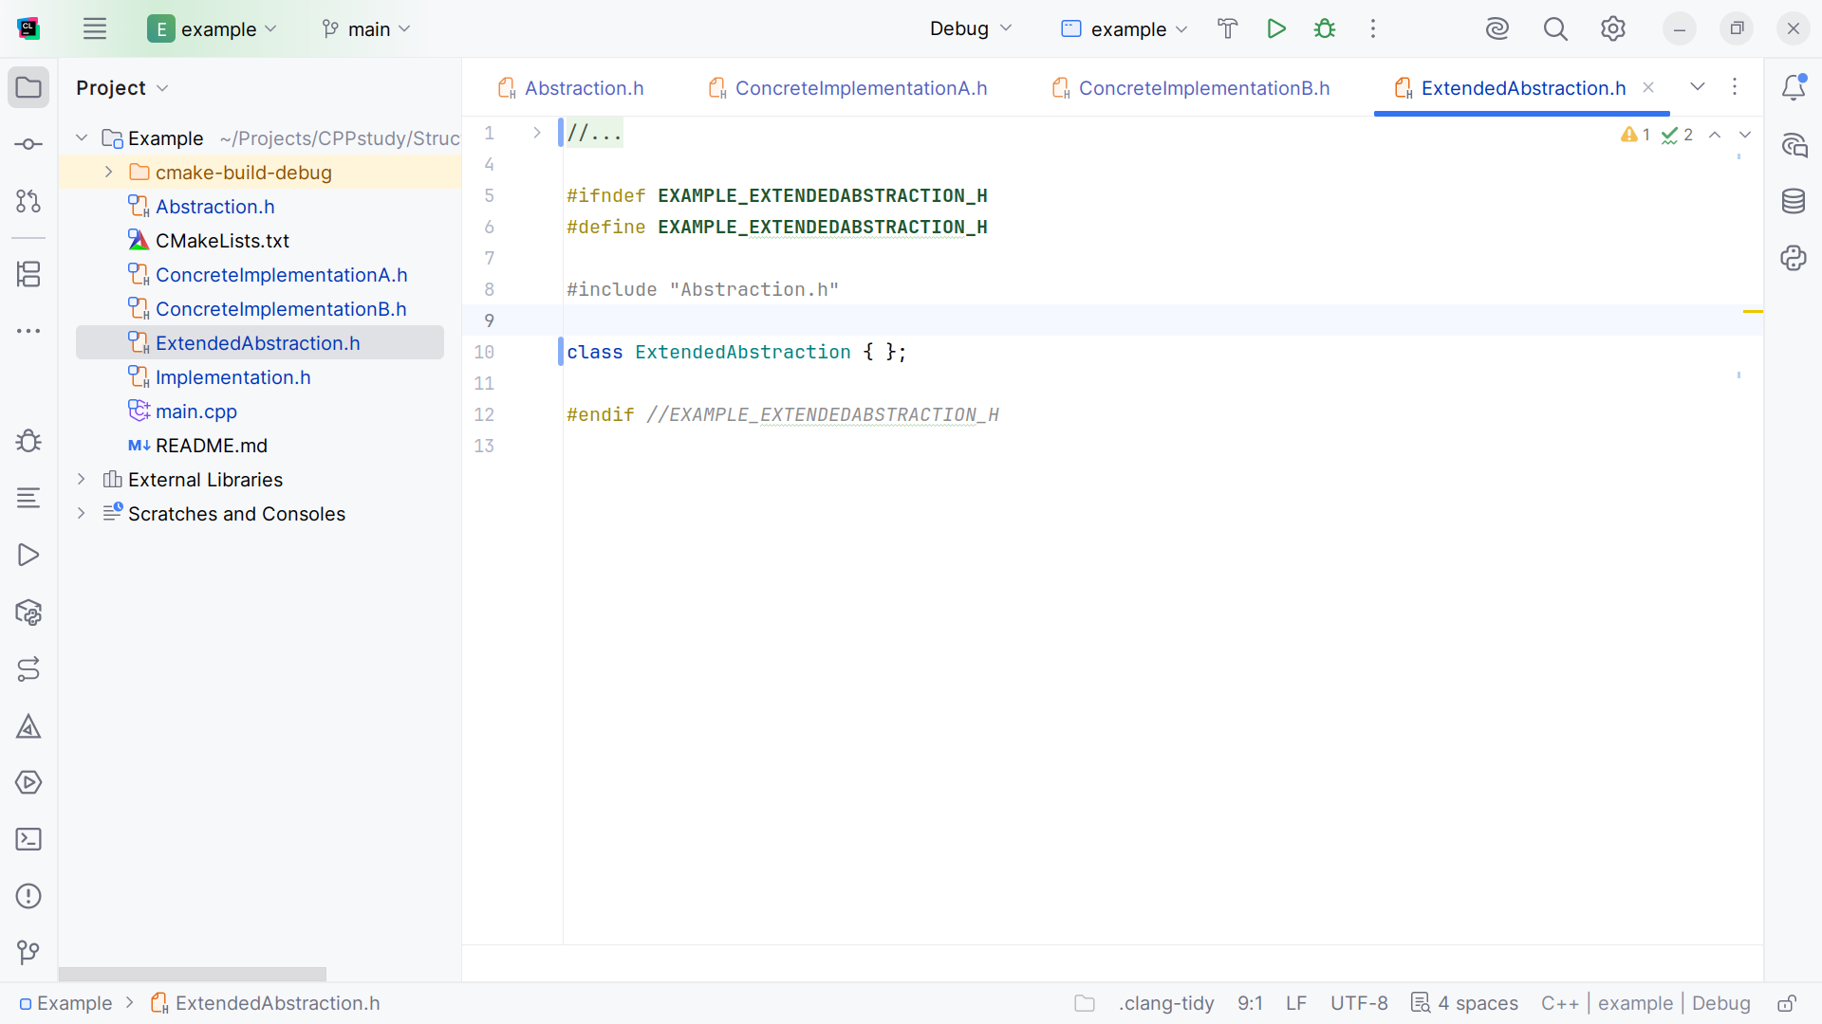
Notes:
We start with the class structure and we include Abstraction at the top

Slide 25
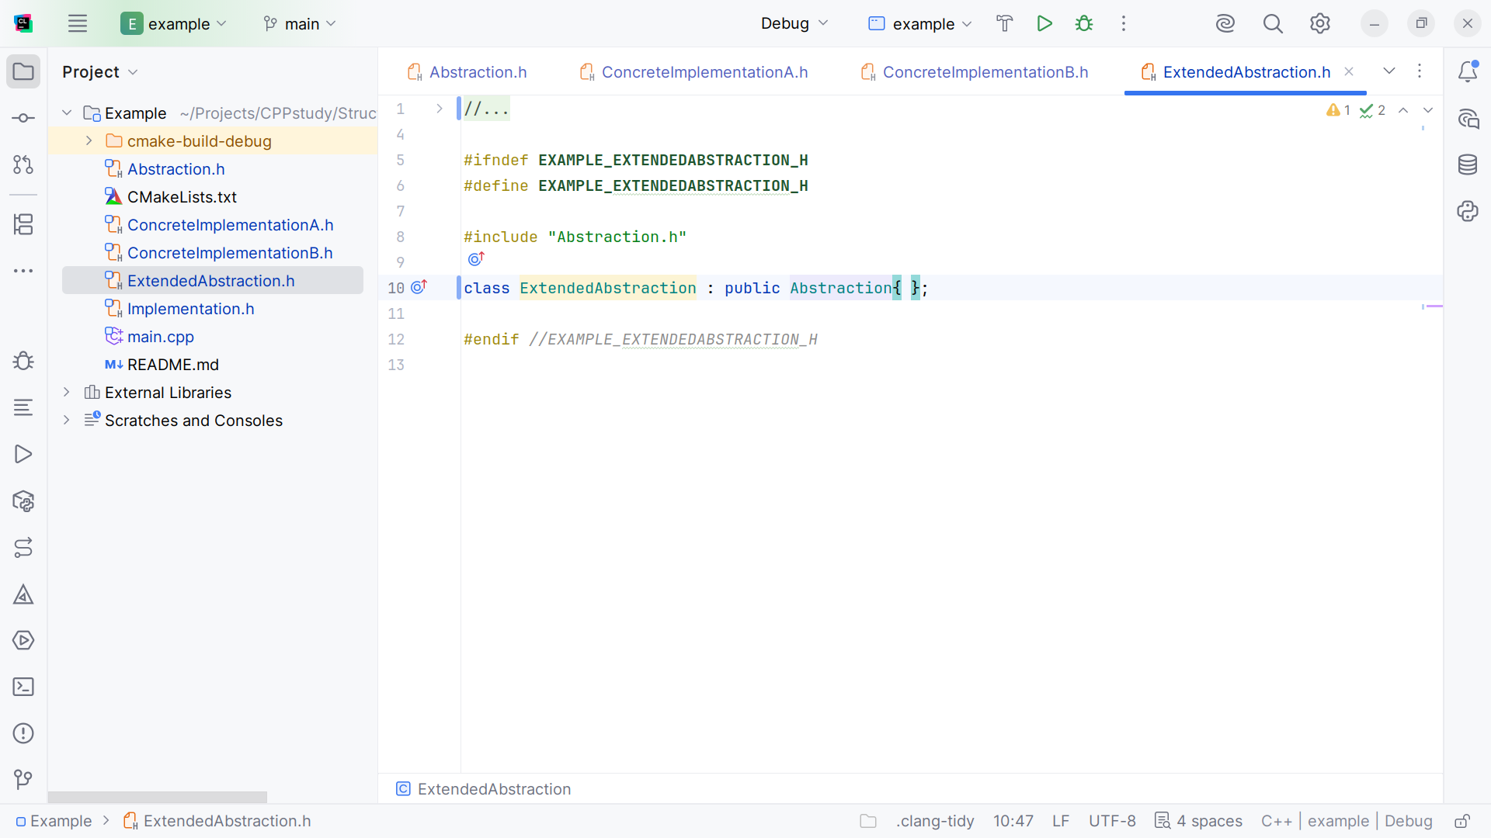
Notes:
With Abstraction we extend this class

Slide 26
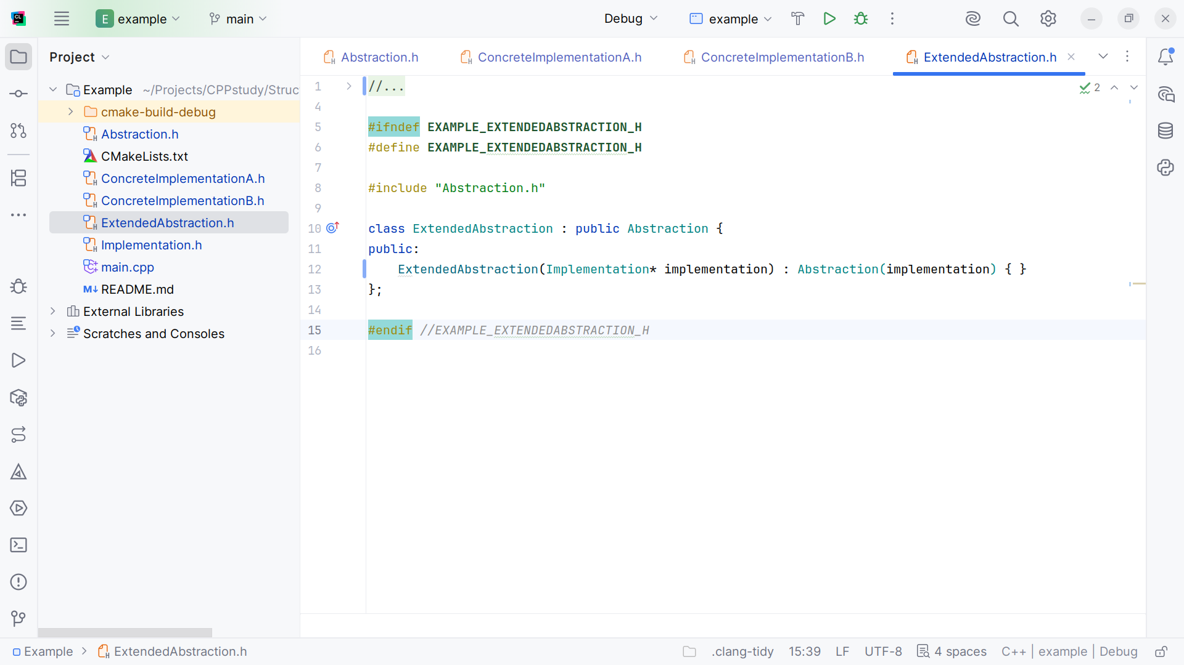
Notes:
We pass in a pointer to the implementation

Slide 27
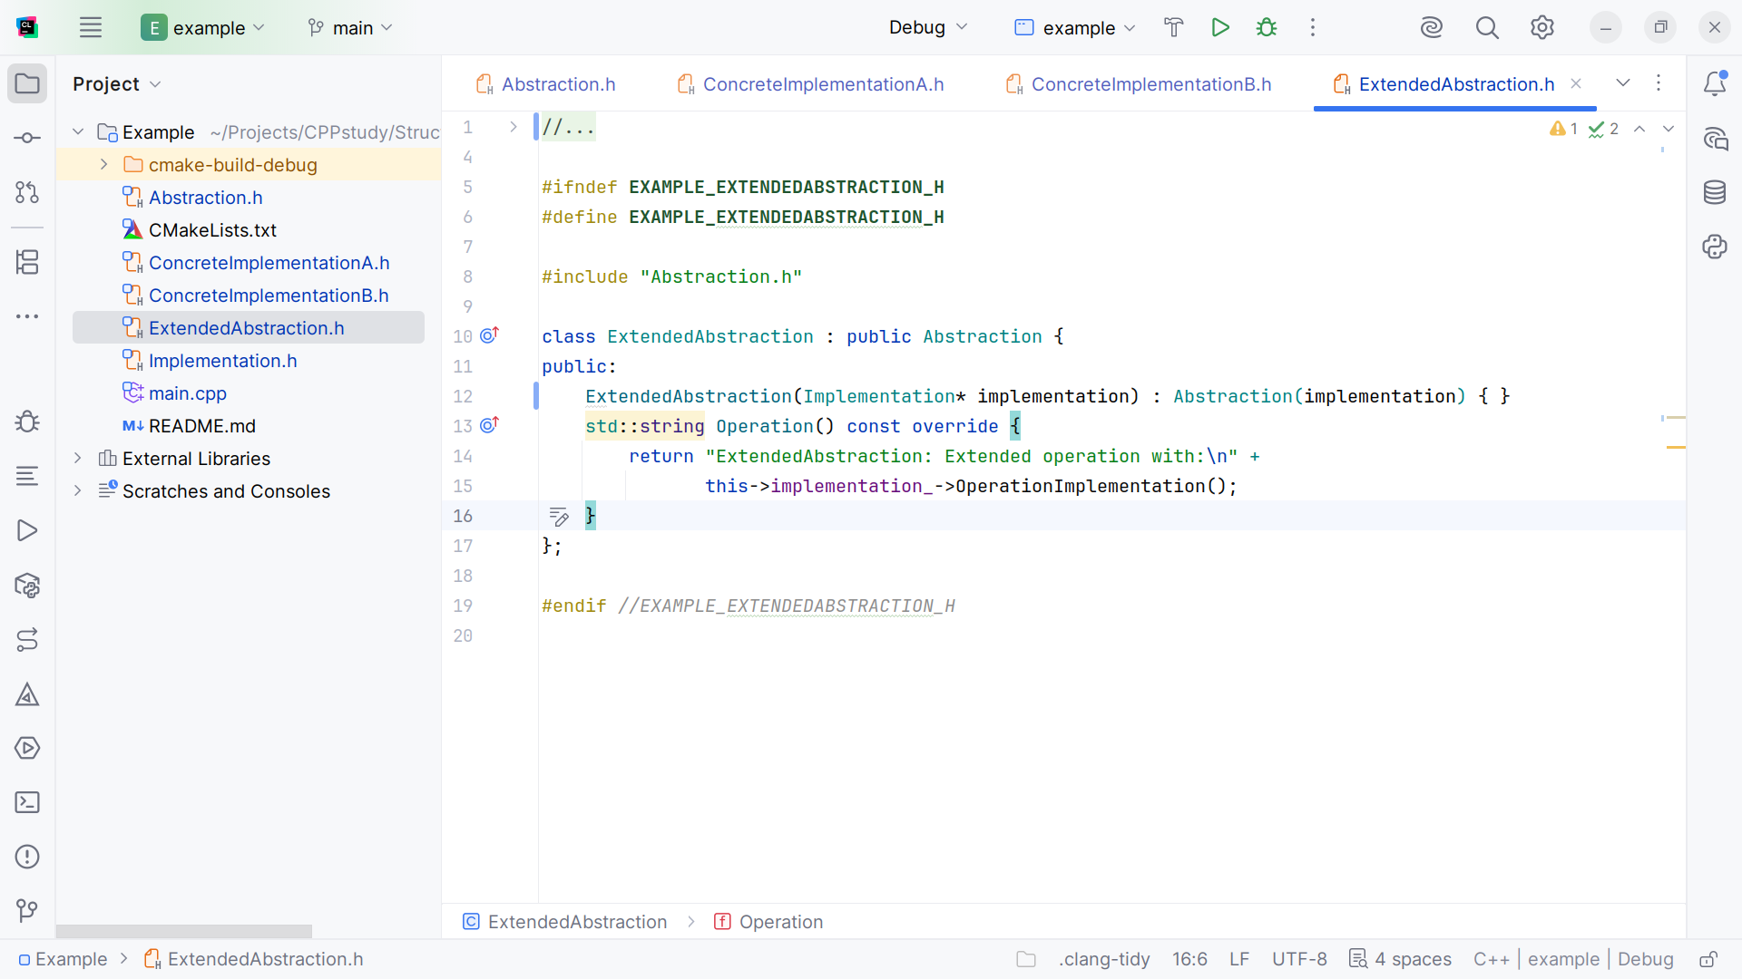
Notes:
And we return the string “Extended Abstraction: Extended operation with: the Operation Implementation that was passed in

Slide 28
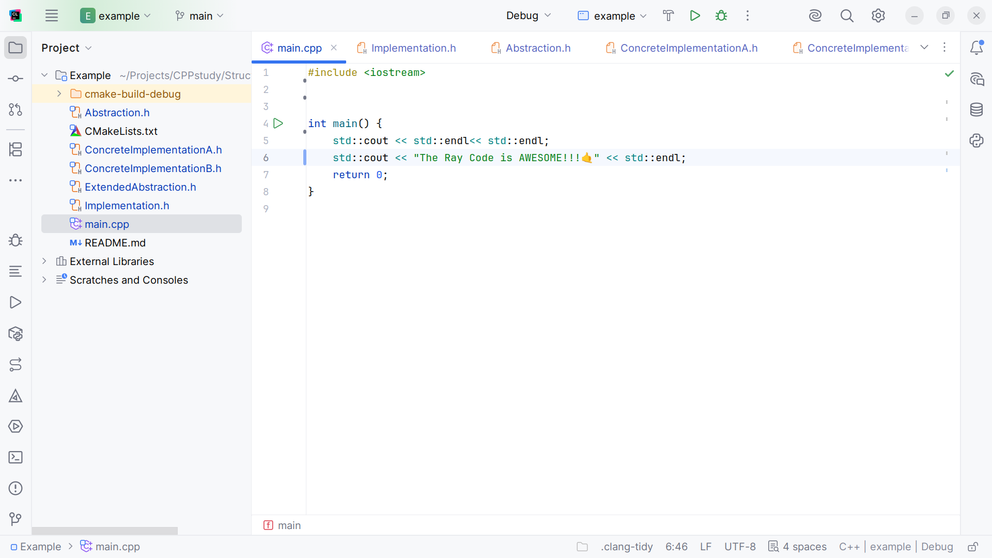
Notes:
Now let’s go to main for our demo

Slide 29
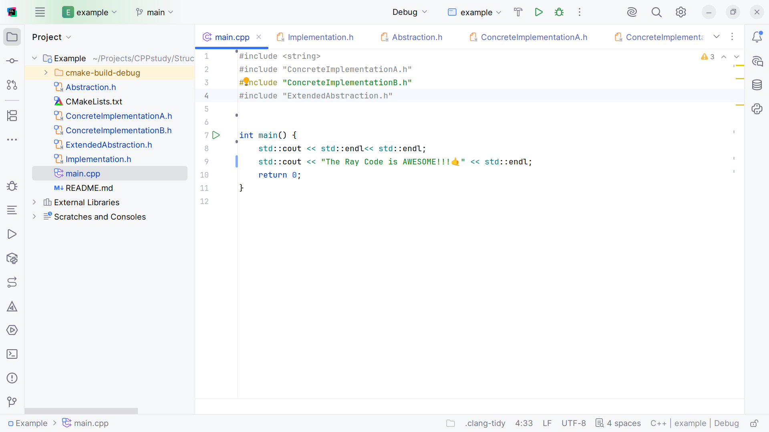
Notes:
At the top we include string
Concrete Implementation A and B
We no longer need IO Stream because that can be found in the Implementation class
And we include the Extended Abstraction

Slide 30
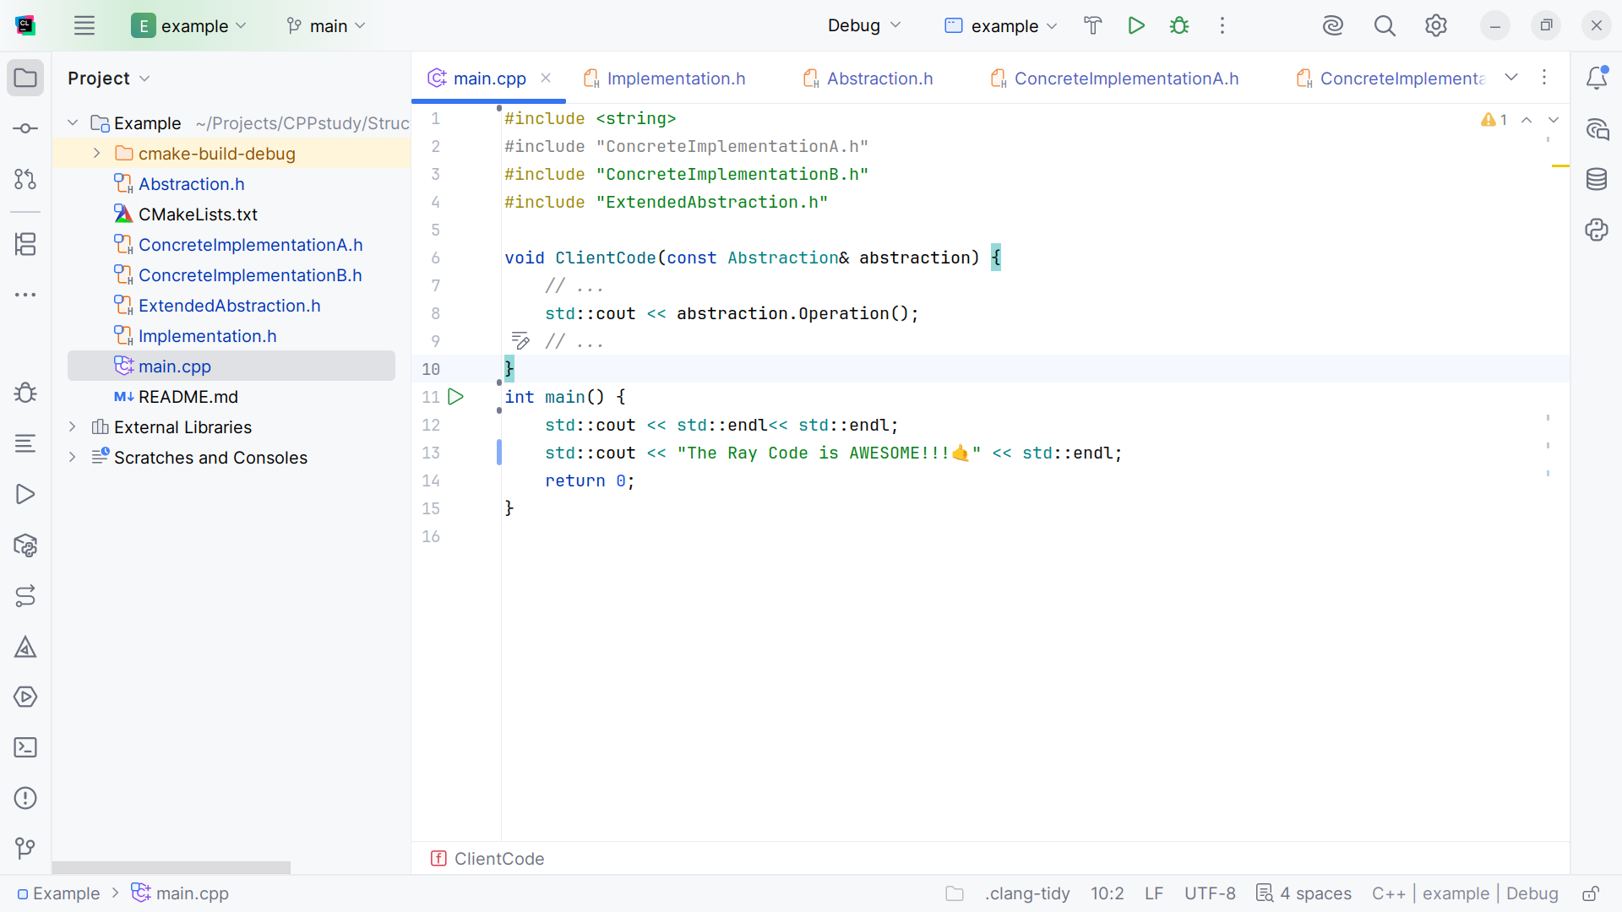
Notes:
We create some client code to return the Operation call on the abstraction

Slide 31
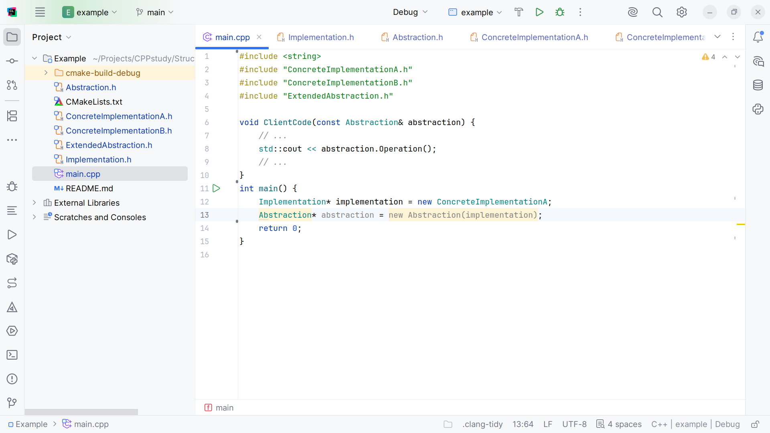
Notes:
We setup an implementation pointer to a new Concrete Implementation A
And an abstraction pointer pointing to a new Abstraction with the implementation passed in

Slide 32
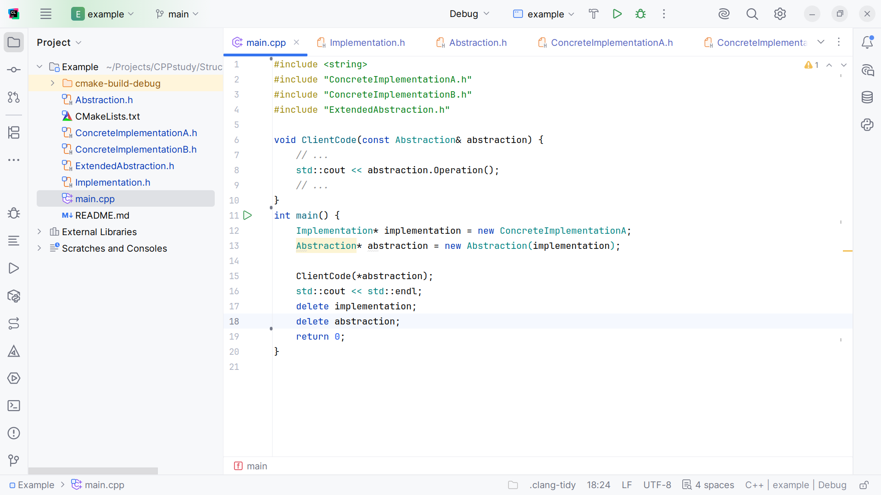
Notes:
We pass the abstraction into the client code and do some cleanup

Slide 33
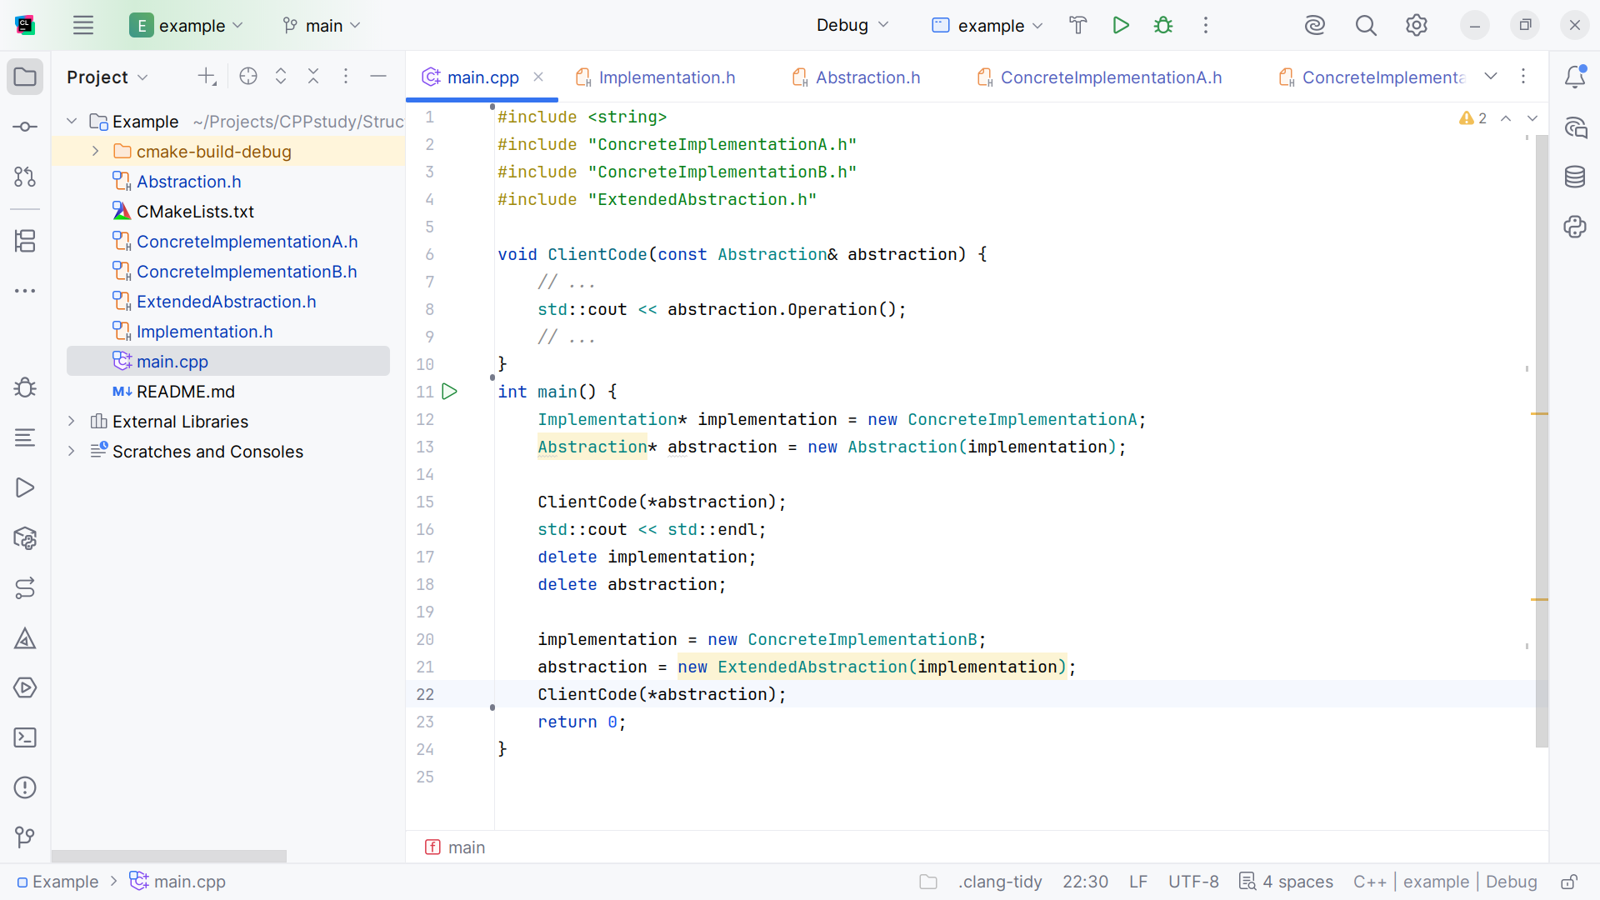
Notes:
Let’s setup another implementation we call Concrete Implementation B
And pass this abstraction into the client code

Slide 34
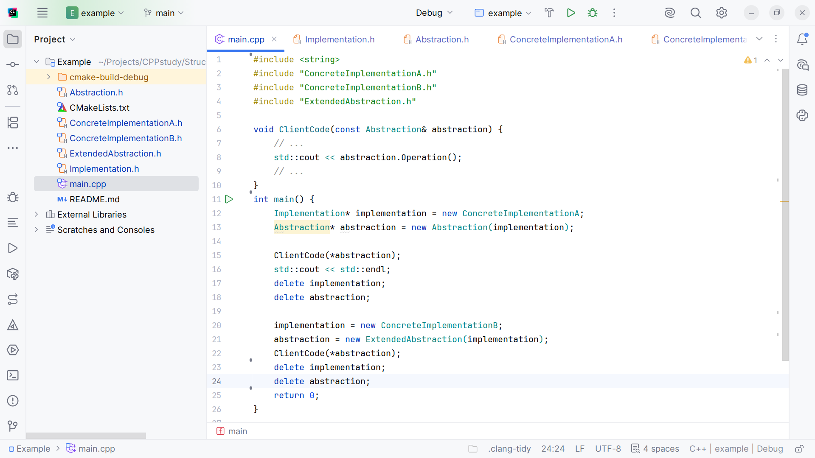
Notes:
And we do some cleanup at the end. I think we are ready to run

Slide 35
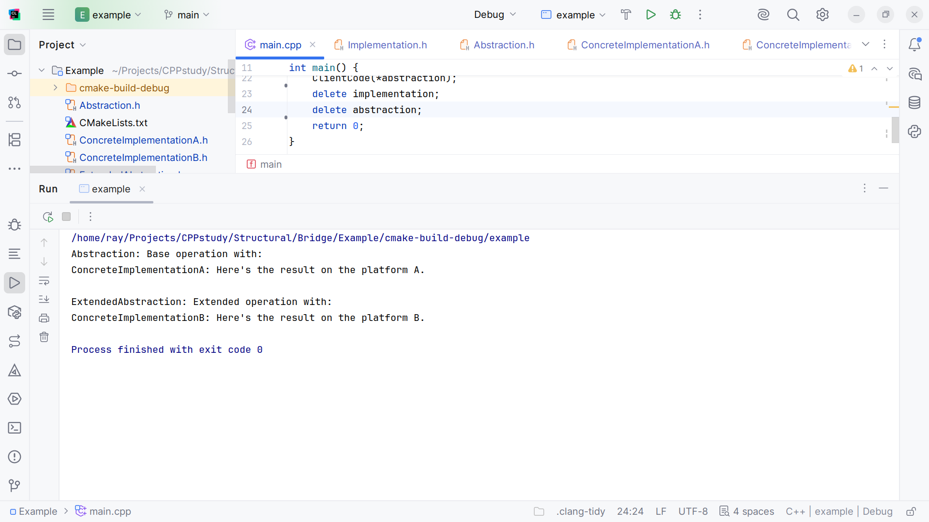
Notes:
We get
Abstraction: Base operation with:
Concrete Implementation A: Here's the result on the platform A.
Extended Abstraction: Extended operation with:
Concrete Implementation B: Here's the result on the platform B.
My name is Ray al ways code with a smile

