Slide 1

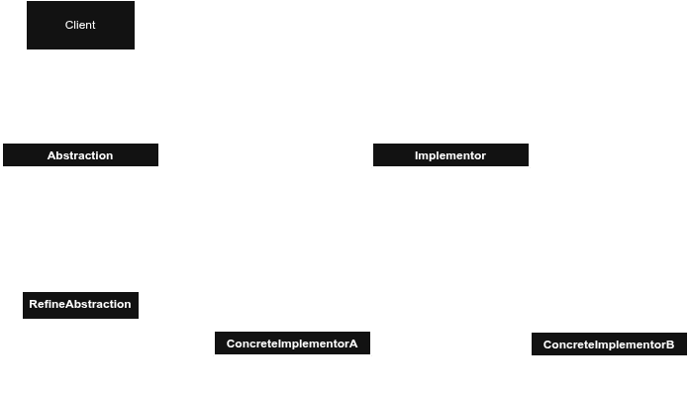
Notes:
No sound

Slide 2
Notes:
## UML for the Pattern: Structural Bridge for the C++ Student

Slide 3
Notes:
No sound

Slide 4
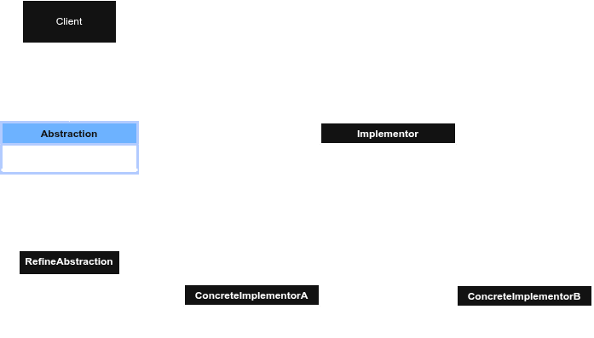
Notes:
### Abstraction
1. Defines the high-level interface that the client uses.
2. Holds a pointer or reference to an `Implementor`
3. Delegates actual work to the `Implementor` object instead of doing it directly.
4. In C++, often implemented as a base class with virtual functions.

Slide 5
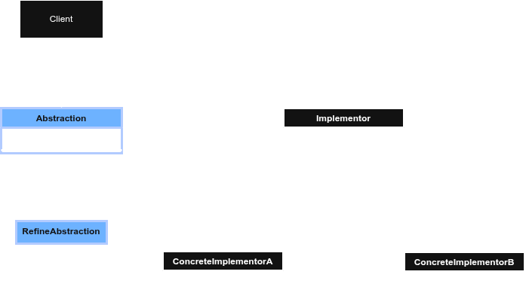
Notes:
### RefinedAbstraction
1. Extends `Abstraction` with more specific behavior.
2. Uses the inherited `Implementor` pointer to perform operations.
3. Adds or overrides functionality without changing the implementation layer.
4. In C++, typically overrides virtual functions from `Abstraction`.

Slide 6
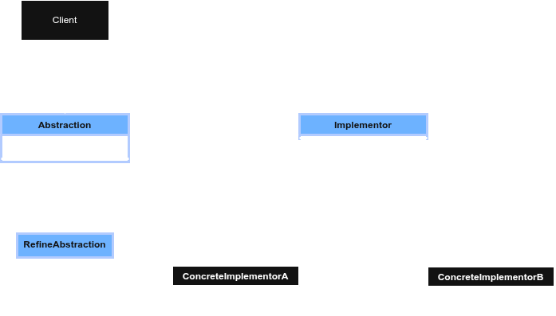
Notes:
### Implementor
1. Defines the interface for implementation classes.
2. Provides low-level operations that `Abstraction` relies on.
3. Does not need to match the `Abstraction` interface exactly.
4. In C++, usually an abstract base class with pure virtual functions.

Slide 7
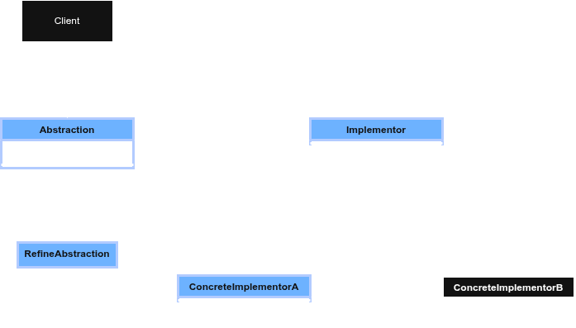
Notes:
ConcreteImplementorA
Implements the Implementor interface with specific behavior.
Provides concrete definitions for all required operations.
Can vary independently from other implementors.
In C++, overrides all pure virtual functions from Implementor.

Slide 8
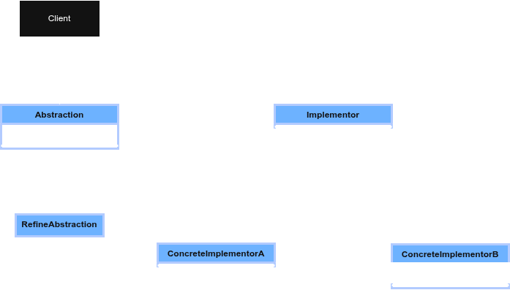
Notes:
ConcreteImplementorB
1. Provides an alternative implementation of the `Implementor` interface.
2. Implements the same operations differently than `ConcreteImplementorA`.
3. Allows switching implementations at runtime via pointers.
4. In C++, used interchangeably through base-class (`Implementor*`) pointers.

Slide 9
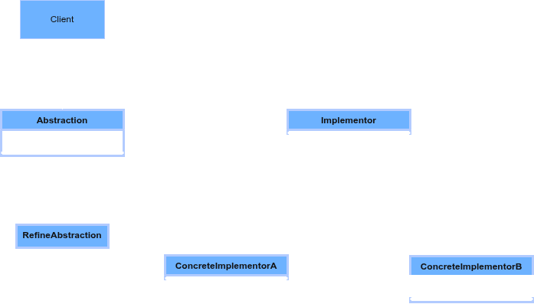
Notes:
### Client
1. Interacts only with the `Abstraction` interface.
2. Does not directly depend on concrete implementation classes.
3. Supplies or selects a `ConcreteImplementor` to be used.
4. In C++, typically creates objects and passes `Implementor*` to `Abstraction`.

Slide 10
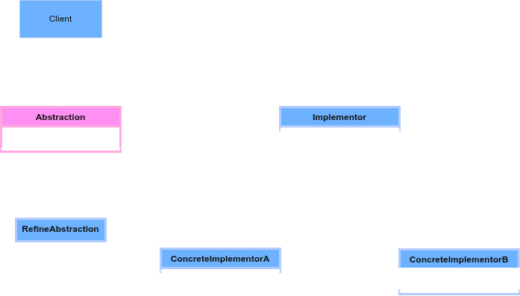
Notes:
**Abstraction**: The main interface your program uses; holds a pointer to the implementation.

Slide 11
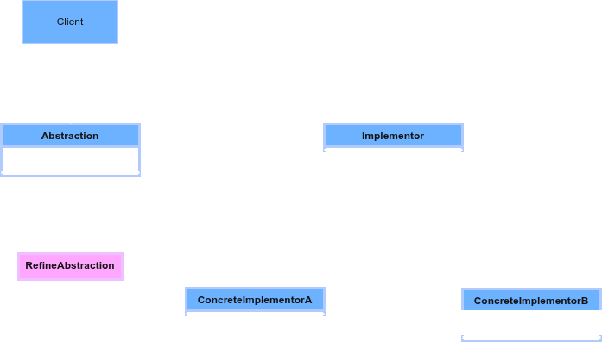
Notes:
** RefinedAbstraction**: A specialized version of the abstraction with added behavior.

Slide 12
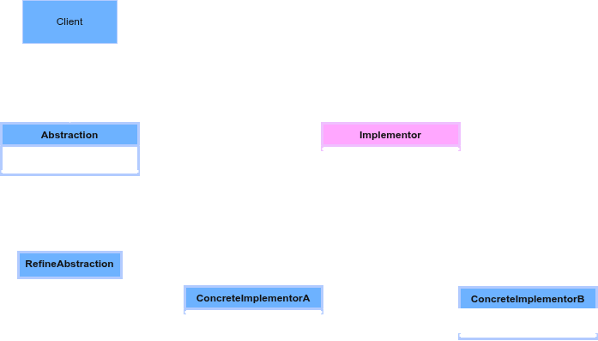
Notes:
### **Implementor**: The interface for low-level work; defines what implementations must do.

Slide 13
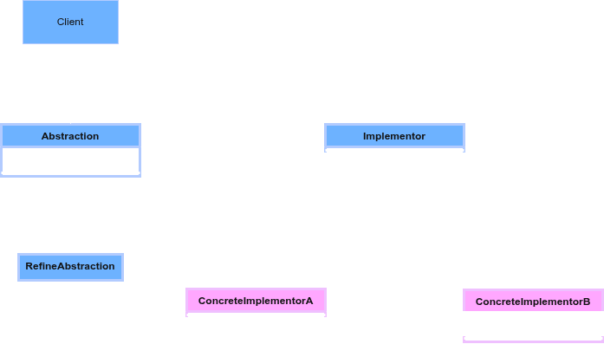
Notes:
**ConcreteImplementorA**: One specific way to implement the low-level operations.
* **ConcreteImplementorB**: Another interchangeable implementation with different behavior.

Slide 14
Notes:
**ConcreteImplementorA**: One specific way to implement the low-level operations.
* **ConcreteImplementorB**: Another interchangeable implementation with different behavior.

Slide 15
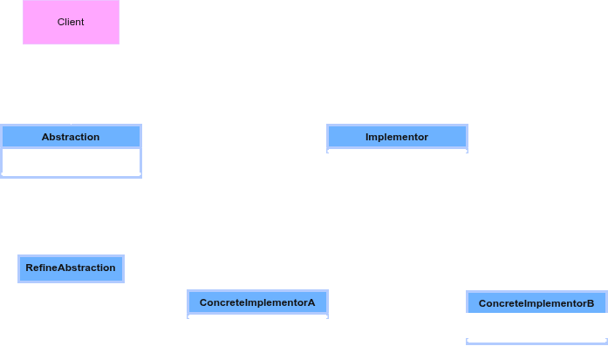
Notes:
** Client**: The user of the abstraction; wires everything together using pointers.

Slide 16
Notes:
No sound

Slide 17
Notes:
### Participant: Abstraction
1. Defines the high-level interface that the client uses.
2. Holds a pointer or reference to an `Implementor`
3. Delegates actual work to the `Implementor` object instead of doing it directly.
4. In C++, often implemented as a base class with virtual functions.

Slide 18
Notes:
### Participant: Abstraction
1. Defines the high-level interface that the client uses.
2. Holds a pointer or reference to an `Implementor`
3. Delegates actual work to the `Implementor` object instead of doing it directly.
4. In C++, often implemented as a base class with virtual functions.

Slide 19
Notes:
### Participant: Abstraction
1. Defines the high-level interface that the client uses.
2. Holds a pointer or reference to an `Implementor`
3. Delegates actual work to the `Implementor` object instead of doing it directly.
4. In C++, often implemented as a base class with virtual functions.

