Slide 1

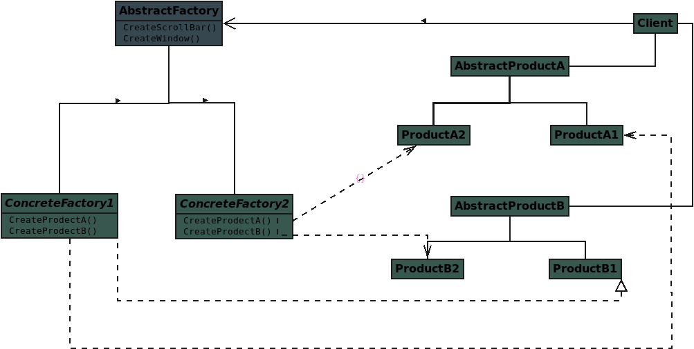

Slide 3
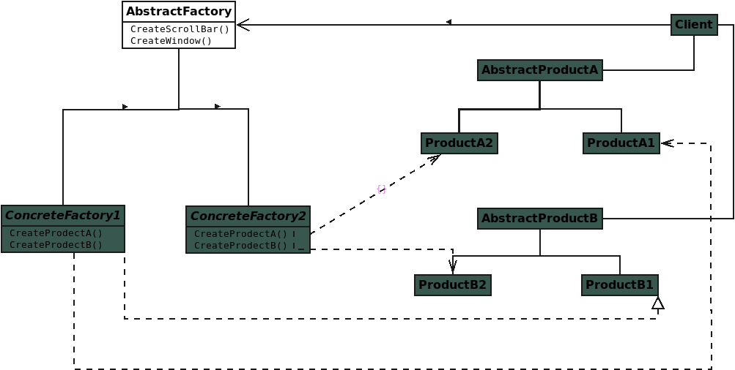
Notes:
Abstract Factory: declares an interface for operations that create abstract product objects

Slide 4
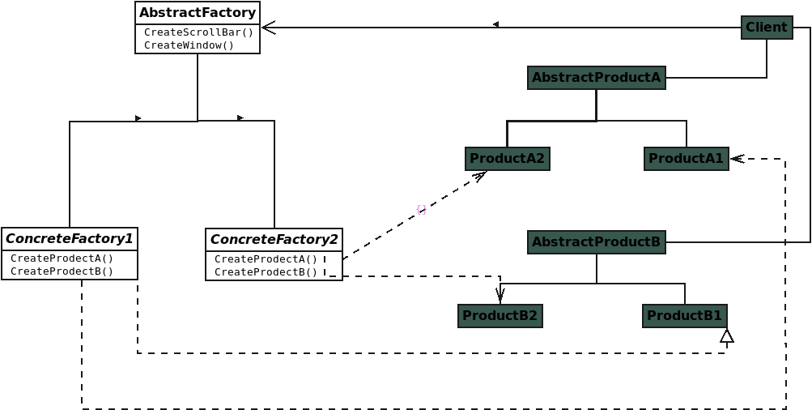
Notes:
Concrete Factory: implements the operations to create concrete product objects

Slide 5
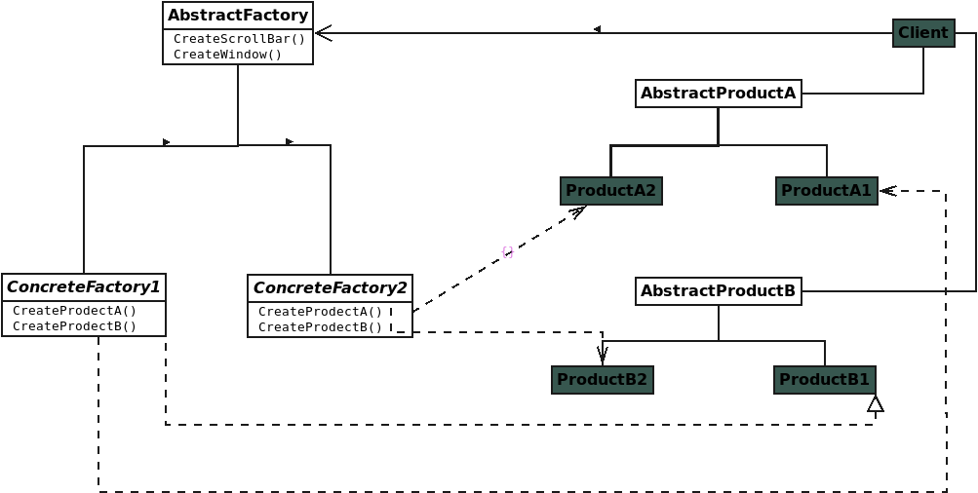
Notes:
Abstract Product: declares an interface for a type of product object

Slide 6
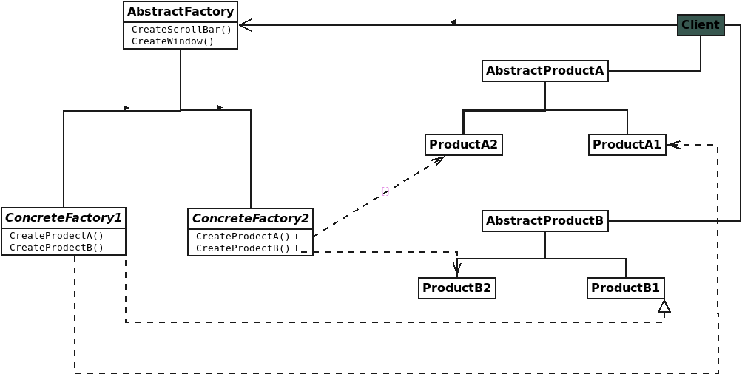
Notes:
Concrete Product defines a product object to be created by the corresponding concrete factory

Slide 7
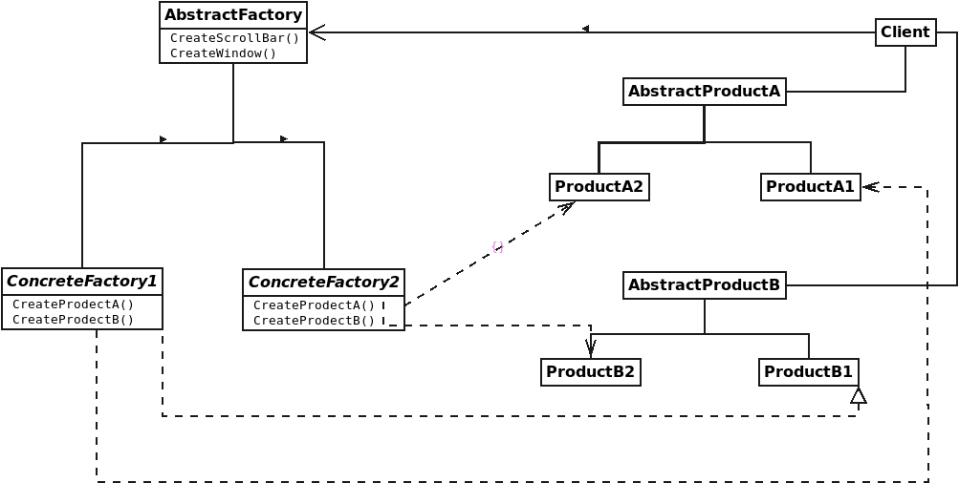
Notes:
Client: uses only interfaces declared by Abstract Factory and Abstract Product classes

Slide 8
Notes:
Client: uses only interfaces declared by Abstract Factory and Abstract Product classes

Slide 9
Notes:
Client: uses only interfaces declared by Abstract Factory and Abstract Product classes

Slide 10
Notes:
Client: uses only interfaces declared by Abstract Factory and Abstract Product classes

Slide 11
Notes:
Client: uses only interfaces declared by Abstract Factory and Abstract Product classes

Slide 12
Notes:
Client: uses only interfaces declared by Abstract Factory and Abstract Product classes

