Slide 1

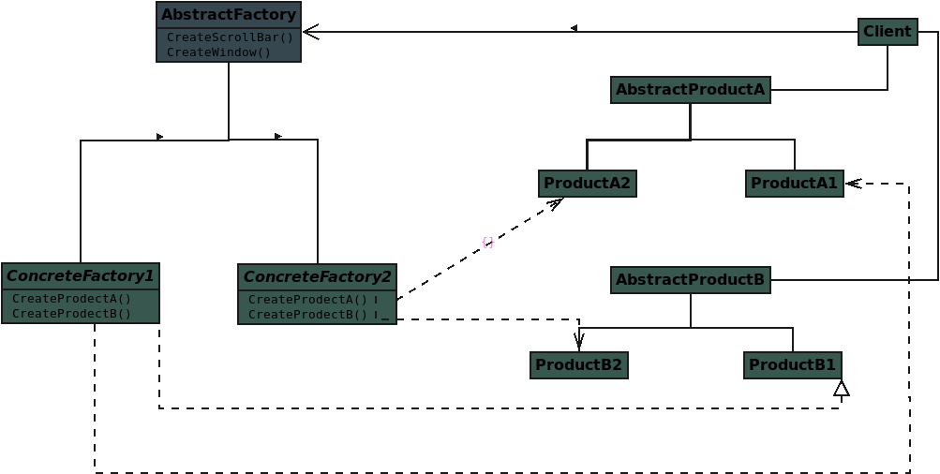

Slide 2
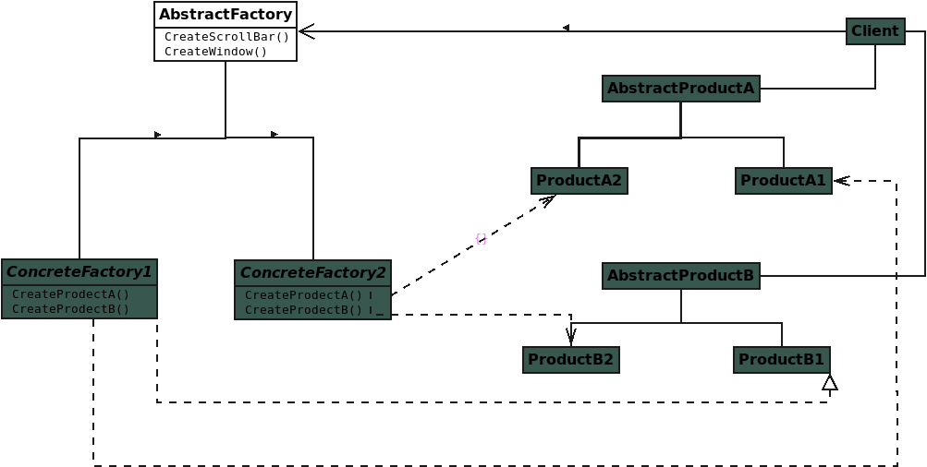
Notes:
Abstract Factory: declares an interface for operations that create abstract product objects

Slide 3
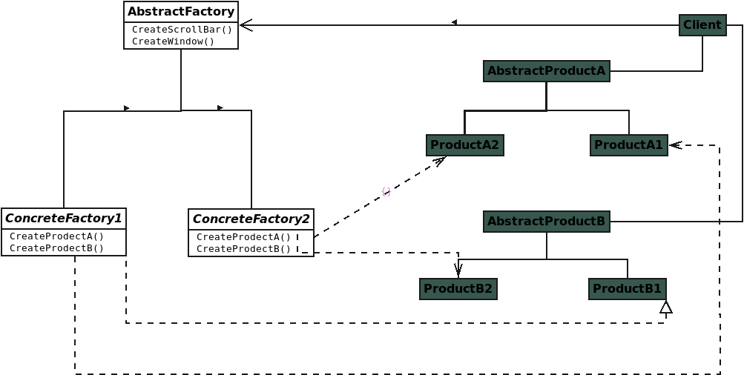
Notes:
Concrete Factory: implements the operations to create concrete product objects

Slide 4
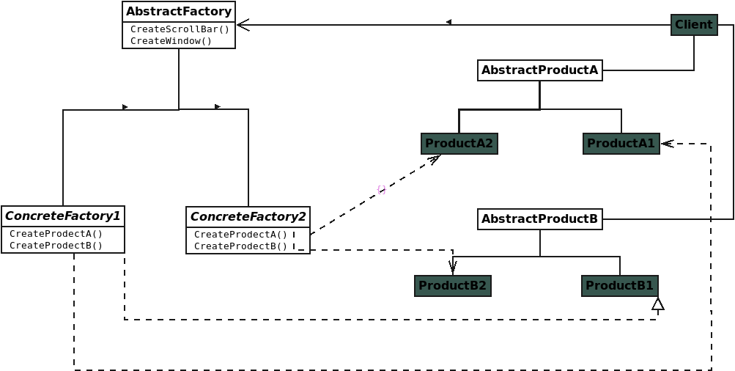
Notes:
Abstract Product: declares an interface for a type of product object

Slide 5
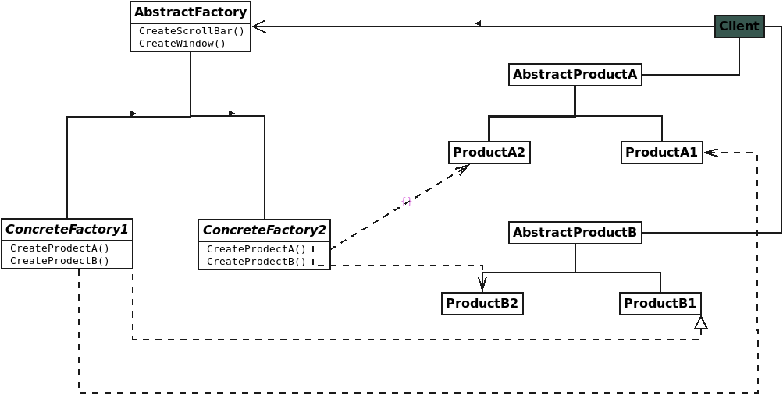
Notes:
Concrete Product defines a product object to be created by the corresponding concrete factory

Slide 6
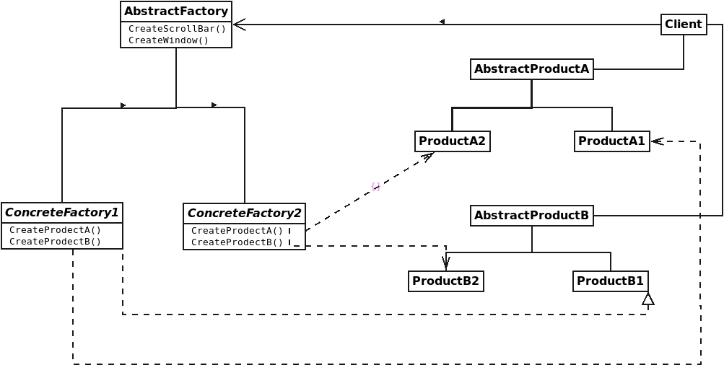
Notes:
Client: uses only interfaces declared by Abstract Factory and Abstract Product classes

Slide 7
Notes:
Why C++ developers should study the Strategy design pattern

