Slide 1
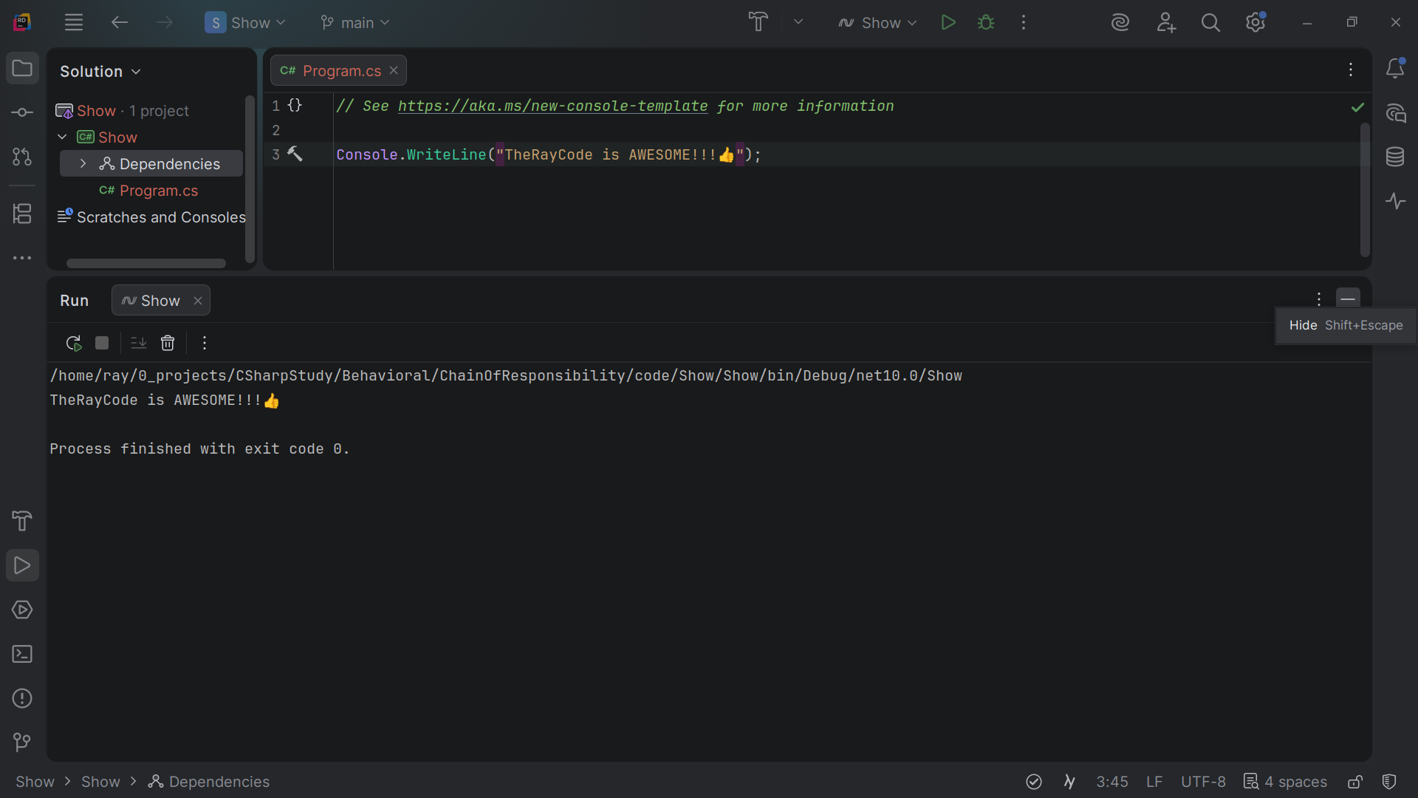
Notes:
No Sound

Slide 2
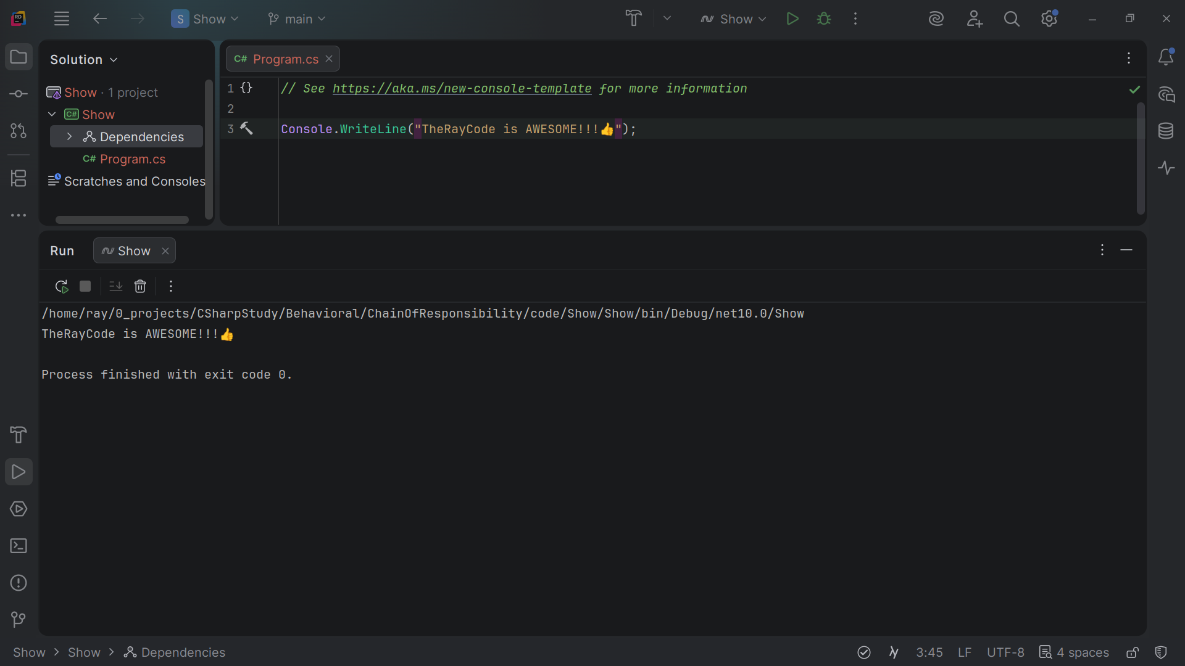
Notes:
Hello, my name is Ray and I’m the Ray in TheRayCode.
In this video I plan to porvide you an example of the Chain-of-responsibility design pattern

Slide 3
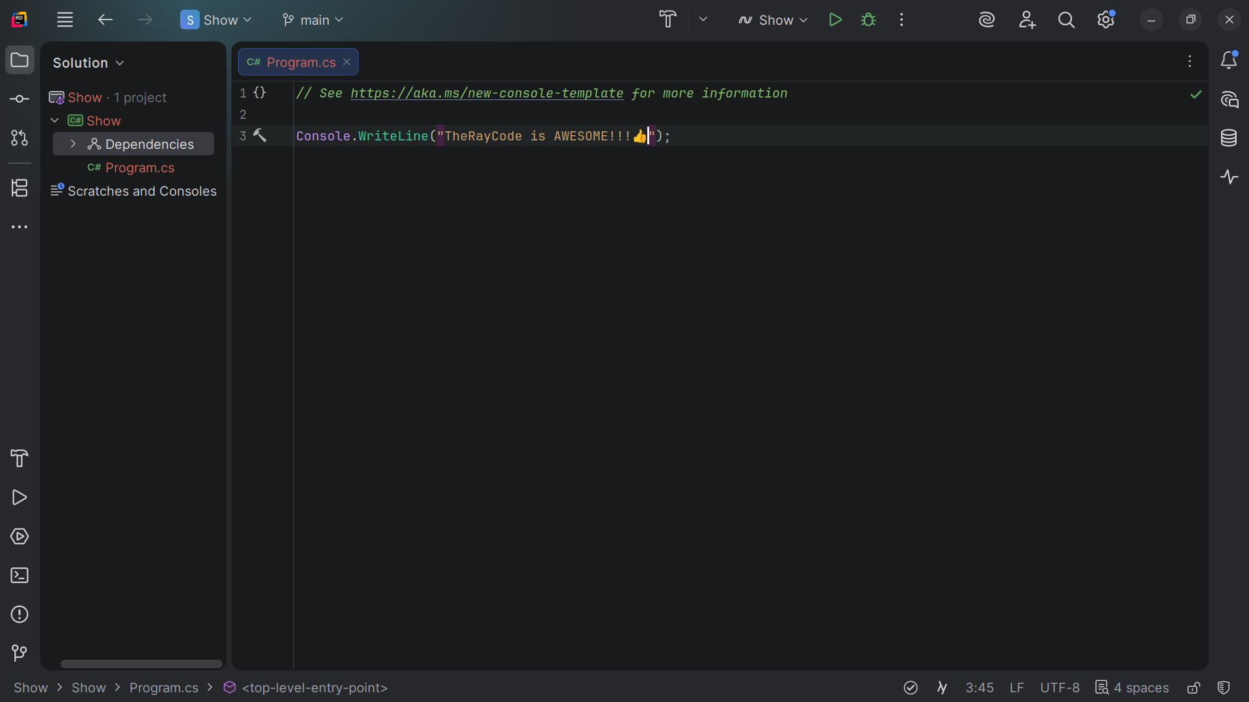
Notes:
The Chain of Responsibility lets multiple C# handler objects process a request sequentially passing it int a chain until one object handles it reducing tight coupling between sender and reviver

Slide 4
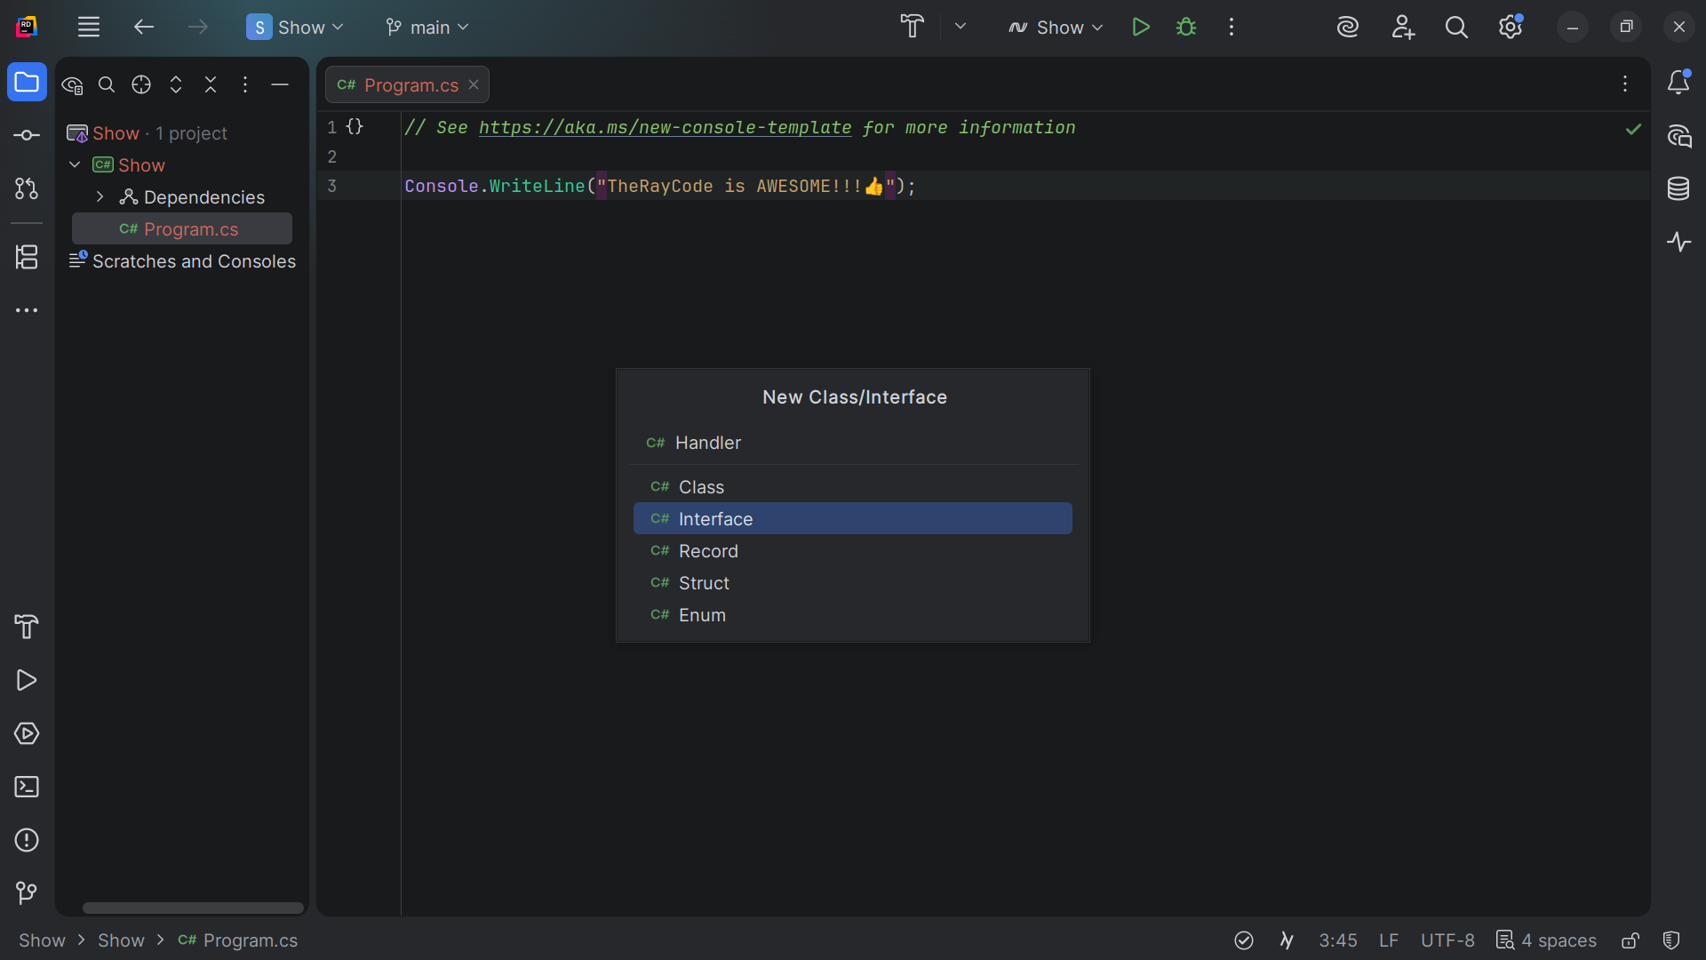
Notes:
We start with the Handler interface

Slide 5
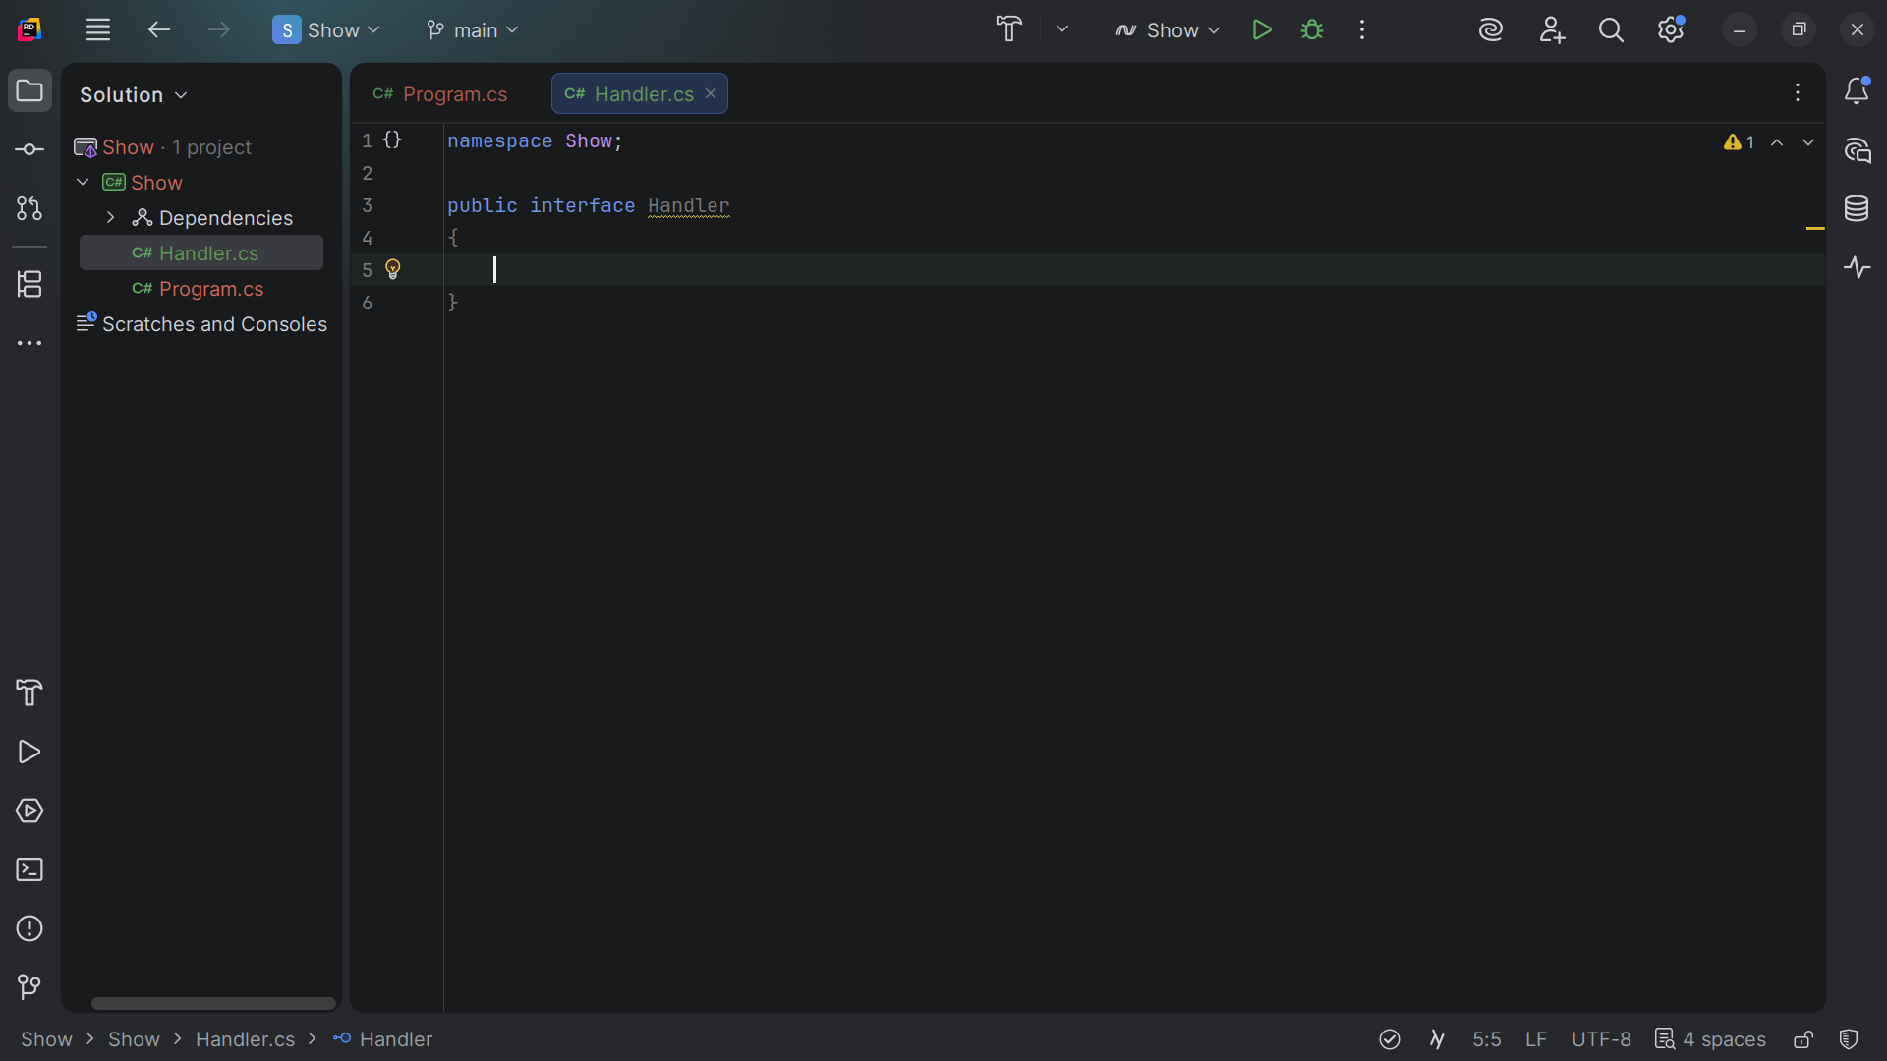
Notes:
We have the interface structure

Slide 6
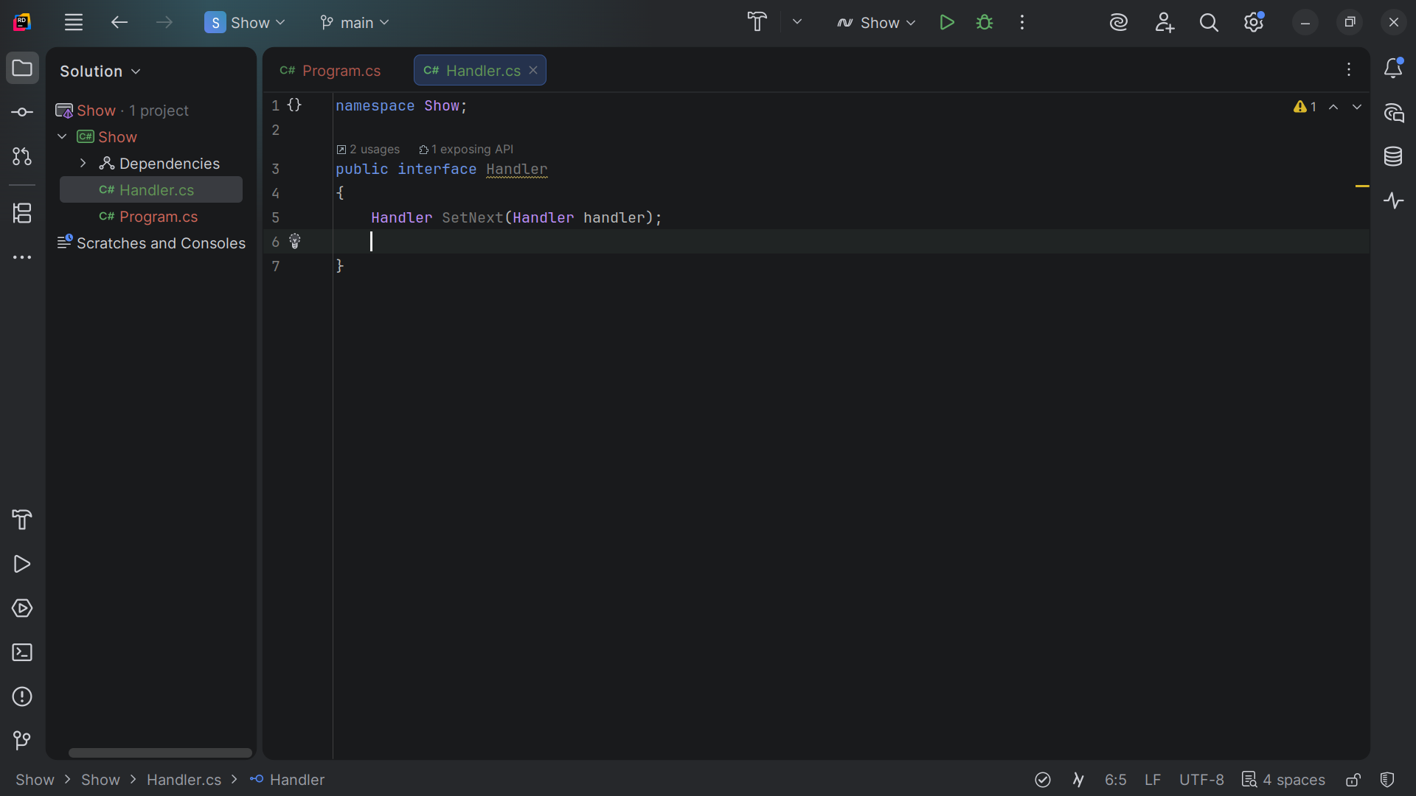
Notes:
We add a requirement for a method to Set Next which takes a Handler object

Slide 7
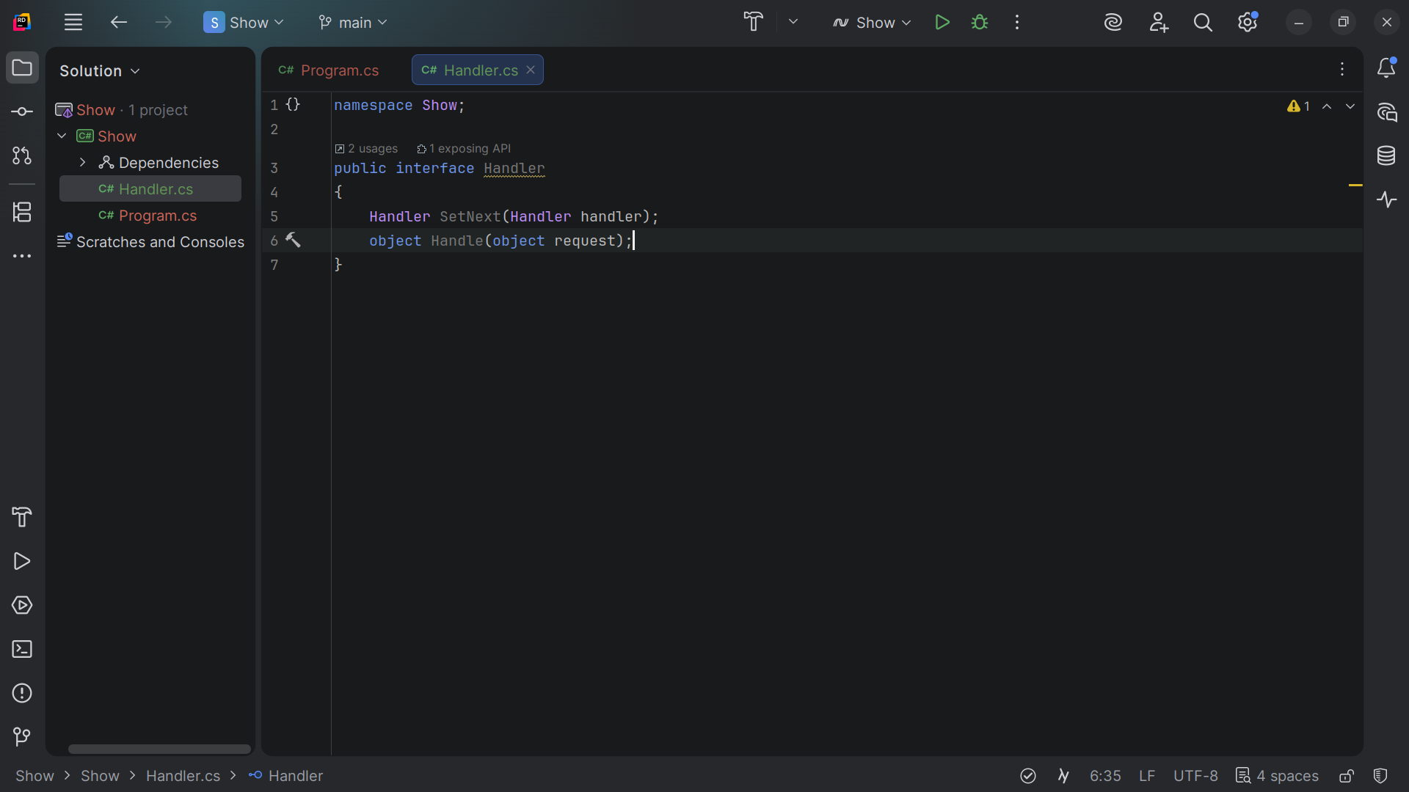
Notes:
A handle that takes a request

Slide 8
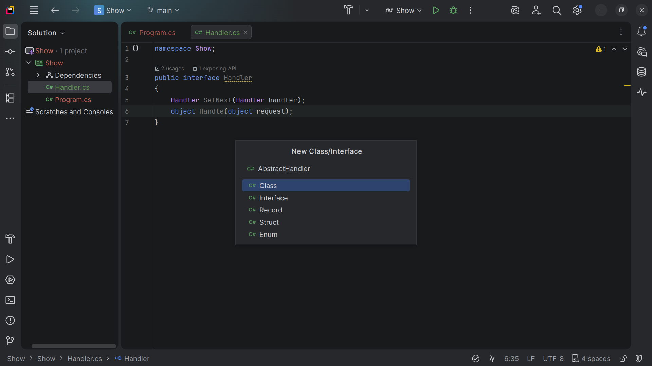
Notes:
We create an Abstract Handler class

Slide 9
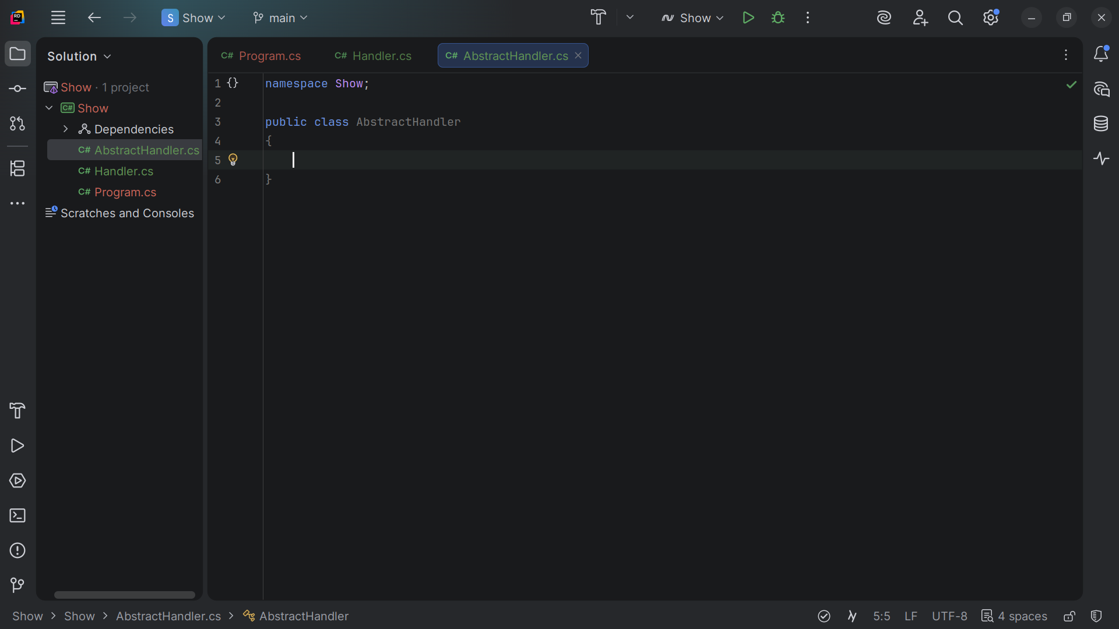
Notes:
Here we have the class structure

Slide 10
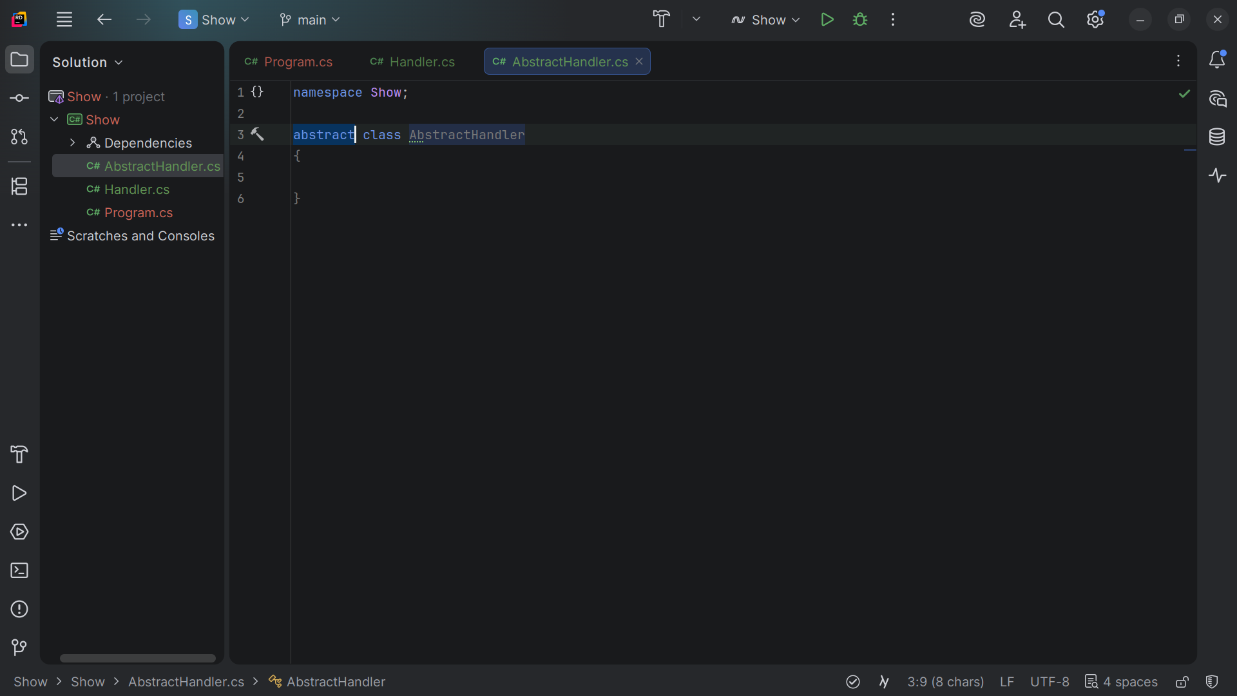
Notes:
But I want this to be an abstract class

Slide 11
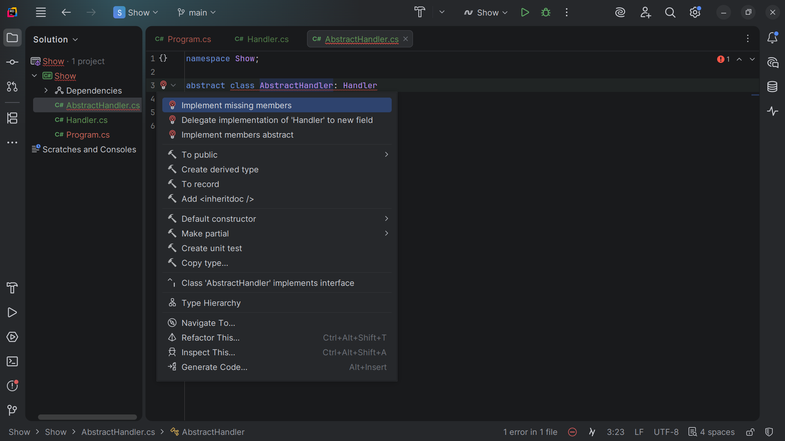
Notes:
We implement the missing members

Slide 12
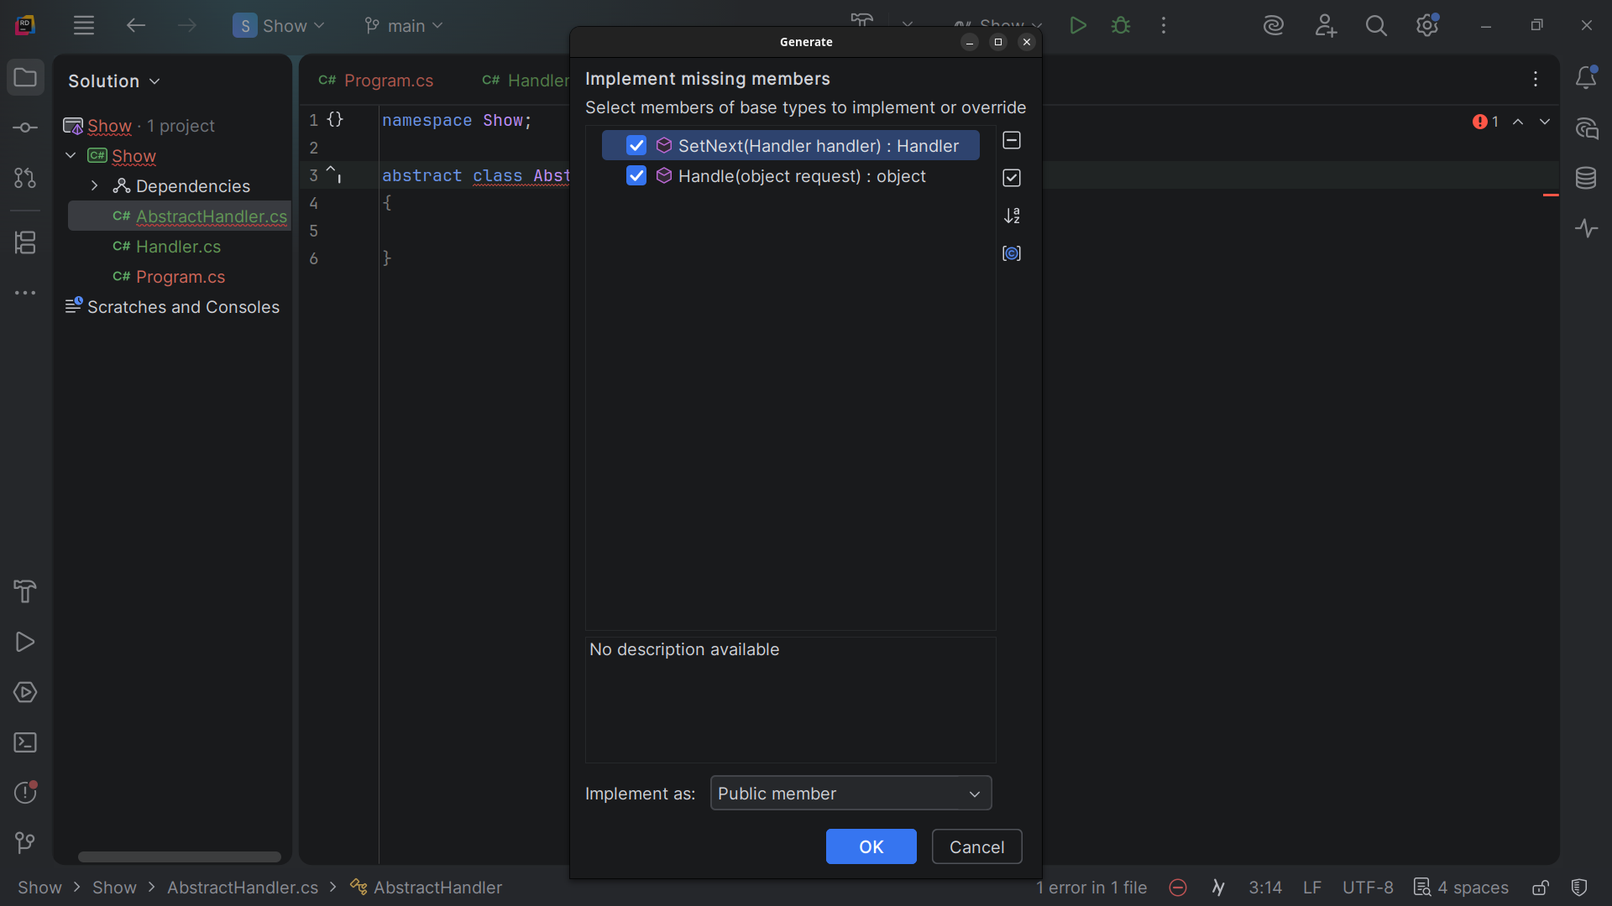
Notes:
Set Next and handle object

Slide 13
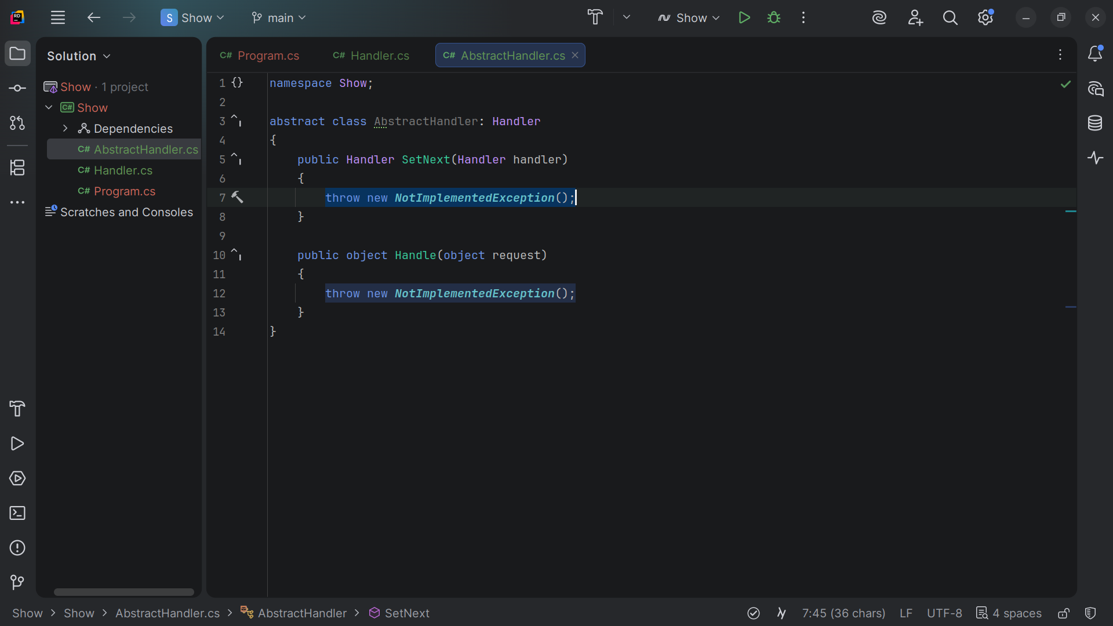

Slide 14
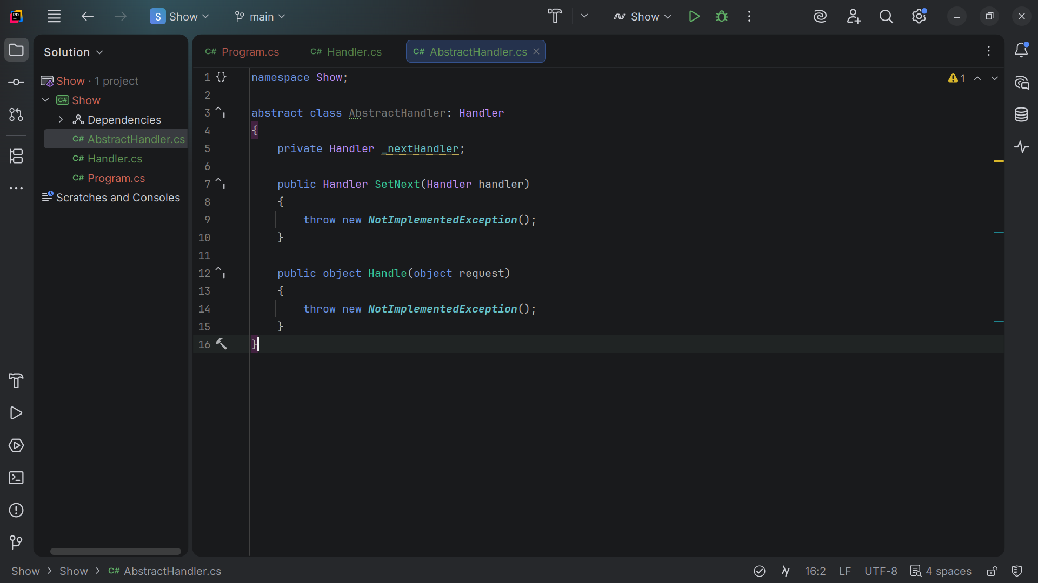
Notes:
At the top we add a private handler for the next handler

Slide 15
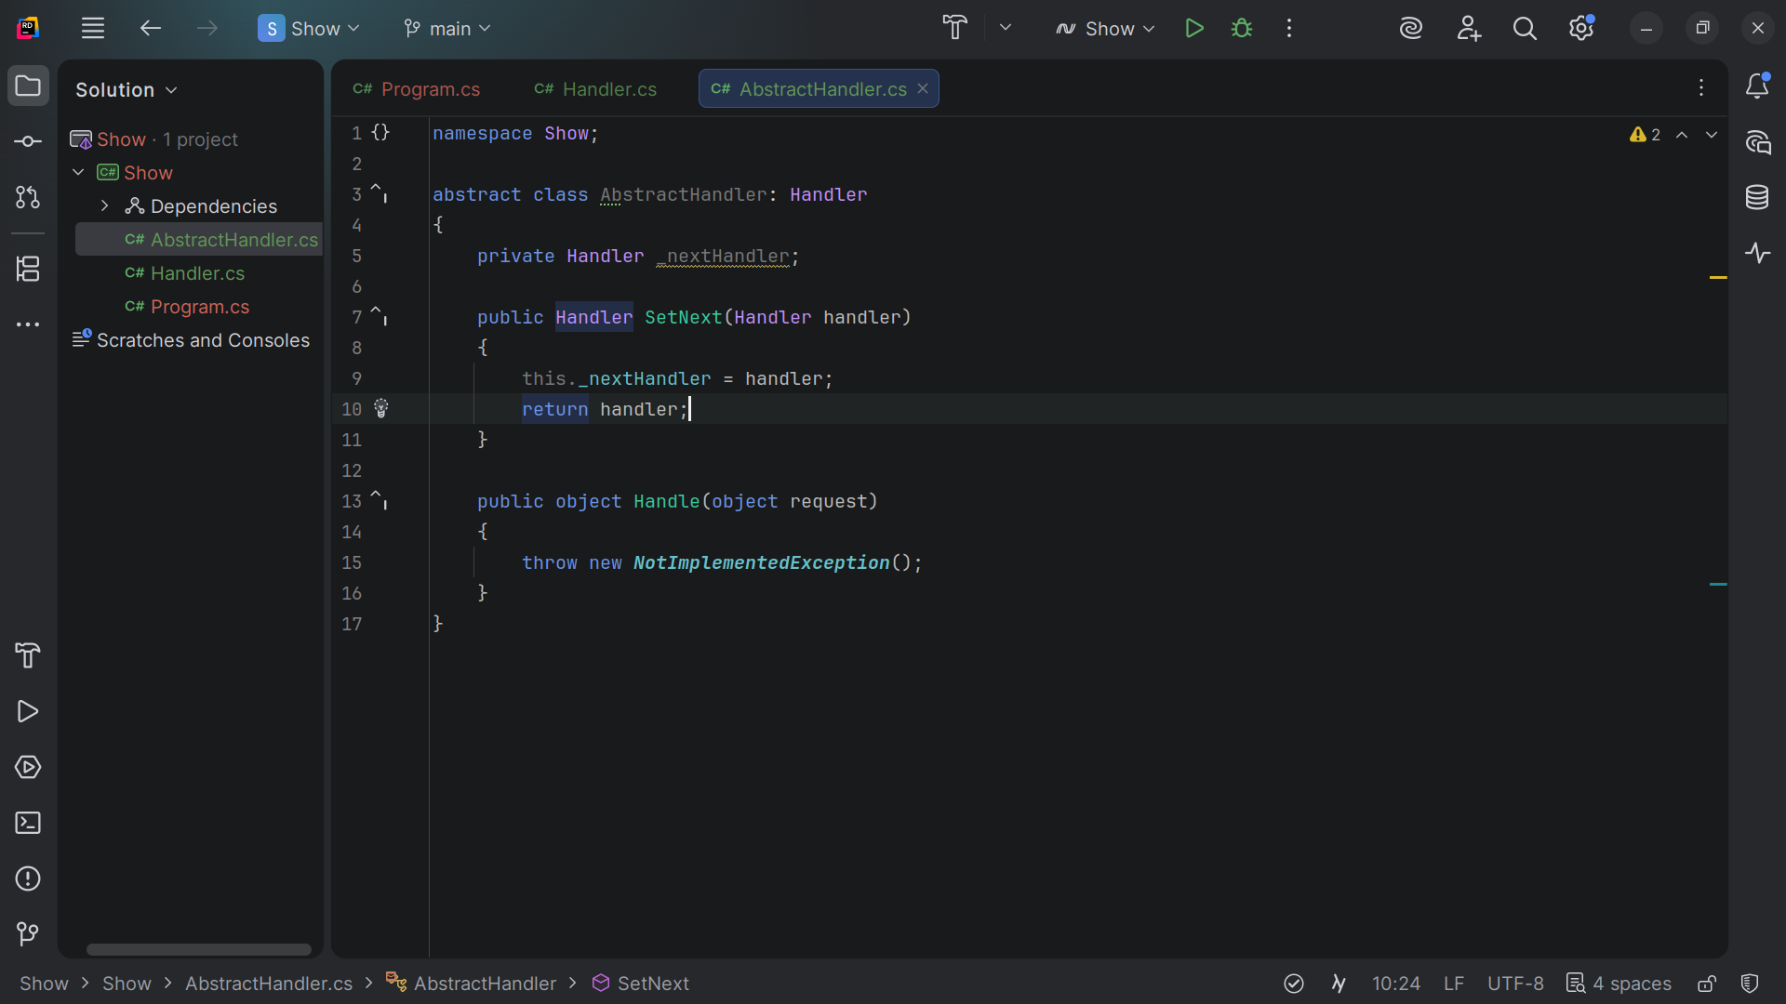
Notes:
This dot Handler is set to the Handler we passed in and we return the Handler

Slide 16
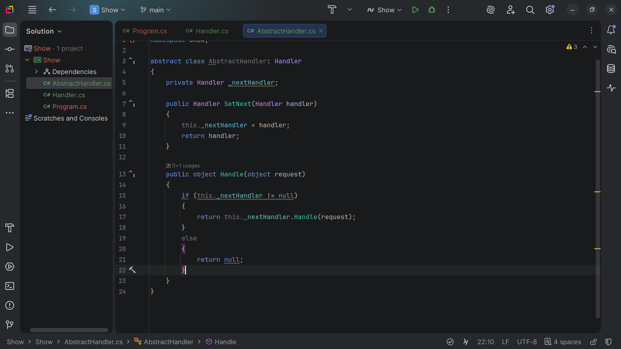
Notes:
For public object Handle we pass the request a check to see if Next Handle is not null and we return it

Slide 17
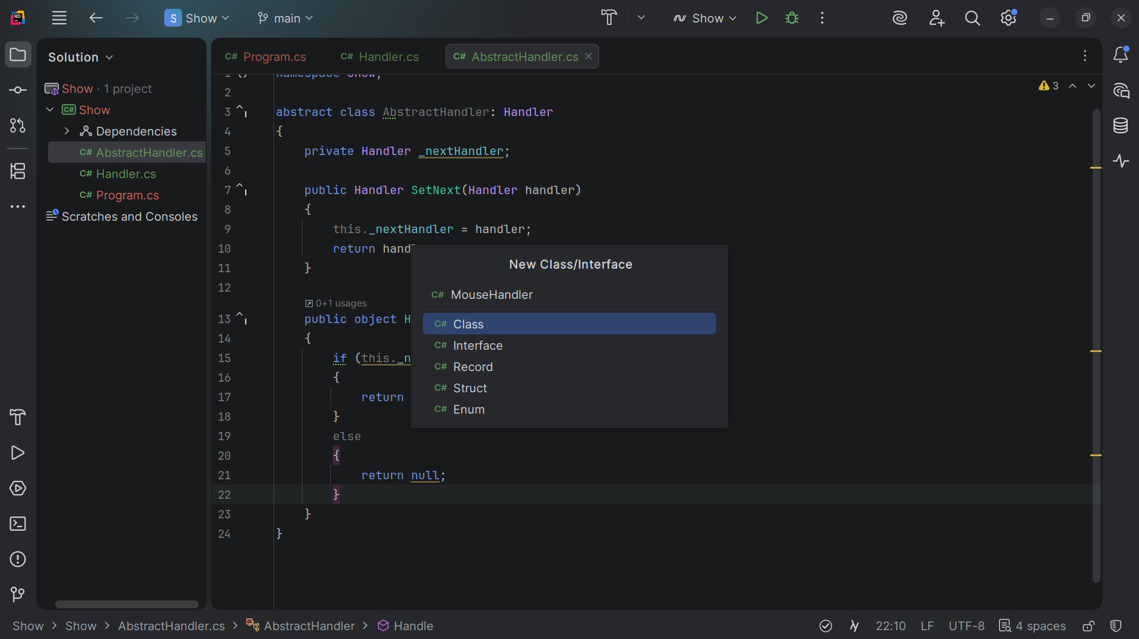
Notes:
Now let’s create a Mouse Handler class

Slide 18
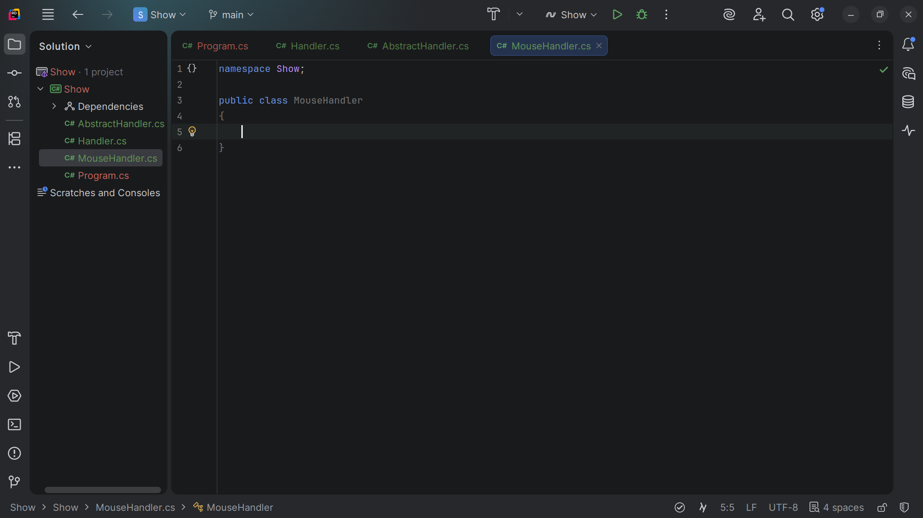
Notes:
We have the class structure

Slide 19
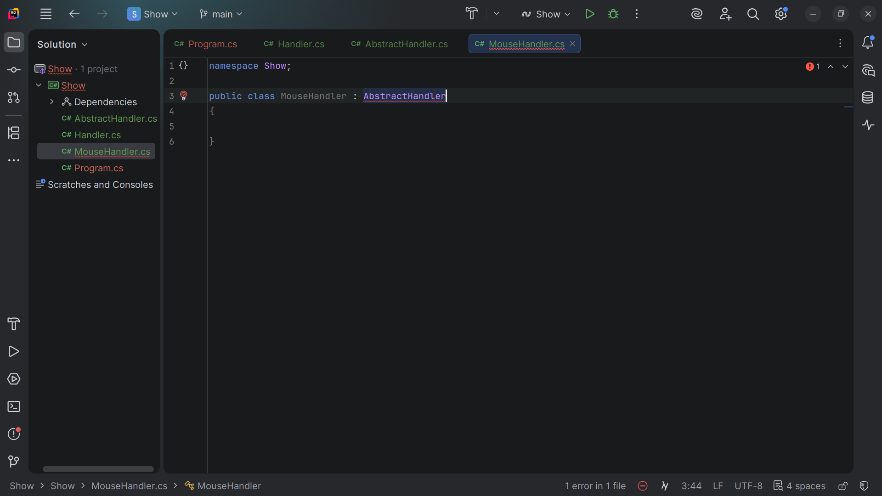
Notes:
We extend it with the Abstract Handler

Slide 20
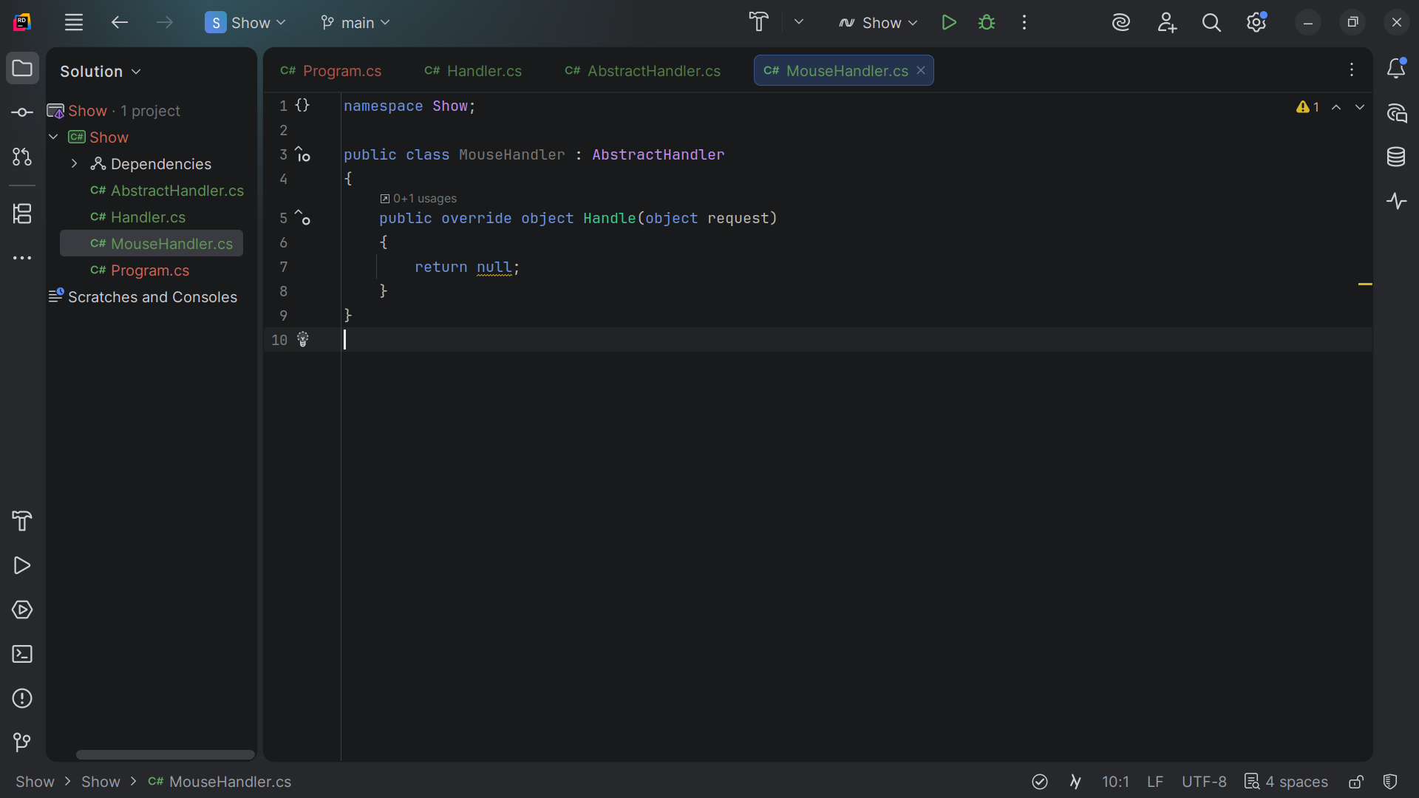
Notes:
We over ride the object handler and pass into it a request object

Slide 21
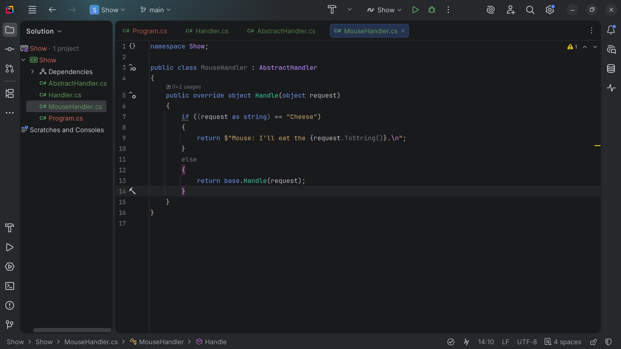
Notes:
If the object is Cheese then the mouse takes it and returns the string “I'll eat the cheese”
Else the mouse does nothing with it and returns the base Handle with the request passed in

Slide 22
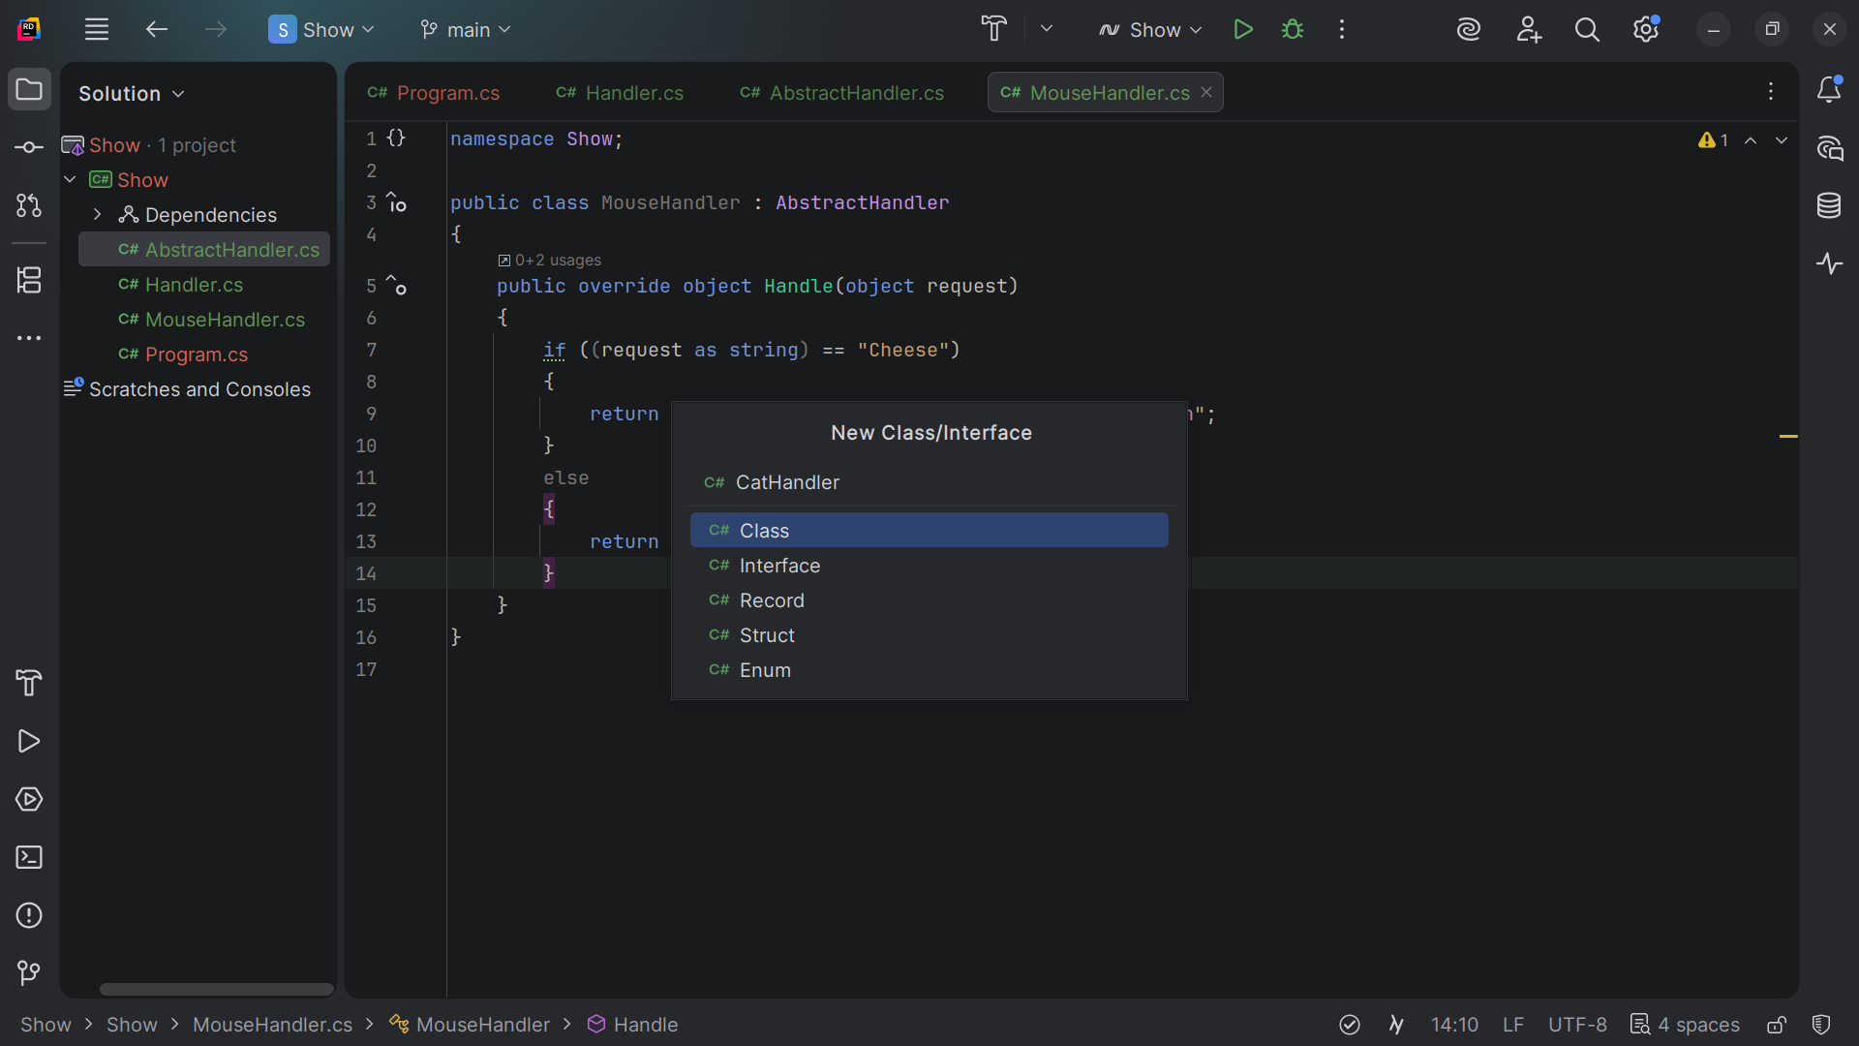
Notes:
Now lets create the Cat Handler class

Slide 23
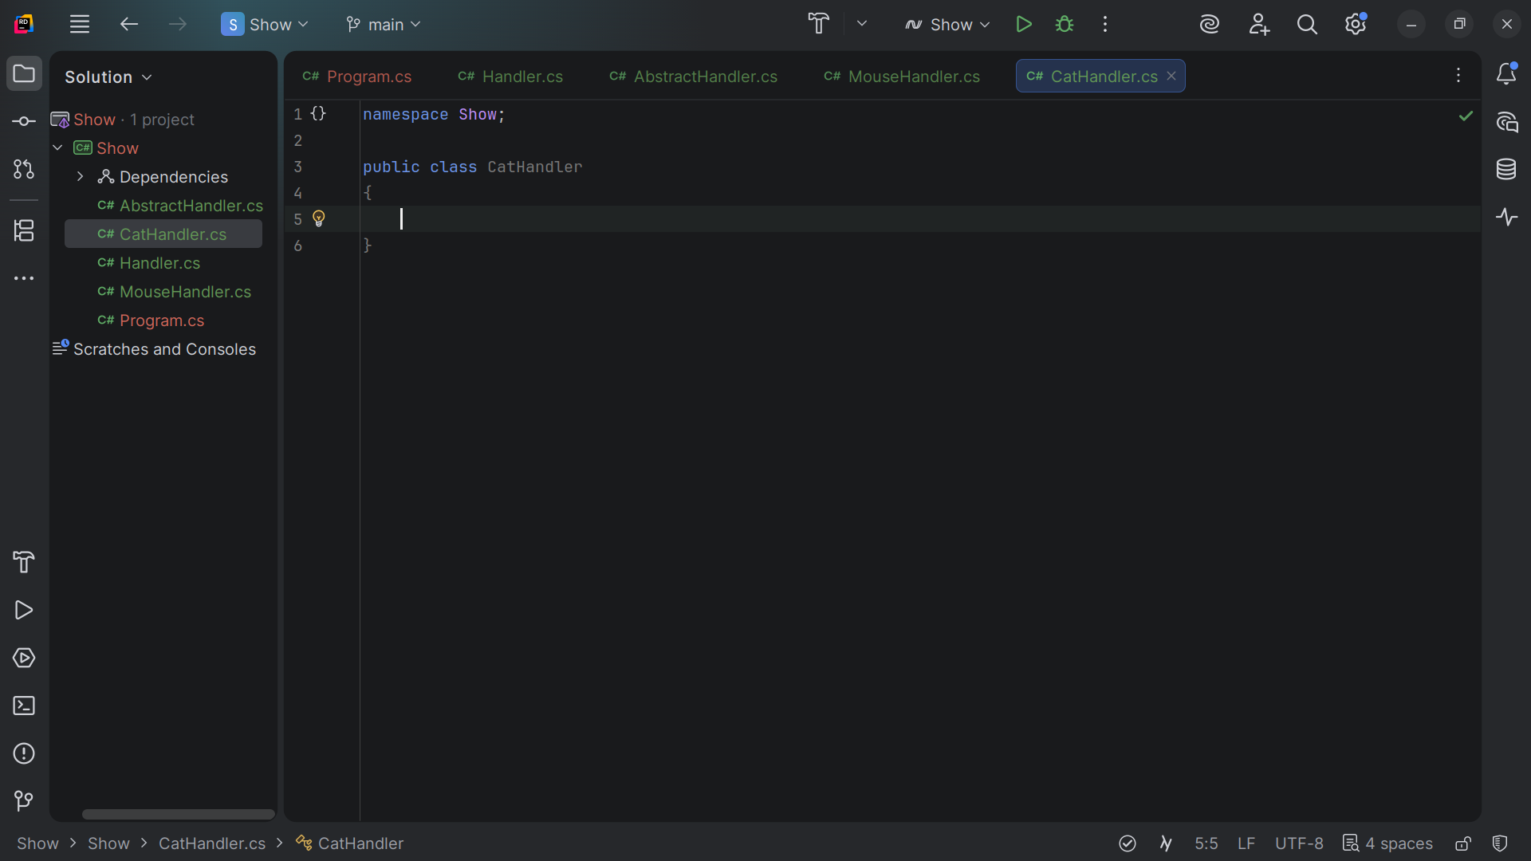
Notes:
We have the class structure

Slide 24
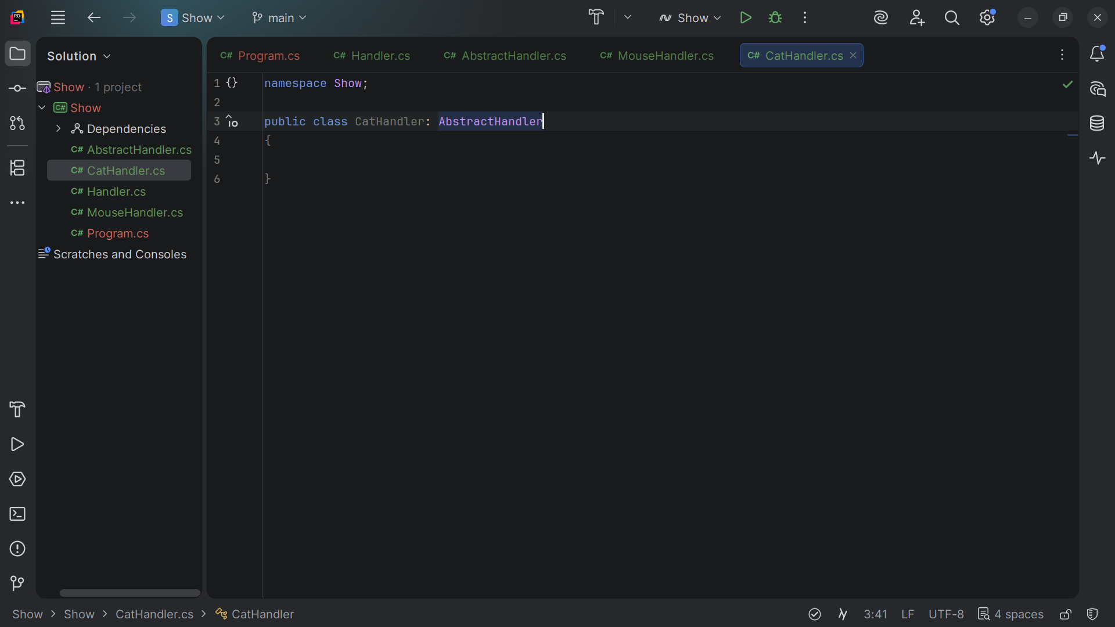
Notes:
We extend it also with the Abstract Handler making this class a Abstract Handler type

Slide 25
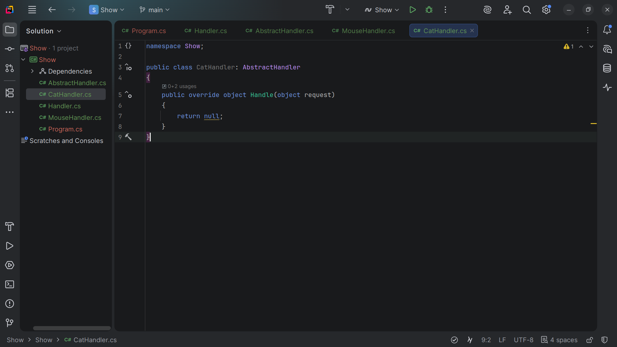
Notes:
We can auto generate the method required by the Abstract Handler interface

Slide 26
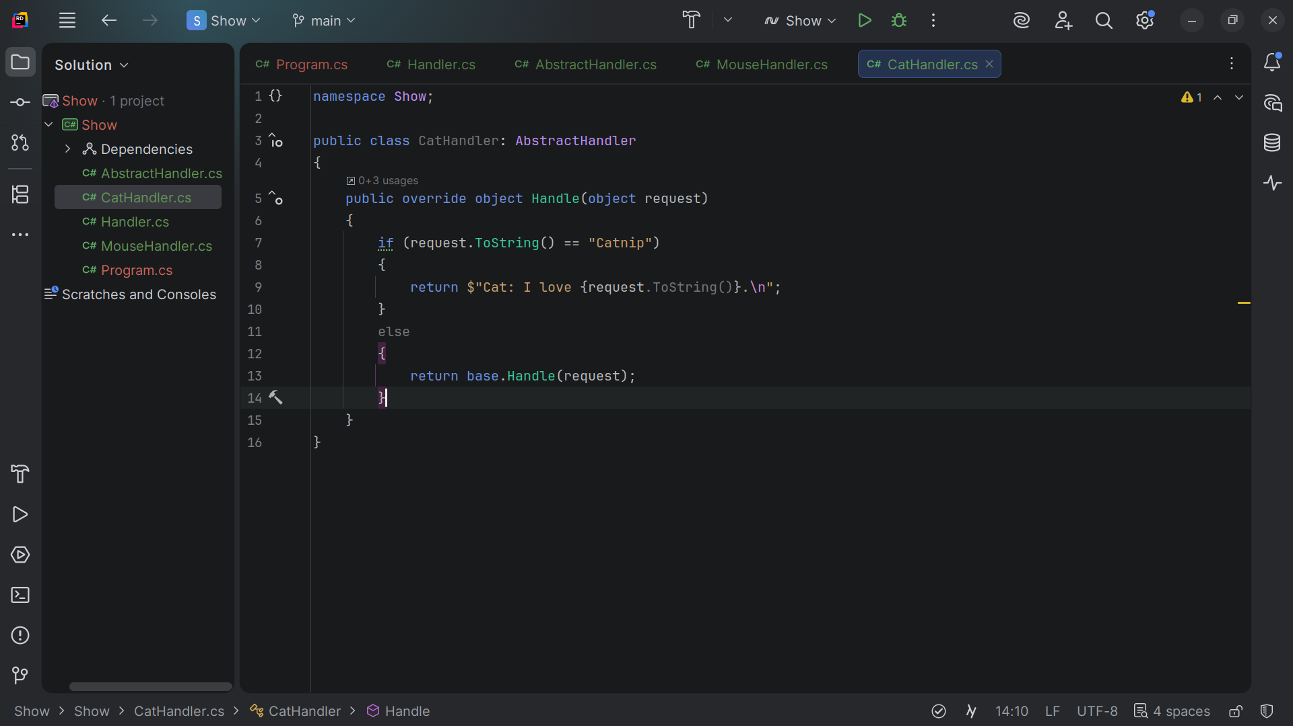
Notes:
If the request is Cat Nip then of course the Cat will take it else the cat returns it

Slide 27
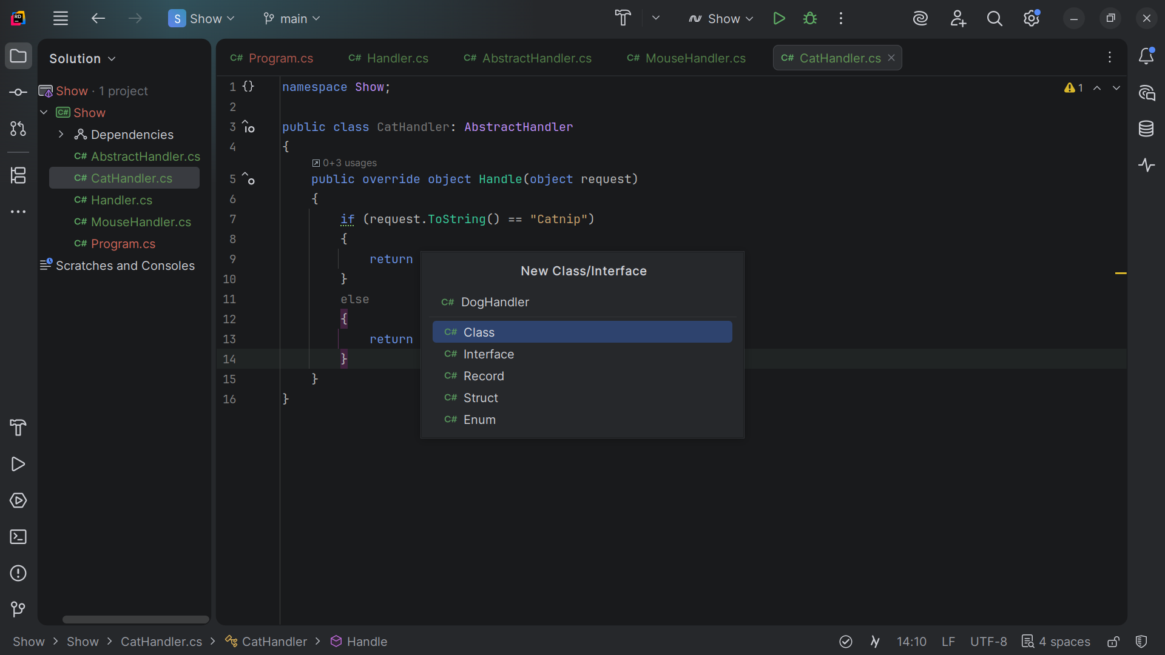
Notes:
Let’s create a Dog Handler class

Slide 28
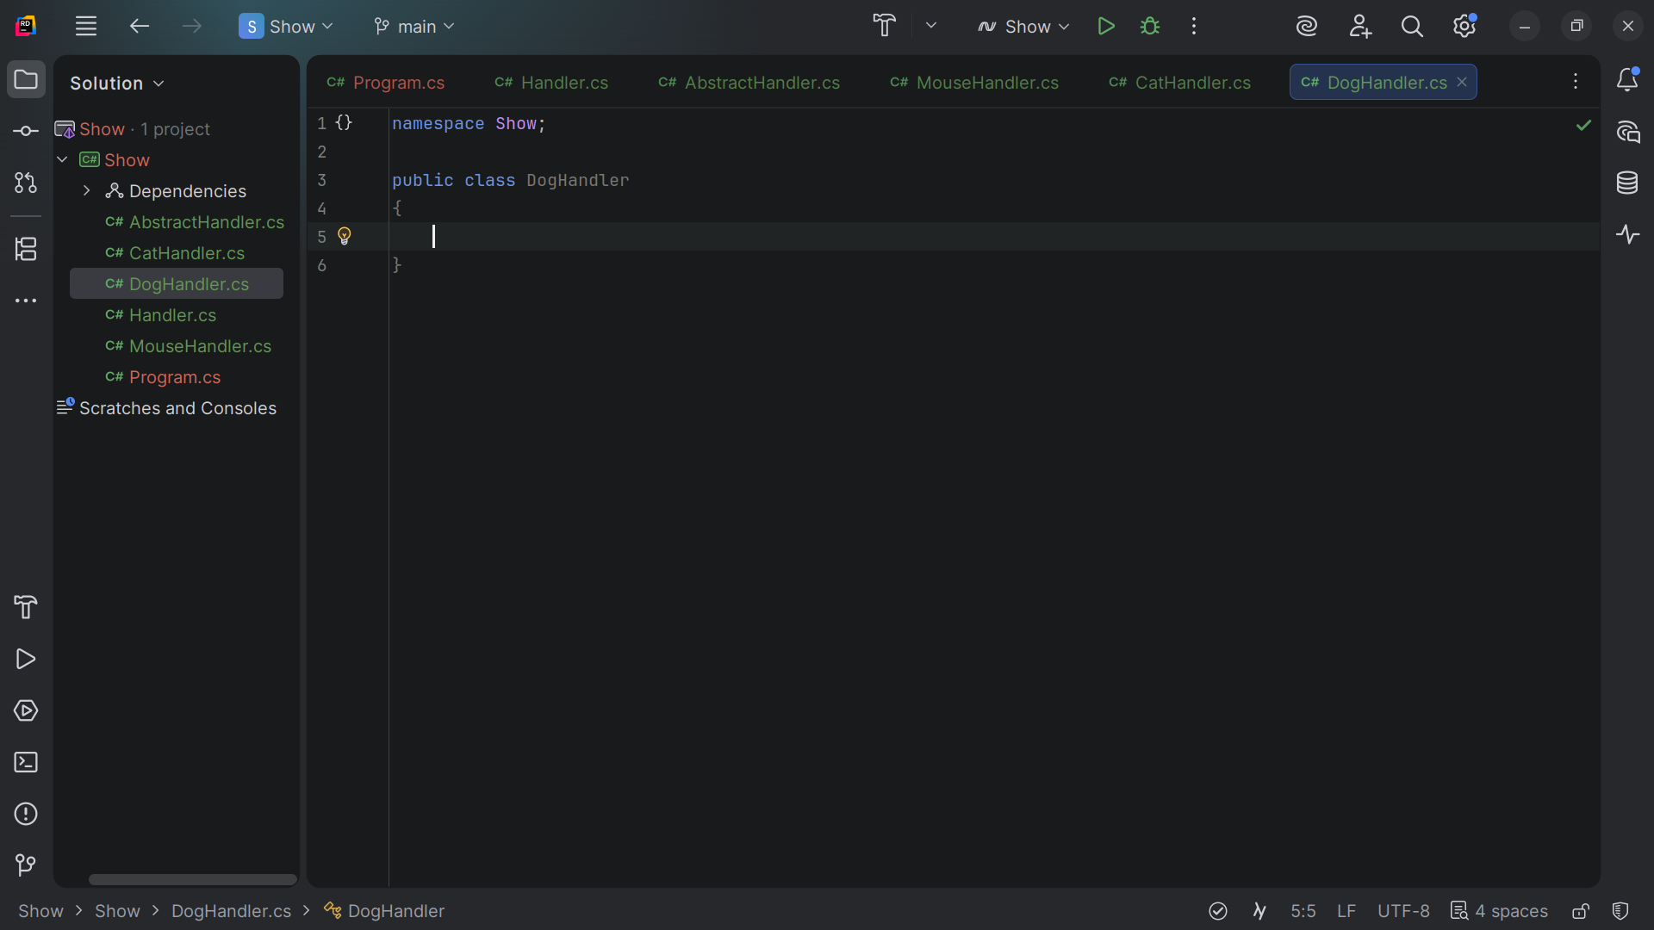
Notes:
We have the class structure

Slide 29
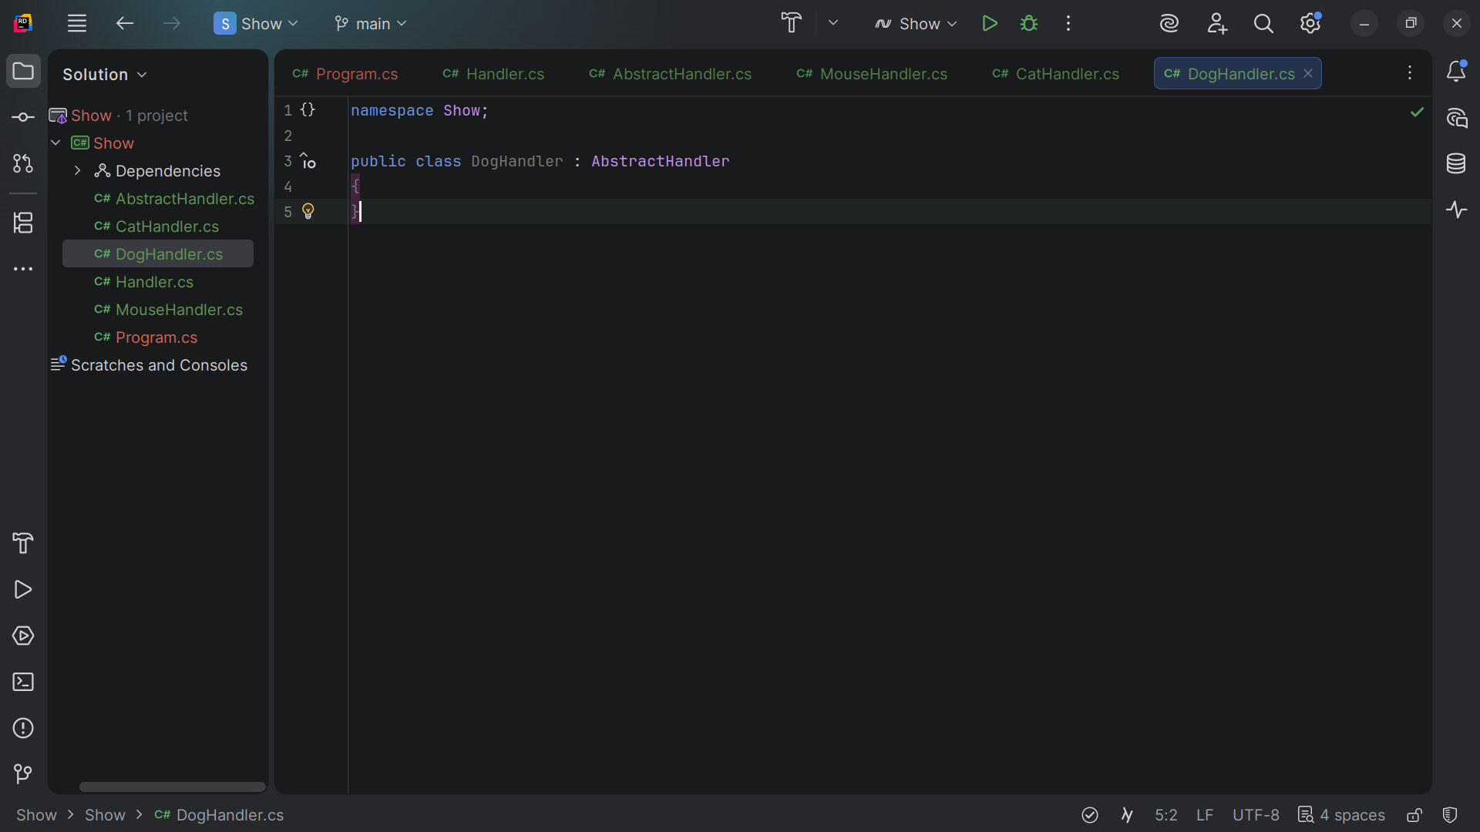
Notes:
We also extend it with the Abstract Handler just like we did for the Mouse and Cat

Slide 30
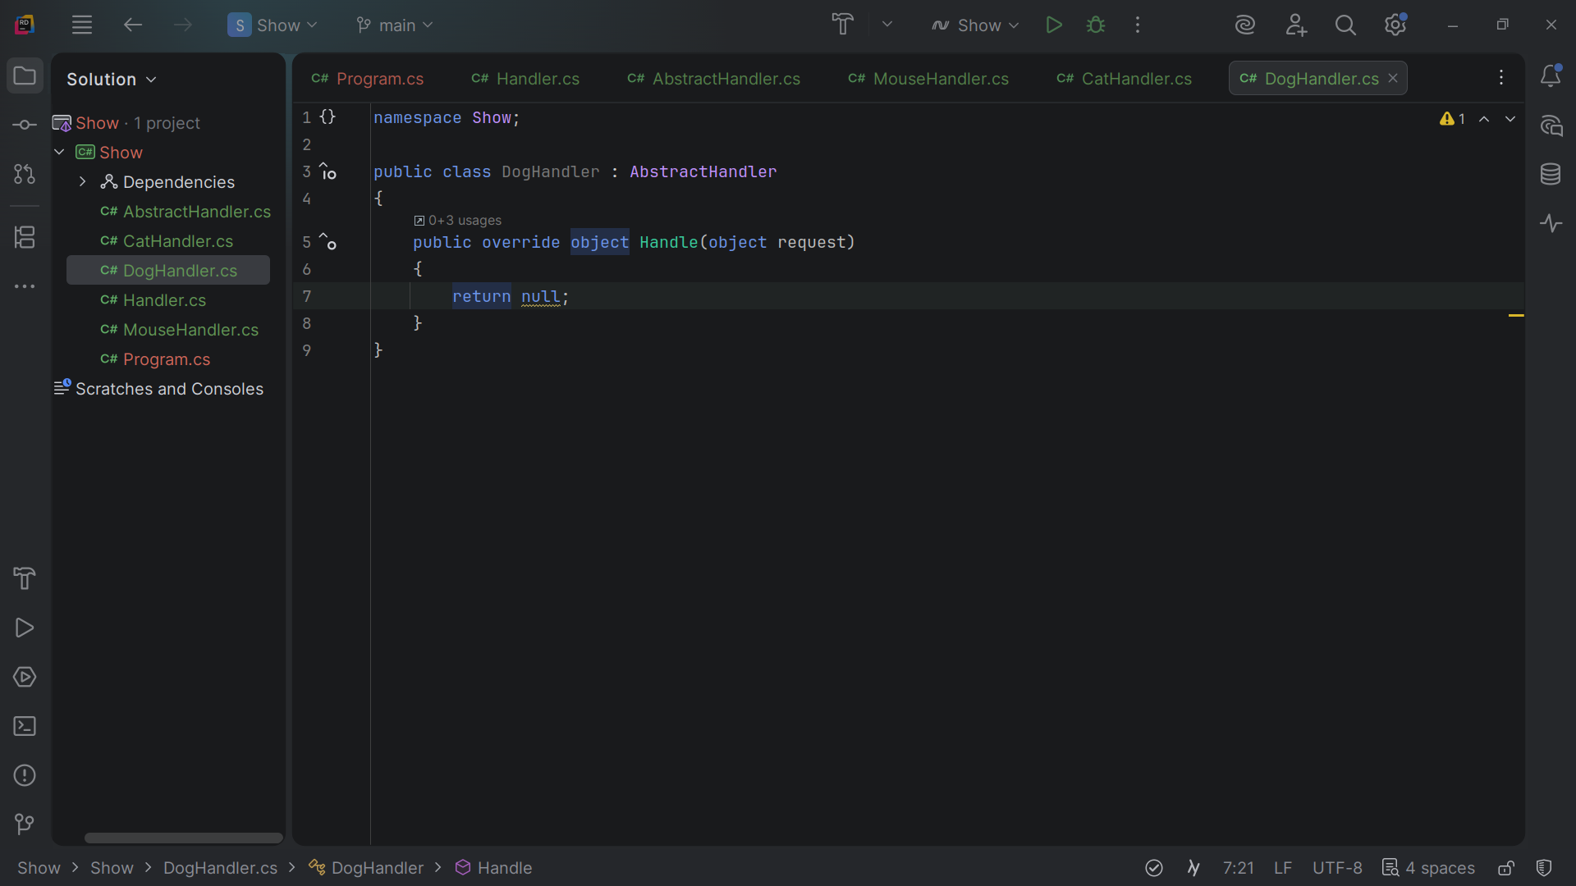
Notes:
We over ride the object Handle and pass into it a request obect

Slide 31
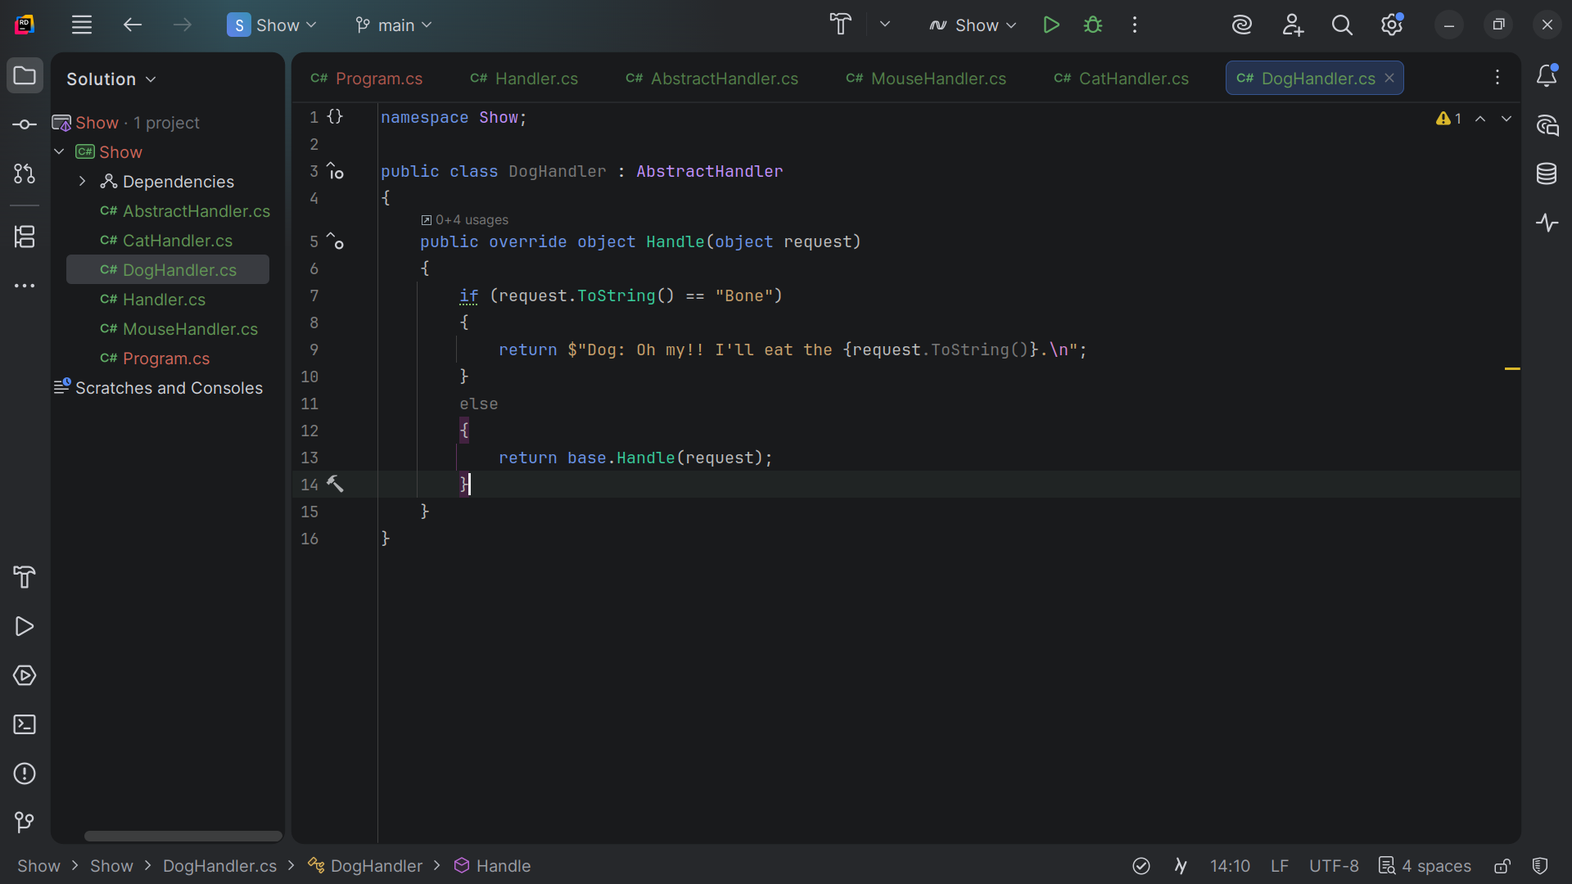
Notes:
If the request object is a bone the dog takes it else the dog returns it untouched

Slide 32
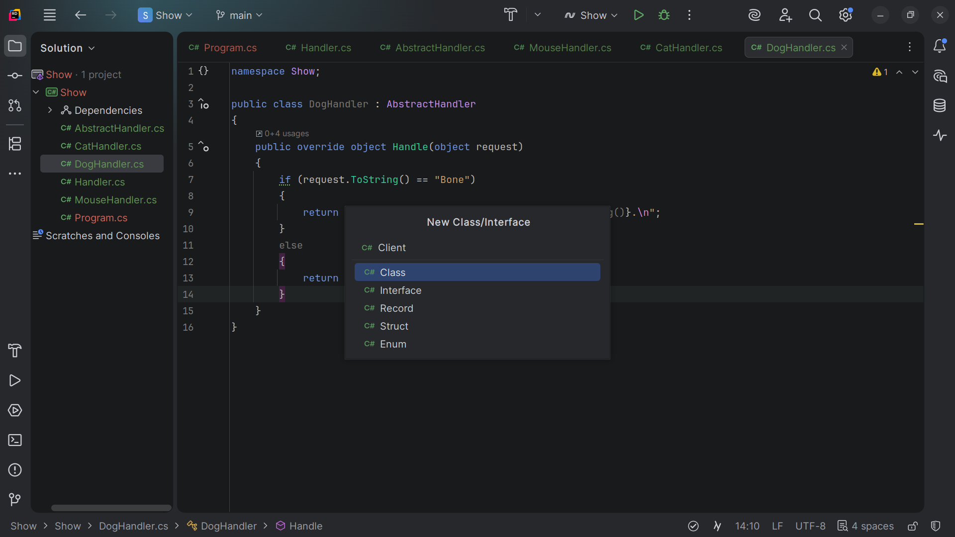
Notes:
Now let’s create a Client for our demo

Slide 33
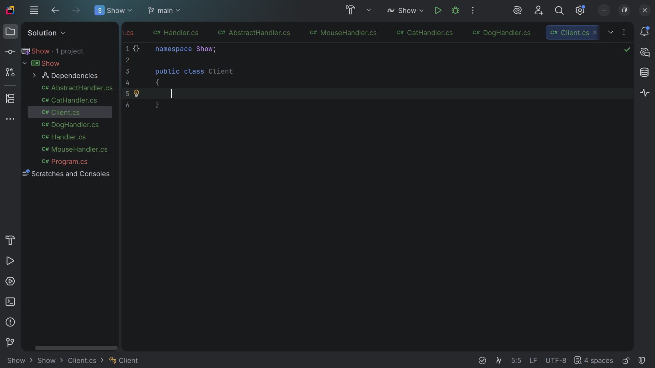
Notes:
The client code is usually suited to work with a single handler.
In most cases, it is not even aware that the handler is part of a chain.

Slide 34
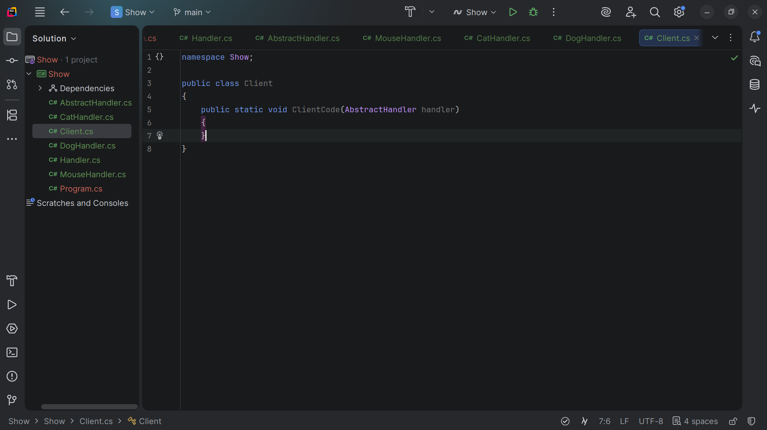
Notes:
The Client Code takes a handler object

Slide 35
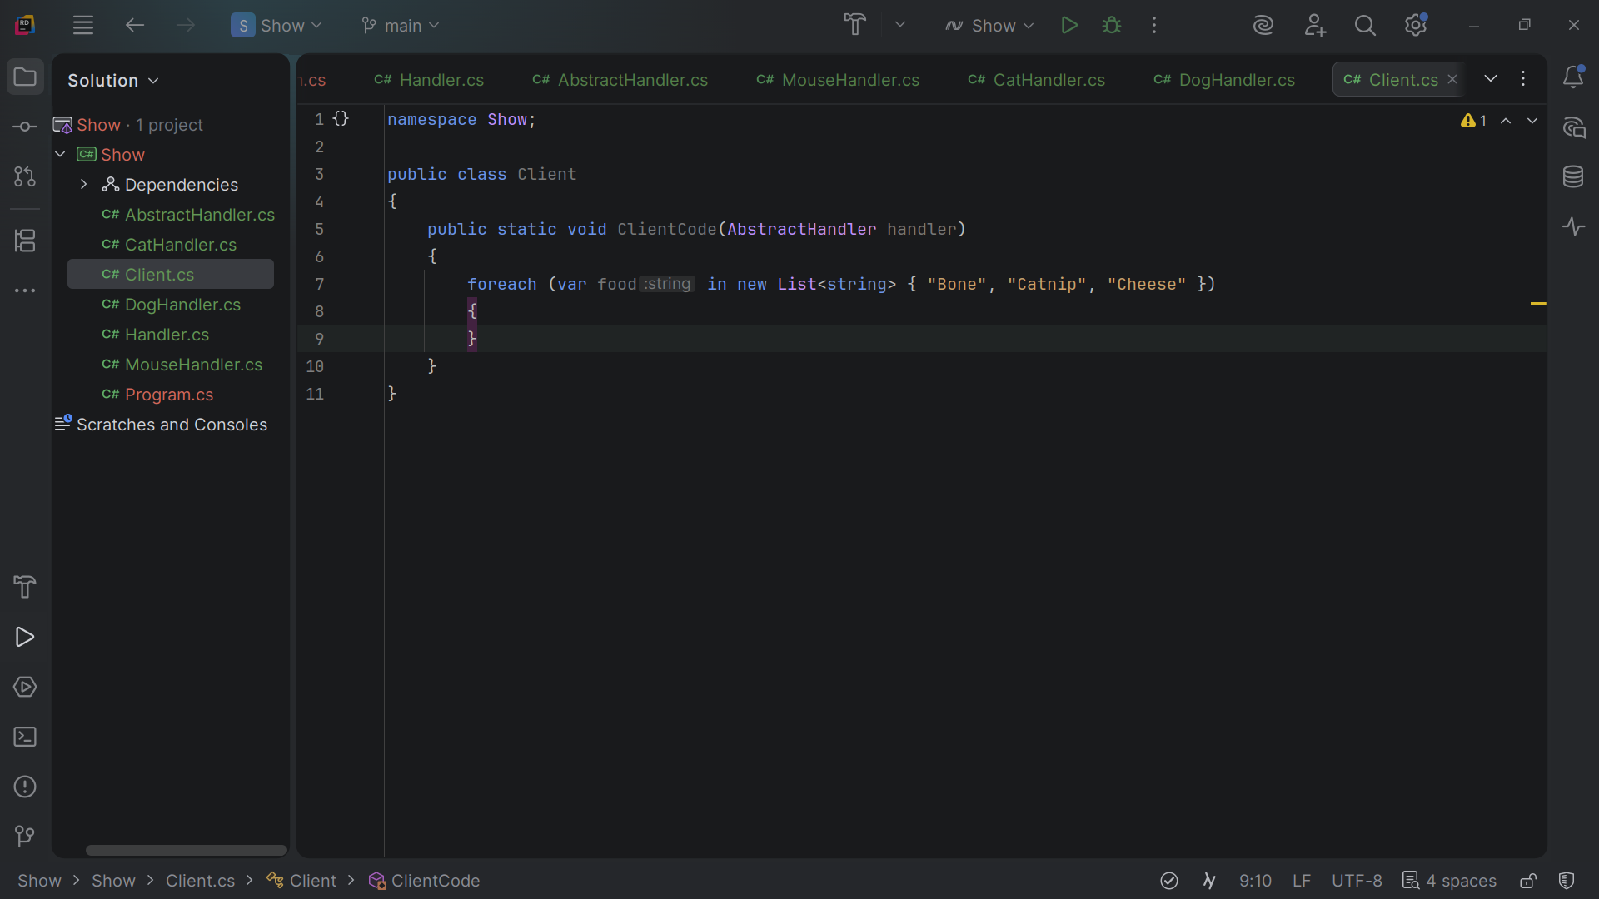
Notes:
We cycle thru each item in the List

Slide 36
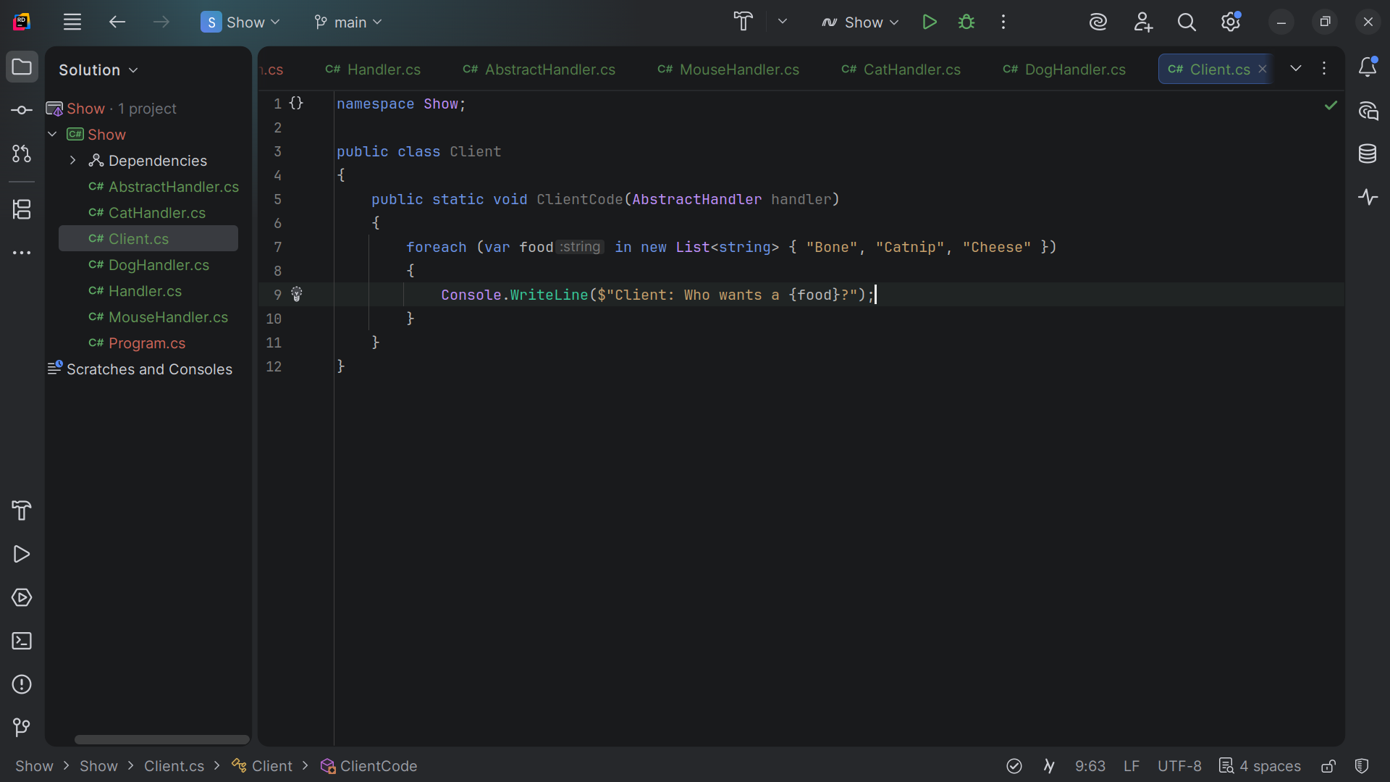
Notes:
We ask who wants the item

Slide 37
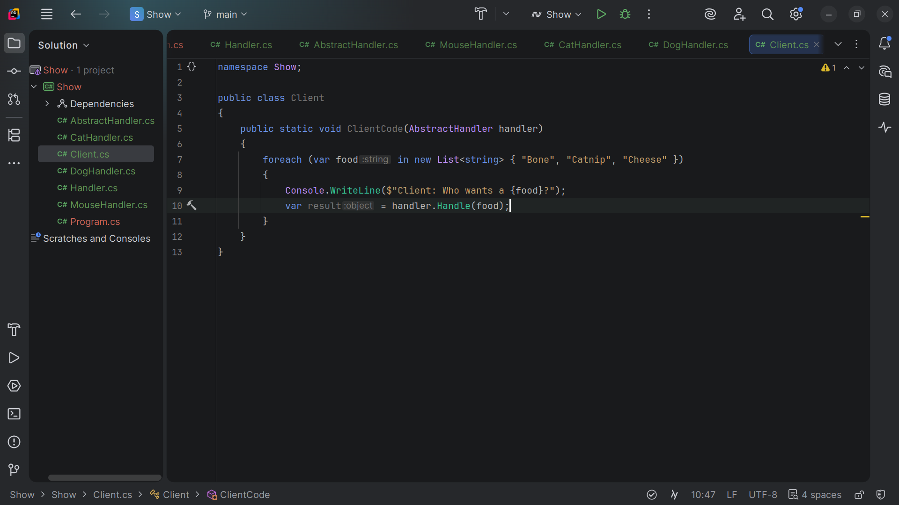
Notes:
We have a var result

Slide 38
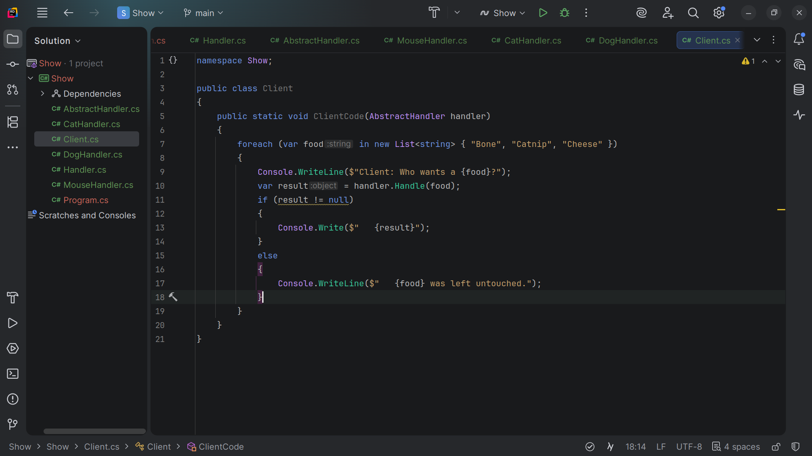
Notes:
If the result is not null we write out the result else we write the item was untouched

Slide 39
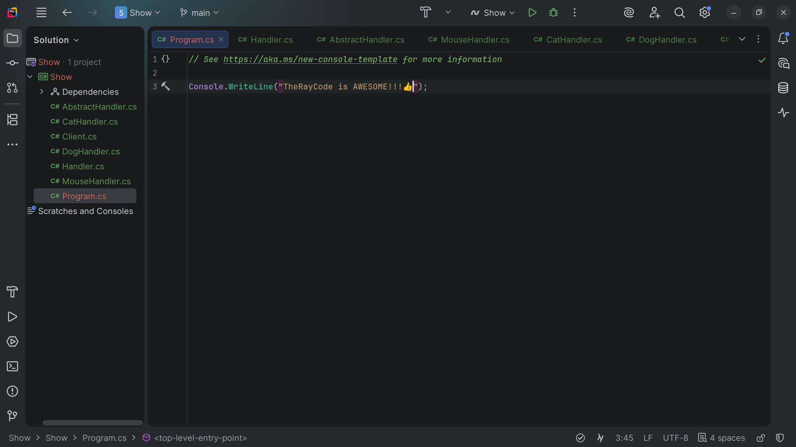
Notes:
Let’s go to the Program dot cs page to continue our demonstration

Slide 40
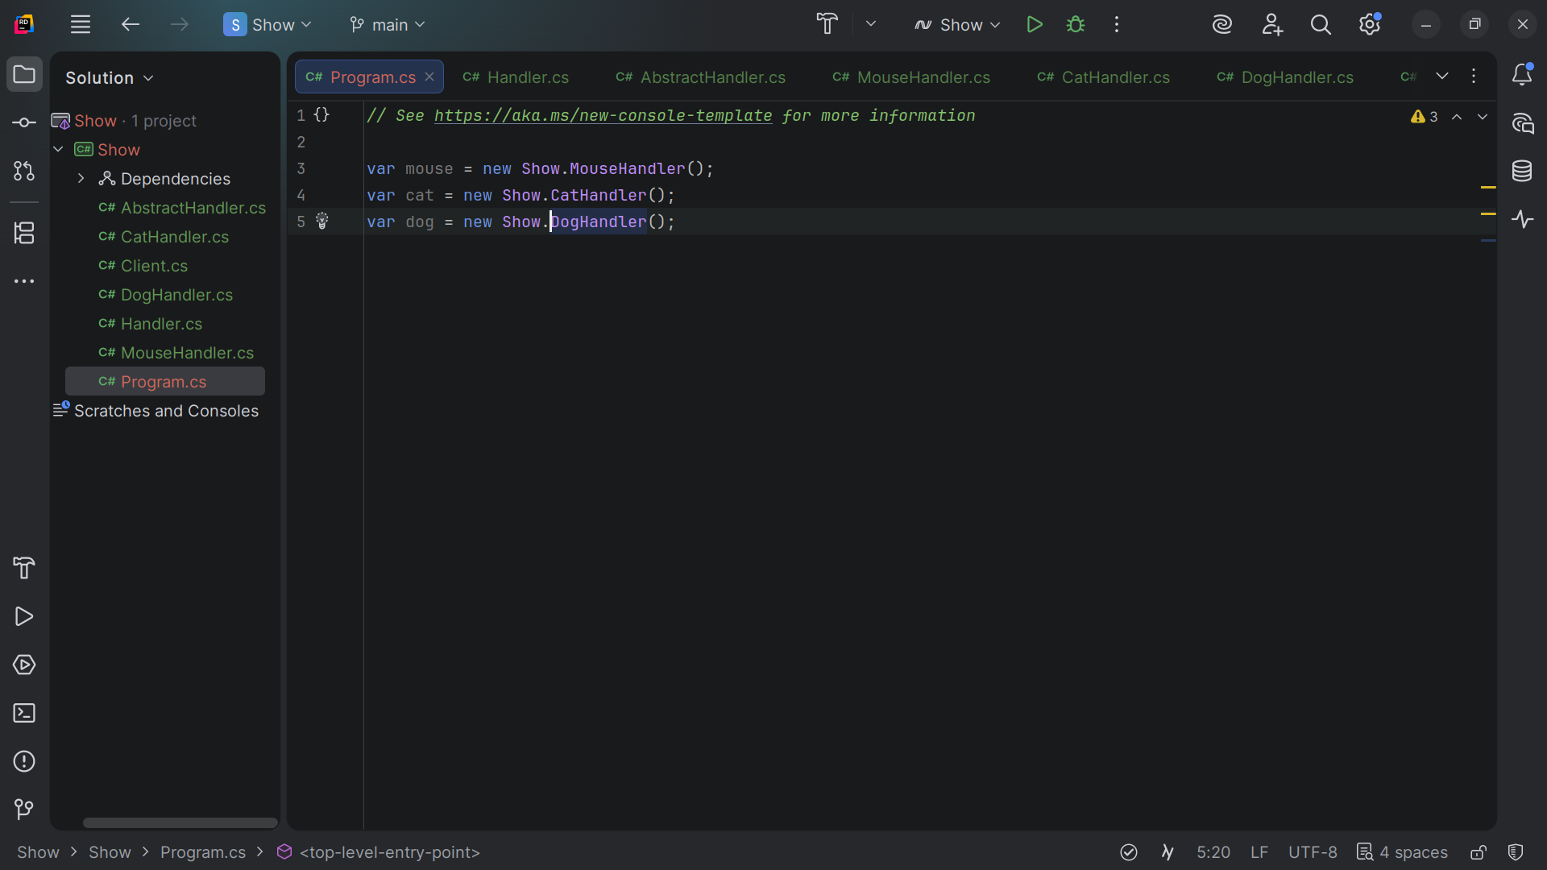
Notes:
At the to we declare the Mouse, Cat and Dog Handlers

Slide 41
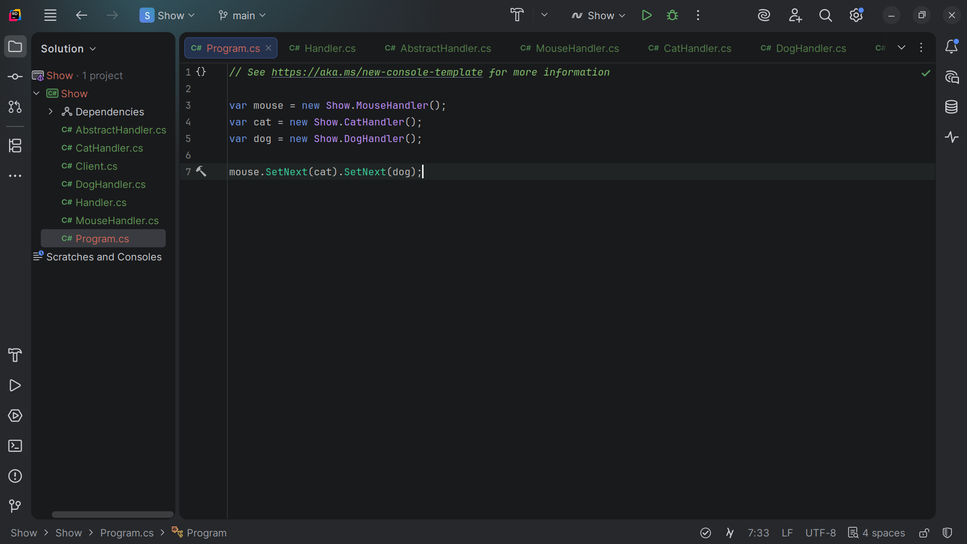
Notes:
Next we build the chain.
The Mouse handle Sets Next the cat handle and the cat handle Sets Next to the Doge Handle

Slide 42
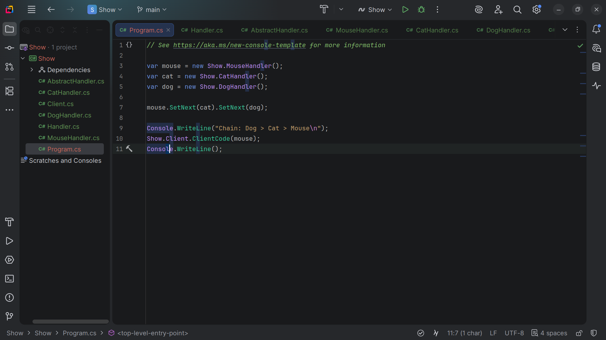
Notes:
We Console Write Line the Result for the mouse

Slide 43
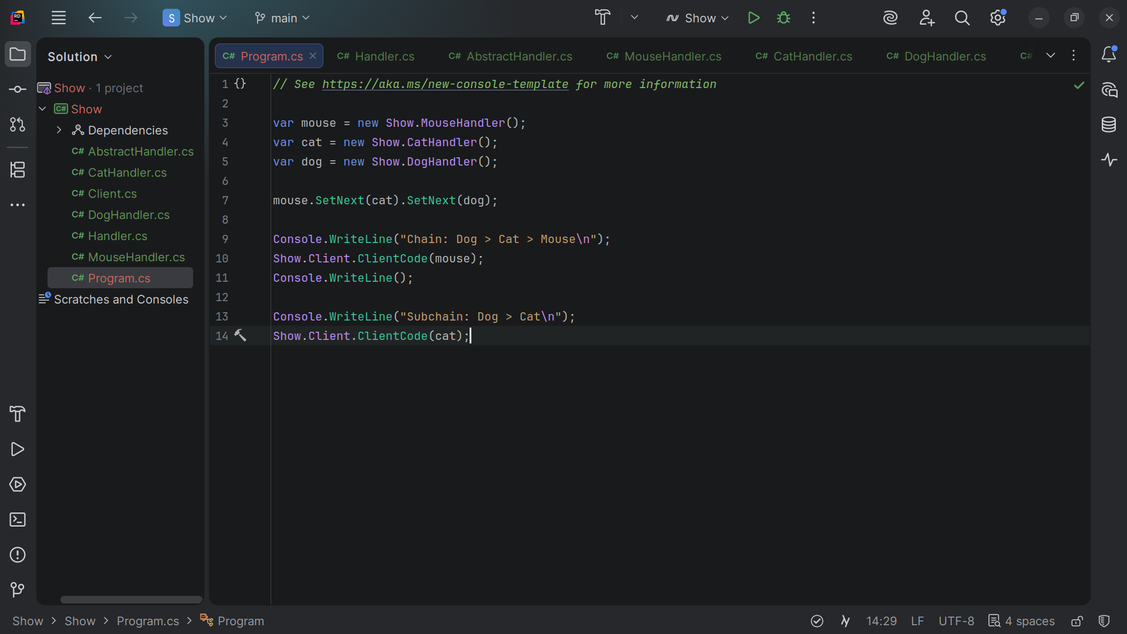
Notes:
We wite the result for the cat starting the chain. Let’s press run

Slide 44
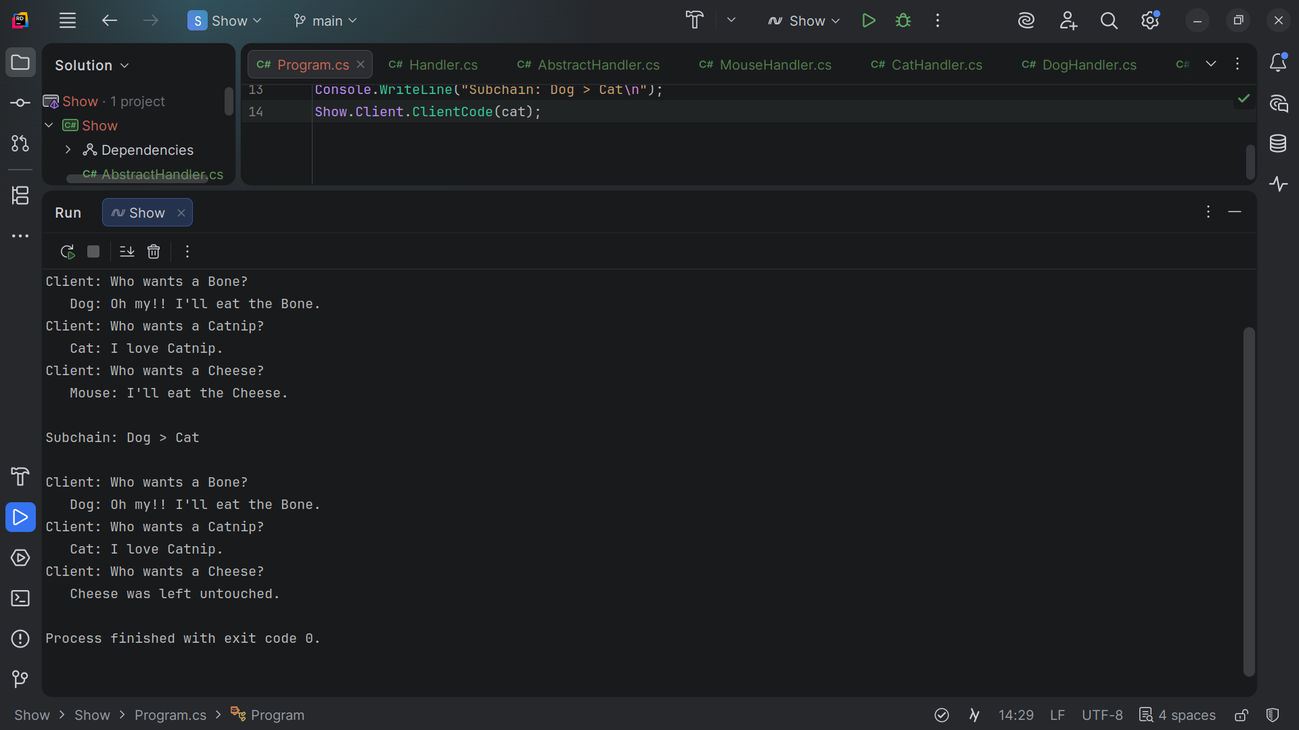
Notes:
Chain: Dog > Cat > Mouse
Client: Who wants a Bone?
Dog: Oh my!! I'll eat the Bone.
Client: Who wants a Catnip?
Cat: I love Catnip.
Client: Who wants a Cheese?
Mouse: I'll eat the Cheese.
Subchain: Dog > Cat
Client: Who wants a Bone?
Dog: Oh my!! I'll eat the Bone.
Client: Who wants a Catnip?
Cat: I love Catnip.
Client: Who wants a Cheese?
Cheese was left untouched.
Or shall we say the cheese stands alone My name is Ray Always code with a smile

