Slide 1

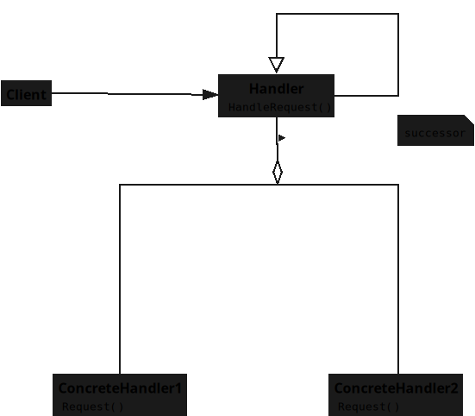

Slide 3
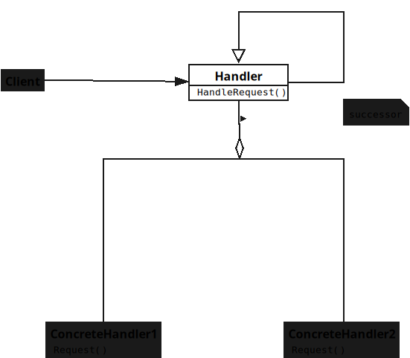
Notes:
## **Handler**
* Declares the method for handling requests.

Slide 4
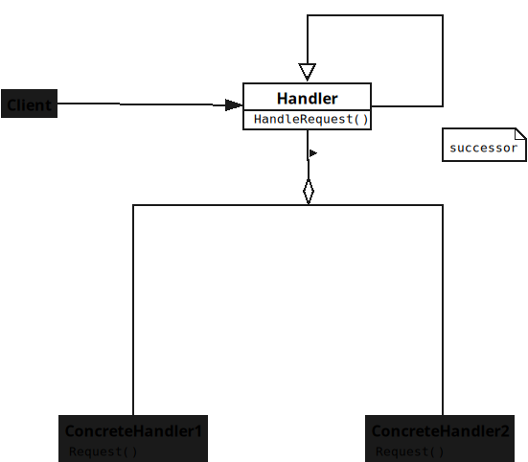
Notes:
* Stores a reference to the next Handler.
* Forwards requests when unable to handle.

Slide 5
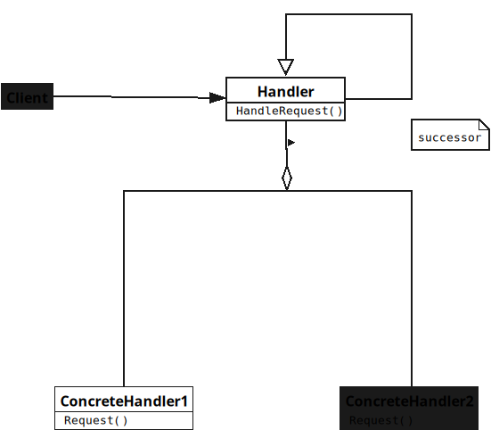
Notes:
## **ConcreteHandler**
* Handles requests within its responsibility range.

Slide 6
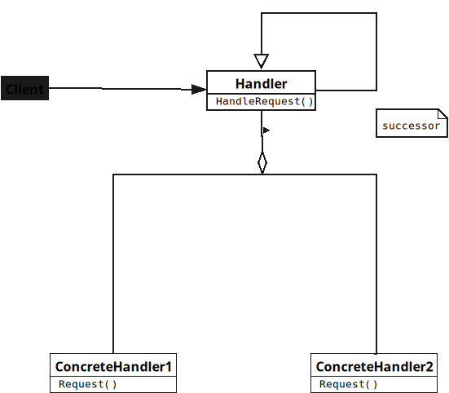
Notes:
* Decides whether to process or pass forward.
* Sends unhandled requests to successor.

Slide 7
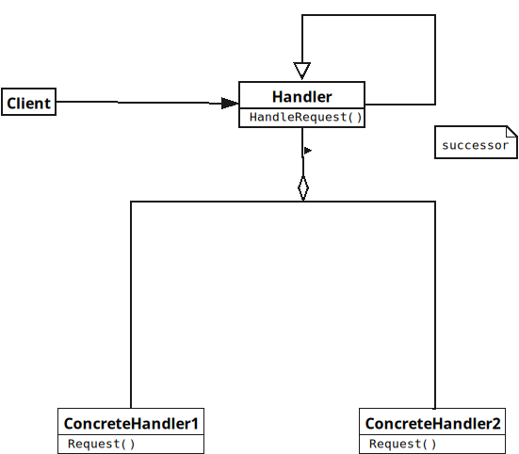
Notes:
## **Client**
* Sends request to the first Handler.
* Does not know which Handler will process it.
* Relies on the chain to manage requests.

