Slide 1
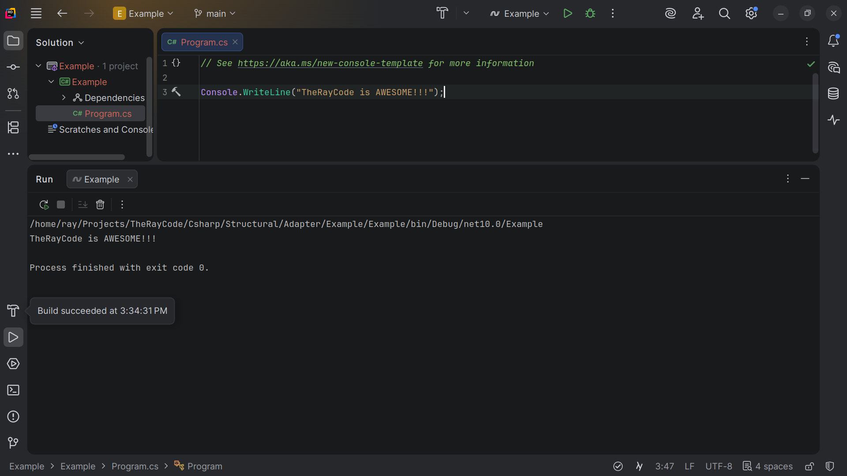
Notes:
Hello, My name is Ray and I am the Ray in TheRayCode

Slide 2
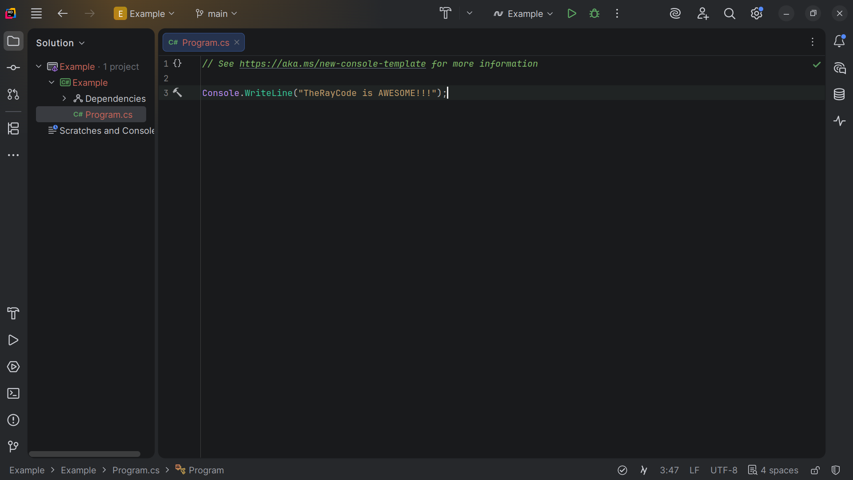
Notes:
In this video I will give you a demonstration of the Adapter design pattern with is a Structural design pattern and I will be using C#

Slide 3
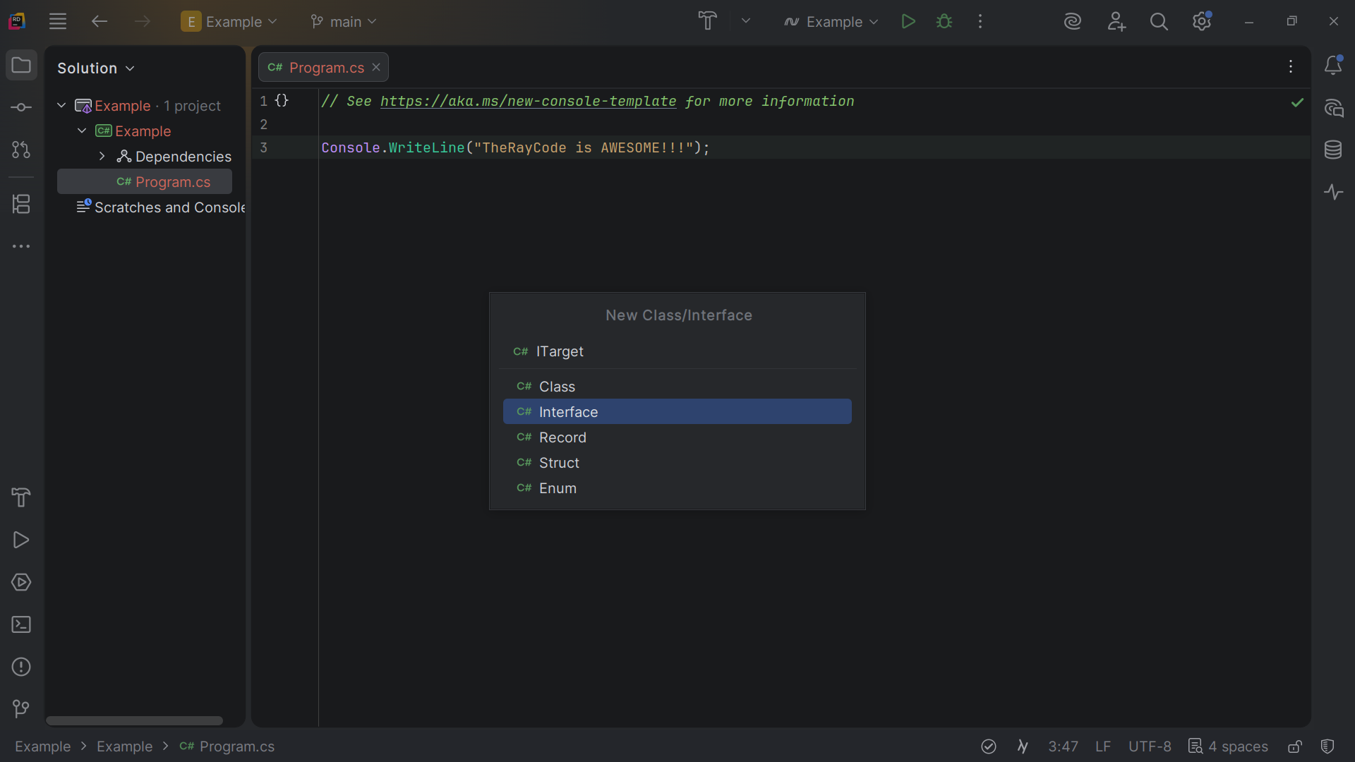
Notes:
We start be creating an interface we call I - Target

Slide 4
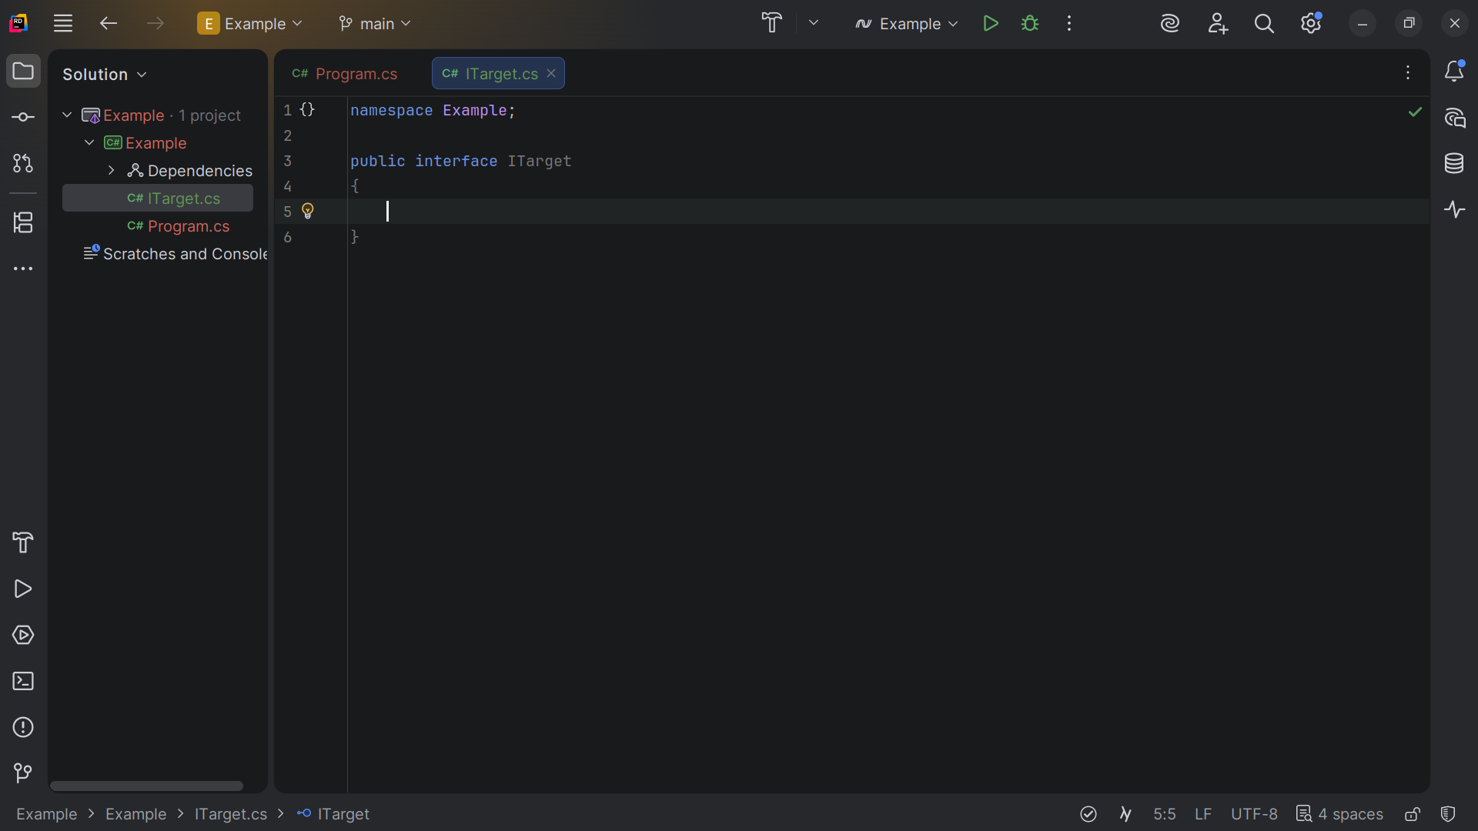
Notes:
I - Target is the interface expected by the Client. It defines the domain-specific interface that Client uses.

Slide 5
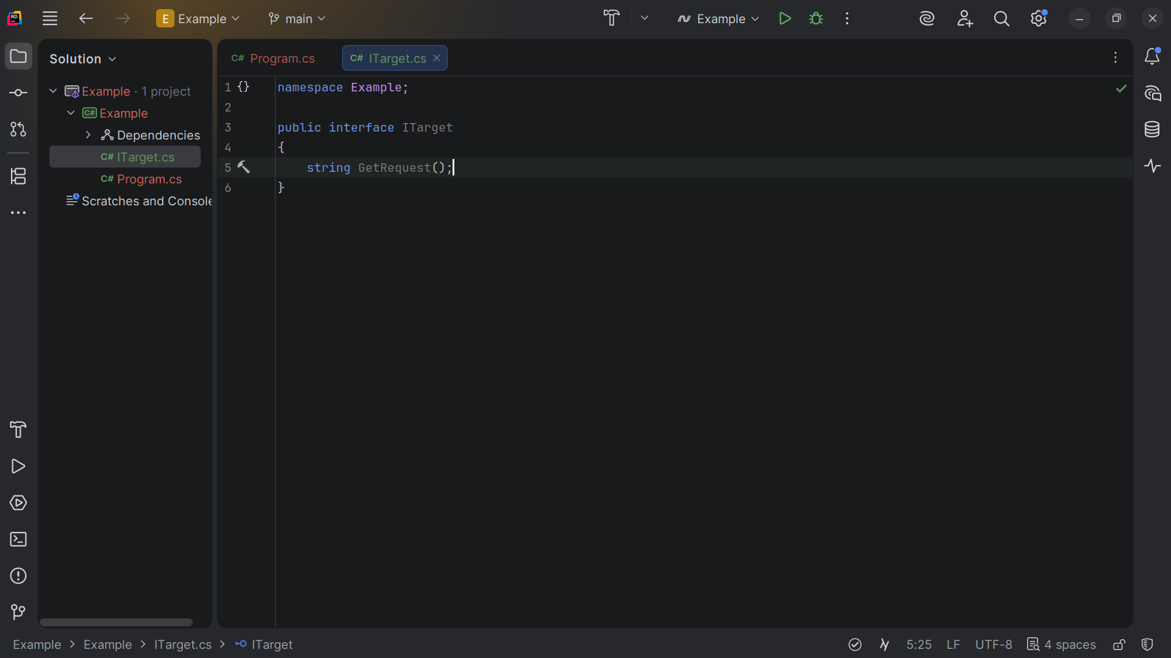
Notes:
We require a Get Request method

Slide 6
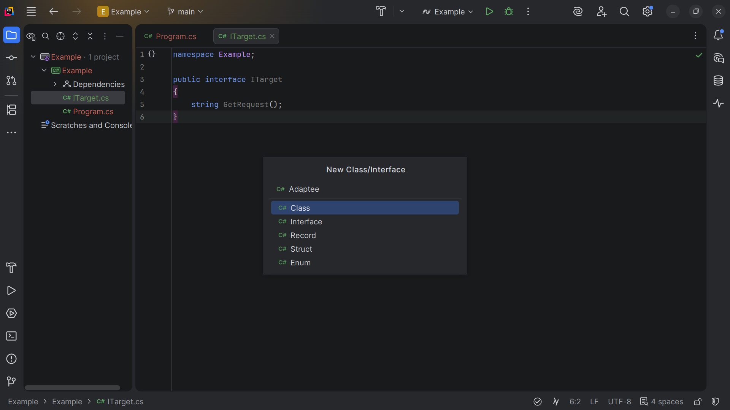
Notes:
Next I want to create a class I call the Adaptee

Slide 7
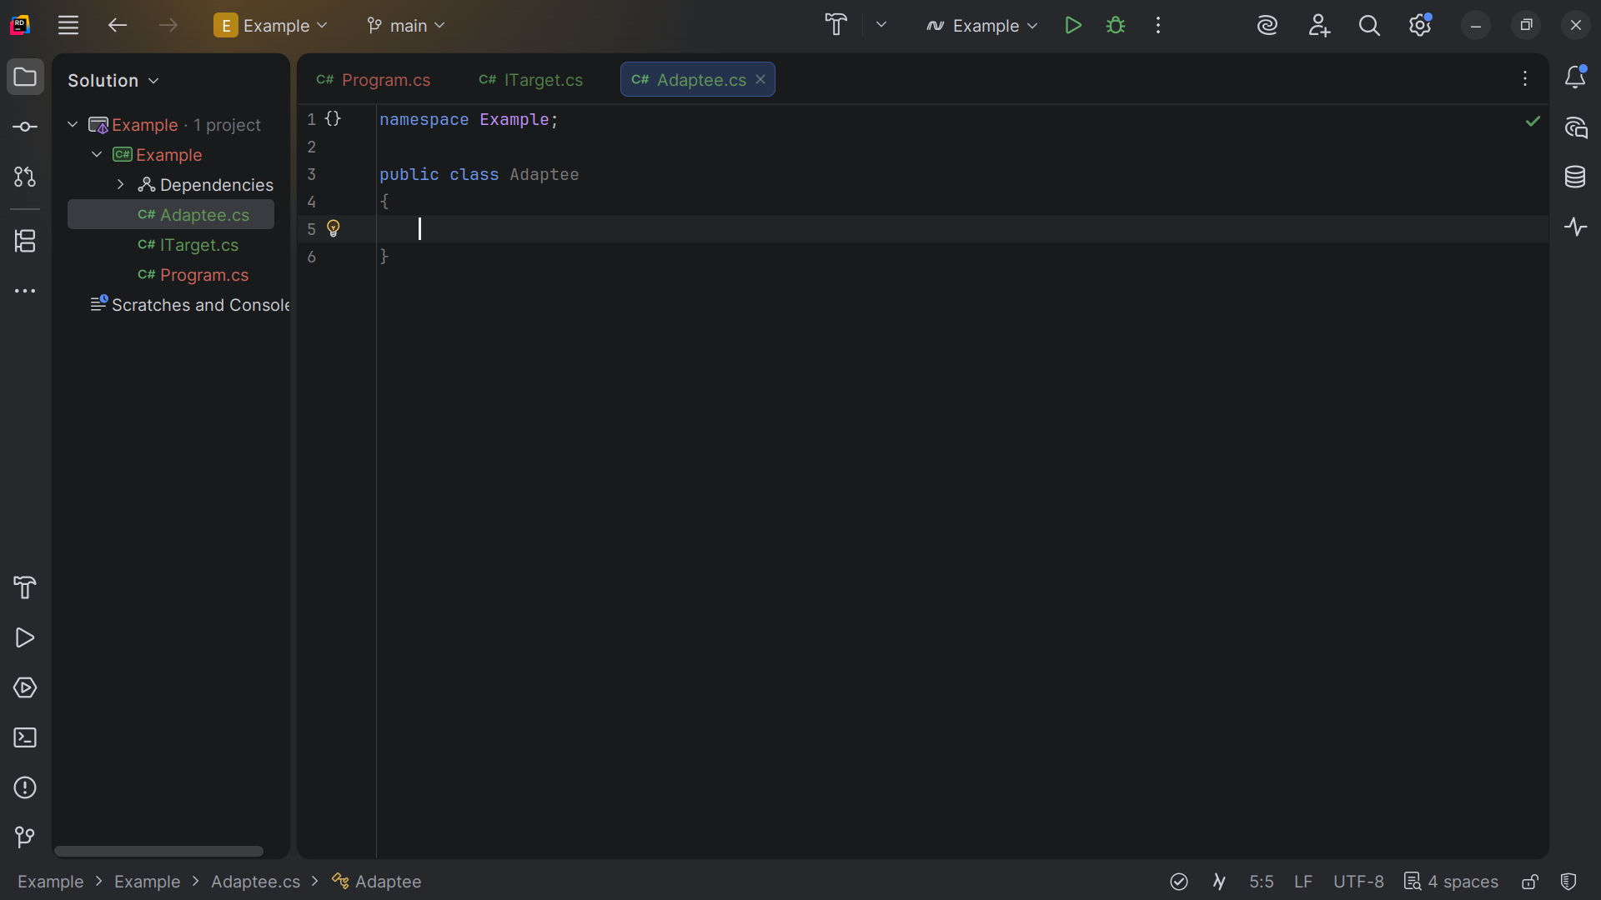
Notes:
Adaptee is the class that has a different interface and needs to be adapted.

Slide 8
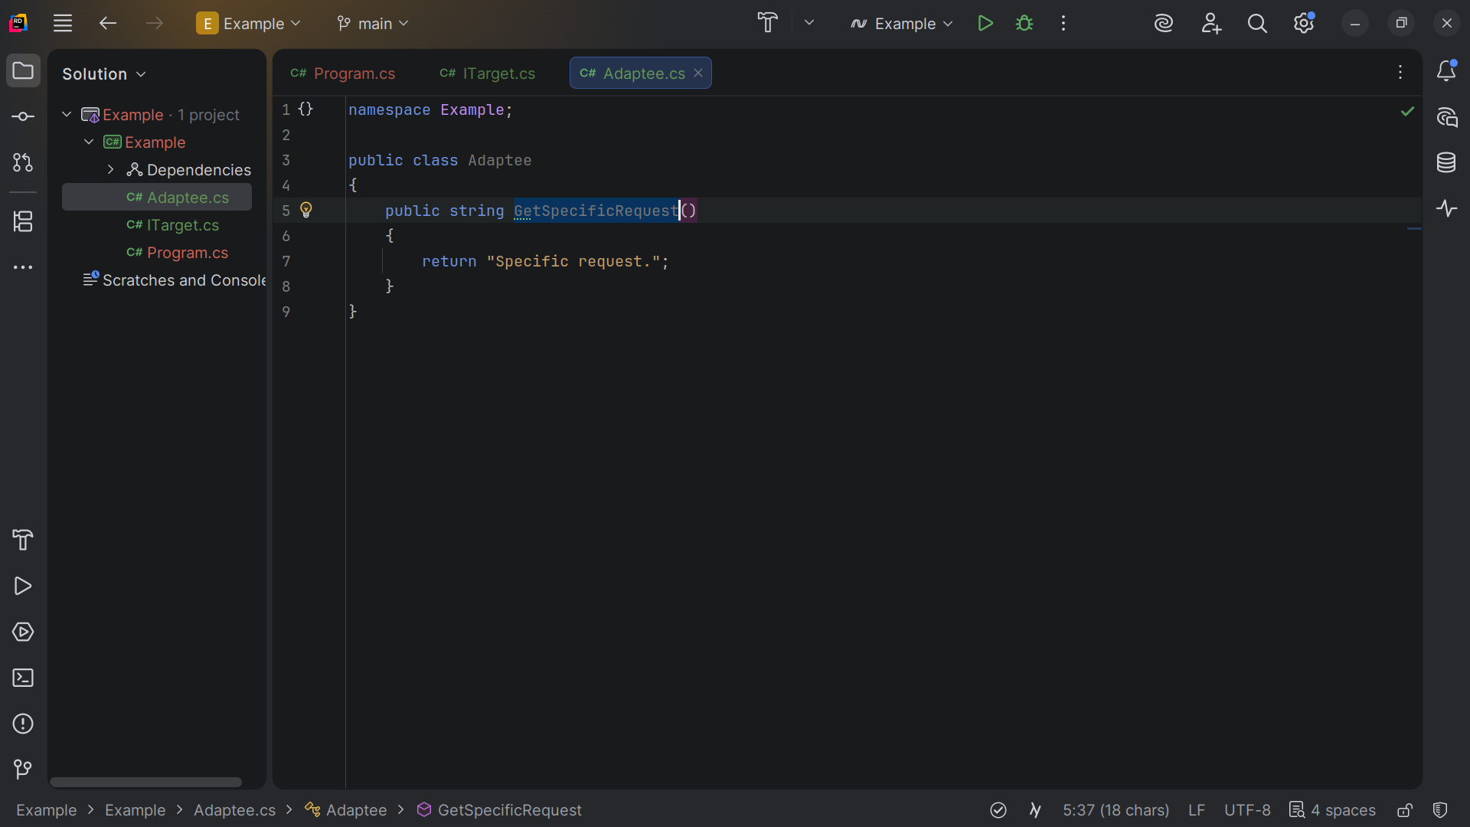
Notes:
Get Specific Request returns the string Specific request

Slide 9
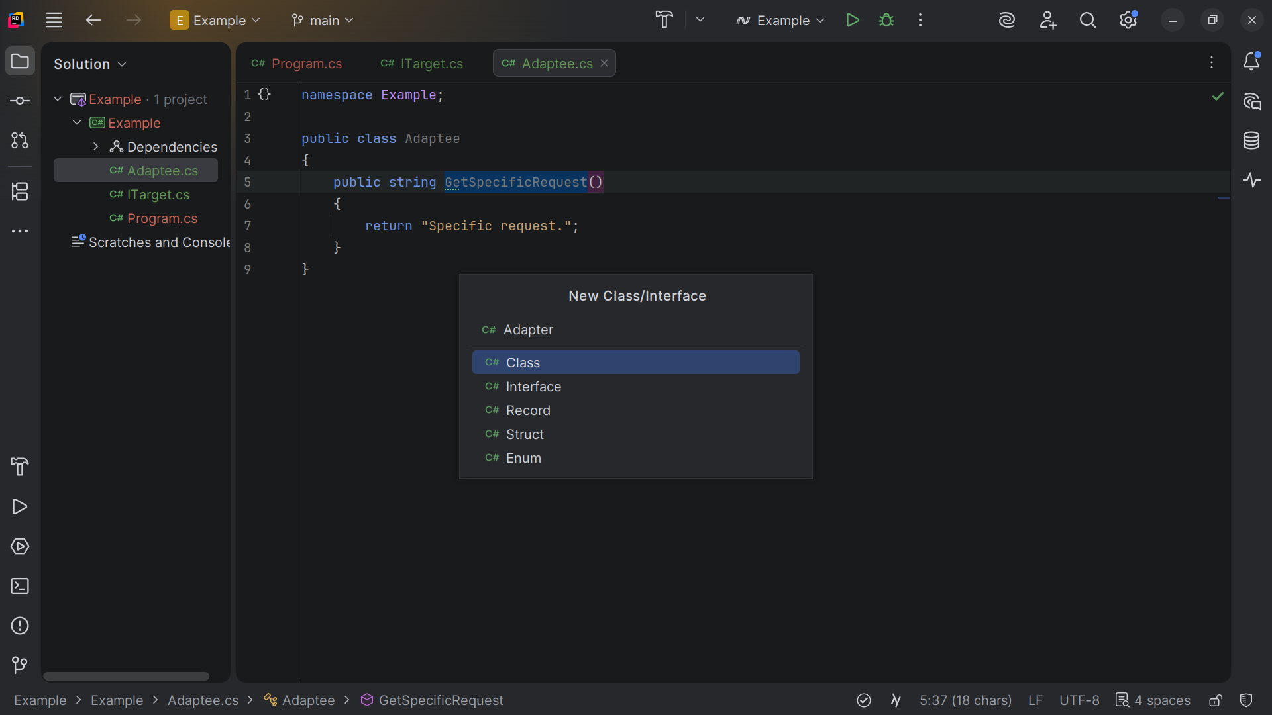
Notes:
Next I will create an Adapter

Slide 10
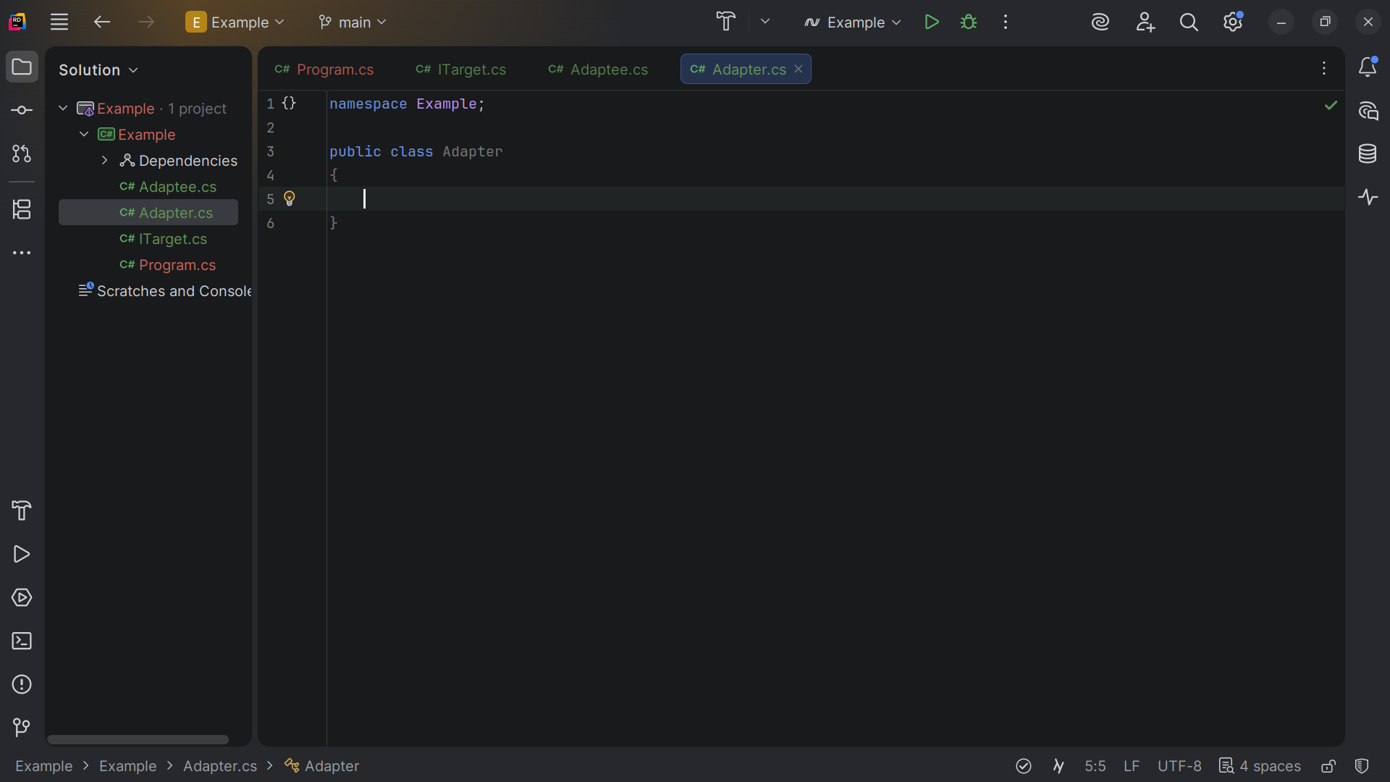
Notes:
Adapter will make the Adaptee's interface compatible with the I - Target interface.

Slide 11
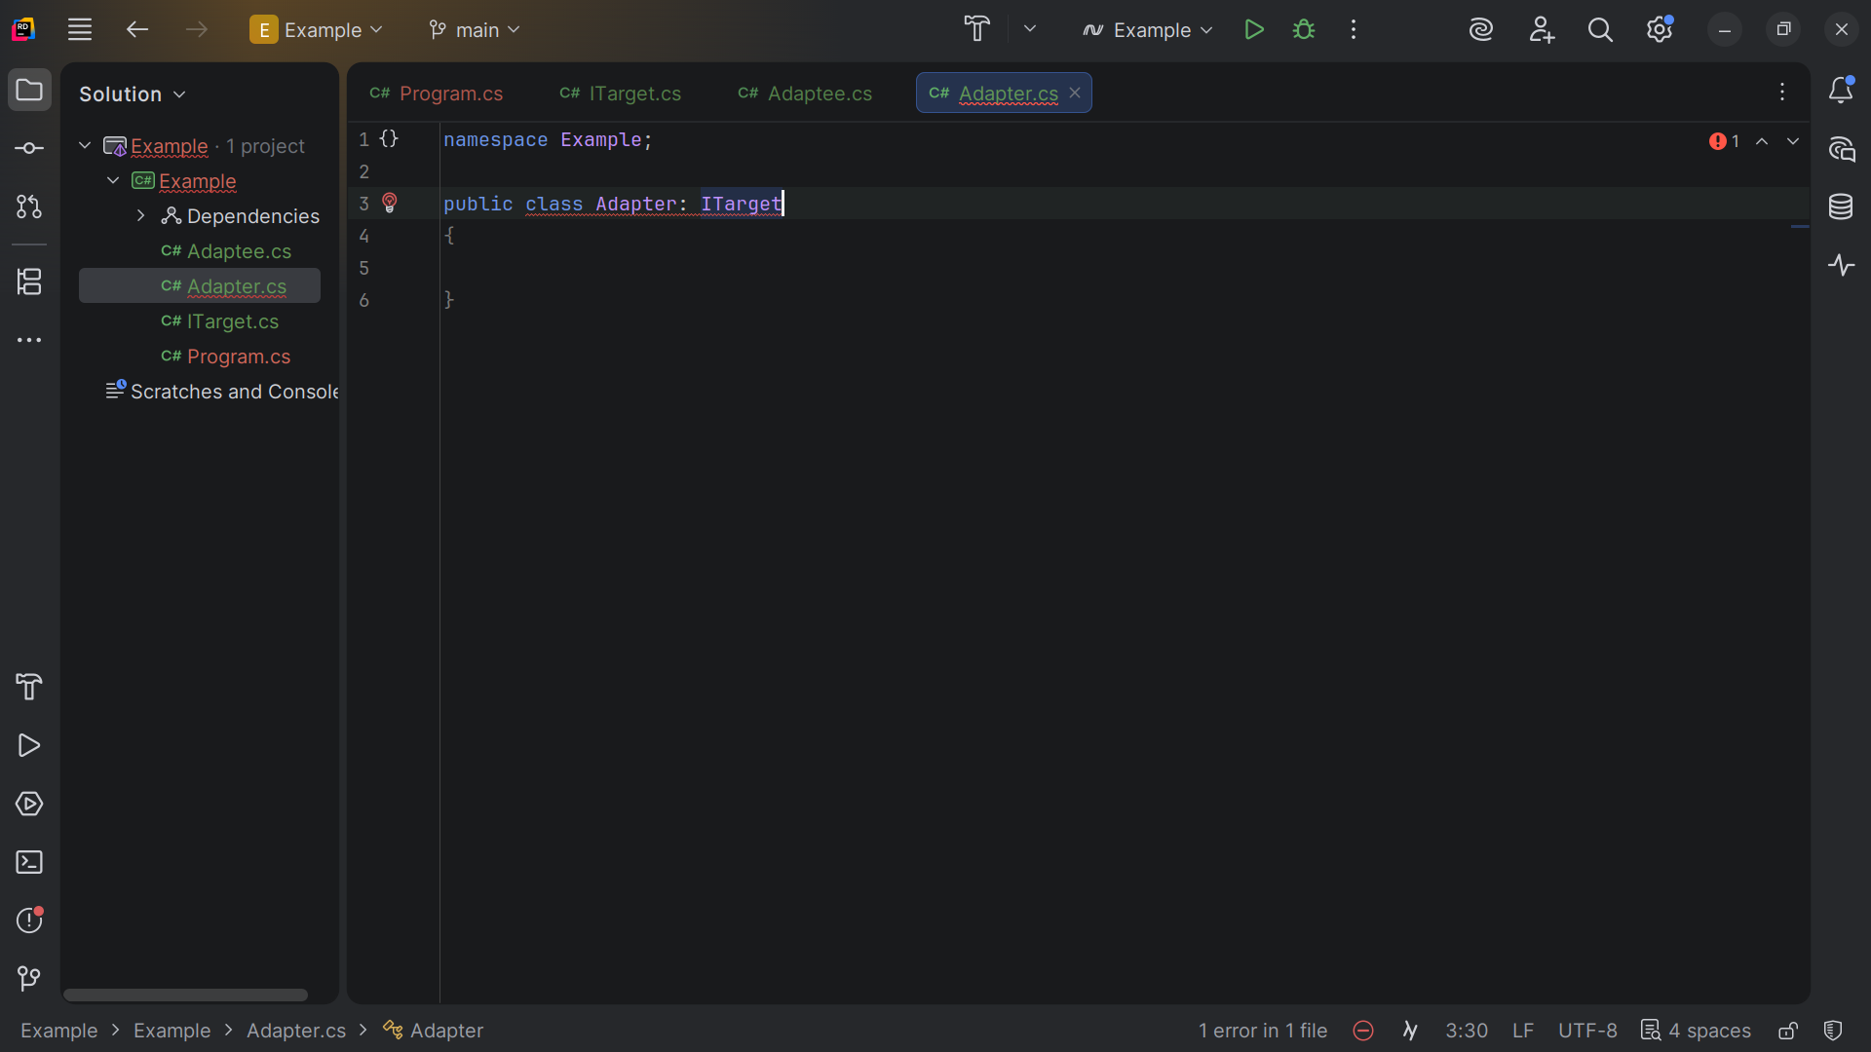
Notes:
We extend the Adapter with the I Target interface which requires a Get Request Method

Slide 12
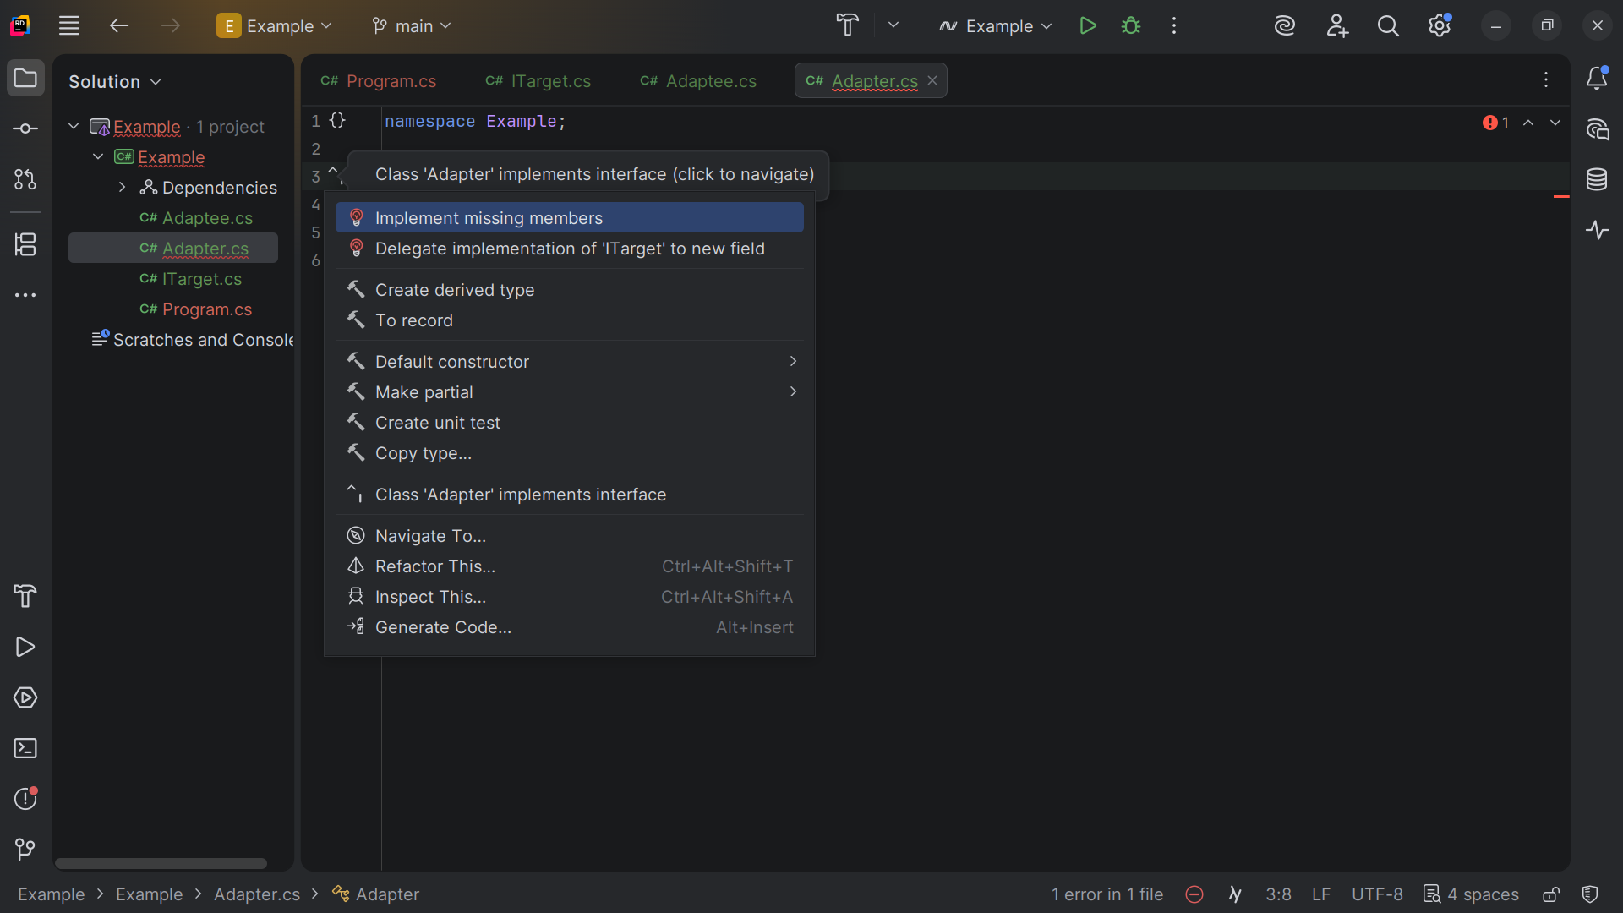
Notes:
So we use use the code generator to create it

Slide 13
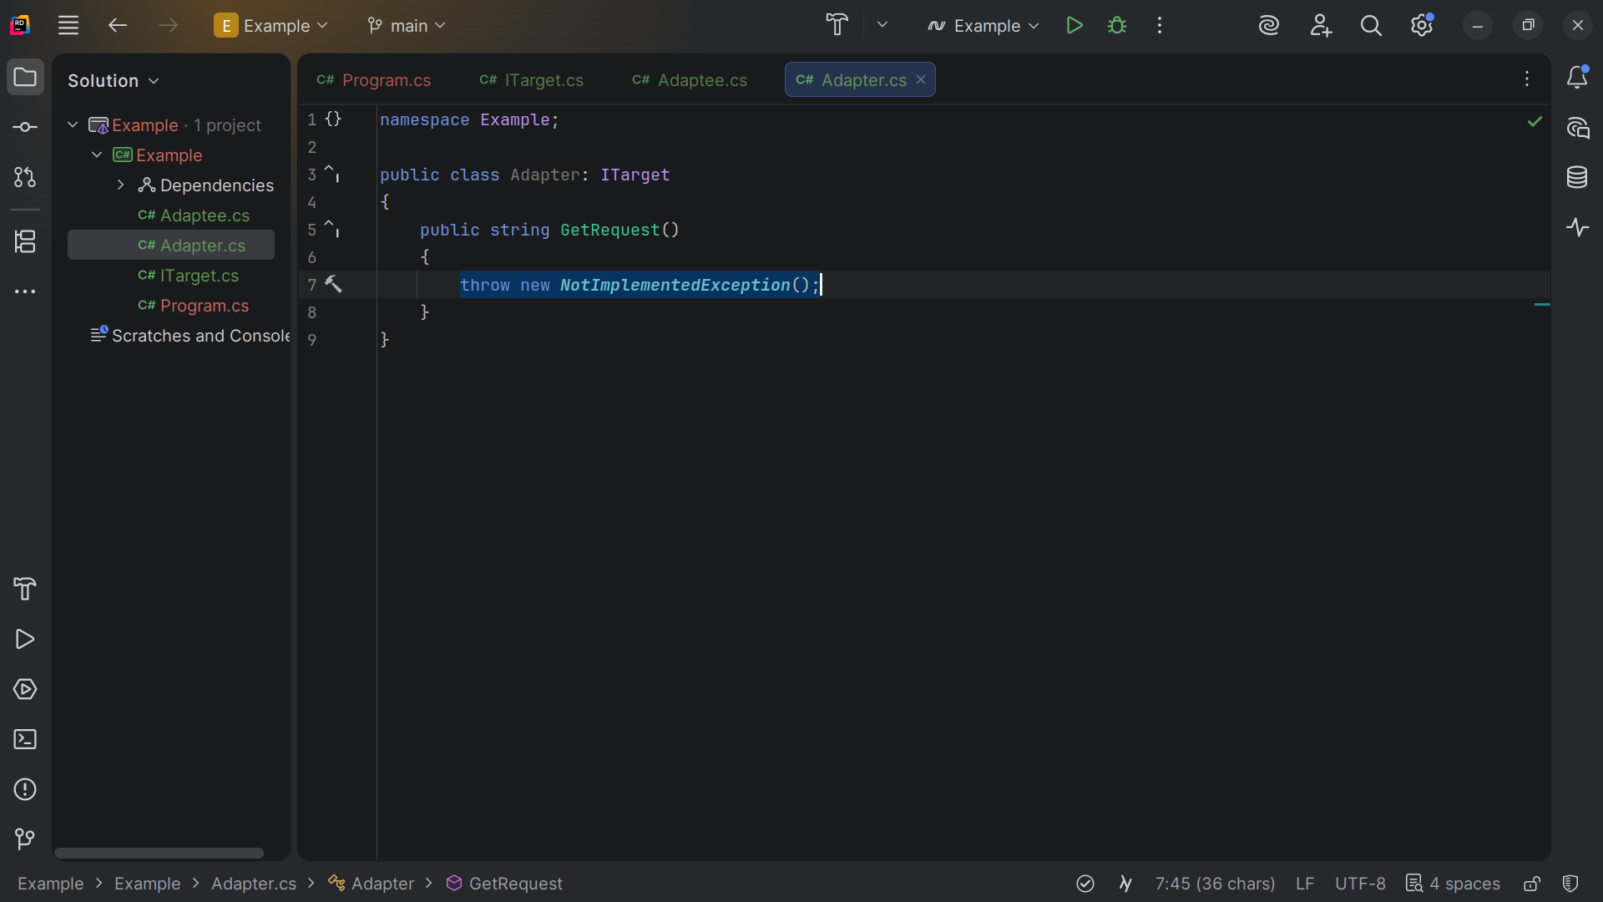
Notes:
Get Request in not implemented yet we just trow an error

Slide 14
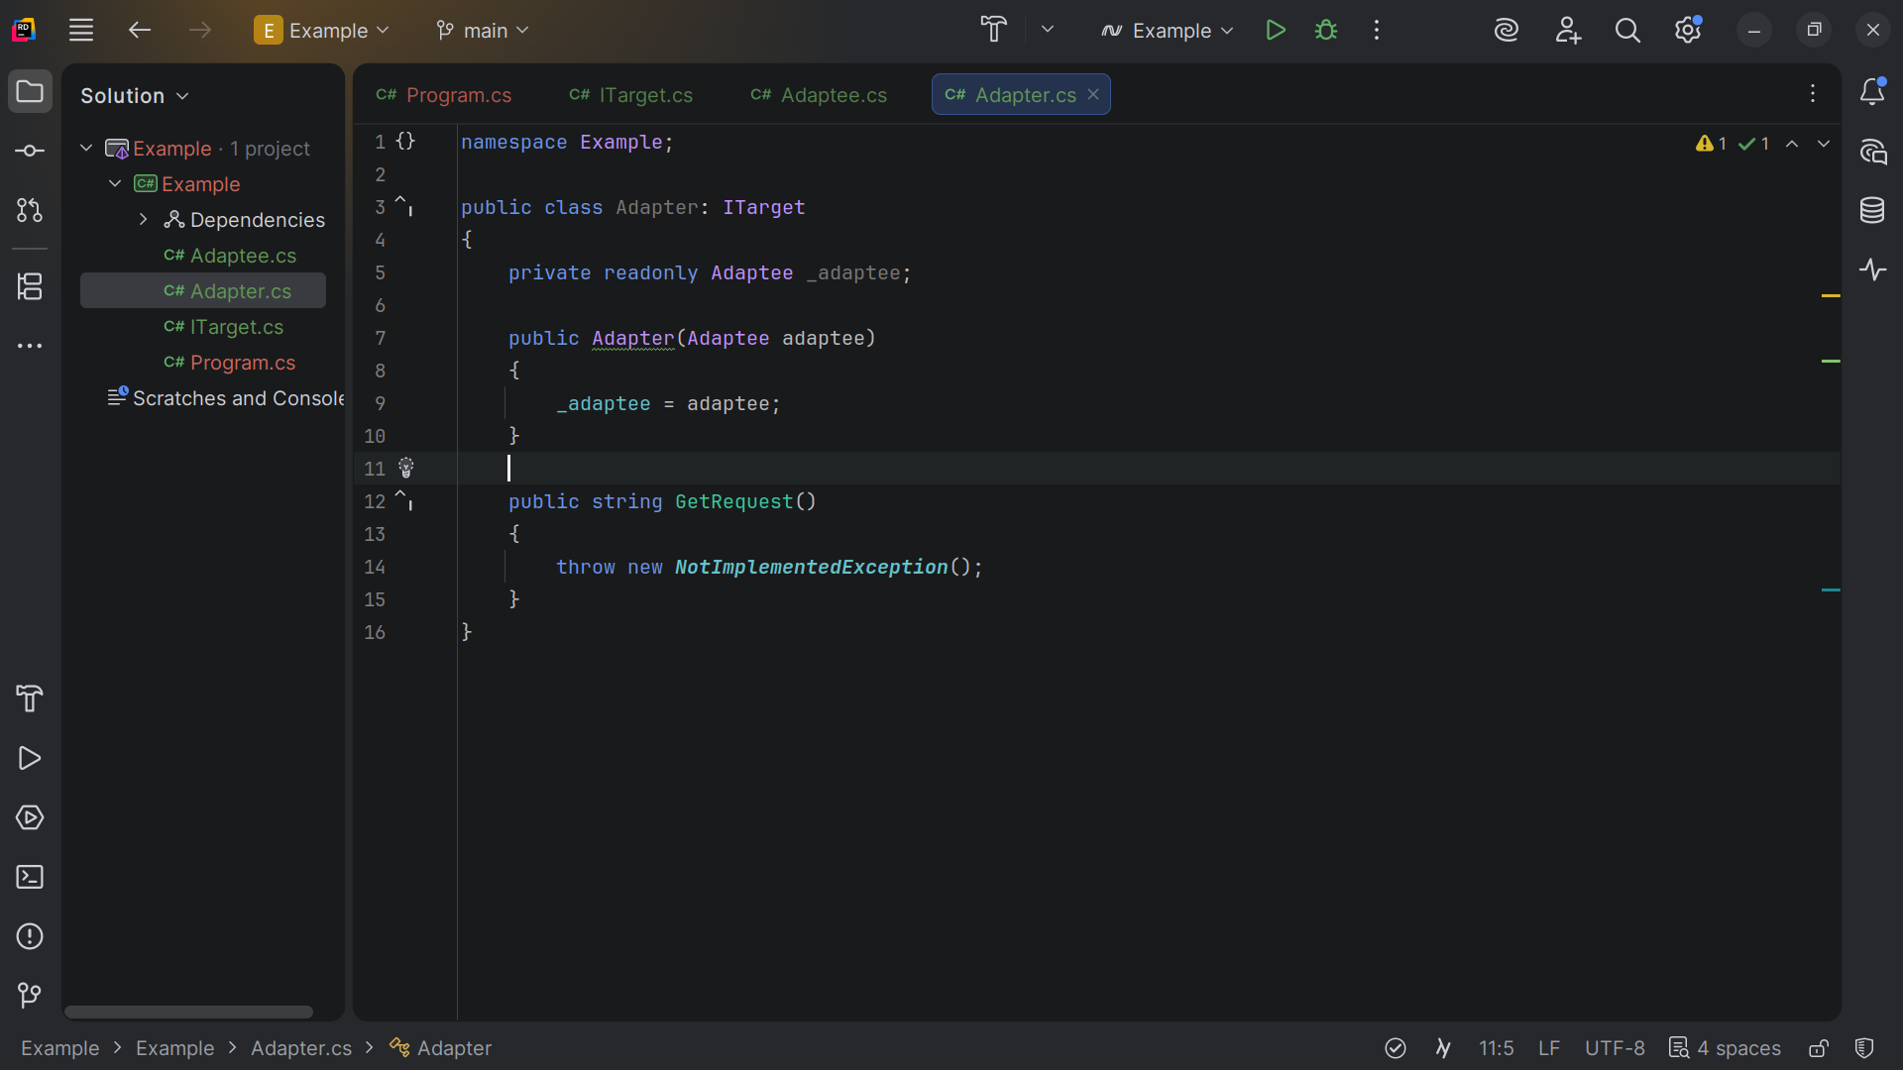
Notes:
At the top we create a new Adaptee, The Adapter takes the adaptee

Slide 15
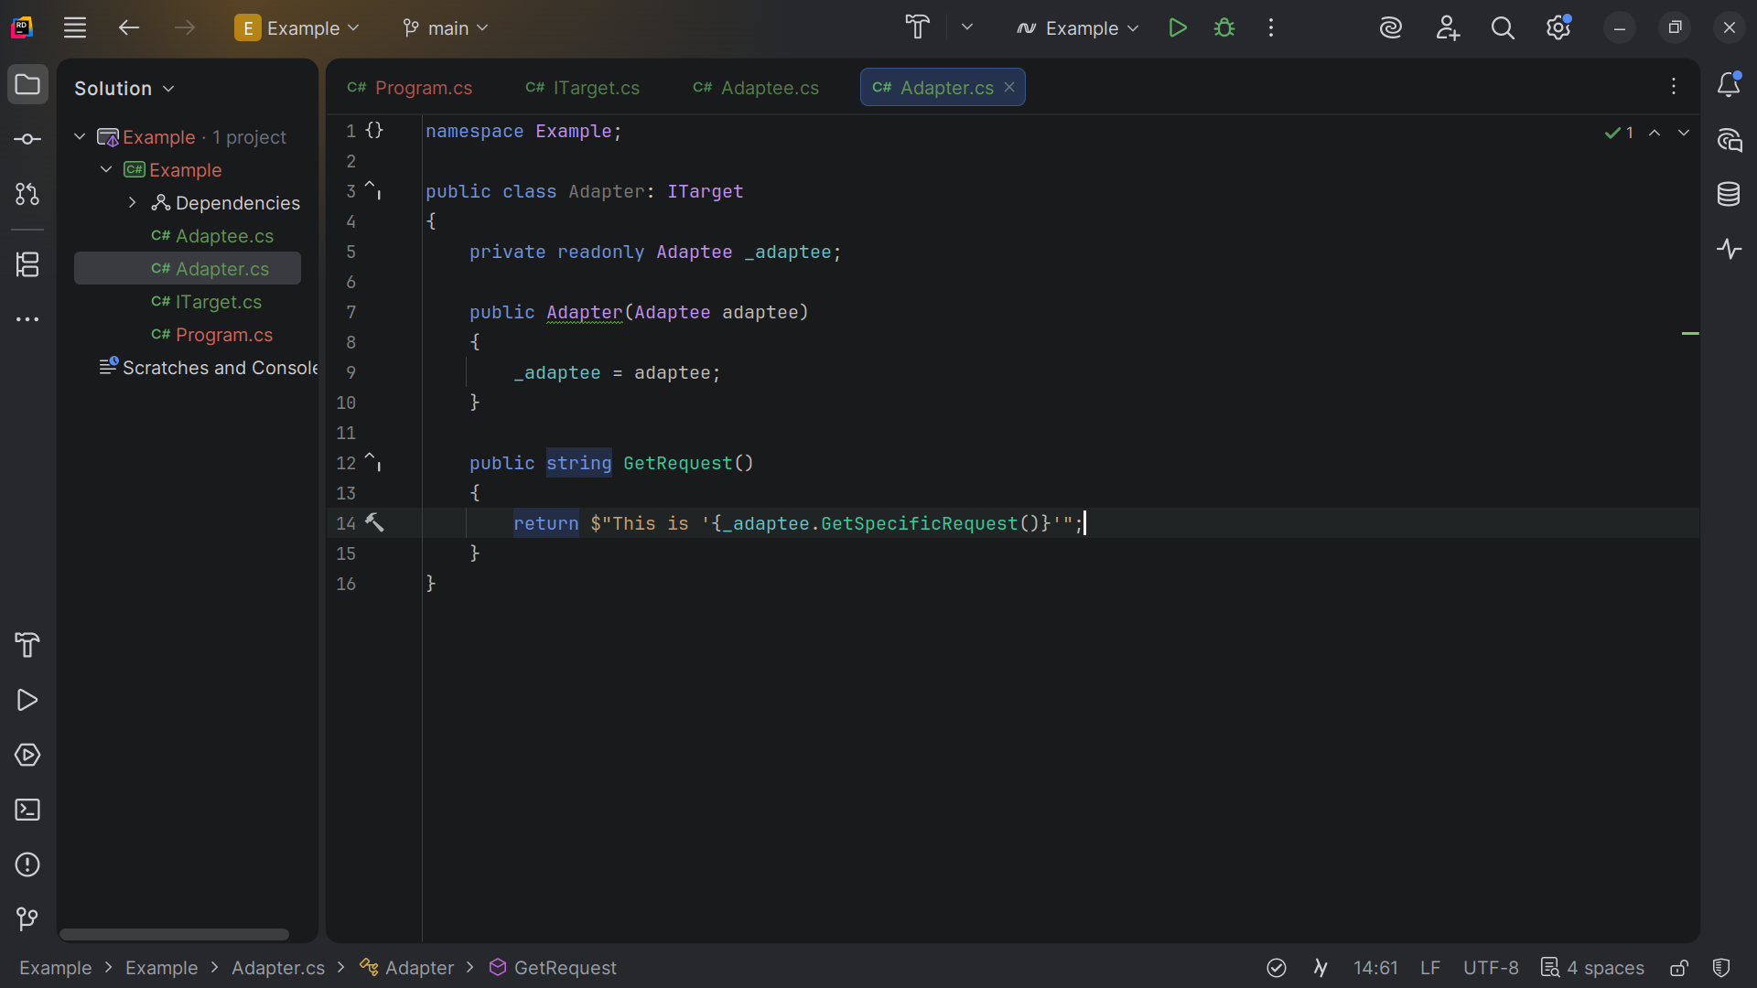
Notes:
And with Get Request we return string this is the adaptee dot get specific request

Slide 16
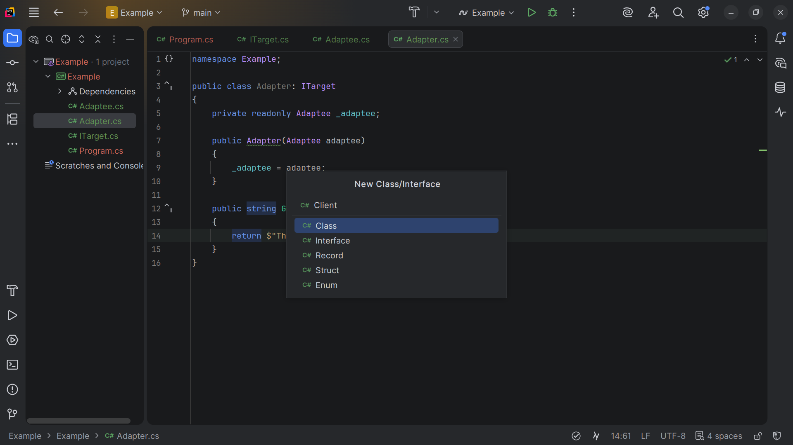
Notes:
Now let’s make a Client class for our demo

Slide 17
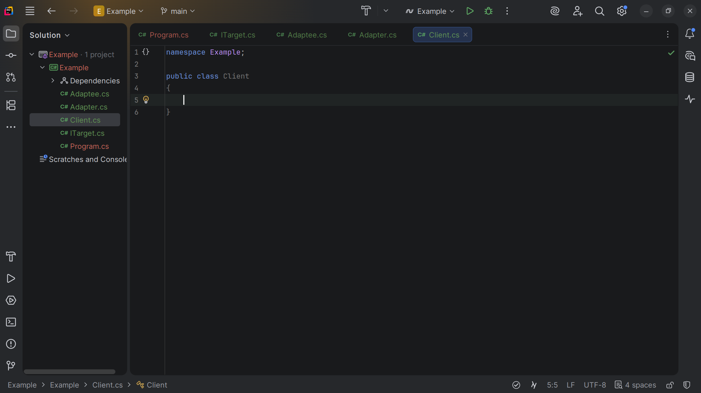
Notes:
The Client class that depends on the I - Target interface. It's unaware of Adaptee and Adapter.

Slide 18
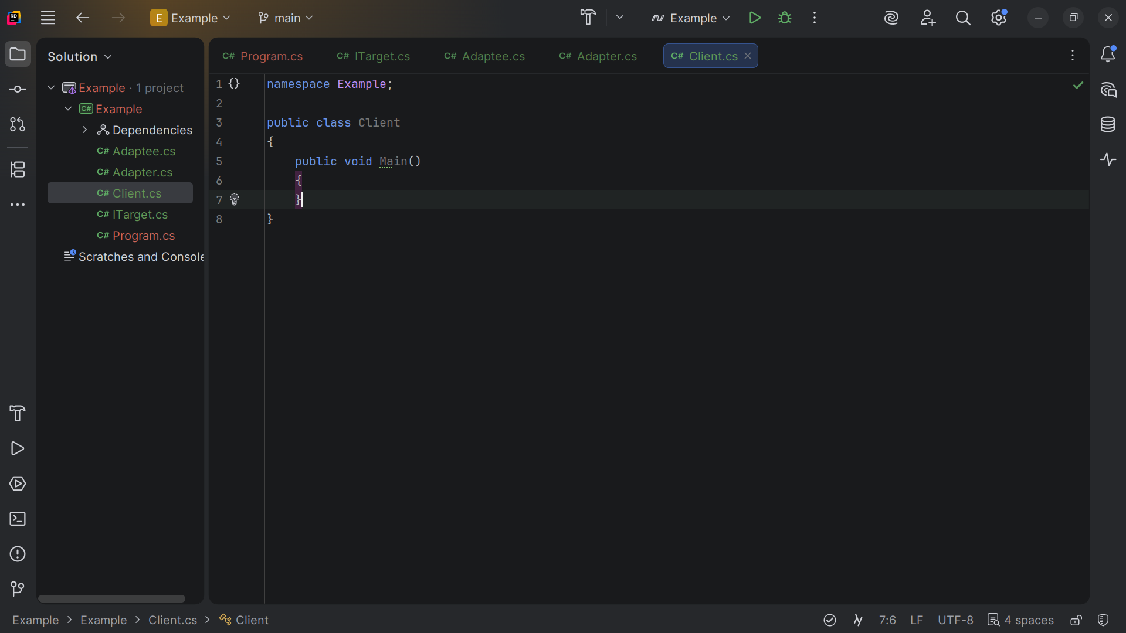
Notes:
We create a Main method

Slide 19
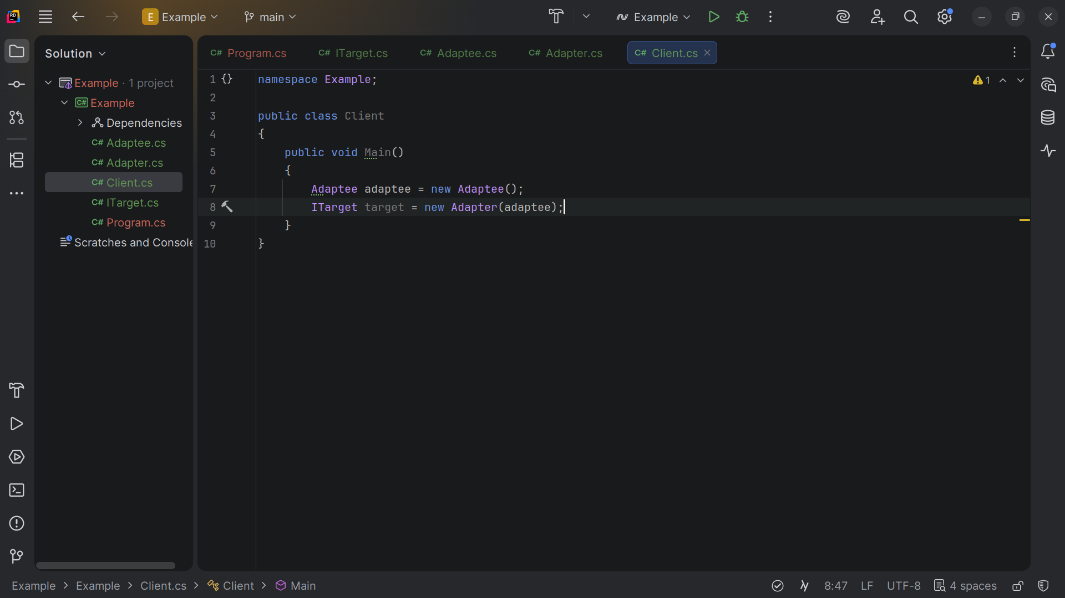
Notes:
We create a new Adaptee and set the target to a new Adapter of which we pass in the adaptee

Slide 20
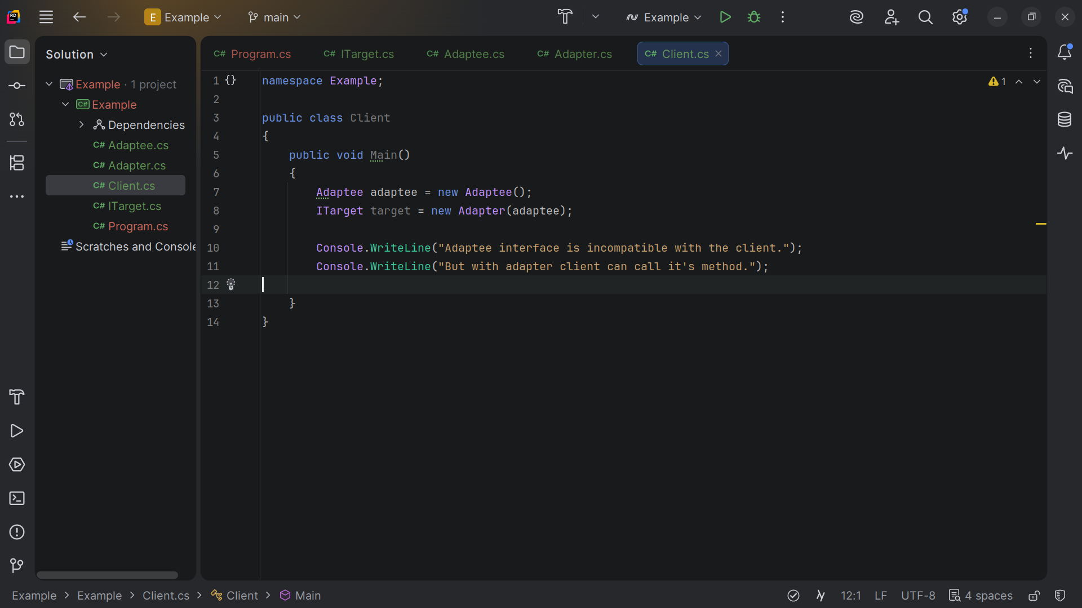
Notes:
We write to the console Adaptee interface is incompatible with the client.
But with adapter client can call it's method.

Slide 21
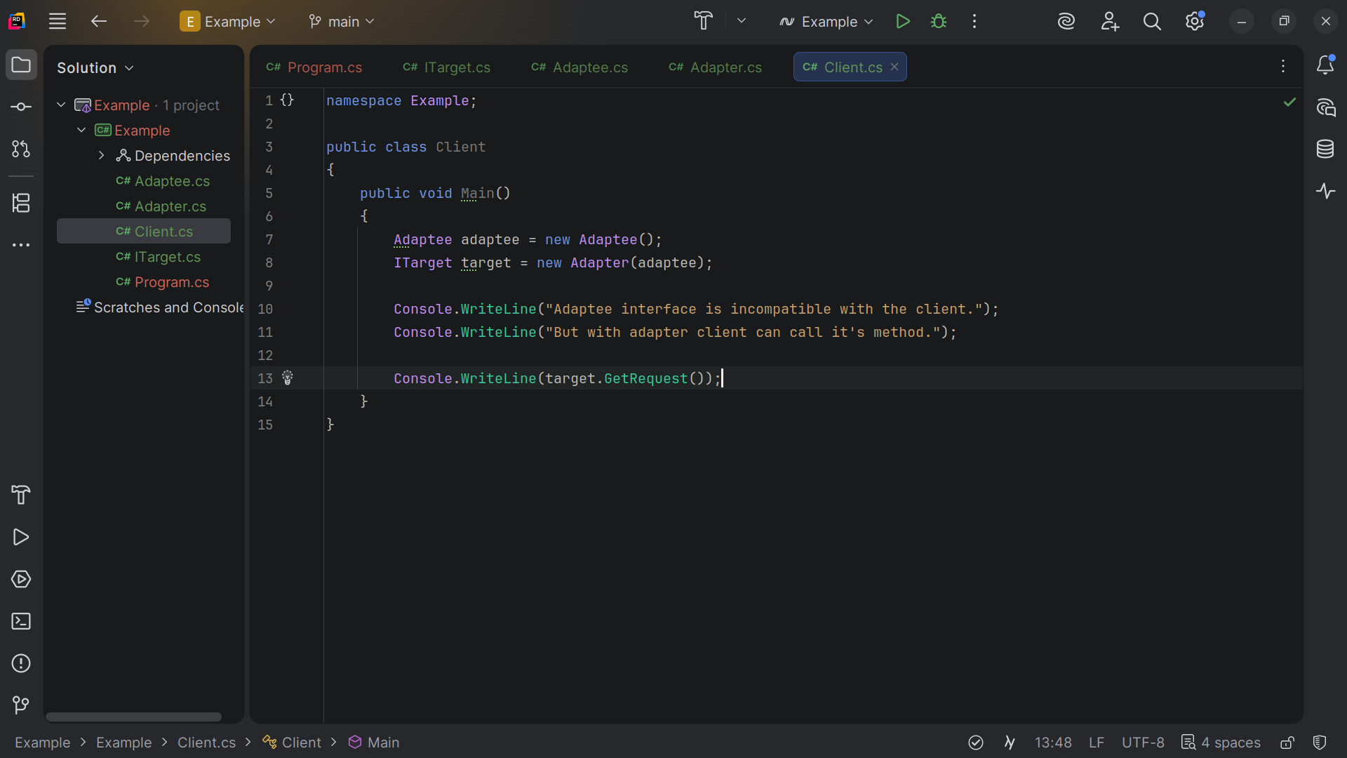
Notes:
And we write to the console target dot Get Request

Slide 22
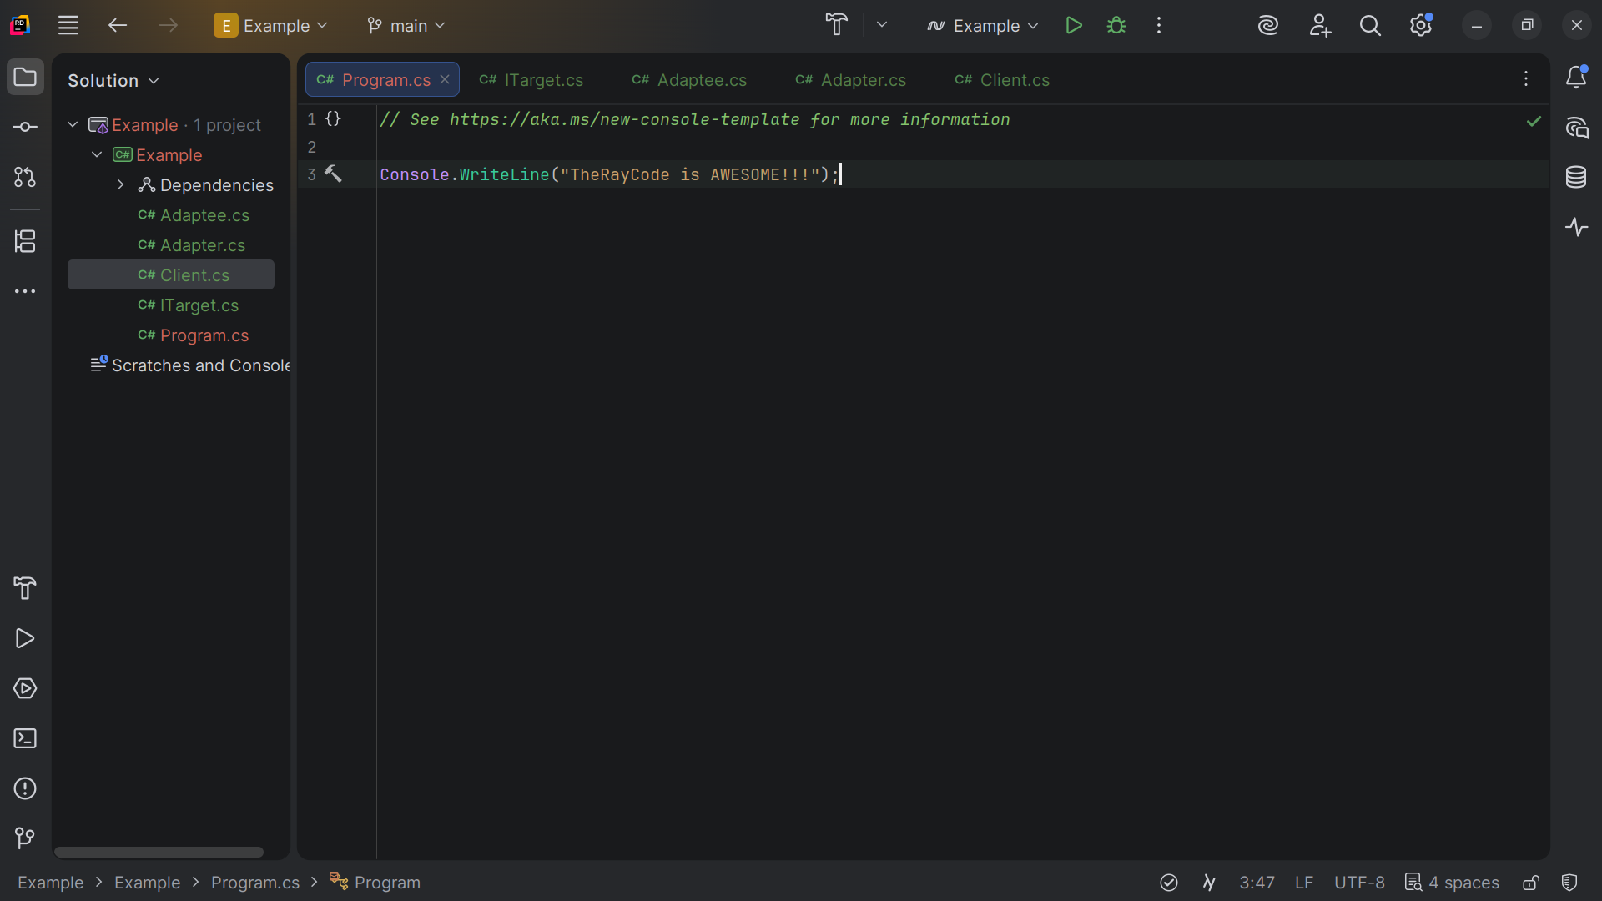
Notes:
Let’s now go to our Program dot CS page

Slide 23
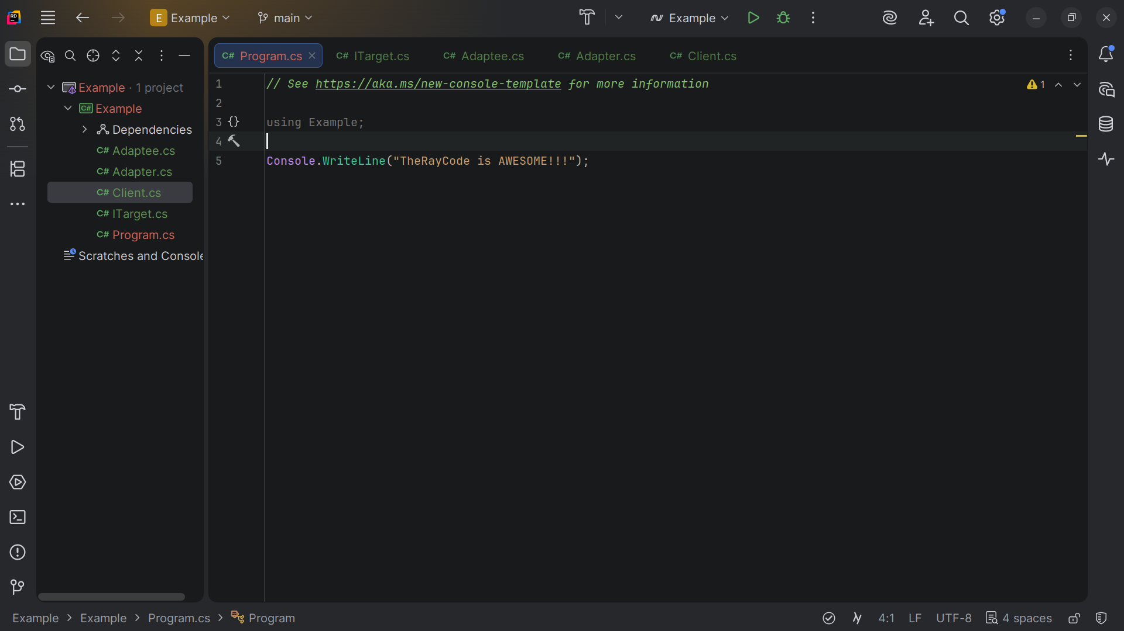
Notes:
At the top we note using Example

Slide 24
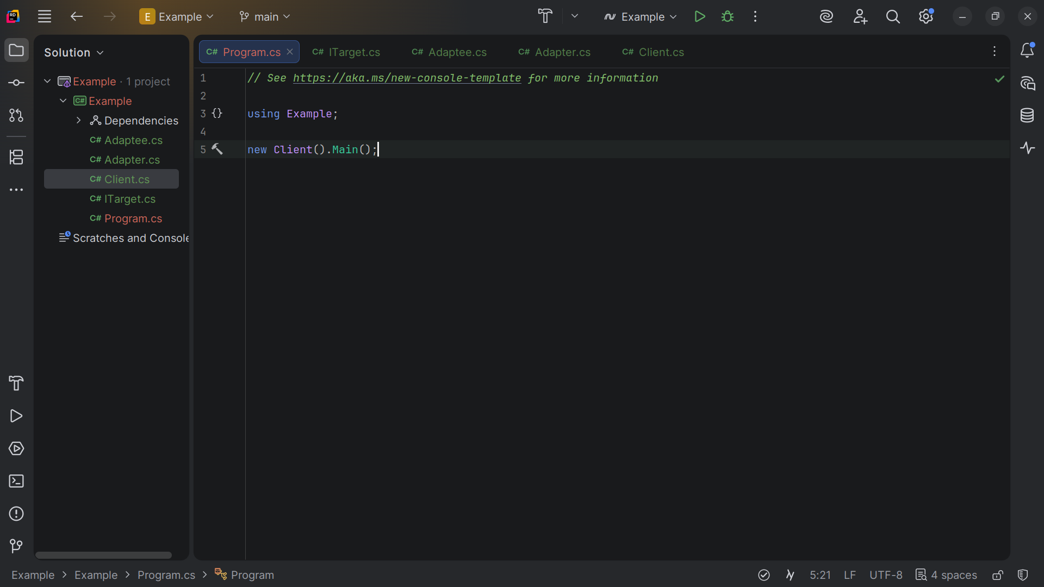
Notes:
We Add a new Client and we call main and we get

Slide 25
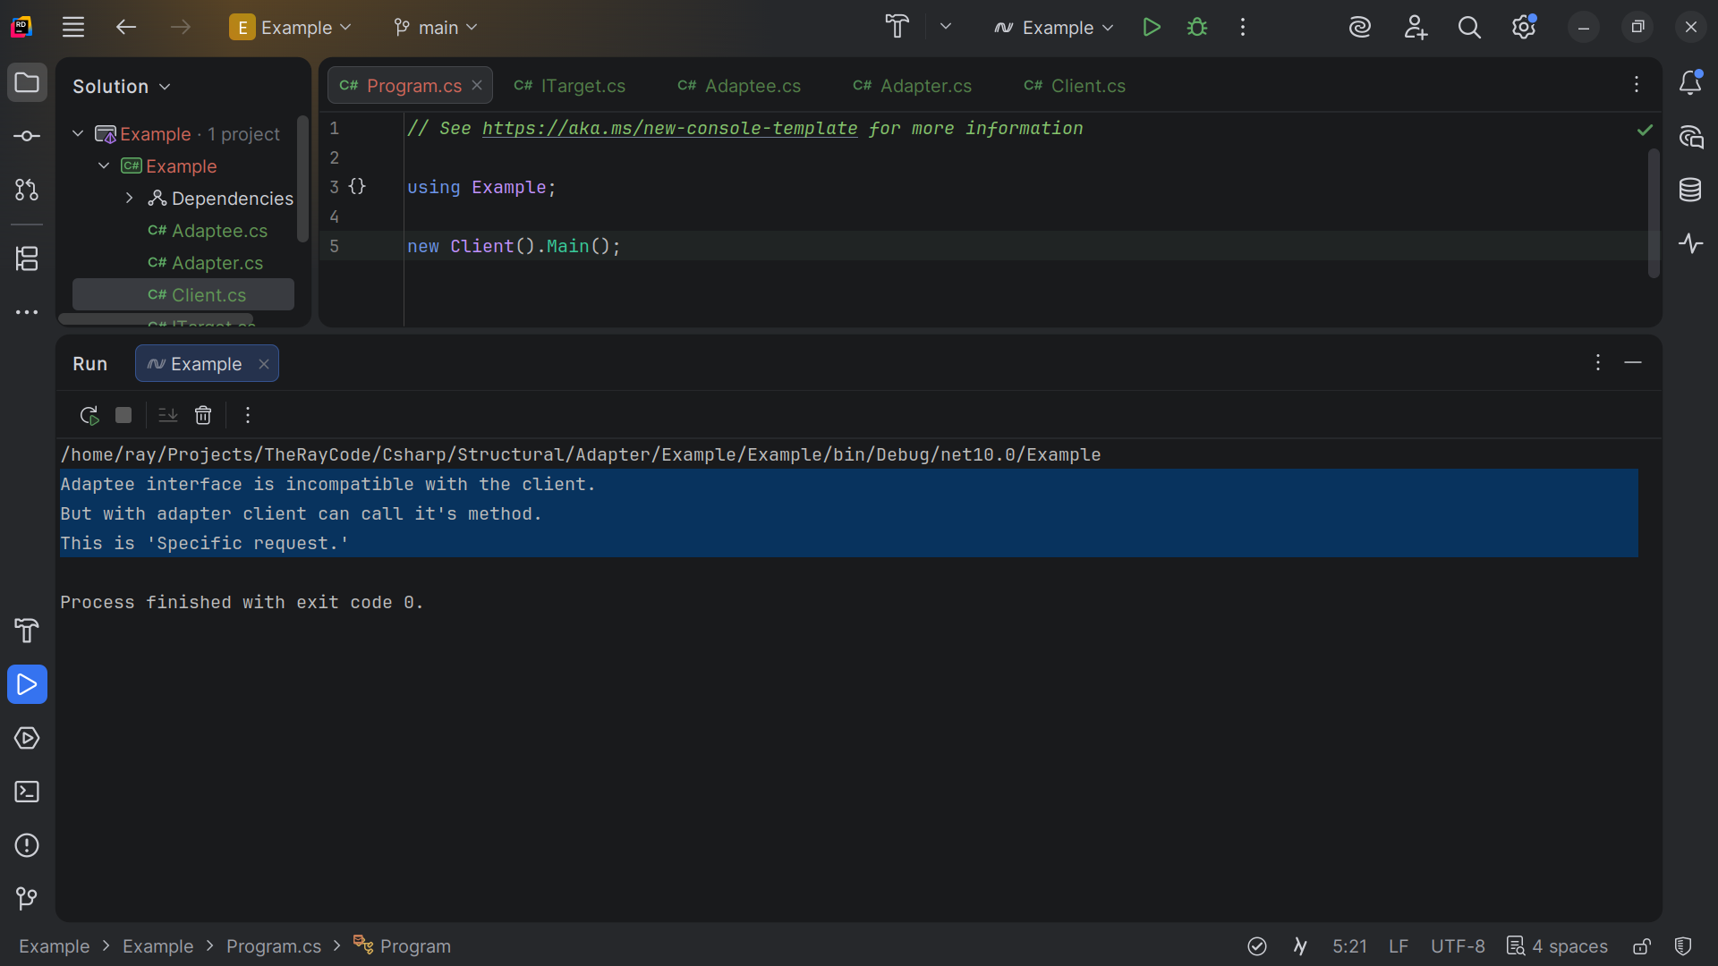
Notes:
Adaptee interface is incompatible with the client.
But with the adapter client can call it's method.
This is 'Specific request.'
*****
This example demonstrates how the Adapter pattern can be used to integrate classes with incompatible interfaces.
The Client can use the Adaptee via the Adapter without changing its code.
My name is Ray always code with a smile

