Slide 1

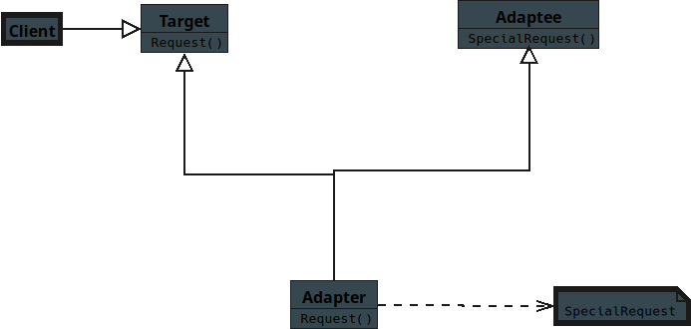
Notes:
(No Sound)

Slide 2
Notes:
Structural Pattern — Adapter for C# Students

Slide 3
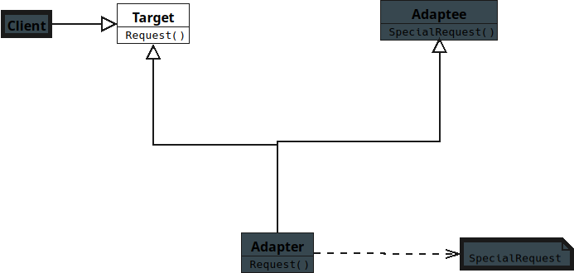
Notes:
Target
* Defines the interface the Client expects to use.
* Represents the standard behavior used by the system.
* Used directly by the Client.

Slide 4
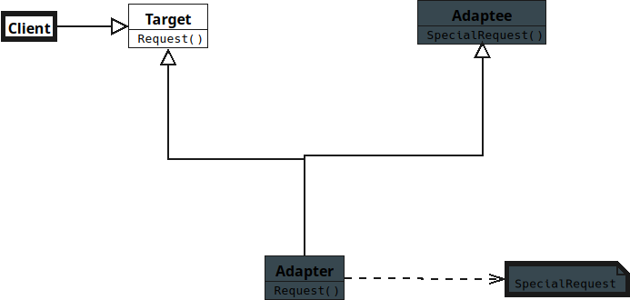
Notes:
Client
Works with objects through the Target interface.
Does not know about Adaptee’s interface.
Uses Adapter to interact with Adaptee.

Slide 5
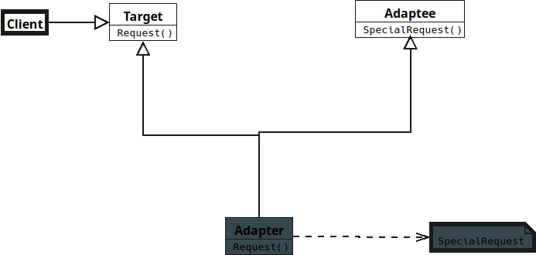
Notes:
**Adaptee**
* Has an existing interface incompatible with Target.
* Contains useful functionality already implemented.
* Cannot be easily modified.

Slide 6
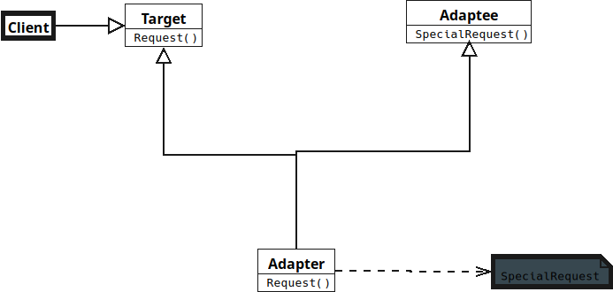
Notes:
**Adapter**
* Implements the Target interface..

Slide 7
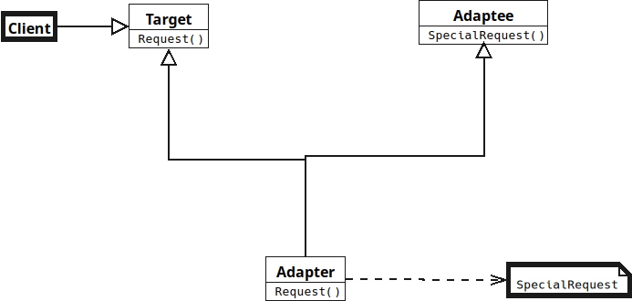
Notes:
* Converts Client requests into Adaptee method calls.
* Allows incompatible interfaces to work together.

Slide 8
Notes:
No Sound

