Slide 1



Slide 4
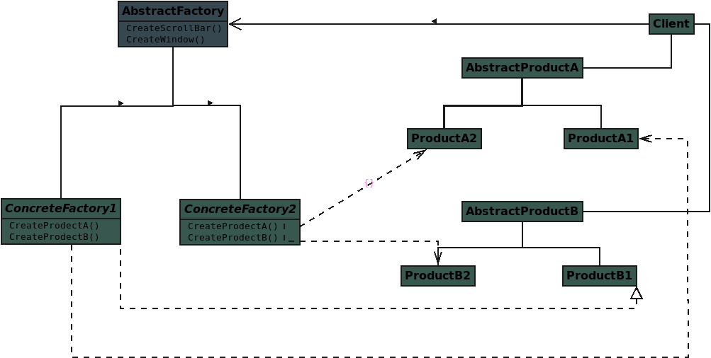

Slide 6
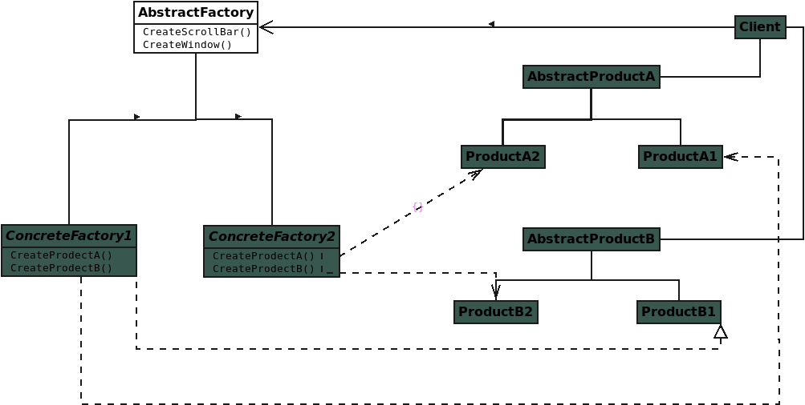
Notes:
Abstract Factory: declares an interface for operations that create abstract product objects

Slide 7
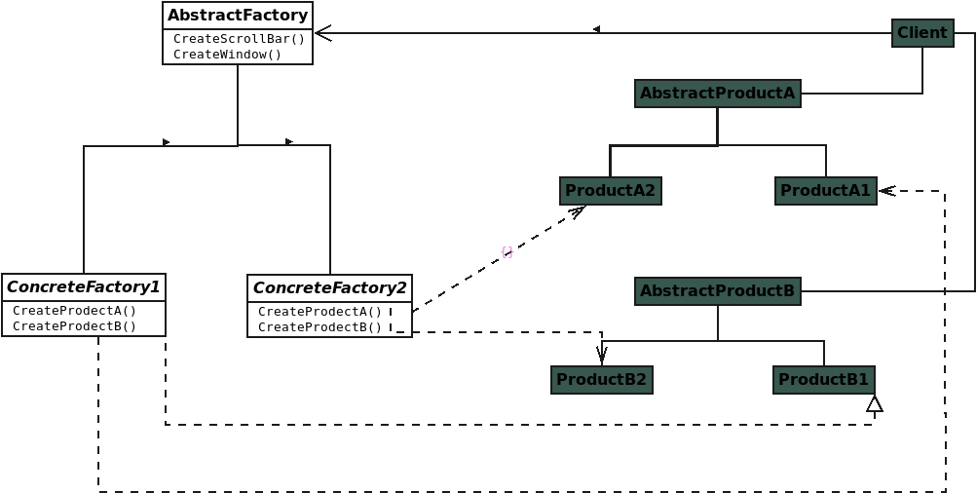
Notes:
Concrete Factory: implements the operations to create concrete product objects

Slide 8
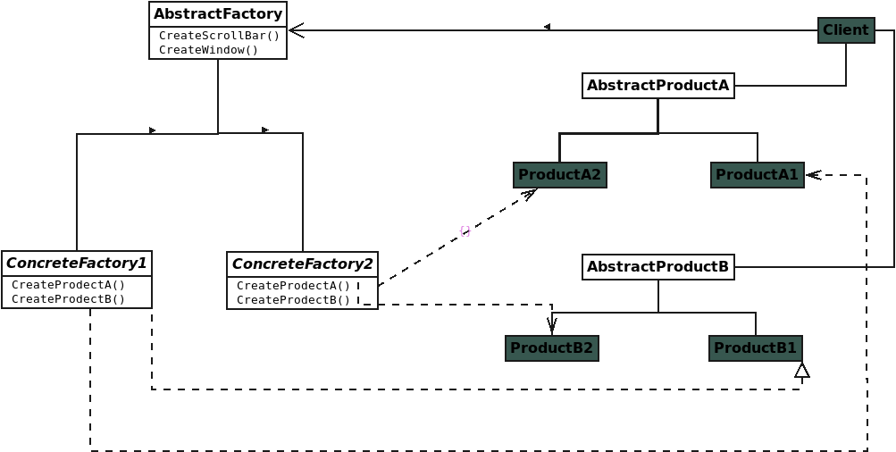
Notes:
Abstract Product: declares an interface for a type of product objec

Slide 9
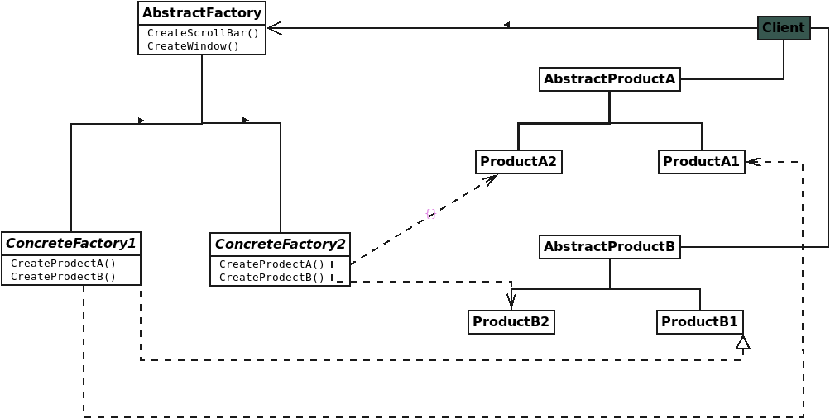
Notes:
Concrete Product defines a product object to be created by the corresponding concrete factory

Slide 10
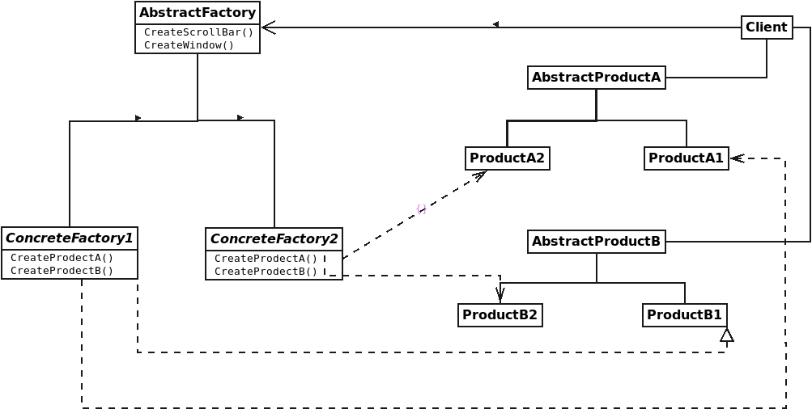
Notes:
Client: uses only interfaces declared by Abstract Factory and Abstract Product classes

Slide 11
Notes:
Client: uses only interfaces declared by Abstract Factory and Abstract Product classes

Slide 12
Notes:
Client: uses only interfaces declared by Abstract Factory and Abstract Product classes

Slide 13
Notes:
Client: uses only interfaces declared by Abstract Factory and Abstract Product classes

Slide 14
Notes:
Client: uses only interfaces declared by Abstract Factory and Abstract Product classes

