Slide 1
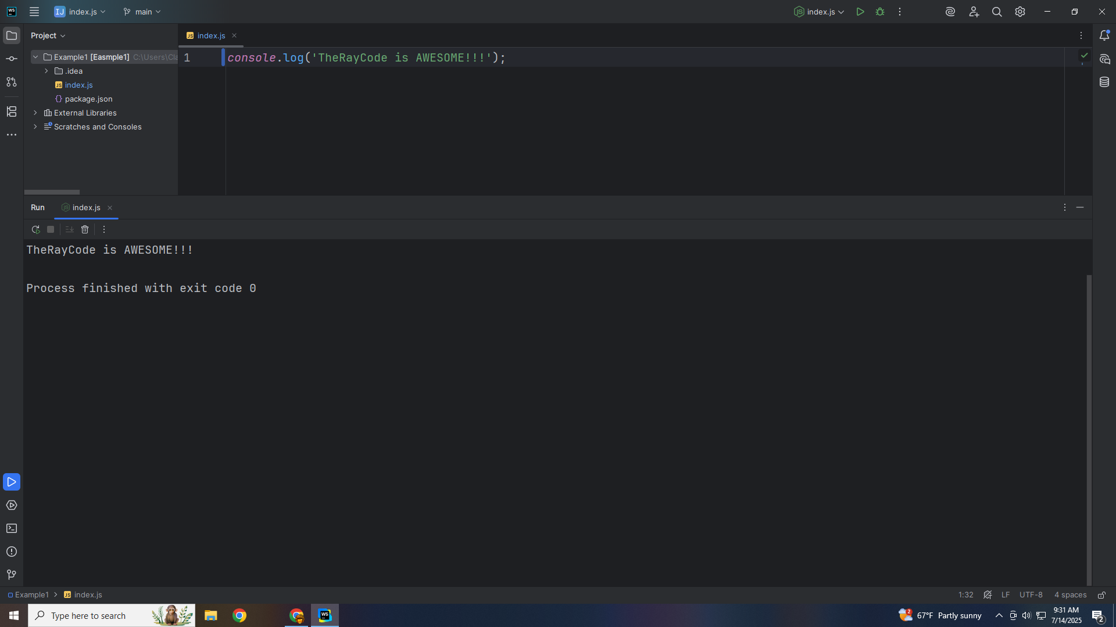
Notes:
Hello I’m Ray of TheRayCode. In this show I would like to give you a demo of the Composition design pattern

Slide 2
Notes:
Which is a Structural Design patter according to the Gang of Four .. I will be using JavaScript

Slide 3
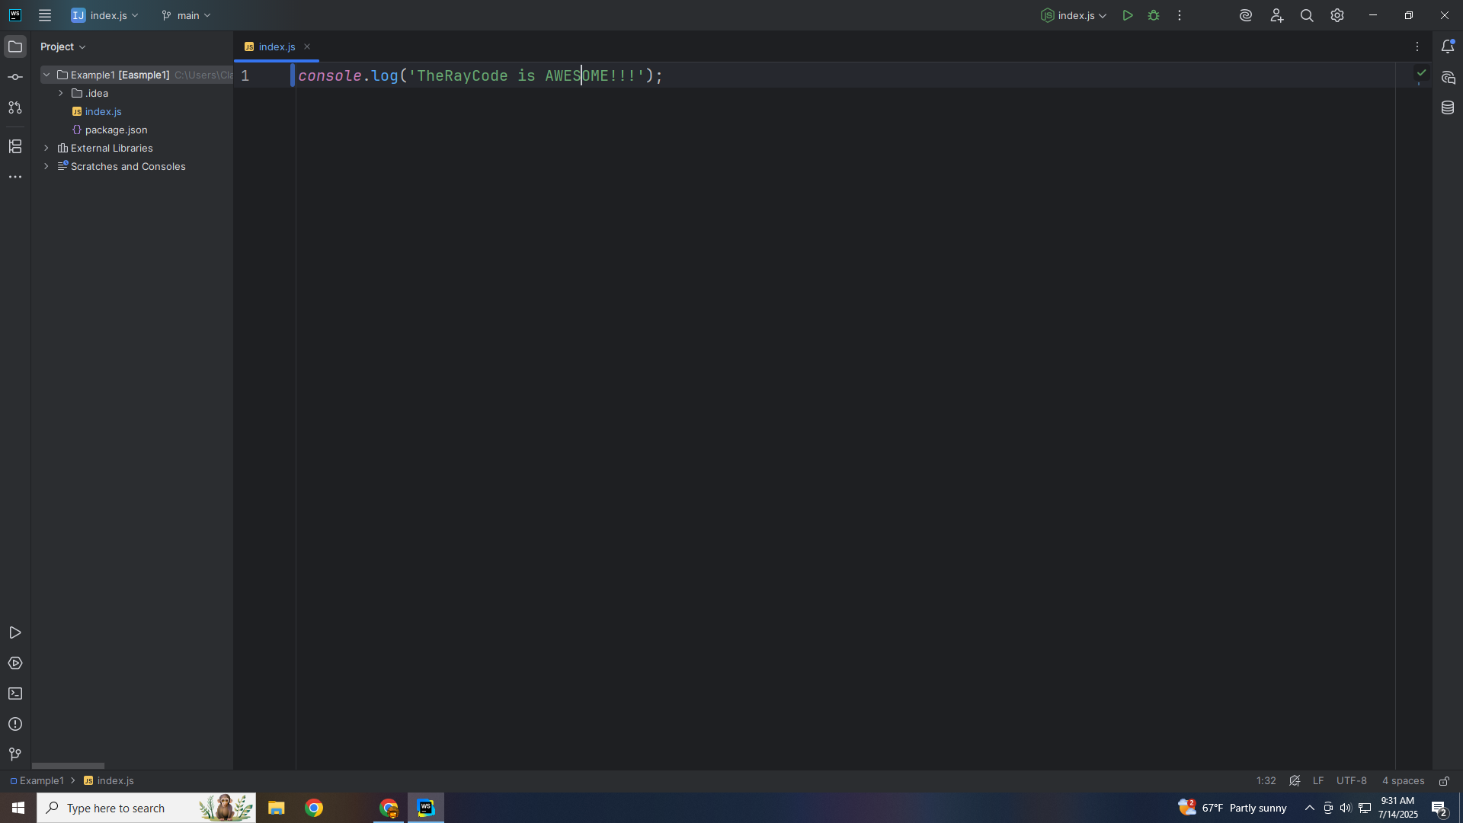
Notes:
I will stick close to the class names that are given in the example that is in the book on page 159

Slide 4
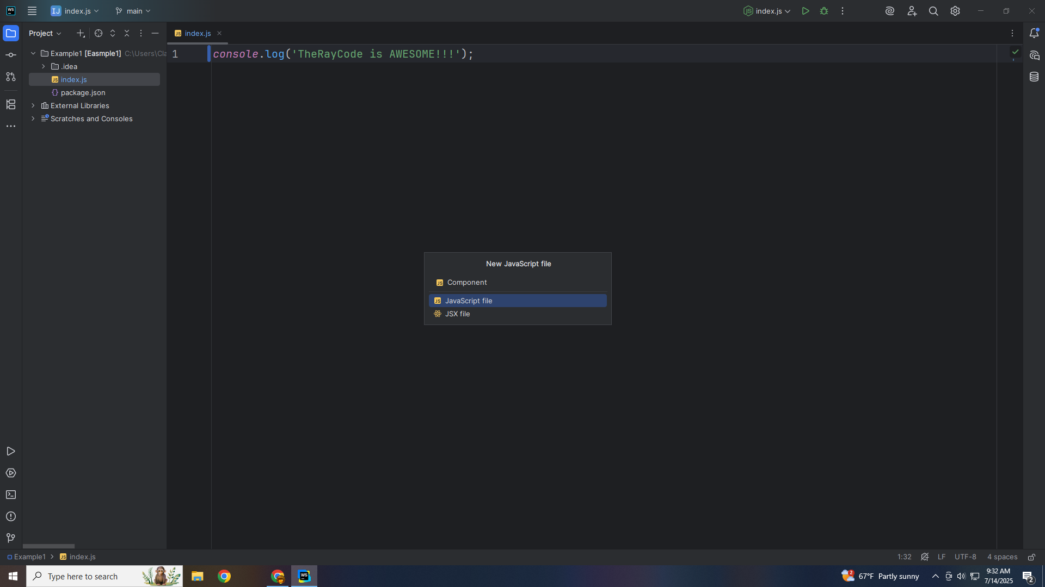
Notes:
We start with a class named Component

Slide 5
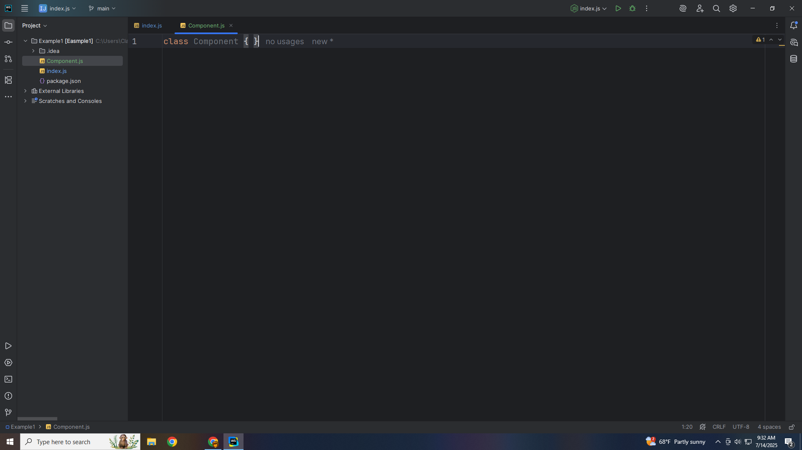
Notes:
The Component will be an abstract interface for all objects in the composition

Slide 6
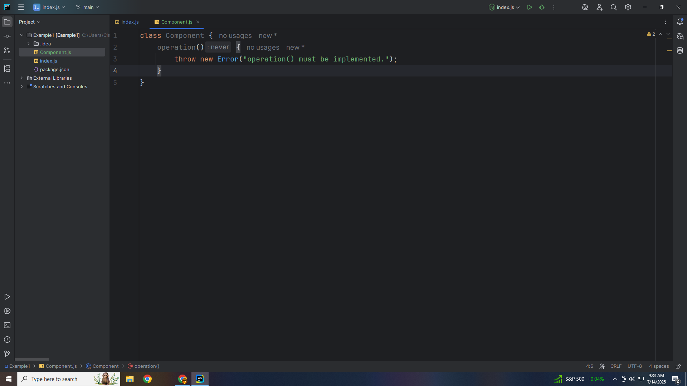
Notes:
If the operation is not implemented we throw an error

Slide 7
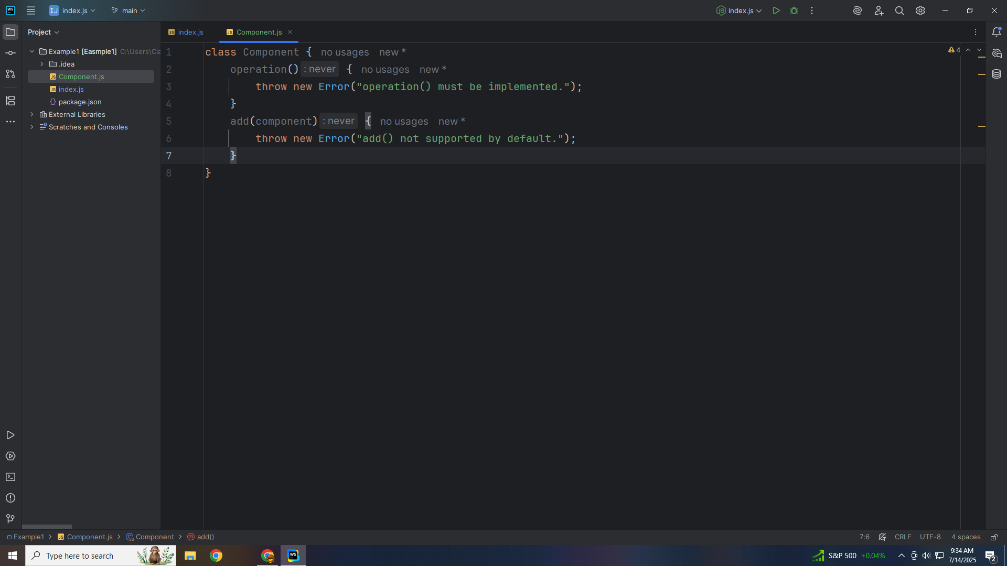
Notes:
The Add method is not supported by default

Slide 8
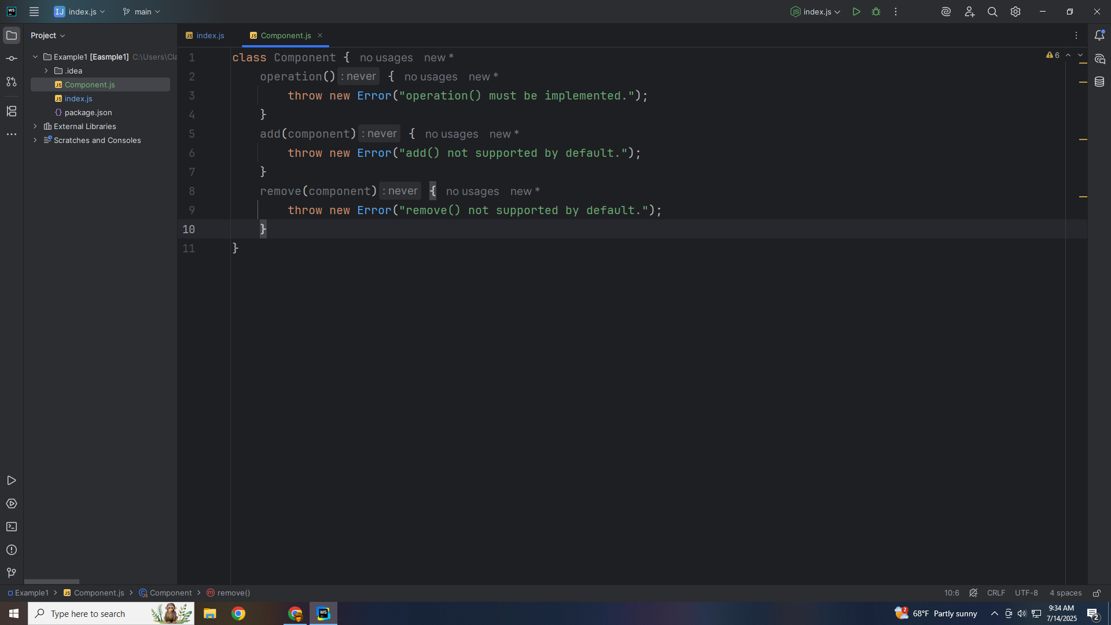
Notes:
Remove is also not supported

Slide 9
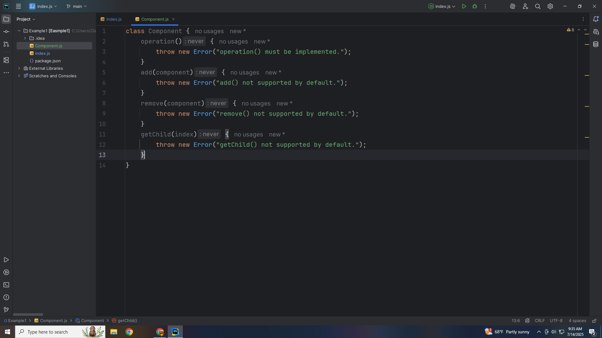
Notes:
And so is get Child

Slide 10

Notes:
And We export this module for use in our demo

Slide 11
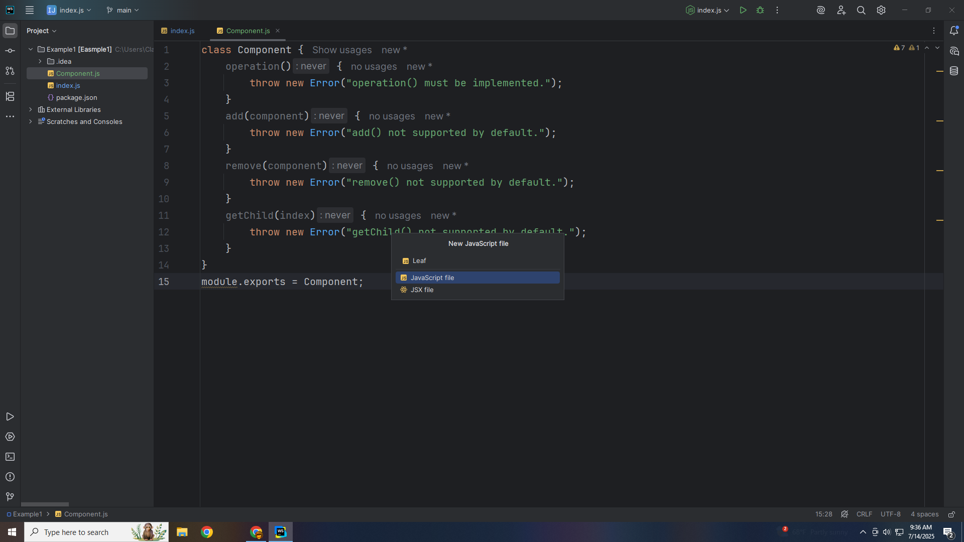
Notes:
Let’s now create a class we call Leaf

Slide 12

Notes:
Leaf: represents individual objects, no children
At he top we require The Component class

Slide 13

Notes:
So we may extend this class with it

Slide 14

Notes:
The construct stores the name of the leaf

Slide 15
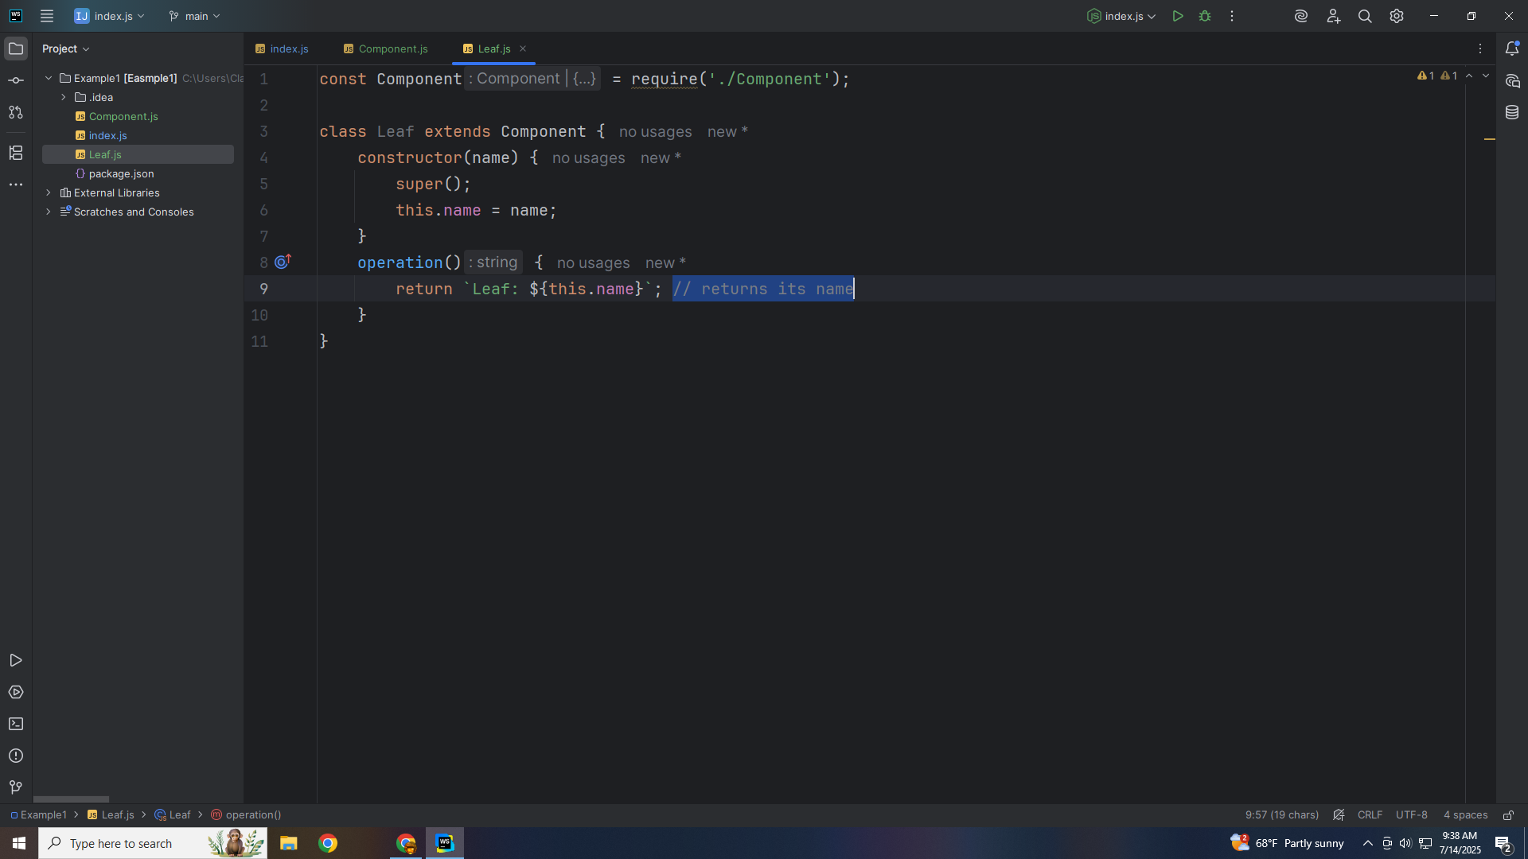
Notes:
We add an operation method to store the name of the leaf

Slide 16
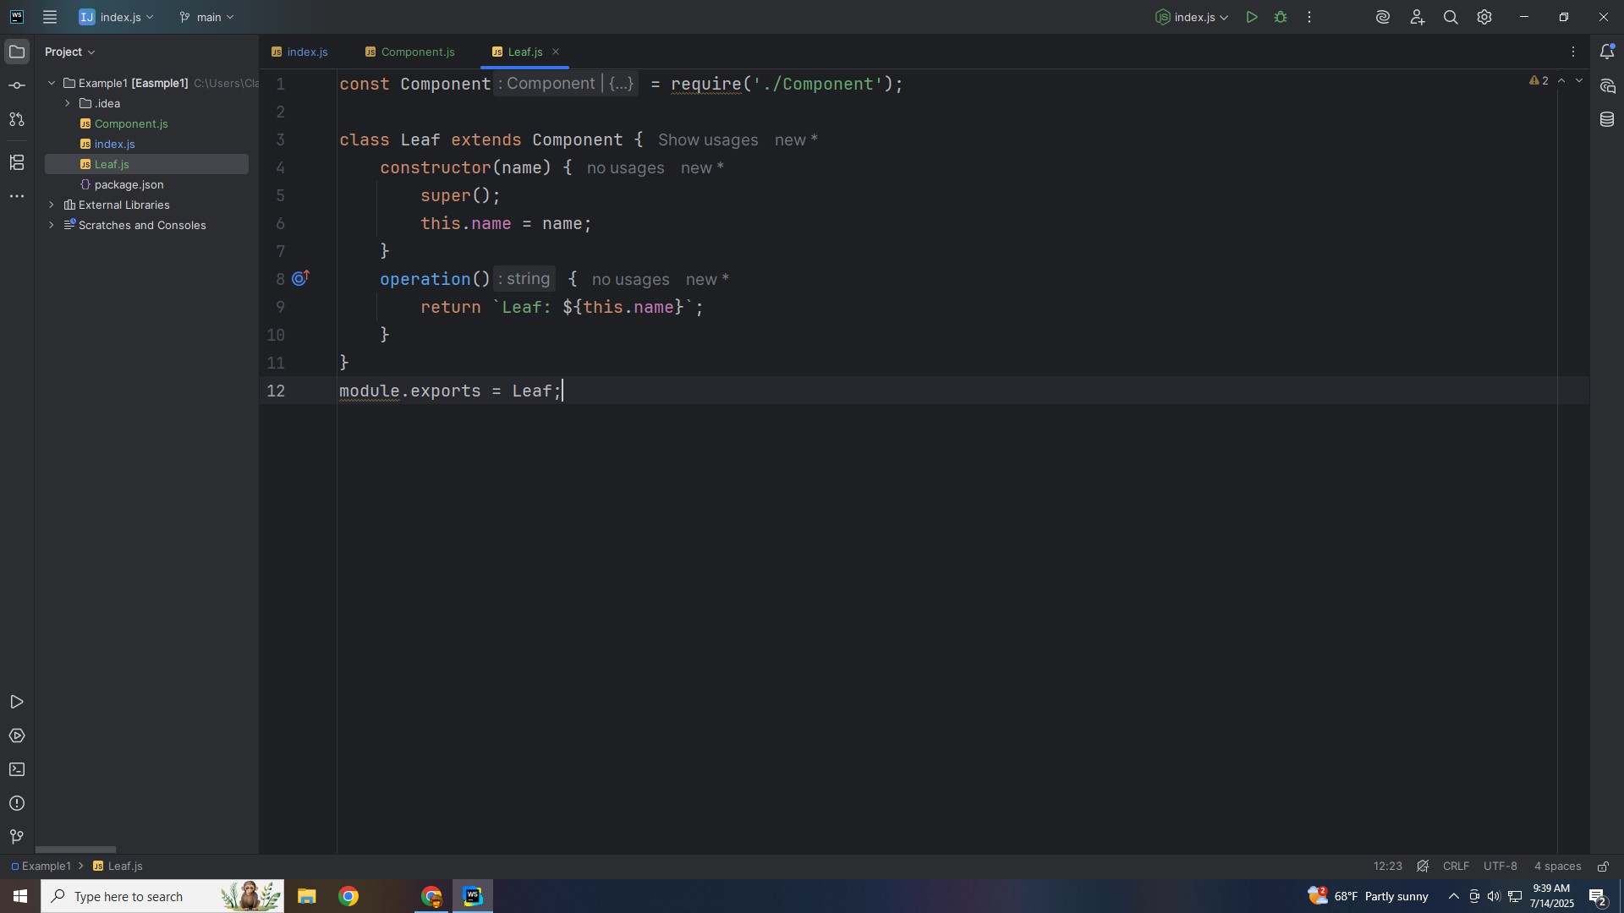
Notes:
And we close this module with an export for our main demo

Slide 17
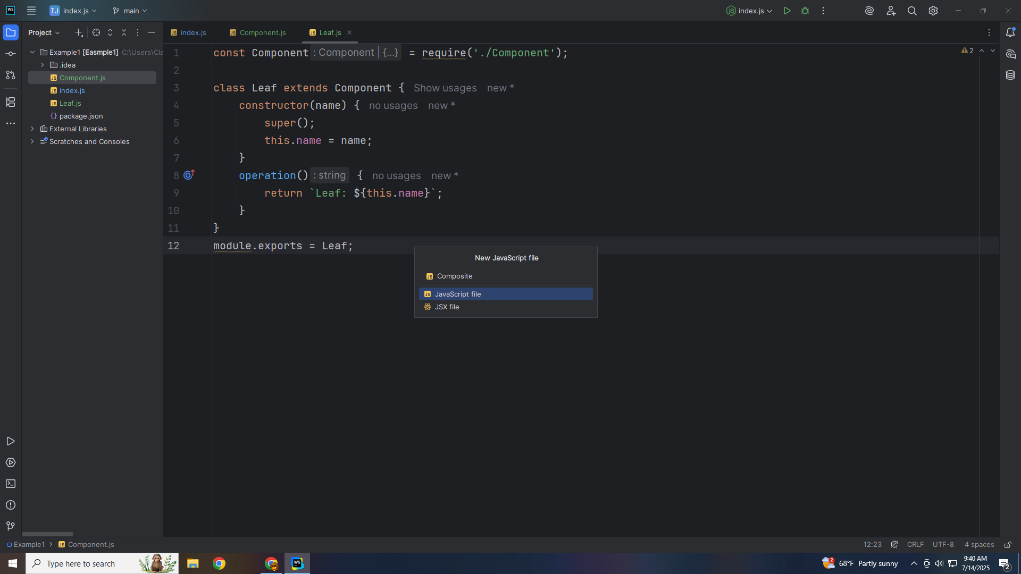
Notes:
The next class we will work on is the Composite

Slide 18
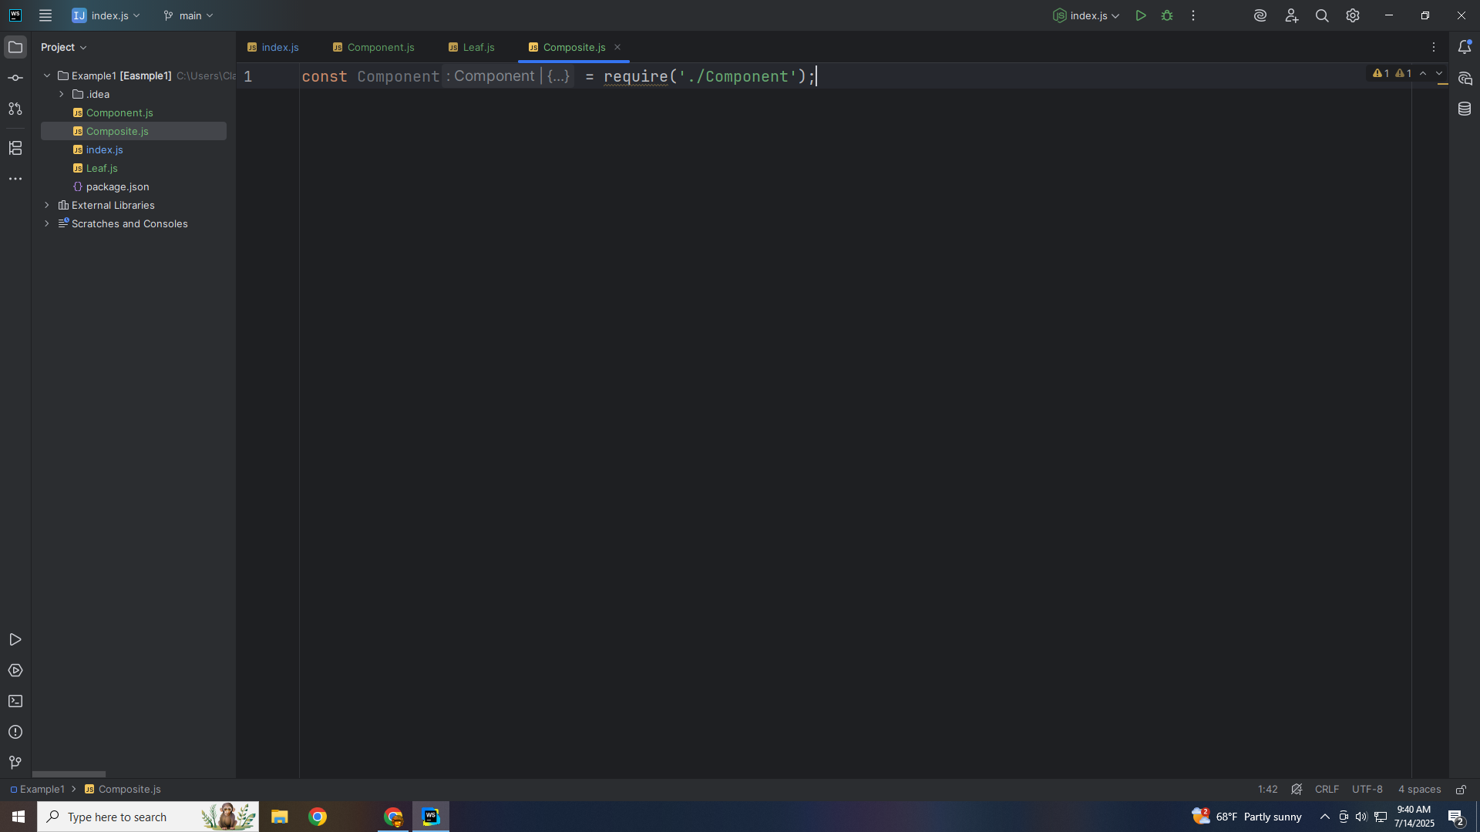
Notes:
At the top we require the Component Class

Slide 19
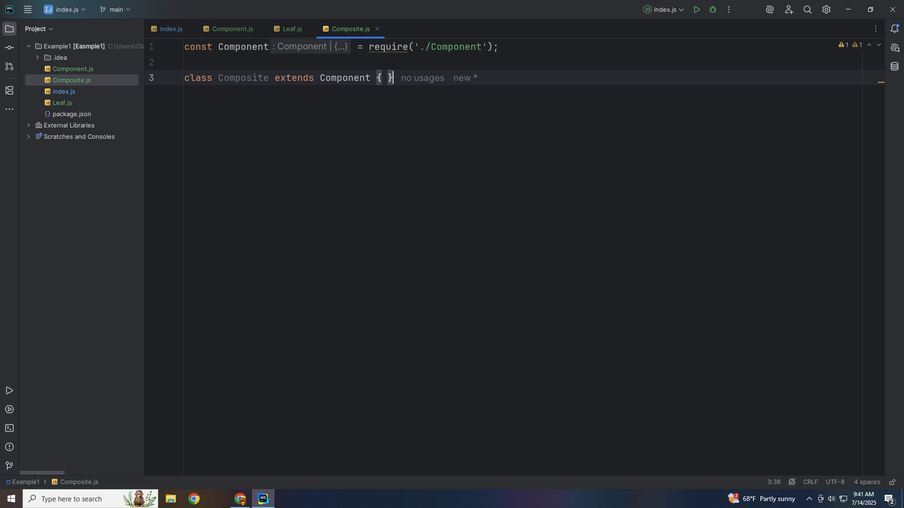
Notes:
So we may extend this class with it

Slide 20

Notes:
We will set this name to name and and this children will be an array

Slide 21
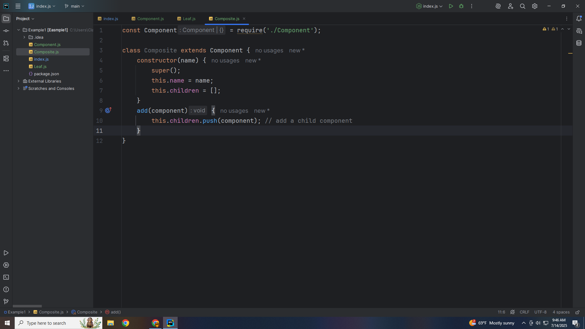
Notes:
The Component is added to the children array

Slide 22
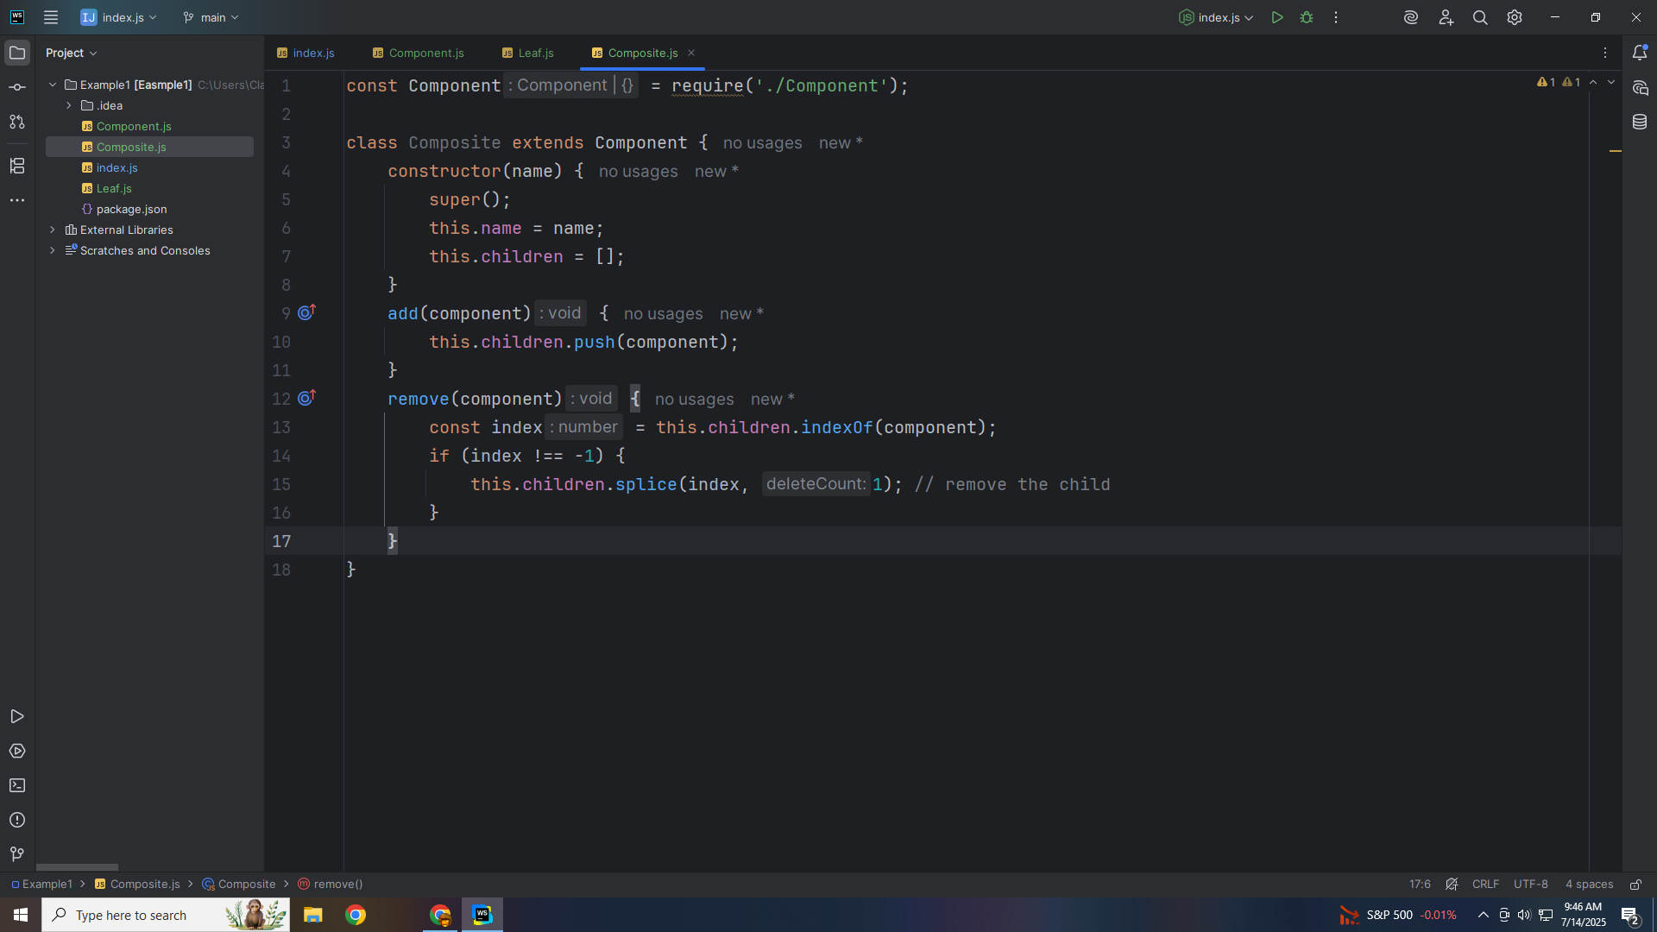
Notes:
For remove we find the index and remove it from our array

Slide 23
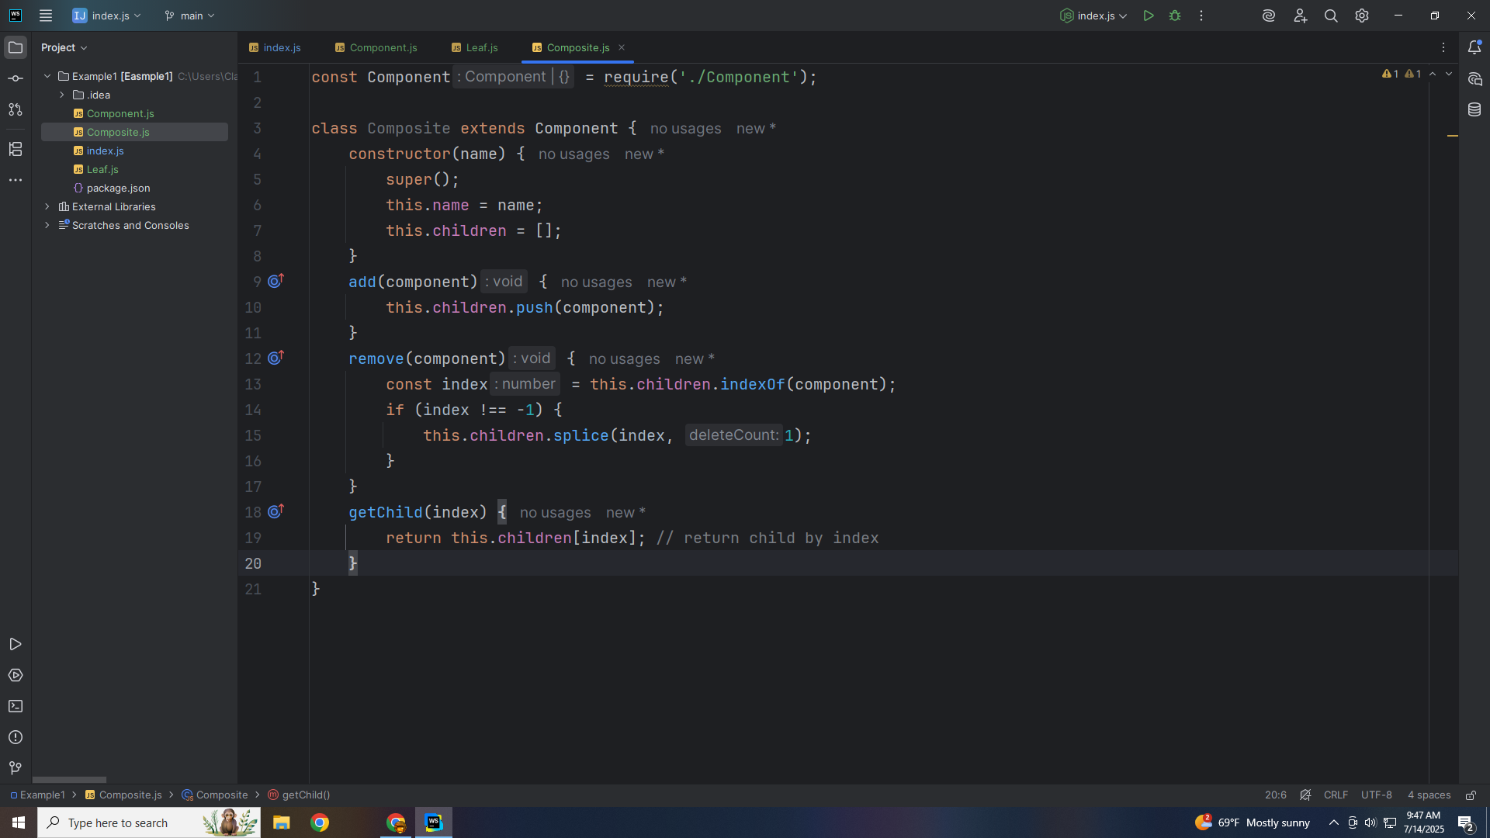
Notes:
Get Child remove the child by index

Slide 24
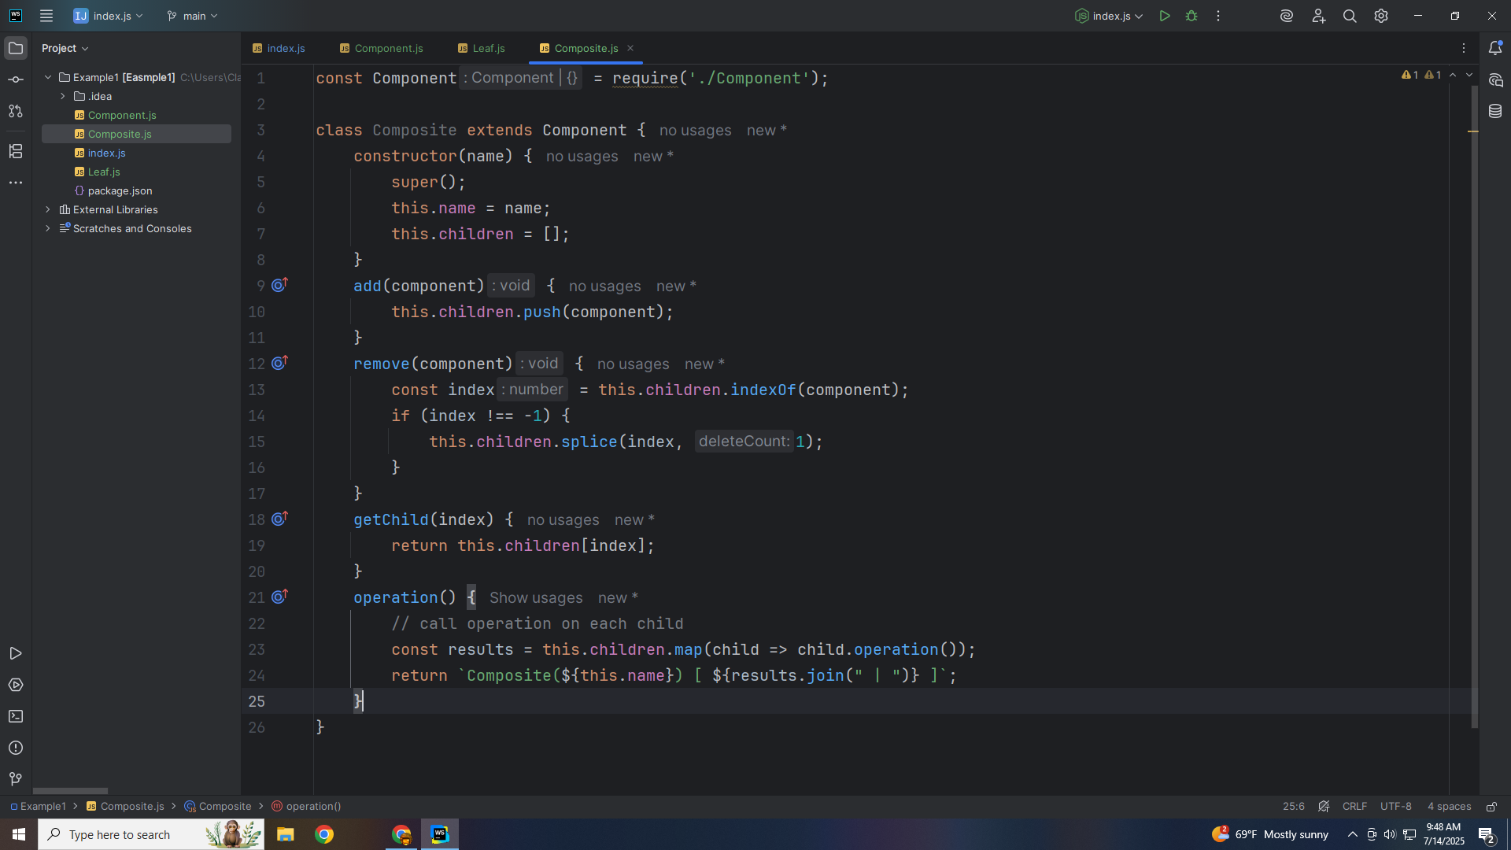
Notes:
Operation call the operation on each child

Slide 25

Notes:
And we export this module for use in our demo

Slide 26
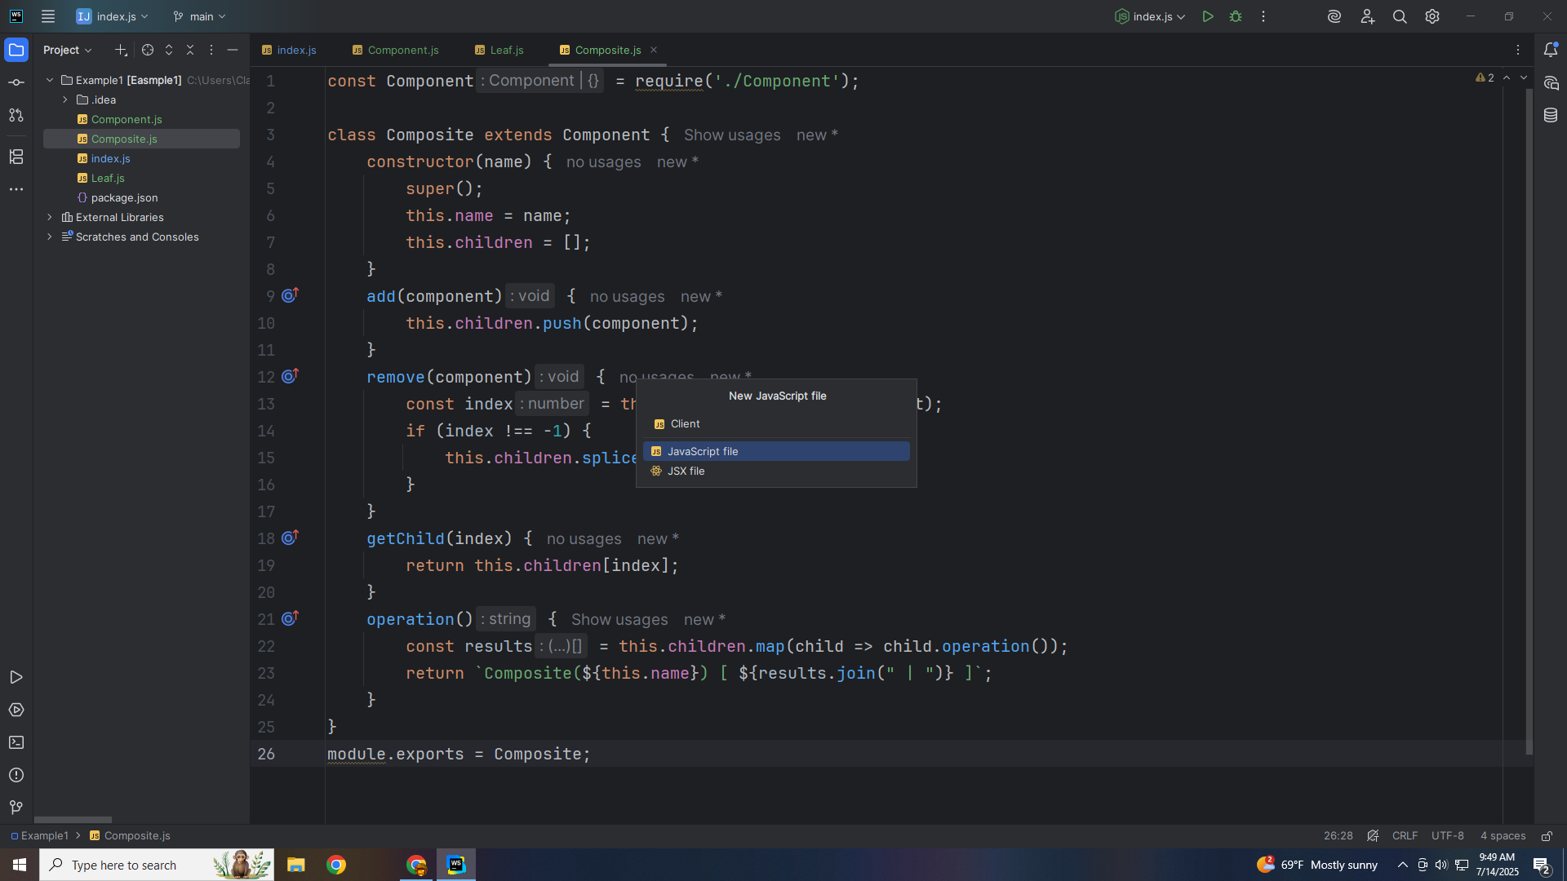

Slide 27


