Slide 1
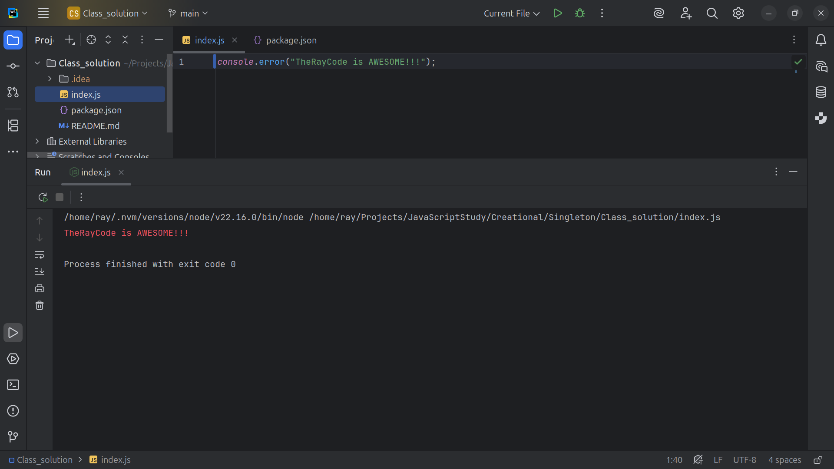
Notes:
Hello, I’m Ray of TheRayCode

Slide 2
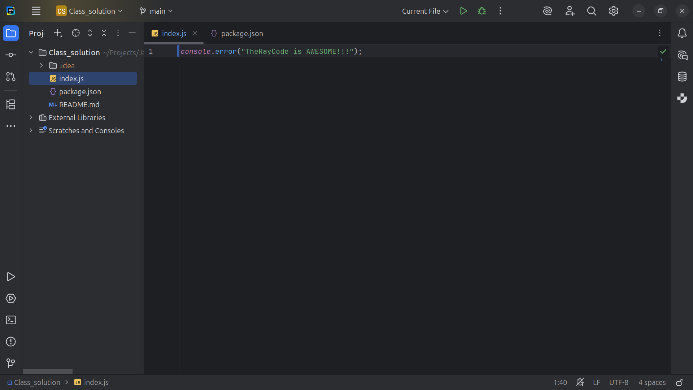
Notes:
In this video I plan to give you and example of the Design Pattern called Singleton I will be using JavaScript

Slide 3
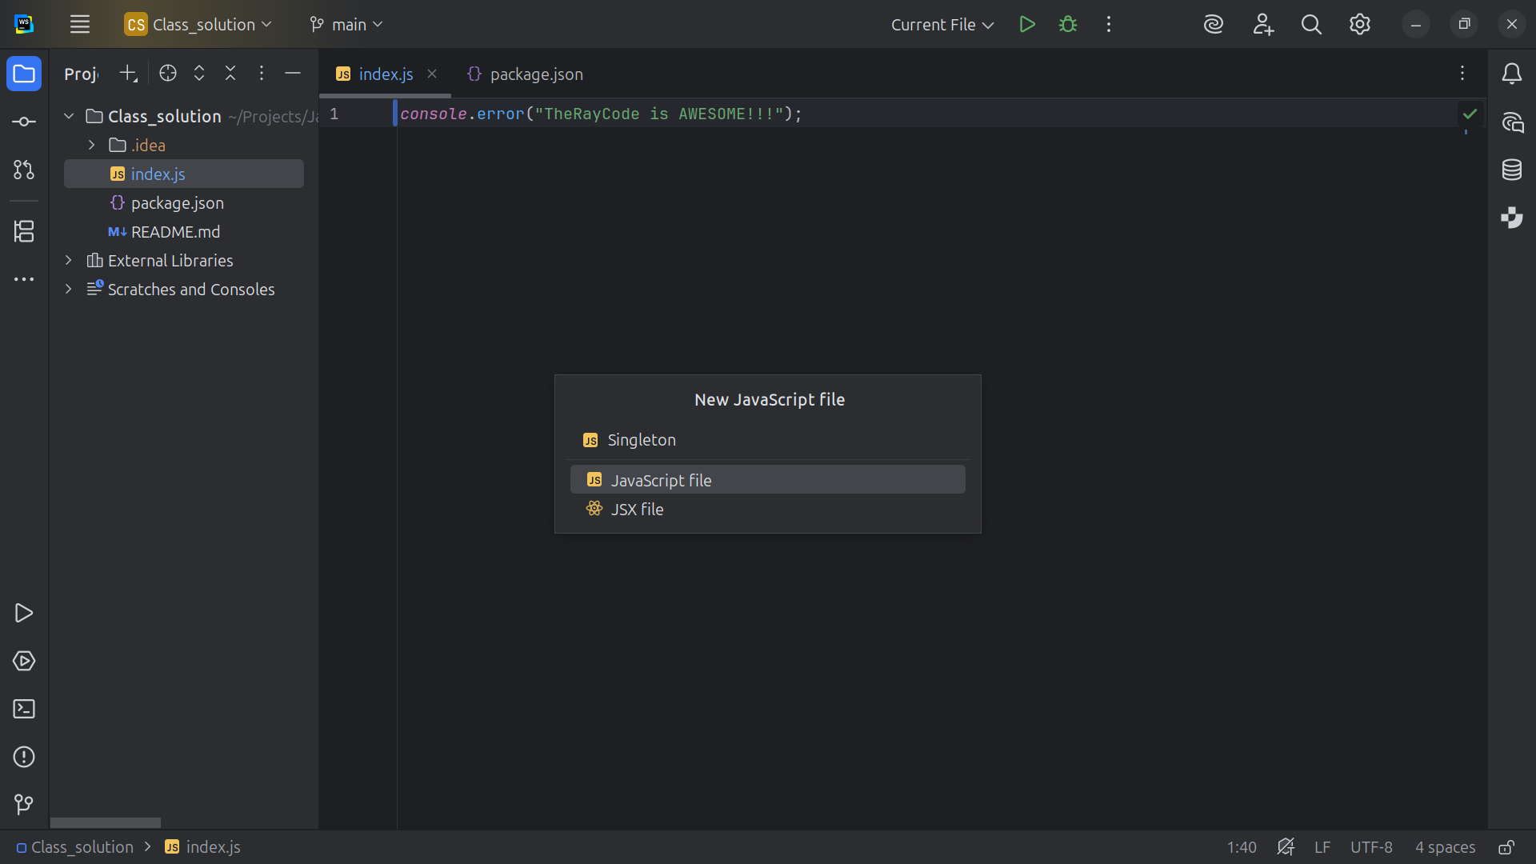
Notes:
We start off with a class file we can Singleton.js

Slide 4
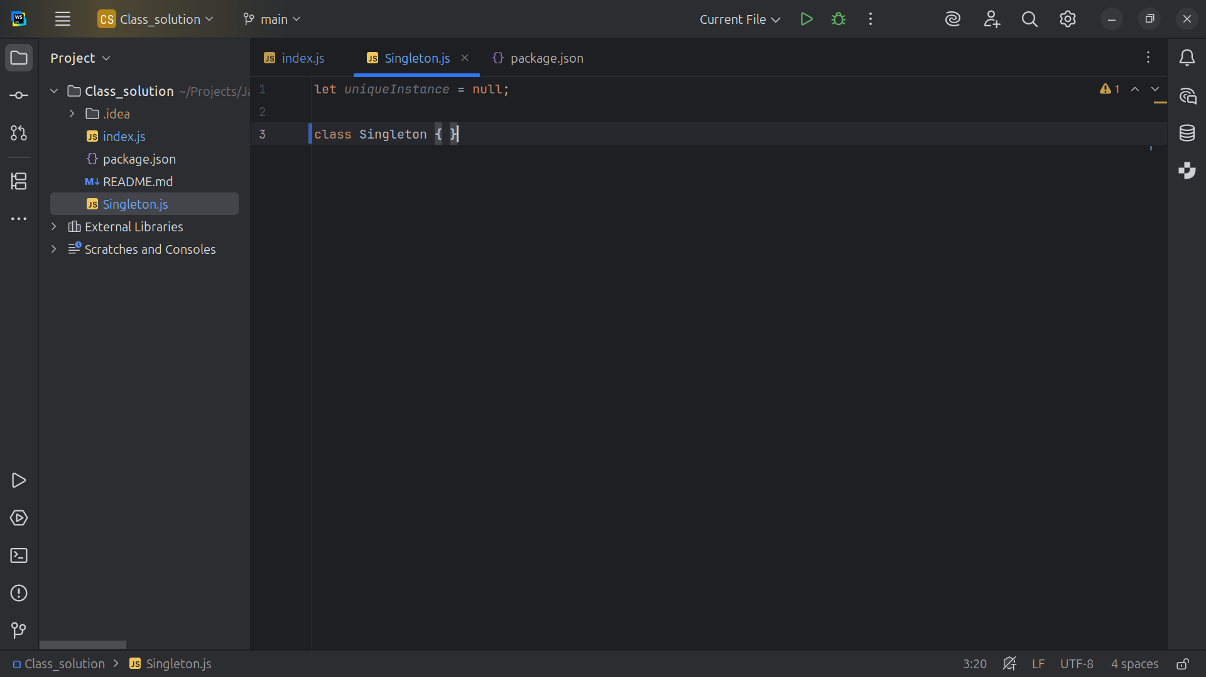
Notes:
To start we Let the unique instance equal to null

Slide 5
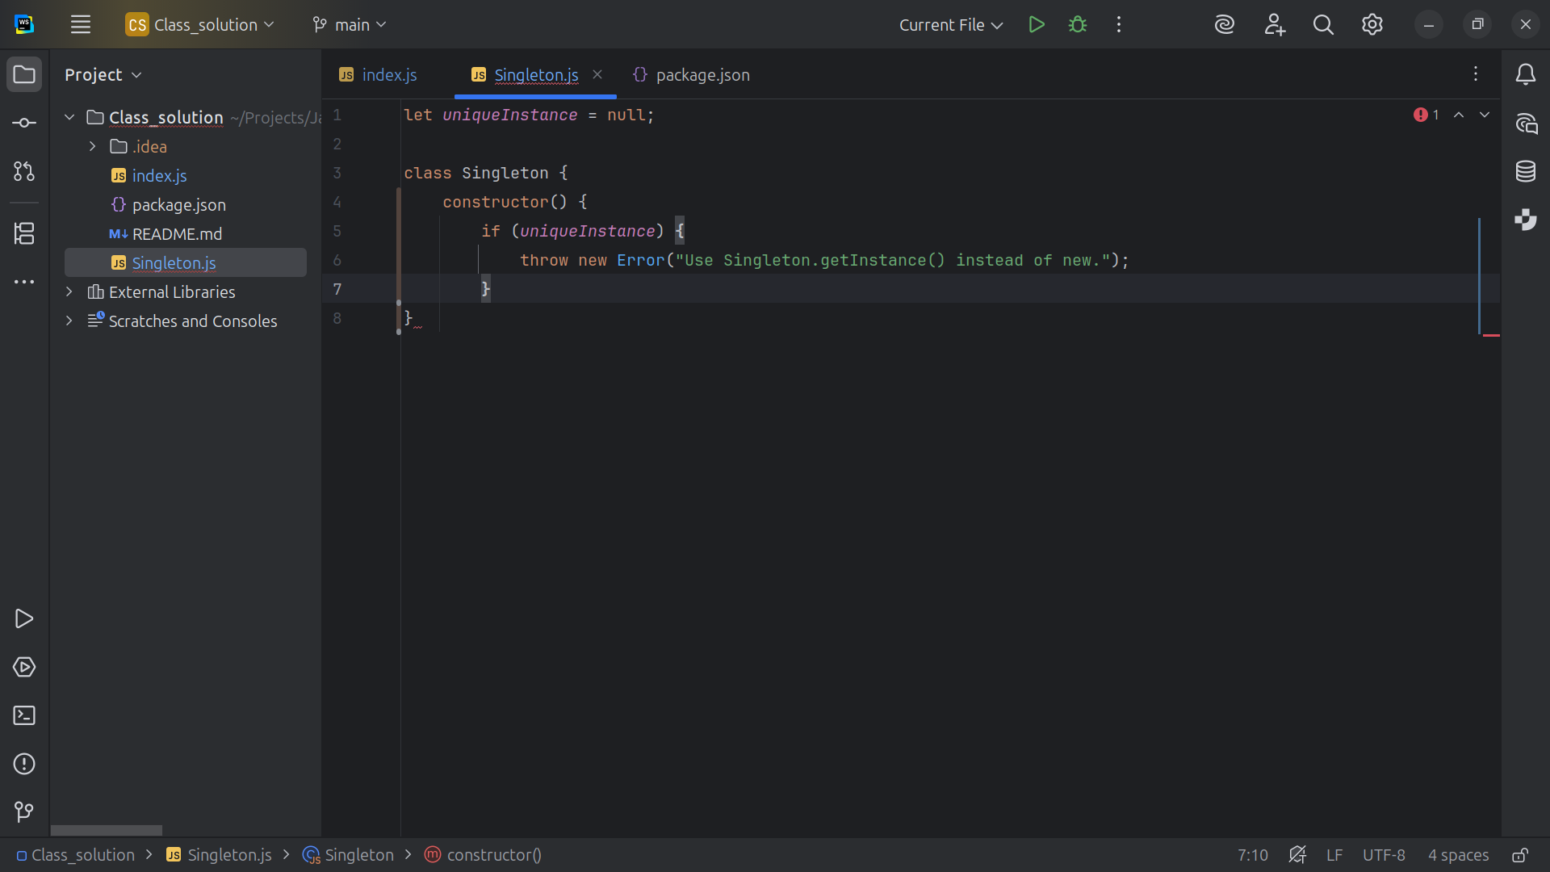
Notes:
If the unique instance has a value we thows an error that reads Use “Singleton.getInstance() instead of new.“

Slide 6
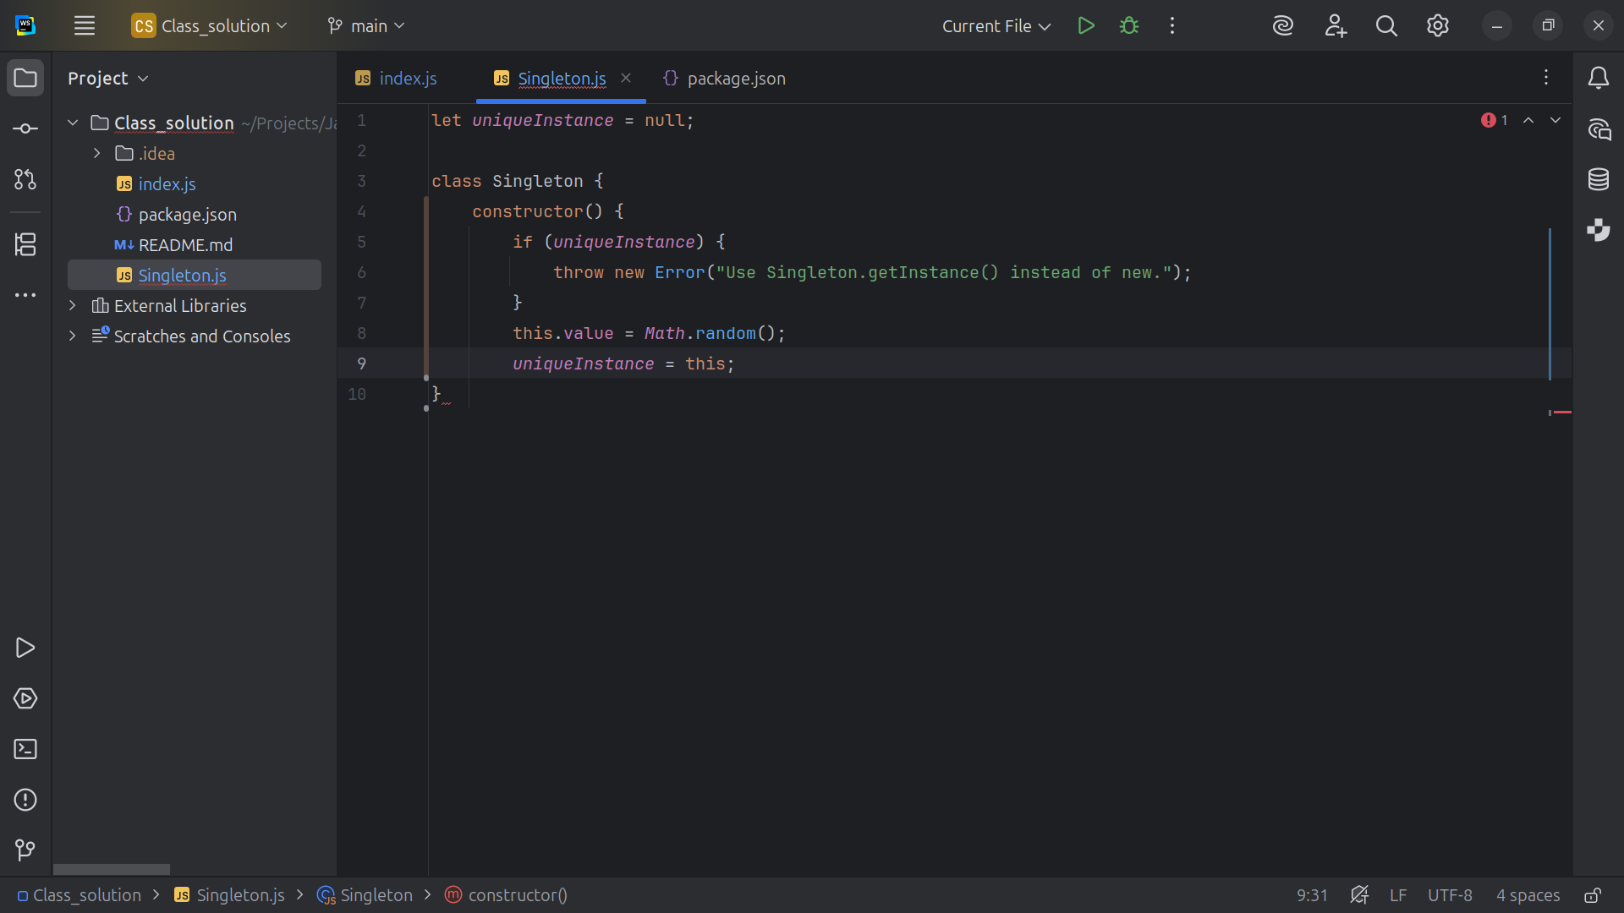
Notes:
We set this dot value to a random value and we set the unique instance is set to this

Slide 7
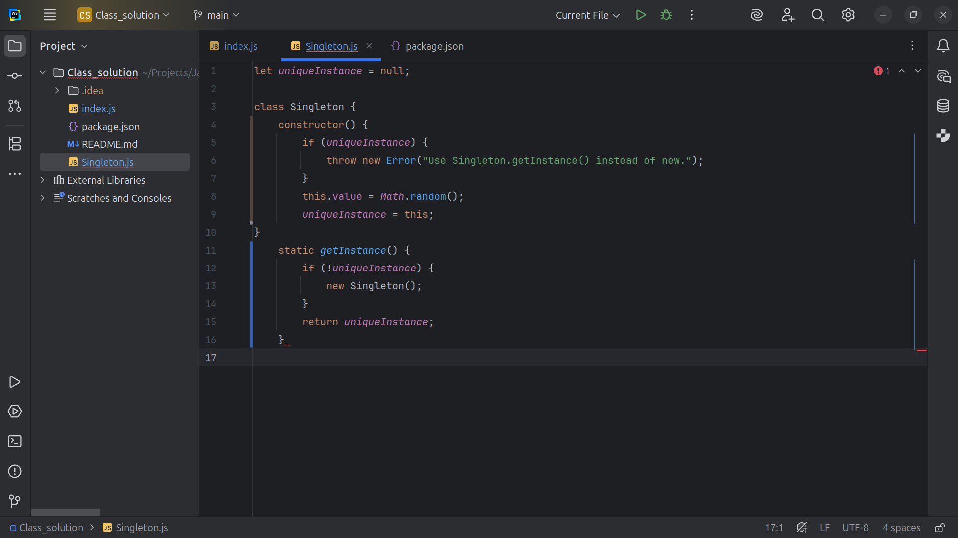
Notes:
And we get an new unique Static instance of the of Singleton if it has no been set yet, else we return the one we have

Slide 8
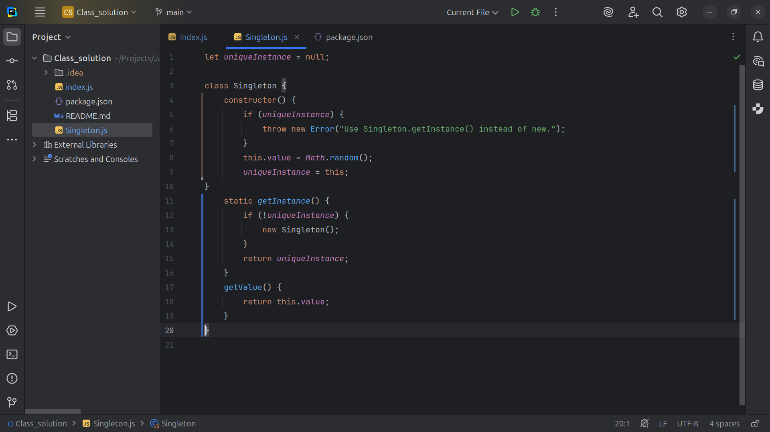
Notes:
And then we can get value by returning this dot value

Slide 9
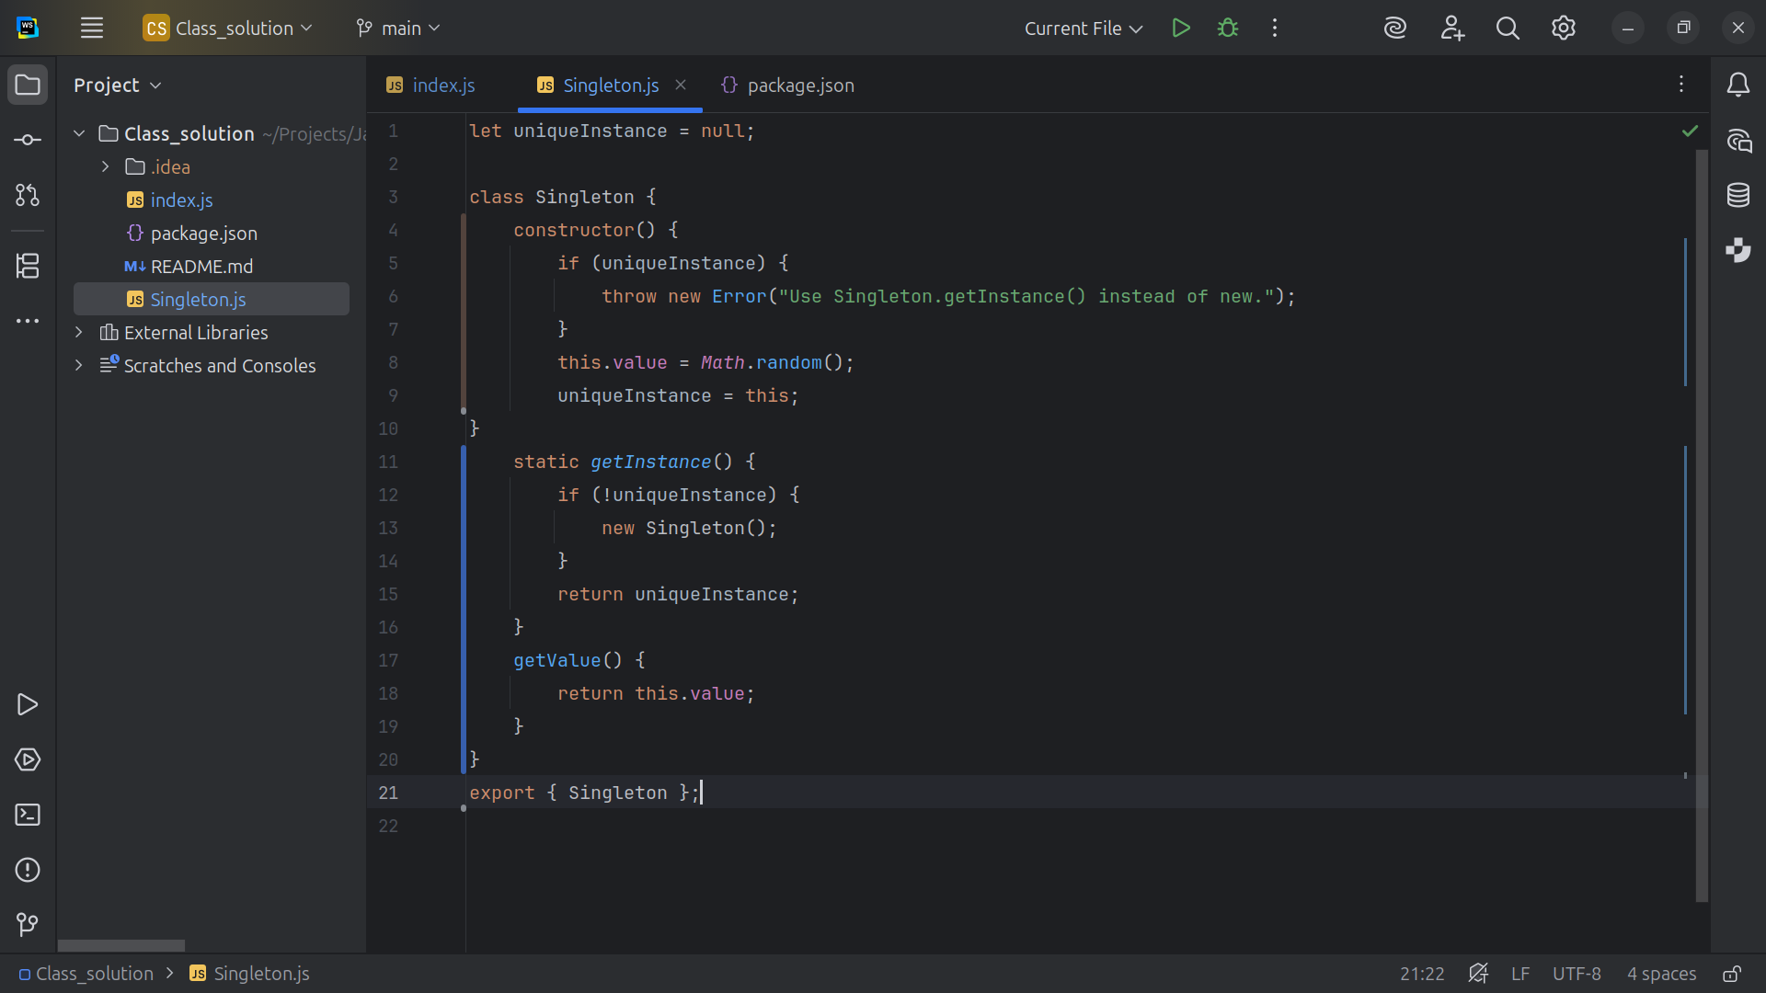
Notes:
Now let’s export our Singleton for our demo

Slide 10
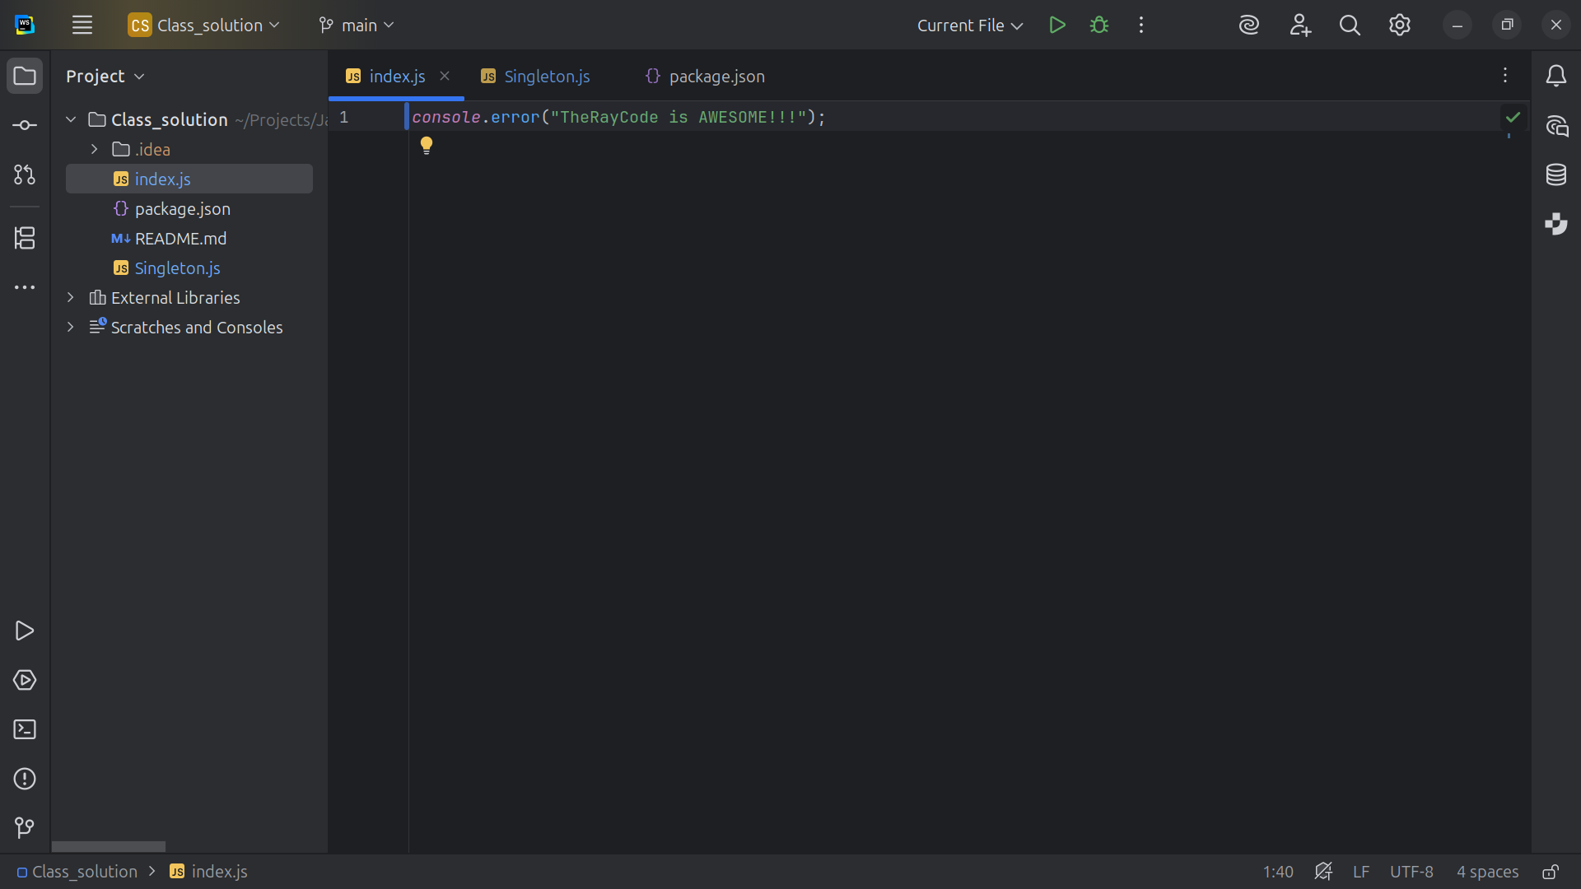
Notes:
So we go to the index dot js page

Slide 11
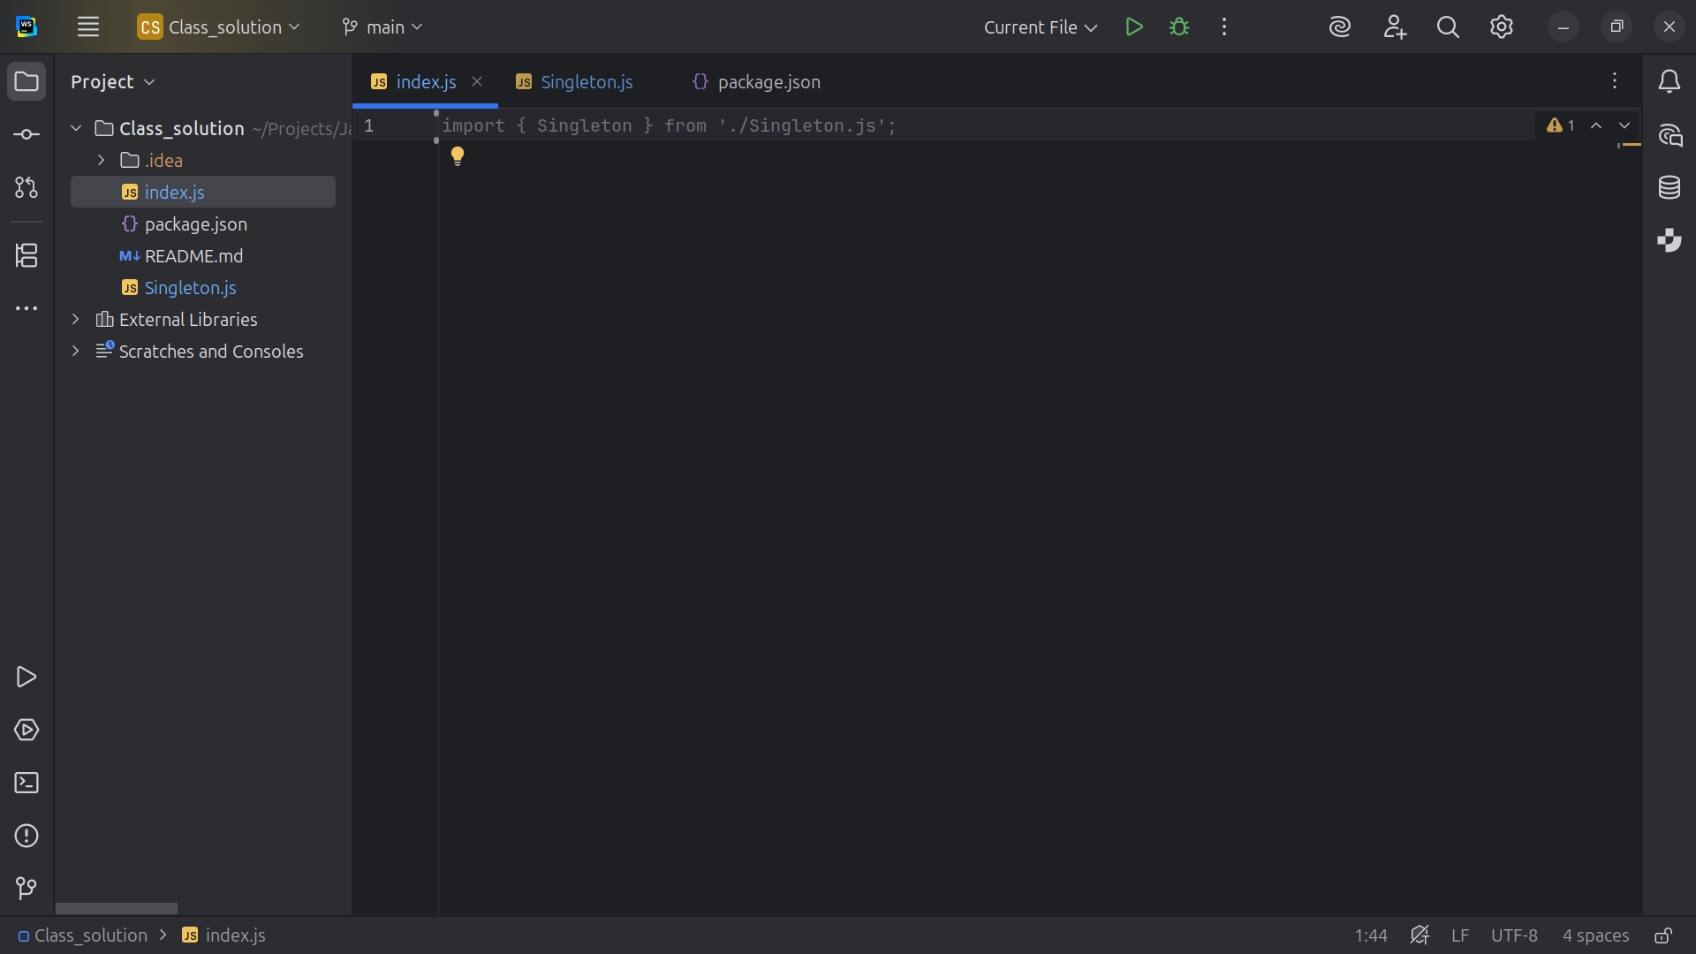
Notes:
We import the Singleton dot js file

Slide 12
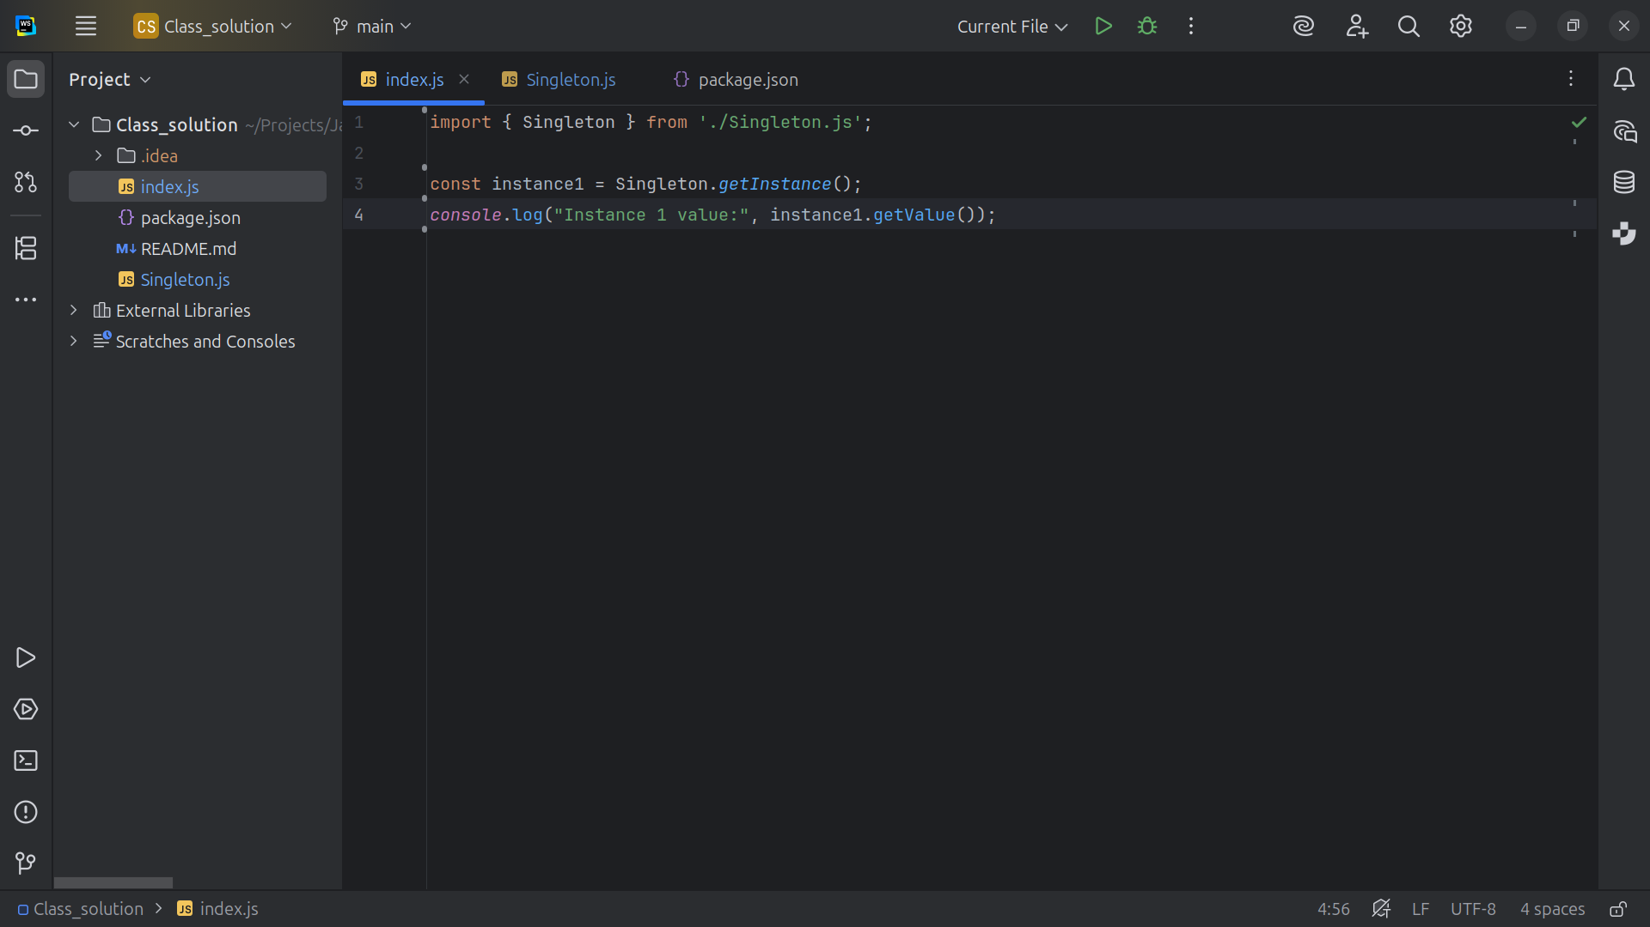
Notes:
We instantiate the Singleton instance One to the get Instance method

Slide 13
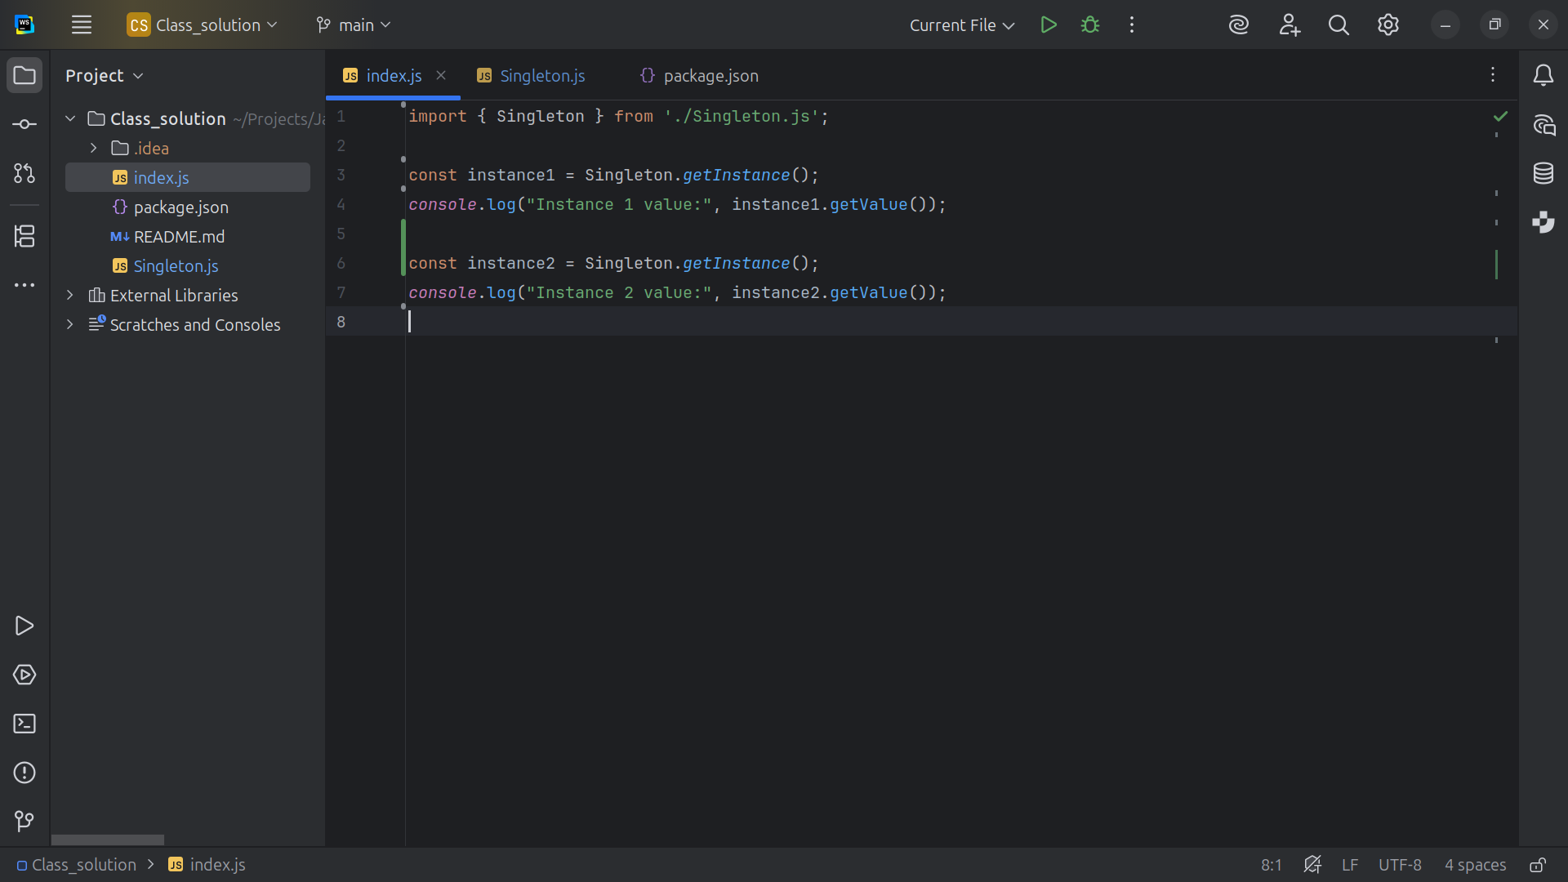
Notes:
We do the same thing for a variable called instance Two

Slide 14
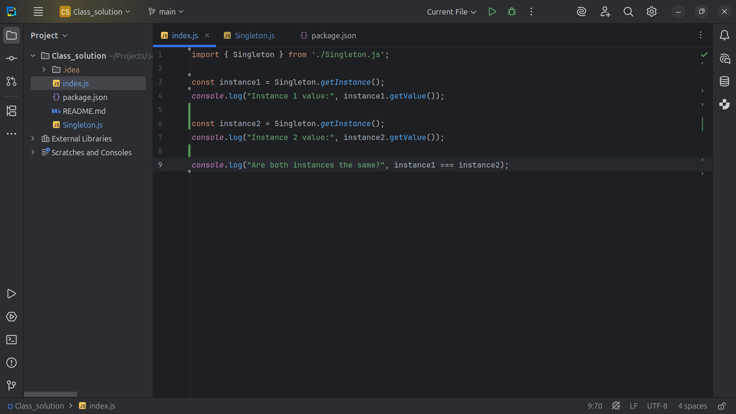
Notes:
We show that they are the SAME object

Slide 15
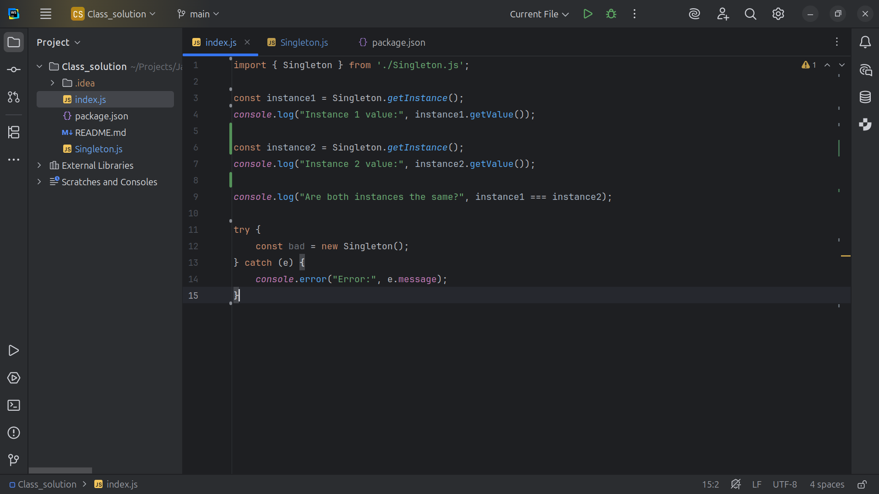
Notes:
And we try to instantiate A new Singleton and Fail because it already exist Now let’s Run the Project

Slide 16
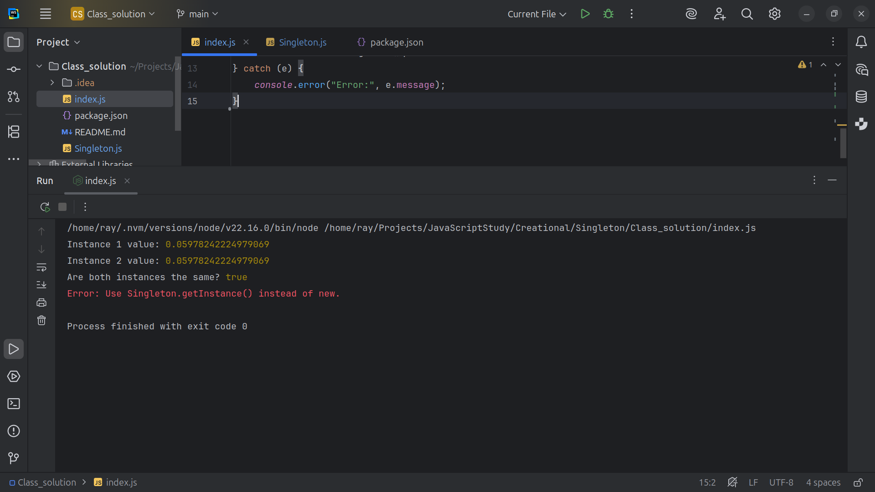
Notes:
We get instance 1 is some random value and so is instance 2
We notify that both instances are the same

Slide 17


