Slide 1

Notes:
(no Sound)

Slide 2
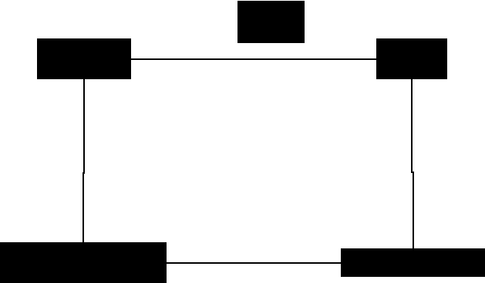
Notes:
ORM for the Iterator Pattern a behavioral pattern with focus on JavaScript

Slide 3
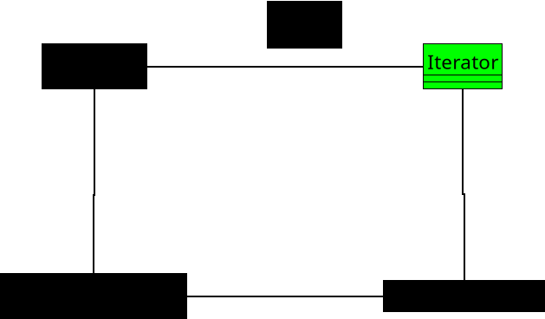
Notes:
**1. Iterator**
• Defines how to move through a collection one item at a time.
• Provides a way to get the next element without knowing how the collection works inside.
• Think of it like a remote control that lets you go “next” or “previous” without touching the wiring.

Slide 4
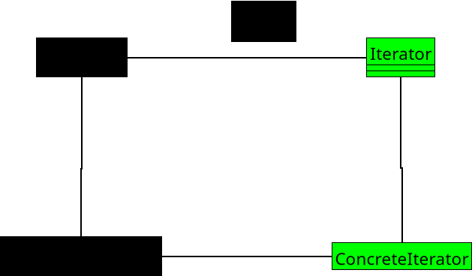
Notes:
**2. Concrete Iterator**
• Keeps track of where you are in the collection.
• Implements the actual steps for moving forward or checking if more items exist.
• It’s like a bookmark that remembers your place while you flip through pages.

Slide 5
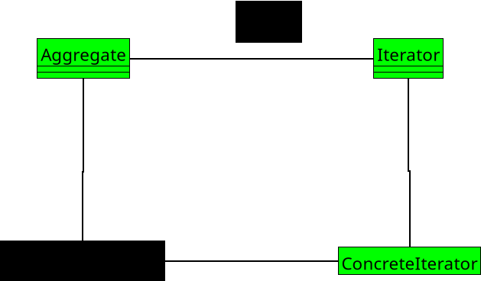
Notes:
**3. Aggregate**
• Declares a way to create an iterator for its items.
• Defines the overall collection structure but not how to walk through it.
• It’s like saying, “Here’s my bookshelf — here’s how you get a helper to browse it.”

Slide 6
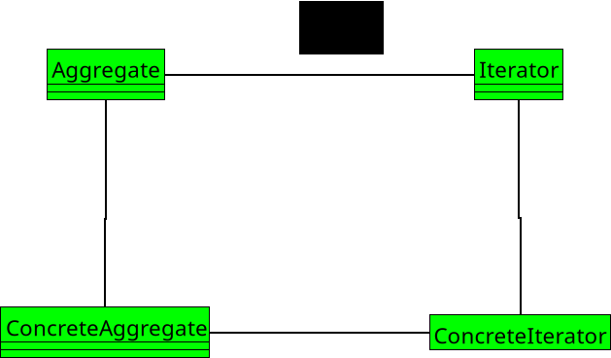
Notes:
No Sound

Slide 7
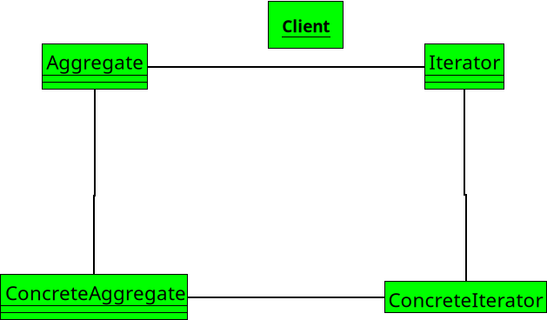
Notes:
**4. Concrete Aggregate**
• Implements the method that returns a specific iterator for the collection.
• Knows the real list or data structure being used.
• It’s the actual bookshelf, ready to hand you the right guide to browse its books.

Slide 8
Notes:
(End)

