Slide 1
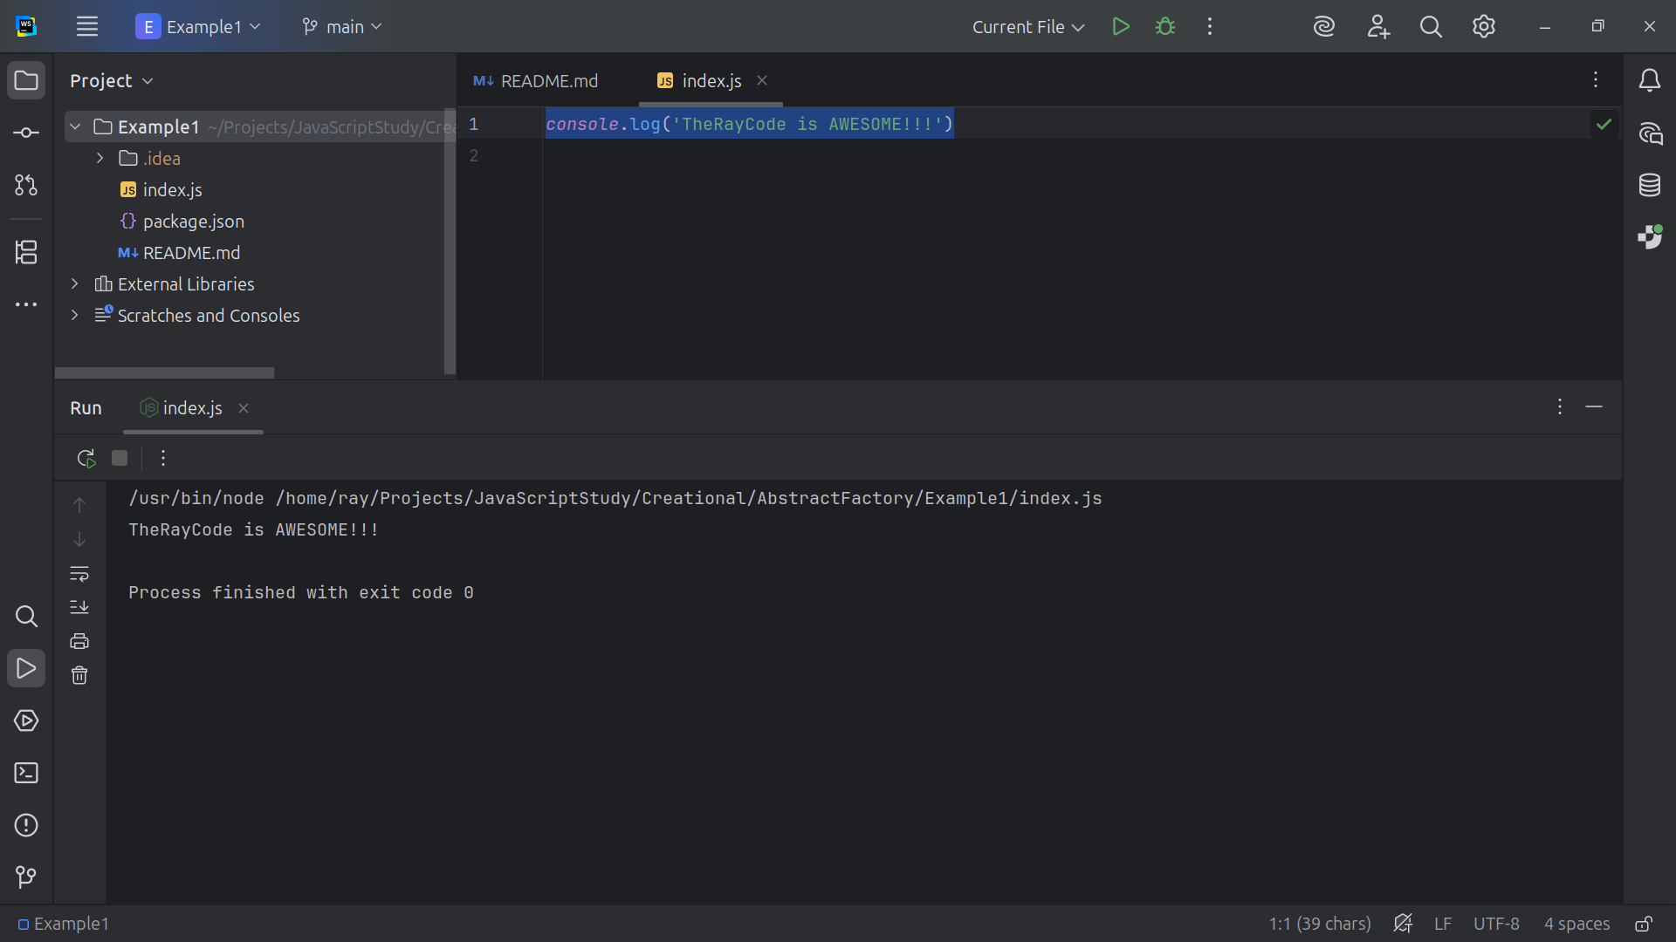
Notes:
Hello, I’m Ray of TheRayCode

Slide 2
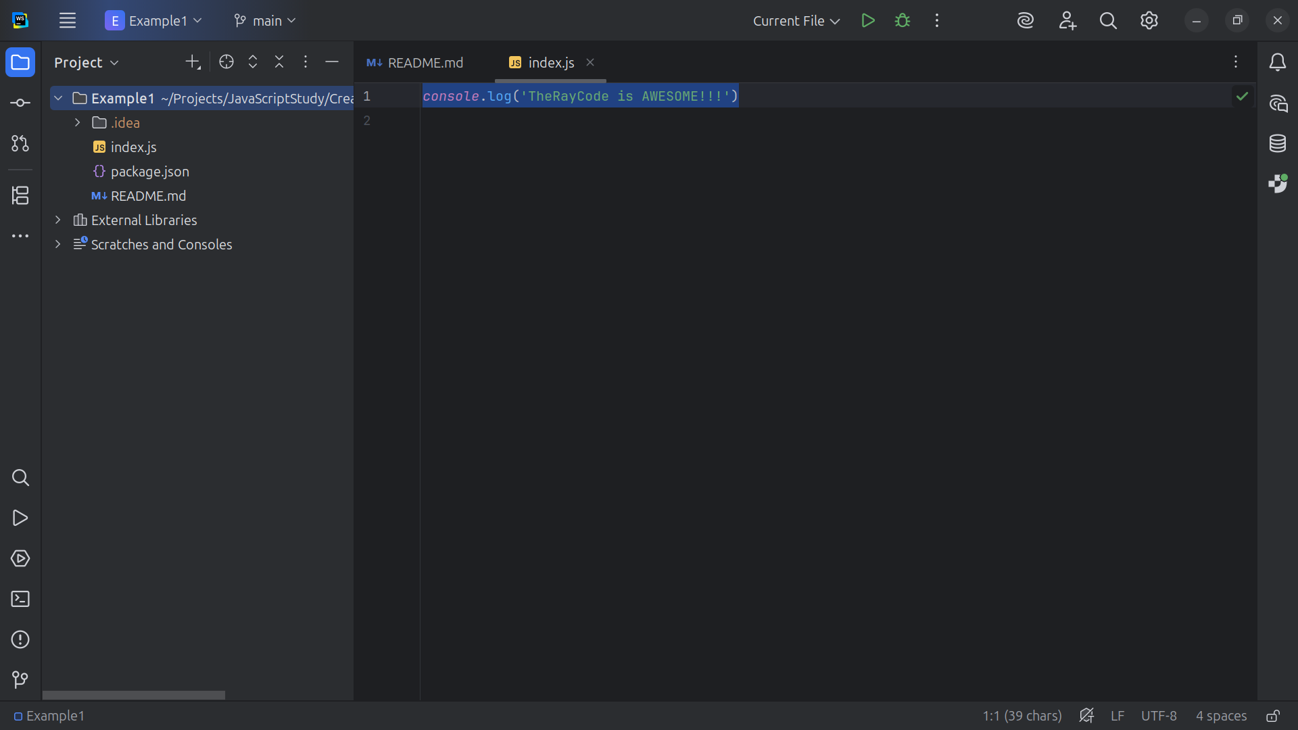
Notes:
In this video I will give an example of the Abstract Factory and I be using JavaScript
I’ve choose to use the same names for the JavaScript classes as those used in the book authored the Gang of Four

Slide 3
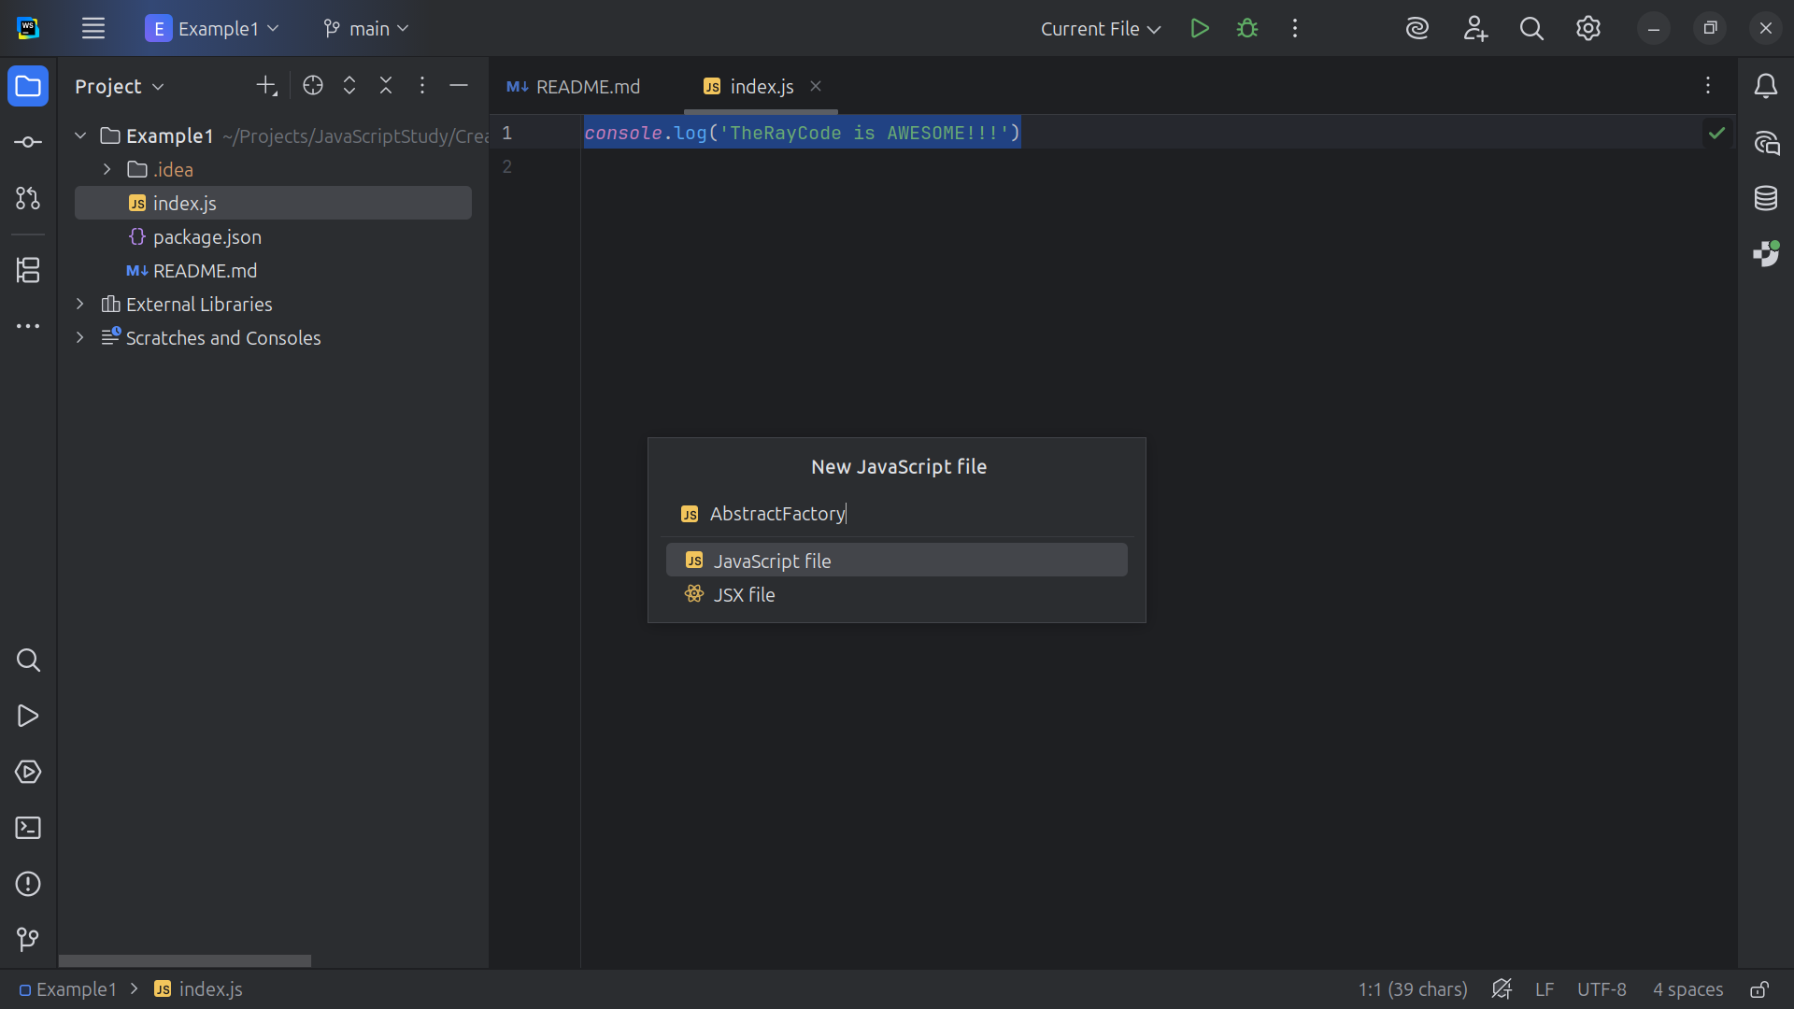
Notes:
We start with the creation of the Abstract Factory class

Slide 4
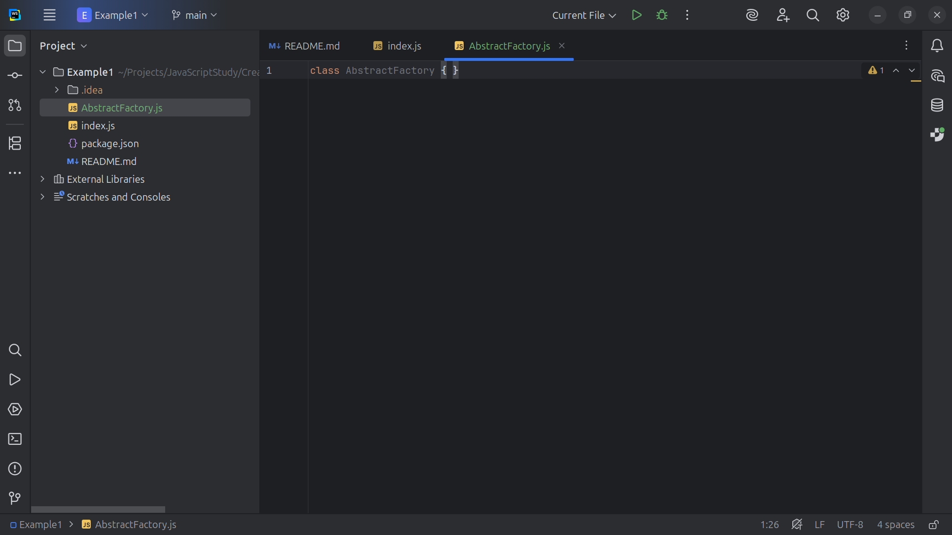
Notes:
This Abstract class is for declaring creation methods for abstract product families

Slide 5
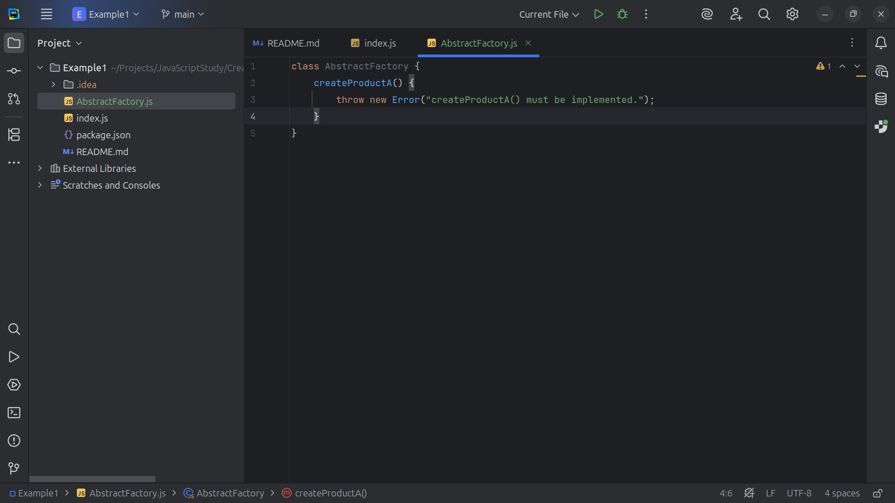
Notes:
We create a Method to create products of types A

Slide 6
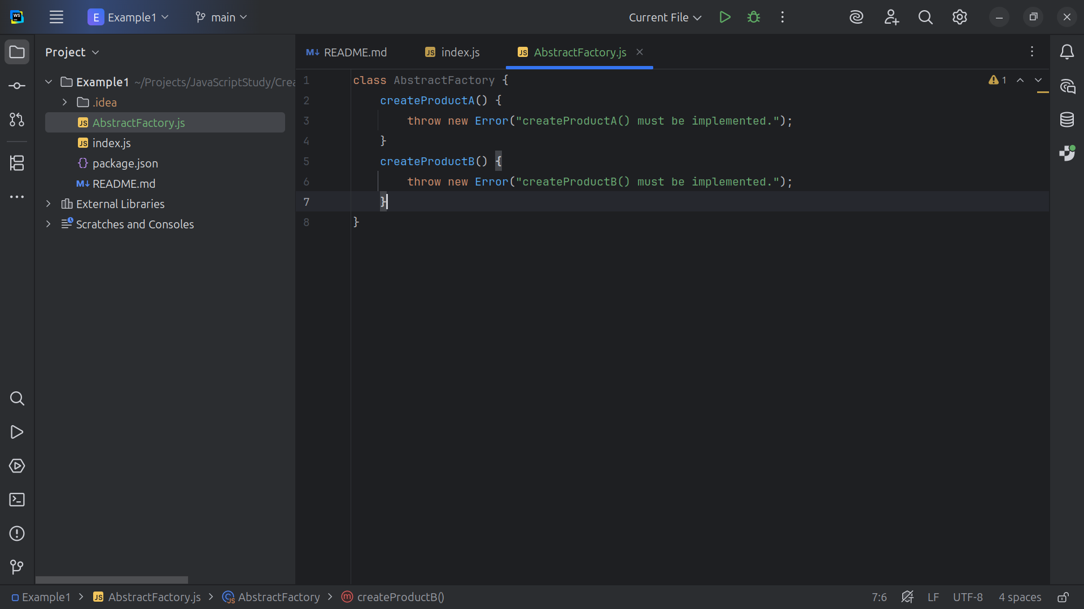
Notes:
And a Method to create a products of type B

Slide 7
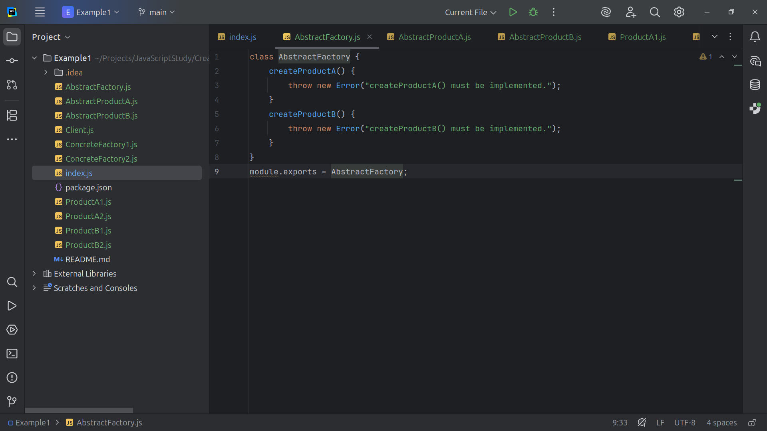
Notes:
We export this Abstract Factory class for use

Slide 8
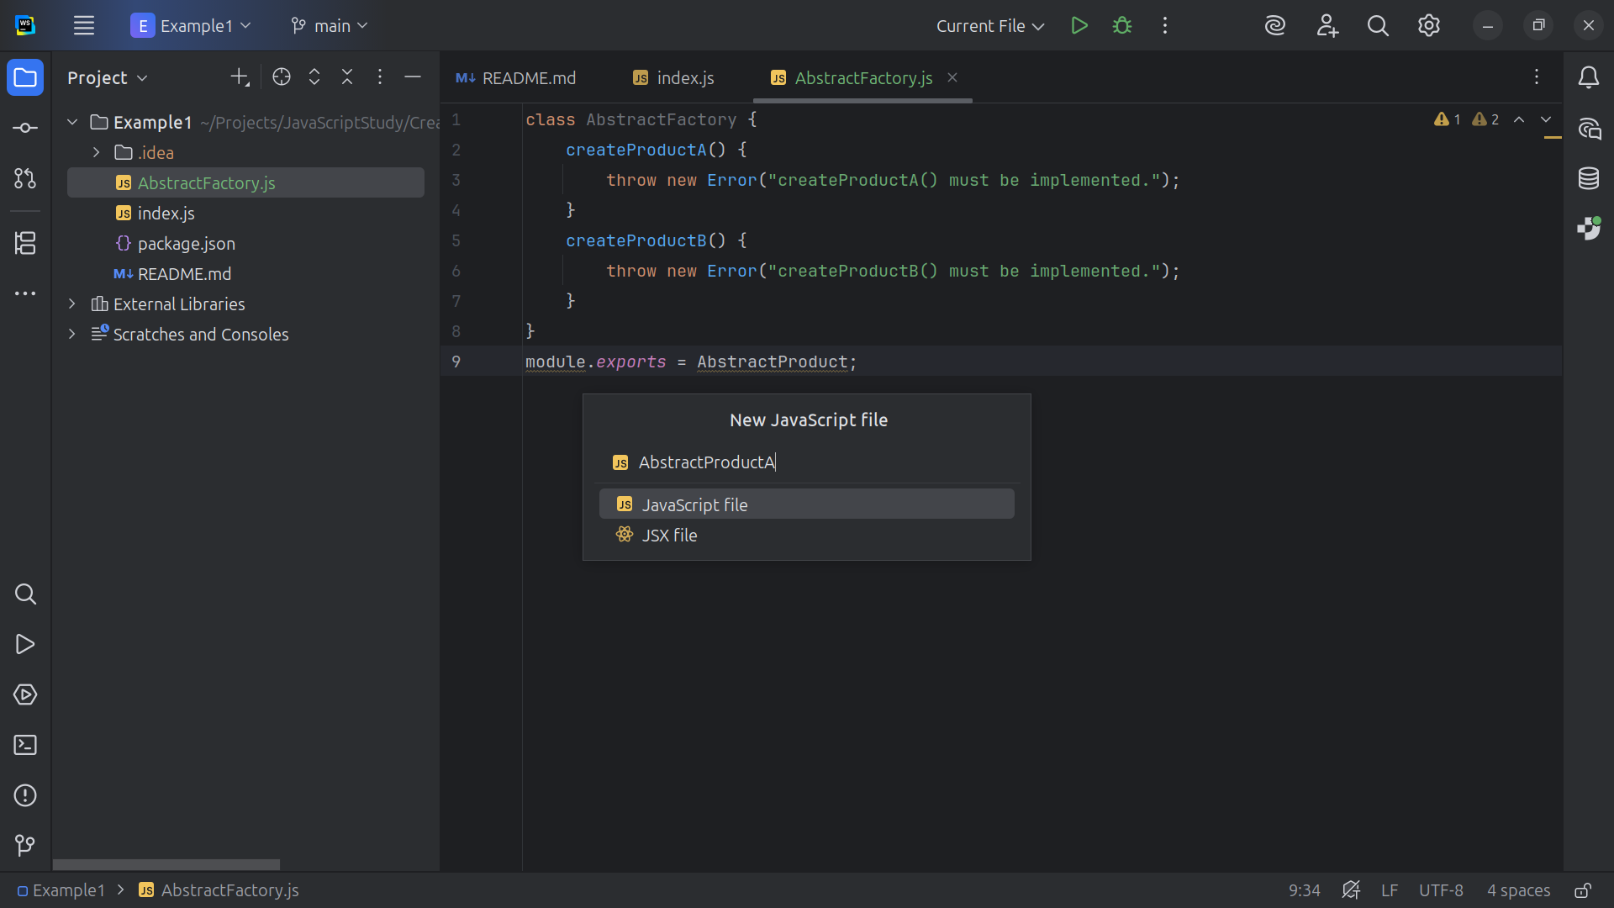
Notes:
Now let’s create an Abstract Product of type A

Slide 9
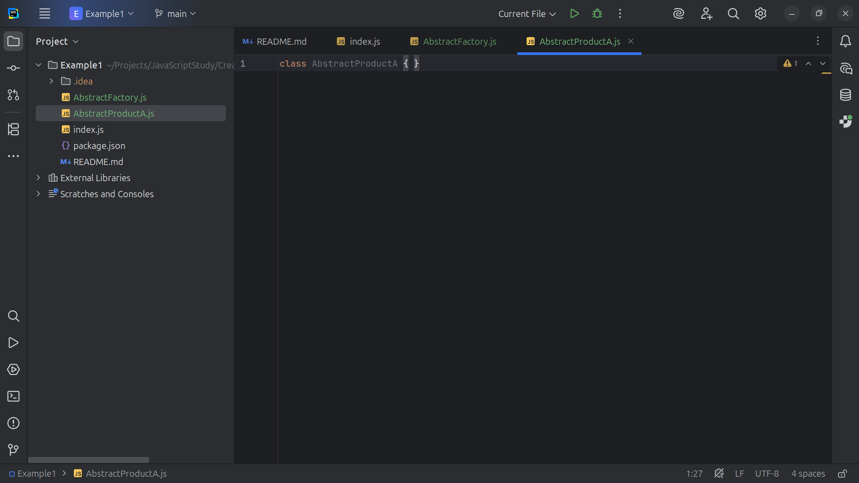
Notes:
This will Abstract that all Product A variants

Slide 10
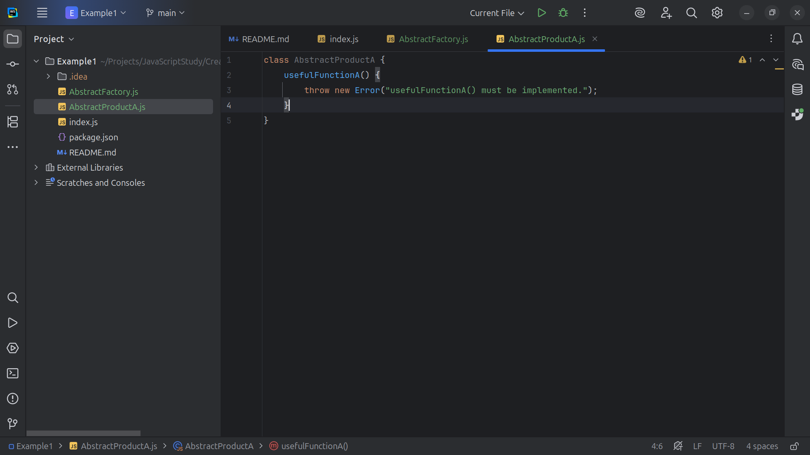
Notes:
All the methods of Product A will be implemented

Slide 11
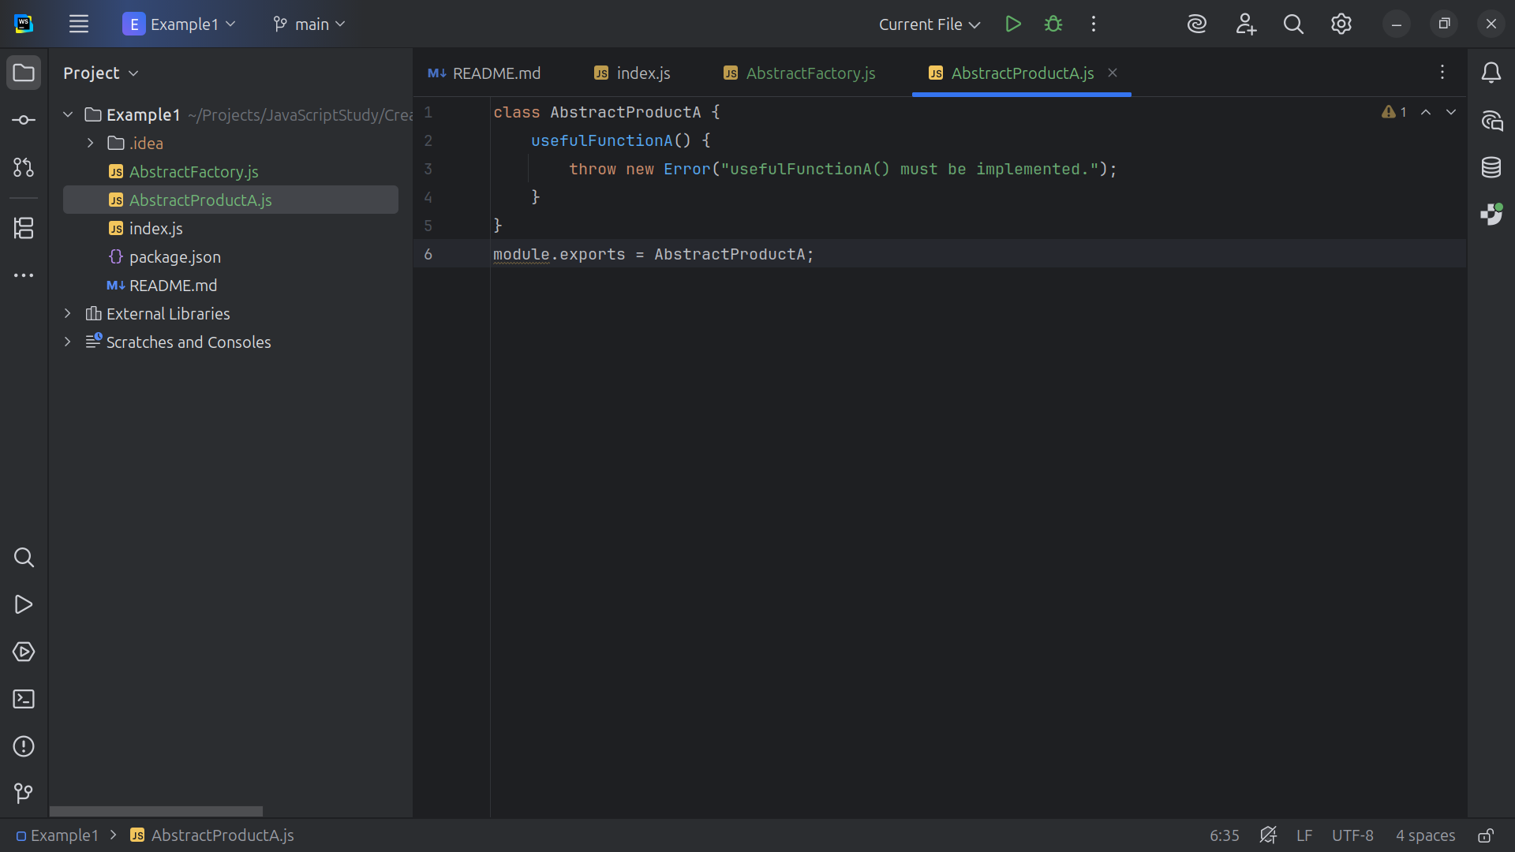
Notes:
And we export the class Abstract Product A for use

Slide 12
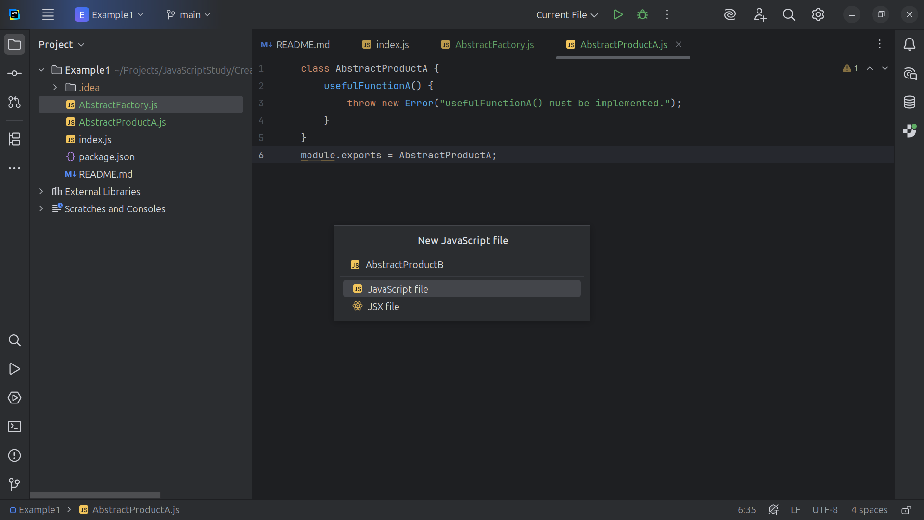
Notes:
Next we create the Abstract Product B family

Slide 13
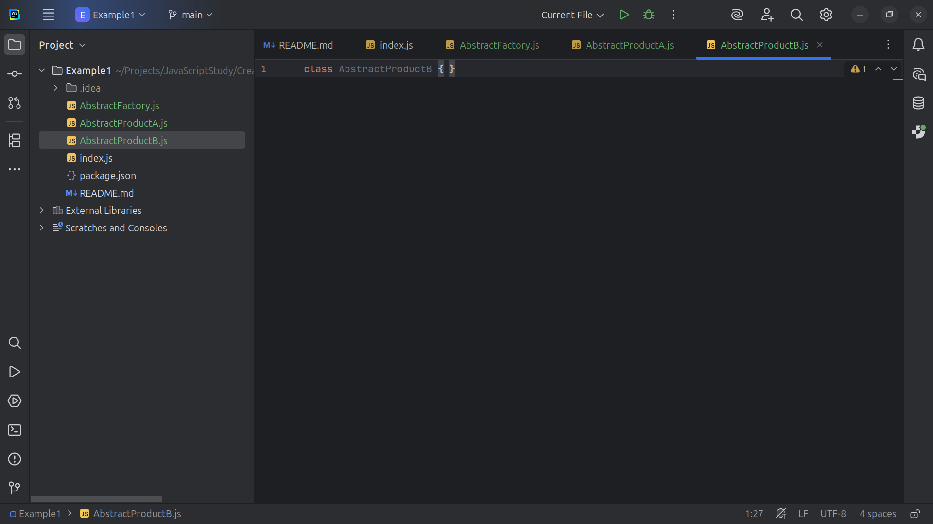
Notes:
This will be the base class for products of family B

Slide 14
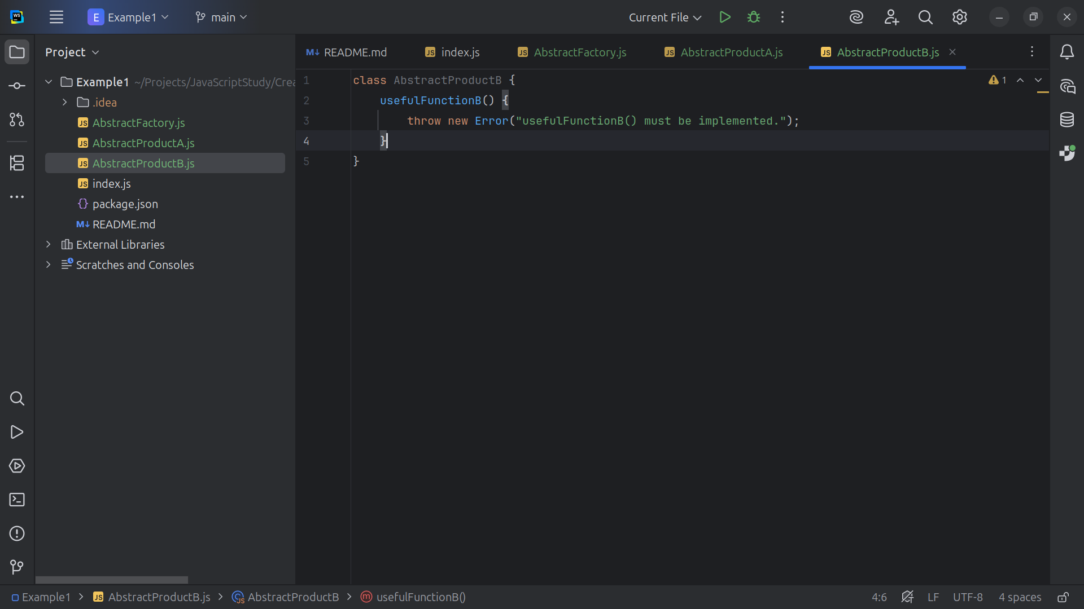
Notes:
This is an Abstract method that must be implemented by Product B variants

Slide 15
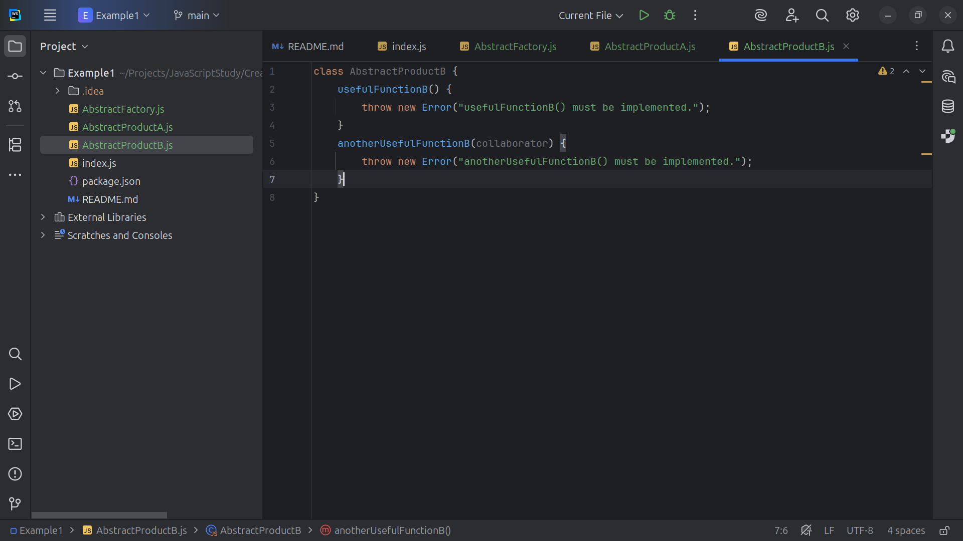
Notes:
And we create another required abstract method that collaborates with Product A

Slide 16
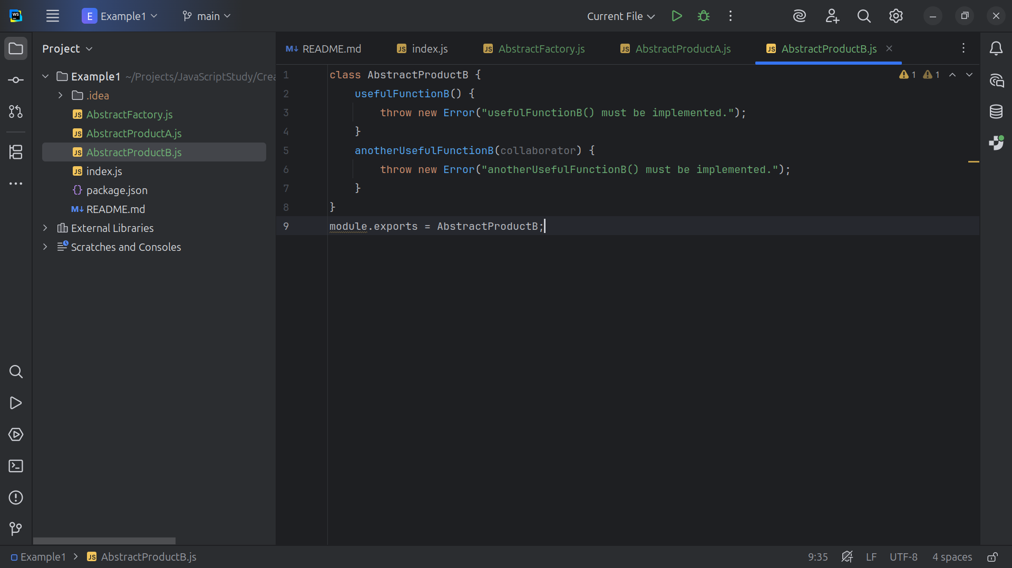
Notes:
And of course we need to export this class for use

Slide 17
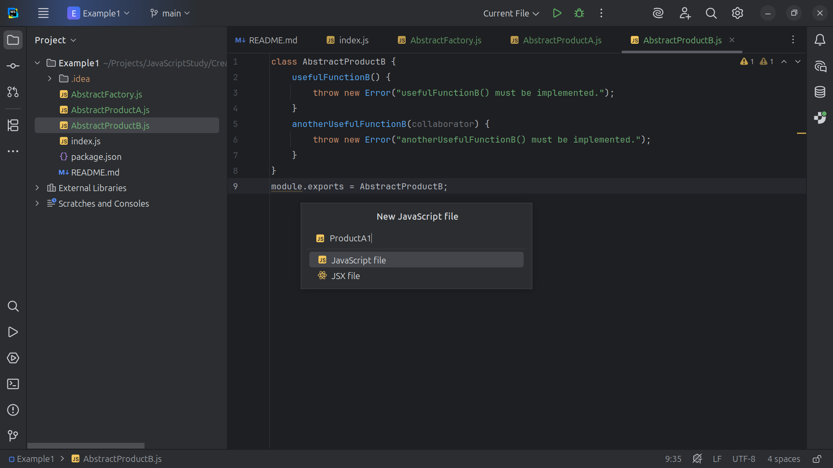
Notes:
Now let’s start creating our products we start with Product A1

Slide 18
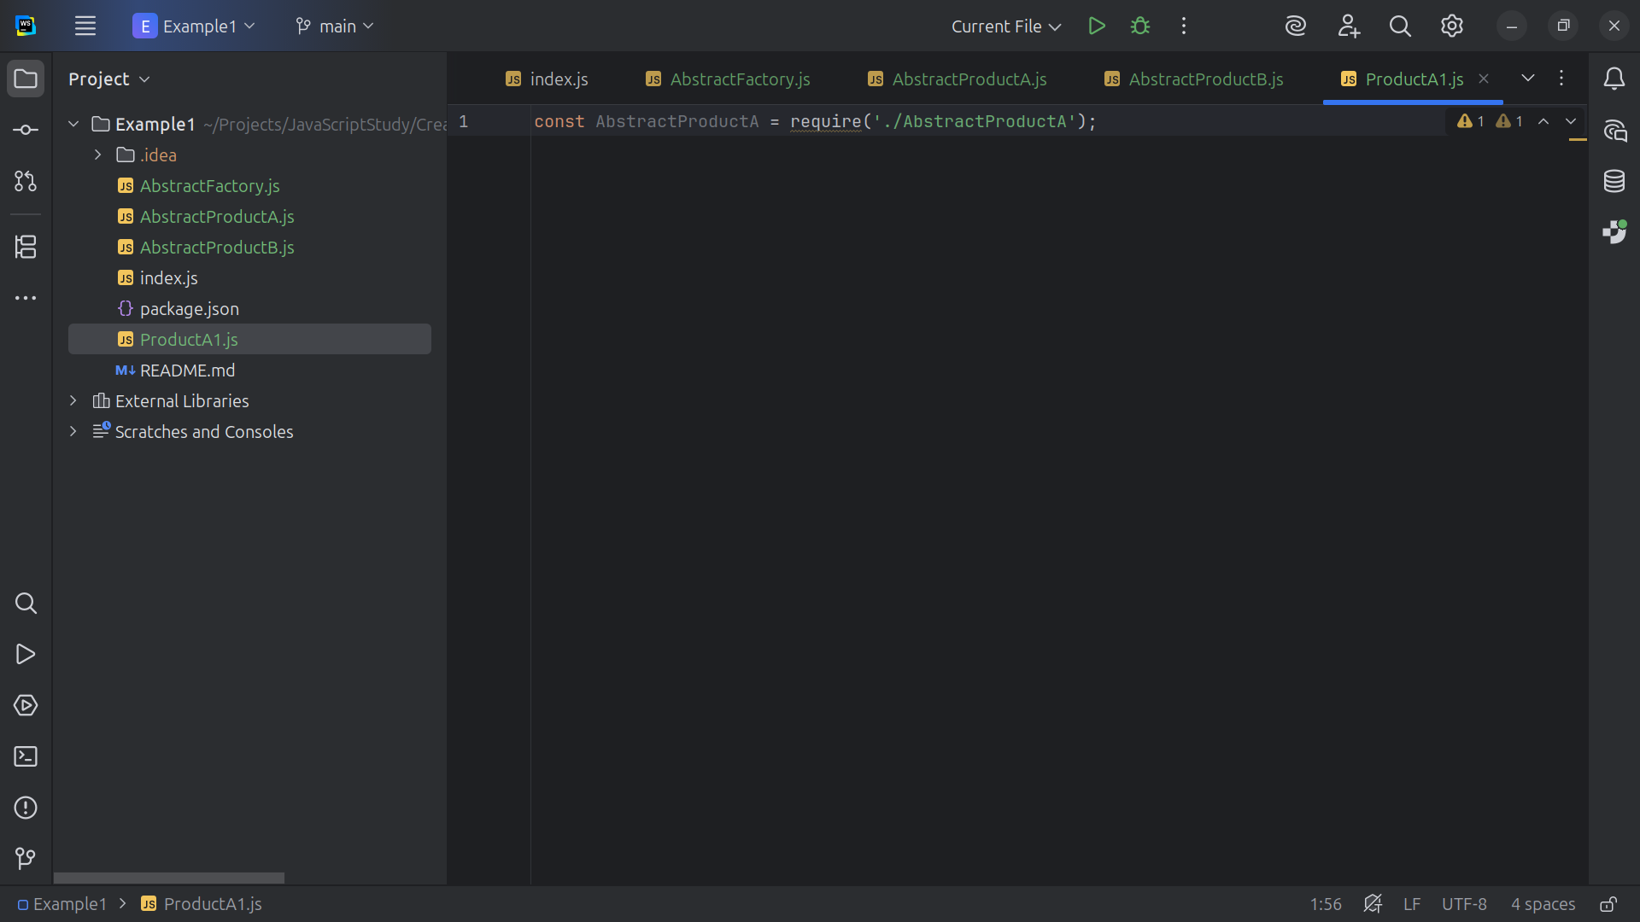
Notes:
At the top we require Abstract Product A

Slide 19
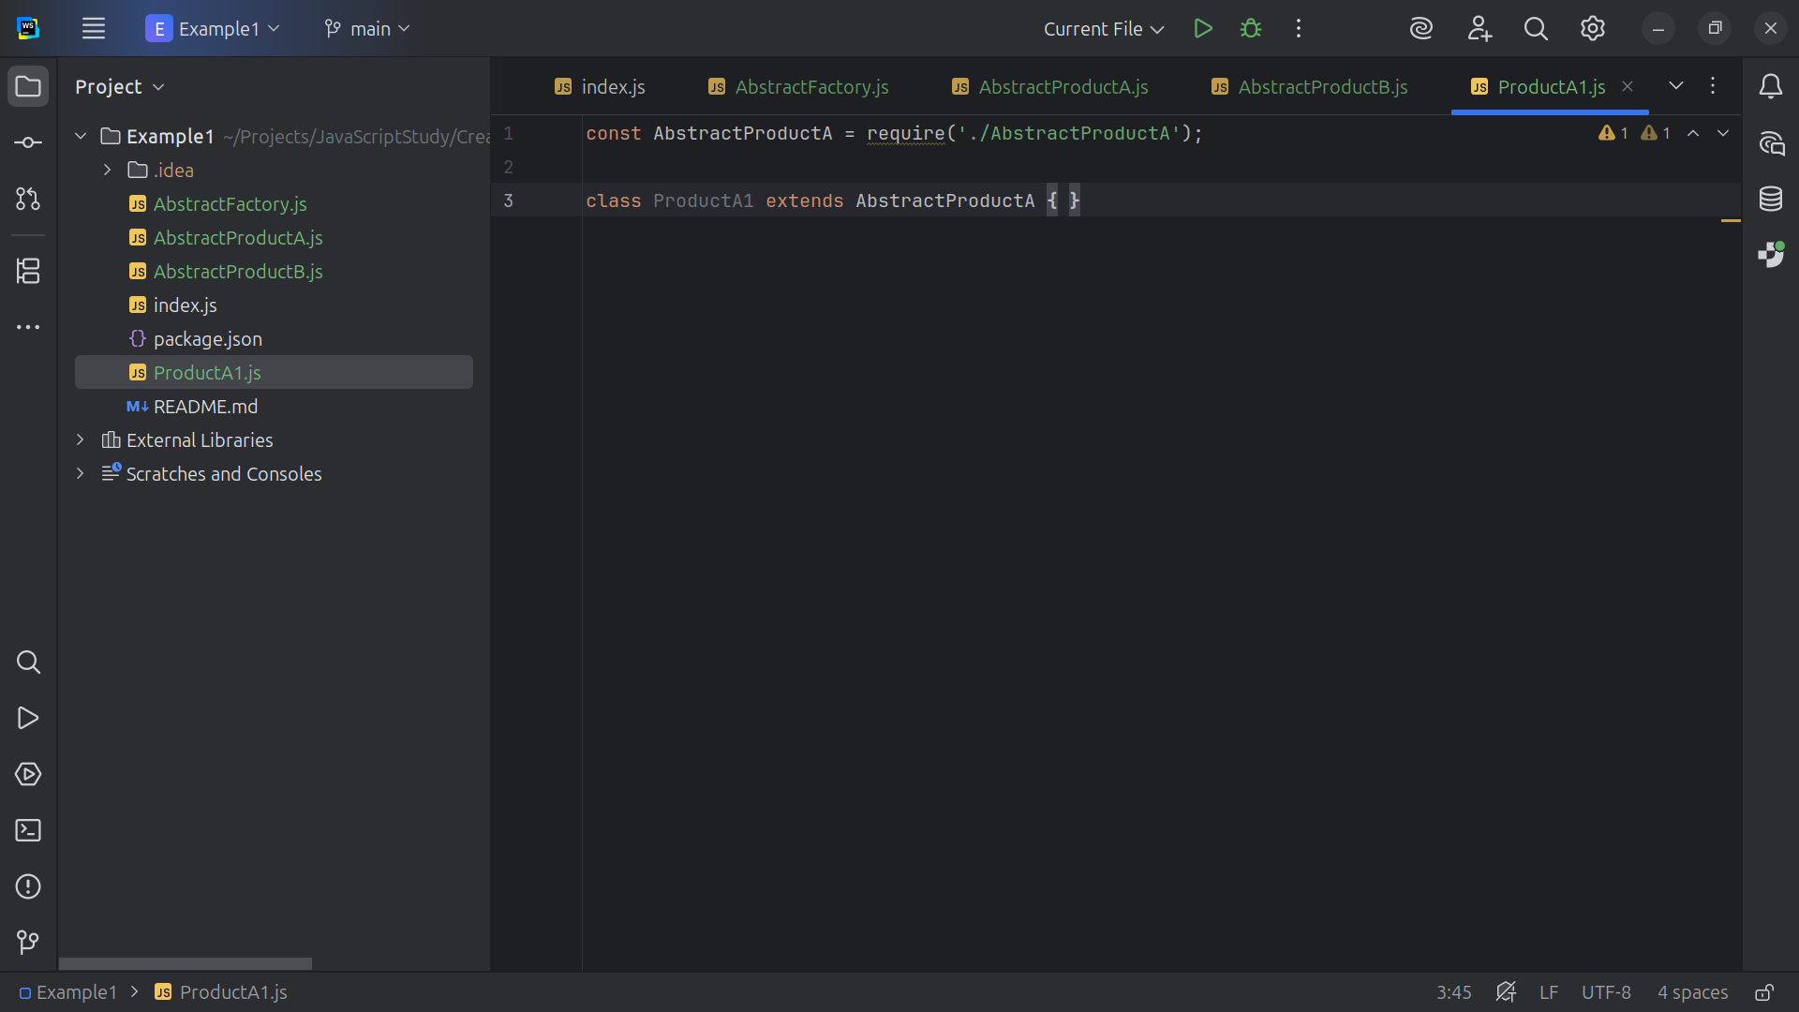
Notes:
So, of course Abstract Product A extends Product A1 because its an “A” type

Slide 20
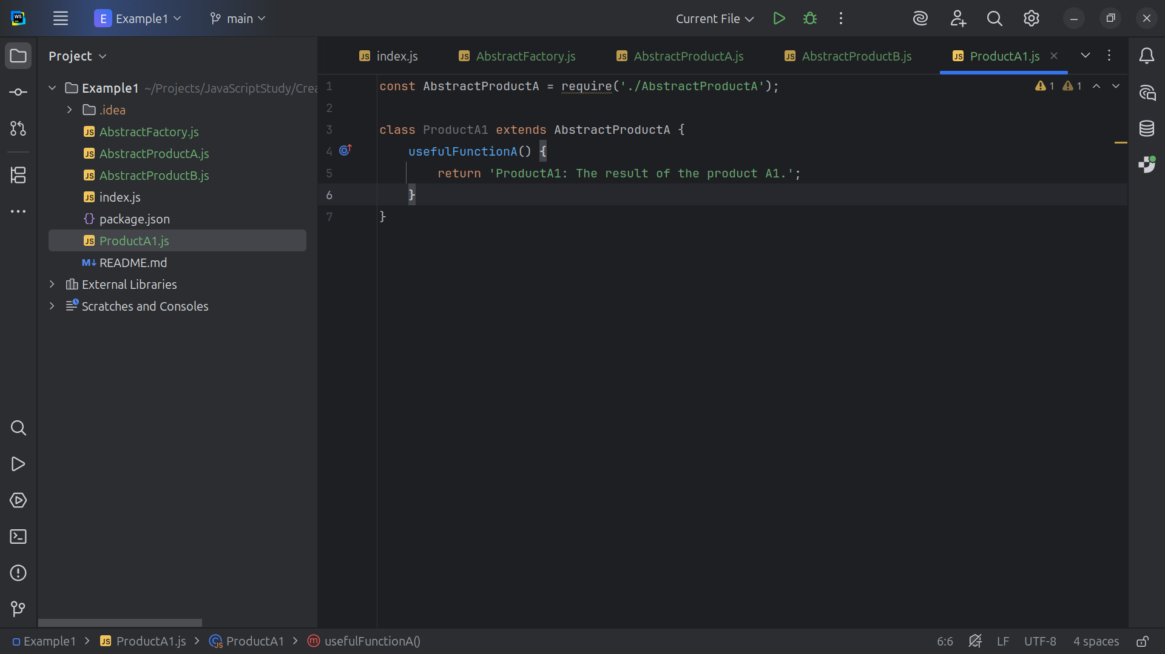
Notes:
So we have a Concrete implementation of Abstract Product A namely product A1

Slide 21
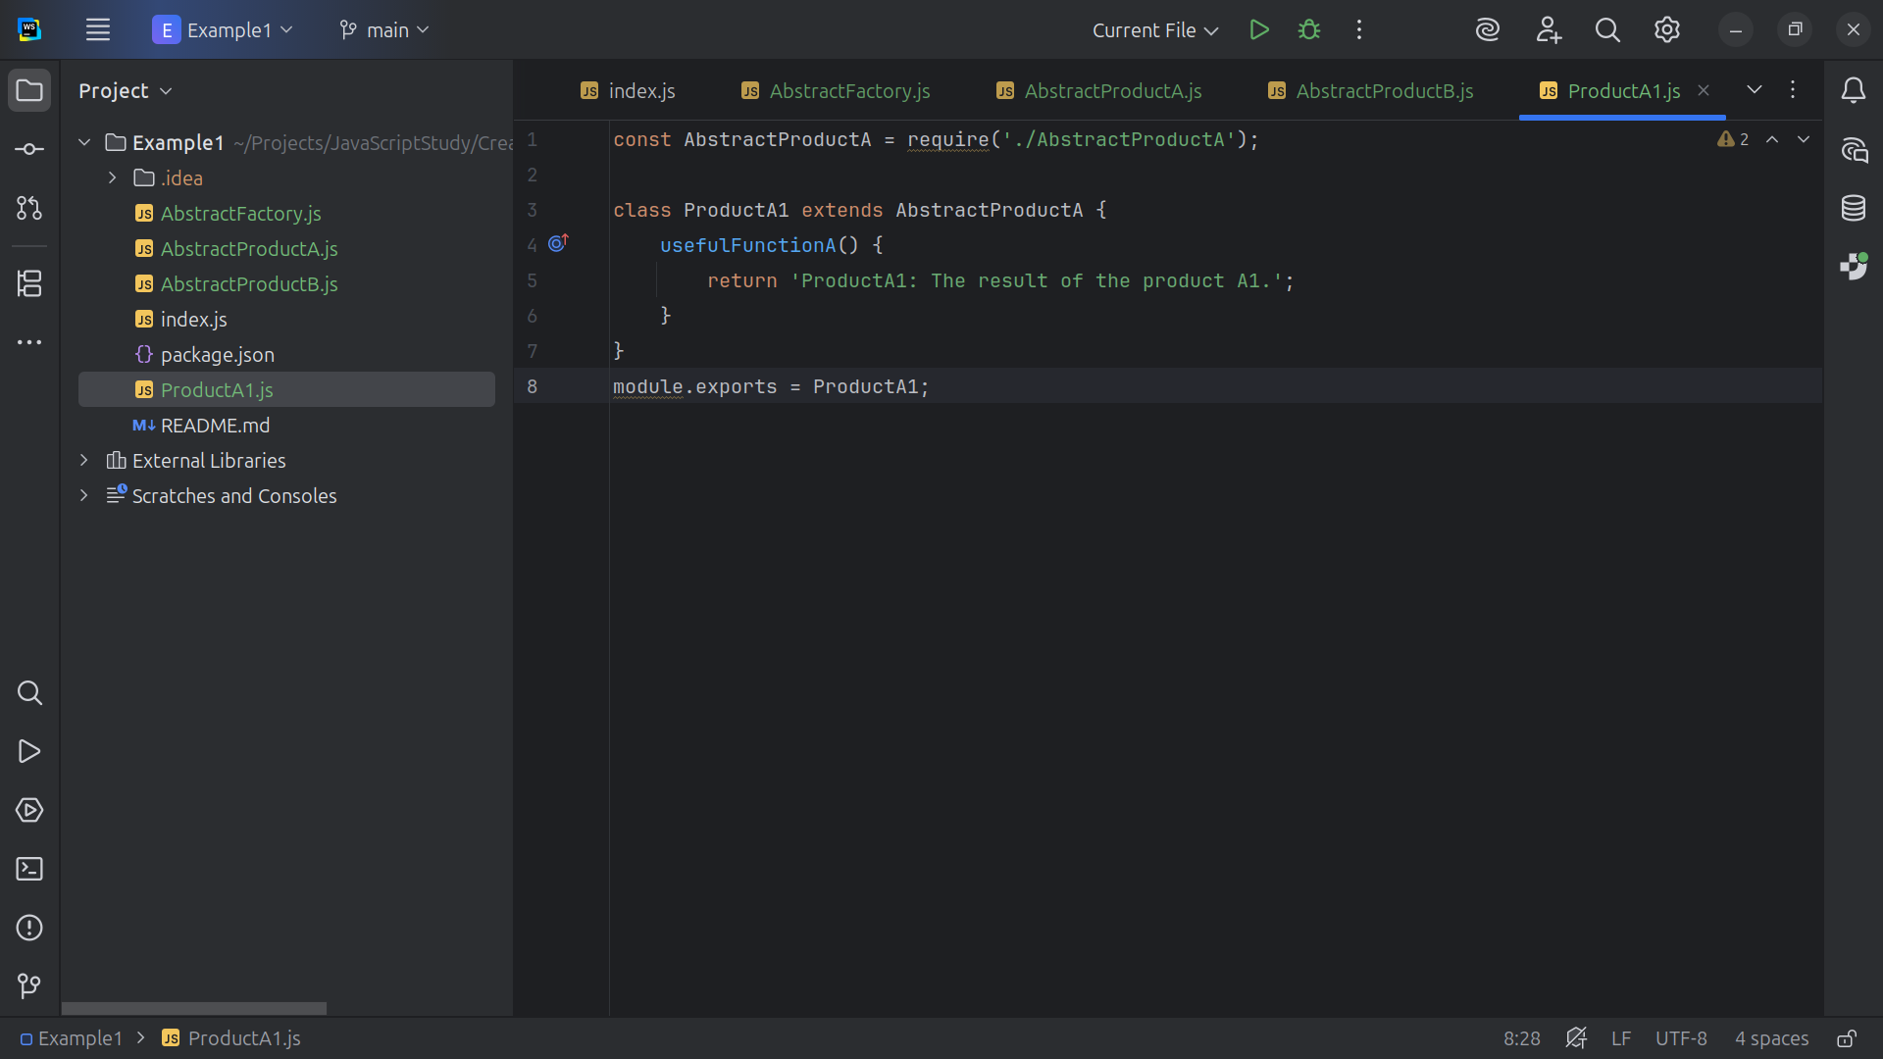
Notes:
And we close this class by exporting it for use in our project

Slide 22
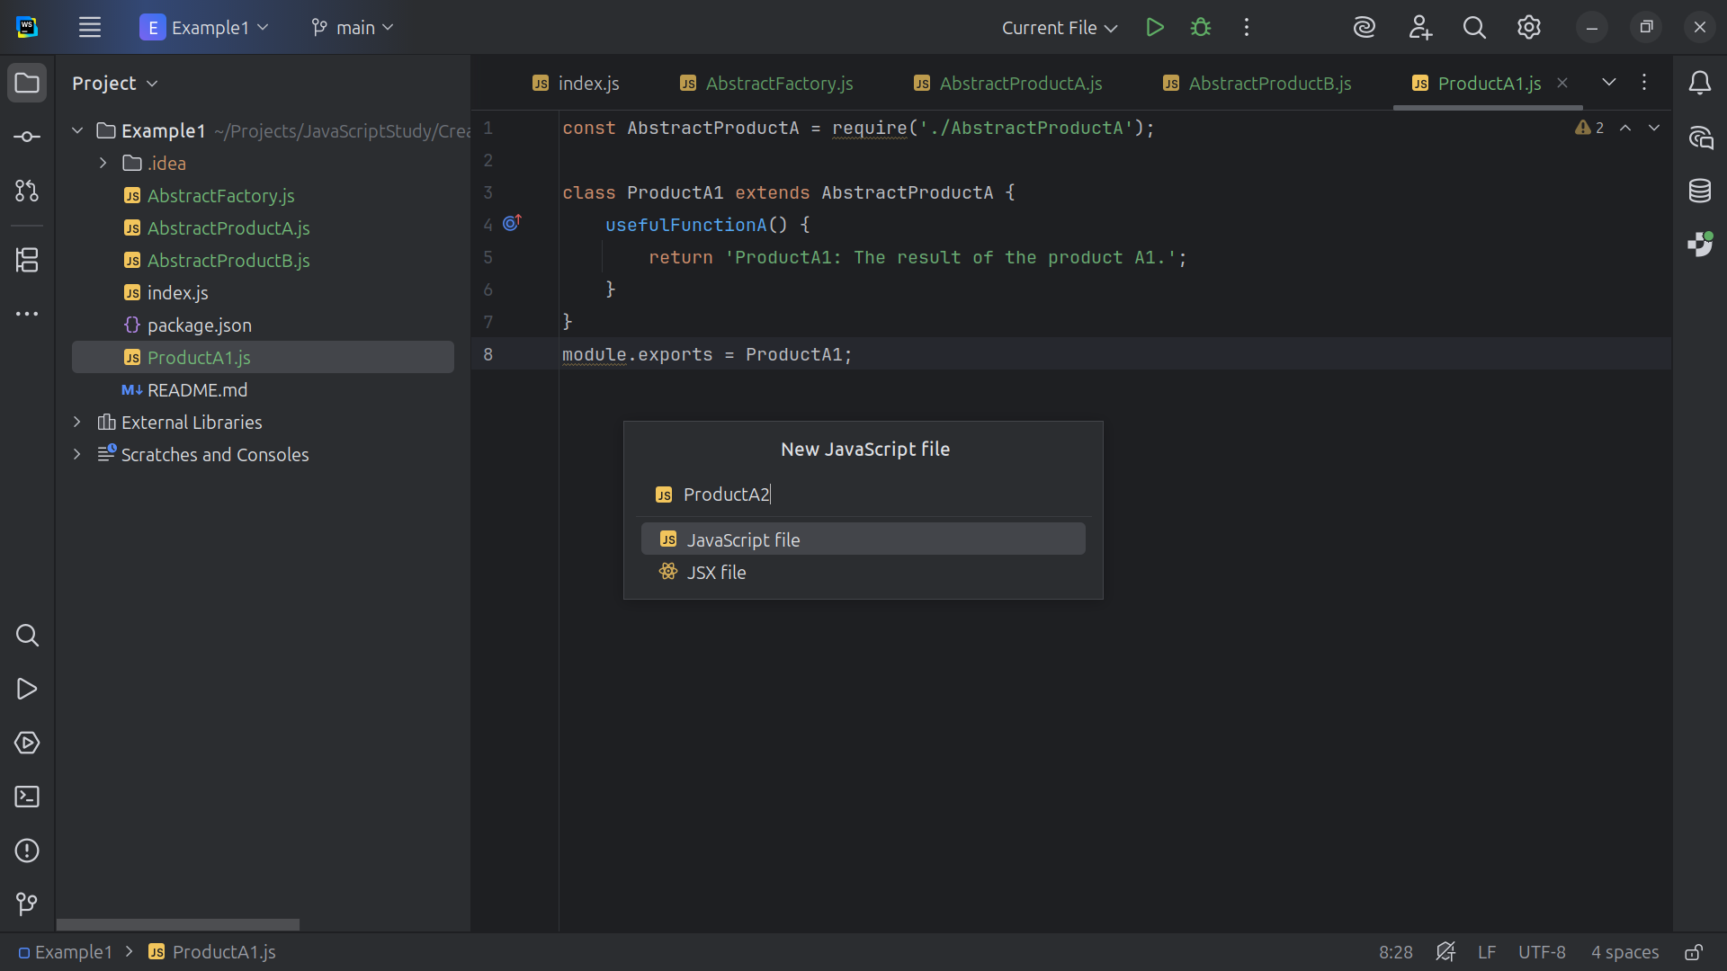
Notes:
Let’s create another Abstract Product A type

Slide 23
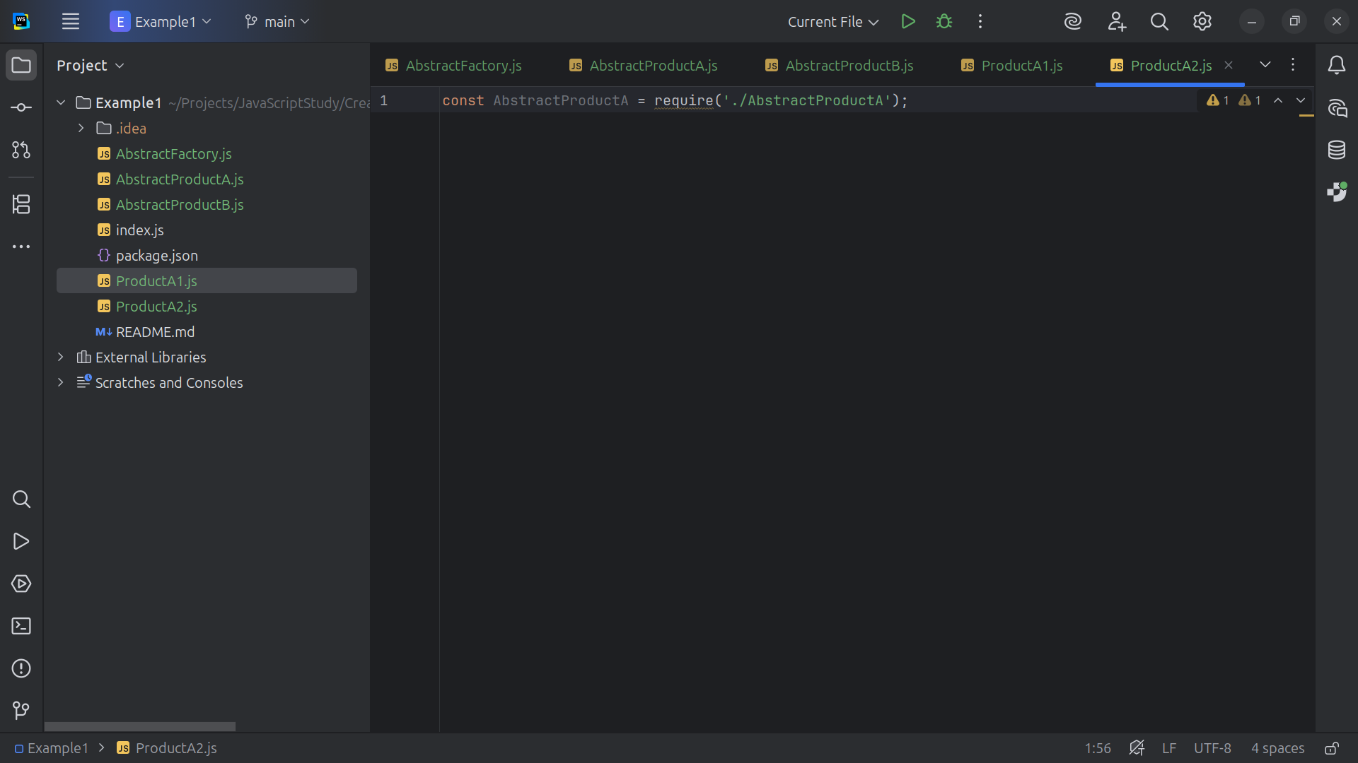
Notes:
Product A2 will require the Abstract Product A interface

Slide 24
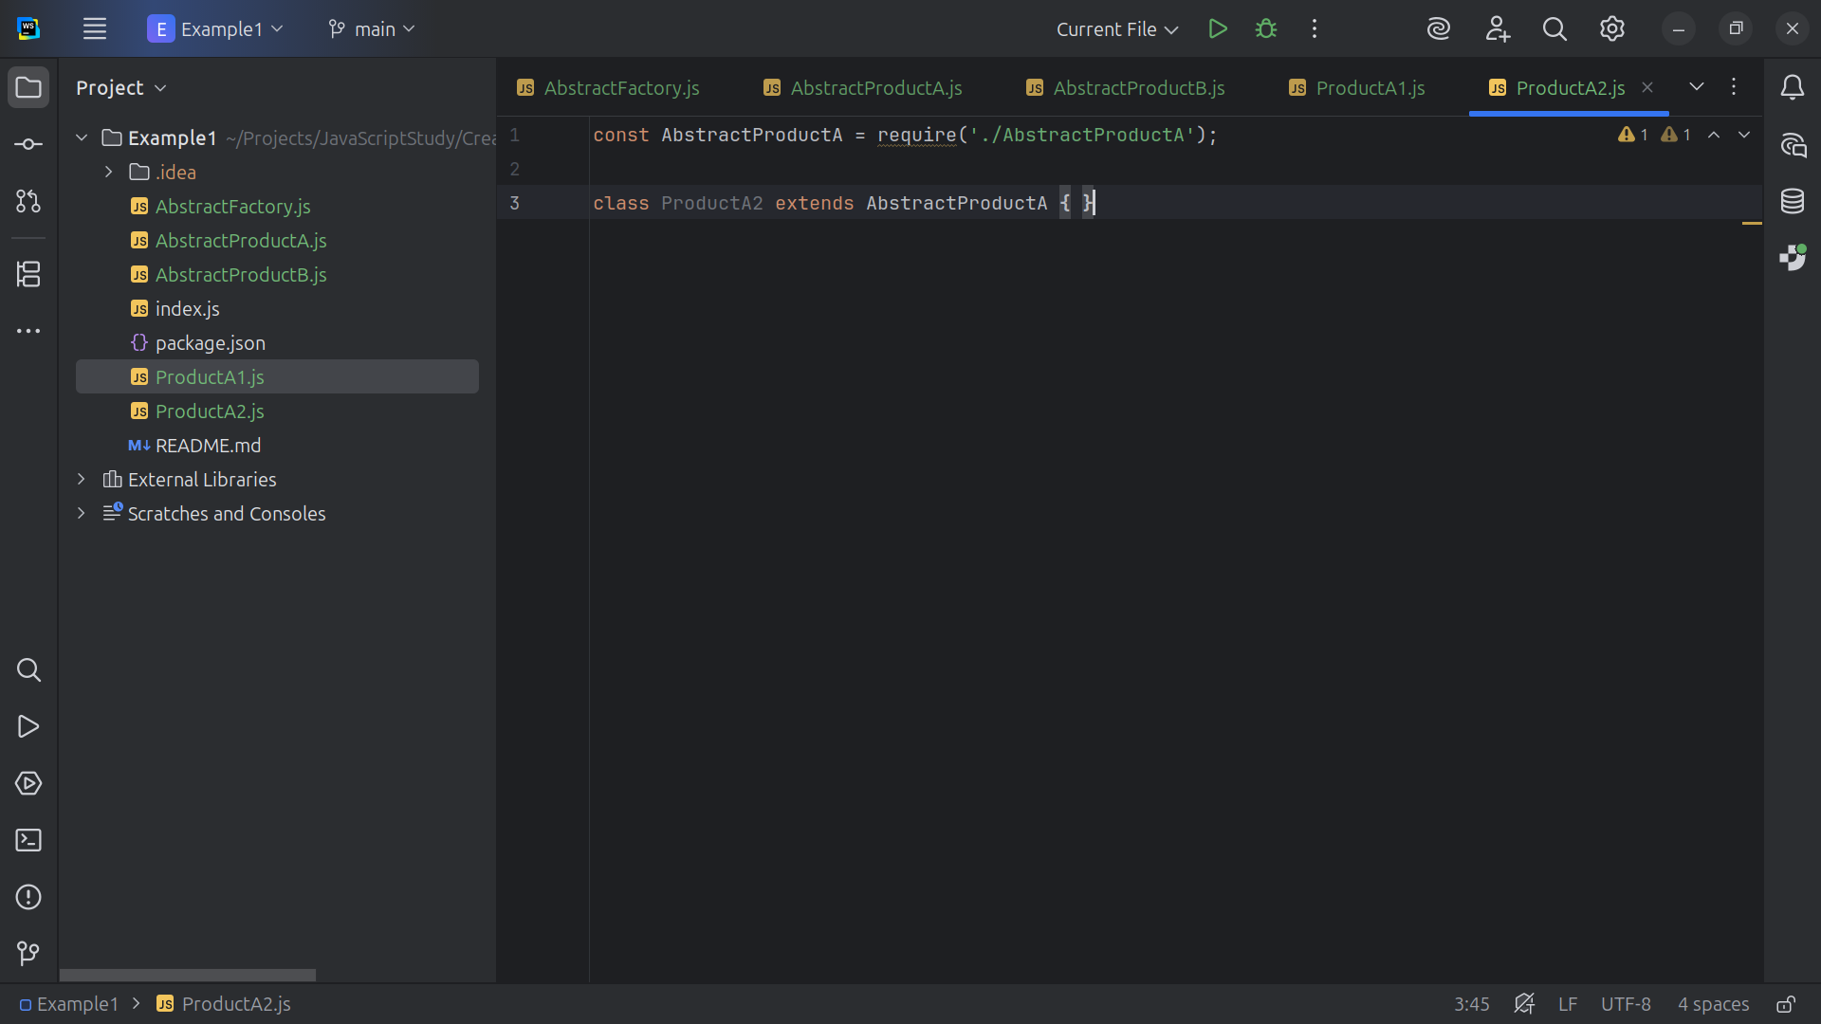
Notes:
We extend Product A 2 with Abstract Product A

Slide 25
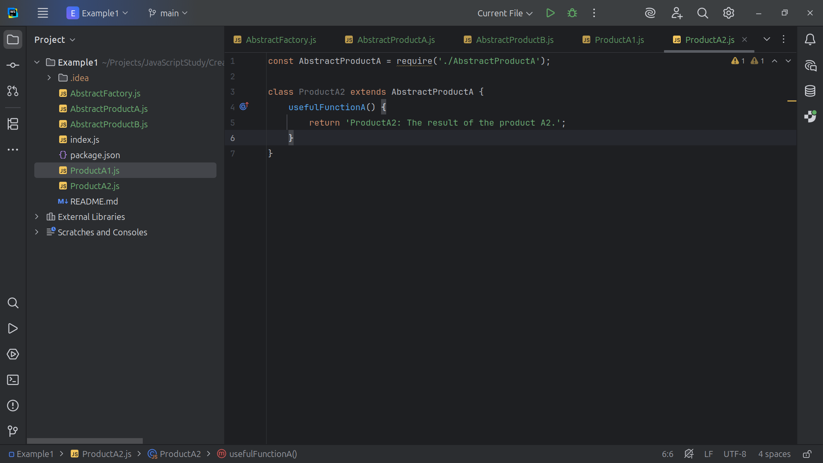
Notes:
We are required to have a useful Function A by the interface and from the method we return the string “Product A 2: The result of the product A 2”

Slide 26
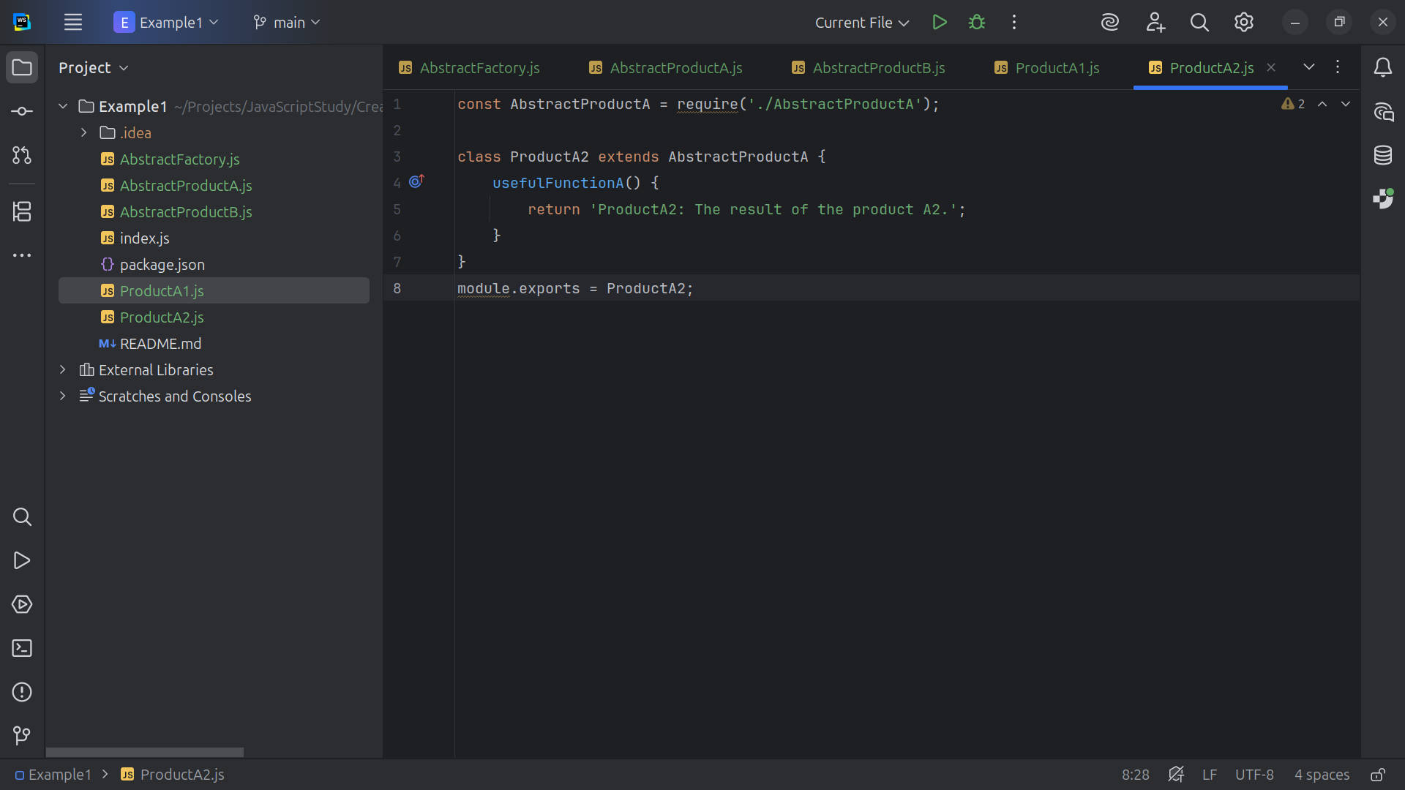
Notes:
And lastly we export this module for use

Slide 27
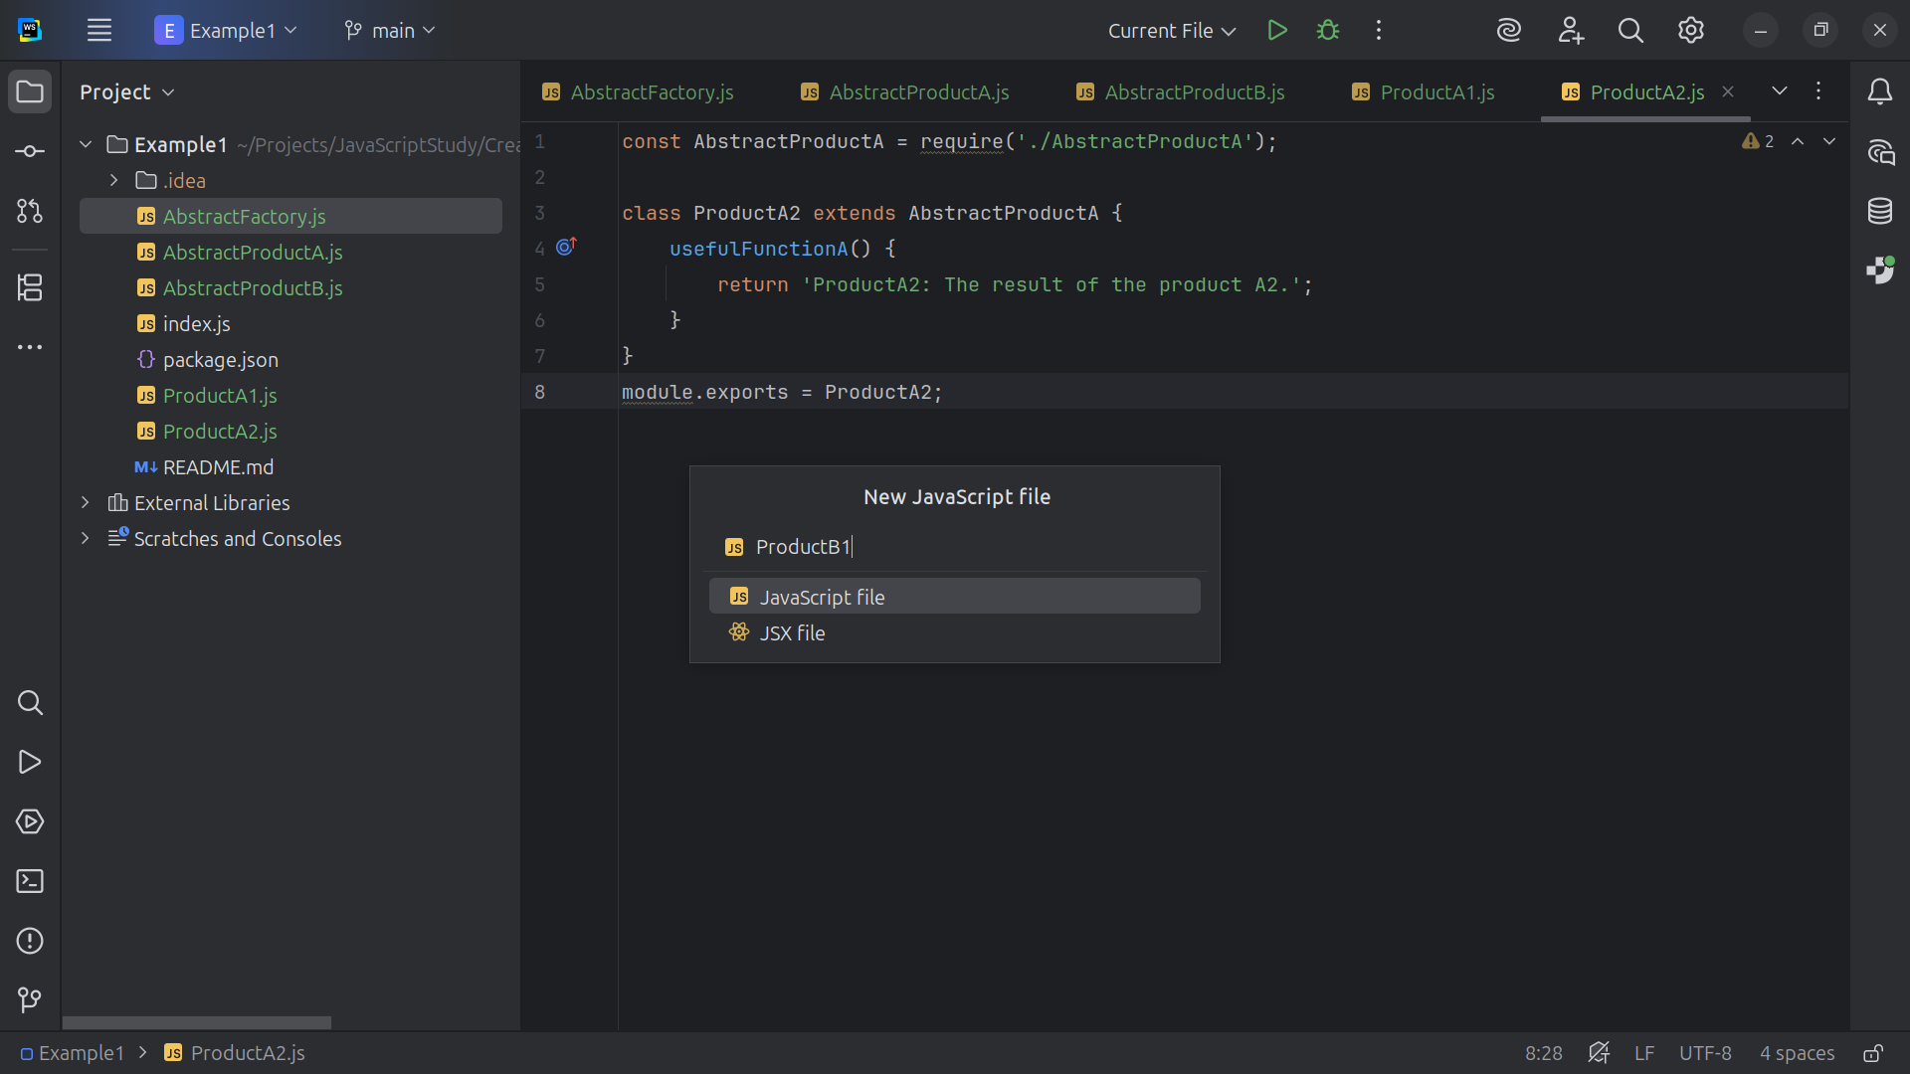
Notes:
Now let’s create our B products

Slide 28
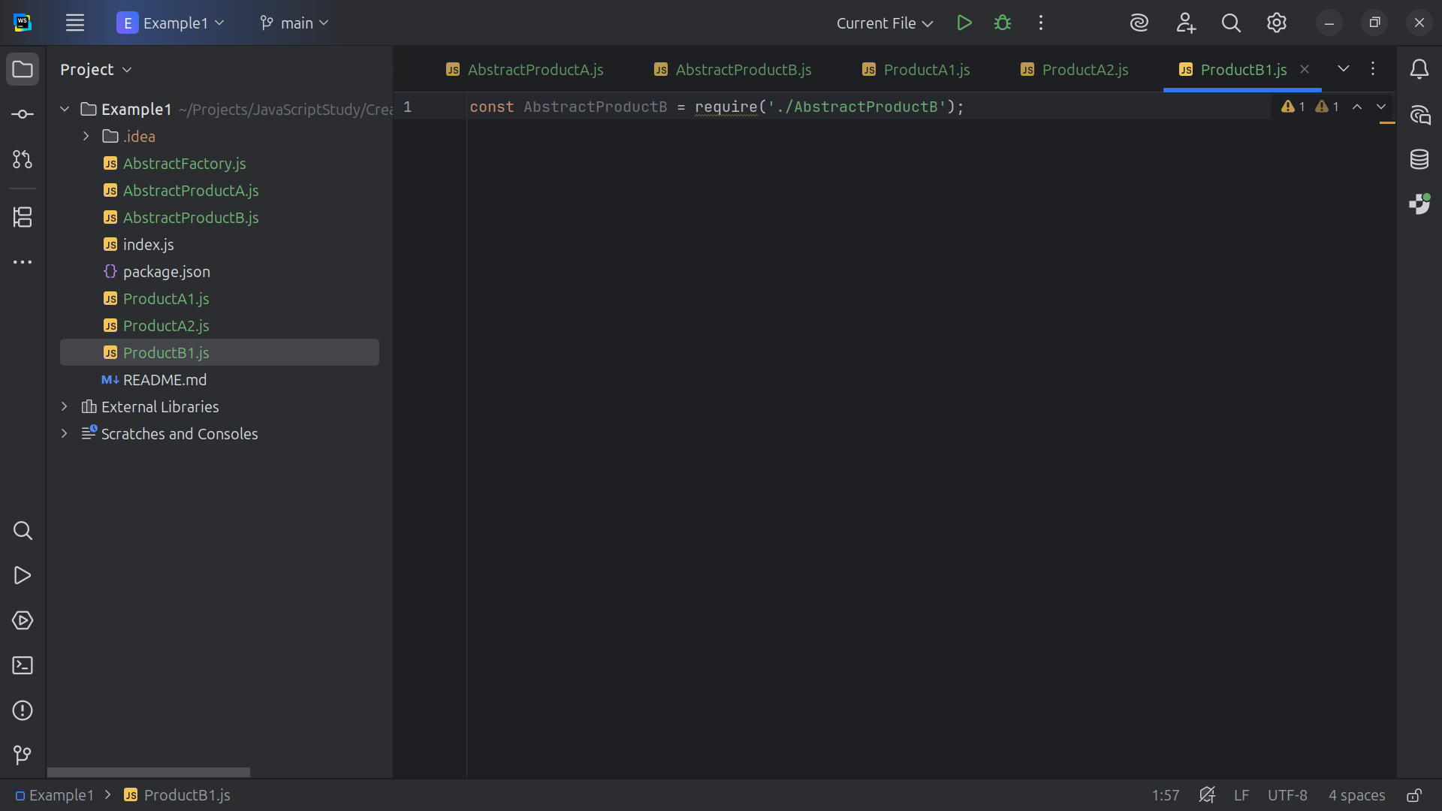
Notes:
Inside of Product B 1 we are requiring the Abstract Product B interface

Slide 29
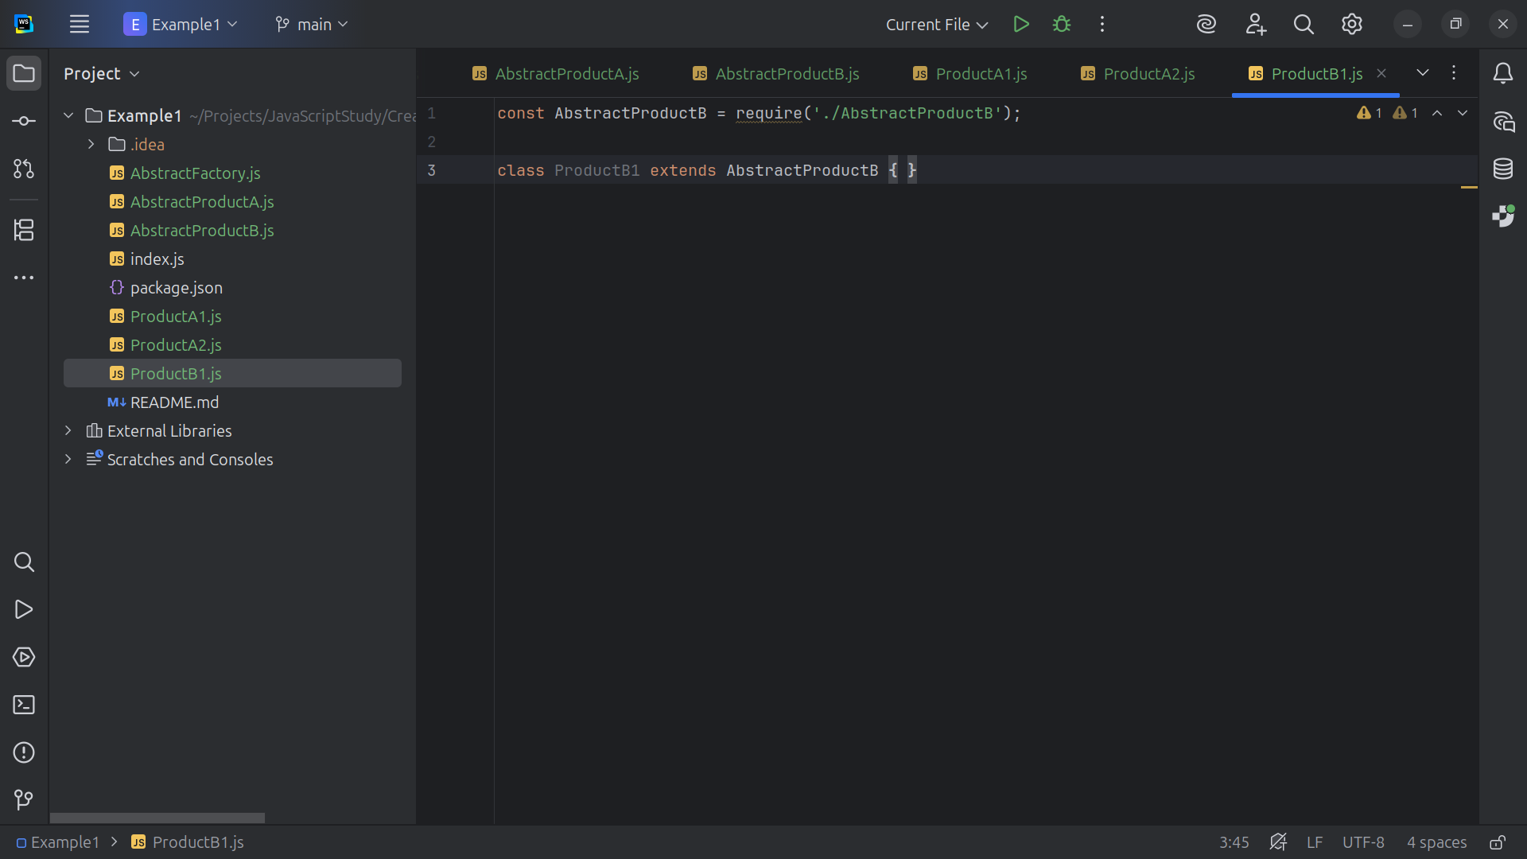
Notes:
This will be a Concrete implementation of Abstract Product B

Slide 30
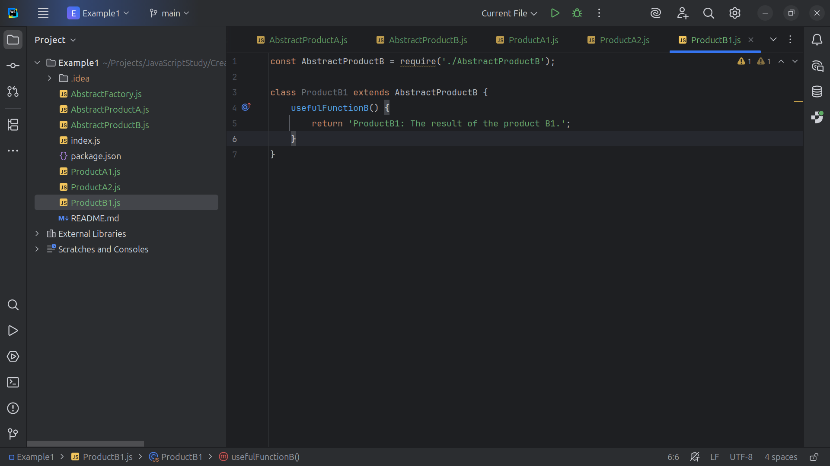
Notes:
And from the useful Function B we return the string “Product B 1: The result of the product B 1“

Slide 31
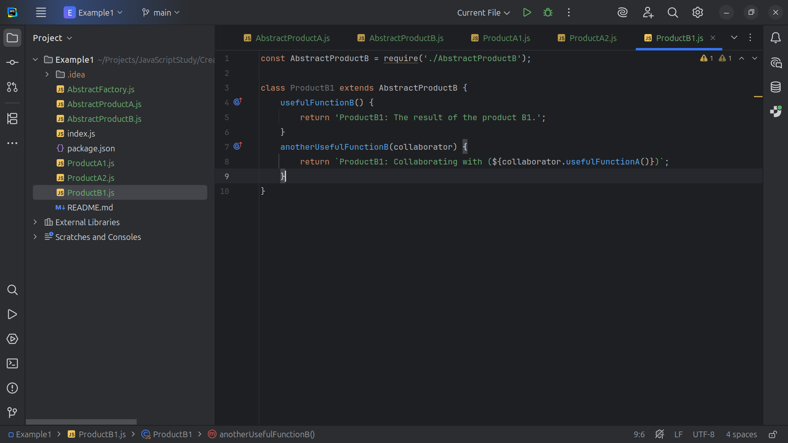
Notes:
And as per the interface Abstract Product B we need to return the results of another Useful Function B as we pass in a collaborator object

Slide 32
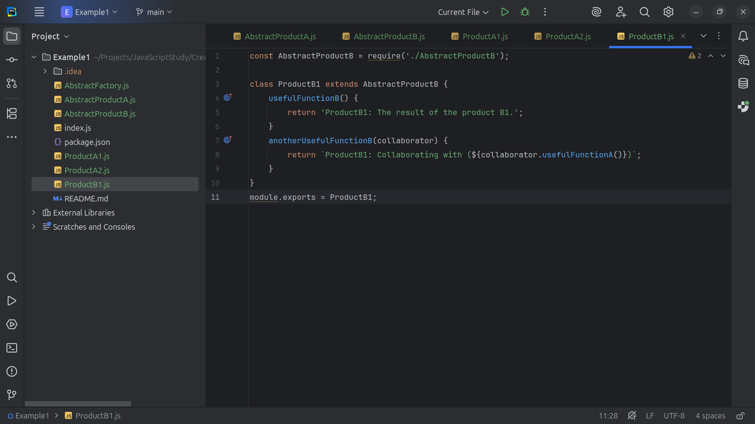
Notes:
And at the end we export this module for use

Slide 33
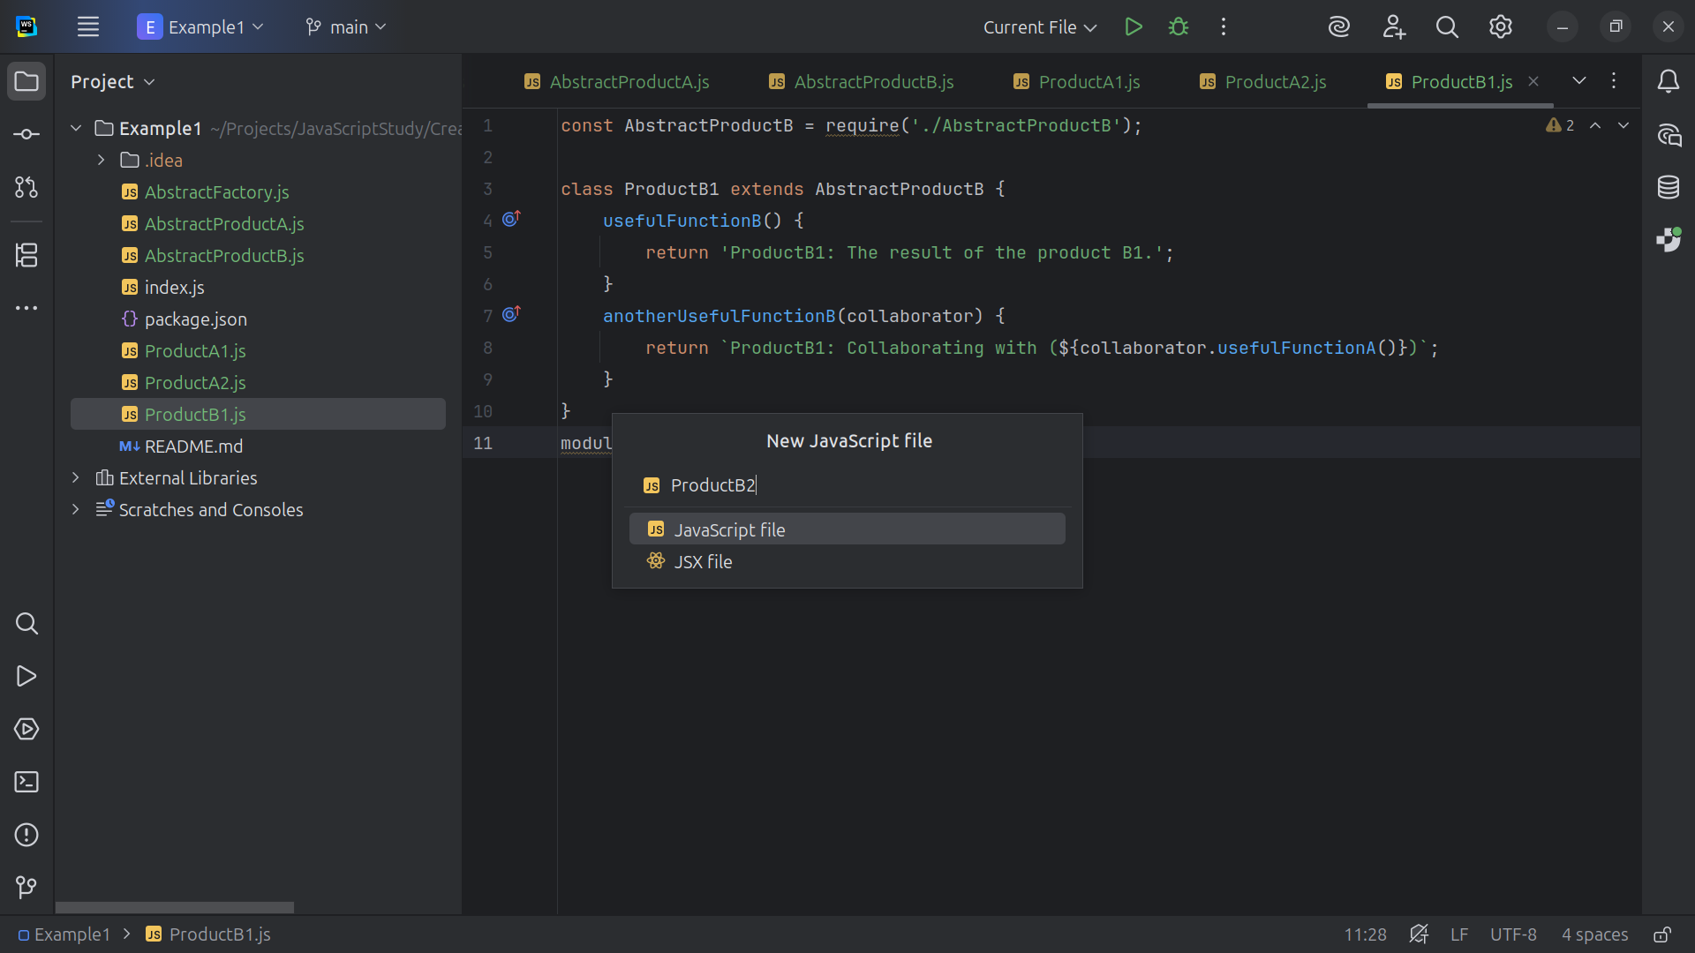
Notes:
Next we create a Product B 2 type

Slide 34
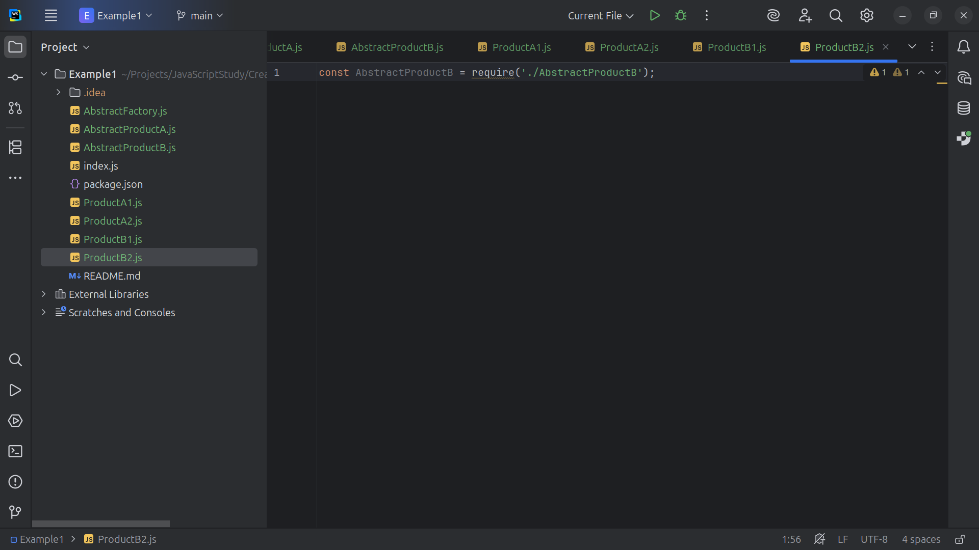
Notes:
In Product B2 we require the Abstract Product B interface

Slide 35
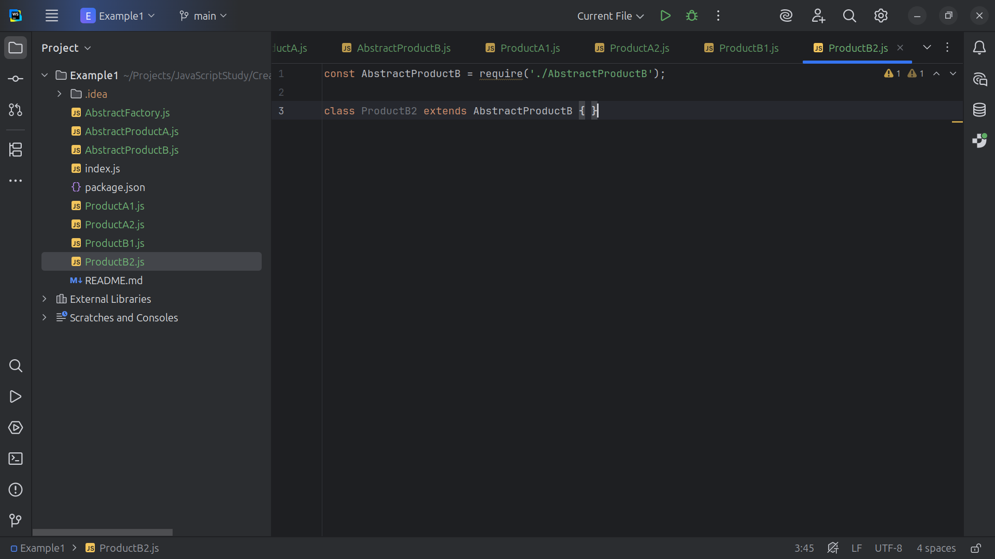
Notes:
So we have Product B 2 will be Concrete an implementation of the Abstract Product B interface

Slide 36
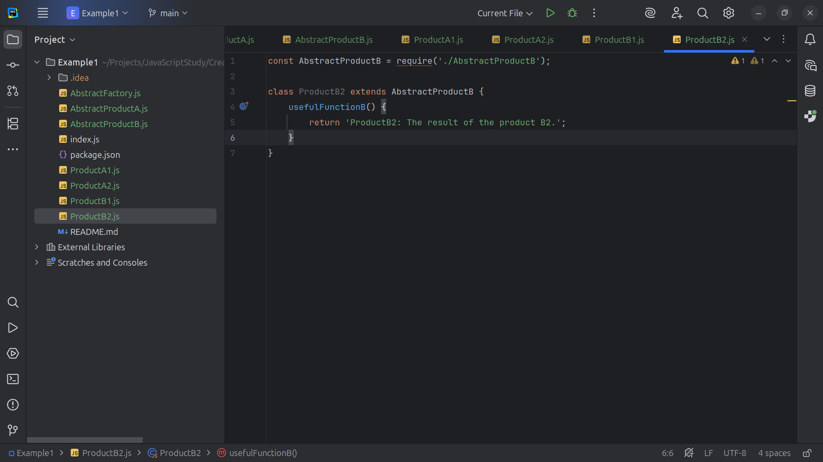
Notes:
And as a requirement, we have to have a useful Function B from which we return the string “The result of the product B 2”

Slide 37
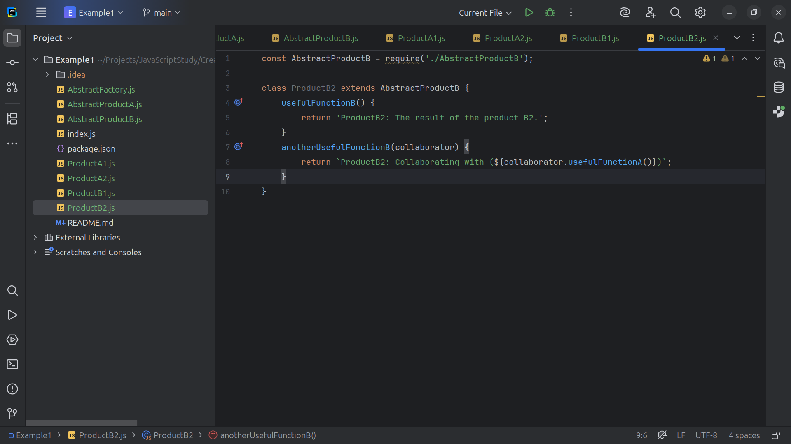
Notes:
Also we will need a another Useful Function B which we choose to return Product B2 Collaborating with Product A type in which we call the “useful Function A” method

Slide 38
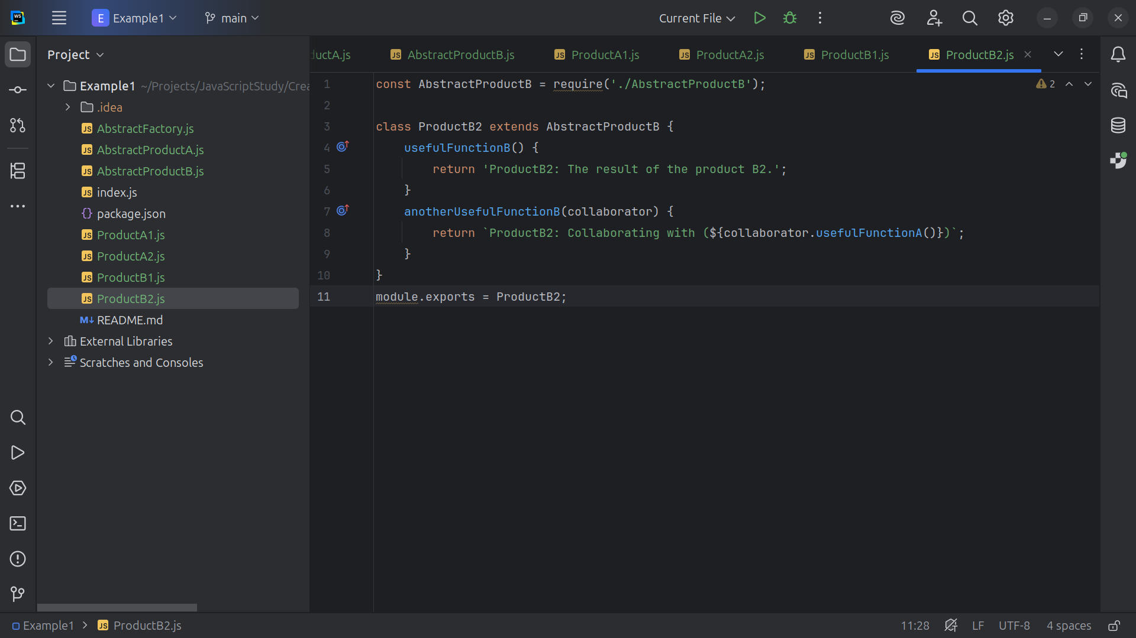
Notes:
And we close this module with an export

Slide 39
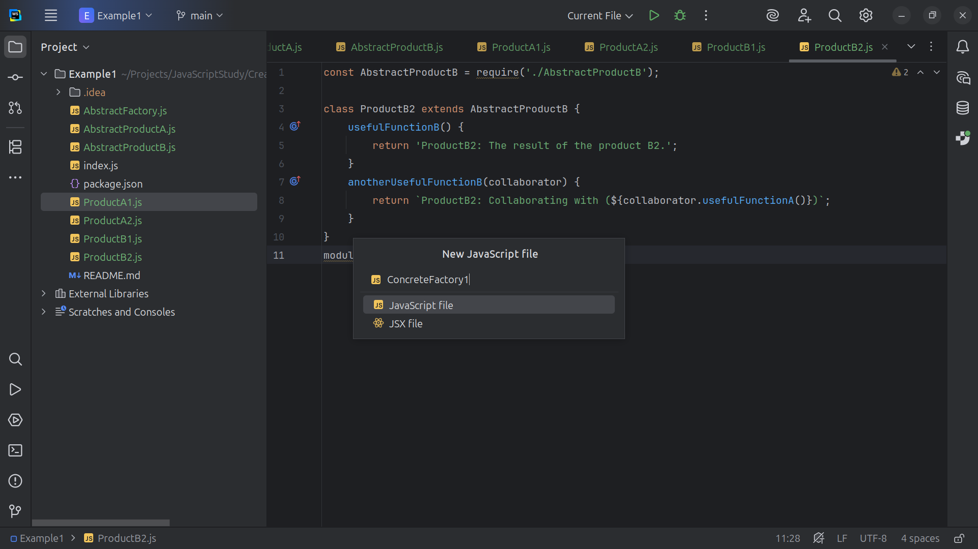
Notes:
Now let’s create a couple of Concrete Factories

Slide 40
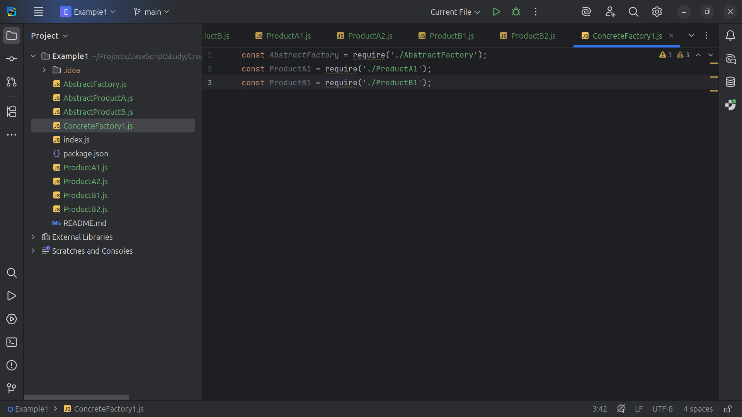
Notes:
Concrete Factory 1 will produce concrete Product A1 object and concrete Product B1 objects

Slide 41
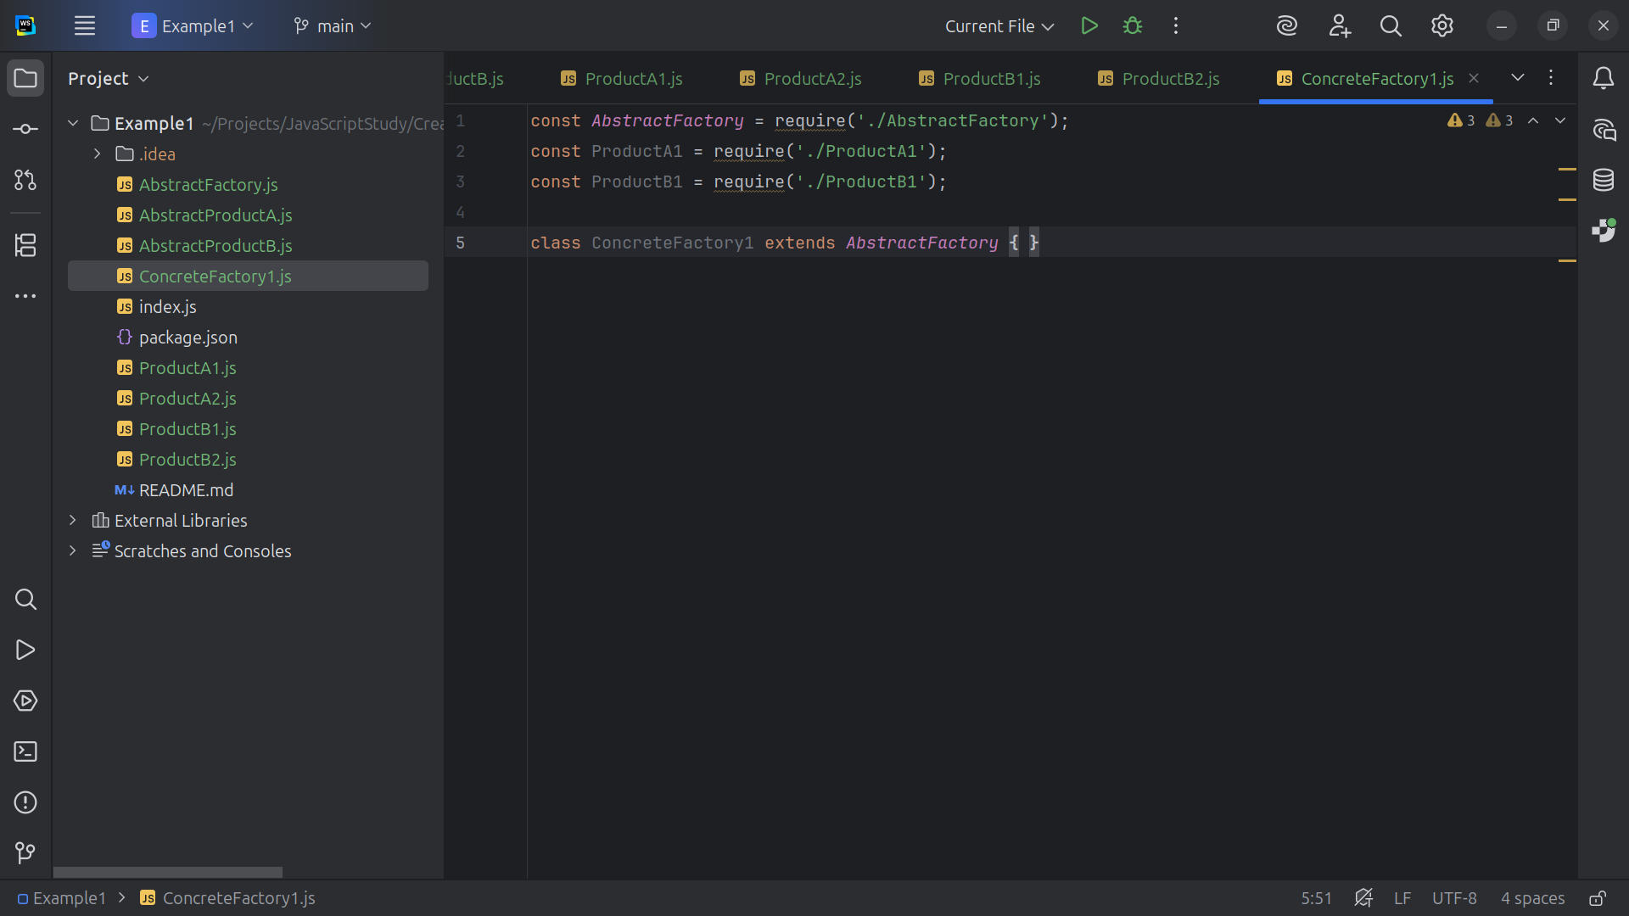
Notes:
So Concrete Factory 1 is extended with the Abstract Factory which is the Super class of Abstract Products A and B

Slide 42
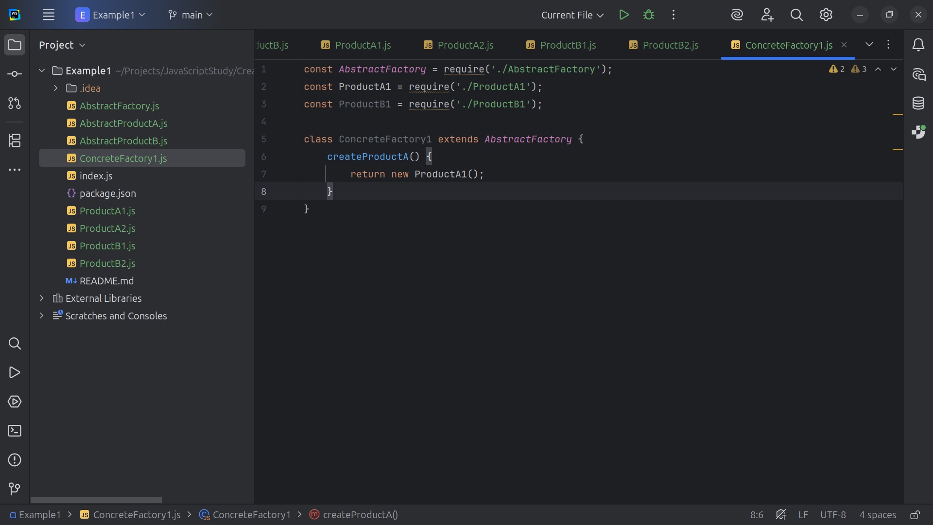
Notes:
So we let’s create Product A return a Product A1 object

Slide 43
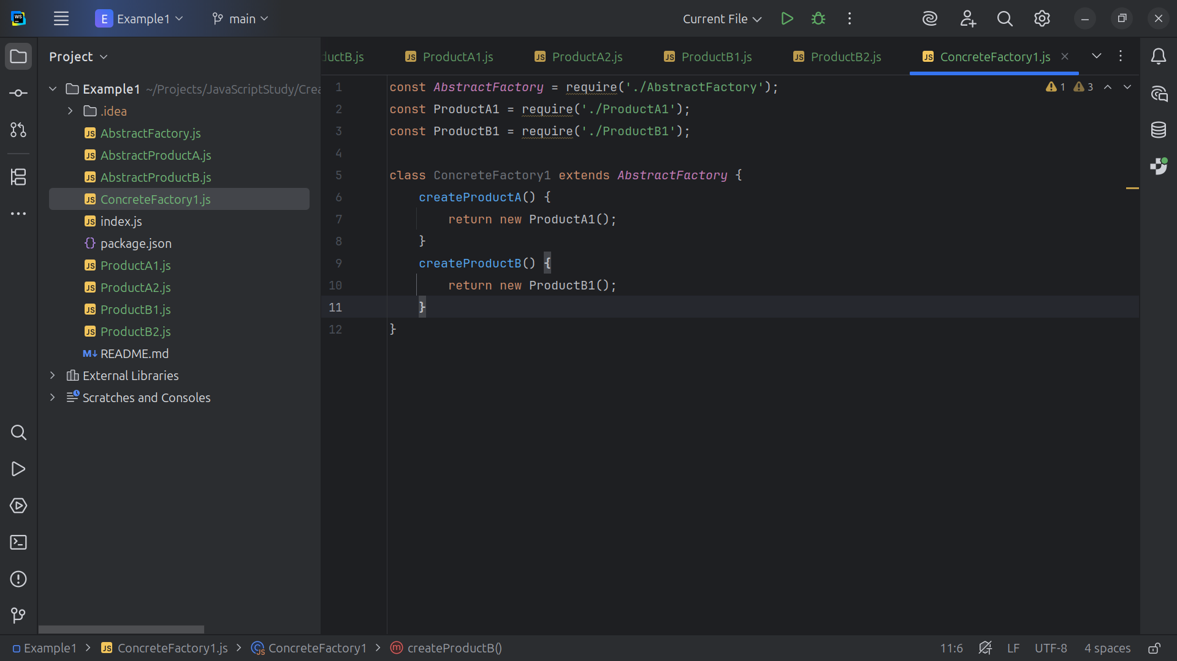
Notes:
And with create Product B we return a Product B 1 object

Slide 44
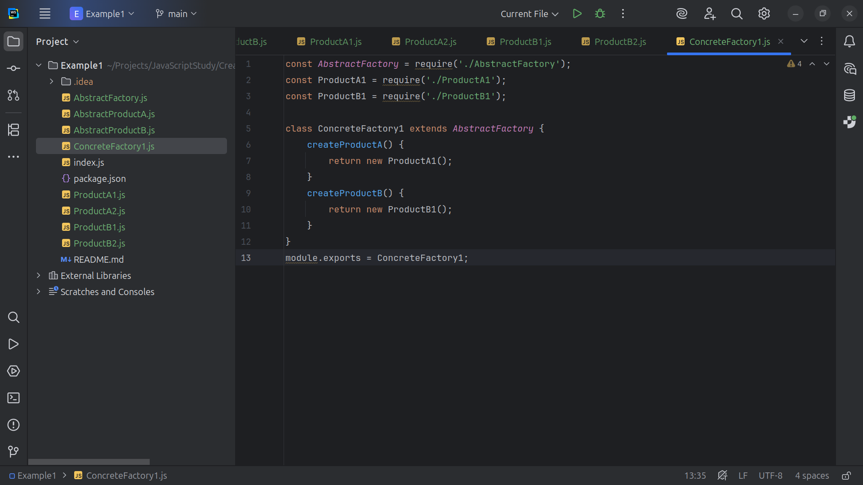
Notes:
And at the end we export this module for use

Slide 45
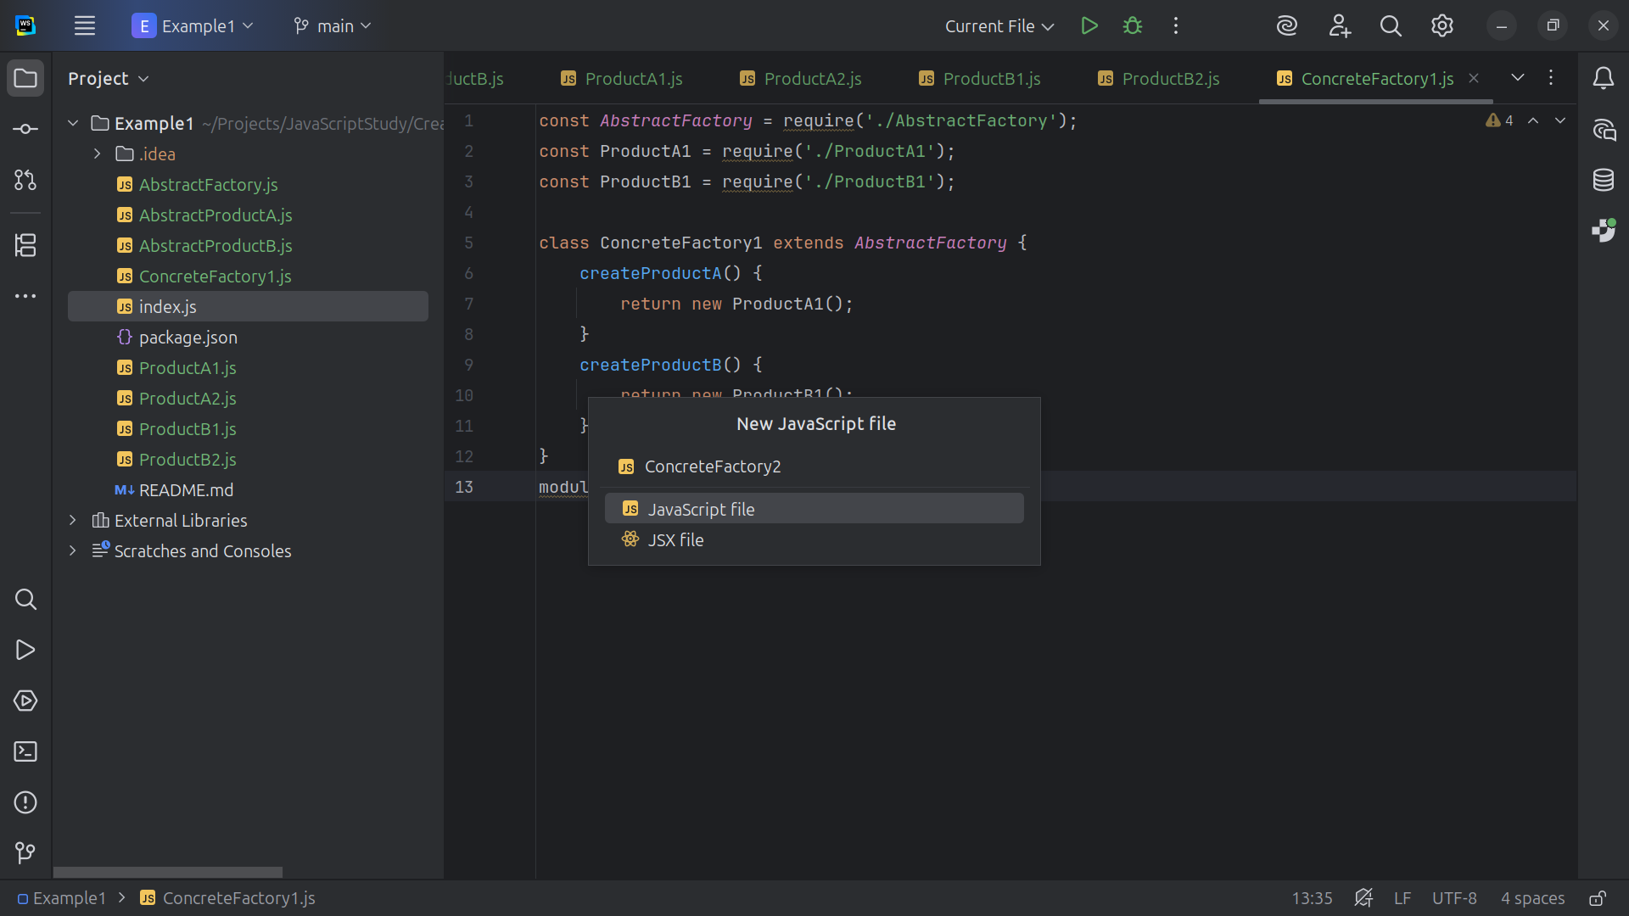
Notes:
Let’s create another Concrete Factory we will call Concrete Factory 2

Slide 46
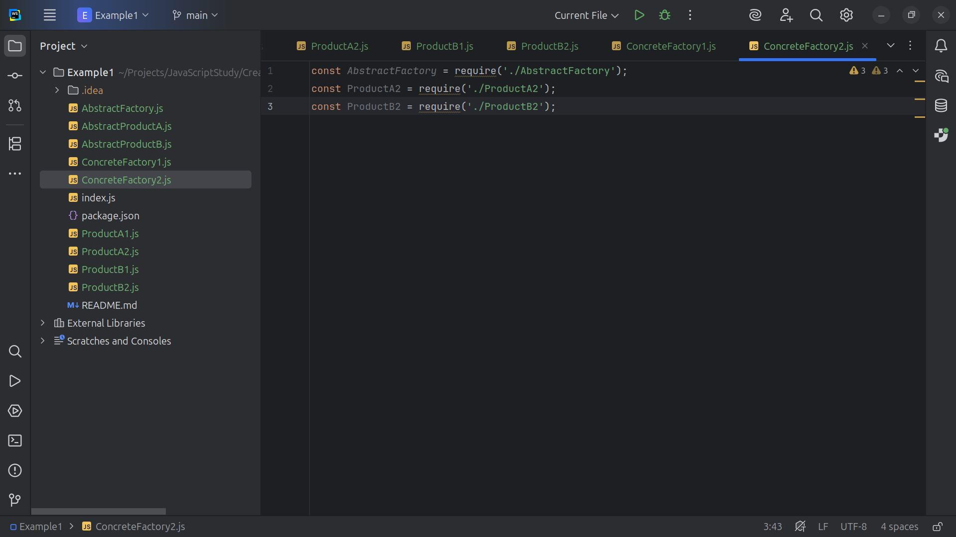
Notes:
At the top we include the Abstract Factory and the types of Product we expect to return. For this Factory we plan to return A2 and B2 Products

Slide 47
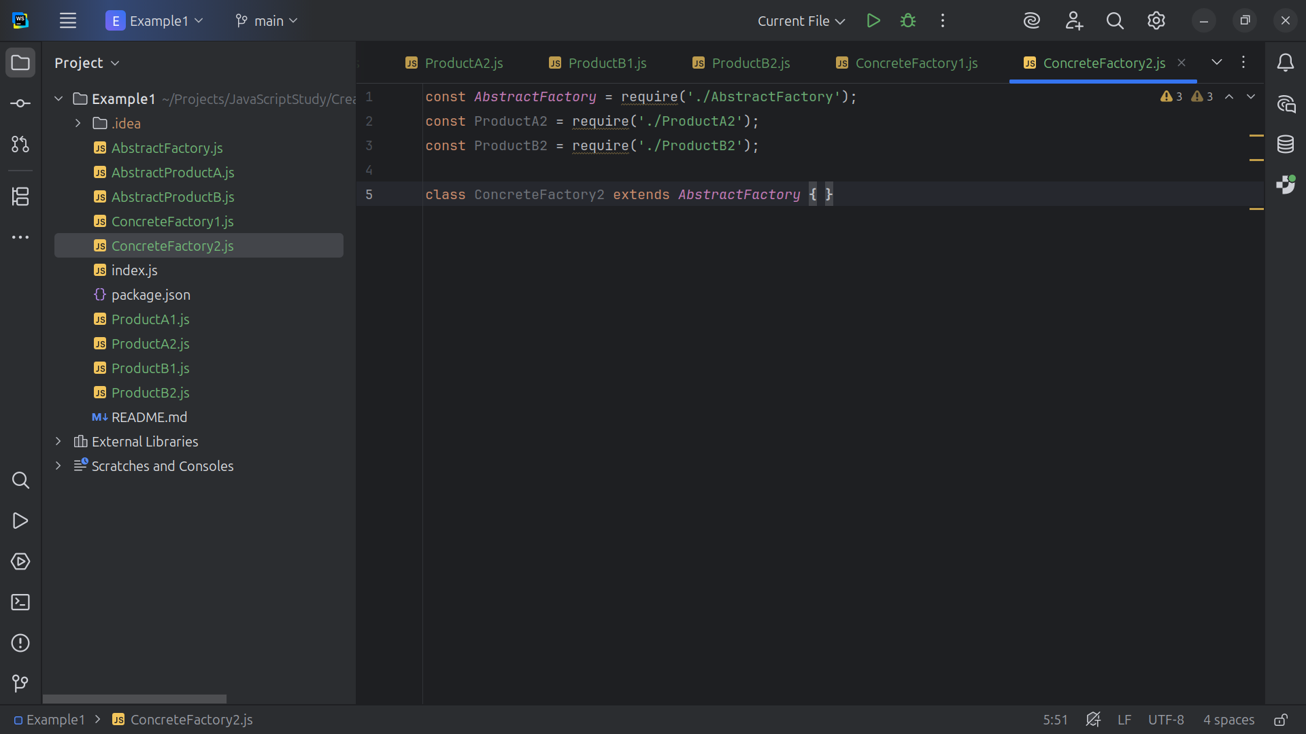
Notes:
Our first Concrete Factory

Slide 48
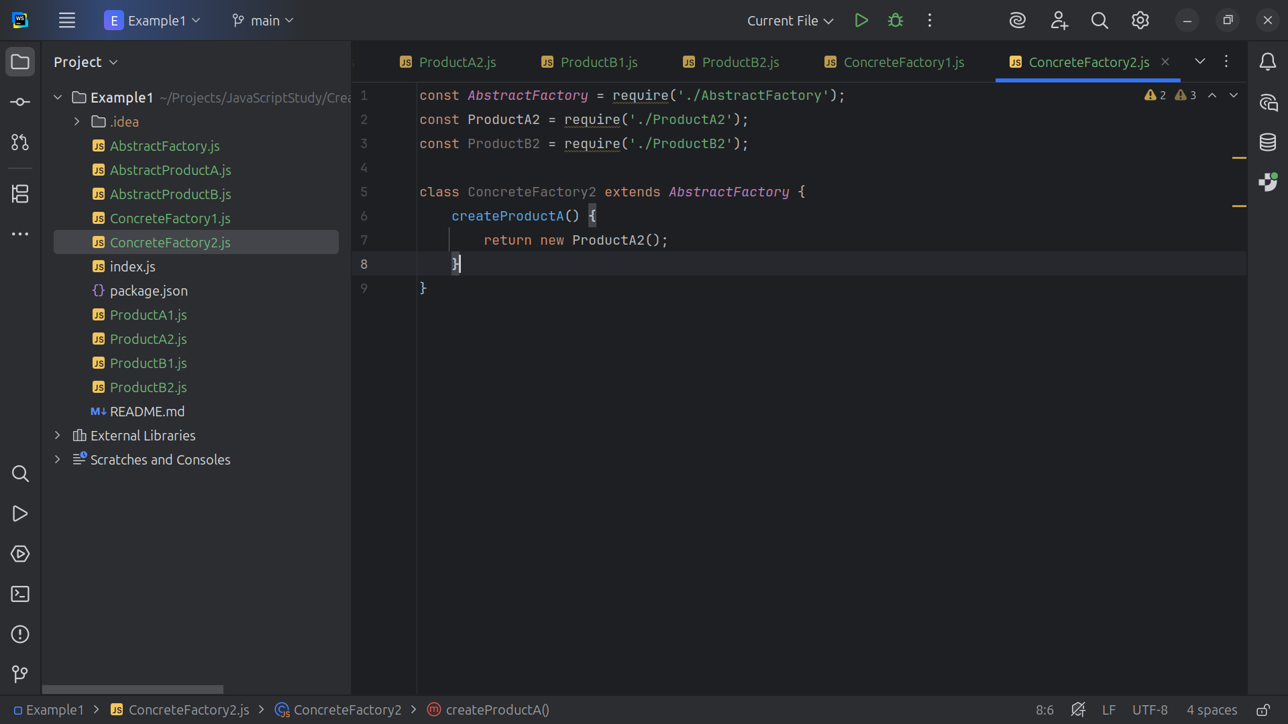
Notes:
, Concrete Factory 2 will return new A2 products

Slide 49
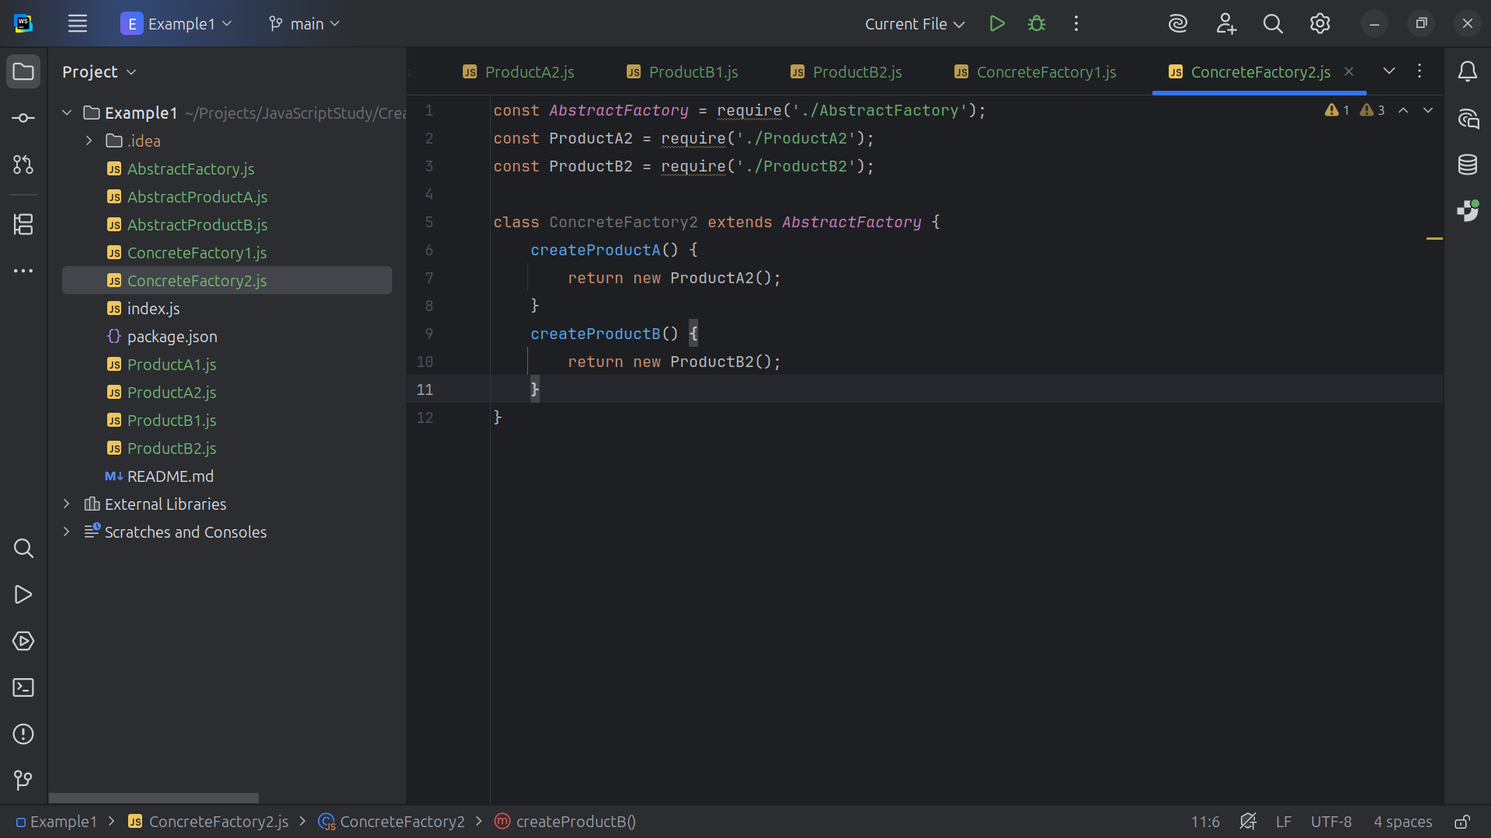
Notes:
And for our create Product B method we will return a new B2 Product

Slide 50
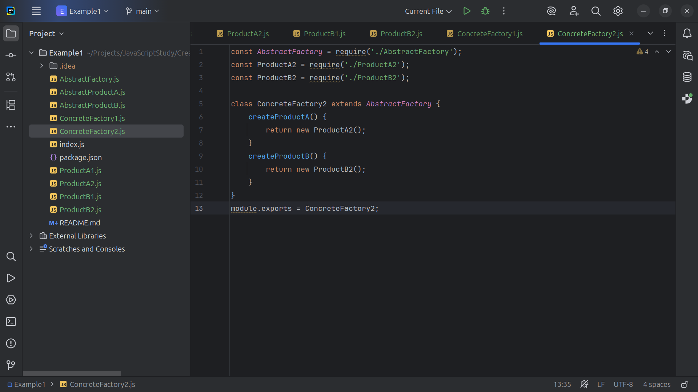
Notes:
. . . And we close this class with an export for use

Slide 51

Notes:
Now we create a Client for our demo

Slide 52

Notes:
The client class will be the class that we will put in our index .js file

Slide 53

Notes:
We assign this . Product A to the factor method create Product A and we do the same for Product B

Slide 54

Notes:
And we write to the consol log product B’s useful Function and Product B’s another Useful Function B with a product A object we Let Product B collaborate with Product A

Slide 55

Notes:
And we export it for use

Slide 56

Notes:
Now over to the index .js file

Slide 57

Notes:
We requier Concrete Factories 1 and 2 and the Client

Slide 58

Notes:
Demonstrate behavior using ConcreteFactory1

Slide 59

Notes:
Demonstrate behavior using ConcreteFactory2 so now let’s view the result

Slide 60

Notes:
We get
Client: Testing client code with the first factory type...
ProductB1: The result of the product B1.
ProductB1: Collaborating with
(ProductA1: The result of the product A1.)
Client: Testing the same client code with the second factory type...
ProductB2: The result of the product B2.
ProductB2: Collaborating with
(ProductA2: The result of the product A2.)

