Slide 1
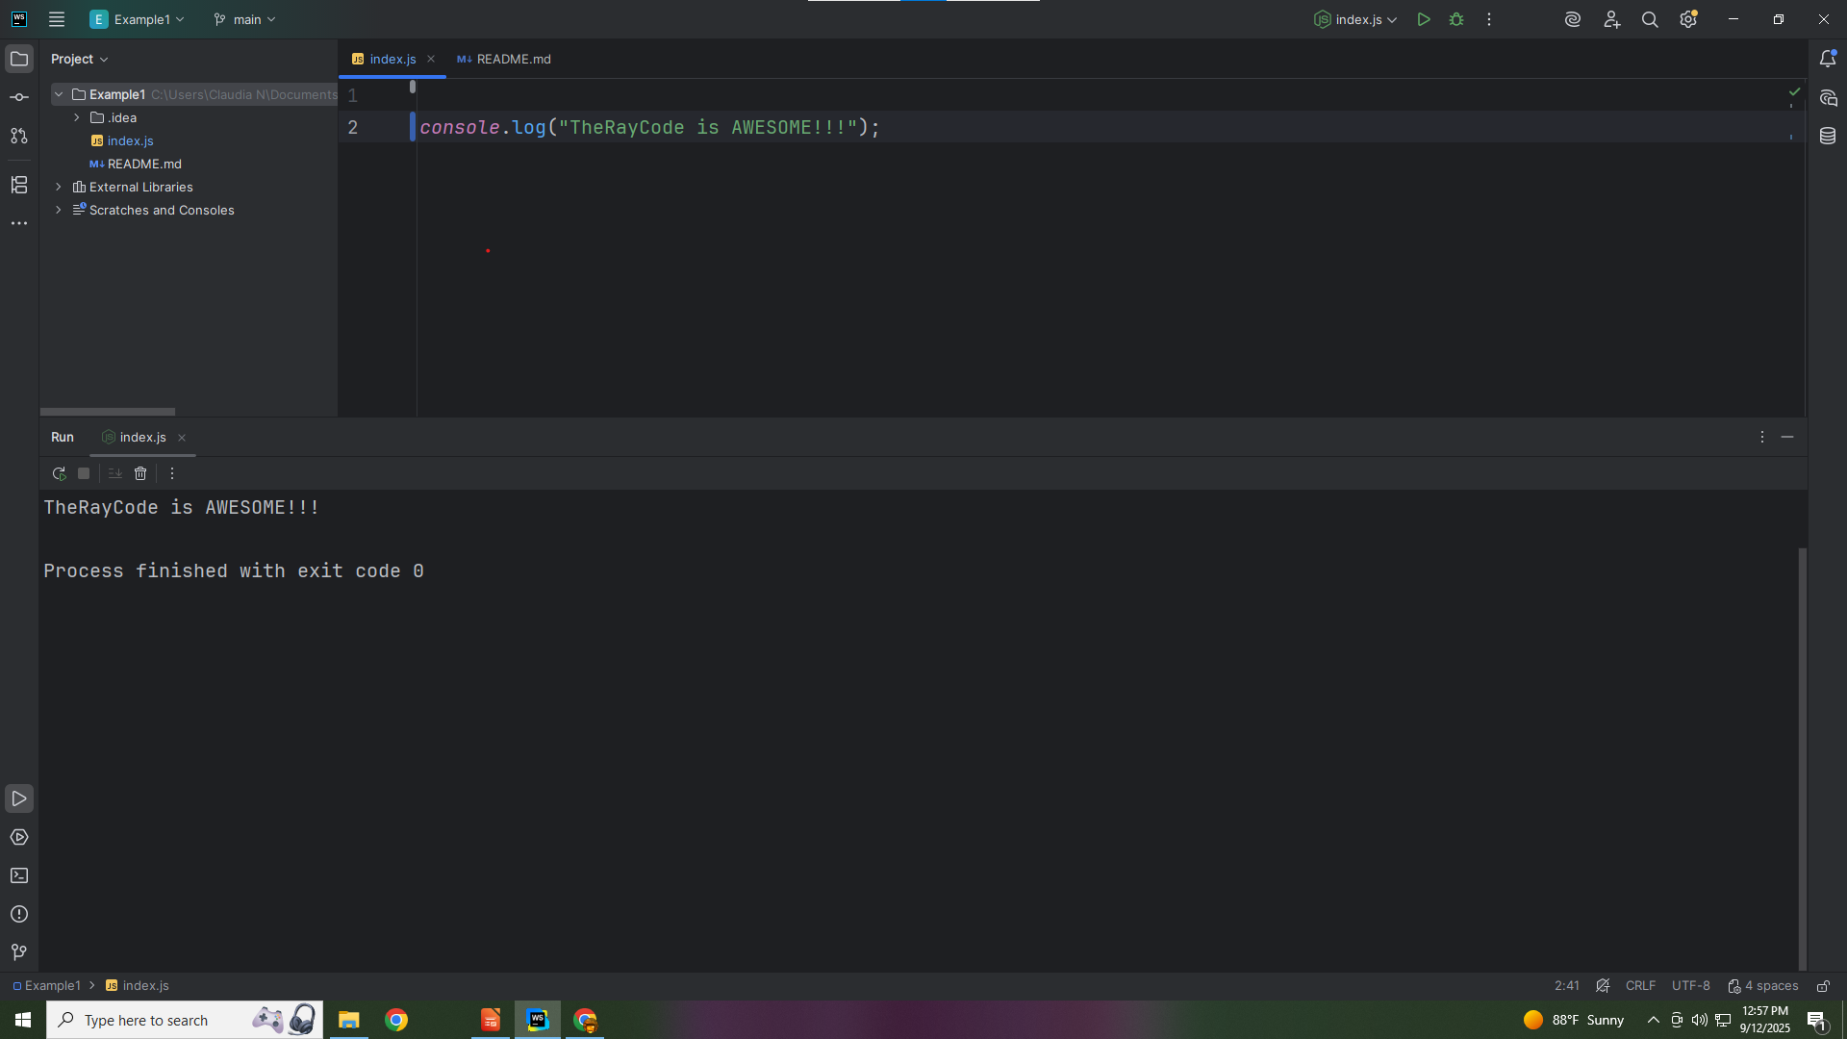
Notes:
none

Slide 2
Notes:
Hello, my name is Ray,, The Ray in TheRayCode
In this show I plan to review the Design Pattern called The Chain of Responsibility which is a Behavioral pattern..

Slide 3
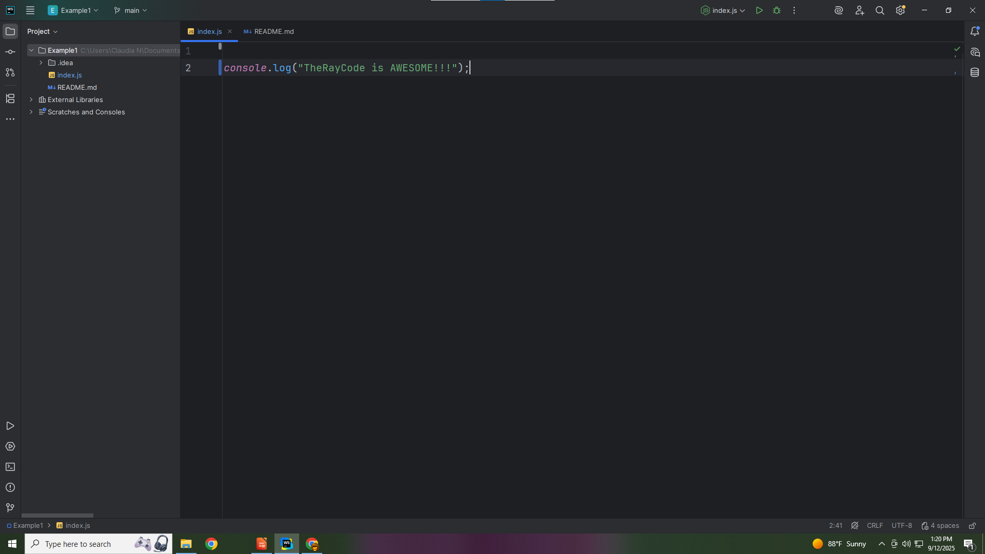
Notes:
I will be using JavaScript
The names of the Class and interface will follow the UML from the book Elements of Reusable Object-Oriented Software

Slide 4
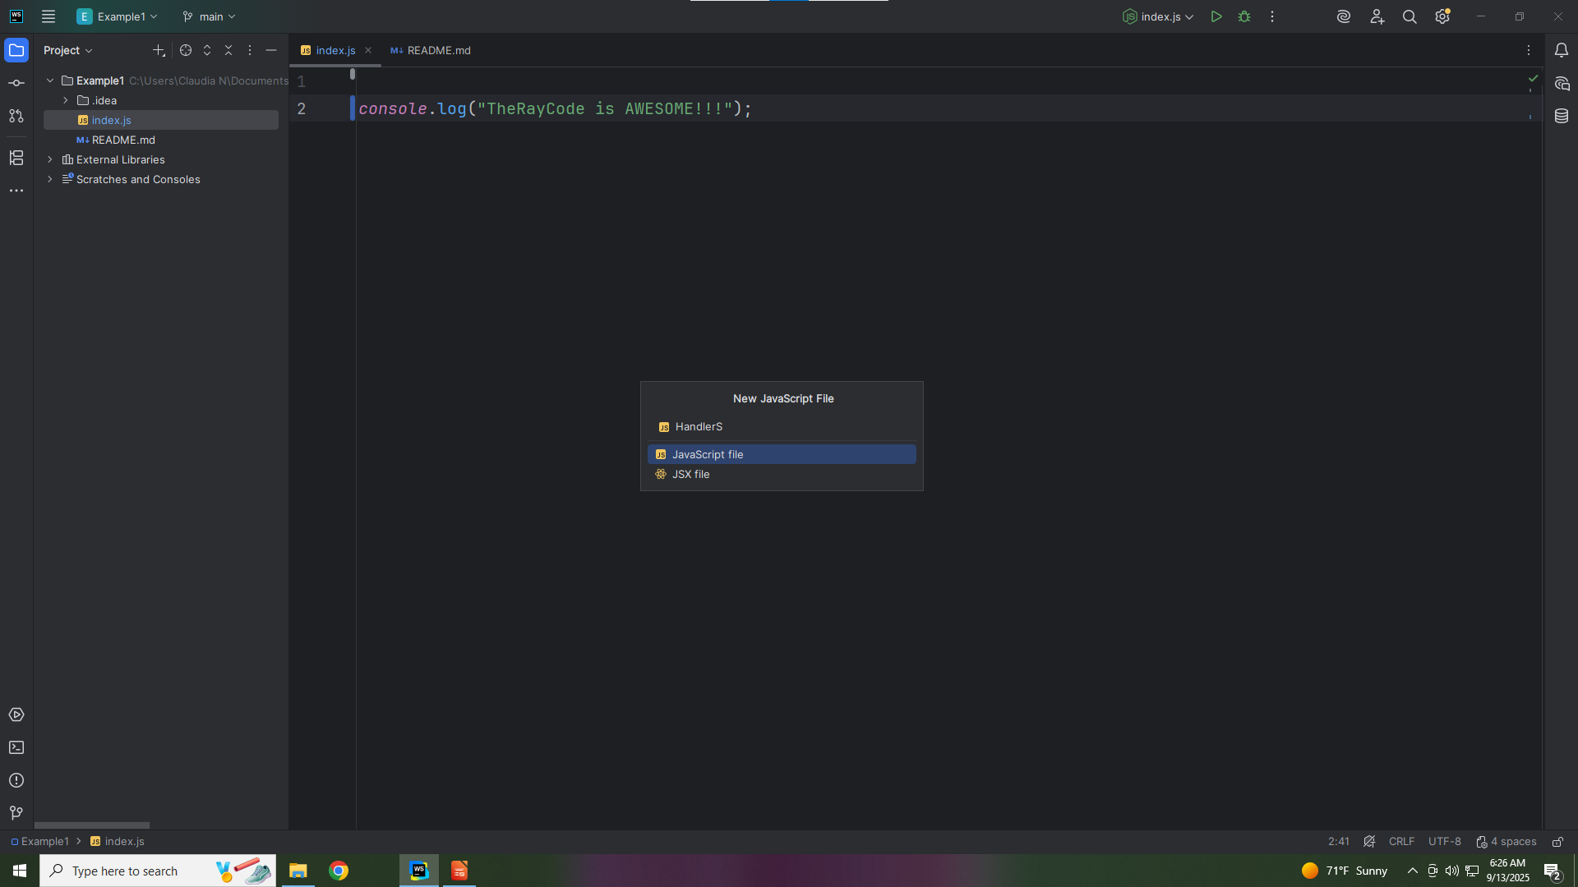
Notes:
We start with the JavaScript file we name Command

Slide 5
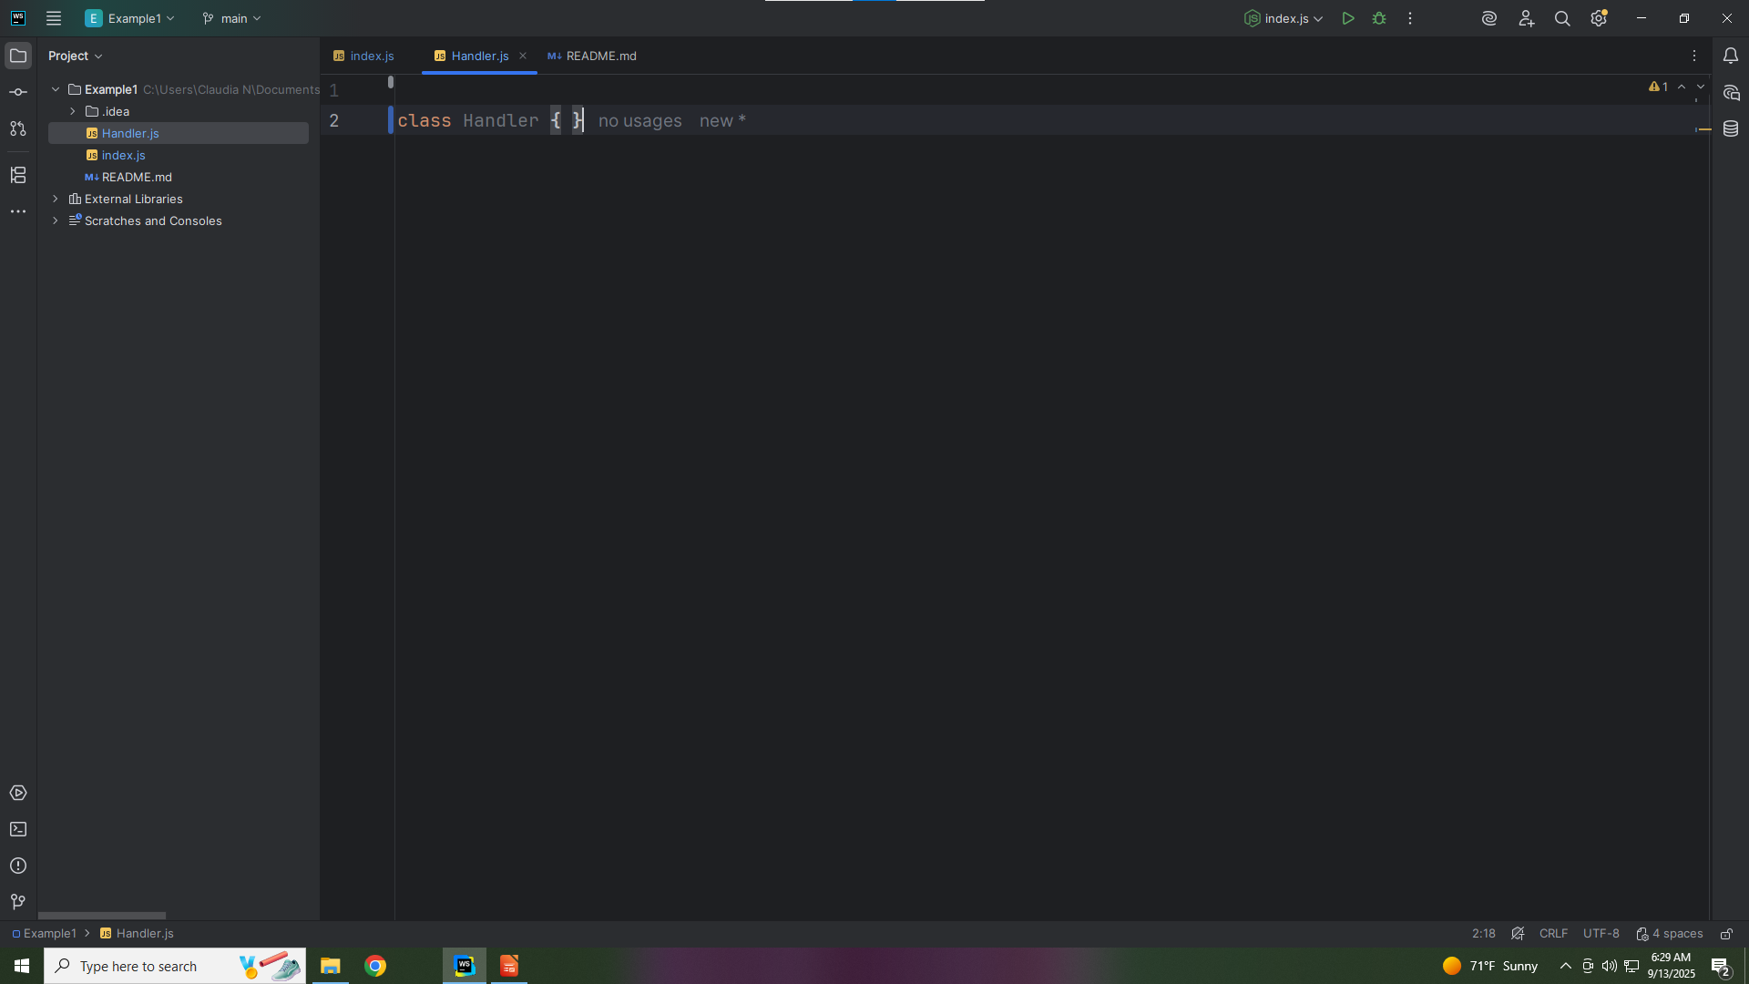
Notes:
Command is an abstract interface for all commands.
It declares the execute() method.
It allows Concrete Command classes to be used interchangeably.

Slide 6

Notes:
constructor is an abstract method meant to be overridden
We have the constructor to set the next actor in the chain we start with null
.

Slide 7
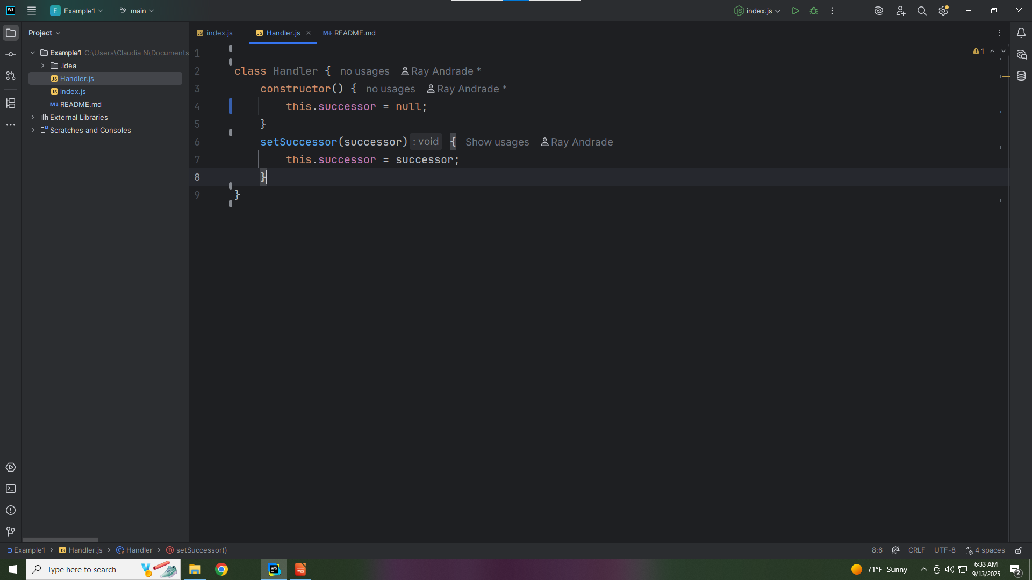
Notes:
And we set the successor

Slide 8
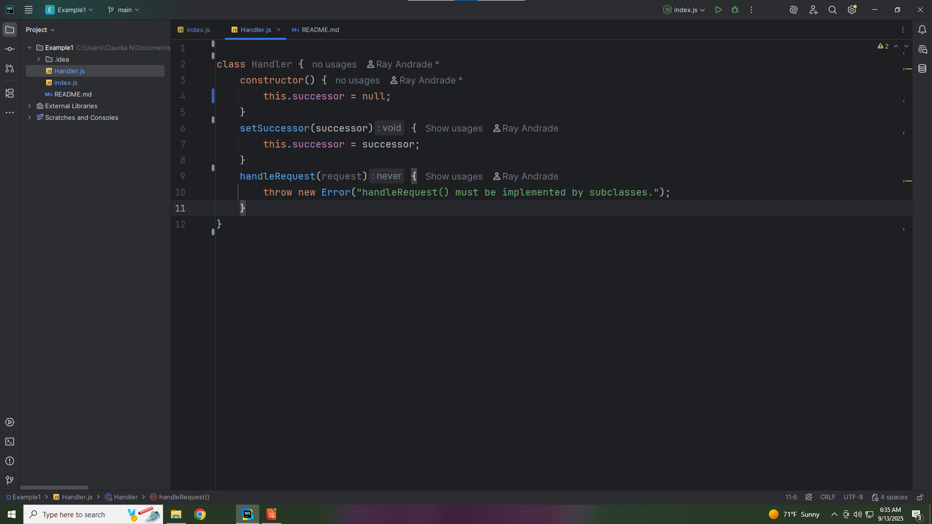
Notes:
Handle Request() must be implemented by sub classes

Slide 9

Notes:
Now let’s export this interface for use in our demo

Slide 10
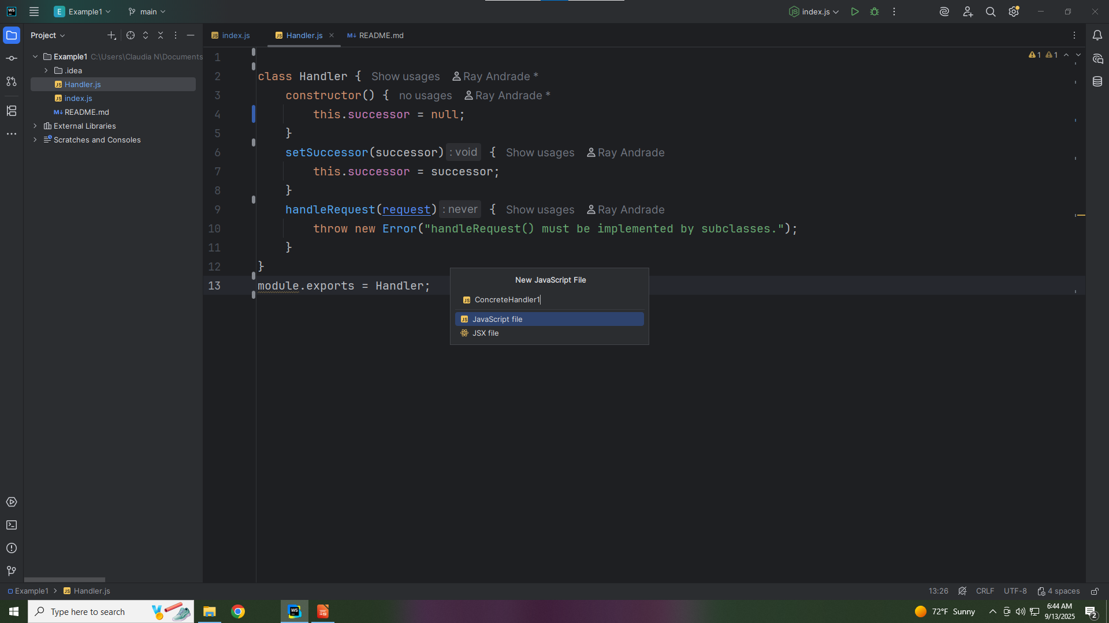
Notes:
The next file we create is called Concrete Handler One

Slide 11
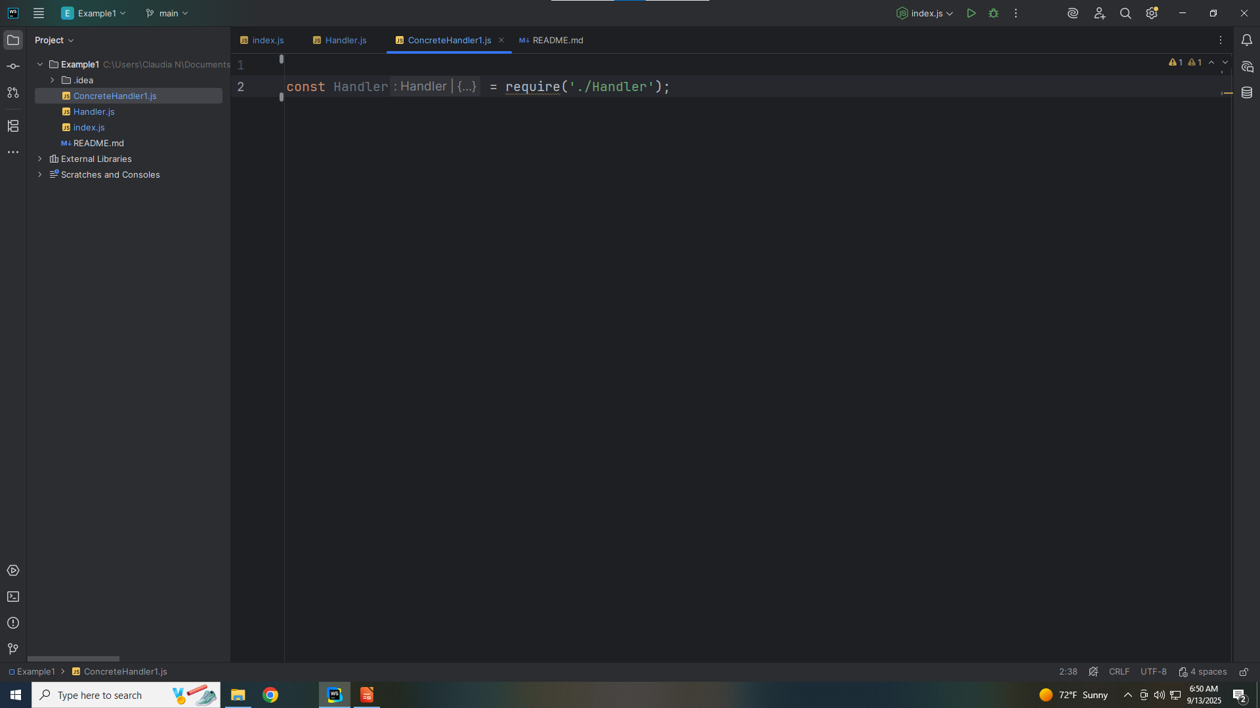
Notes:
The Purpose Concrete Handler One is to processes requests it understands; otherwise forwards to the successor

Slide 12
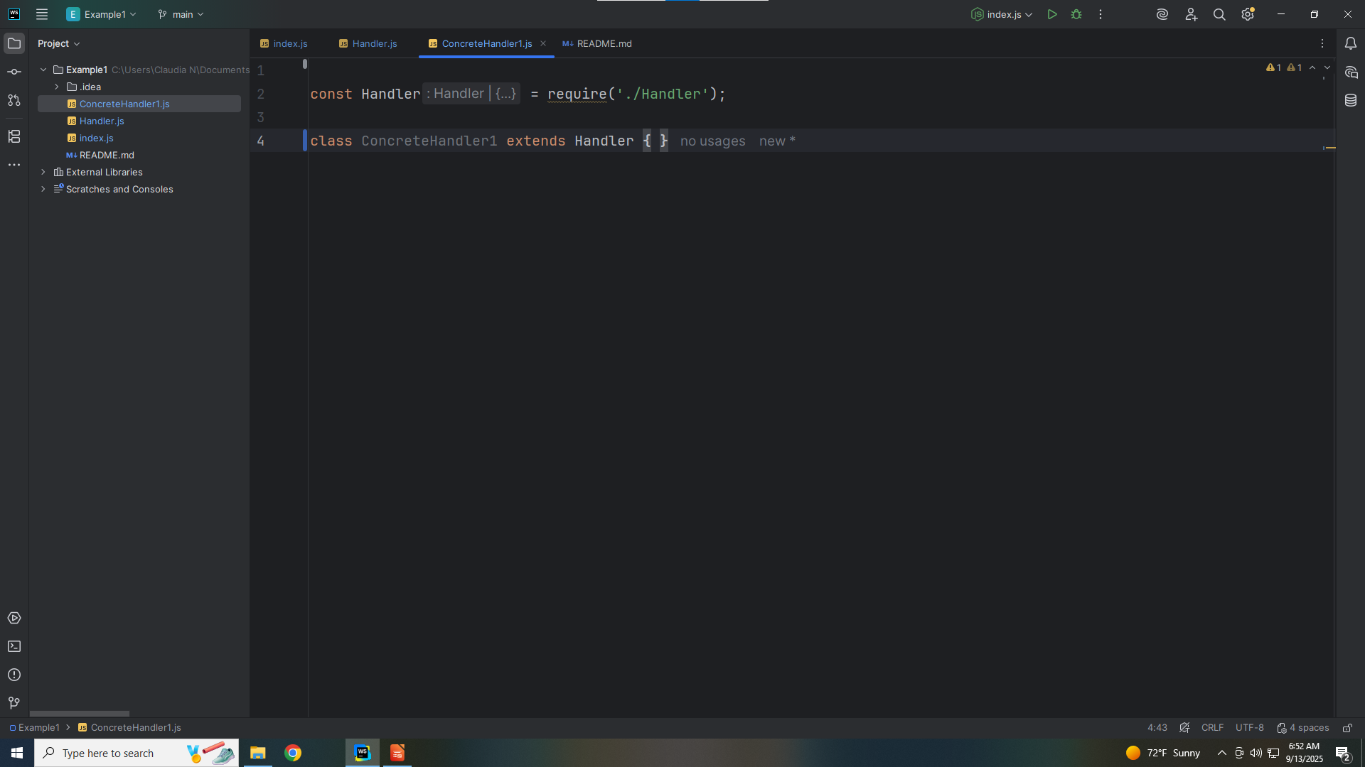
Notes:
So we extend this class with the Handler interface

Slide 13
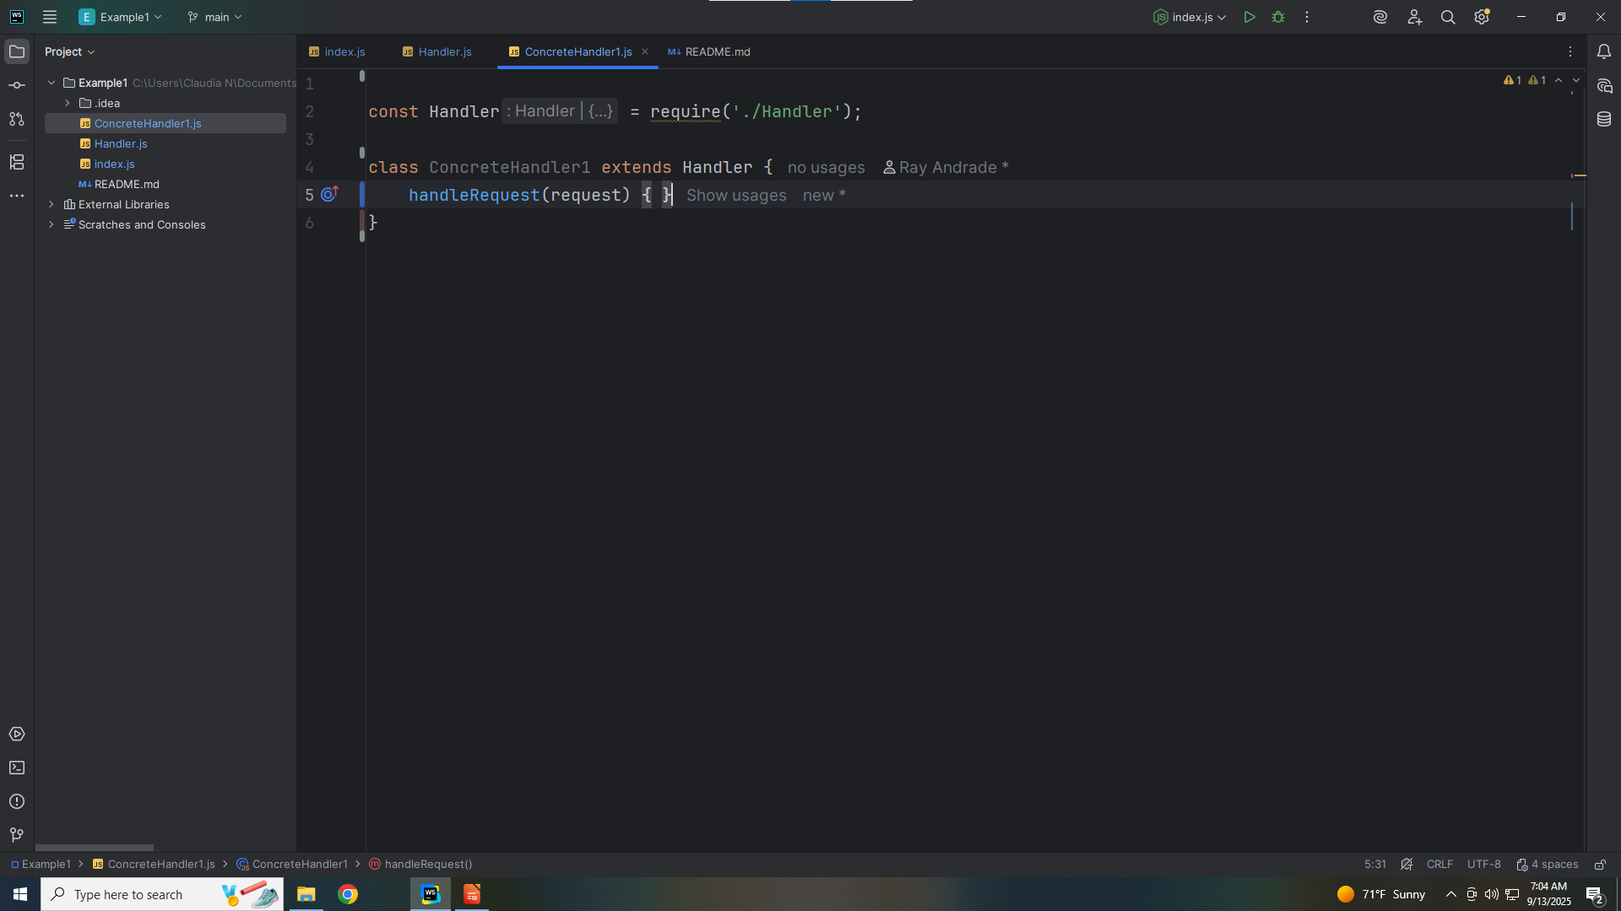
Notes:
We add the required method

Slide 14
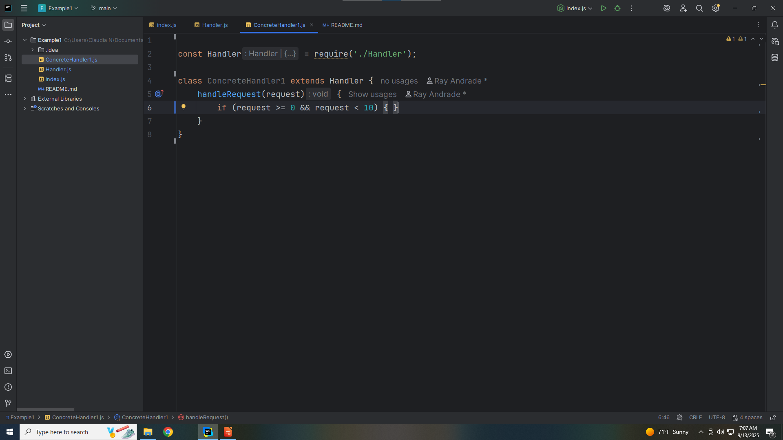
Notes:
And if our request is between zero and ten

Slide 15

Notes:
We write to the console Concrete Handler One handled the request

Slide 16
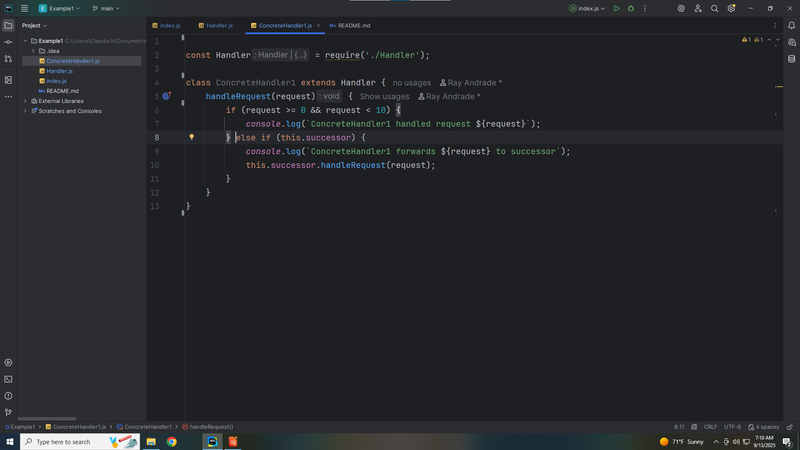
Notes:
Else we pass it along the chain

Slide 17

Notes:
Let’s export this module for use in our demo

Slide 18
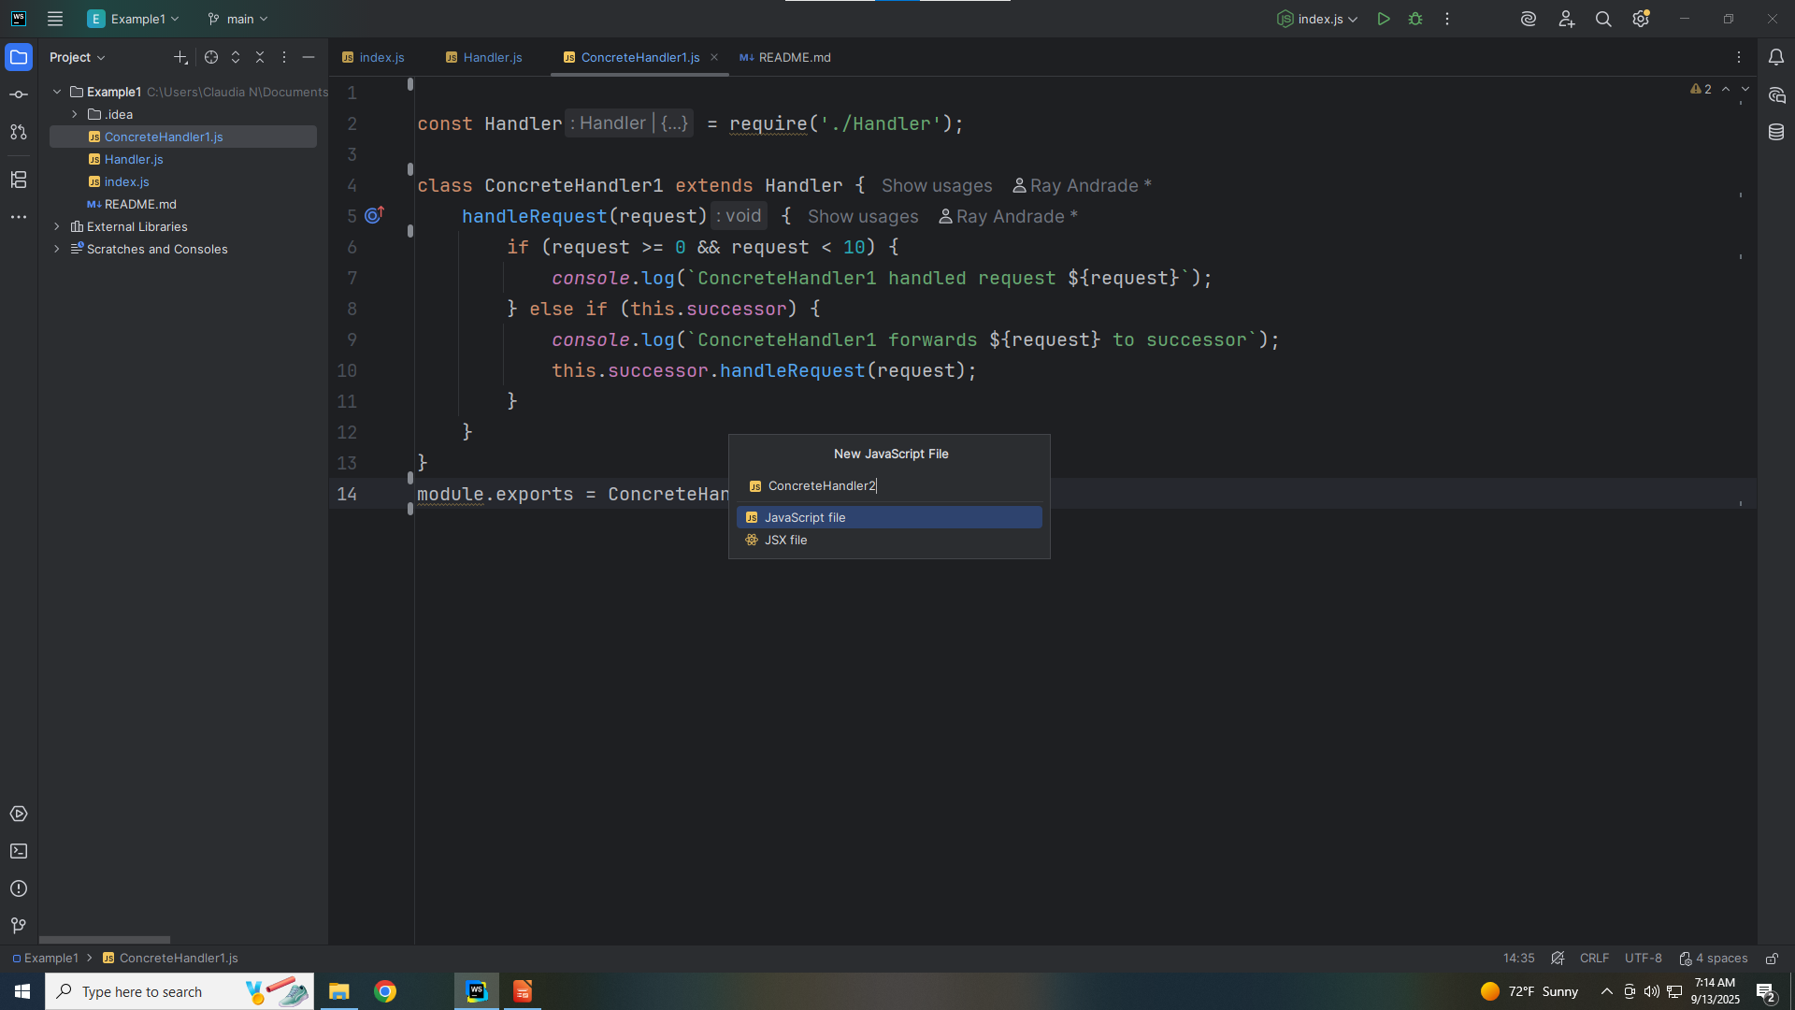
Notes:
Let’s create another class we call Concrete Handler Two

Slide 19

Notes:
Concrete Handler Two will also be extended with Handler interface and
Having done so

Slide 20

Notes:
We have to have the Handle Request method which takes a request object

Slide 21

Notes:
If the request object is between Ten and Twenty including Ten we handled the request

Slide 22

Notes:
Else we pass it to the next

Slide 23
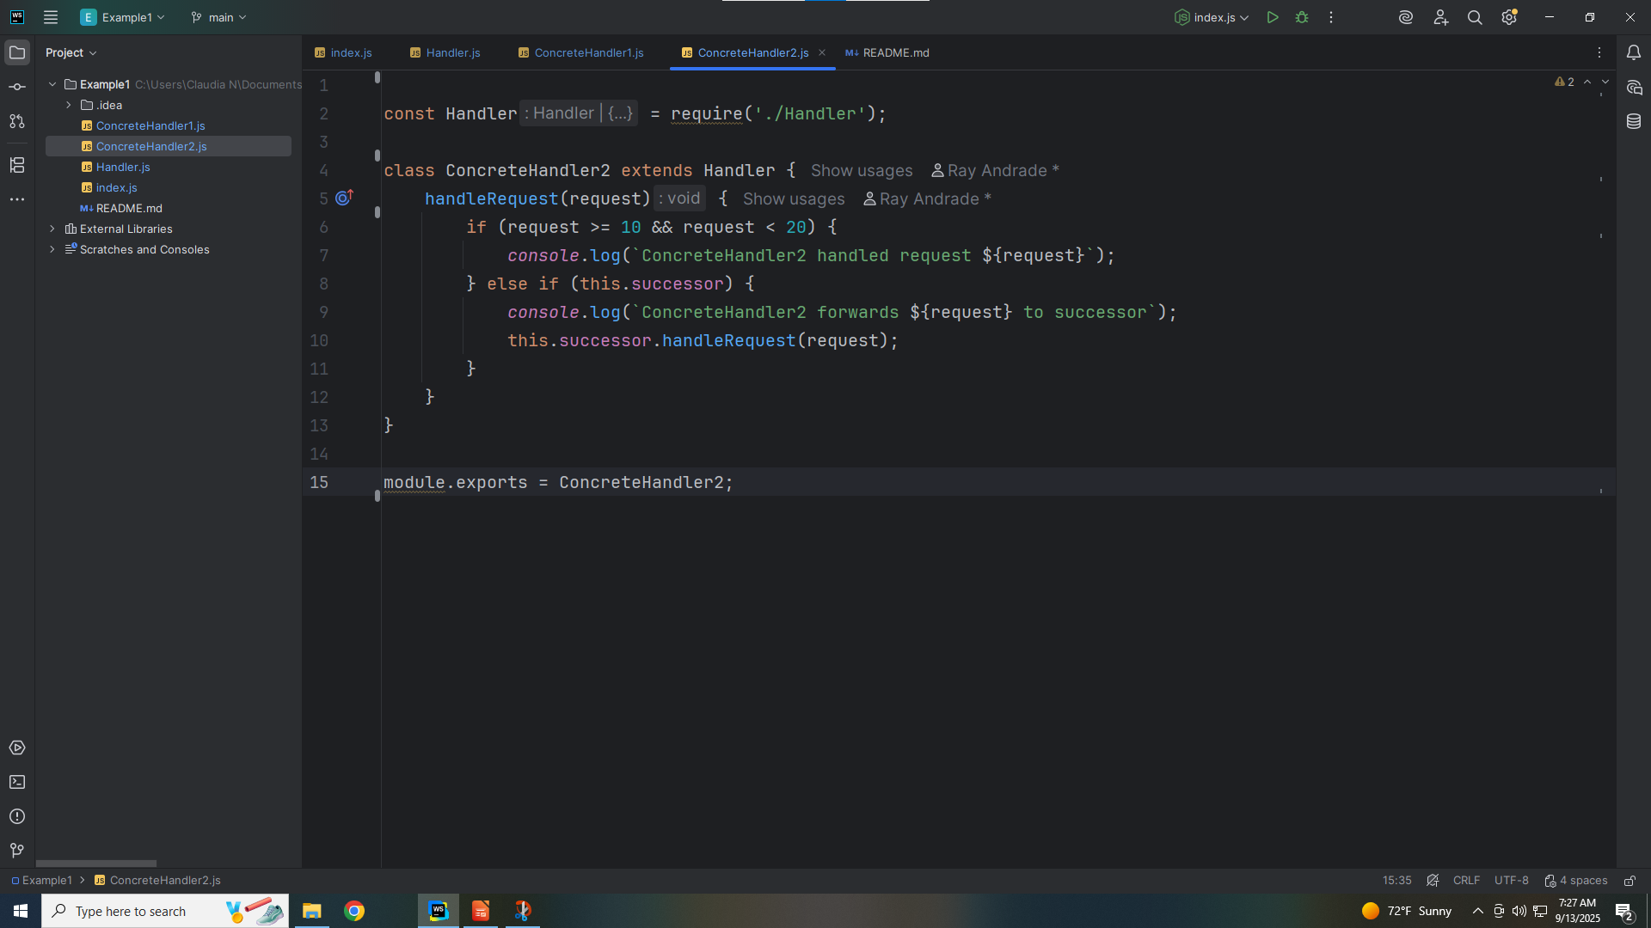
Notes:
We export this module for use in our demo

Slide 24
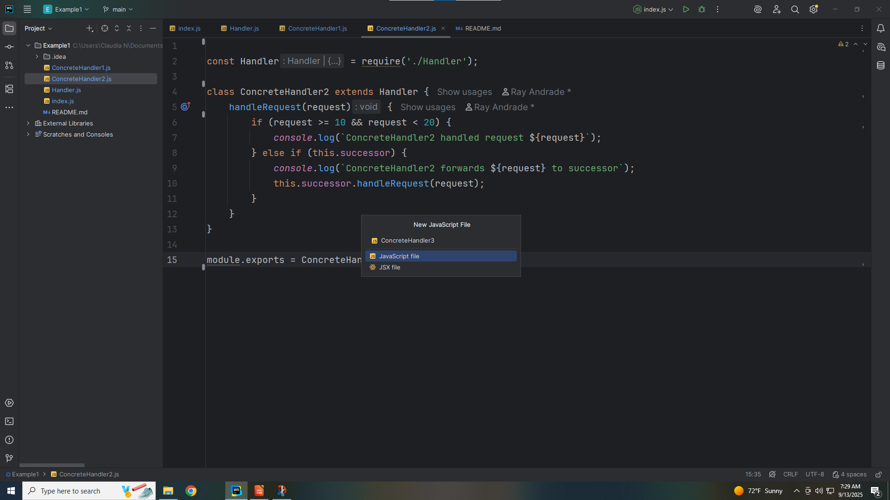
Notes:
Let’s create one me Concrete Handler we call Concrete Handler Three

Slide 25
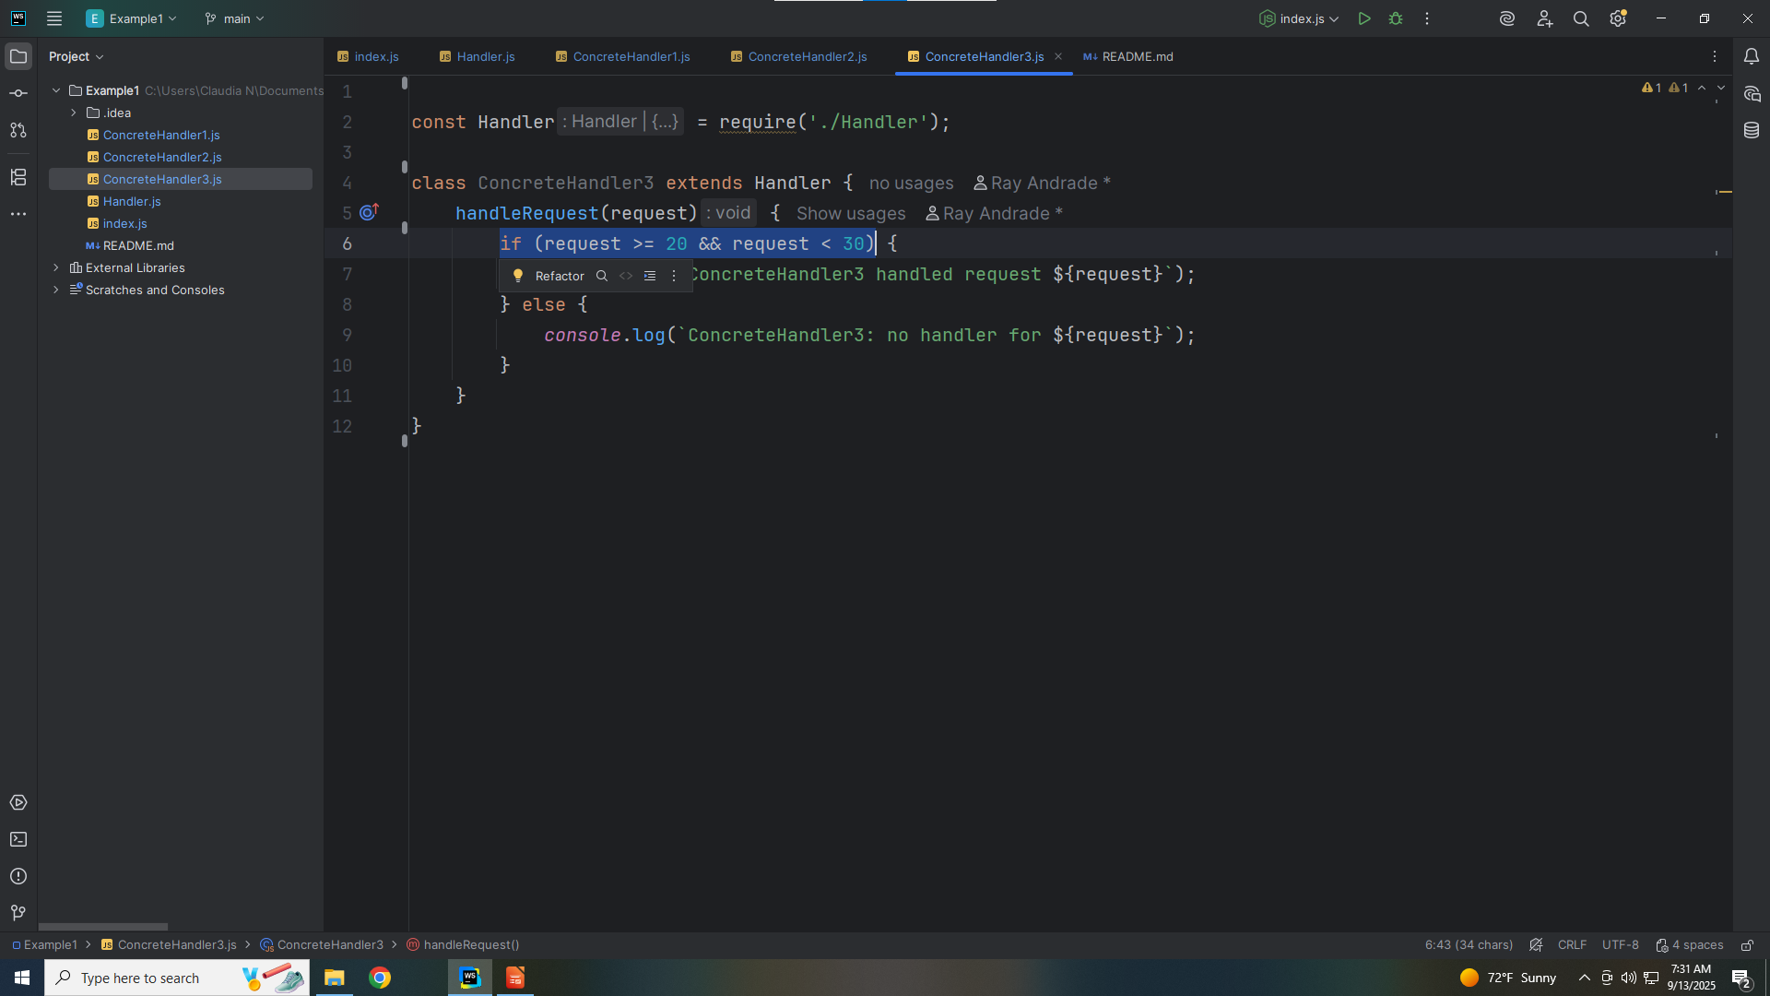
Notes:
Concrete Handler will look like the other Handlers but in this case it will handle Request between 20 and 30 including 20
Else it passes to the next class in the chain

Slide 26
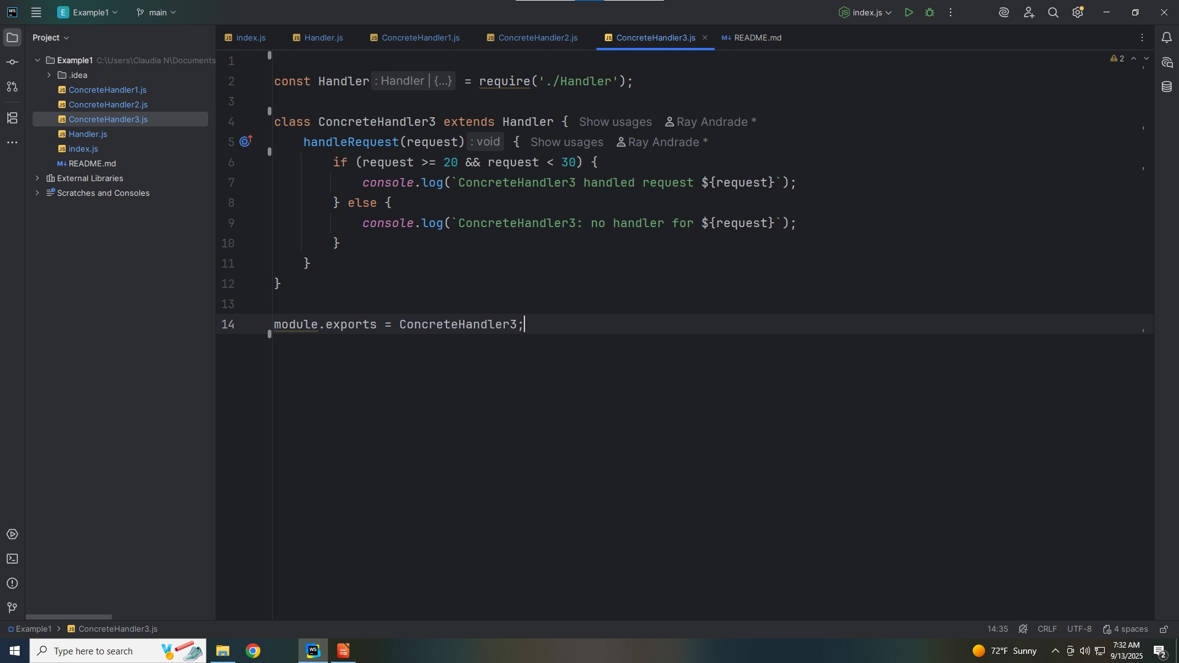
Notes:
We export this module for use in our Demo

Slide 27
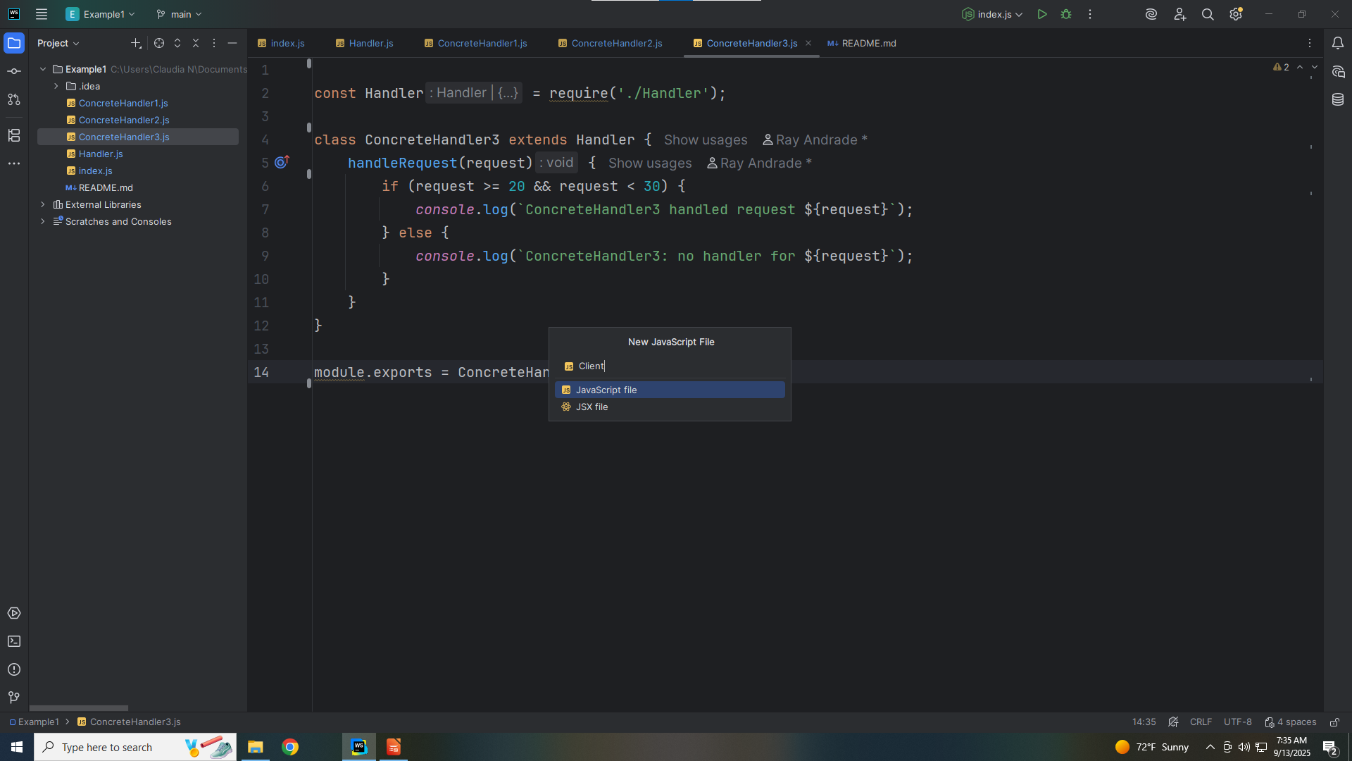
Notes:
Let’s create another class called Client

Slide 28
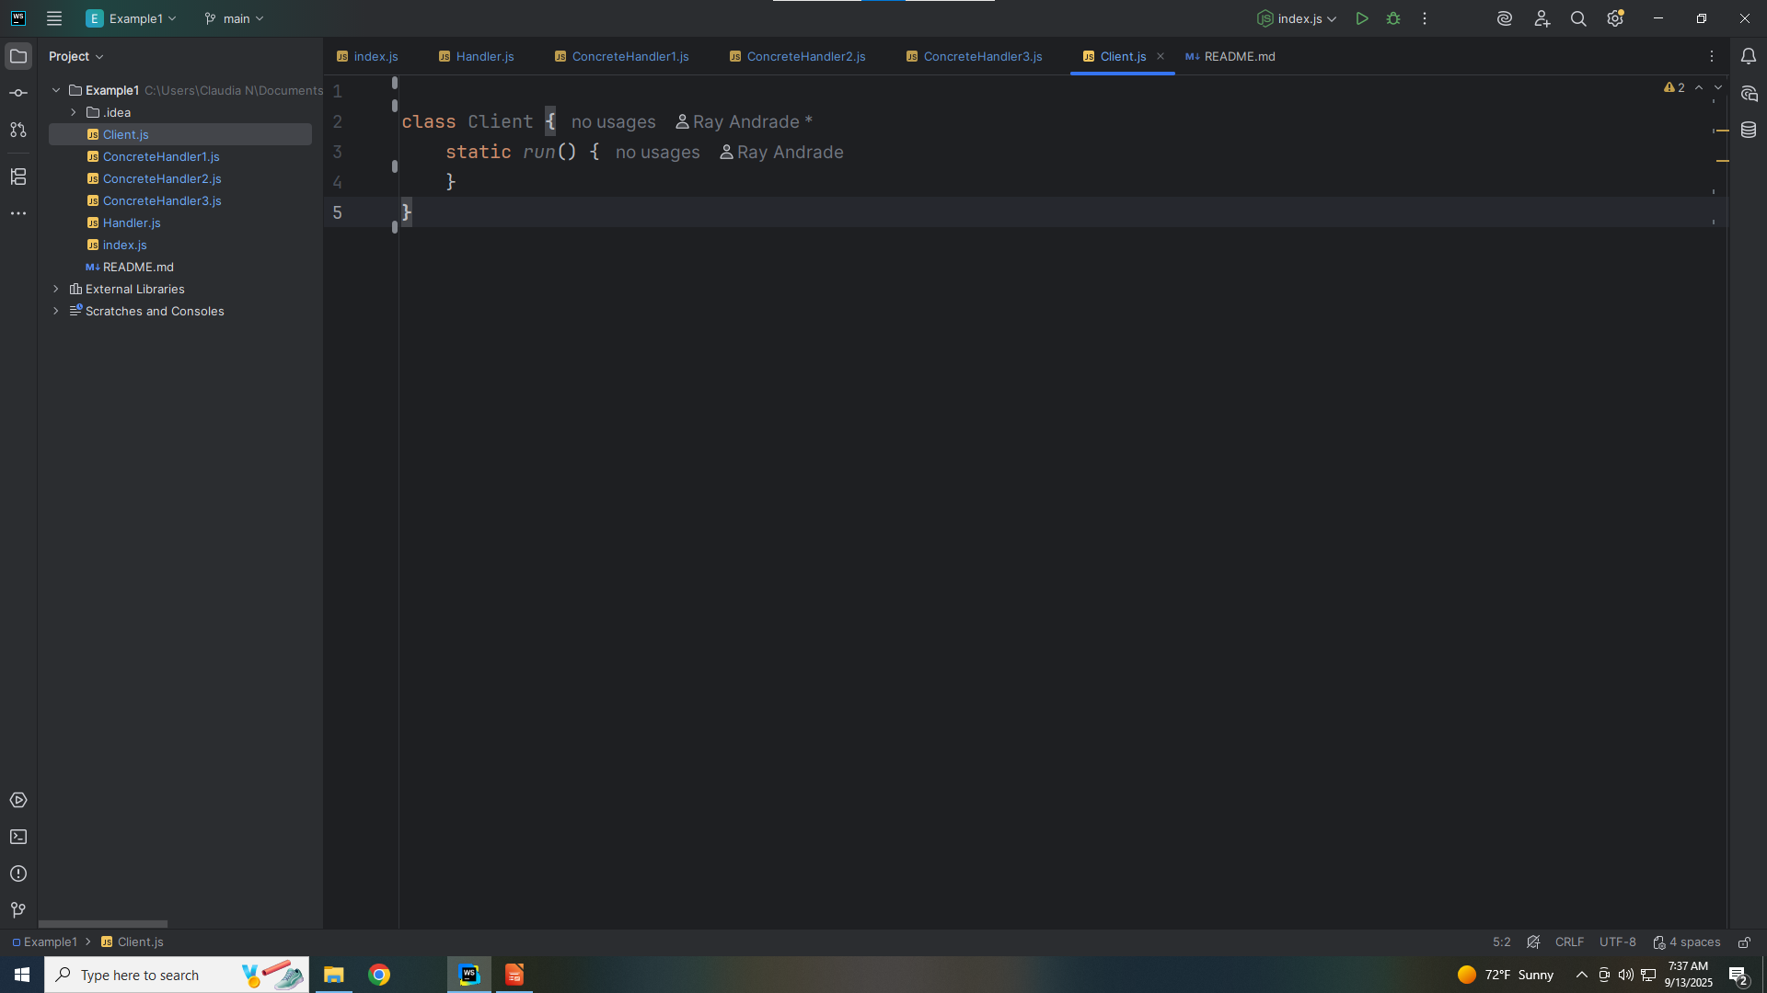
Notes:
The Purpose of Client is that it Configures the chain of handlers and initiates requests.

Slide 29
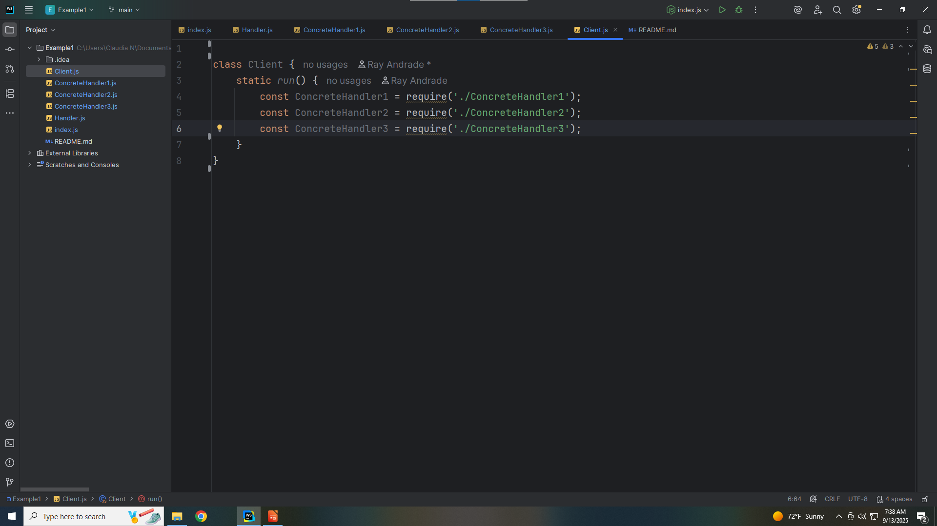
Notes:
We declare const Concrete Handler 1 2 & 3 by requiring the Concrete Handlers 1 2 & 3

Slide 30
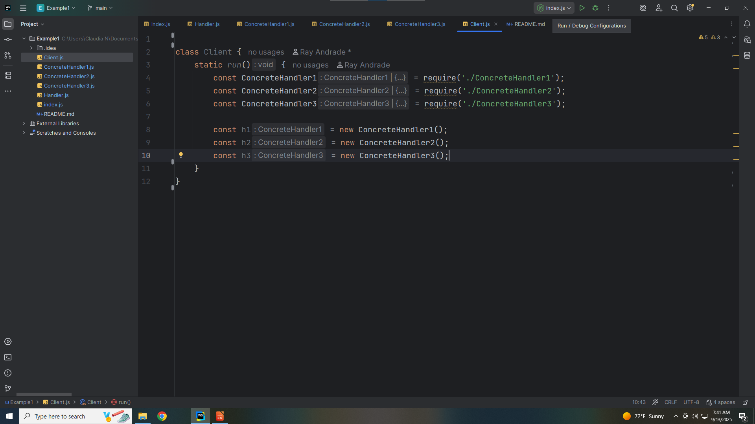
Notes:
We set H one, Two and Three as Concrete Handlers One, two and Three

Slide 31
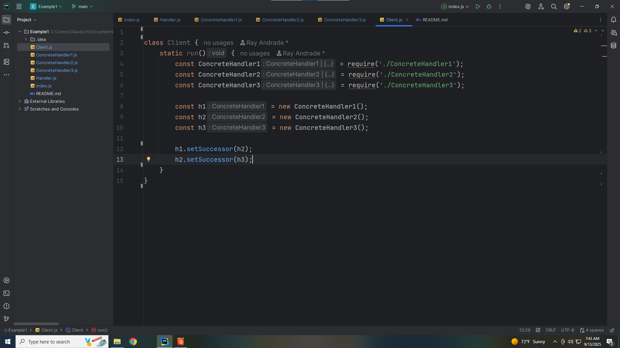
Notes:
We chain the handlers. We chain h1 to h2 and the Successor of h3 is h2

Slide 32
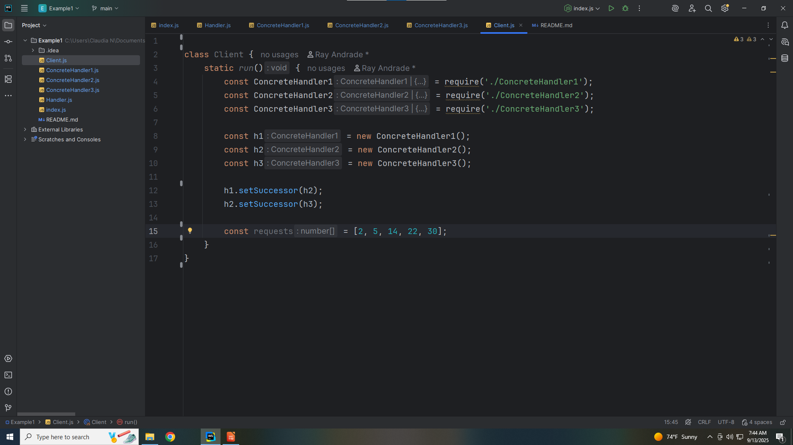
Notes:
We create an array of numbers to run our demo

Slide 33
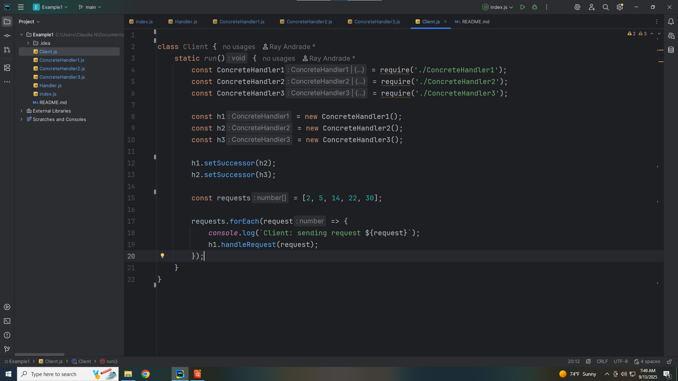
Notes:
For each request we write a response to the console

Slide 34

Notes:
So let’s export this class for our demo

Slide 35
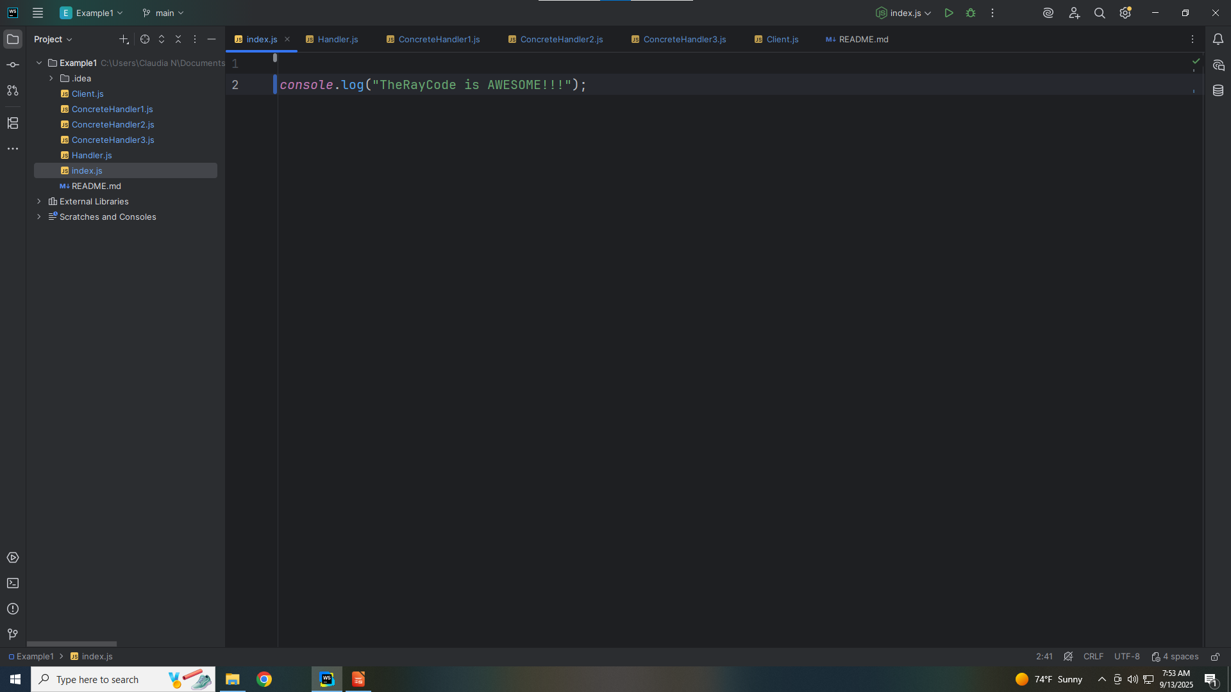
Notes:
No let’s go to the index

Slide 36
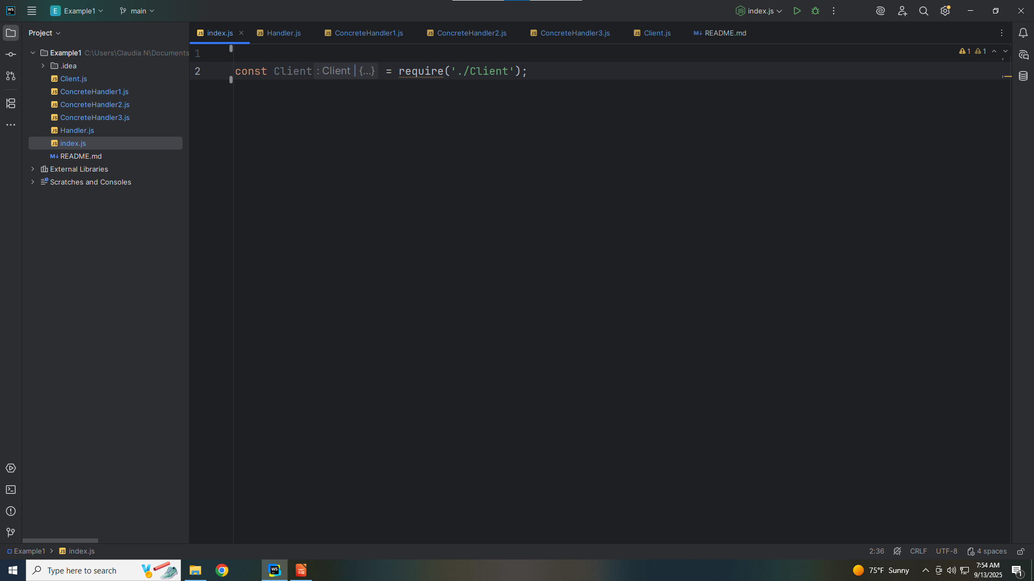
Notes:
We require the client

Slide 37
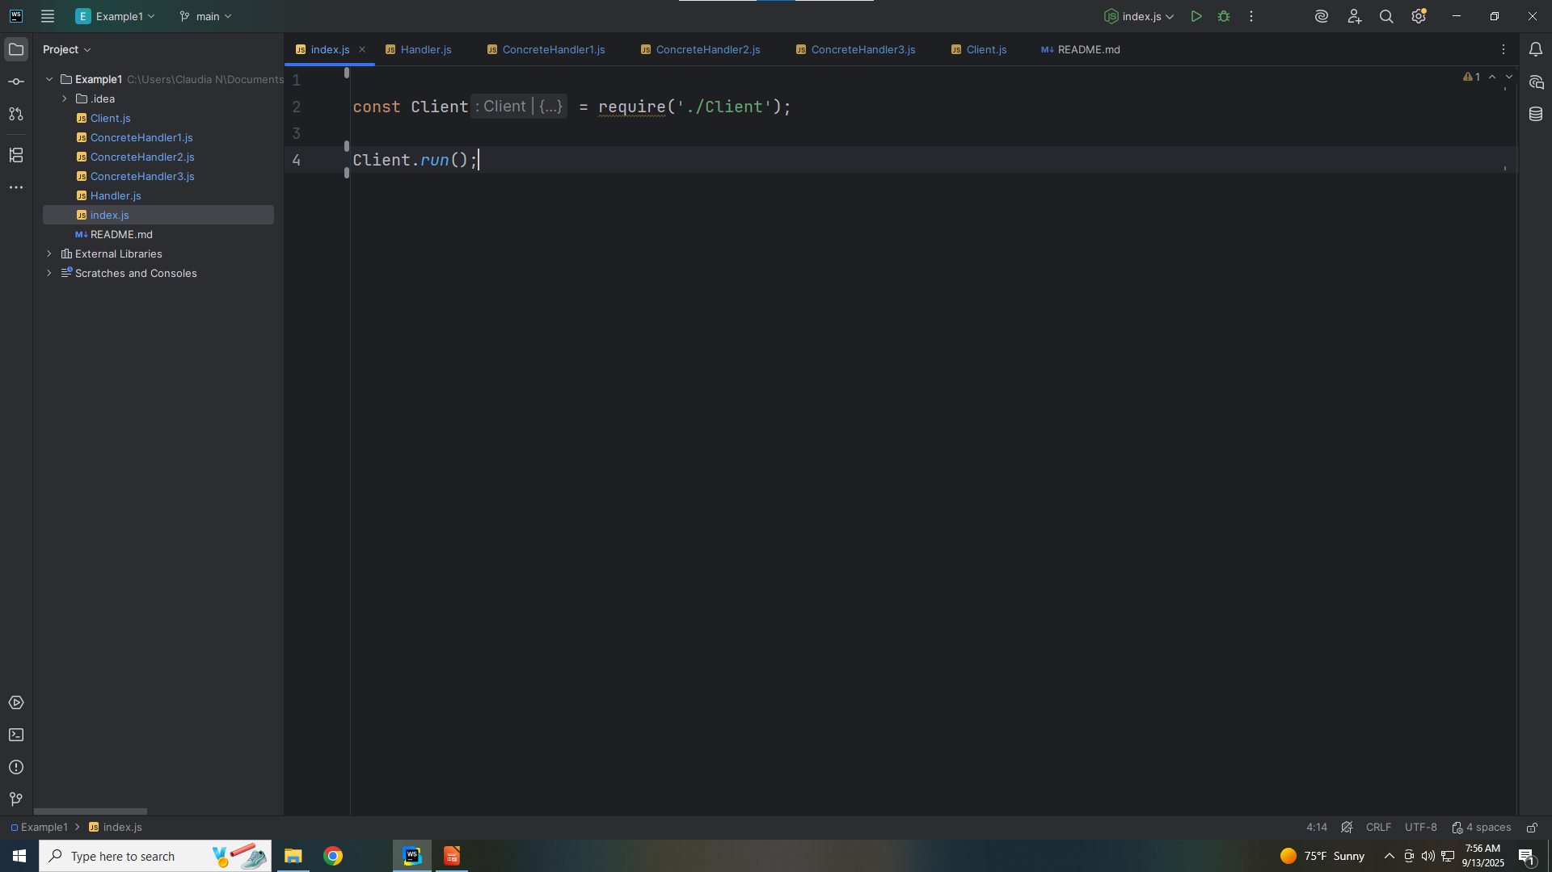
Notes:
With the client we execute the run method and we get

Slide 38
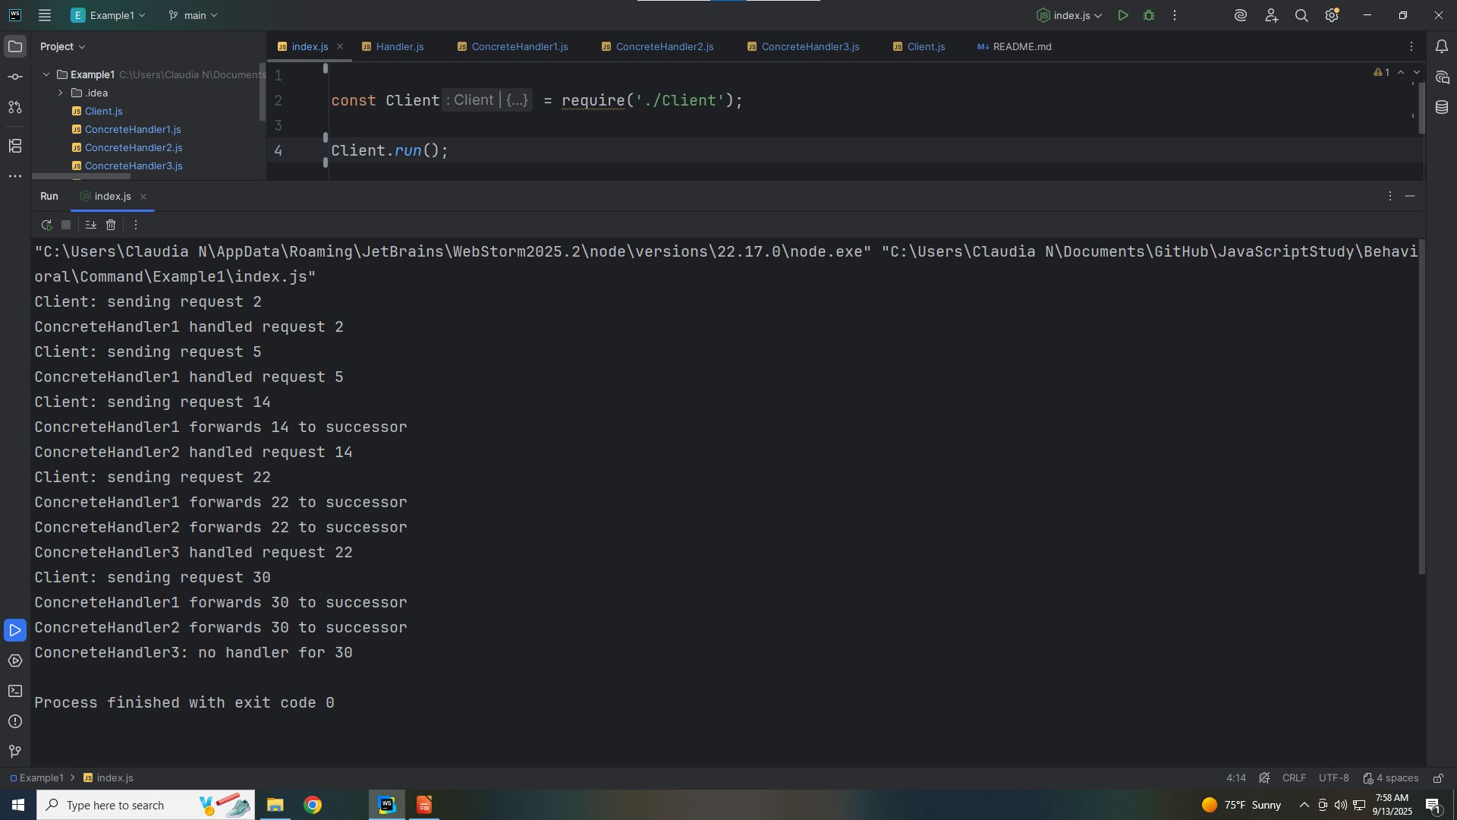
Notes:
Client: sending request 2
ConcreteHandler1 handled request 2
Client: sending request 5
ConcreteHandler1 handled request 5
Client: sending request 14
ConcreteHandler1 forwards 14 to successor
ConcreteHandler2 handled request 14
Client: sending request 22
ConcreteHandler1 forwards 22 to successor
ConcreteHandler2 forwards 22 to successor
ConcreteHandler3 handled request 22
Client: sending request 30
ConcreteHandler1 forwards 30 to successor
ConcreteHandler2 forwards 30 to successor
ConcreteHandler3: no handler for 30
My name is Ray always code with a smile

