Slide 1
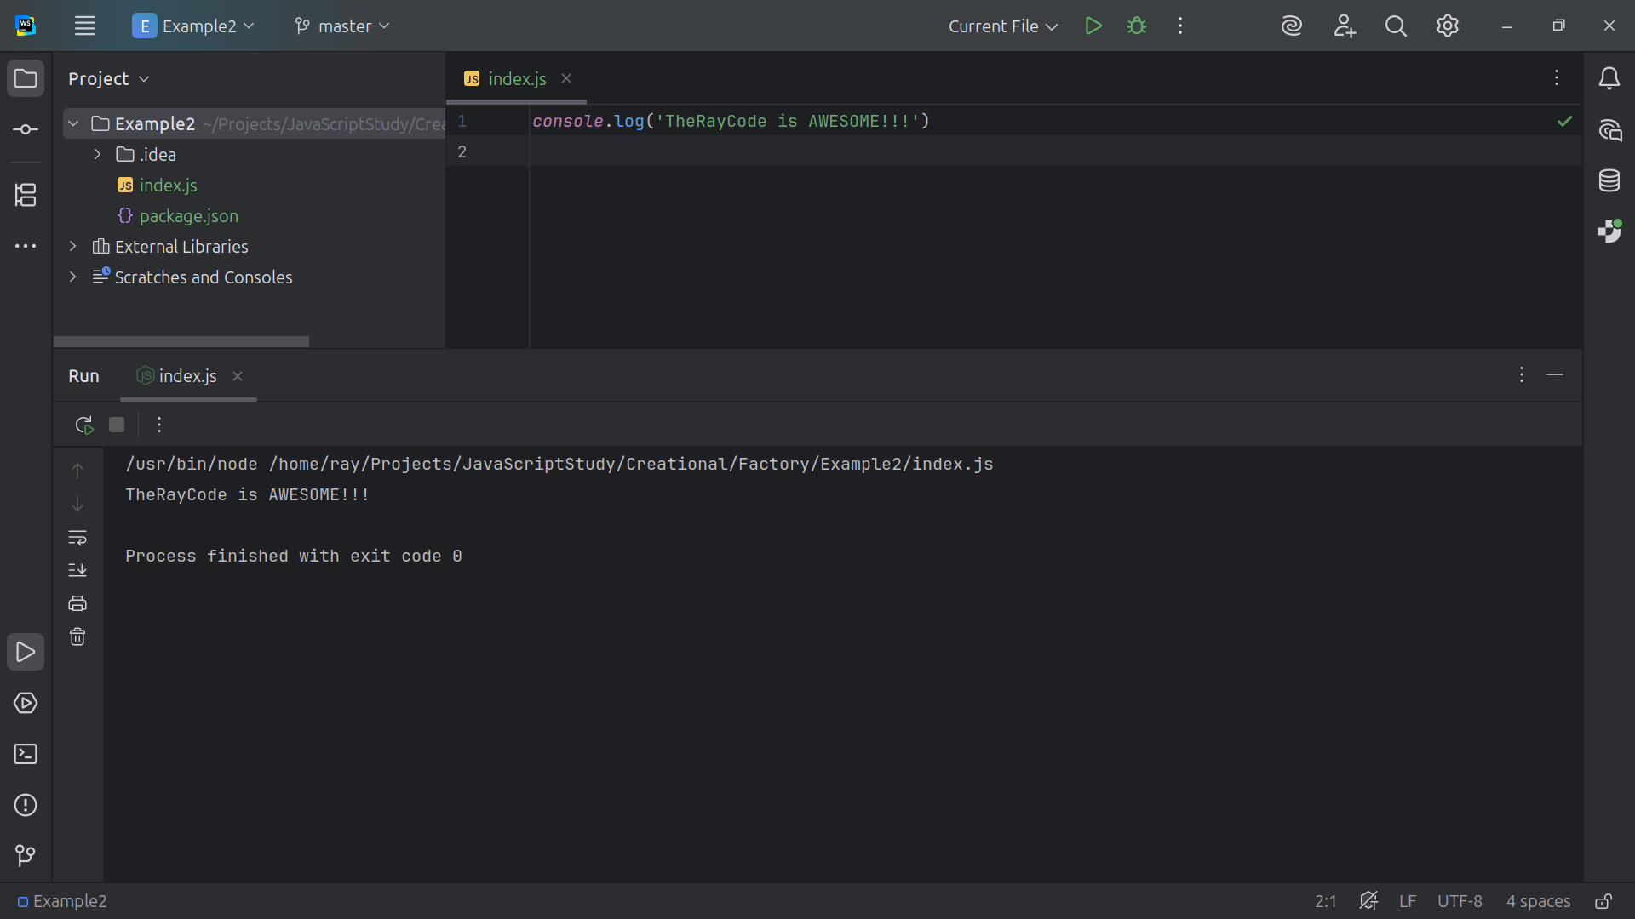
Notes:
Hello, I’m Ray of TheRayCode

Slide 2
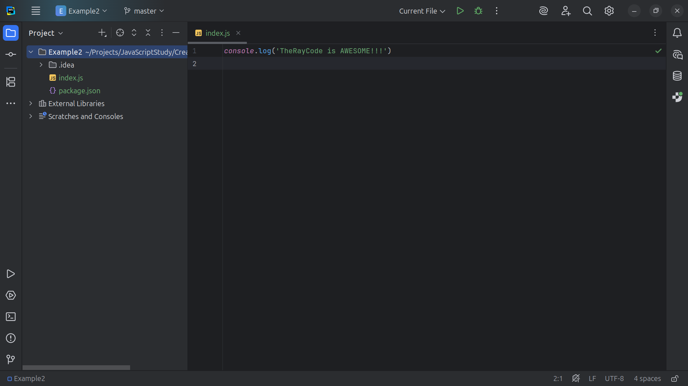
Notes:
Today I will give you an example of the Design Pattern called Factory and I will using JavaScript

Slide 3
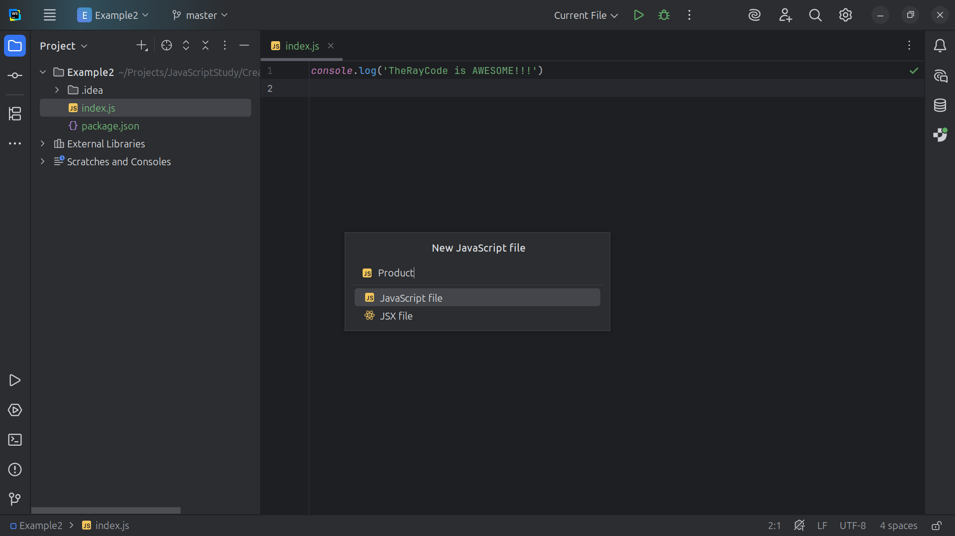
Notes:
We start off with a JavaScript file called Product

Slide 4
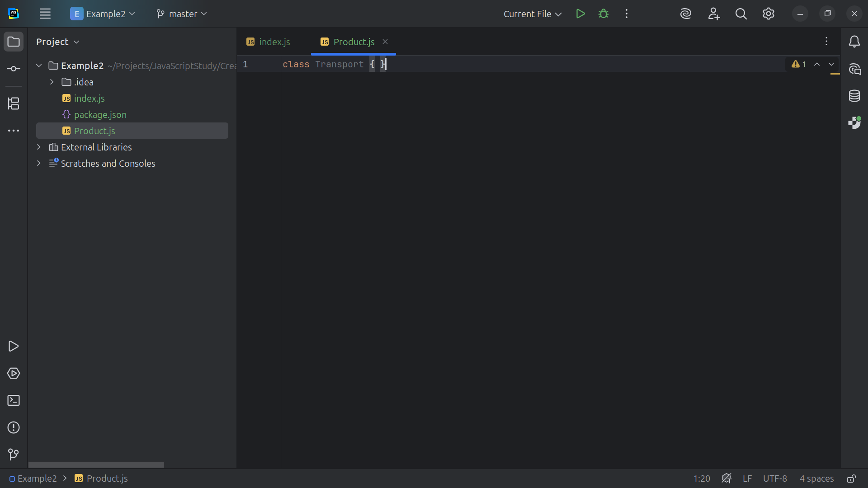
Notes:
We call this class Transport .. This is a Concrete Product.

Slide 5
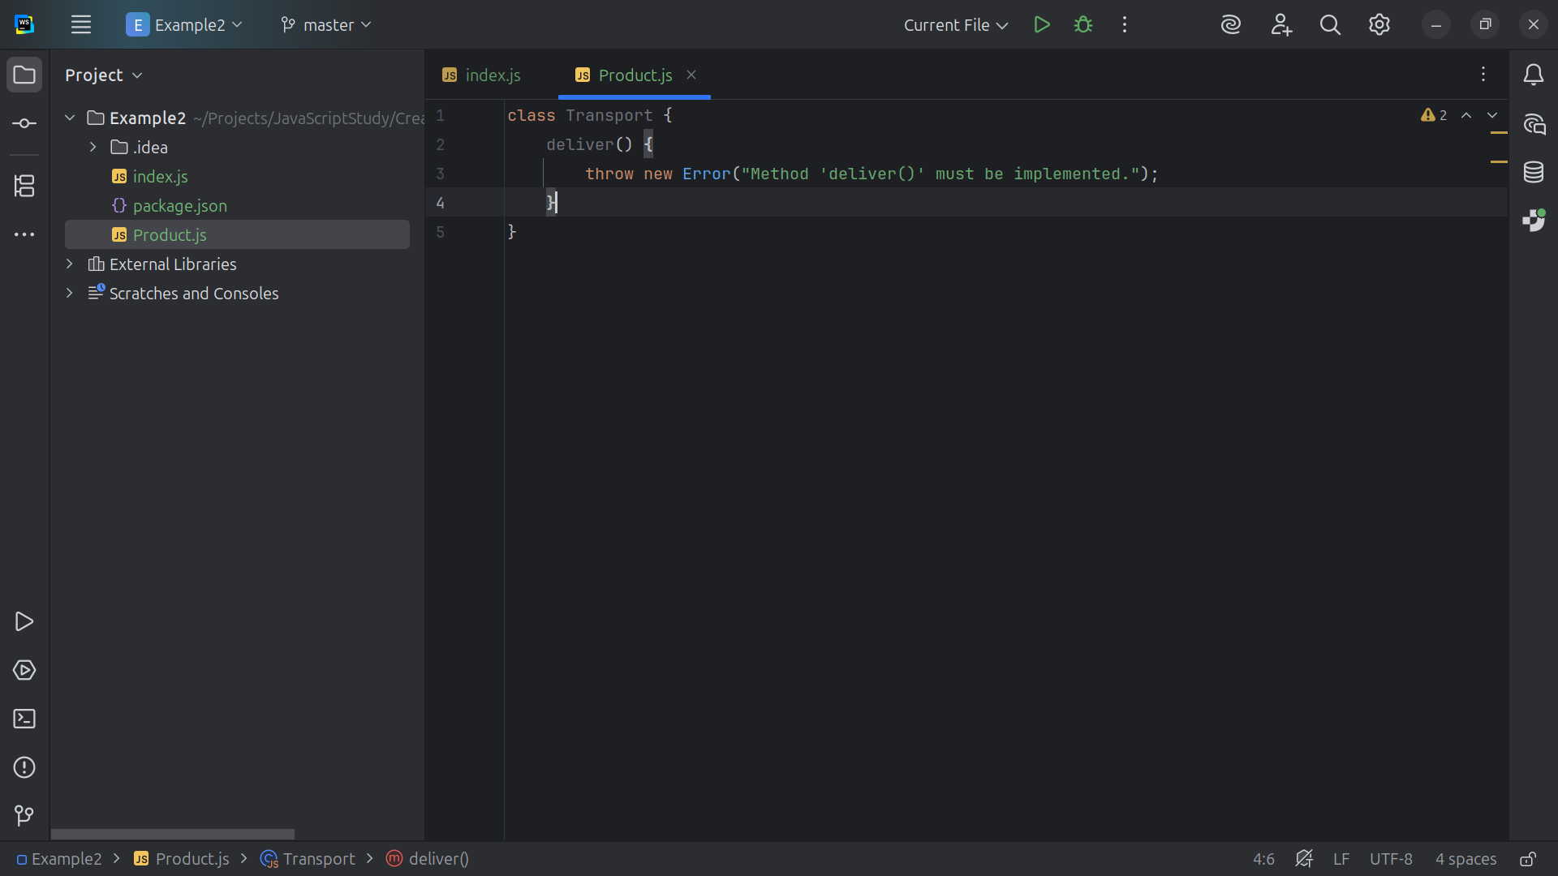
Notes:
It implements the deliver() method with truck-specific behavior.

Slide 6
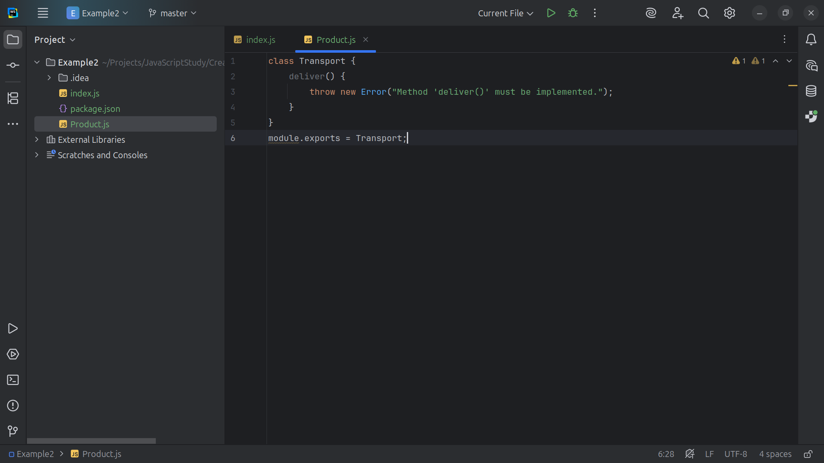
Notes:
. . . and we export Ship for use in our demo

Slide 7
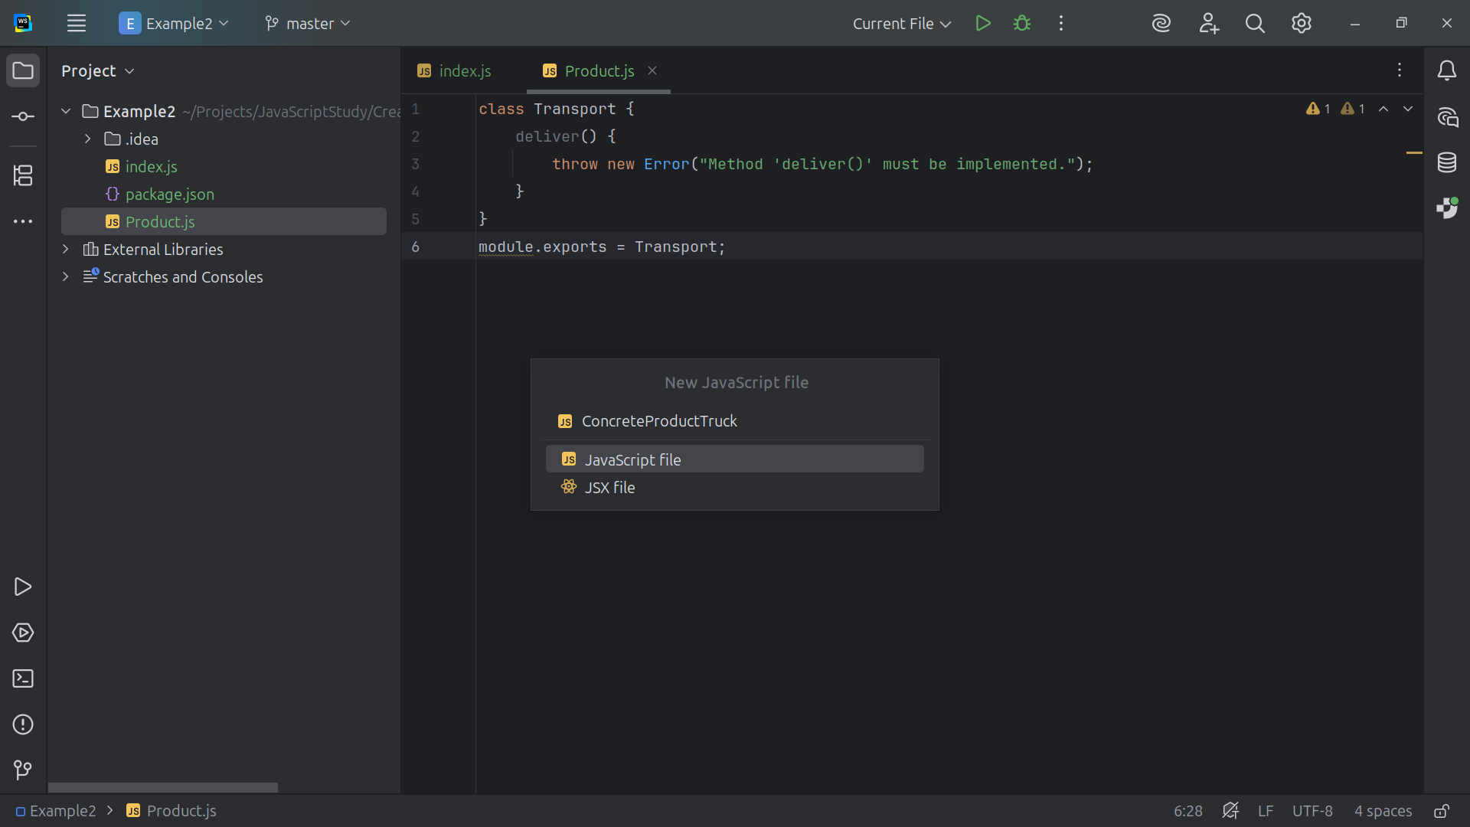
Notes:
Next we create the Concrete Product Truck

Slide 8
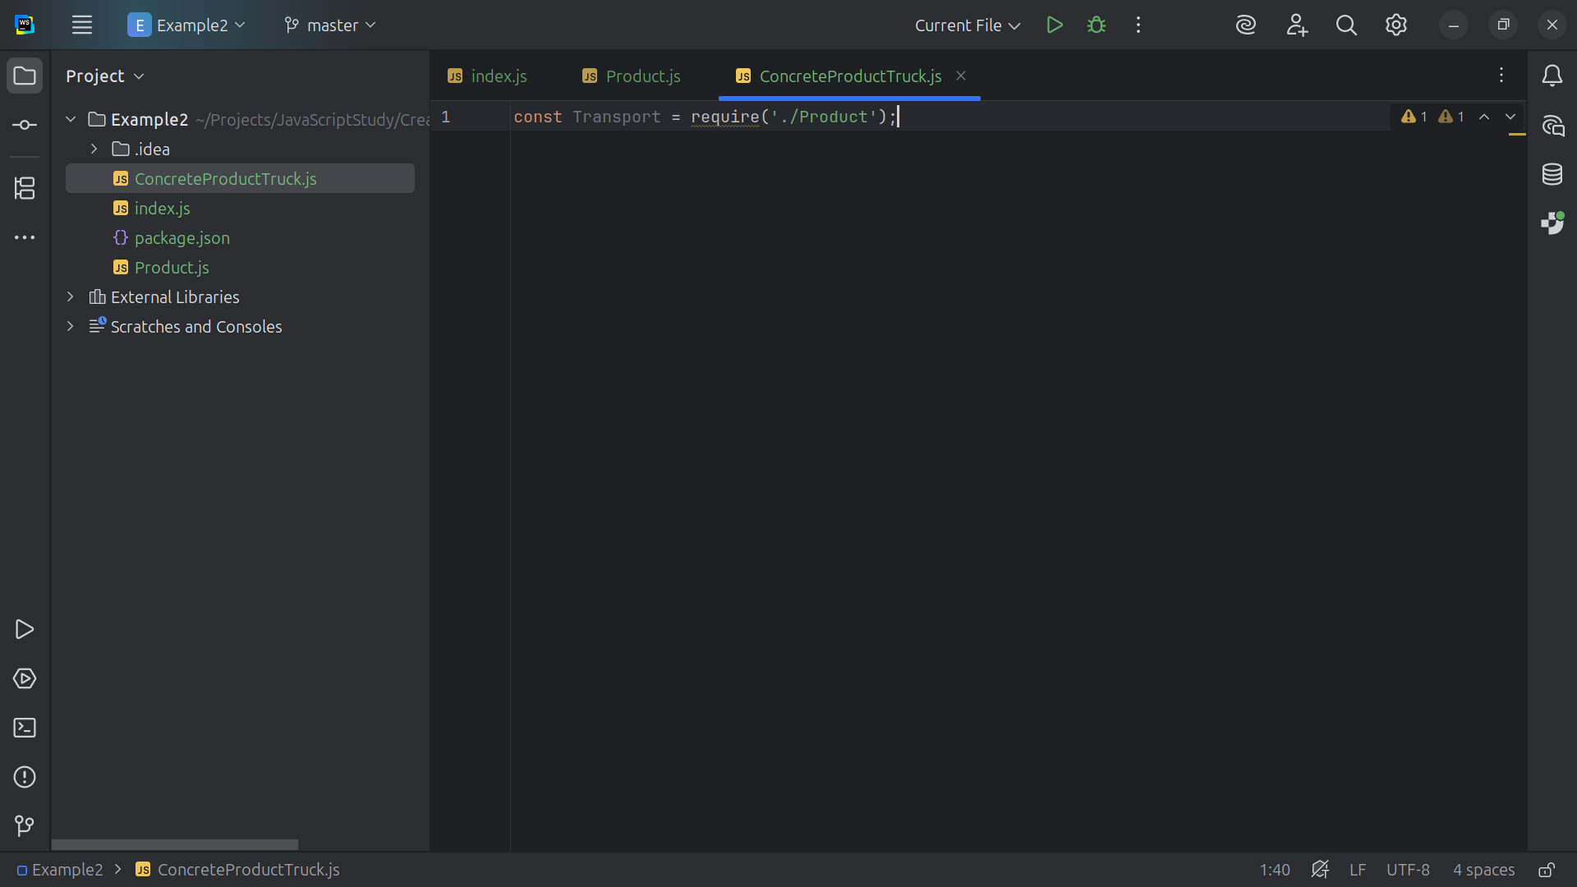
Notes:
We require Product at the top

Slide 9
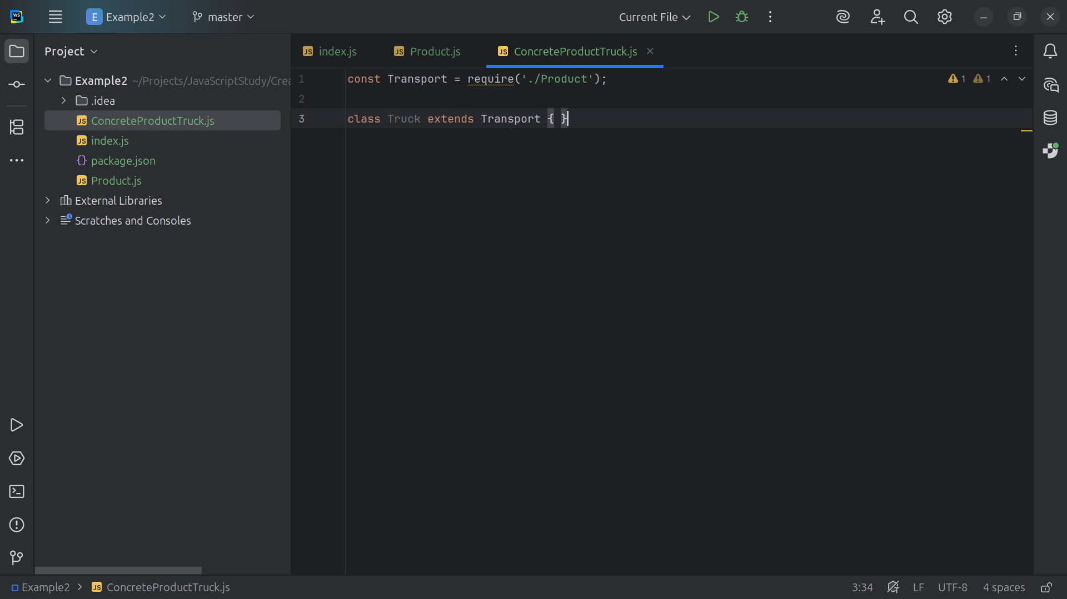
Notes:
The class Implements Transport with shipping-specific behavior.

Slide 10
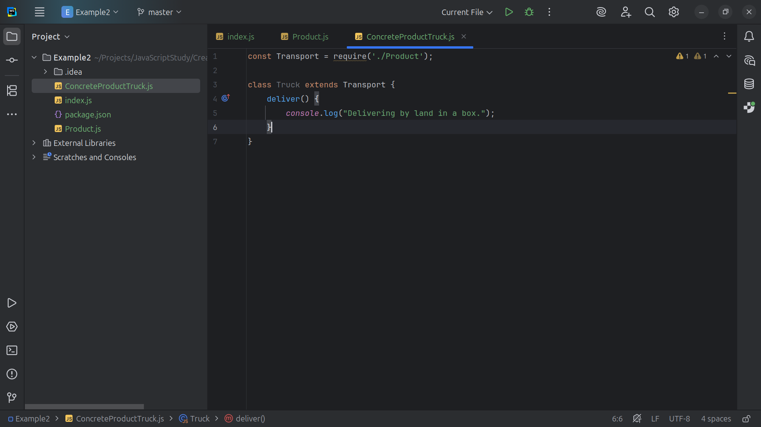
Notes:
Abstract factory method — to be overridden and it gives the message “Delivering by land in a box.”

Slide 11
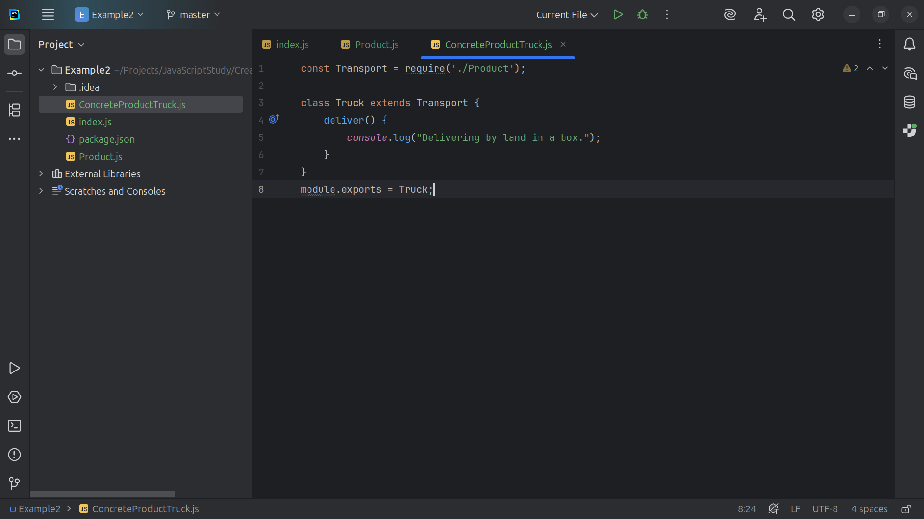
Notes:
. . . end this module by exporting Truck for our use in the demo

Slide 12
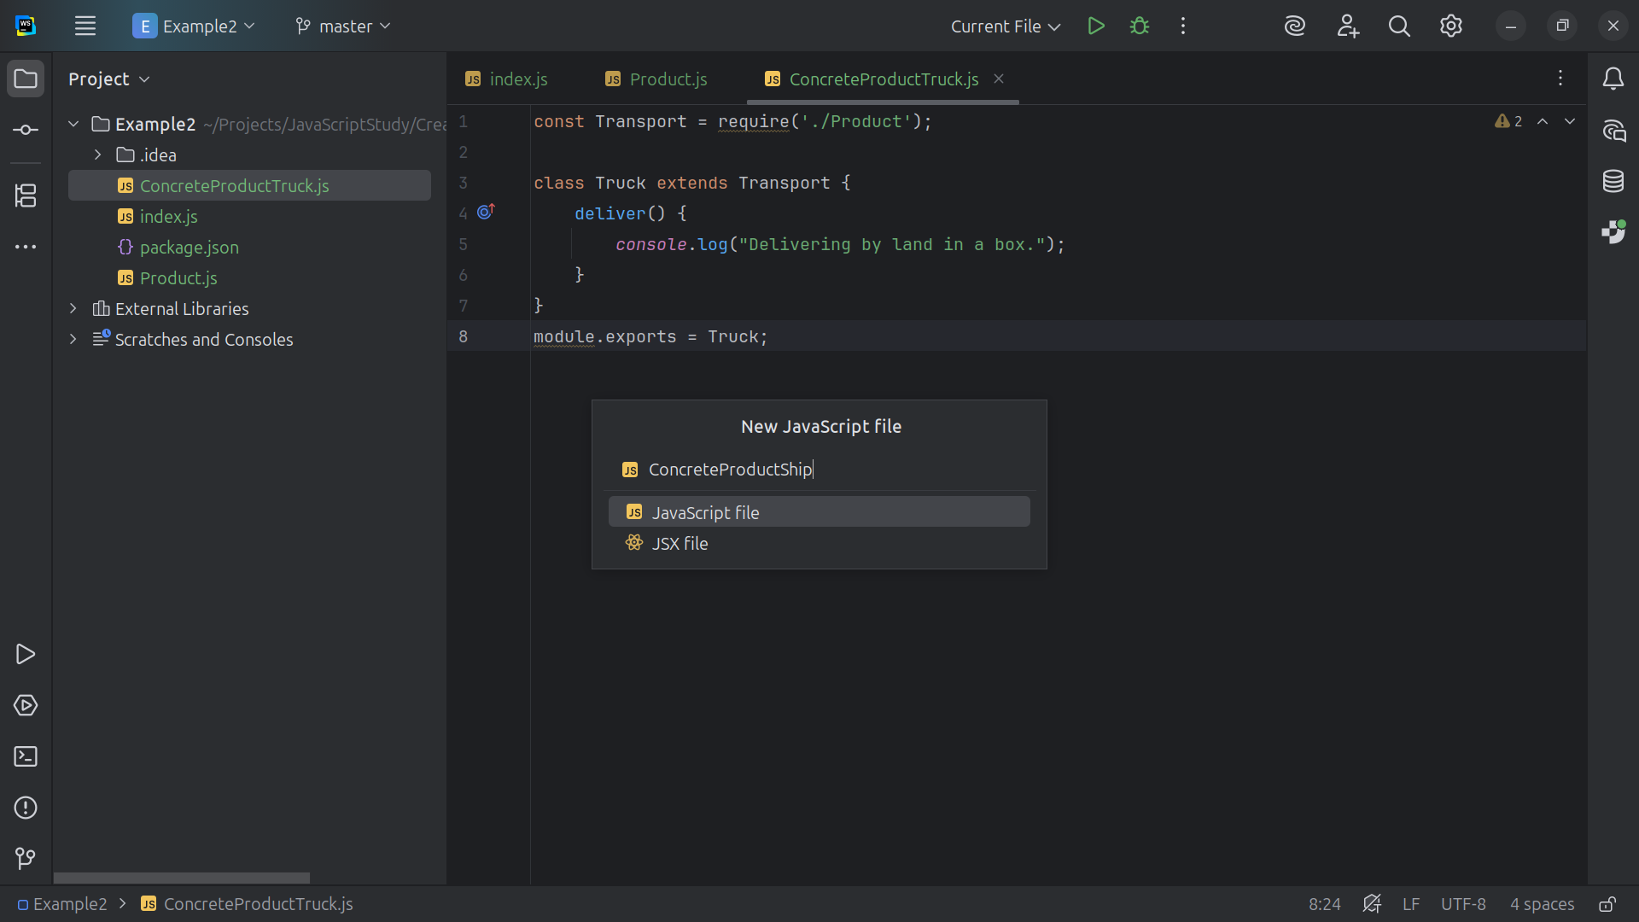
Notes:
Now let’s create a Concrete Product Ship

Slide 13
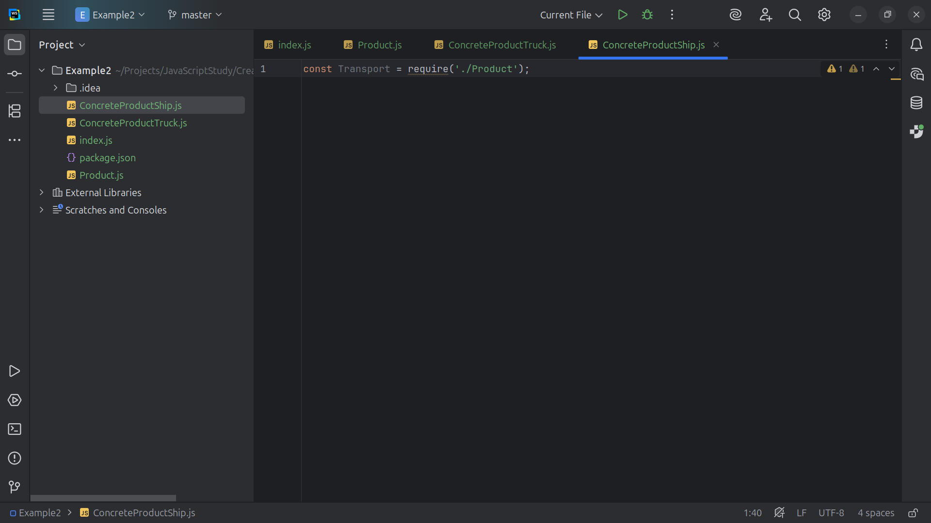
Notes:
At the top we require Product dot js

Slide 14
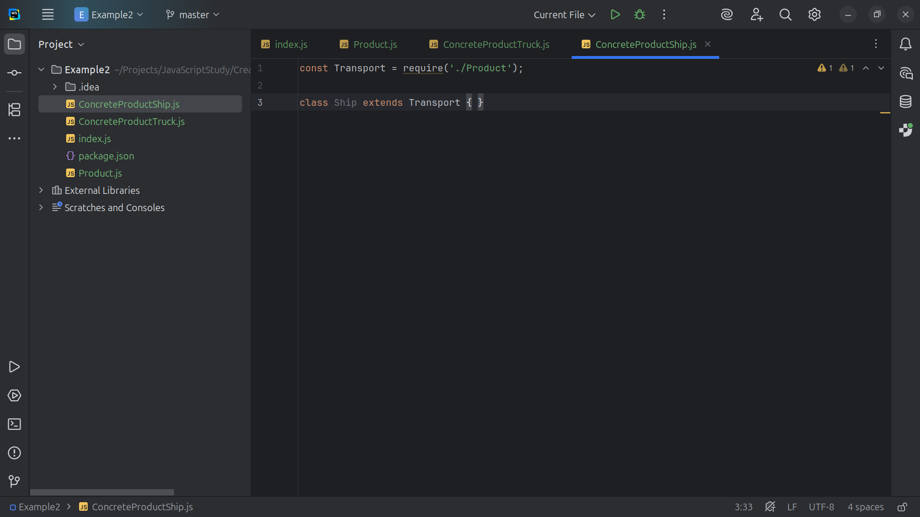
Notes:
So our Ship is Extended by Transport

Slide 15
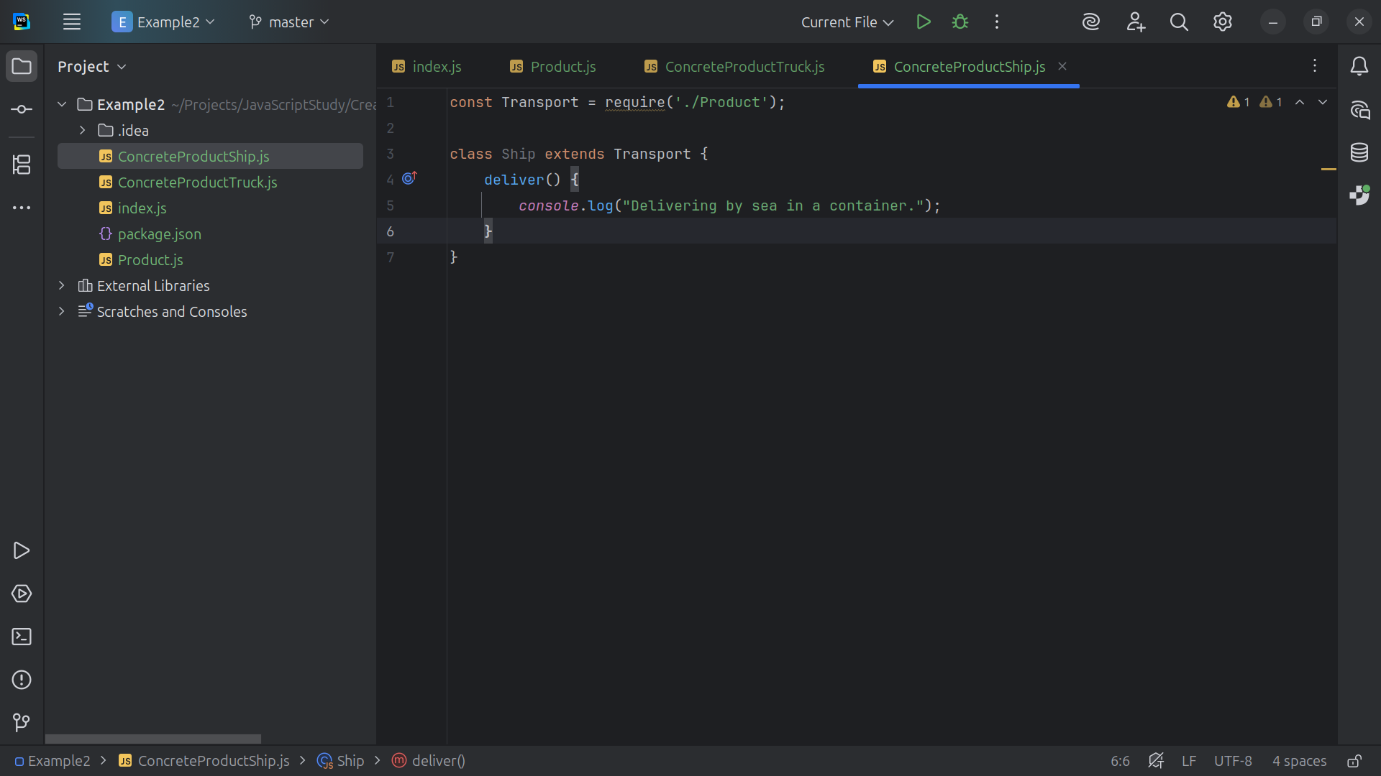
Notes:
Concrete product: Ship which returns the Delivering by sea in a container

Slide 16
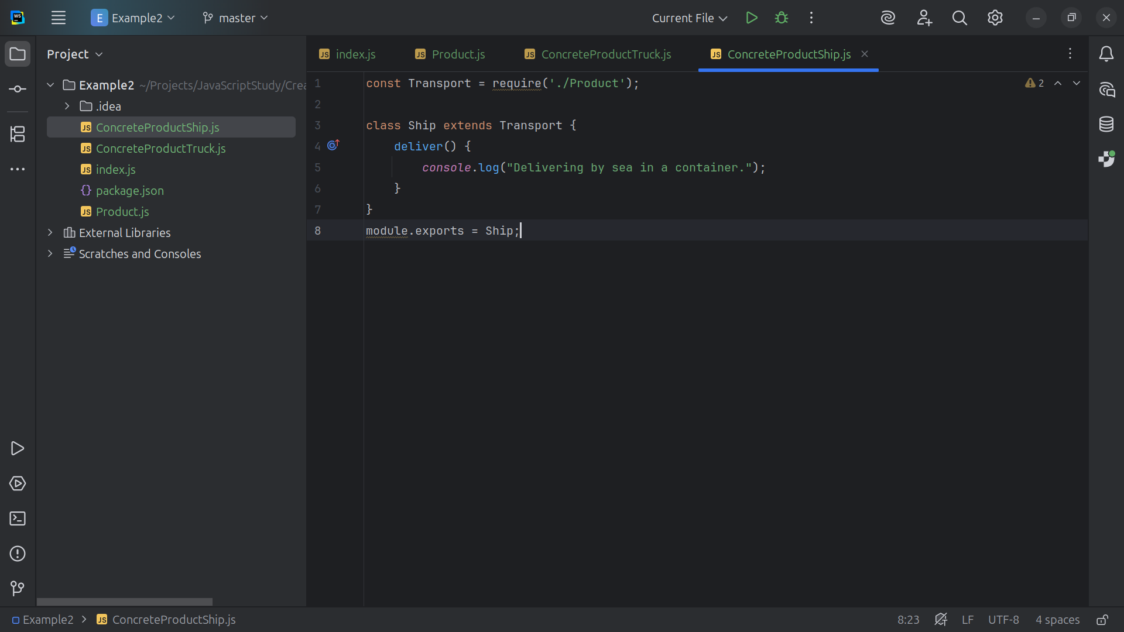

Slide 17
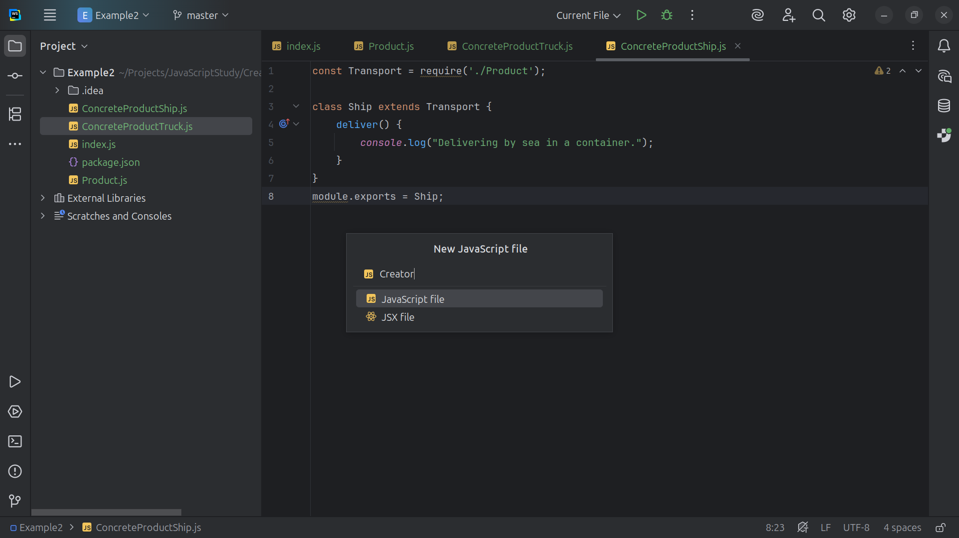

Slide 18
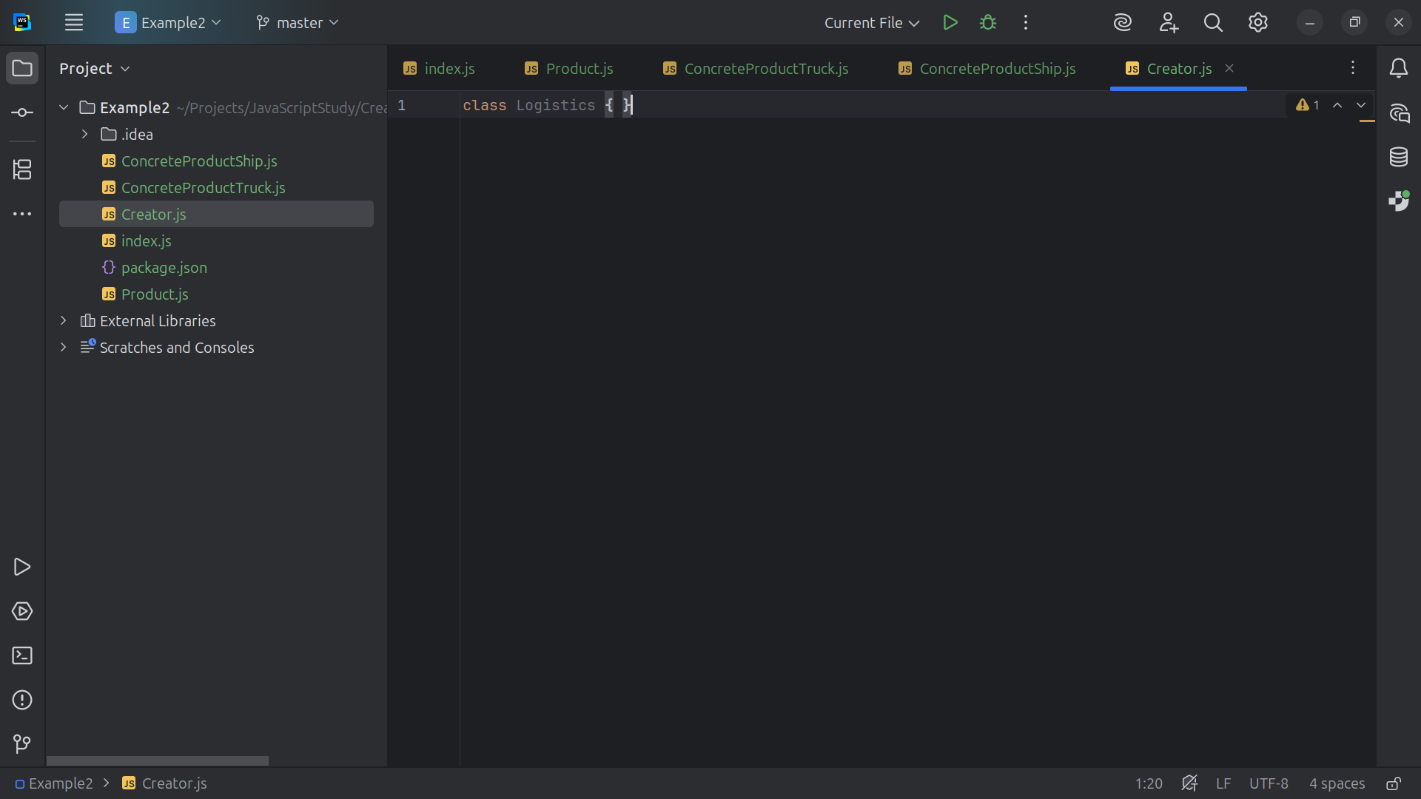

Slide 19
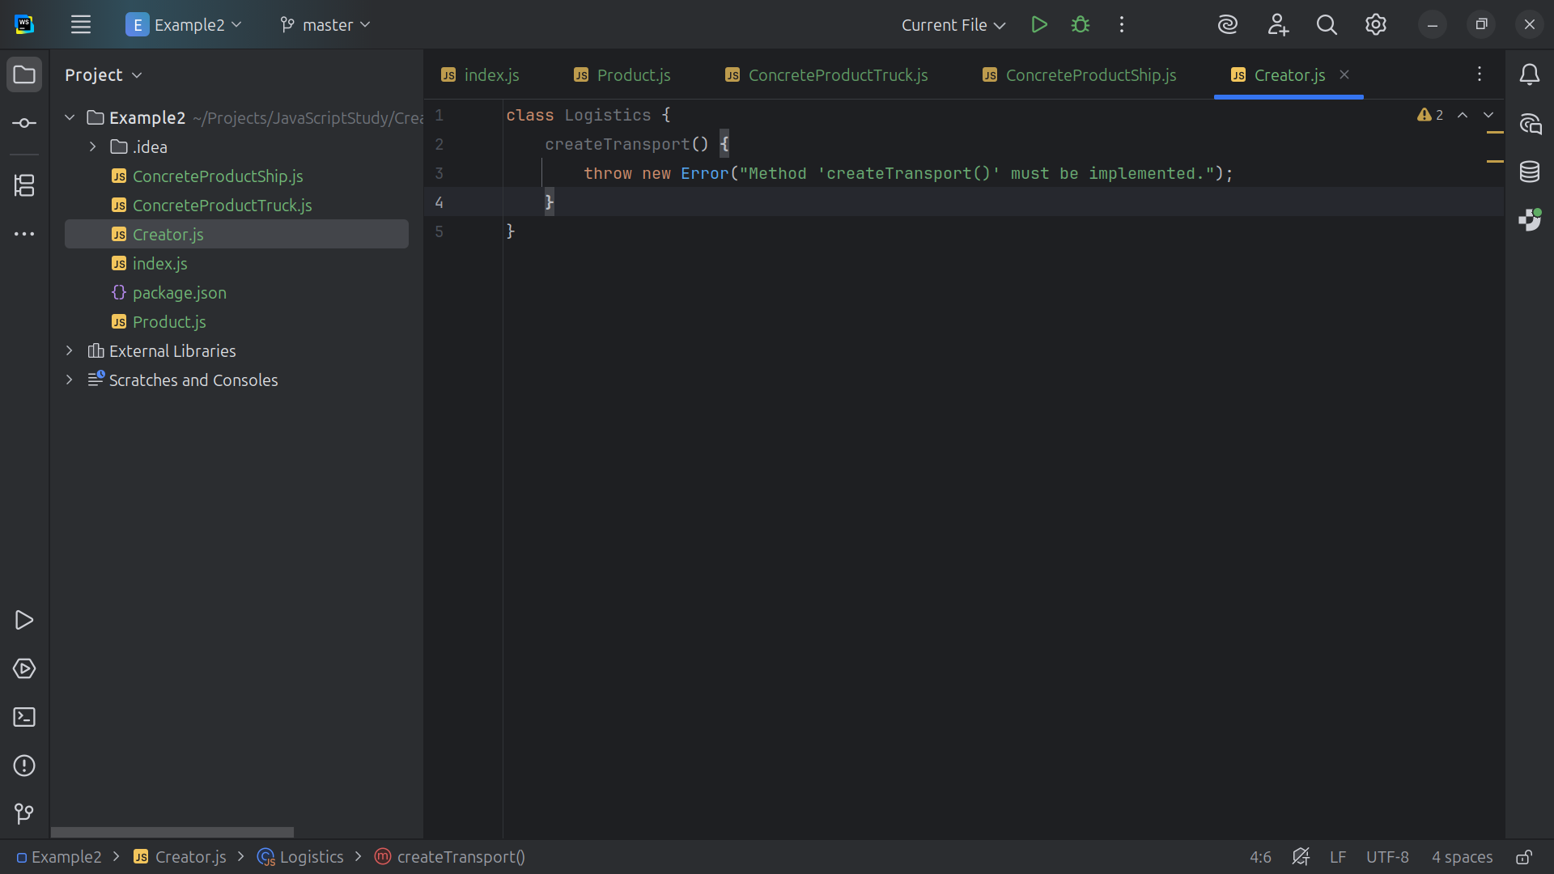

Slide 20
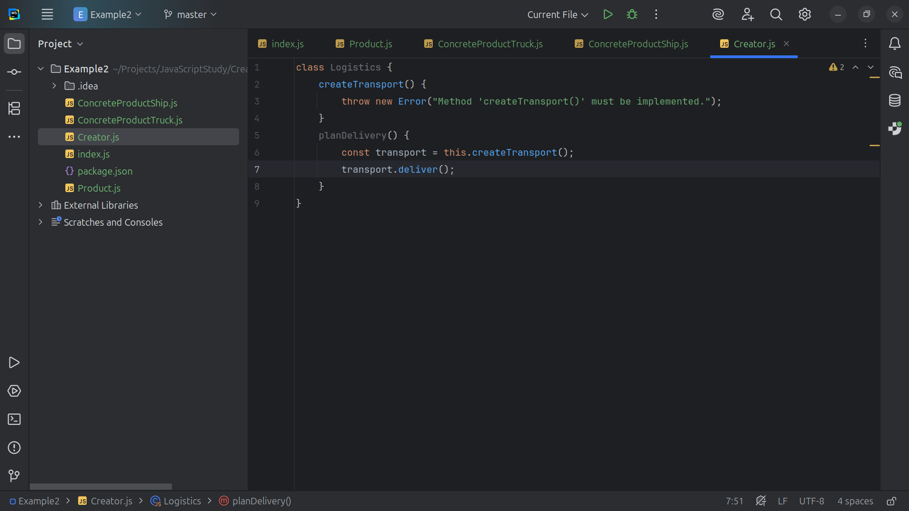

Slide 21
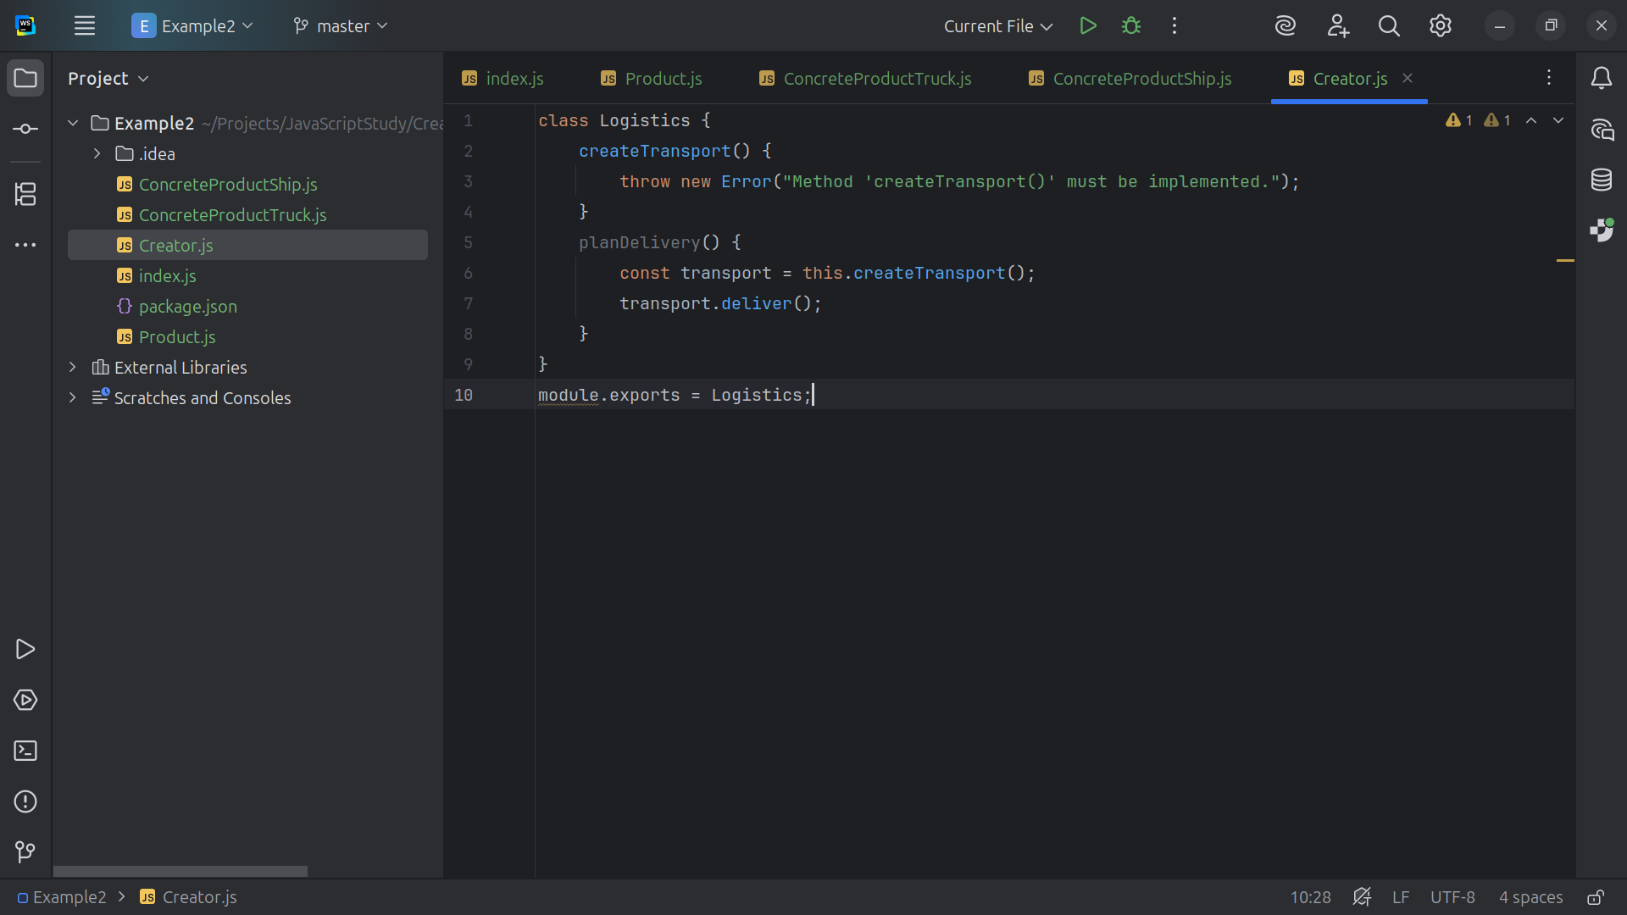

Slide 22
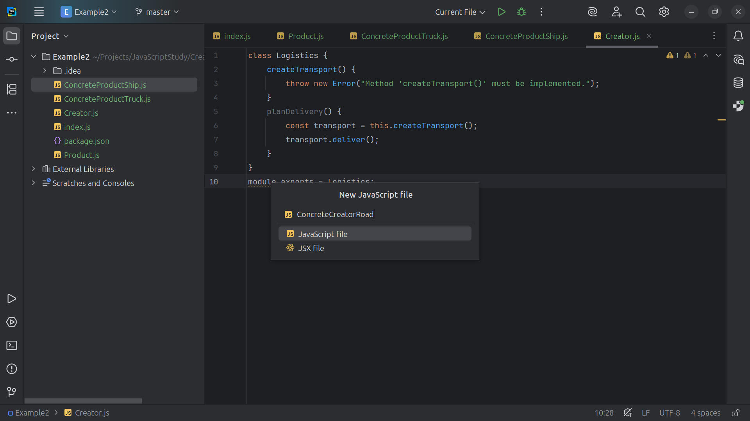

Slide 23
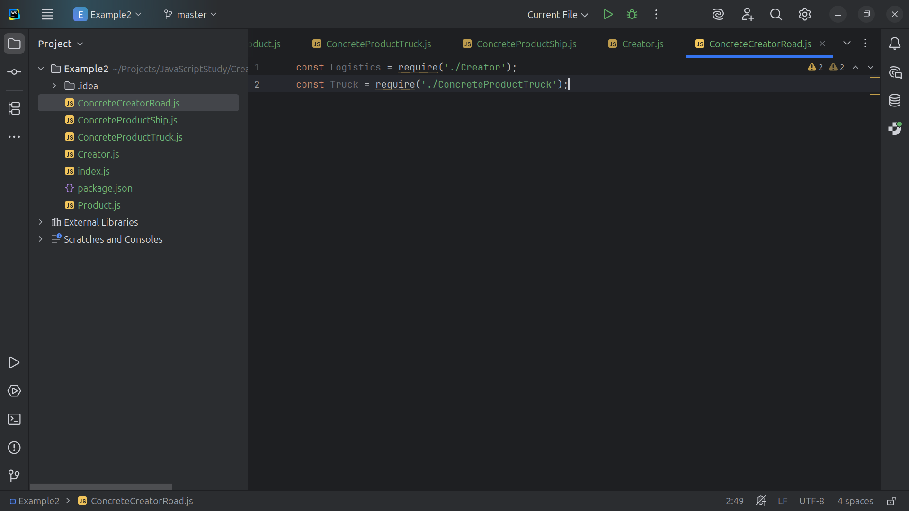

Slide 24
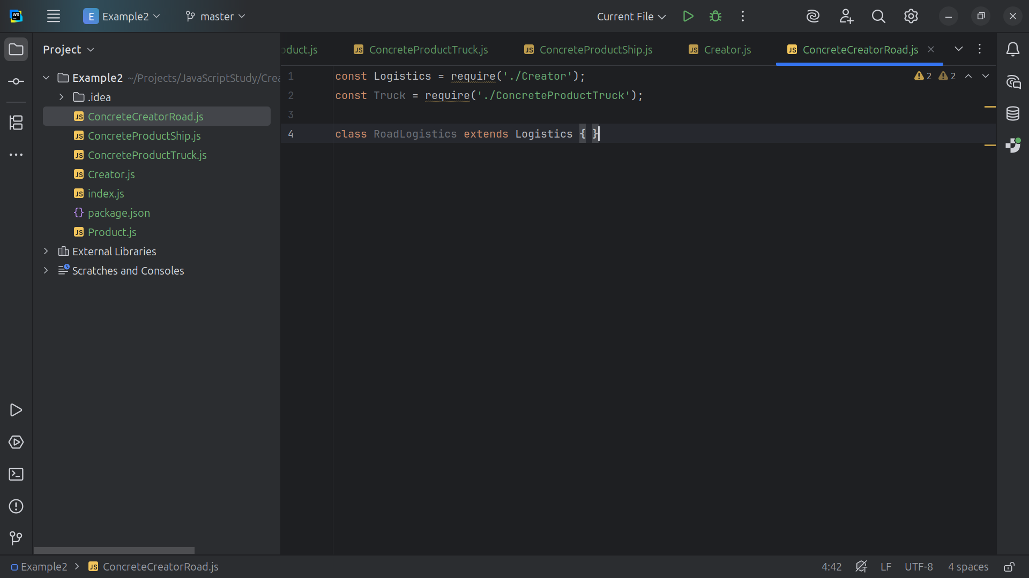

Slide 25
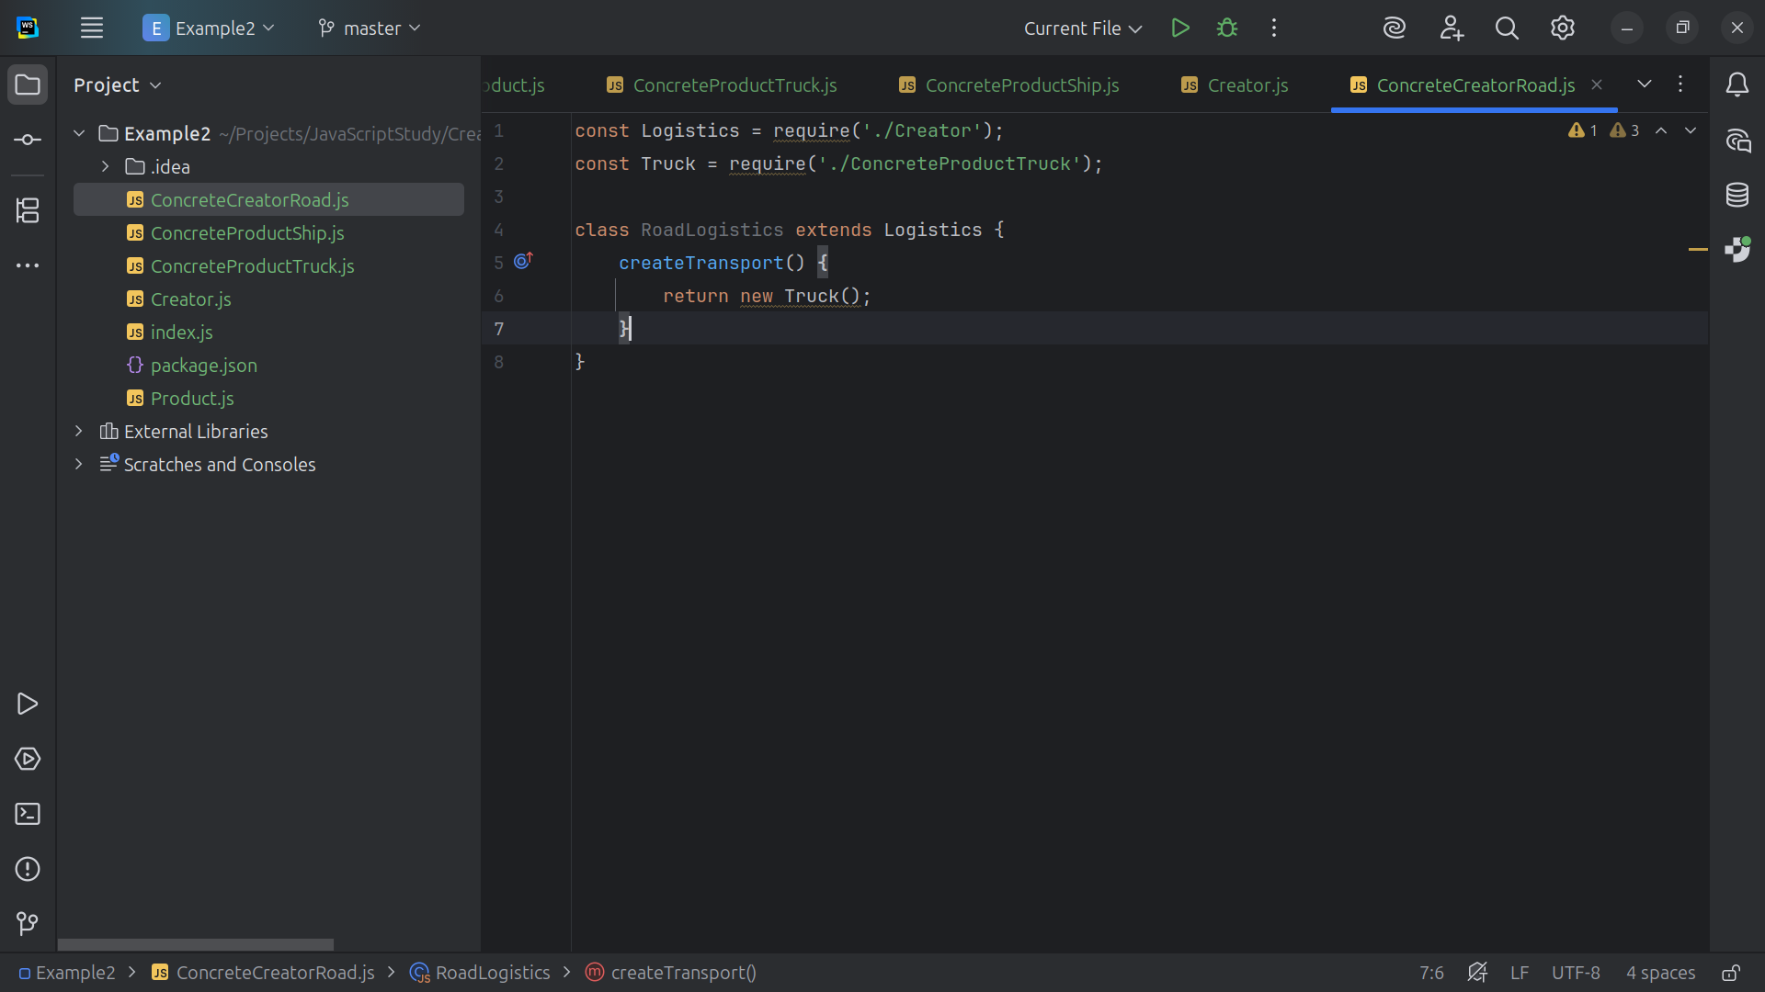

Slide 26
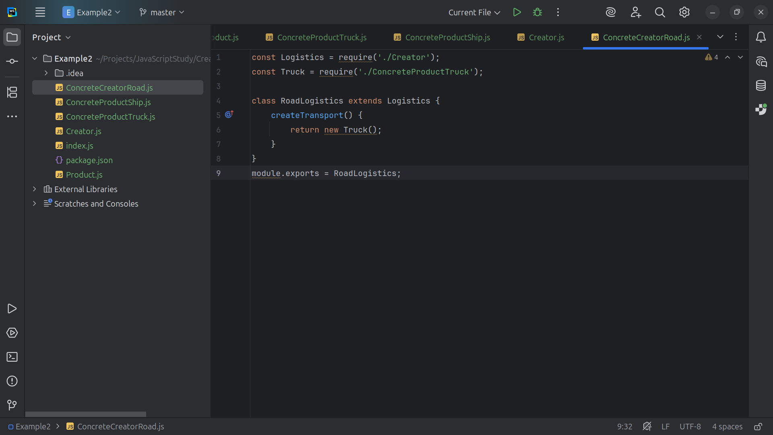

Slide 27
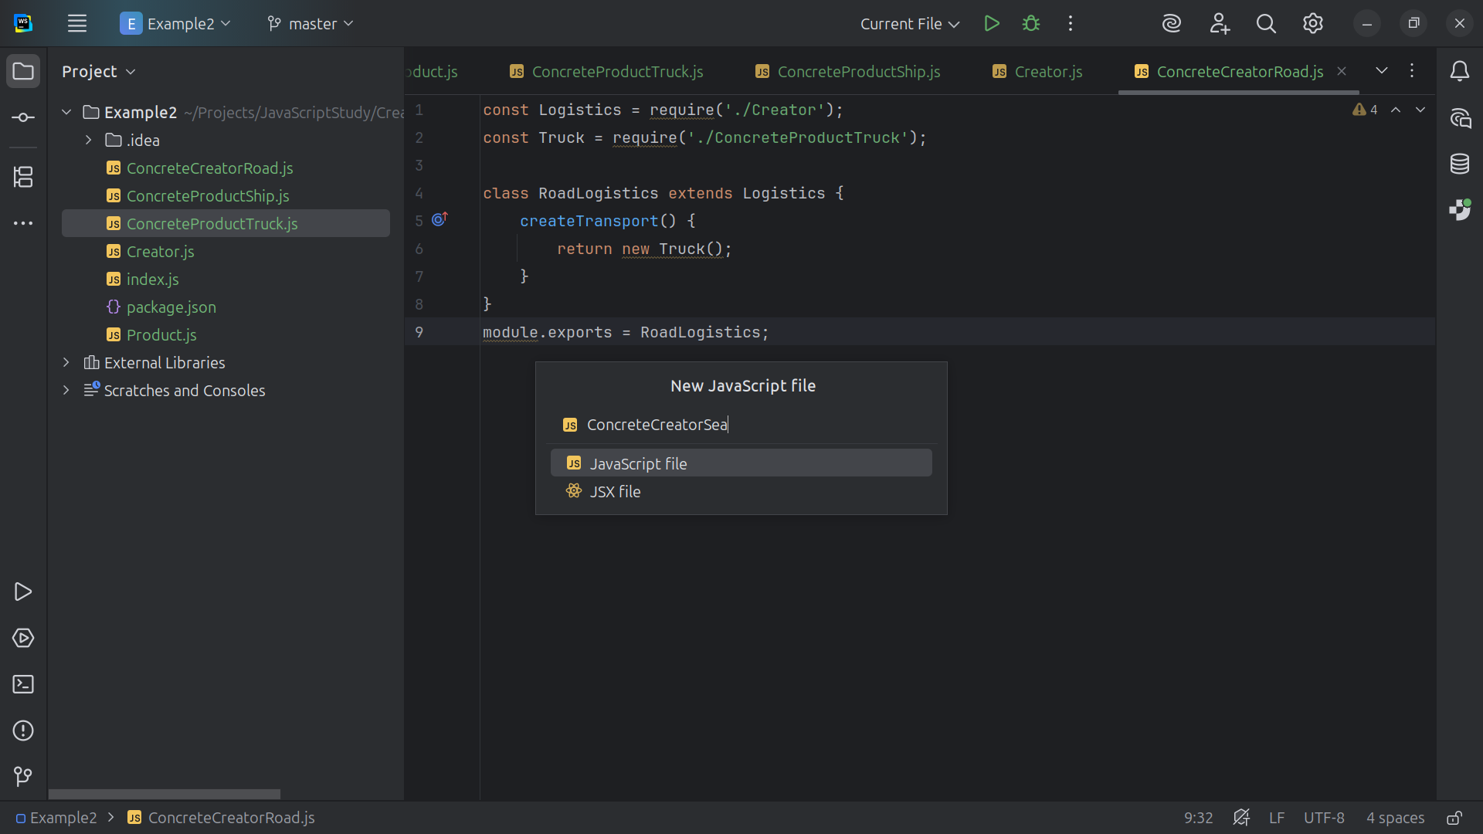

Slide 28
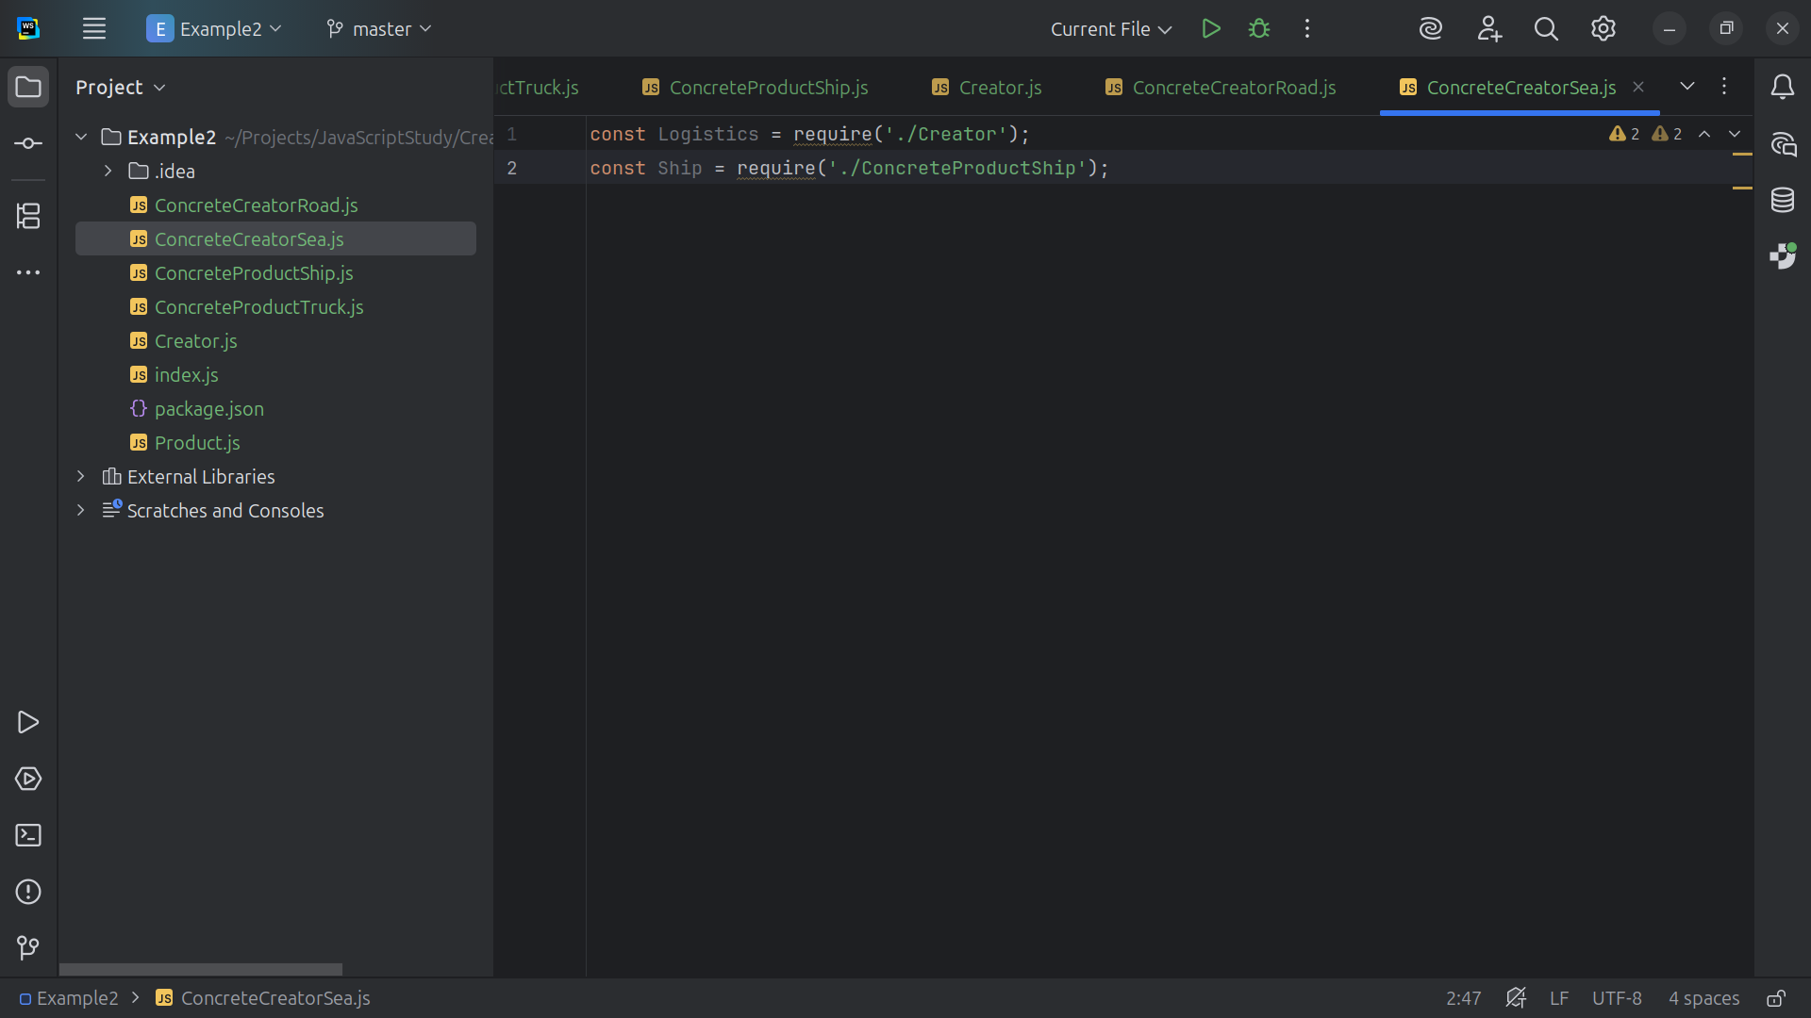

Slide 29
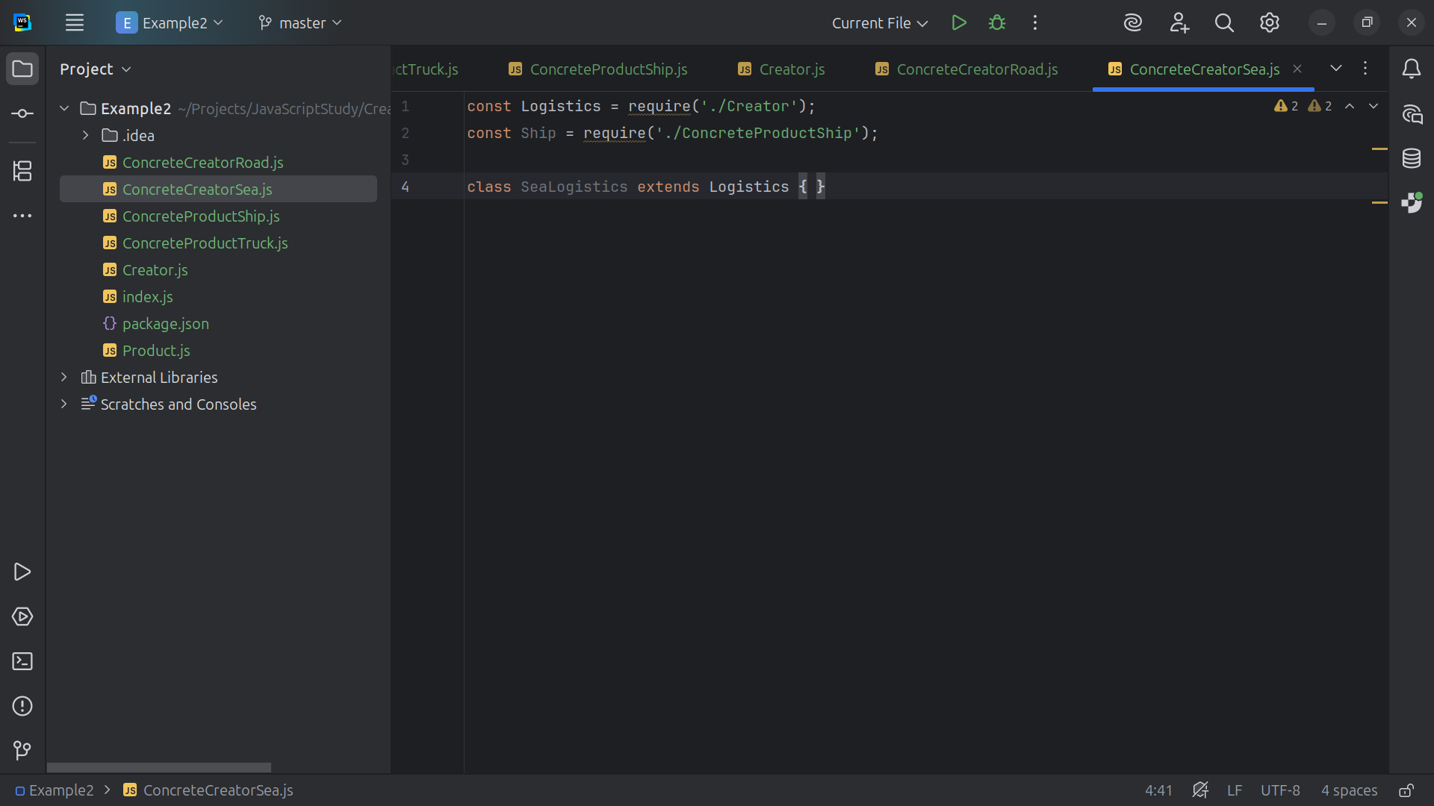

Slide 30
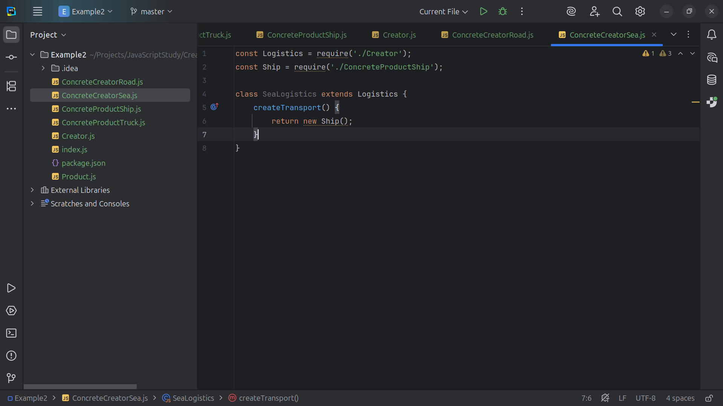

Slide 31
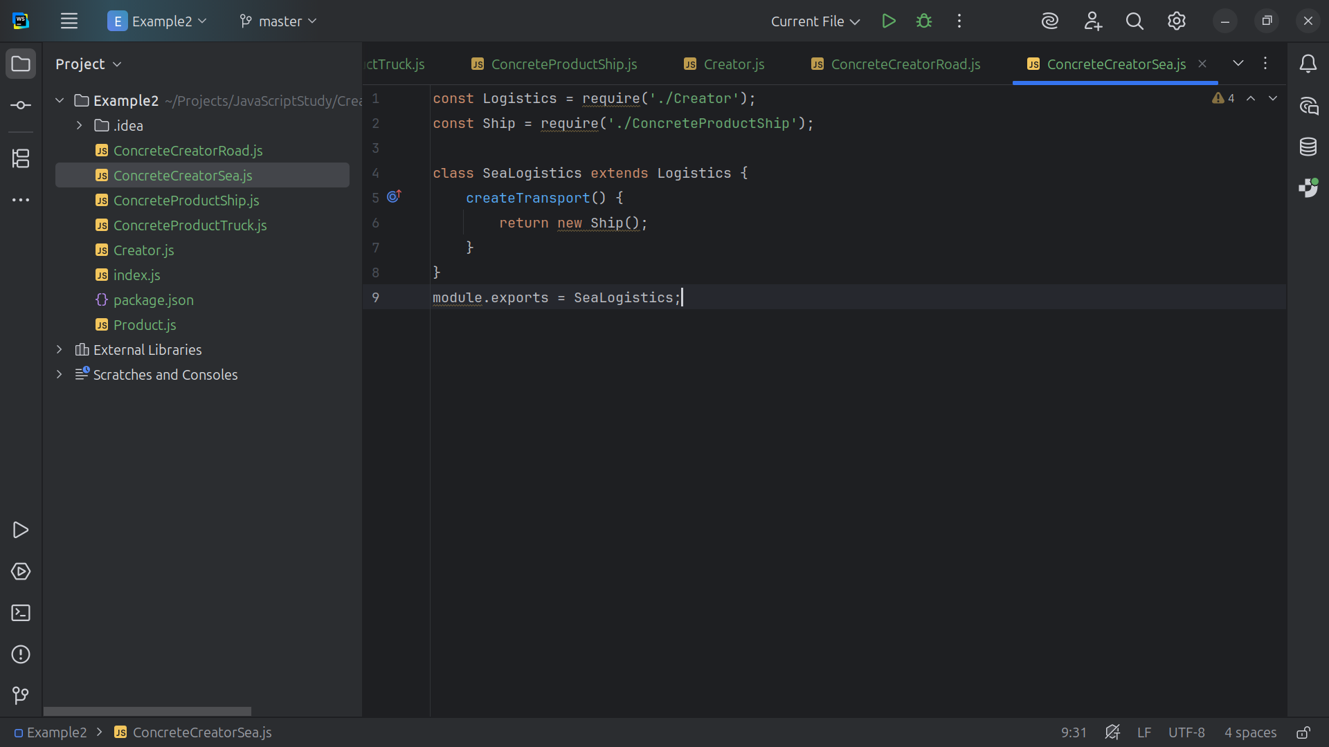

Slide 32
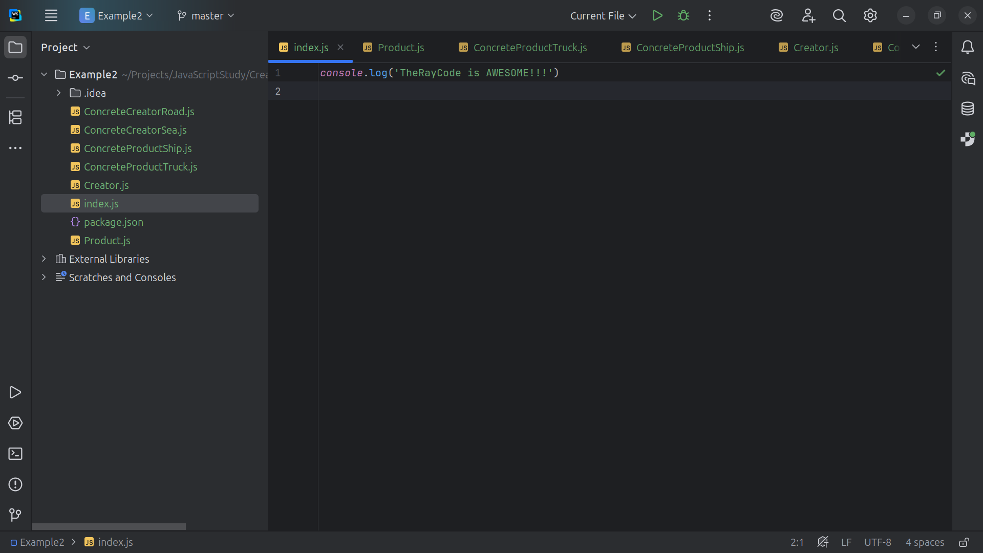

Slide 33


Slide 34
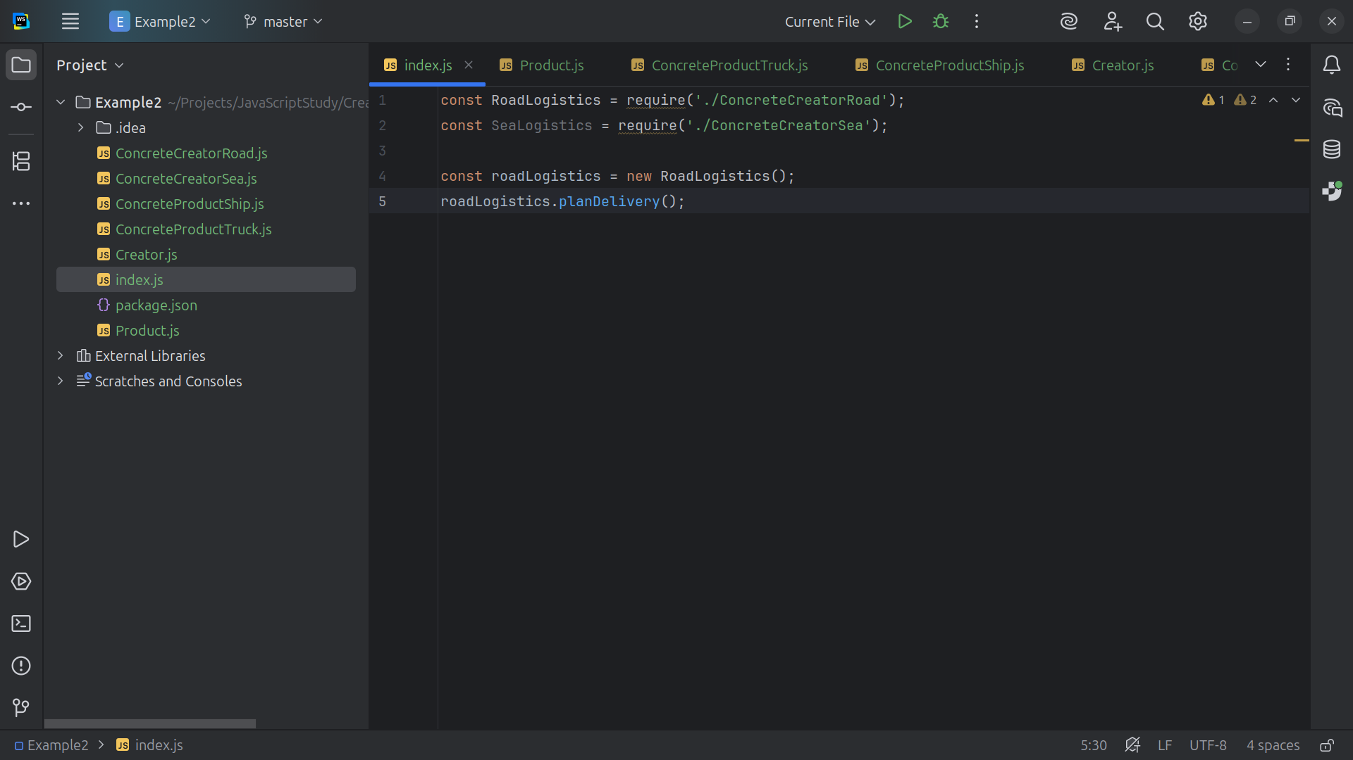

Slide 35
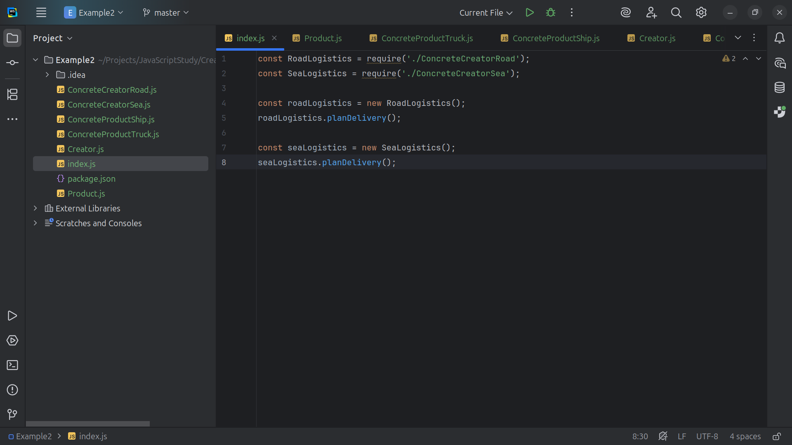

Slide 36


