Slide 1
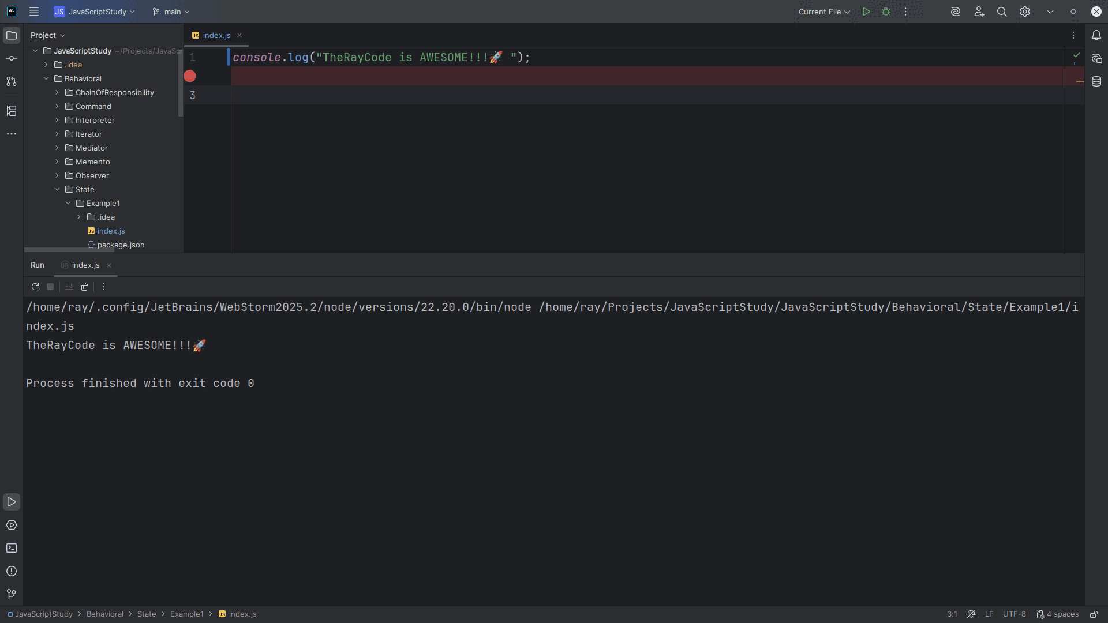
Notes:
(no sound)

Slide 2
Notes:
Hello, My name is Ray the Ray in TheRayCode.
In this video I plan to review a design pattern known as the the State design pattern as per the gang of 4
I will be using JavaScript.

Slide 3
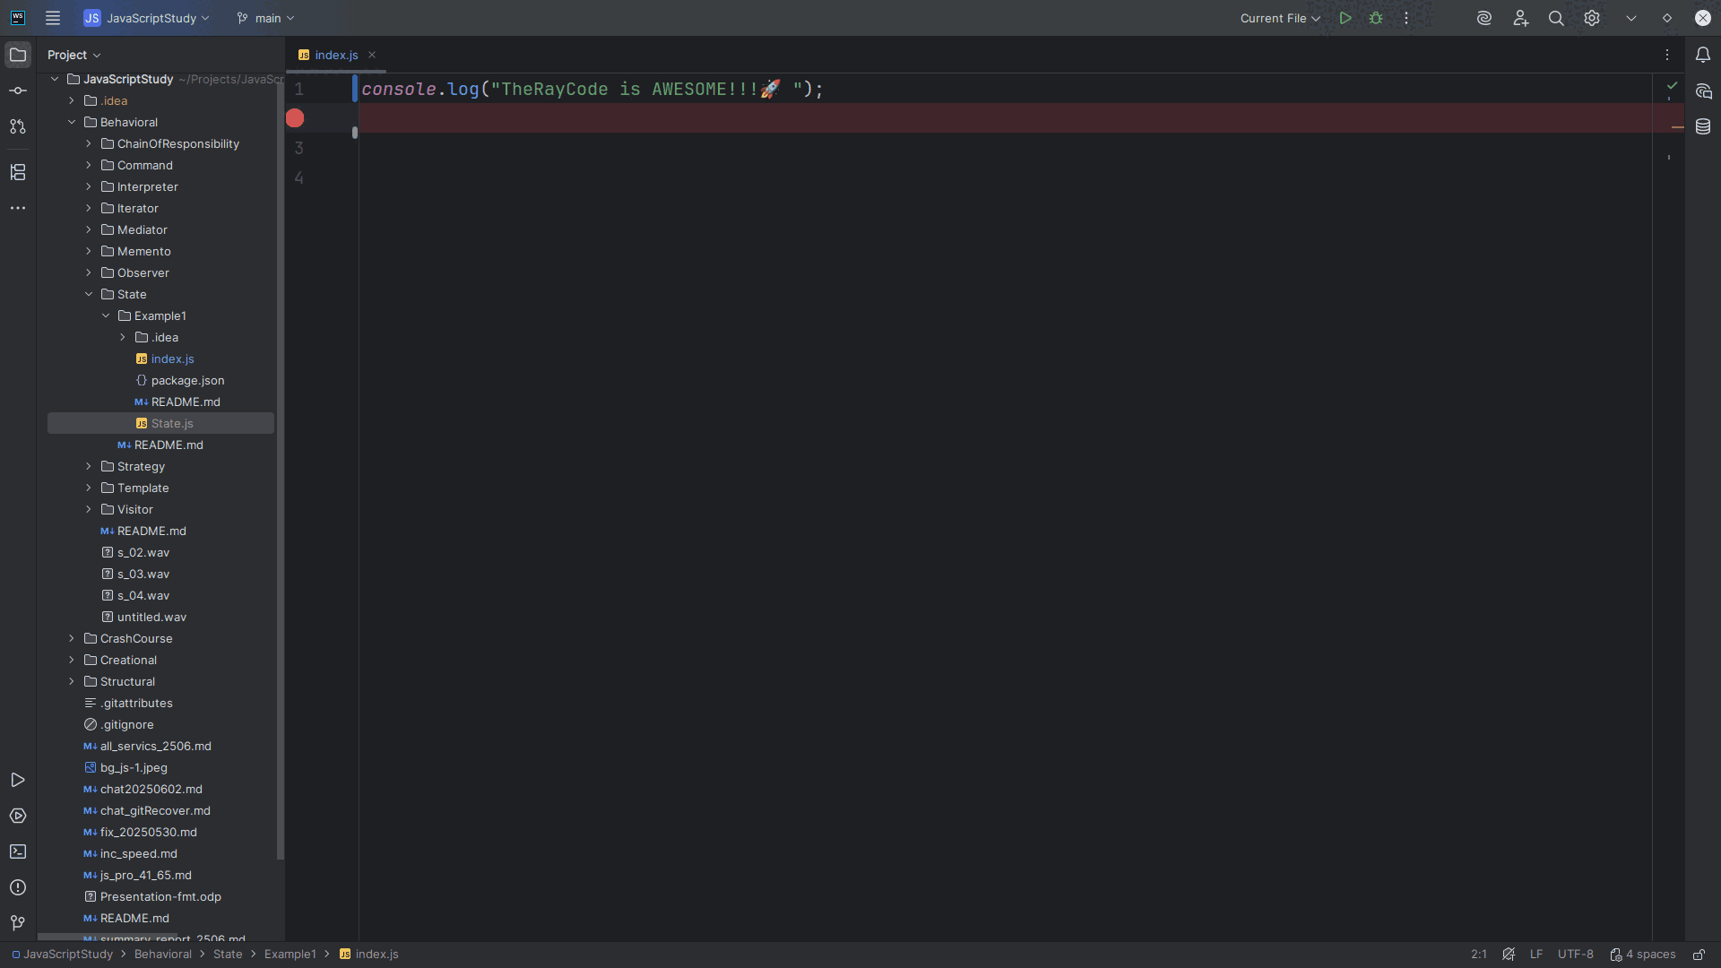
Notes:
The State pattern is a behavioral pattern that allows an object to change its behavior when its internal state changes, appearing to change its class.

Slide 4
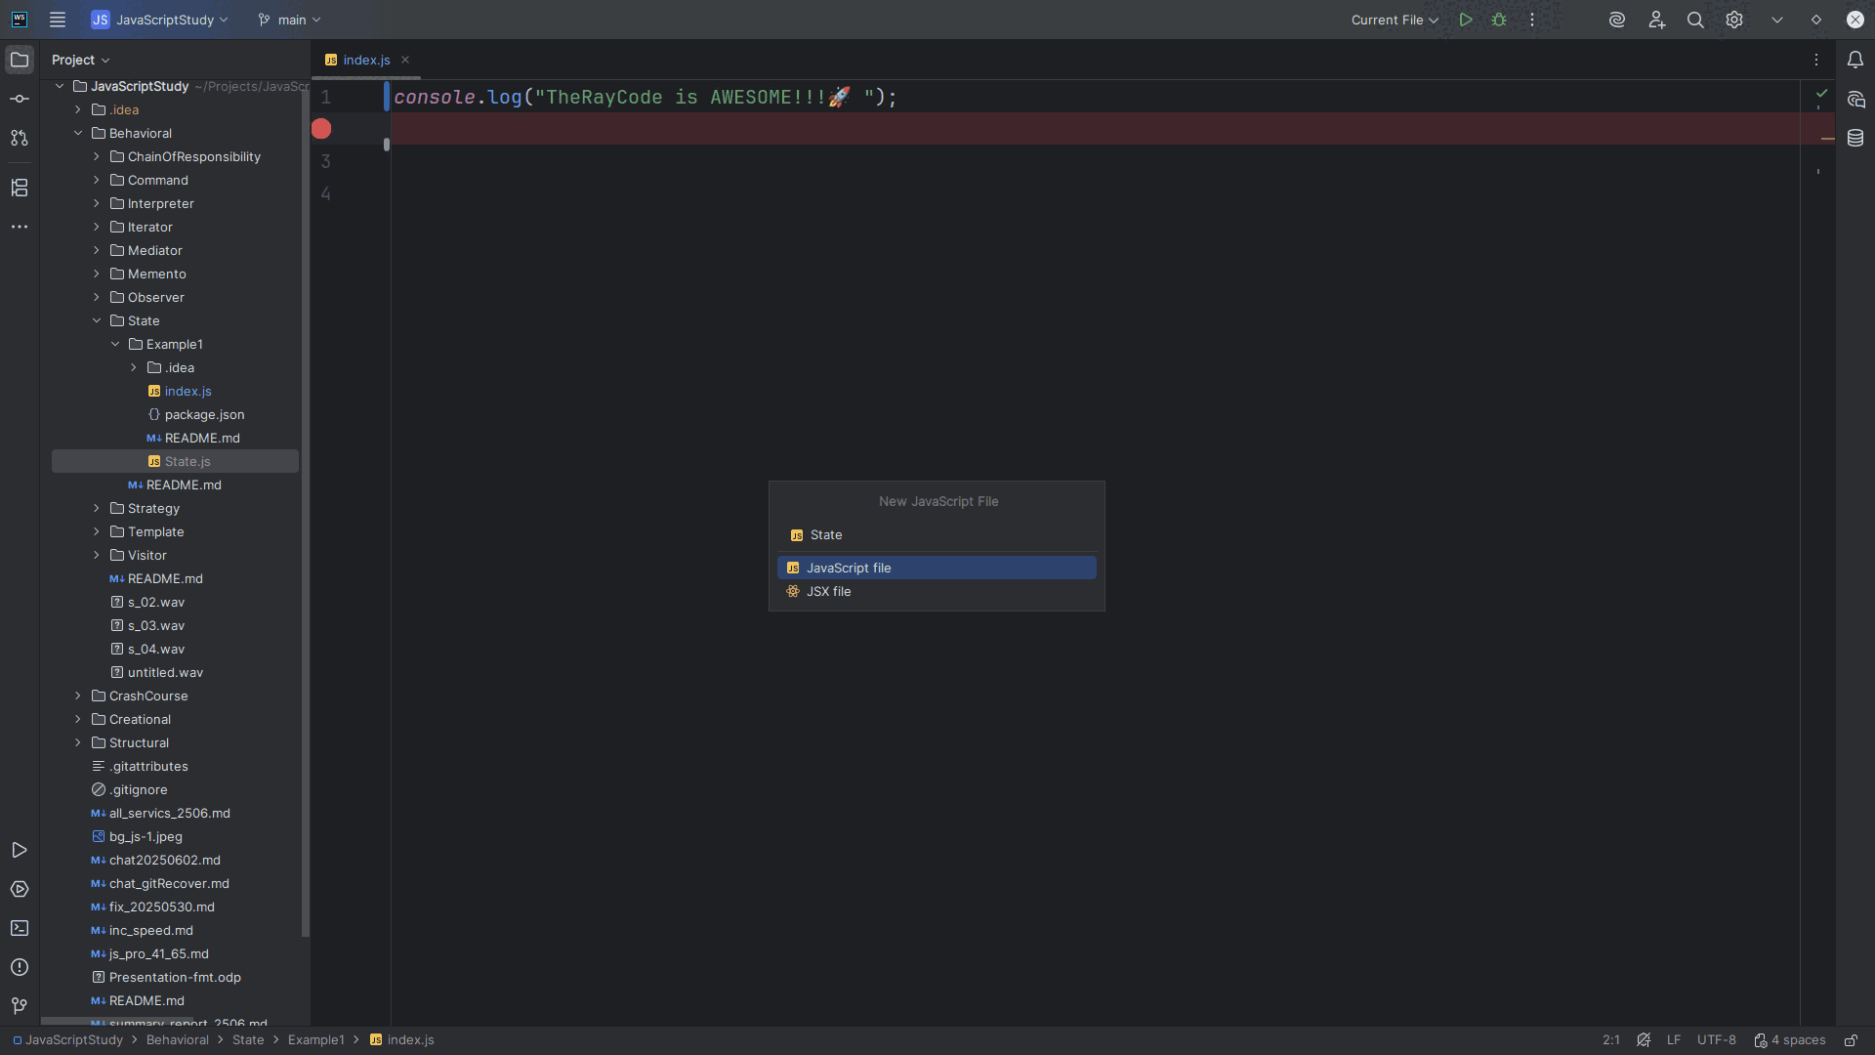
Notes:
We start by creating a class object we call State

Slide 5
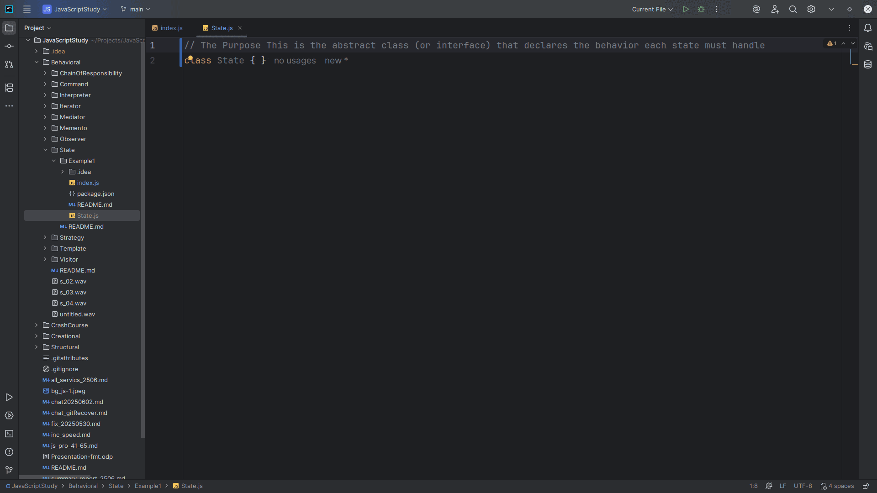
Notes:
The Purpose This is the abstract class (or interface) is that it declares the behavior of the state must handle.

Slide 6
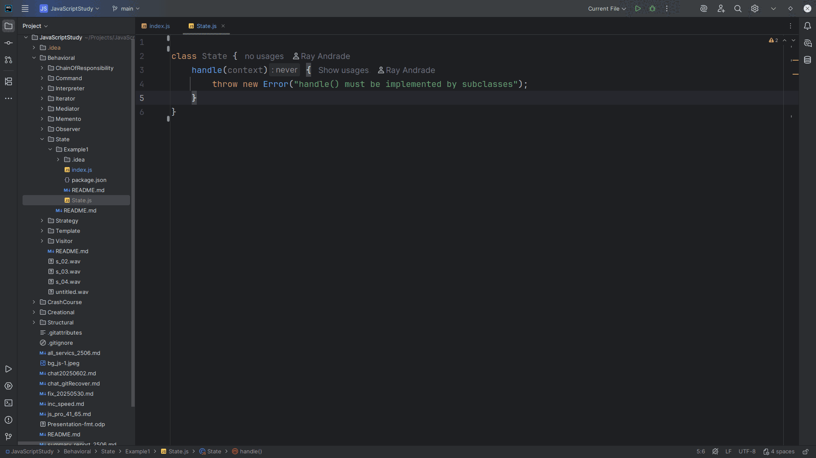
Notes:
The Handle takes a context object and it must be implemented or it will trow an error

Slide 7
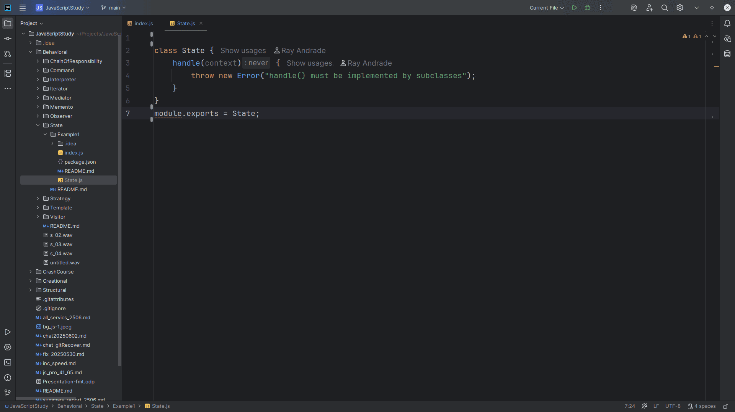
Notes:
We export this abstract class for use in our demo

Slide 8
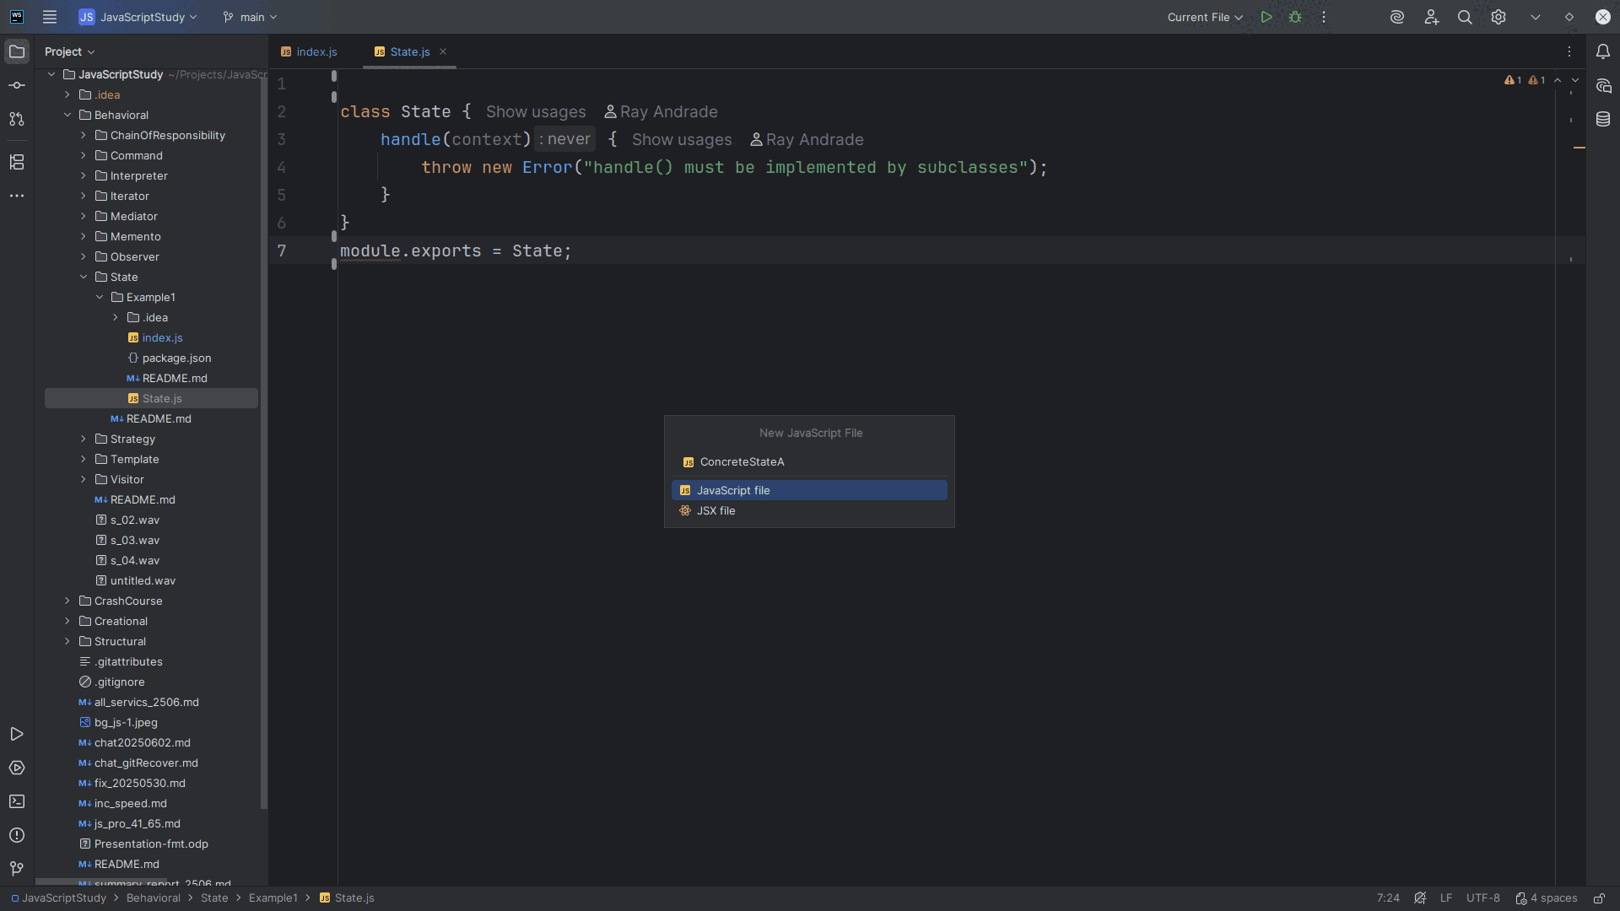
Notes:
Now let’s create a class we call Concrete State A

Slide 9
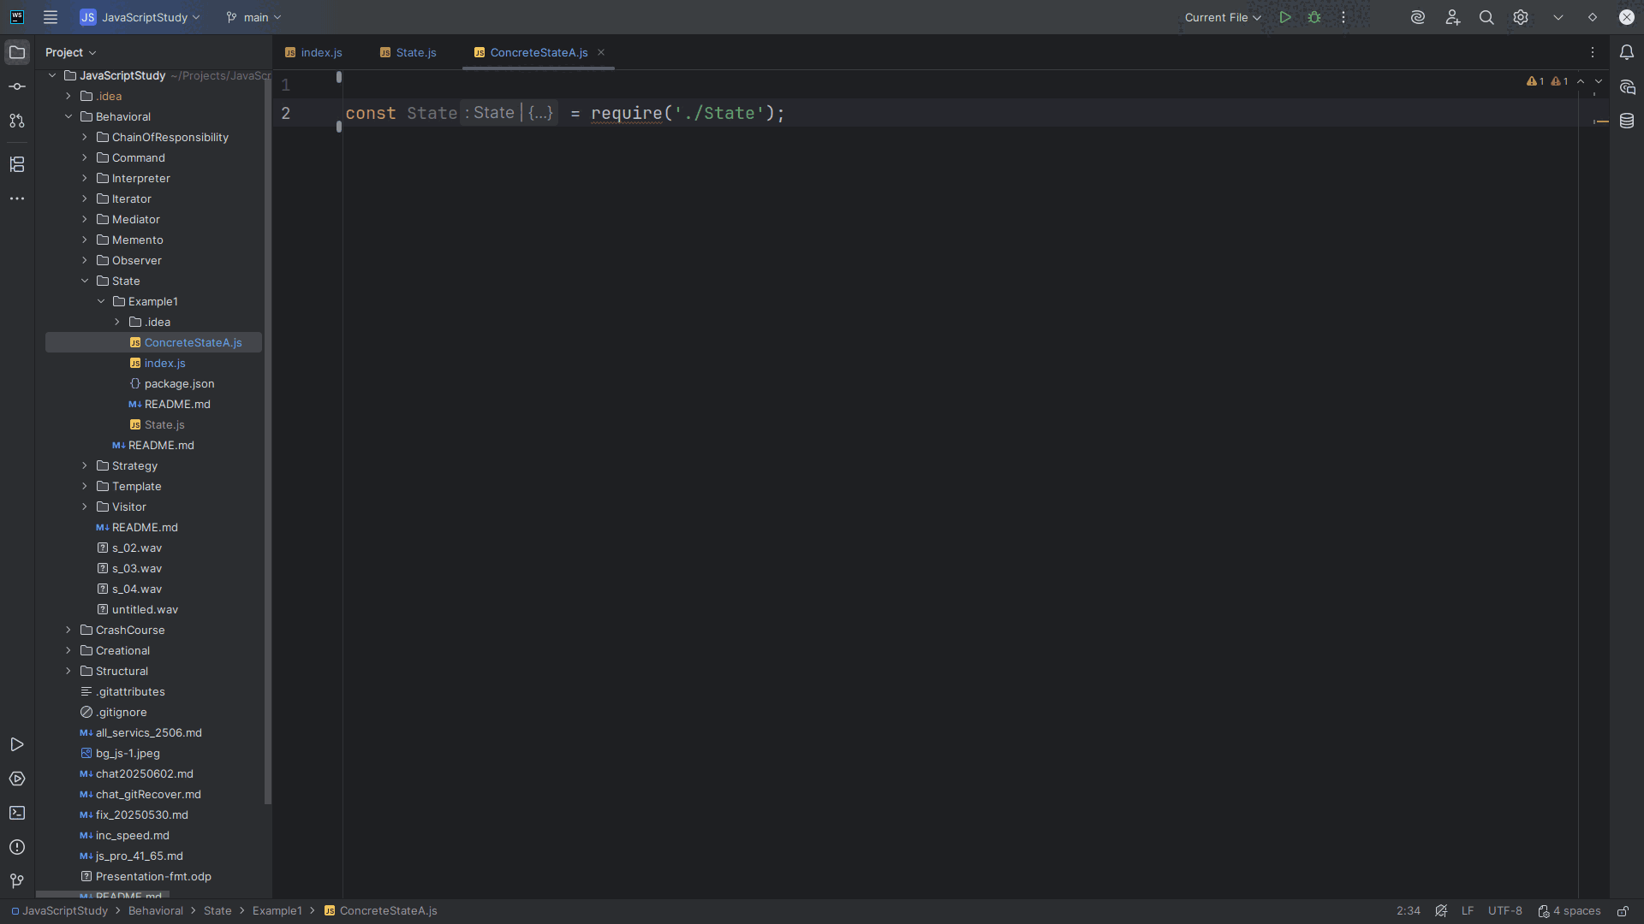
Notes:
We require the state abstract class at the top

Slide 10
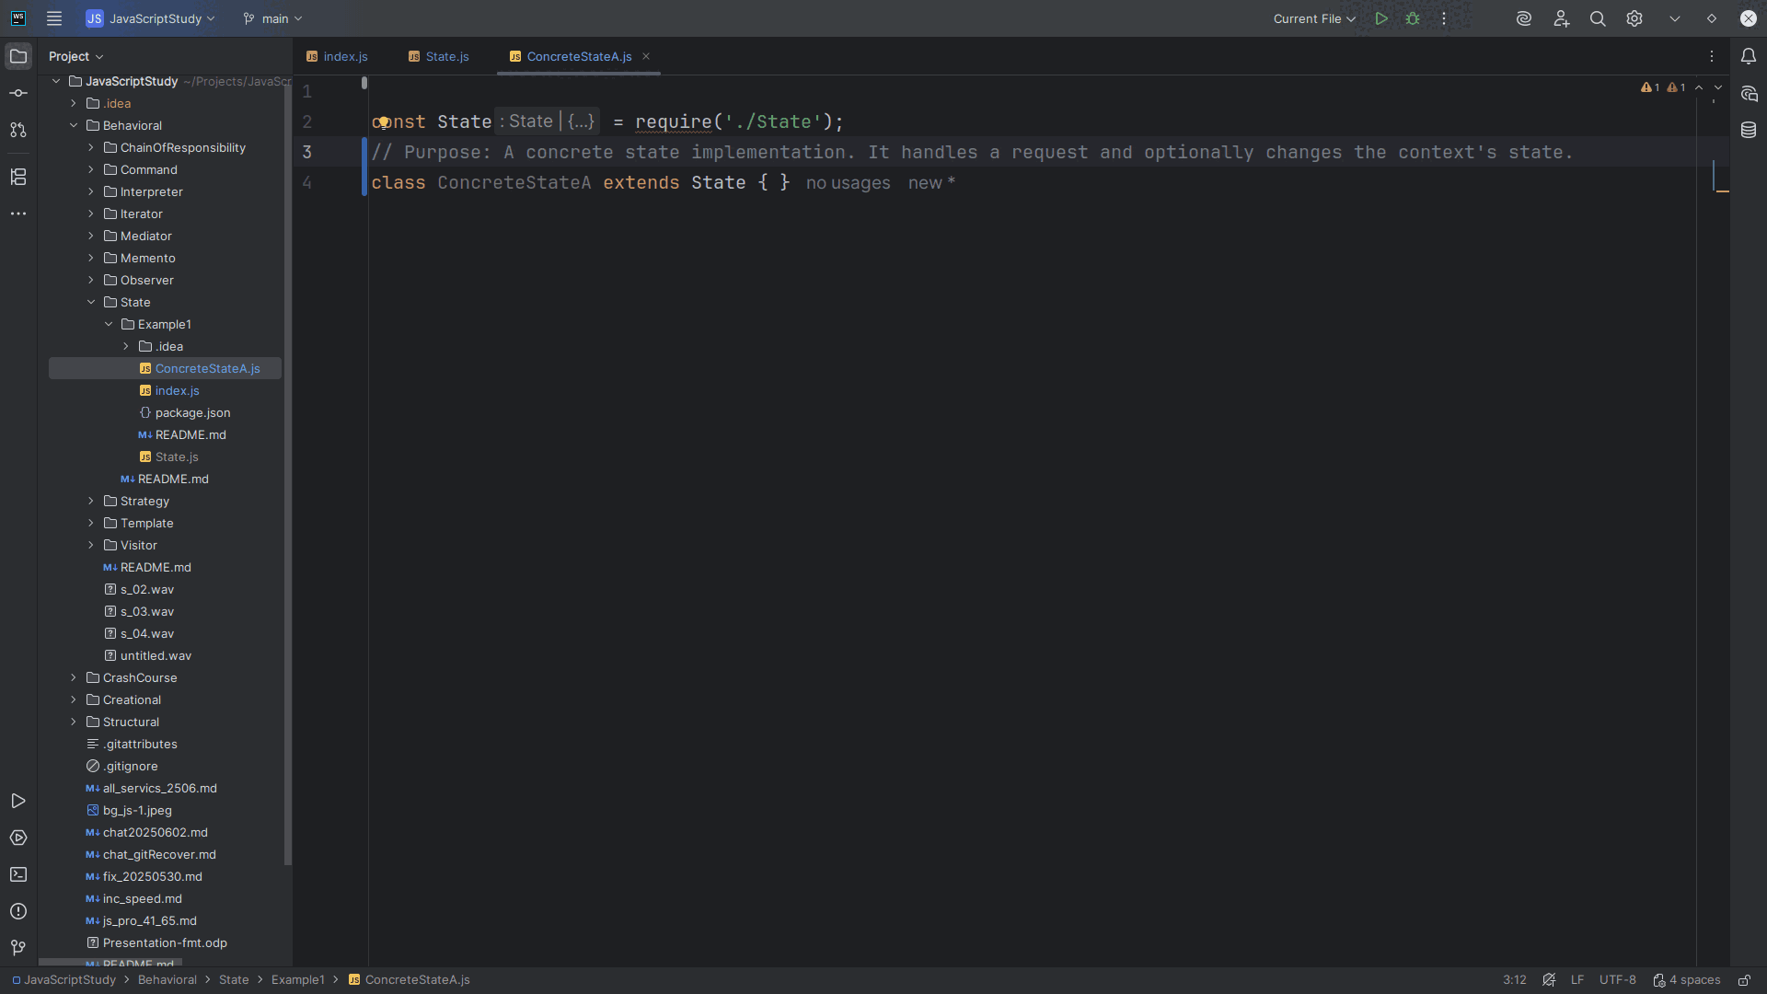
Notes:
Concrete State A is extended with the State class

Slide 11
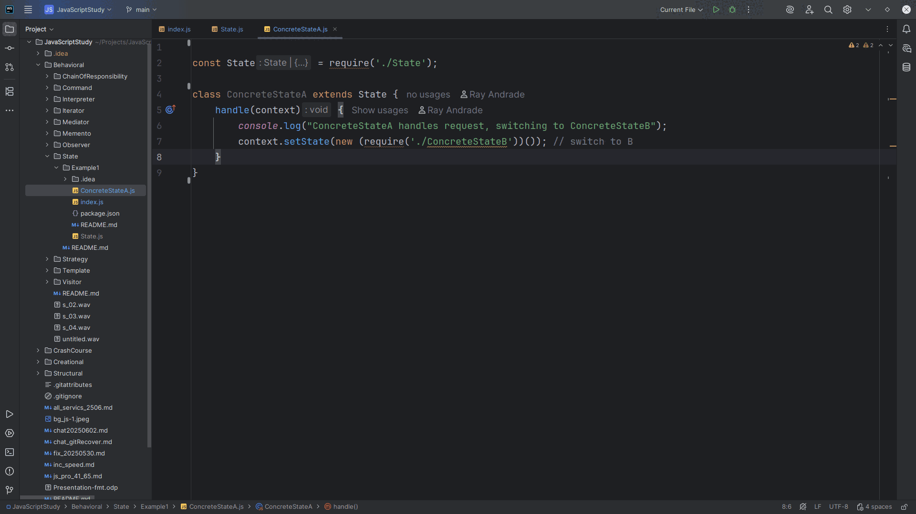
Notes:
We create a handle method that handles the request, switching to Concrete State B

Slide 12
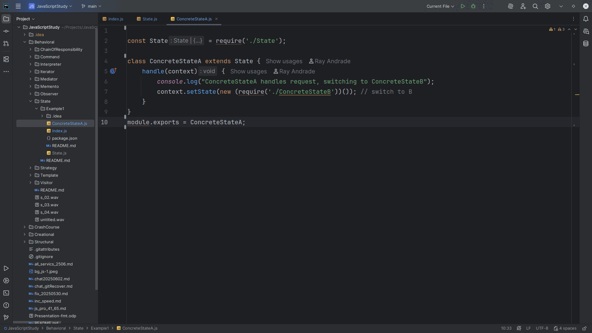
Notes:
Let’s export this class for use in our demo

Slide 13
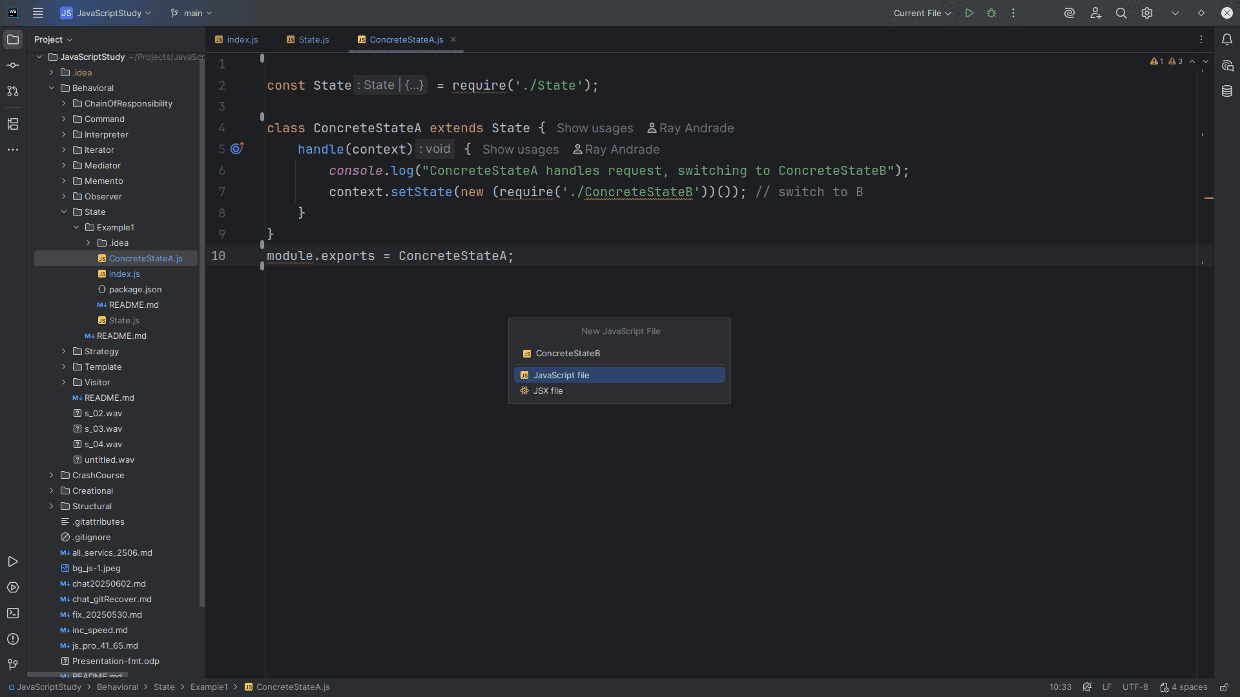
Notes:
The next Class I want to create will be the Concrete State B

Slide 14
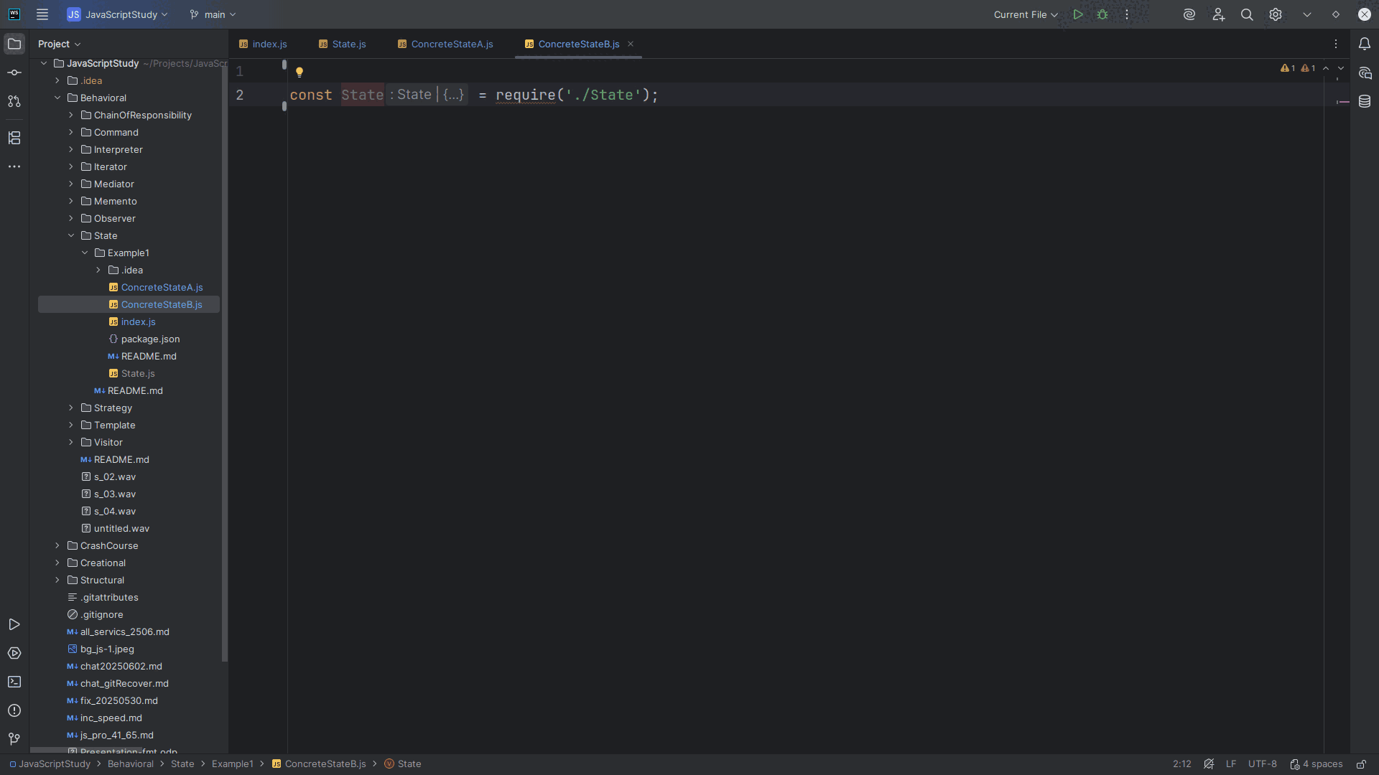
Notes:
At the top, like we did for Concrete State A we require the State interface

Slide 15
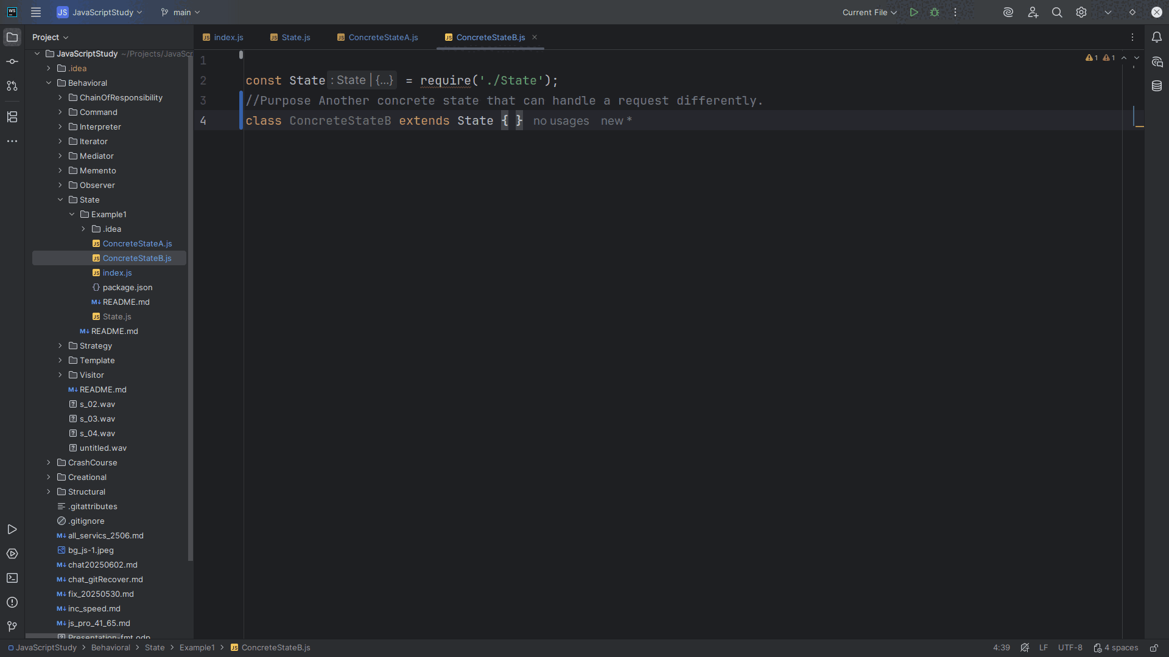
Notes:
So we may extend this class with it.
The Purpose of this concrete state implementation is that It handles a request and optionally changes the context's state

Slide 16
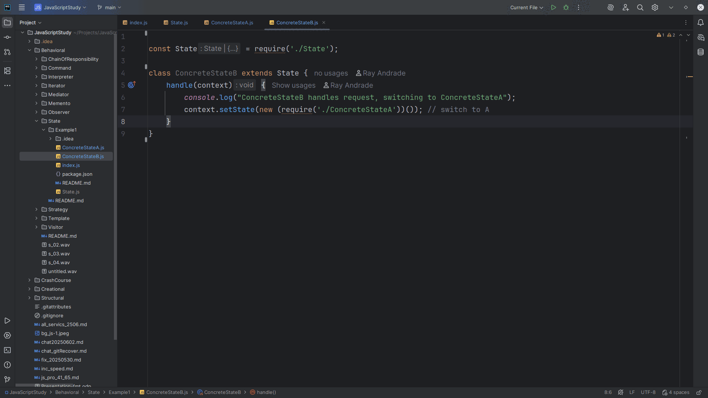
Notes:
Handel takes a context object.
We write to the console Concrete State A handles request, switching to Concrete State B
And then we set State to a new Concrete State of which we switch to

Slide 17
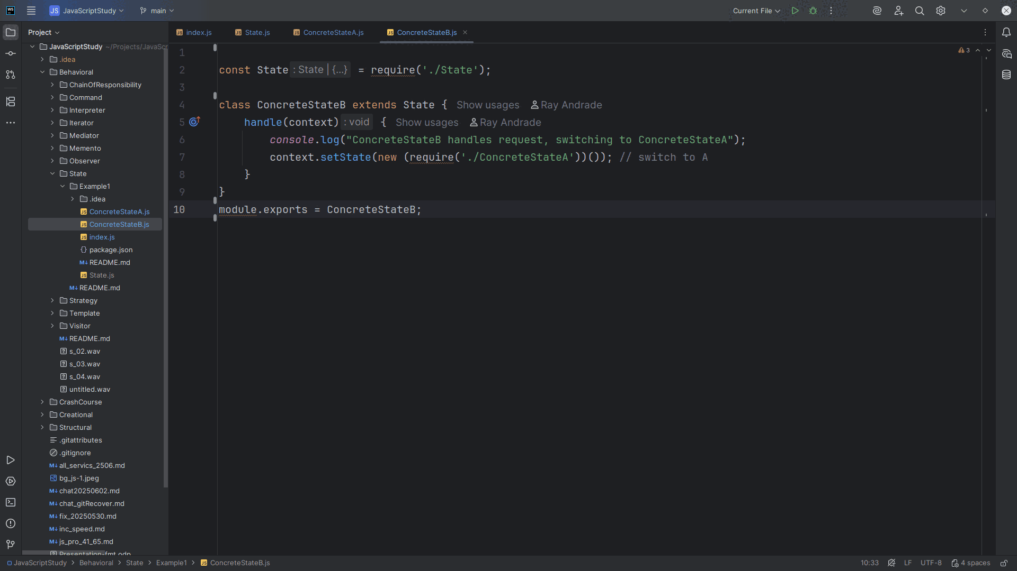
Notes:
And we export this module for use in our demo

Slide 18
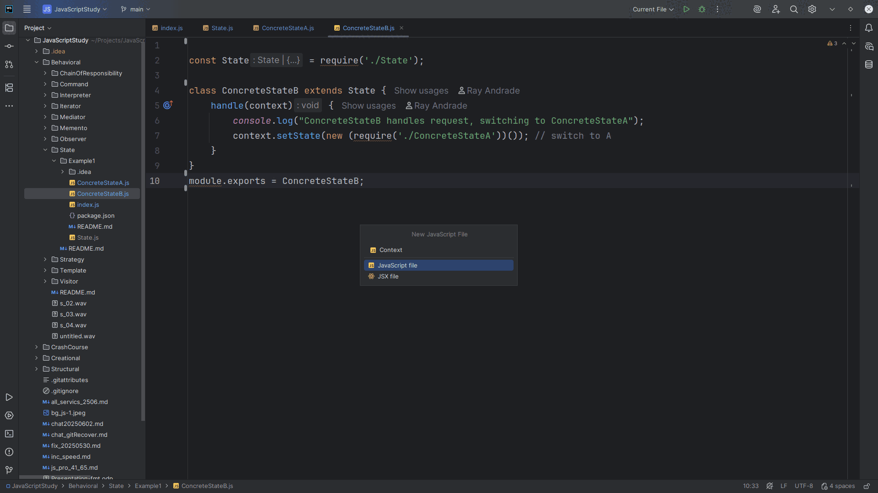
Notes:
No let’s create a Context file

Slide 19
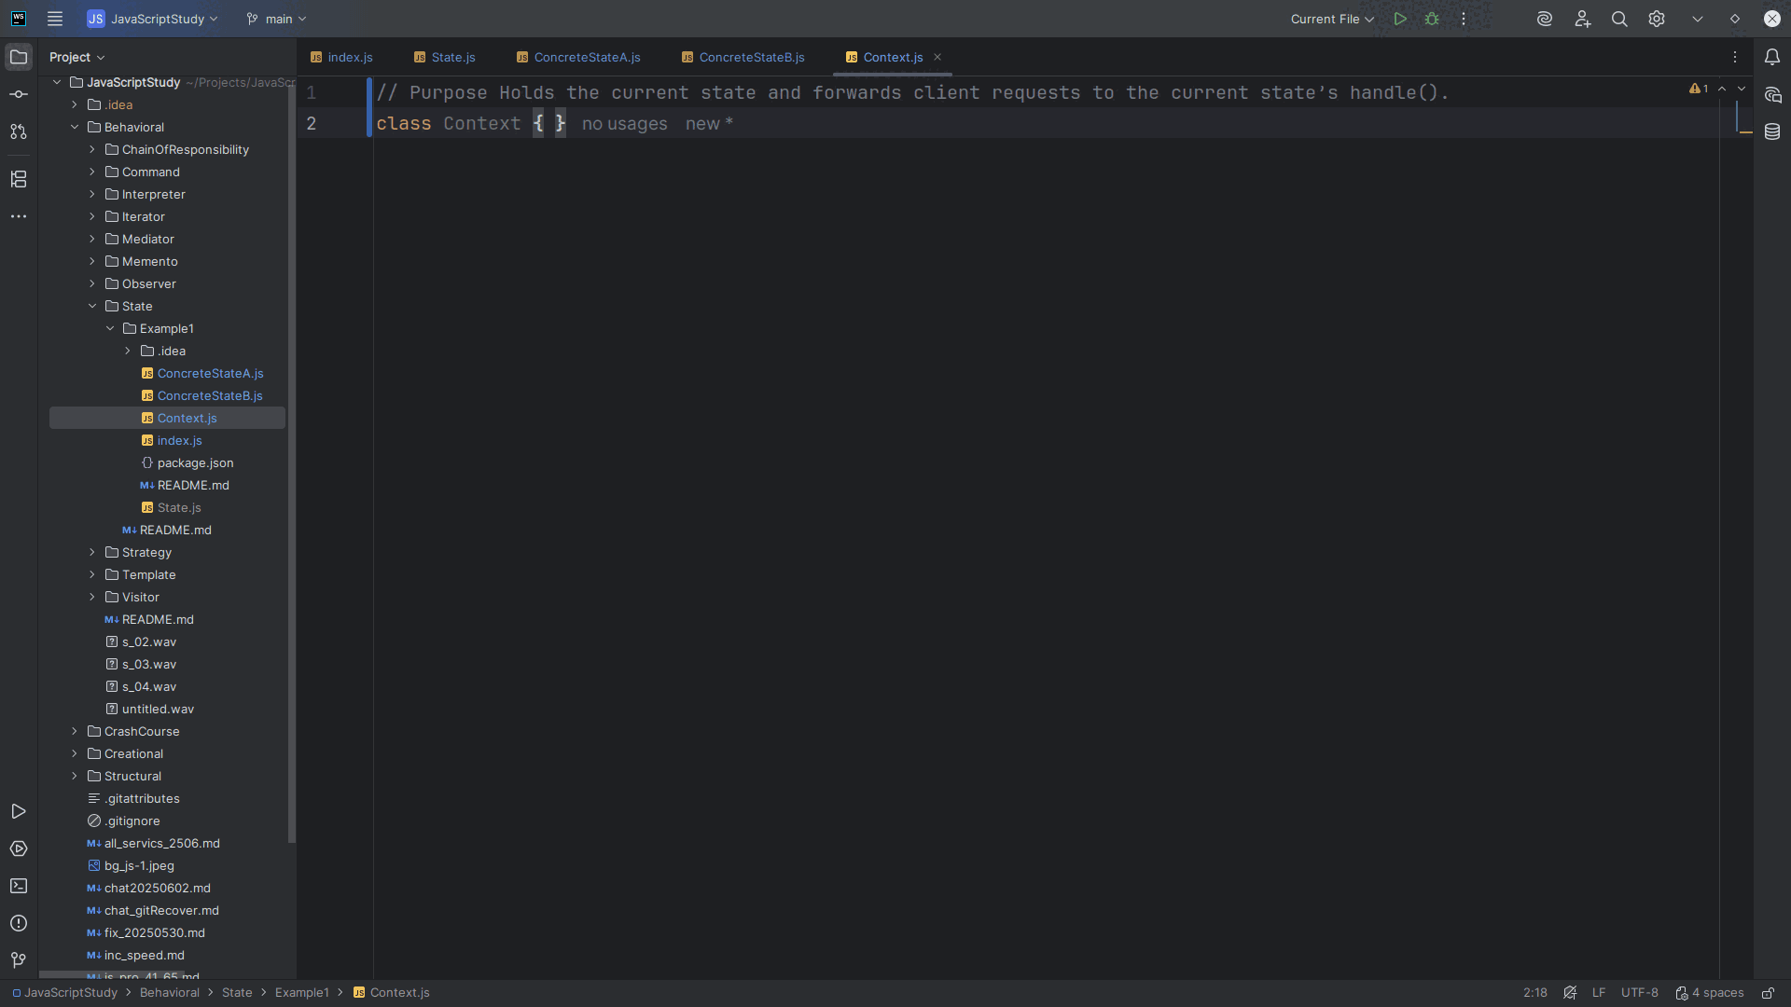
Notes:
Context Holds the current state and forwards it to the client request for the current state’s handle().

Slide 20
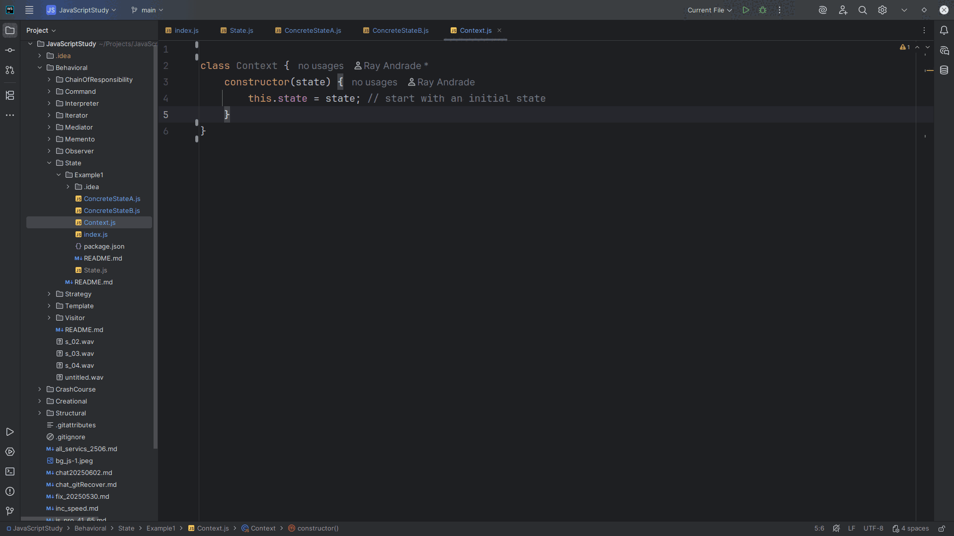
Notes:
We create a constructor that accepts a state and we set this state to that state

Slide 21
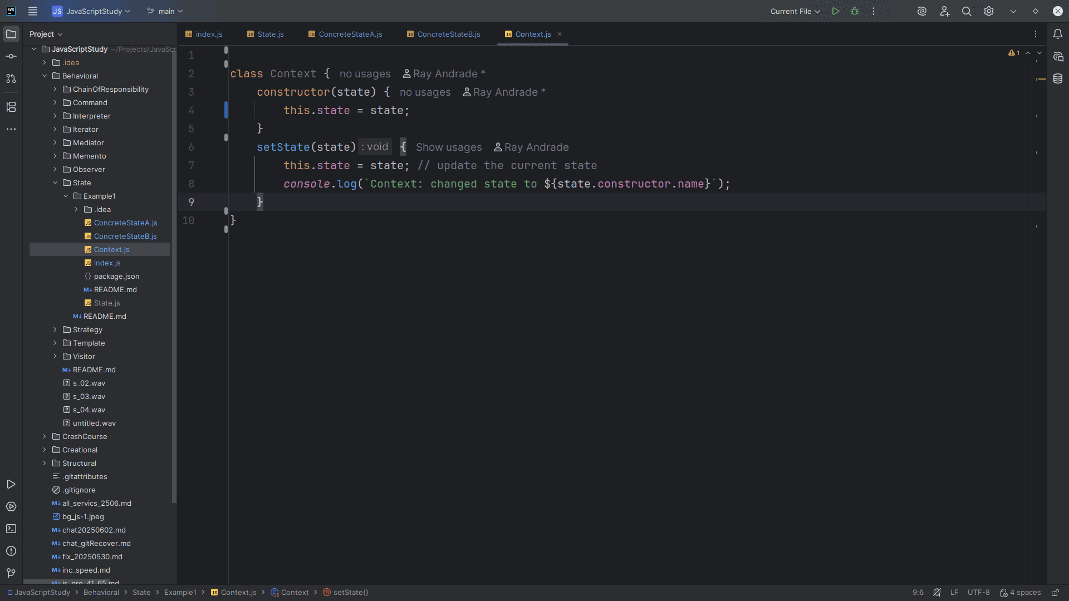
Notes:
With Set State, we take the state object and set this state to it.
This will update the current state

Slide 22
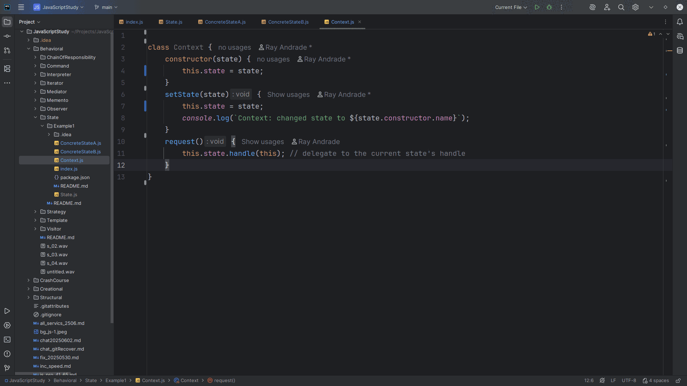
Notes:
If you make a request, the Context is delegate to the current state's handle

Slide 23
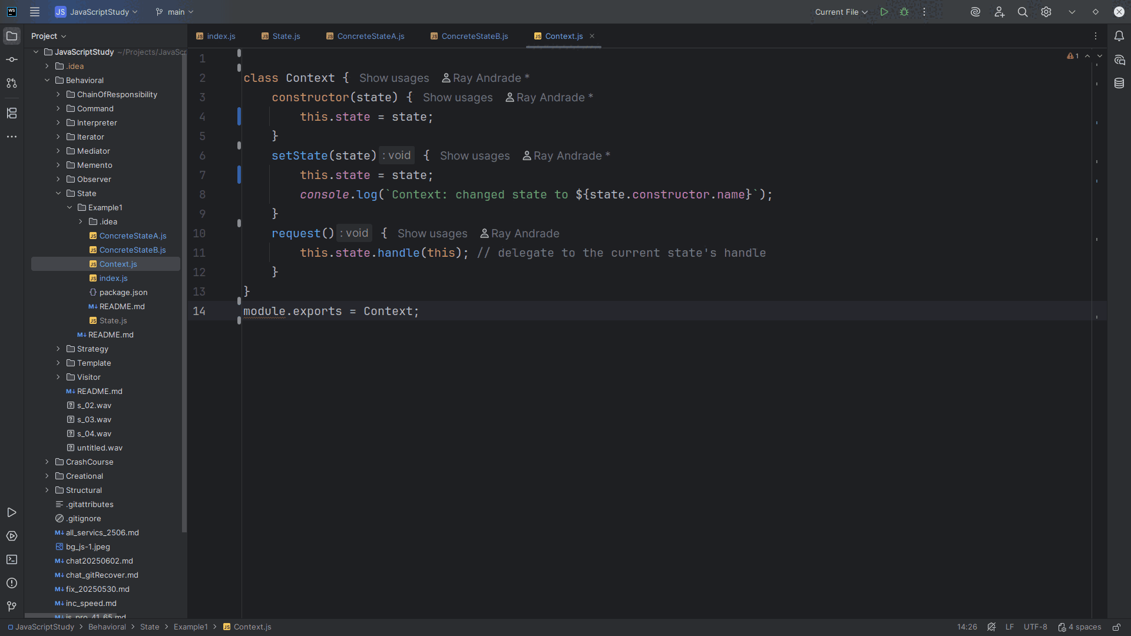
Notes:
We export this module for use as Context

Slide 24
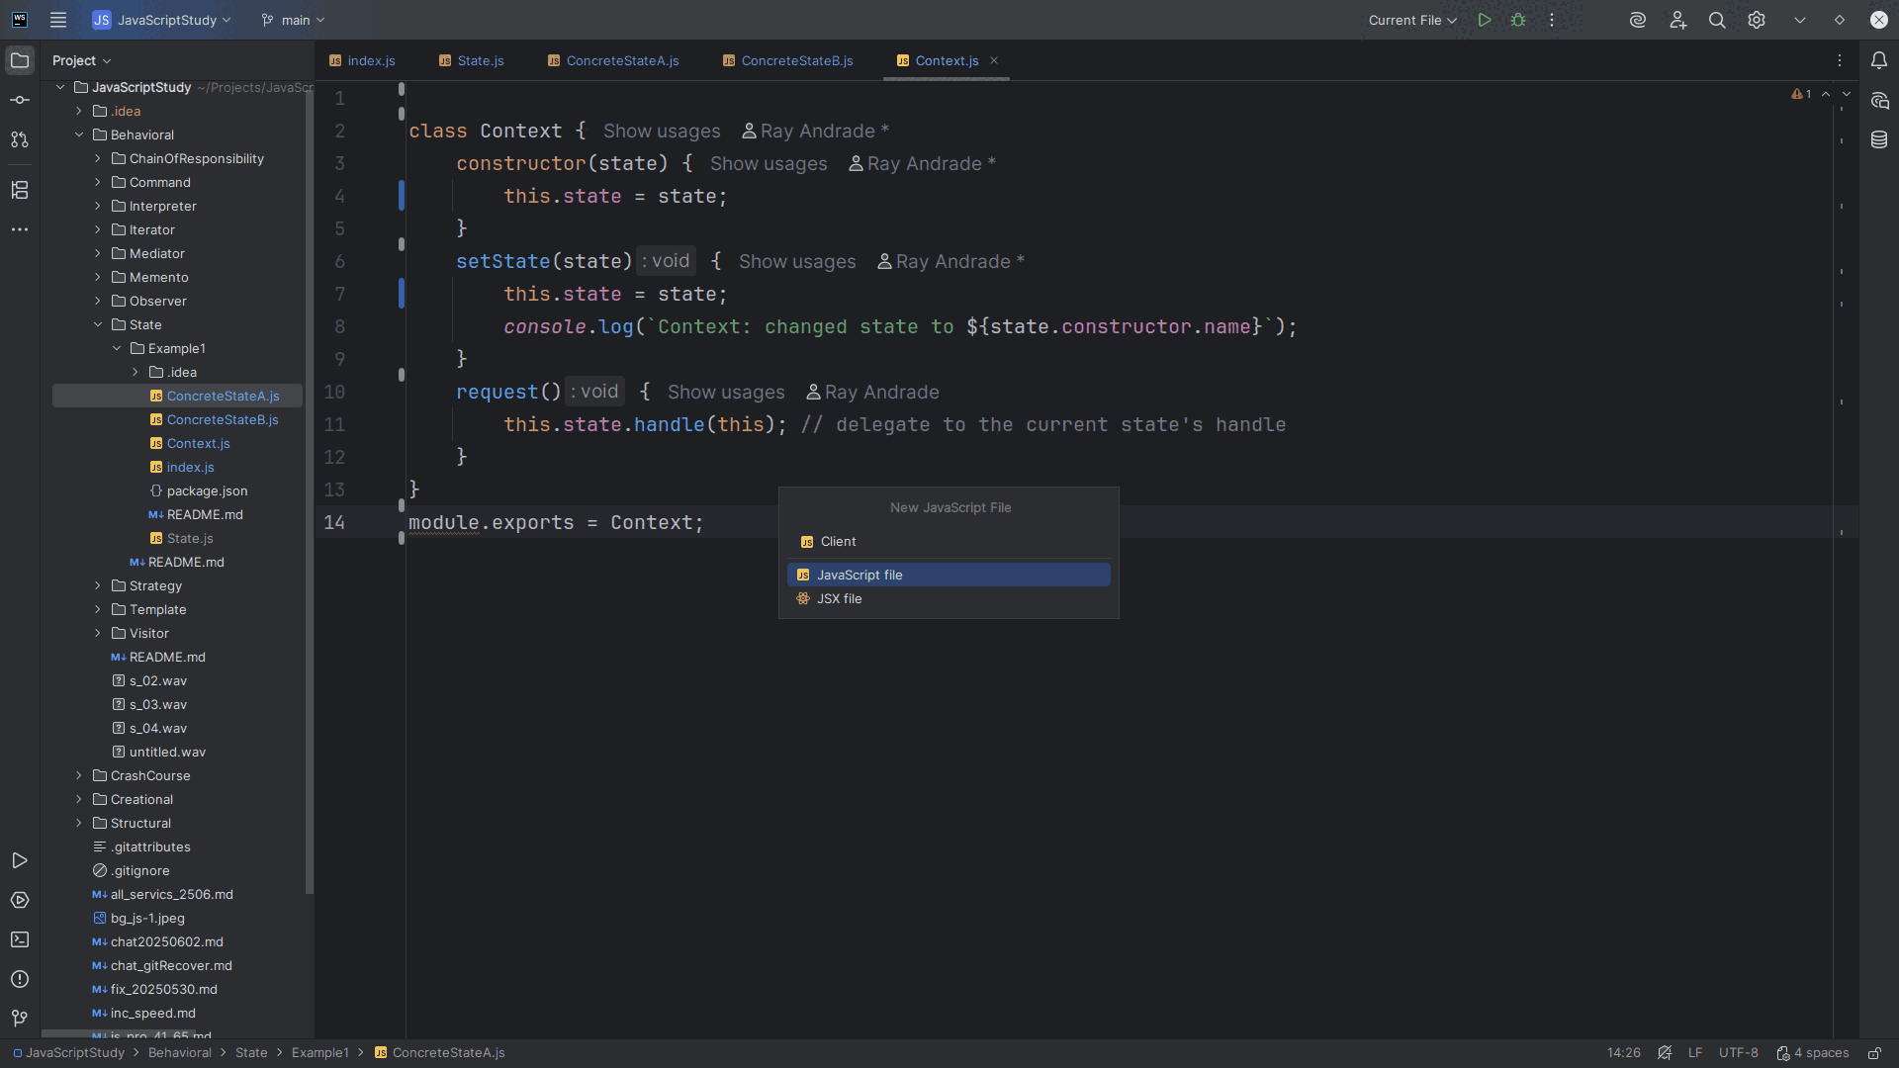
Notes:
Next we build the Client

Slide 25
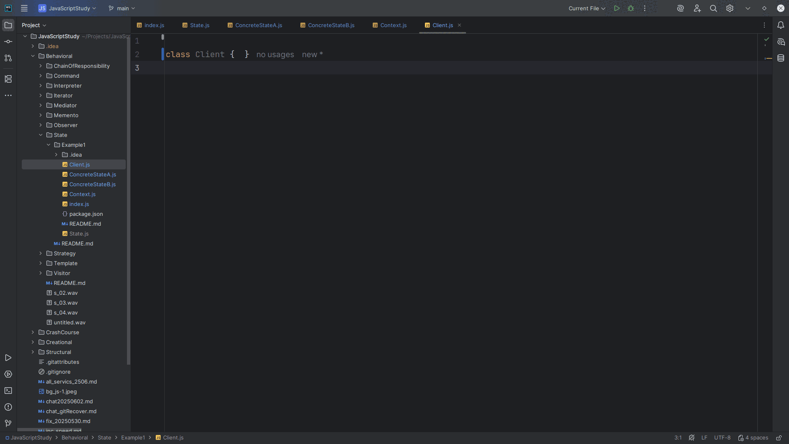
Notes:
Client sets up context and triggers request

Slide 26
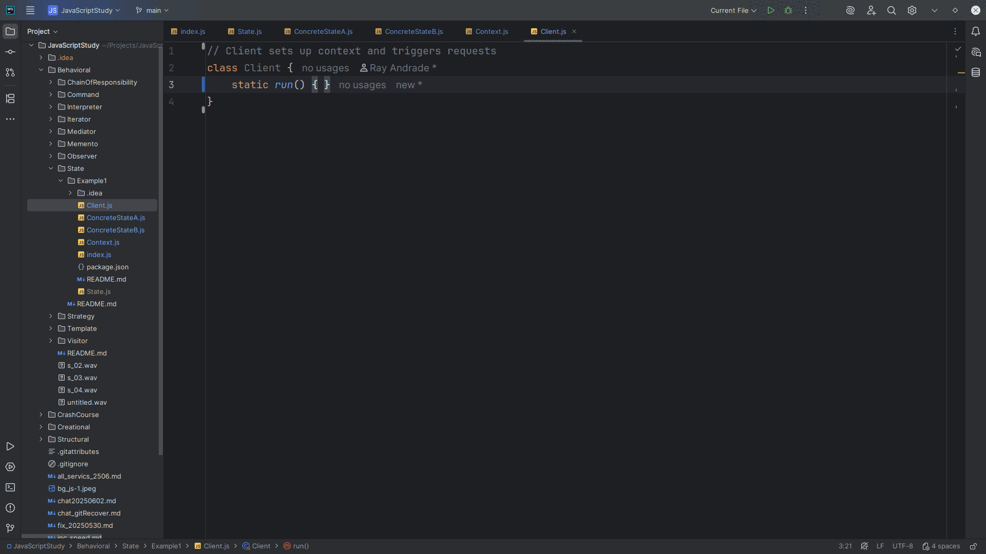
Notes:
Thus we have a static run() method

Slide 27
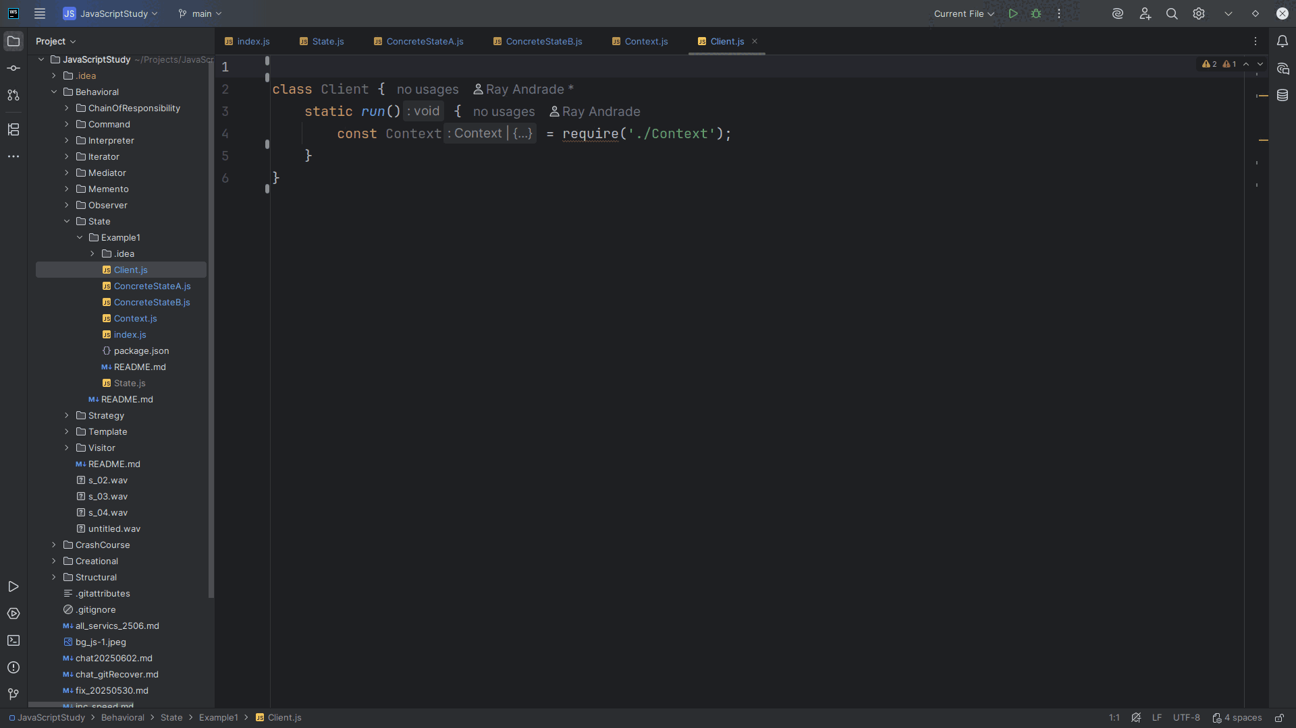
Notes:
We require the context

Slide 28
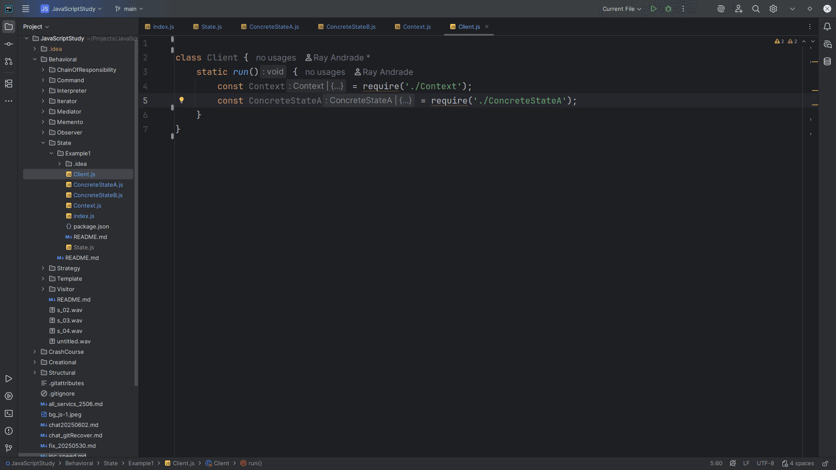
Notes:
And Concrete State A

Slide 29
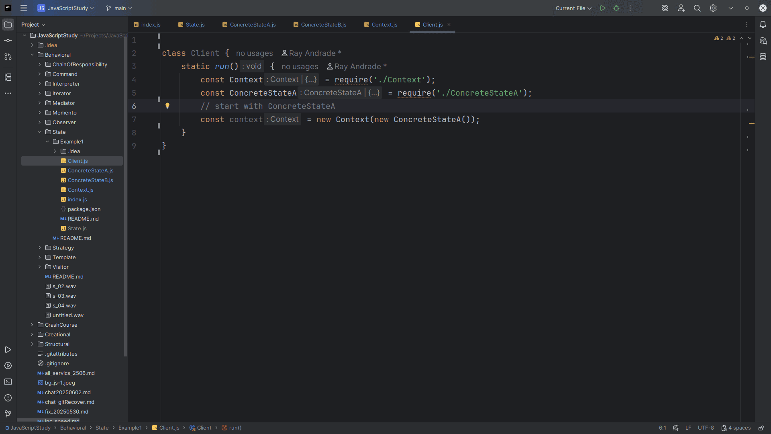
Notes:
We start with a Concrete State A object

Slide 30
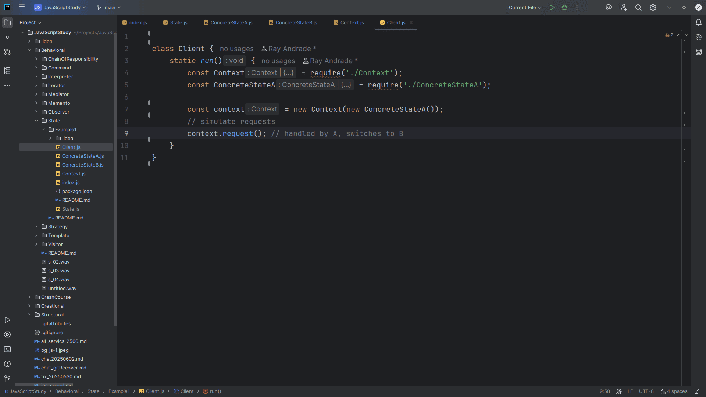
Notes:
And we’ll simulate some requests
We run the request and it’s handled by the Concrete State A and switches to B

Slide 31
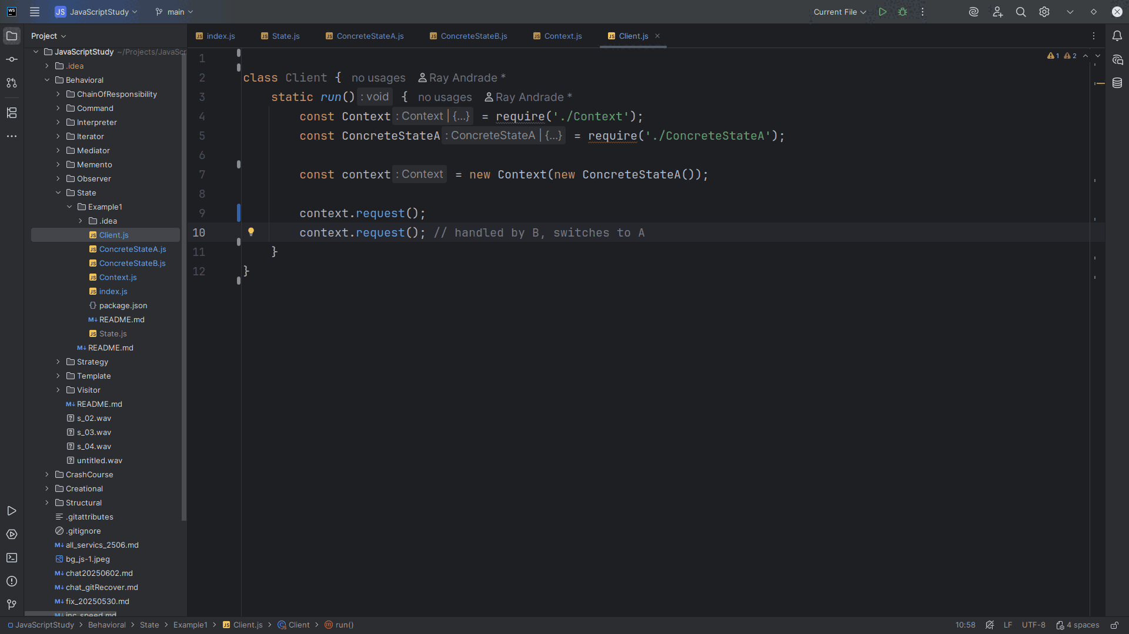
Notes:
Concrete State B switches back to A

Slide 32
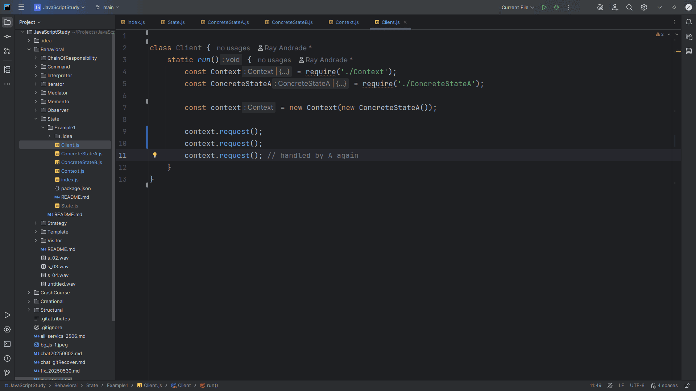
Notes:
And again Back to A

Slide 33
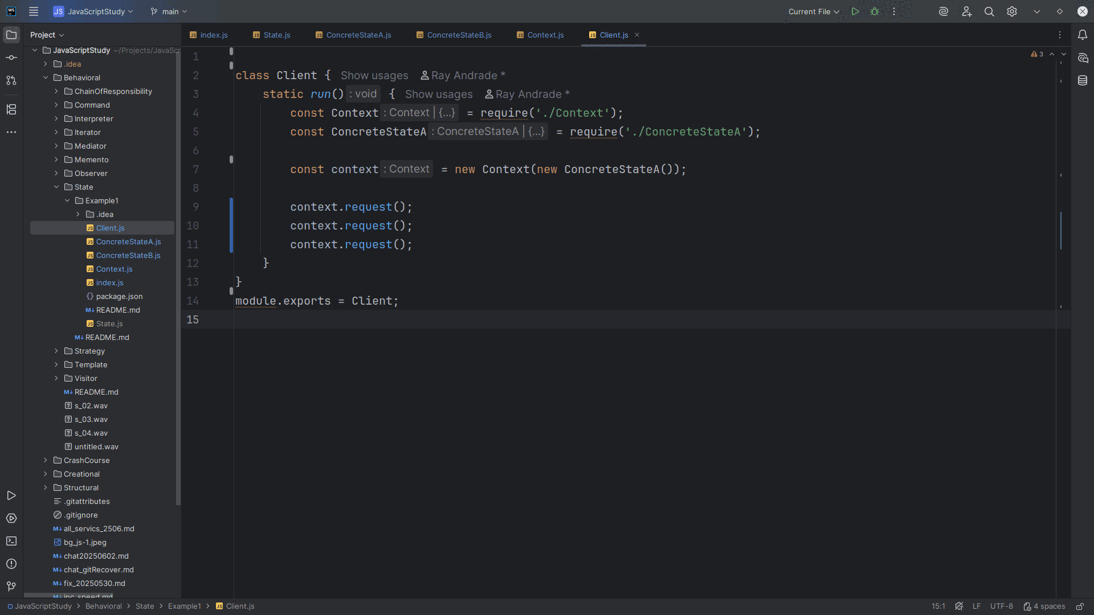
Notes:
Let’s export this Class for use in our demo

Slide 34
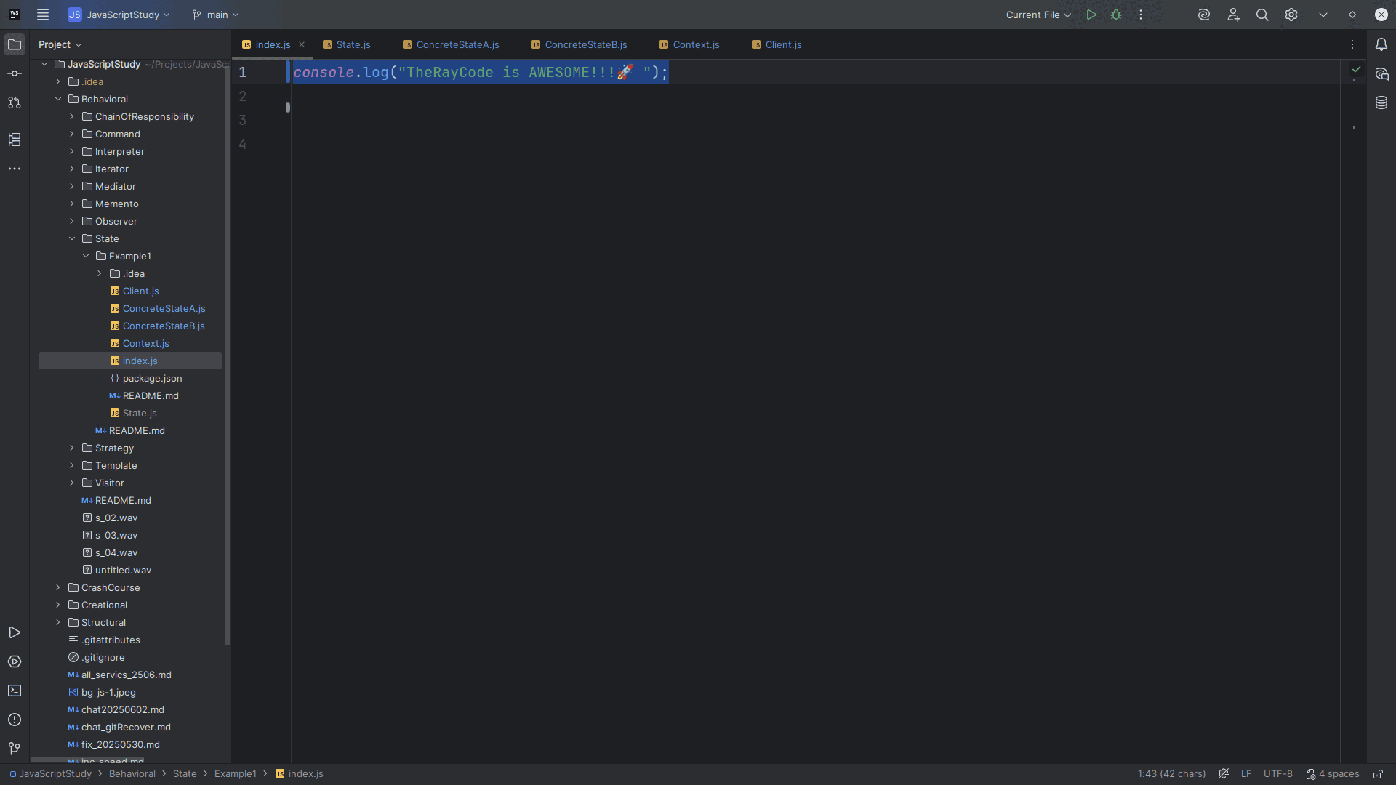
Notes:
So let’s go to the index dot js page

Slide 35
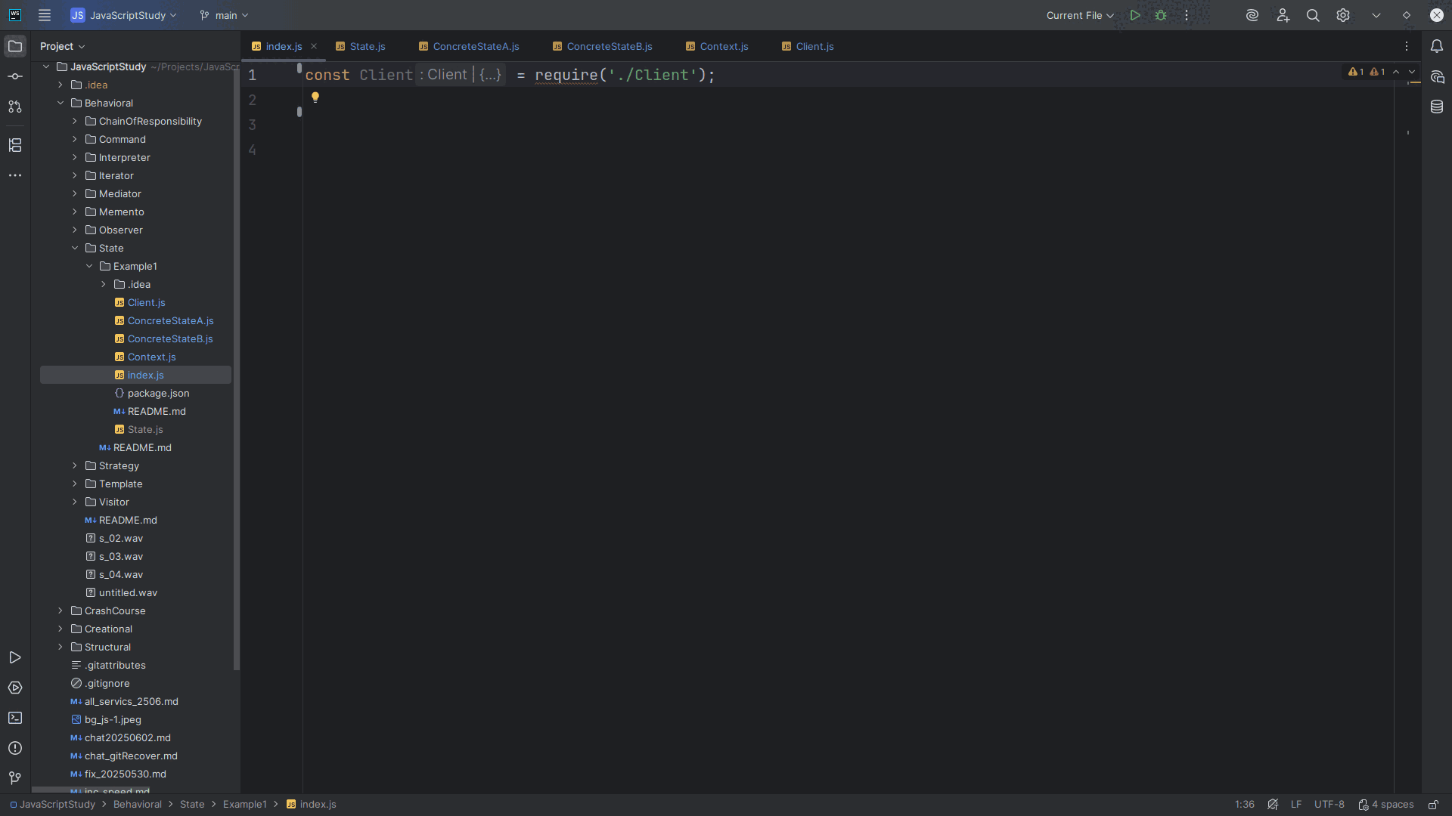
Notes:
And we require the require

Slide 36
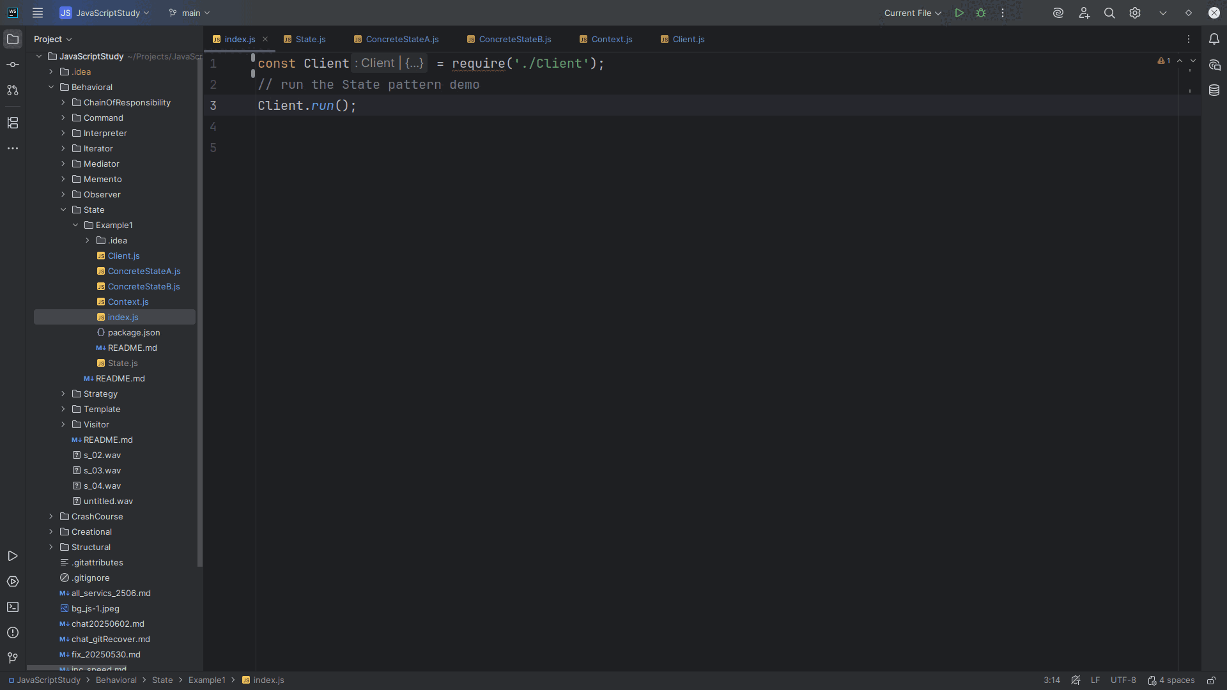
Notes:
And run the client

Slide 37
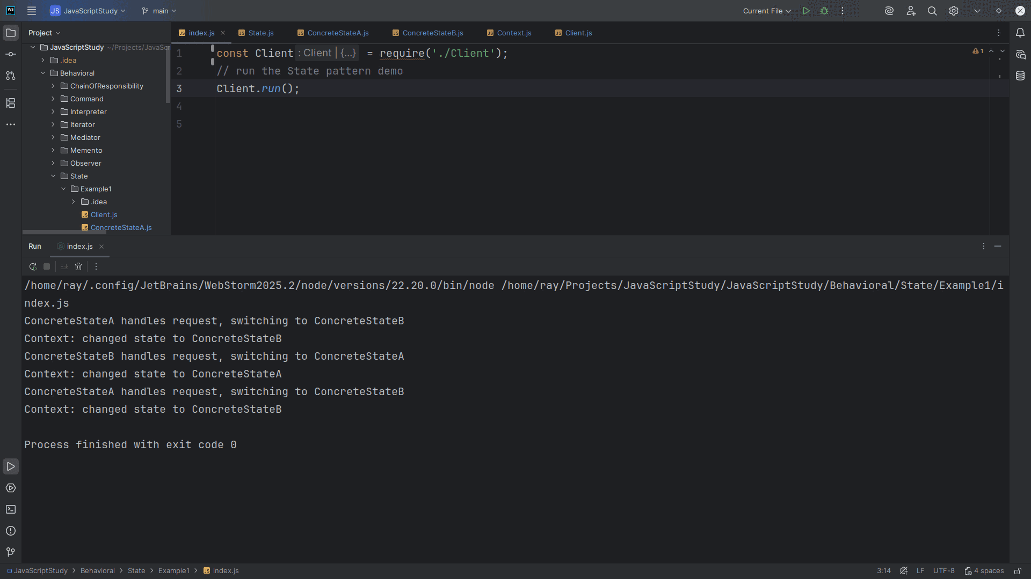
Notes:
We get:
ConcreteStateA handles request,
switching to ConcreteStateB
Context: changed state to ConcreteStateB
ConcreteStateB handles request,
switching to ConcreteStateA
Context: changed state to ConcreteStateA
ConcreteStateA handles request,
switching to ConcreteStateB
Context: changed state to ConcreteStateB
My name is Ray always code with a smile

