Slide 1

Notes:
Start .. no sound

Slide 2
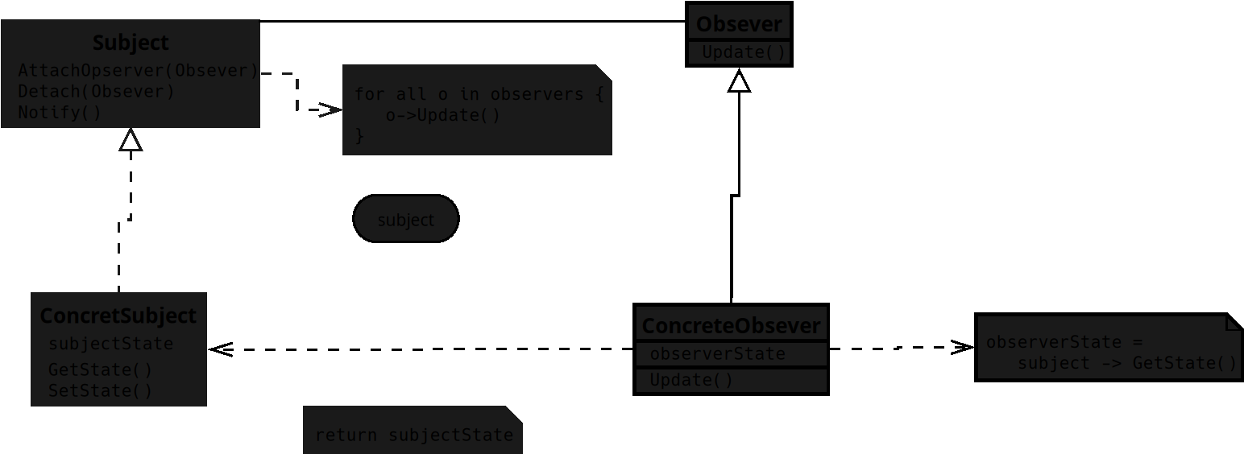
Notes:
The UML for the Observer design pattern which is a Behavioral pattern I will focus on JavaScript in this track

Slide 3
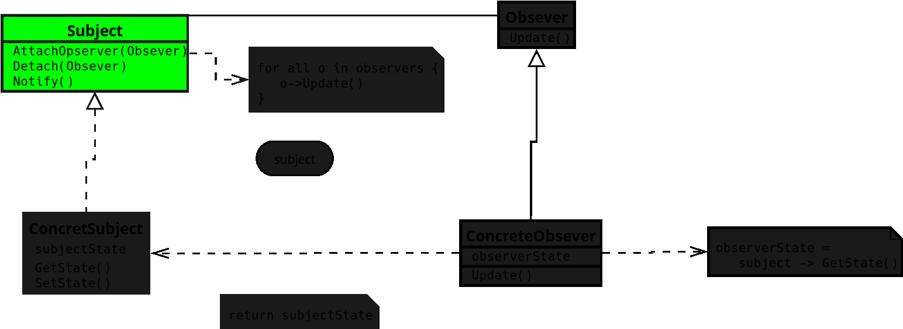
Notes:
**1. Subject**
• Knows its observers and provides a way to add or remove them.

Slide 4
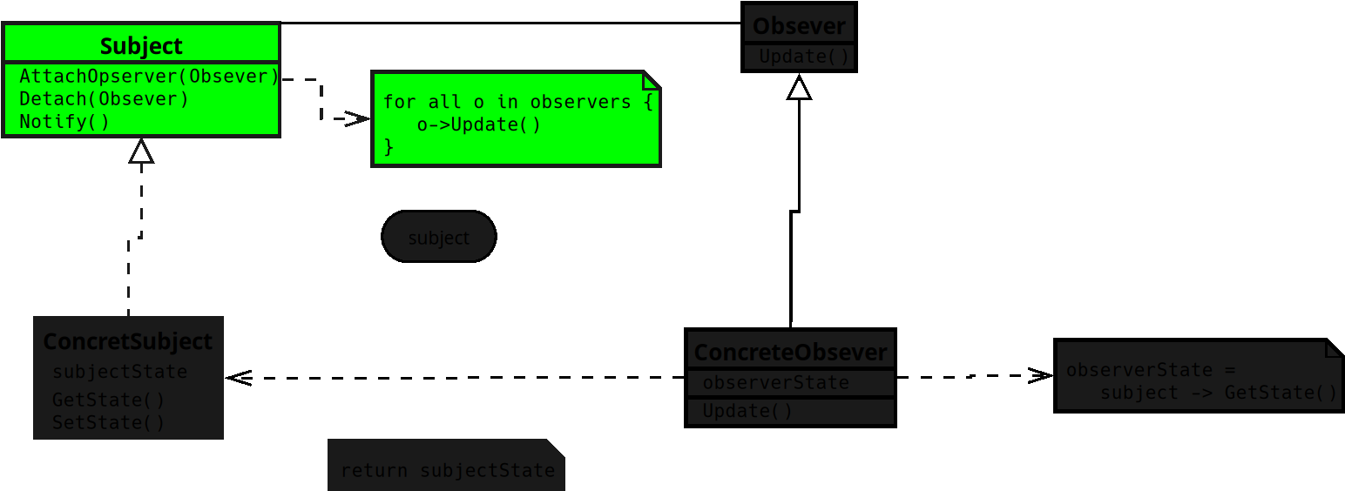
Notes:
• When something changes, it notifies all its observers.

Slide 5
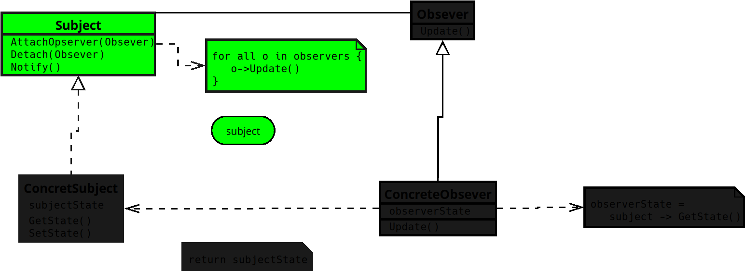
Notes:
• Think of it like a YouTube channel that alerts all subscribers when a new video drops.

Slide 6
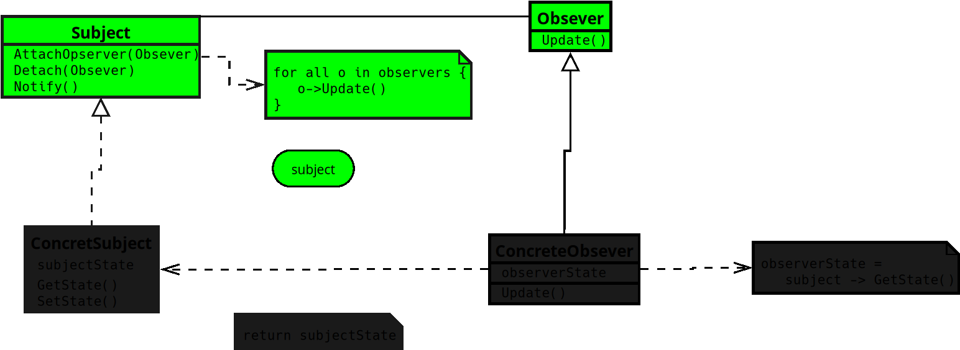
Notes:
**2. Observer**
• Defines the interface for objects that want to get updates from the subject.
• Each observer reacts when it’s notified of a change.
• It’s like a subscriber who gets a notification and decides what to do with it.

Slide 7
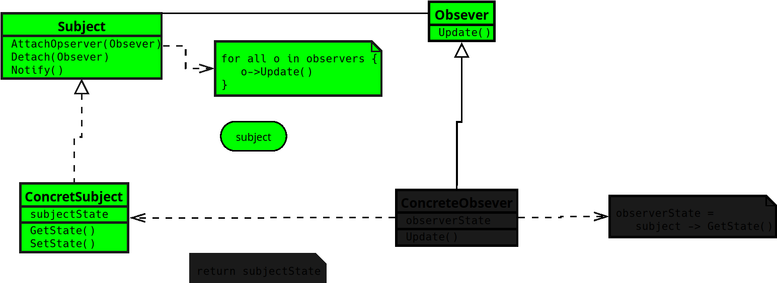
Notes:
**3. Concrete Subject**
• Holds the real state that observers care about.
•

Slide 8
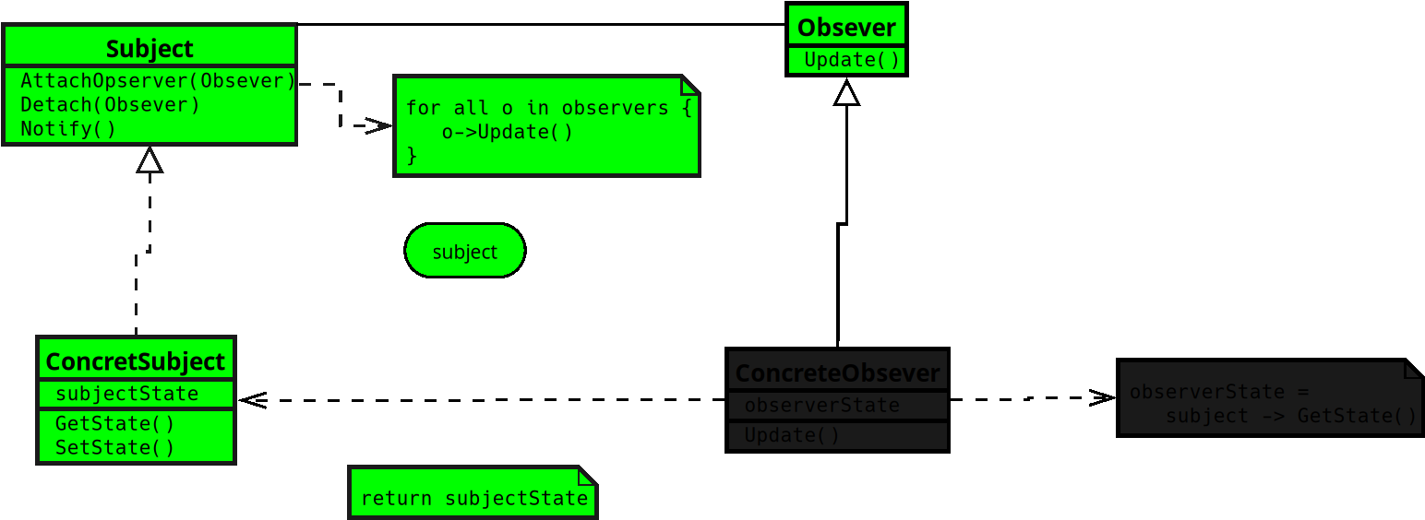
Notes:
Sends notifications to all registered observers when its state changes.
• It’s the actual channel doing the publishing whenever something new happens.

Slide 9
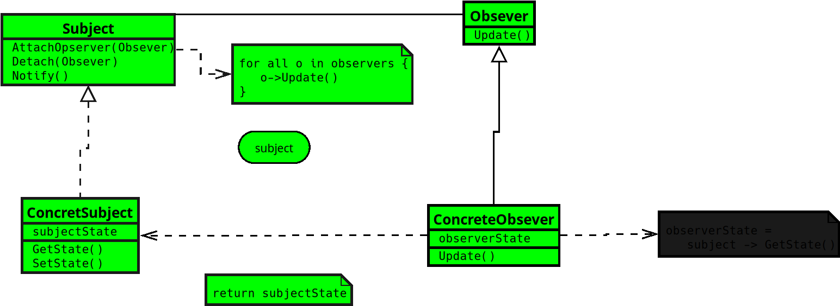
Notes:
**4. Concrete Observer**
• Keeps a reference to the subject it’s watching.

Slide 10
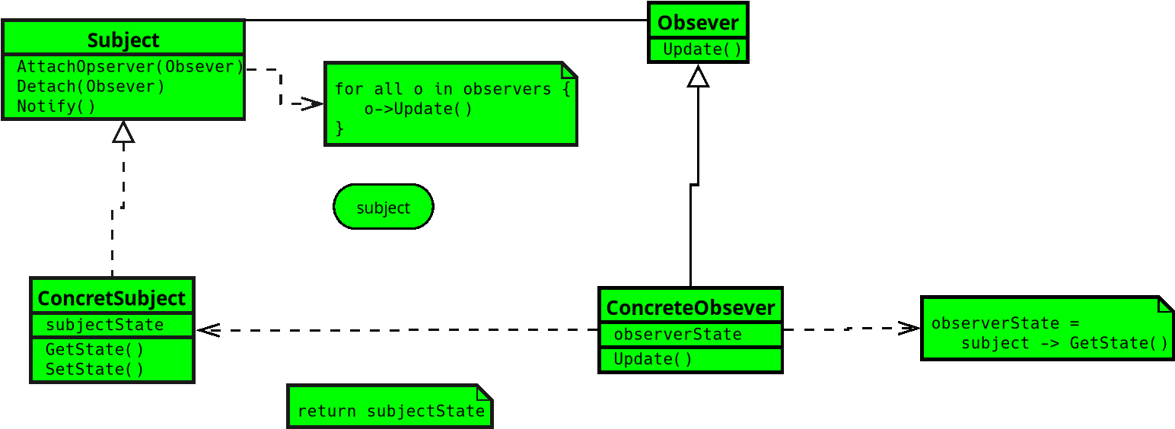
Notes:
• Updates its own state to stay in sync when notified.
• It’s like an app user whose feed updates automatically when the channel posts something new.
… (End )

