Slide 1

Notes:
(no sound)

Slide 2
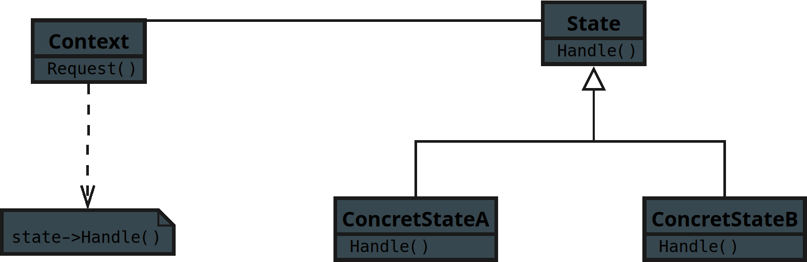
Notes:
This is the UML explanation for the Behavioral Pattern State
For the JavaScript tract

Slide 3
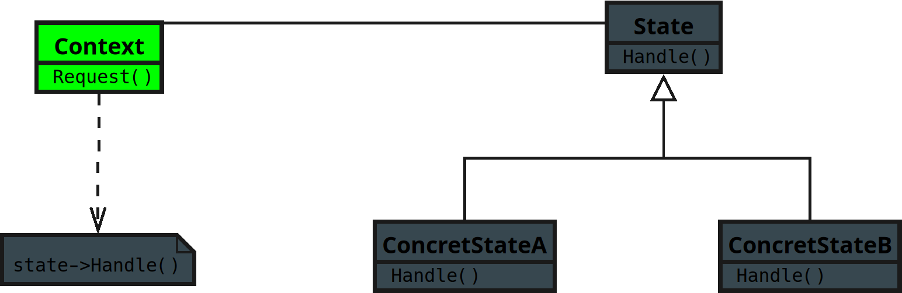
Notes:
**1. Context**
• Holds a reference to a State object that represents its current behavior.

Slide 4
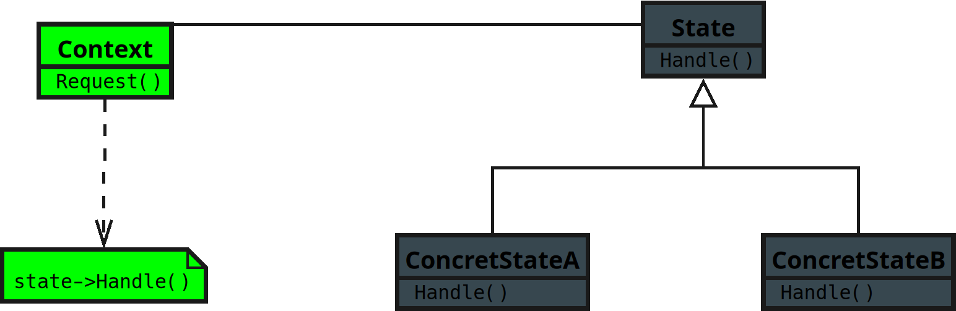
Notes:
• Delegates work to the current State instead of handling it directly.
• Think of it like a game character that changes its moves depending on its current mode — walking, running, or jumping.

Slide 5
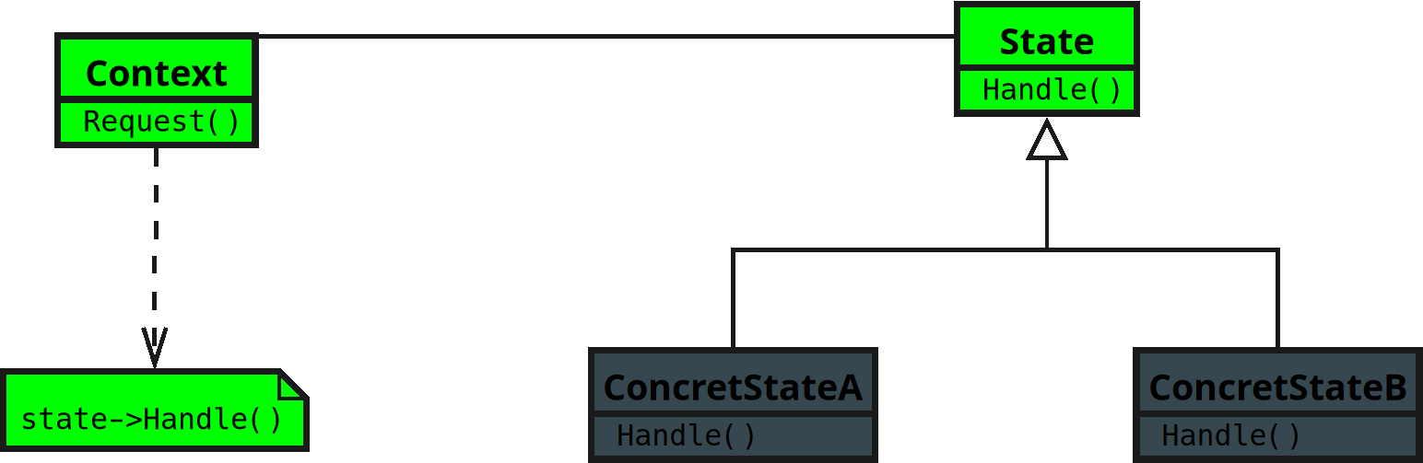
Notes:
**2. State**
• Defines an interface for behavior associated with a particular state.
• Every concrete state will implement this interface differently.
• It’s like a rulebook that says, “If I’m in this mode, here’s how I behave.”

Slide 6
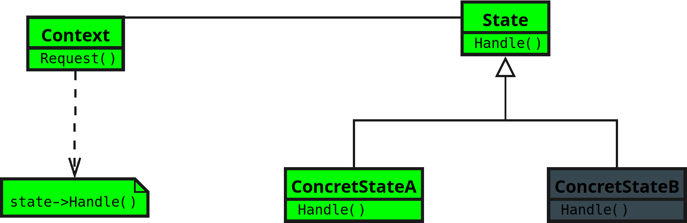
Notes:
Concrete State subclasses**
• Each represents a specific state with its own behavior.

Slide 7
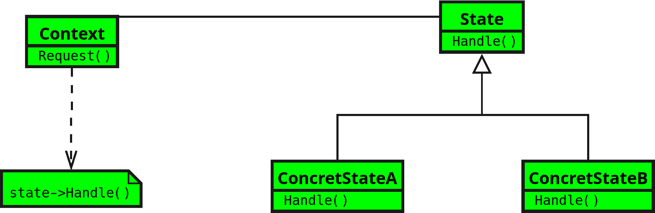
Notes:
• When the state changes, the Context switches to a different Concrete State.
• It’s like swapping out the rule book to instantly change how the object reacts.
(End)

