Slide 1

Notes:
No Sound

Slide 2
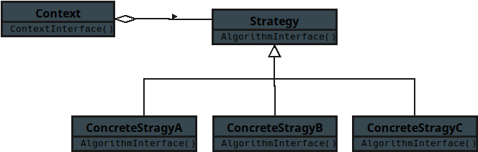
Notes:
This is a UML presentation of the design pattern Strategy for the JavaScript tract

Slide 3
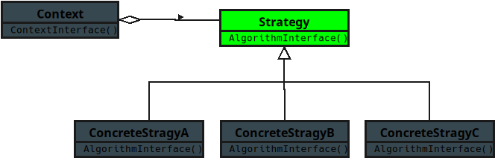
Notes:
**1. Strategy**
• Defines a common interface for all supported algorithms.
• Each strategy describes how a specific task can be carried out.
• Think of it as a set of interchangeable playbooks that all solve the same problem in different ways.

Slide 4
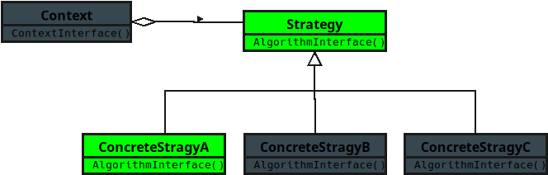
Notes:
**2. Concrete Strategy**
• Implements a particular algorithm defined by the Strategy interface.

Slide 5
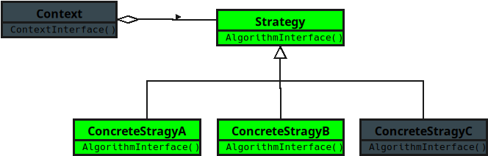
Notes:
• Each one represents a distinct way to accomplish the goal.

Slide 6
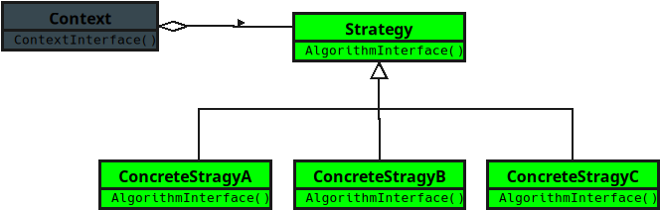
Notes:
• It’s like choosing between different routes on a map — all reach the same destination, but in their own style.

Slide 7
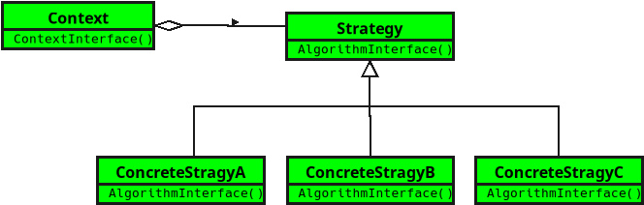
Notes:
**3. Context**
• Maintains a reference to a Strategy object.
• Uses the current Strategy to perform its work without knowing the details of the algorithm.
• It’s like a driver who just follows GPS directions — the route can change, but the driving process stays the same.
(The End)

