Slide 1

Notes:
(No Sound)

Slide 2
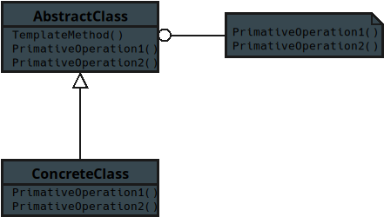
Notes:
This is the UML diagram taken from the book Elements of Reusable OO Software by the gang of four
This will be for JavaScript tract

Slide 3
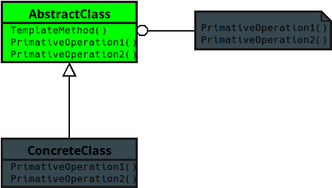
Notes:
**1. Abstract Class**
• Defines the skeleton of an algorithm — the fixed steps everyone must follow.

Slide 4
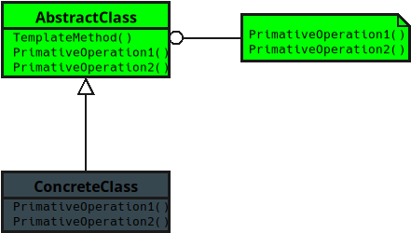
Notes:
• Some steps are handled here, while others are left open for subclasses to fill in.
• Think of it like a recipe outline that says, “These steps are always the same, but you can customize the ingredients.”

Slide 5
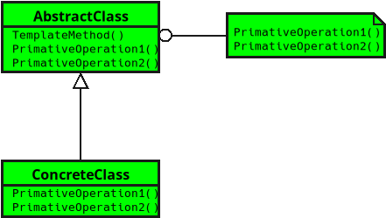
Notes:
**2. Concrete Class**
• Implements the missing steps defined by the Abstract Class.
• Fills in the details while keeping the overall structure the same.
• It’s like a chef using the same recipe but adding their own seasoning and flair.
(The End)

